Slide 1
Welcome!
Room # 743
Mrs Wiggins
American History

Slide 2
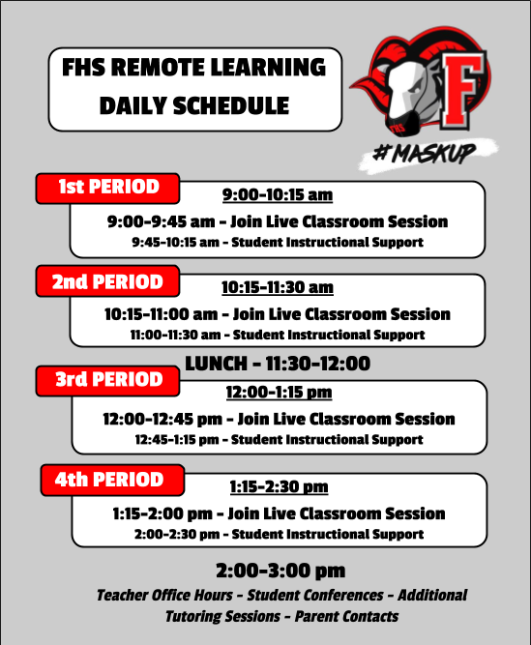
CLASS INFORMATION
GOOGLE CLASSROOM—log in and join the course from Canvas
We cover from early Native Americans to 1877
Grades are updated in Powerschool every Thursday afternoon

Slide 3
SYLLABUS OVERVIEW
CLASS EXPECTATIONS
Sign in and do daily assignments
Keep up with due dates
Communicate with me with any questions
GO TO GOOGLE CLASSROOM DAILY!!!!!!
Intruction will look very different this year while we are on remote learning! Please be patient with me

Slide 4
HOW DO I FIND CLASSROOM INFORMATION?
CANVAS OVERVIEW
PARENTS CAN ACCESS ALL INFORMATION USING THE FHS WEBPAGE.
THIS INCLUDES SYLLABUS, DAILY INFORMATION AND
CLASSROOM UPDATES
What is Canvas?
Canvas is our “Launch Pad” for our students and can be accessed by parents to keep up with all of the daily activites and learning goals in each class.
Students have full access to the classroom information and may also use Google Classroom for assignments, content information, and grades.
Link to Teacher Canvas Page
GO TO THE FHS WEBPAGE
CLICK ON “ACADEMICS”
THEN LOOK FOR THE TEACHER IN THE APPROPRIATE DEPARTMENT.

Slide 5
How is School Messenger Used?
SCHOOL MESSENGER
Teachers will send emails to parents and students using School Messenger. FHS will also make phone calls and send out other important information using this system.
What is School Messenger?
School Messenger is a parent and student communication platform that allows information to be shared on a regular basis.
Parents need to make sure that their phone numbers and email addresses are up-to-date in order to receive communications.
STRONG COMMUNICATION IS KEY…
Please look for weekly emails from your student’s teachers and help us maintain strong two-way communication.
All teachers have dedicated office hours on the schedule.

Slide 6
Need to contact me?
sandrawiggins@fcschools.net
Follow me on Instagram (I will not follow you back until you graduate)
@wiggyworld2019

