Slide 1
Welcome!
Room # 210
Walker, Clarence
Introduction to Construction
FHS Faculty, Staff, & Administrators

Slide 2
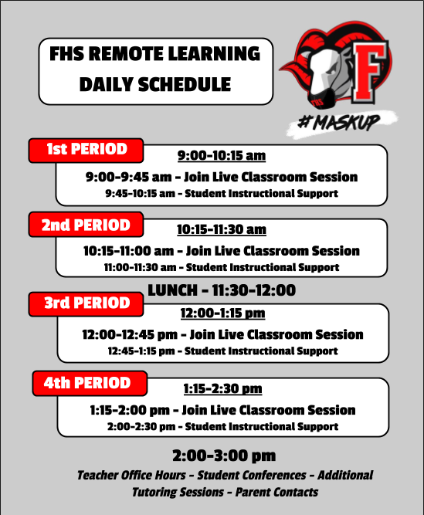
CLASS INFORMATION
You will be in Core “Introduction to Construction” 1st period
This is an introductory course of construction trade and industrial industry.
Trades includes Masonry, Carpentry, Electrical, HVAC, Welding, Landscaping, Plumbing, Ect.
Communication –School Messenger, CANVAS, Emails & Phone Calls

Slide 3
SYLLABUS OVERVIEW
CLASS EXPECTATIONS
Safe Environment for learning
Participation
Attendence
Positive Attitude
Credential / Cerification
Introduction to Construction
Class will be devoted to learning the construction language, types of materials, use of equipment and installation techniques. Construction knowledge you may use in a career, a supplemental income, community service projects or just around the house.

Slide 4
HOW DO I FIND CLASSROOM INFORMATION?
CANVAS OVERVIEW
PARENTS CAN ACCESS ALL INFORMATION USING THE FHS WEBPAGE.
THIS INCLUDES SYLLABUS, DAILY INFORMATION AND
CLASSROOM UPDATES
What is Canvas?
Canvas is our “Launch Pad” for our students and can be accessed by parents to keep up with all of the daily activites and learning goals in each class.
Link to Teacher Canvas Page
GO TO THE FHS WEBPAGE
CLICK ON “ACADEMICS”
THEN LOOK FOR THE TEACHER IN THE APPROPRIATE DEPARTMENT.

Slide 5
How is School Messenger Used?
SCHOOL MESSENGER
Teachers will send emails to parents and students using School Messenger. FHS will also make phone calls and send out other important information using this system.
What is School Messenger?
School Messenger is a parent and student communication platform that allows information to be shared on a regular basis.
Parents need to make sure that their phone numbers and email addresses are up-to-date in order to receive communications.
STRONG COMMUNICATION IS KEY…
Please look for weekly emails from your student’s teachers and help us maintain strong two-way communication.
All teachers have dedicated office hours on the schedule.

Slide 6
We look forward to having a great “Year”
ClarenceWalker@fcschools.net 919-494-2332
Ext. 316
SHOW ME YOUR FRIENDS AND I WILL SHOW YOU YOUR
“FUTURE”

