Slide 1
Money Matters
Role of Finance
Financial Analysis LAP 354

Slide 2
Finance in Business
Finance: Function involving money management matters
Finance goals:
Ensuring the business is profitable
Reducing financial risk
Notes:
What finance is:
What do you think of when you hear the word "finance"?
You might think of
A verb or noun
Money
A major in college
No matter what you think of when you hear “finance,” the word is very important in the business world.
In business, finance is the function that involves all money and money management matters.
It also encompasses all the tools and analysis that financial managers use to make the decisions involved in that money management.
A company’s financial managers have a few main goals, including:
Ensuring that the business is as profitable as it can be
Reducing the business’s financial risks
DISCUSSION #2: Ask students if they can identify any other goals a company’s financial managers might have.

Slide 3
Finance and Accounting
Closely interrelated and may overlap
Key differences:
Focus
Finance—money management decisions
Accounting—recordkeeping activities
Notes:
Finance and accounting:
Finance and accounting functions are closely interrelated and even overlap in some areas.
Telling the difference can become even more confusing in small businesses where a few employees (or even just one!) are responsible for the whole company’s finance and accounting activities.
However, there are several key differences between the finance and accounting functions.
Focus
The finance function primarily focuses on money management decisions.
Accounting focuses on recordkeeping activities.
Accounting, remember, is the process of keeping and interpreting financial records.

Slide 4
Finance and Accounting
Key differences:
Ultimate purpose
Finance—boost growth, reduce risks
Accounting—provide accurate and timely information
Notes:
Ultimate purpose
The purpose of the finance function is to:
Boost the company’s growth.
Reduce its risks.
The purpose of the accounting function is to provide accurate and timely information about the company’s finances at any point in time.
It’s easy to see how these two functions work together.
The accounting function records and generates the information needed to plan and make decisions in the finance function.
This is not to say that accountants never make decisions or that financial managers never keep records—there is just a difference in primary focus and purpose.
ON THE WEB: Still confused about the differences between finance and accounting? Watch this informative video from Certified Public Accountant (CPA) Zach De Gregorio: https://www.youtube.com/watch?v=_8bAY-Tspd4.

Slide 5
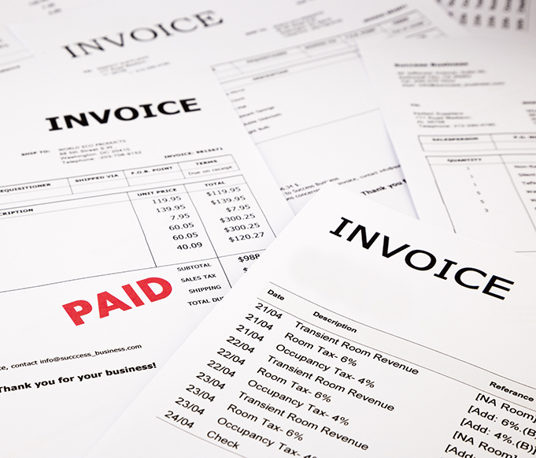
Importance of Finance
Helps set goals for the future
Plans and controls company spending
Ensures sufficient financing
Makes sure customers pay their bills
Invests company money wisely
Notes:
Finance serves many important purposes within a business, including:
Helping set goals for the future
Successful companies are always thinking about and planning for the future, whether it involves a:
New product line
Merger or acquisition
New business facility
The finance function helps companies accomplish their goals by producing budgets and strategies for moving forward.
It also ensures that the business’s financial priorities are in line with its organizational priorities and objectives.
Planning and controlling the company’s spending
Companies have to spend money to make money, but that doesn’t mean they should spend all of their money!
DISCUSSION #5: Ask students to give examples of ways that companies must spend money to make money.
A system must be in place to plan and control that spending so that it:
Stays within the company’s budget
Still allows the company to make a profit
That’s where the finance function comes in—it provides a central “hub” for monitoring company spending throughout all the different departments.
Ensuring sufficient financing
Acquisition of funds is a main finance activity.
A business relies on its finance function to make sure that adequate funds will be available, not only for financing new projects or equipment, but also for paying debts and taxes.
Financial managers must keep close track of a business’s accounts payable, or all the money the business owes.
Making sure customers pay their bills
If customers don’t pay their bills on time (or at all!), it’s hard for a company to make money!
The flip side of accounts payable, accounts receivable is all the money owed to the business by others.
The finance function keeps an eye on accounts receivable to make sure the business receives the money it is owed.
It’s important for financial managers to balance accounts payable and receivable and ensure that the company’s cash flow stays positive.
Investing company money wisely
This refers to the administration of assets.
It is absolutely essential for a company’s financial managers to make smart investment decisions.
They can make or break a company financially.
In short, the finance function contributes to the company by keeping it on track in terms of money—obviously, this is vital to the success of any business!
ON THE WEB: What do robots, automation, and artificial intelligence have to do with finance? In the near future, technologies such as these may dramatically change the way that finance professionals and businesses operate. To learn more about what technology holds for the finance industry, check out this article and the accompanying videos from KPMG International: https://info.kpmg.us/news-perspectives/technology-innovation/reinventing-the-finance-function-for-the-digital-age.html.

Slide 6
Capital Investment Decisions and Working Capital Management
Capital investment decisions—long term
Which projects to invest in
How to finance
Whether to pay dividends
Notes:
Two important responsibilities of financial managers are capital investment decisions and working capital management.
Capital investment decisions determine:
Which projects the business will invest in
How the investment(s) will be financed
Whether to pay dividends to the company’s shareholders

Slide 7
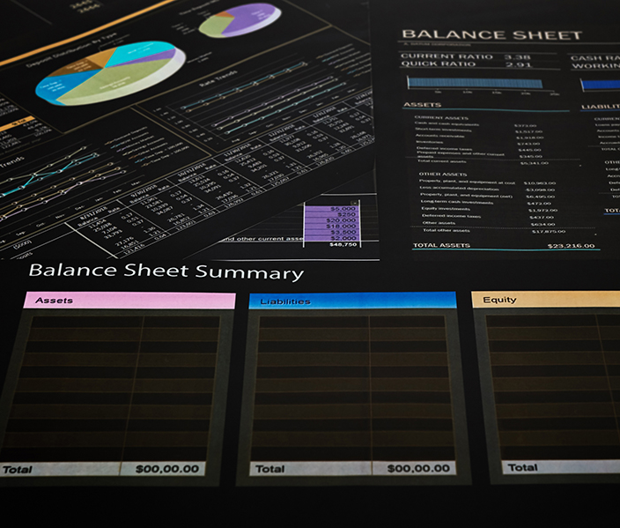
Capital Investment Decisions and Working Capital Management
Working capital management— short term
Current balance of assets and liabilities
Accounts payable and receivable, inventory, and cash
Notes:
Working capital management focuses on the company’s current balance of assets and liabilities and involves the management of:
Accounts payable and receivable
Inventory
Cash
The trick to remembering the difference between capital investment decisions and working capital management is to think of them in terms of time.
Capital investment decisions are made for the long term—they involve company projects that will (in theory) last for years into the future.
Example: If a manufacturing company is considering purchasing a second facility, this would be considered a capital investment decision.
Working capital management involves decisions made for the short term—in most cases, it refers to accounts payable and receivable that will be settled within one year.

Slide 8
Capital Investment Decisions
Which projects to invest in—capital budgeting
How to finance—capital
Debt
Equity
Whether or not to pay dividends
Notes:
There are three capital investment decisions.
First, a company’s financial managers determine which projects it should invest in.
This process is known as capital budgeting.
The managers make these decisions through the involved process of estimating each potential project’s value to the business.
In other words, financial managers ask themselves “How likely is it that the new project will be profitable?”
Second, the managers determine how to finance the new project(s).
They must figure out the “optimal mix” of financing, or capital structure.
Usually, a company’s capital structure consists of some combination of debt and equity.
Debt funding refers to taking out a loan from a bank or other lending institution.
Equity funding refers to raising money by selling shares in the company.
Example:
Consider a small-business owner who wants to expand her product line.
The company currently sells homemade jams and preserves at farmers’ markets and local grocery stores.
The owner thinks her customers would enjoy homemade salsas, too—but lacks the funds necessary to buy extra ingredients, equipment, and packaging materials.
The business owner could reach out to investors or community members for money, in exchange for shares in the company.
The business owner would benefit from raising the money she needs, and the investors would benefit from owning part of the company—and receiving part of its profits as a result.
ON THE WEB: Choosing the right balance of debt and equity when financing a project or a new company is essential for business success. To learn more about the two different tools for financing, watch this video from the Council for Economic Education: https://www.youtube.com/watch?v=6wBlWqNGyhU.
DISCUSSION #8: Ask students to describe the equity their current places of employment own.
Equity can also mean cash or retained earnings.
If a company happens to have a few million dollars available, it might use it for purchasing new equipment or even acquiring a smaller company.
When a business makes a profit, one of its capital investment decisions is to determine whether to pay dividends to its shareholders and, if so, when and how much.
If the company chooses to pay dividends, it must decide whether to pay them in the form of cash or in the form of stock.
If the company does not choose to pay dividends, it will usually use its profits to either:
Finance new projects
Reinvest in existing ones
It’s up to the financial managers to decide what’s best for the company.
DISCUSSION #9: Ask students if they would prefer to receive dividends in the form of stock or in the form of cash. Why?
ON THE WEB: The decision to pay dividends to stockholders can be tricky. To learn more about the dividend payment process—as well as the pros and cons of paying dividends—check out this article from Investopedia: https://www.investopedia.com/articles/03/011703.asp.

Slide 9
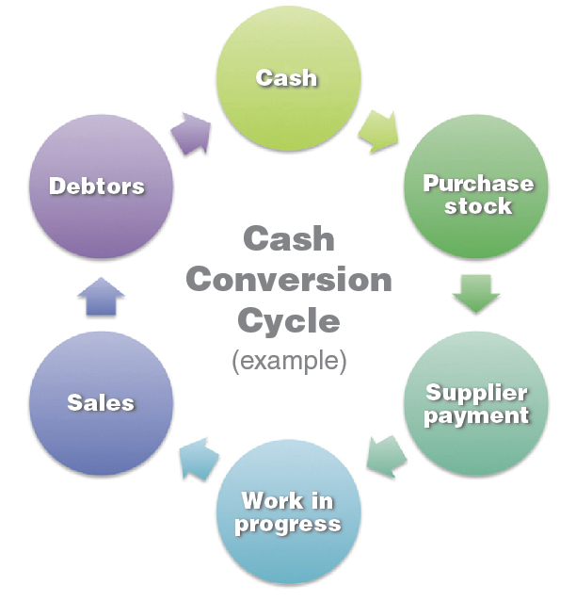
Cash Conversion Cycle
Key component of managing working capital
How long money is “tied up” between buying raw materials and receiving cash from selling products
Cash Conversion Cycle
example
Notes:
A key component of managing working capital is the cash conversion cycle.
The cash conversion cycle goes by many names, including:
Asset conversion cycle
Working capital cycle
Net operating cycle
Cash cycle
It is a ratio that refers to the number of days between a company paying for raw materials and receiving cash from selling the products made from those raw materials.
Financial managers want to keep the cash conversion cycle as short as possible because a longer conversion cycle means that the company’s money is tied up longer.
Of course, financial managers want to have as much free cash to work with as possible!
When investors consider investing in a company, they often look at the cash conversion cycle as an indicator of whether the company has good working capital management.
A downward trend in the cycle is a positive sign, while an upward trend is a negative one.

Slide 10
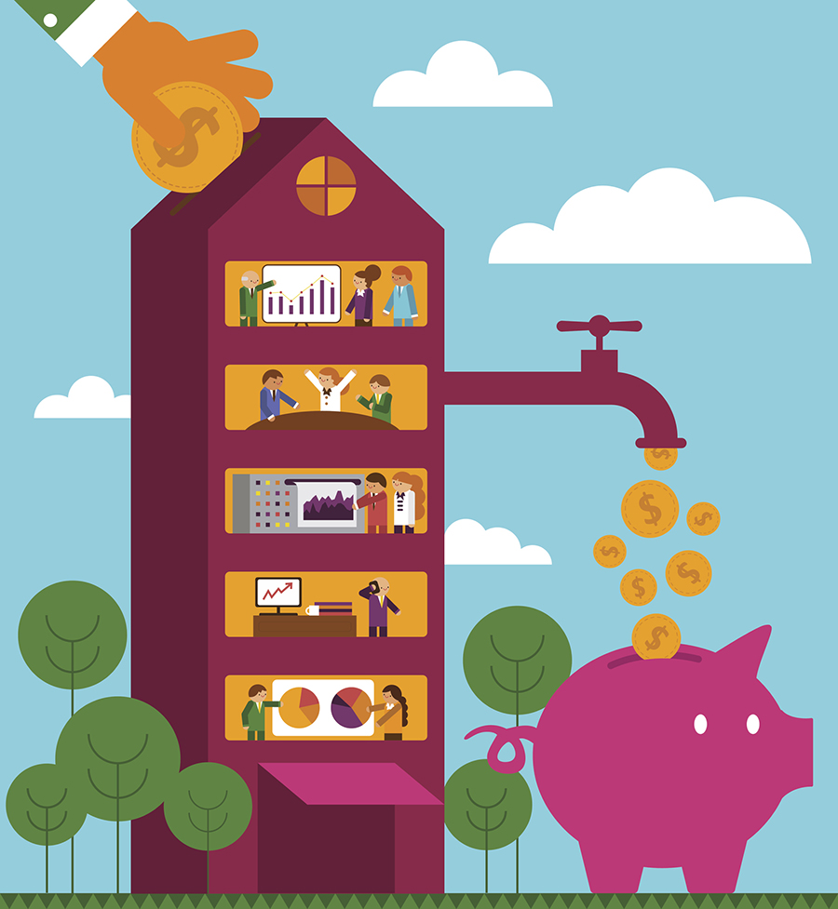
Return on Capital
Key component of managing working capital
How well a company generates cash flow in relation to invested capital
Notes:
Return on capital (also known as return on invested capital) is another key component of managing working capital.
It is a measure of how well a business generates cash flow in relation to the capital (both debt and equity) it has already invested into itself.
It is usually expressed as a percentage.
When return on capital is positive, the company is growing in value.
When it is negative, the company is losing value.
Financial managers need to make sure that return on capital remains high.
Remember, they’re responsible for helping the company grow in value.
Example:
If the packaged-food company has invested $10 million in itself through both debt (loans) and equity (financing from within), and its net profit is $1 million, its return on capital is positive—10%—and the company is growing in value.
This is a reasonable growth expectation.
If the net profit is negative, however, the company is losing value.
ON THE WEB: Watch this brief YouTube video to learn more about return on capital, and why it is so important: https://www.youtube.com/watch?v=ZrvJTn981lo.

