Slide 1
Bunn High School
Re-entry Information for Students Returning
Back-to-School Under Plan B

Slide 2
What will the school day look when I return to school under Plan B?
Bunn High School staff is excited to welcome our students back to campus! In this presentation, we will review procedures and requirements under Plan B and what the school day will look like in order to help keep students and staff safe and healthy. In this presentation we will review:
Daily and Weekly Schedules
Transitioning Between Classes
Arrival To School
Breakfast
Lunch
Bathroom and Mask Breaks
New Attendance and Discipline Policies
Dismissal

Slide 3
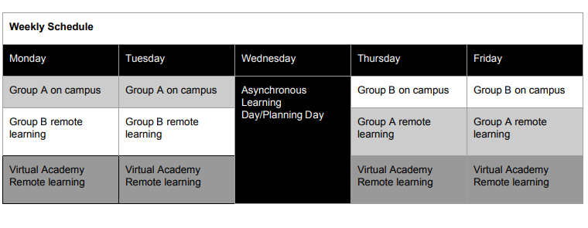
Weekly Schedule
Under a Phased-in Plan B, students returning to school will be divided into two groups- Group A and Group B. Each group will attend face-to-face instruction two days a week, and receive instruction remotely 3 days a week. Virtual Academy students will receive instruction remotely 5 days a week, with Wednesday being an offline day for all students to work independently on assignments. Students returning for face-to-face instruction should have received a student assignment letter indicating which group they have been assigned to. Students are to come to school only on their assigned group days. Student group assignments will not be changed to place friends together.

Slide 4
Daily Schedule
Students should not arrive at school before 8:15 a.m
8:40-8:45 a.m. Class Change to 1st Period (5 minutes)
8:45-10:03 a.m. 1st Period & Announcements (78 minutes)
10:03-10:10 a.m. Class Change (7 minutes)
10:10-11:30 a.m 2nd Period (80 minutes)
11:30-11:37 a.m. Class Change (7 minutes)
11:37 a.m-1:32 p.m. 3rd Period & Lunch (120 minutes)
1:32-1:39 p.m. Class Change (7 minutes)
1:39-3:00 p.m. 4th Period (81 minutes)

Slide 5
Transitioning Between Classes
Students will have 7-minutes to transition between each class.
All student traffic will go in a one-way direction following GREEN arrows on the floor.
All students will walk down the center of the hallway staying 6 feet apart and single file while wearing masks.
School staff will be in the hallways to help students follow the appropriate traffic patterns.
On the first day of school, students are to report to their 1st period class. 1st period teachers will review the transition procedures for each hallway located at the end of this presentation. Students will also receive a copy of their schedules and a school map.

Slide 6
Procedures During Arrival Time
Before entering the school building, students will be asked health screening questions and will have their temperatures checked by school staff at one of three locations on campus depending on how students are transported to school. Students must have a temperature below 100.4 to enter the building and answer no to all screening questions.
Students must maintain social distancing at all times while on campus and on the buses. Masks are required at all times with the exception of mask breaks or eating breakfast or lunch. This includes traveling to and from the student parking lot, carpool, and buses. Students are not to congregate in any area of the school. They must be transitioning or in a class at all times. Students who report to school without a mask will be provided with one to use. The school will provide each student with 5 reusable cloth masks.

Slide 7
Procedures for Bus Riders
Students taking the bus to school will answer health screening questions and have their temperature checked before boarding the bus. Students will be required to wear a mask while riding the bus. Students who refuse to wear a mask will not be allowed to board. All students will unload and enter the school building through the gym entrance and are to go directly to their 1st period class.

Slide 8
Procedures for Car Riders
For car riders, the carpool line will run as usual and will take place at the front entrance of the school. Students will answer health screening questions and have their temperature checked prior to exiting the car during carpool. After clearing the health screening and temperature check, students are to report directly to their 1st period class. On cold days, please turn down the heat in the car before approaching the school building, so an accurate temperature can be recorded.

Slide 9
Procedures Student Drivers
In order to park on campus, student drivers must have completed the BHS Student Parking Agreement Form which is on the BHS website and adhere to all the rules and regulations outlined in that document.
Failure to adhere to those rules and regulations will result in suspension of parking privileges or your vehicle being towed.
Carpooling is not permitted unless it is a family member living at the same address as the student driver.
BHS will assign each student driver a parking spot.
Once parked in an assigned spot, student drivers are not allowed to congregate with other student drivers nor are they allowed to sit in another student’s vehicle.
Students will need to enter and exit the parking lot by the baseball field.
All students drivers are required to enter the school by the 300 Hall and have their temperature checked and answer the health screening questions and then report directly to their 1st period class. Late arrival students are to report to the main office before going to class.

Slide 10
Procedures for Breakfast
Breakfast will be Grab and Go. Students are to take their breakfast and eat it in their 1st period class. Breakfast bags will be available at the following locations:
Car riders and bus riders are to pick up breakfast in the front lobby near the main office.
Student drivers are to pick up breakfast in the 300 Hall.

Slide 11
Procedures for Lunch
Students will eat lunch in the cafeteria.
There will be a maximum of 50 students in the cafeteria.
Students will be assigned a specific lunch time and seat in the cafeteria. This will be their daily assigned seat in the cafeteria.
Tables will be numbered to help students find their seat.
Students will enter the cafeteria from the 300 hall. They will exit the cafeteria at the parking lot entrance.
Students will go through the line and grab a bag lunch. They will then take their seat.
Once students are seated we will start the 15 minute timer. Once the 15 minutes are over, students will return to the classroom. Students may have a restroom break once they return to the classroom. No food or drink should be removed from the cafeteria.

Slide 12
Procedures for Restroom Breaks
Class restroom breaks will done during 2nd and 4th period. Due to cleaning requirements, teachers will have assigned times for students to go to the restroom. If a student needs to go to the restroom during 1st or 3rd period, the teacher will need to call the front office to have someone escort the student to a restroom.

Slide 13
Procedures for Mask Breaks
A ten minute mask break will take place during 2nd period and 4th period. Teachers may take their classes outside for the mask breaks (weather permitting) or out in the hallway.

Slide 14
Dismissal Procedures
The following groups of students will be dismissed from school by their 4th period teacher at the following times:
3:00 p.m. Student Drivers are dismissed
3:02 p.m. Bus Riders
3:04 p.m. Car Riders

Slide 15
New Attendance Requirements for Plan B for Remote Learning Days
Once students re-enter under Plan B, they will have 2 ways to demonstrate daily attendance while working remotely during the “at home days”.
Submit a daily assignment through Canvas or Google Classroom by 11:59 p.m. or
Participate in a Google Meet facilitated for each class.
The option of just checking Canvas by 11:59 p.m. will no longer count for attendance. Students must either submit a daily assignment or attend a Google Meet to be counted present for a class.

Slide 16
Behavior Reminders
Students are expected to follow all the safety guidelines as well as all the school and districts rules. We will still follow the Franklin County Code of Student Conduct. Any conduct which causes a disruption during an activity or function, or which interferes with the health, safety, well-being or rights of others is prohibited.
BHS CODE OF CONDUCT
Bring all necessary materials to class each day.
Be in your assigned place and ready to work when the tardy bell rings.
Be recognized before speaking or leaving the assigned place.
Show respect and be polite to all people.
Respect the property of others.
Respect the instructional process.
Be honest at all times.
This is not all inclusive. Please refer to the Franklin County Schools Student Handbook for additional guidance concerning student conduct.

Slide 17
Behavior Reminders
PUBLIC DISPLAYS OF AFFECTION
The guidelines regarding physical contact apply to student behavior from the moment that the student arrives on campus or boards a bus until the time the student leaves the school campus or departs from the bus. The guidelines apply to all areas of the school property at all times. Due to social distancing requirements physical displays of affection between students is prohibited, students are to keep their hands to themselves and not touch another person’s body.
The following behaviors are PROHIBITED:
Kissing
Front to front contact, including hugs
Front to back contact, including hugs
Side to side hugs/arms around another person’s waist, shoulders, hips, etc.
Hand holding
All of the behaviors listed above violate the social distancing guidelines.

Slide 18
Transition Procedures for Hallways
For the following slides, teachers will review these hallway transition procedures with students on the first day of school during 1st period. A school map is located at towards the end of this presentation for teachers to use as they review the hallway transition procedures with students.

Slide 19
Transition Procedures for 300 Hallway
Students will exit the 300 hallway at the doors leading to the back of the auditorium. If students need to go to the gym or Ag. building, they will turn left and either go to the doors by the concession stand at the gym or the front door of the Ag. Building. If students need to go anywhere else in the building, they will turn to the right and enter the doors at the auditorium/200 hall.

Slide 20
Transition Procedures for Gym Area
Students will exit the gym area from the doors leading up the steps to the auditorium. Once at the end of the hallway they will then get into the traffic flow in front of the office area.

Slide 21
Transition Procedures for 200 Hallway
Once students enter the doors by the auditorium, they will then follow the traffic flow to the left and head toward the main office. Once they reach that point, they will then follow traffic flow to the right to the doors that lead to the breezeway between the office area and the 100 building. When they reach the door at the 100 building, they will either follow the traffic flow to the left (New 100 building (science/social studies building)) or right (100 hallway).

Slide 22
Transition Procedures for New 100 Building and 100 Hallway Traffic
Students will walk down the 100 hallway towards the 000 hallway. Once there, they will turn right down the 000 Hallway.

Slide 23
Transition Procedures for 000 Hallway Traffic
Students will walk down the 000 hallway towards the steps at the media center. If they have classes in the New 100 building or 100 Hallway, they will exit the building at the media center and join the traffic flow towards the New 100 Building. If students have classes in the 300 hall, gym, or Ag building, they will proceed up the steps toward the 200 hall. Once students are at the 200 hall, by Mrs. Bartholomew’s classroom (Room 206), they will enter the doors that lead to the ramp towards the 300 hall where they will join that traffic flow.

Slide 24
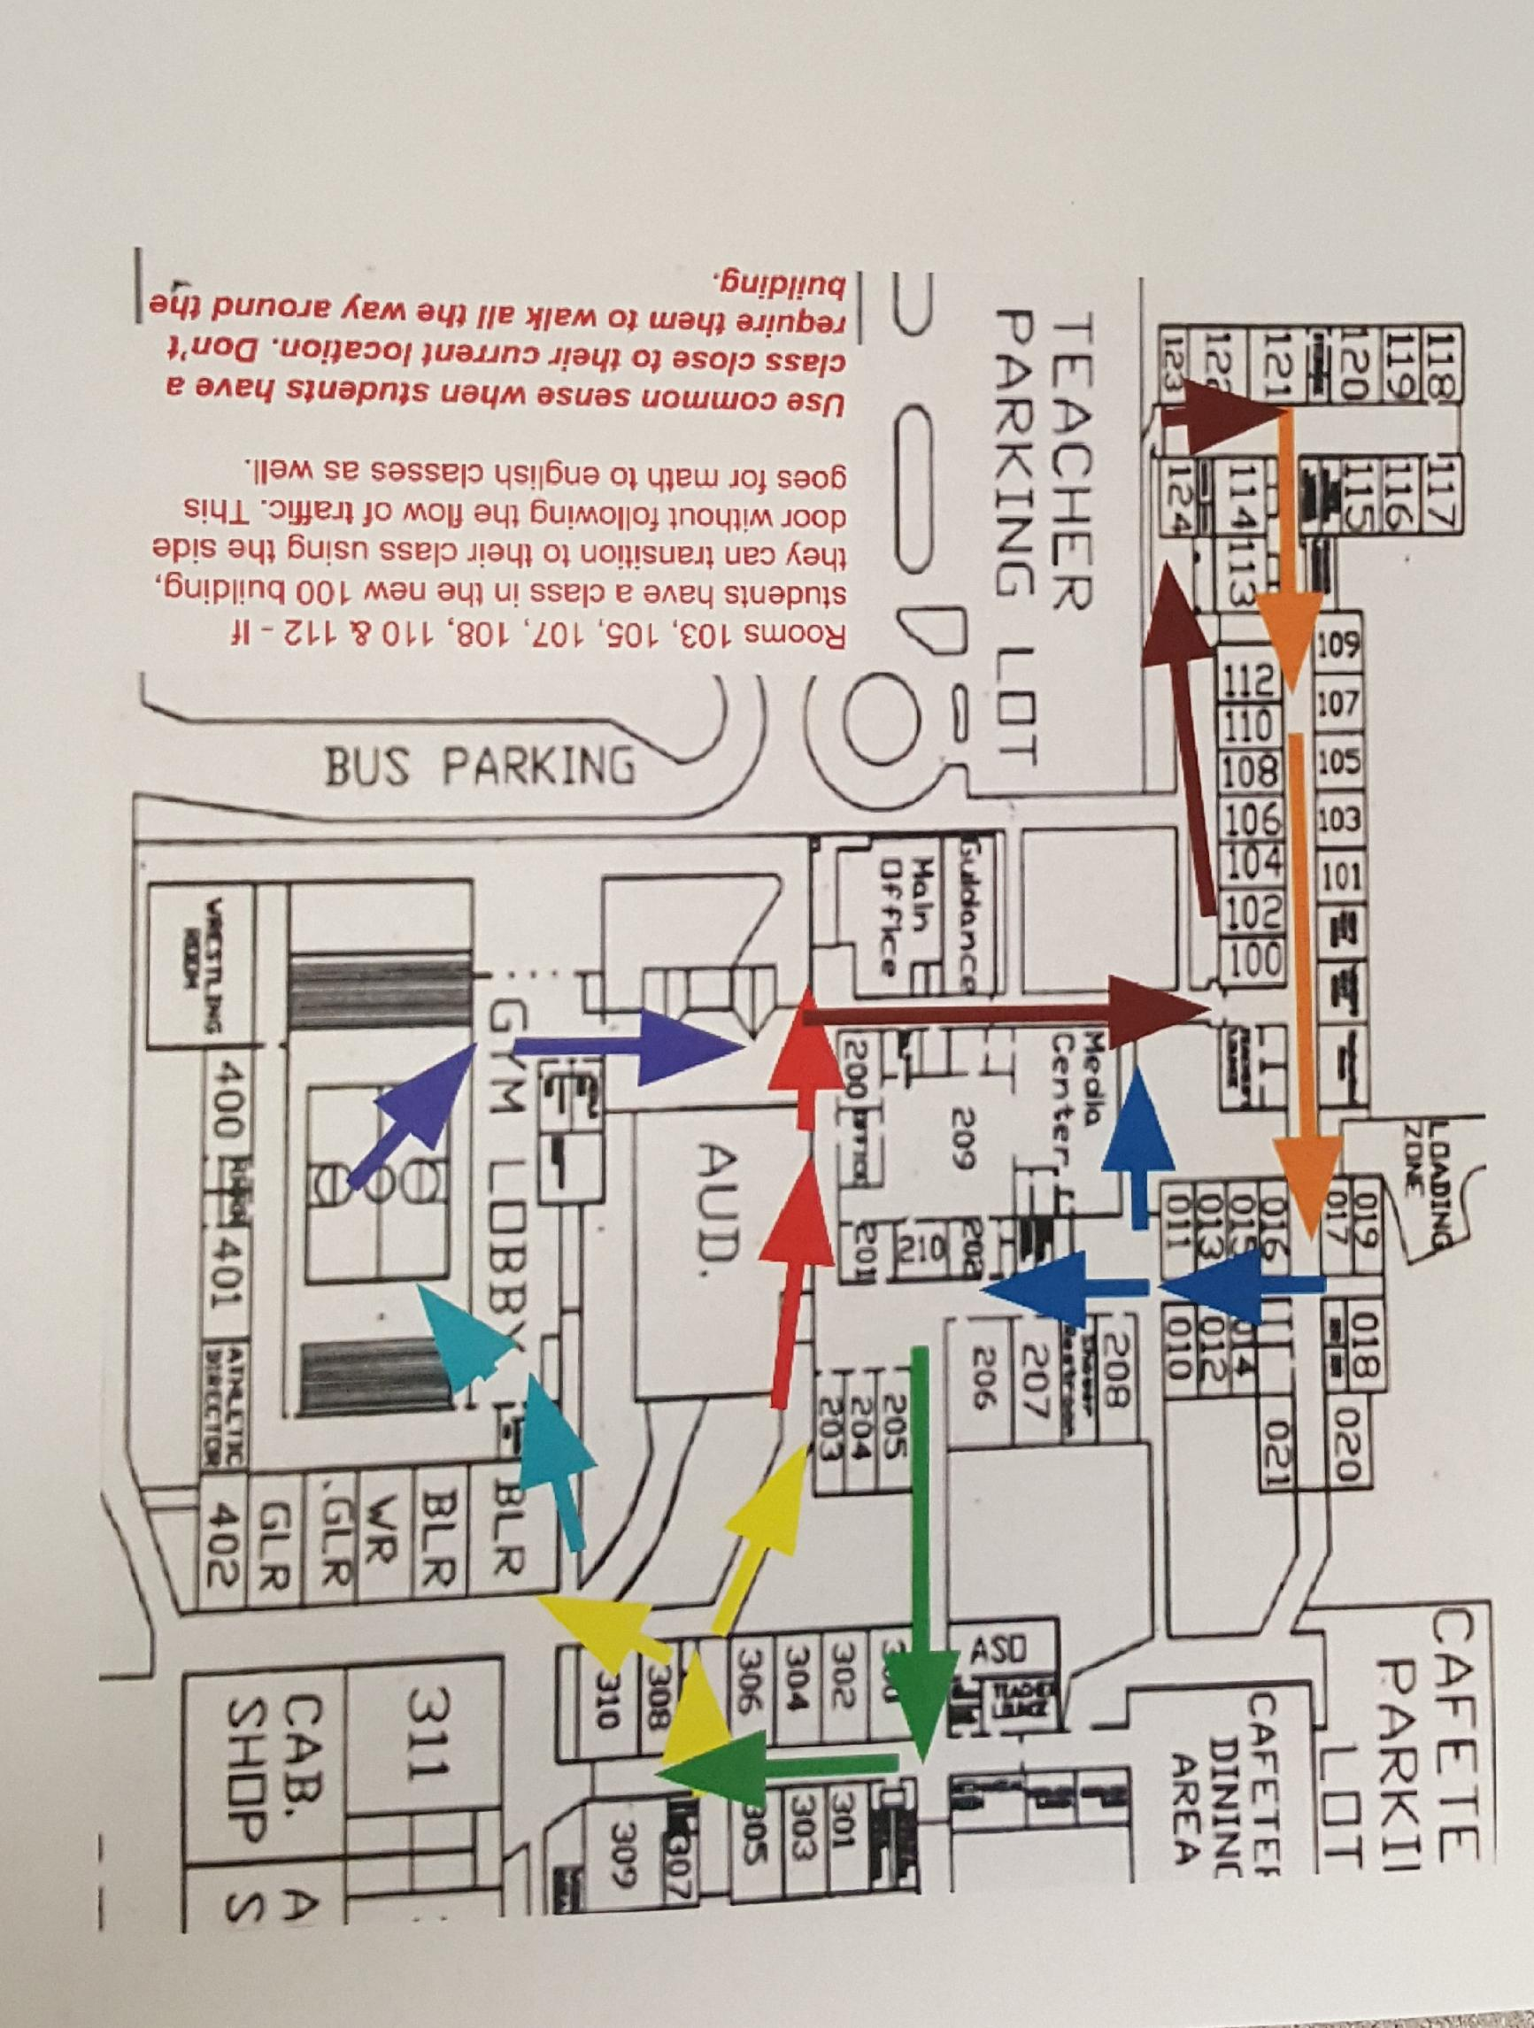

Slide 25
Questions

