Slide 1
Are You Satisfied?
Economics and Economic Activities
Economics LAP 6

Slide 2
Are You Satisfied?
Economics and Economic Activities
Discuss the nature of economics.
Explain economic activities.

Slide 3
Explain economic activities.

Slide 4
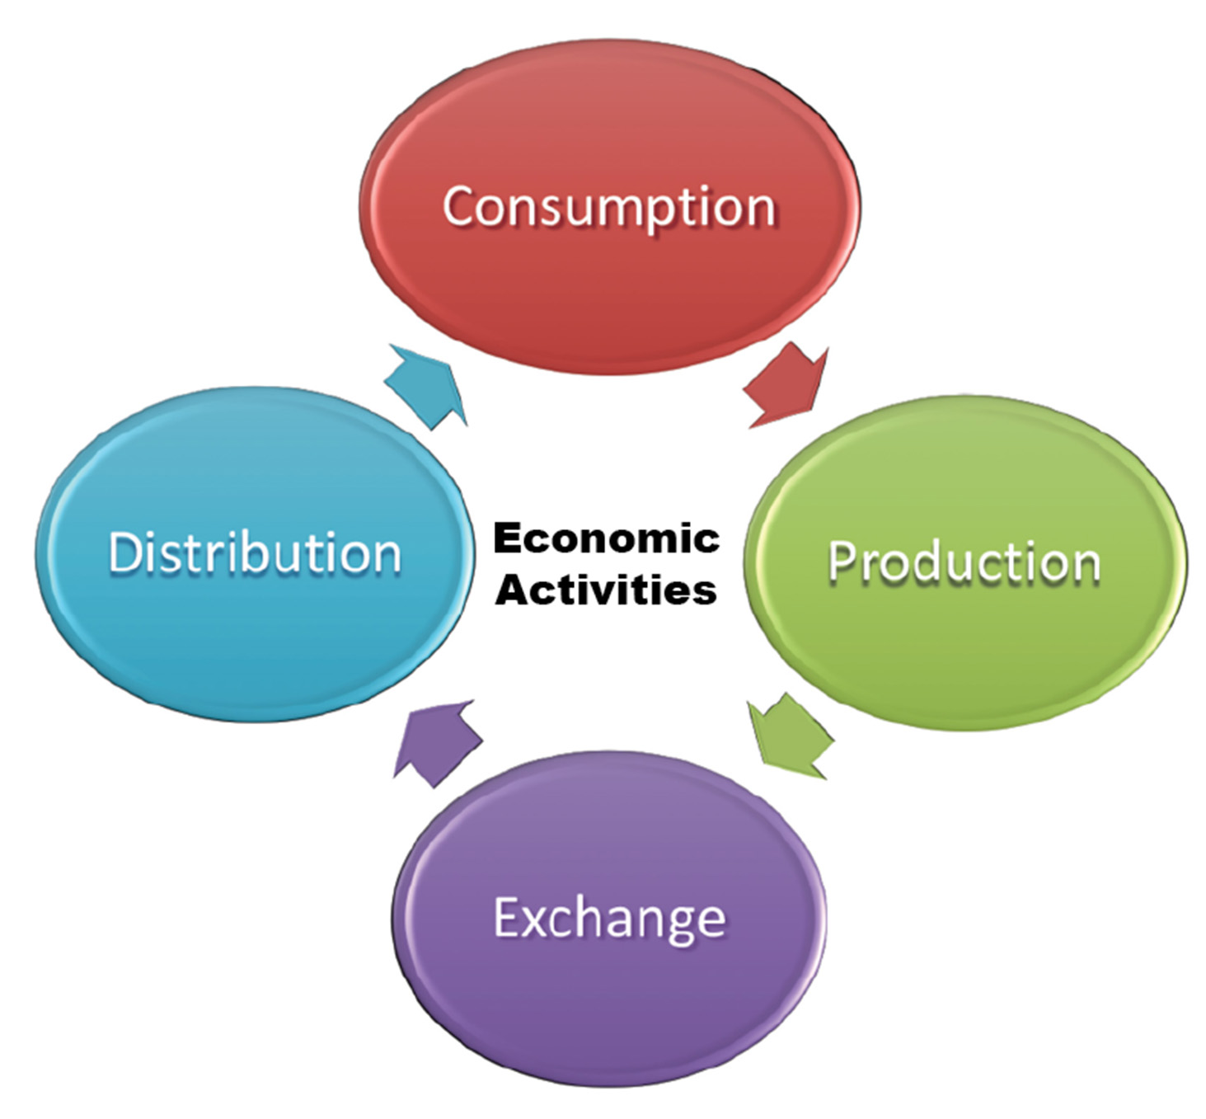
Getting What We Need
Goods, services, and resources move from one person to another.
Four economic activities make this movement possible:
Consumption
Production
Exchange
Distribution

Slide 5
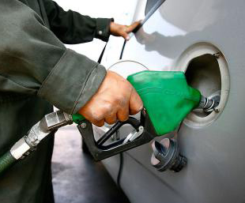
Economic Activities: Consumption
Consumption: the economic process or activity of using goods and services
The ultimate goal of all economic activity is consumption.
Consumer: anyone who uses goods and services

Slide 6
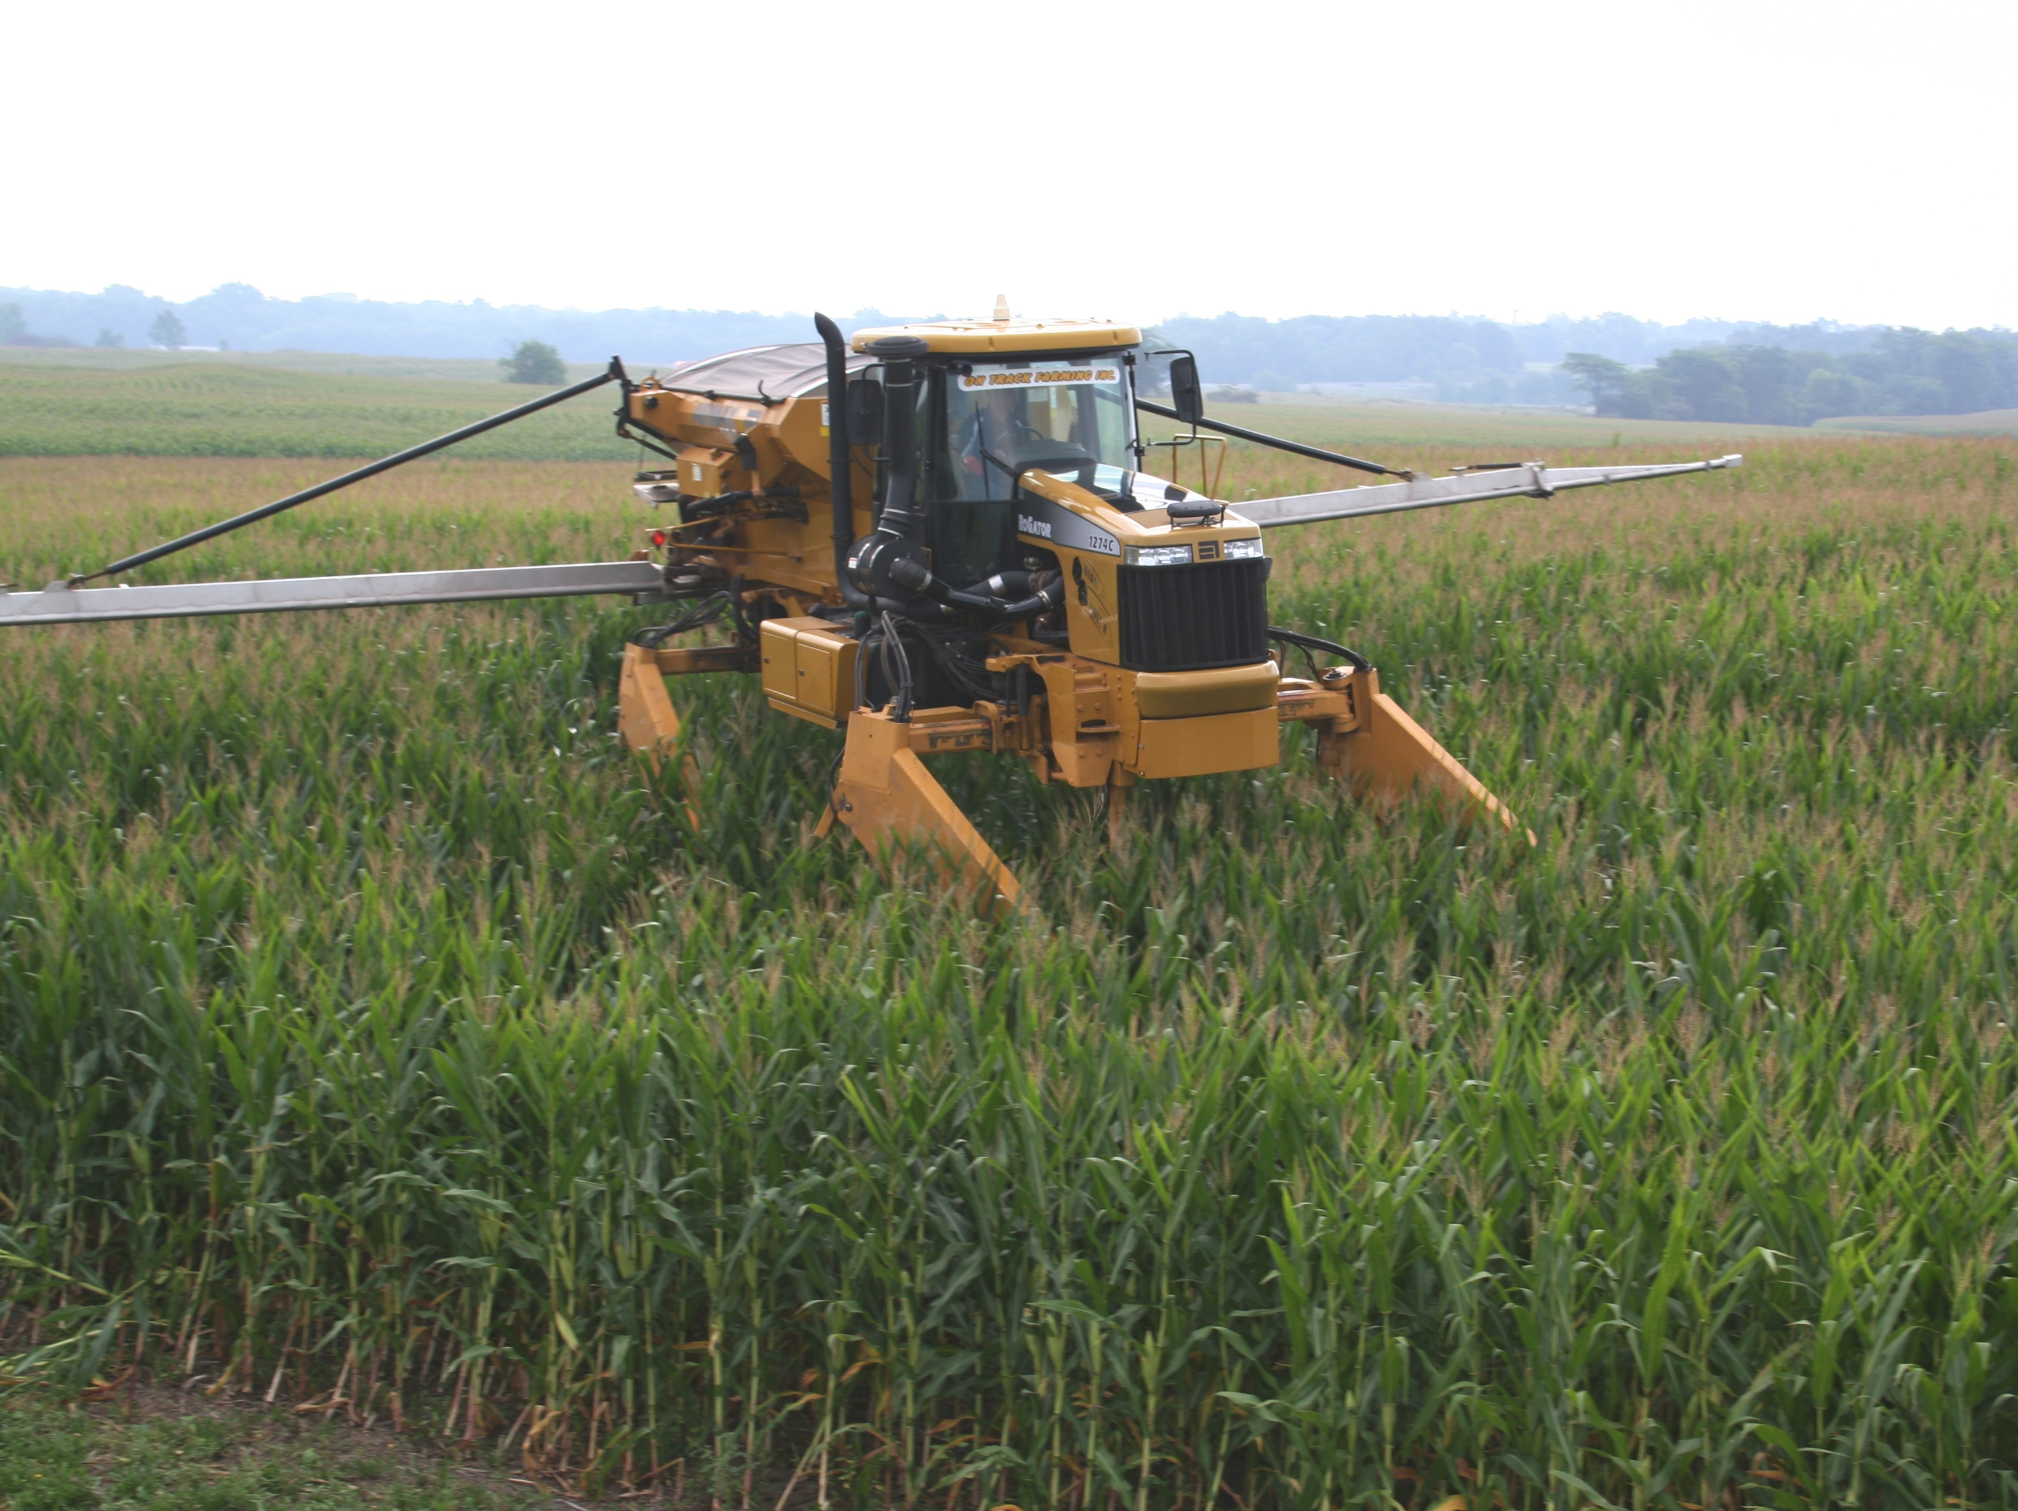
Economic Activities: Production
Production: economic process or activity of producing goods and services for consumption
Producers: individuals or businesses who make or provide goods and services

Slide 7
Economic Activities: Balancing Production and Consumption
The relationship between consumption and production must be balanced.
Sustainable consumption and production: shift toward minimizing resource use and pollution in the process of consumption and production

Slide 8
Economic Activities: Distribution
Distribution This is the process or activity by which income is divided
among resource owners and producers.
Resource owners must feel that their incomes are large enough so that they will continue to supply resources.
Producers must receive enough revenue (profit) to continue making or providing goods and services.

Slide 9
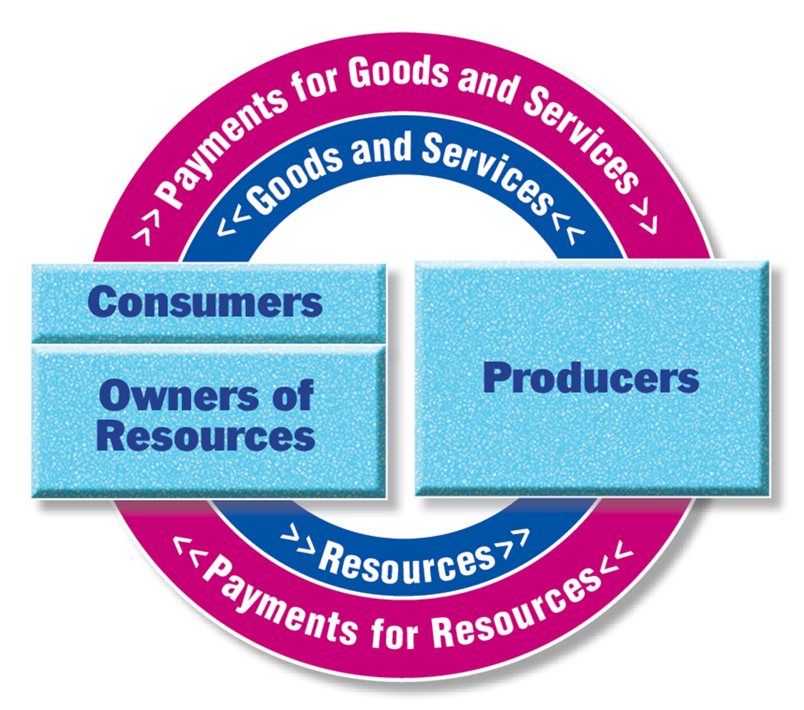
Economic Activities: Exchange
Circular movement of resources, goods, services, and money payments

Slide 10
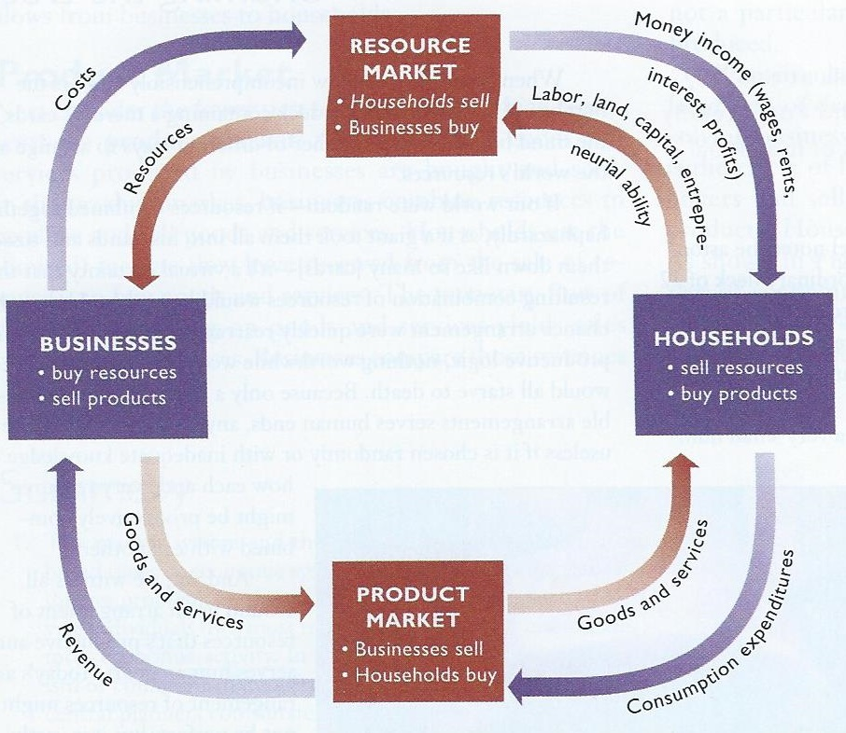
Economic Activities: Exchange
Resource Market: Households sell and businesses buy the factors of production (economic resources)
Product Market: Households buy and producers sell their goods and services
See “Circular Flow” video

