Slide 1
Ideas in Action
Innovation Skills
Professional Development LAP 126

Slide 2
Ideas in Action
Innovation Skills
Describe the importance of innovation in business.
Explain techniques used by business to achieve innovation.

Slide 3
Describe the importance of innovation in business.

Slide 4
Did you use a smartphone today?
Did you watch videos, get directions, listen to tunes, post, message, tweet, or snap?
Not long ago, a phone was only used to make phone calls.

Slide 5
Apple didn’t invent the phone.
But Apple’s innovations made the phone a revolutionary device.
What innovations did Apple create for the phone?

Slide 6
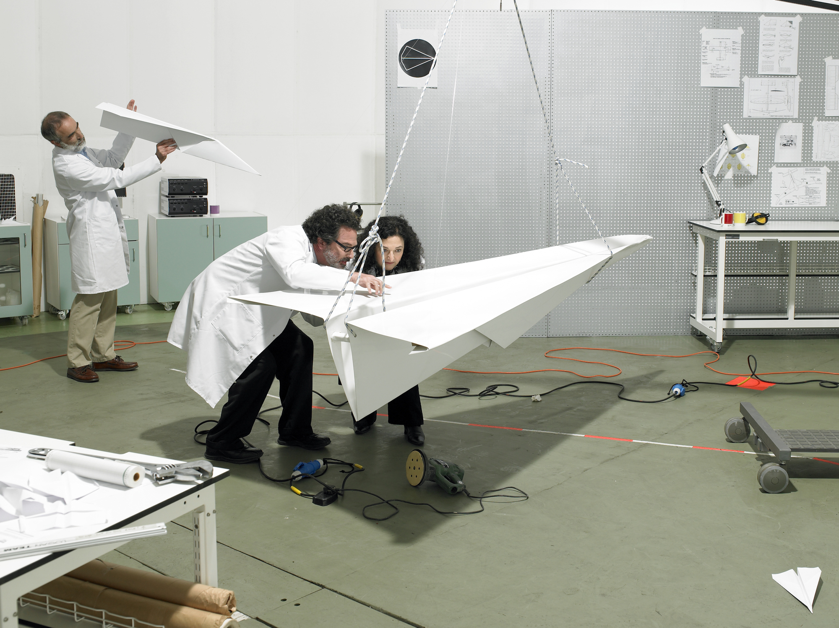
What Is Innovation?
Something new— a product, method, strategy, or process
An improvement to something that already exists
Invention vs. innovation
What is innovation?
http://vimeo.com/77911159

Slide 7
Creativity and Innovation
Creativity: the ability to generate unique ideas, approaches, and solutions
Innovation: putting ideas into action

Slide 8
The BIG Picture...

Slide 9
The difference between Invention and Innovation
Discovery/Invention
Innovation
X-ray
Light sensitivity of silver compounds
Semi conductors
Storage of data on magnetic surfaces
Lasers
E=MC^2
Medical x-ray
Photography & camera
Radio
Magnetic tape, cassettes, & diskettes
CDs, DVDs
Nuclear Power

Slide 10
The Four P’s
Product
Occurs when a business either creates or improves a product
Process
Occurs when a business changes how something is done
Positioning
Occurs when the purpose of a product is changed
Paradigm
Involves a significant change in thinking
Product
Process
Positioning
Paradigm

Slide 11
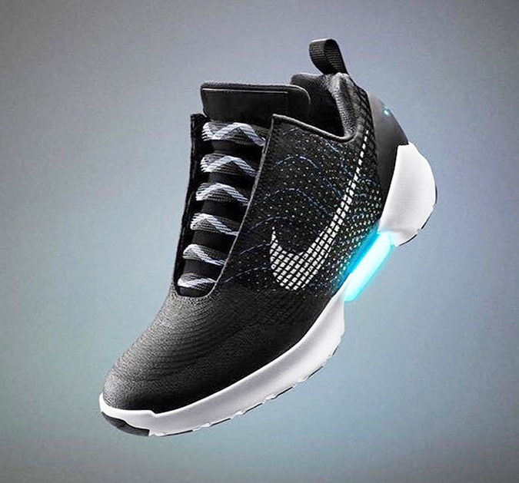
Why Is Innovation Important?
Helps businesses compete
Helps businesses survive
Helps the economy

Slide 12
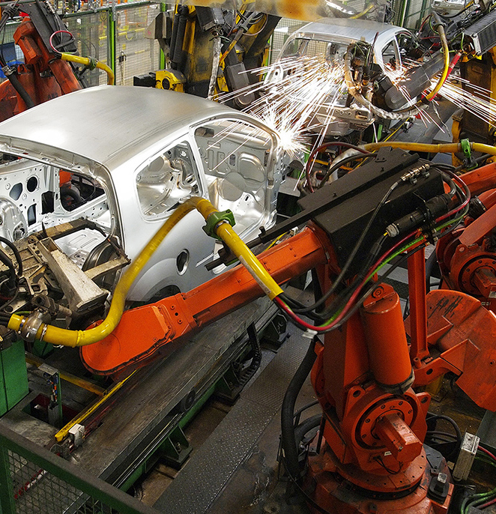
Innovation Risks
Failure
Creative destruction
Loss of jobs
Robots & Us: When Machines Take the Wheel:
https://www.wired.com/video/watch/robots-us-the-ai-and-automation-revolution-when-machines-take-the-wheel

Slide 13
Explain techniques used by businesses to achieve innovation.

Slide 14
What Does It Take to Be Innovative?
Open-mindedness
Flexibility
Curiosity
Problem-solving skills

Slide 15
What Does It Take to Be Innovative?
Creativity
Inside Google X:
https://www.youtube.com/watch?v=5oKmb7U3H6U
Risk-taking ability
Determination and resilience

Slide 16
Sources of Innovation
Observations
Customer needs
New Airport Scanner Could Make Going Through Security a Breeze:
http://www.cnn.com/2014/10/01/tech/innovation/mci-alfa3-scanner/

Slide 17
Sources of Innovation
Demographics
Experience
Trends
Accidents
Looking toward the future

Slide 18
Small Businesses and Innovation
Small businesses:
Are more flexible
Face fewer judgments

Slide 19
How Businesses Can Achieve Innovation
Be open-minded and flexible
Encourage employee suggestions
Research
Make connections
Reduce risk

