Slide 1
1.03 Business Communication
1.03 Select and utilize appropriate formats for professional writing
Part B - Select and utilize appropriate formats for professional writing

Slide 2
Standard 1.03 Business Communication
A Explain the nature of effective communication
B Select and utilize appropriate formats for professional writing
C Edit and revise written work consistent with professional standards
D Write professional e-mails

Slide 3
Ways to Communicate in Business
In person
Email
Letter
Phone
Memo
Can you think of other ways to communicate?

Slide 4
Exchange of information related to business
Can be written or oral
Written messages can be saved for future reference
Internal - employers and employees at all levels of the company
External - clients, independent contractors, industry colleagues and other individuals not working directly for the company
Modern (digital) communication - text messaging, social media, and multimedia business presentations.

Slide 5
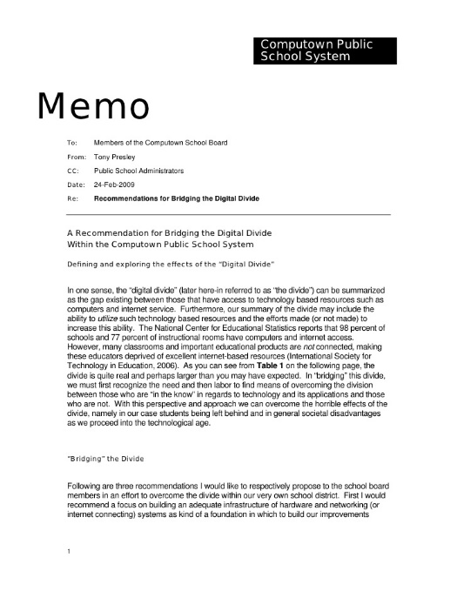
Memorandum (or Memo)
Short means of conveying specific information within an organization
Mainly used to communicate information about internal topics, such as current projects or changes in business

Slide 6
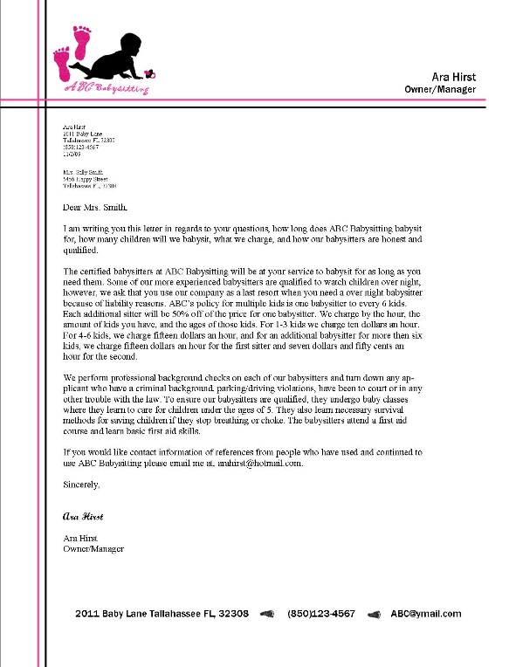
Letter
Helps promote the business image by communicating with the outside world; should be carefully written
Must have a good, appealing layout
Can be used to confirm in writing what has been agreed upon verbally
Examples: sales letters, information-seeking letters, confirmation of verbal communication

Slide 7
Email
Common form of written communication, virtually replacing memos
Rapid delivery, ease of use, and ability to reach large audiences
“Equally admissible” in court as formal paper documents
Its use continues to grow, somewhat replacing formal letters

Slide 8
Differences
Memos | E-mail Messages | Letters
Internal audience Audience may be broad | Internal or external audience Specific group or person | External Specific audience
TO: FROM: DATE: SUBJECT: format | To, From, Date, and Subject are built into the message “Signature” contains name and contact details of sender | Uses a “Dear ____” greeting and a “Sincerely + signature” closing

Slide 9
Tips
Create an draft outline for brevity, clarity, and succinctness
Simplify with bullet points and numbered lists
Offer a telephone number, fax number, or email address
Should conclude with a call to action
Follow up with a telephone call when possible
If unsure of the recipient’s name, use “Dear Sir or Madam”

