Slide 1
Welcome to
Ms. Wilson’s
3rd Grade Class

Slide 2
72dnxyu
Contact Information
Long Mill Elementary 919-554-0667 ext 291
email: monicawilson@fcschools.net

Slide 3
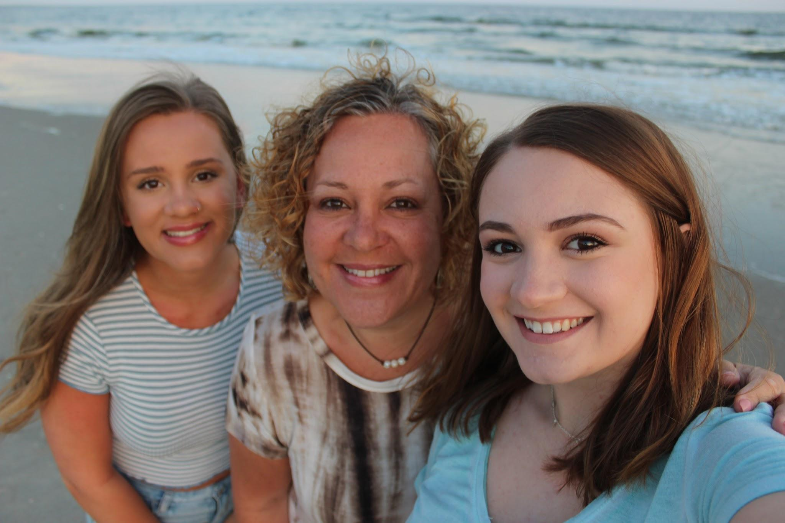
Meet the teacher!
I have taught in FCS for over twenty years, most of my experience is in 3rd grade. I live in Youngsville and enjoy the small community. I moved here 27 years ago from western NYS. NC is my home now. I have two girls in college, one at ECU and the other at UNC Chapel Hill.

Slide 4
Our Schedule
8:00-8:30 Office Hours
8:30-10:15 Math with Ms.Wilson
10:15-12:00 Reading with Miss Davis
12:00-12:45 Lunch
12:45-1:15 Specials
1:15-2:00 iReady/Intervention

Slide 5
Specials 12:45-1:15
Mon - SEL Ms. Arnold
Tues - none
Wed - Music
Thurs - Art
Fri - PE

Slide 6
Staying Healthy
Even though we are not physically meeting in the classroom, make sure you are practicing staying healthy at home (so that you are healthy when it’s time to come back to school) by doing things such as:
Washing your hands.
Not touching your face.
Wearing a mask while in public.
Keeping a social distance of at least 6 feet.

Slide 7
New School Guidelines
No visitors. If you are asked to come to school to pick up something for your student, stay in your car.
Please wear a mask if/when you come to the school to pick up materials, devices, etc.
**These guidelines keep our staff, students, and families safe!**

Slide 8
Mental Health
My number one goal this year is to help children be happy and healthy. I know that last spring was a very difficult time for many families. Mental health will come before academics as we start the year. Long Mill is incorporating a SEL (Social Emotional Learning) class this year to further help students. If at any time you have concerns about your child, please do not hesitate to contact me so we can work together.

Slide 9
Distance Learning
We will be using Google Classroom and Google Meet for instruction during remote learning. I will let you know what time we will be meeting via Google Meet each week. Please email or call me if you are having any technology struggles.
I know that it can be difficult for children to stay engaged during Google Meets. However, these are important because they will be getting their instruction during that time.
If at any point you see your child struggling to stay on task during meetings, please contact me and I will work to make adjustments.

Slide 10
Google Classroom
We will use Google Classroom this summer. My hope is that it will help create easy access and understanding for distance learning. My goal will be to help children learn how to use each piece of this platform so they can be more independent during distance learning.
Don’t hesitate to ask any questions pertaining to google classroom/google meets. We’re all in this together!

Slide 11
Google Classroom Codes
Wilson Math - e67647d
Wilson Science - xlvj5tp
Davis Reading - k5qzwpx
Davis Social studies - vctpfqp
PE - xc5yzsd
Music - jjydlex
Art - duwssnr
SEL - b6iuuv6

Slide 13
Special Needs or Accomodations?
Please let me know if their are any special needs or accomodations you would like me to know about your child so I can help them be successful!

Slide 14
Supply List
2 packs regular pencils
Pencil Case
Dry Erase Markers
Dry Erase Eraser
Dry Erase Board
Composition book (show math work)
Index Cards
Headphones or Earbuds
Chromebook Case (optional)
Crayons/Colored Pencils

