Slide 1
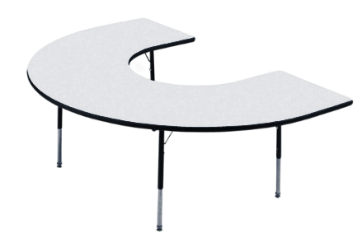
Welcome to Ms. Preddyś Third Grade Classroom

Slide 2
Contact Information
919-554-0667
classroom extension: 289
my email: gingerpreddy@fcschools.net
Google Classroom Code: dwjahc4

Slide 3
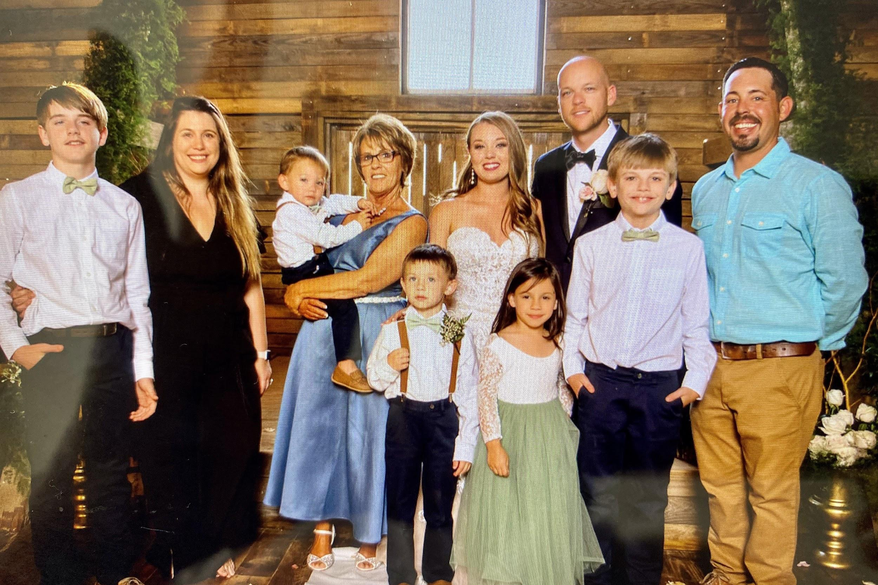
Meet the teacher!
I have been teaching with Franklin County Schools for 21 years. I have two children, Johnnie and Casey, and 6 grandchildren. I love to read, dance, listen to music, and spend time with my family. I can’t wait to get to know you and help you grow this year.

Slide 4
Staying Healthy
Even though we are not physically meeting in the classroom, make sure you are practicing staying healthy at home (so that you are healthy when it’s time to come back to school) by doing things such as:
Washing your hands.
Not touching your face.
Wearing a mask while in public.
Keeping a social distance of at least 6 feet.

Slide 5
New School Guidelines
No visitors. If you are asked to come to school to pick up something for your student, stay in your car.
Please wear a mask if/when you come to the school to pick up materials, devices, etc.
**These guidelines keep our staff, students, and families safe!**

Slide 6
Mental Health
My number one goal this year is to help children be happy and healthy. I know that last spring was a very difficult time for many families. Mental health will come before academics as we start the year. We will spend time reading and talking about books that will help us process how we are feeling. One of our special classes is SEL (Social,Emotional Learning). If at any time you have concerns about your child, please do not hesitate to contact me so we can work together.

Slide 7
Our Schedule
8:00-8:30 Office Hours (Conferences, Questions)
8:30-10:15 Block 1: Preddy (Reading,Writing, Social Studies)
10:15-12:00 Block 2: Weinerman
(Math, Science)
12:00-12:45 Lunch
12:45-1:15 Specials
1:15-2:00 I-Ready/Interventions
2:00-3:00 Planning

Slide 8
Our Special’s
Schedule with Codes
Monday: PE
Tuesday: SEL
Wednesday: NO SPECIAL
Thursday: Music
Friday: Art

Slide 9
Distance Learning
We will be using Google Classroom and Google Meet for instruction during remote learning. Please email or call me if you are having any technology struggle.
I know that it can be difficult for children to stay engaged during Google Meets. However, these are important because they will be getting their instruction during that time.
If at any point you see your child struggling to stay on task during meetings, please contact me and I will work to make adjustments.

Slide 10
Google Classroom
We will use Google Classroom this first nine weeks. My hope is that it will help create easy access and understanding for distance learning. My goal will be to help children learn how to use each piece of this platform so they can be more independent during distance learning.
Don’t hesitate to ask any questions pertaining to google classroom/google meets. We’re all in this together!

Slide 11
Video Chat Expectations
BE PREPARED
PRESENTATION
SPEAKING
Be on time.
Find a quiet learning place without distractions.
Have your materials ready.
Keep your camera on and still.
Check your surroundings.
Dress appropriately.
Stay on mute.
Raise your hand to speak/ask a ?
Stay on topic when speaking.
PARTICIPATION
BE RESPECTFUL
USE SIGNALS
Be focused.
Pay attention.
Be an active participant.
Be respectful with your words, actions, and content (work you share with the class).
Thumbs up = OK
Thumbs down = No
Raised hand = Question
? in chat = Question
! in chat = Comment

Slide 12
Google Classroom
Codes
Preddy Reading/Social Studies: dwjahc4
Weinerman: Math: 72dnxyu
Weinerman: Science: 3pktjle
PE: xc5yzsd
Art: duwssnr
Music: jjydlex
SEL: b6iuuv6

Slide 13
Special Needs or Accomodations?
Please let me know if their are any special needs or accomodations you would like me to know about your child so I can help them be successful!

