Slide 1
Growing Nationalism
Unit 2 – Lesson 8

Slide 2
SECTION 4 – GROWING SECTIONALISM
Nationalism couldn’t stop major differences
Regional Issues – slavery
Up until this point, equal numbers
Slave vs. Free States (Equal Representation in the Senate)
Admission of Missouri becomes a heated issue
Slave State…yes or no
North vs. South

Slide 3
SECTION 4 – GROWING SECTIONALISM
Missouri Compromise – 1820
Henry Clay
Drew the line – 36°30’N
Missouri – slave state
Northern Massachusetts becomes Maine – free state

Slide 4
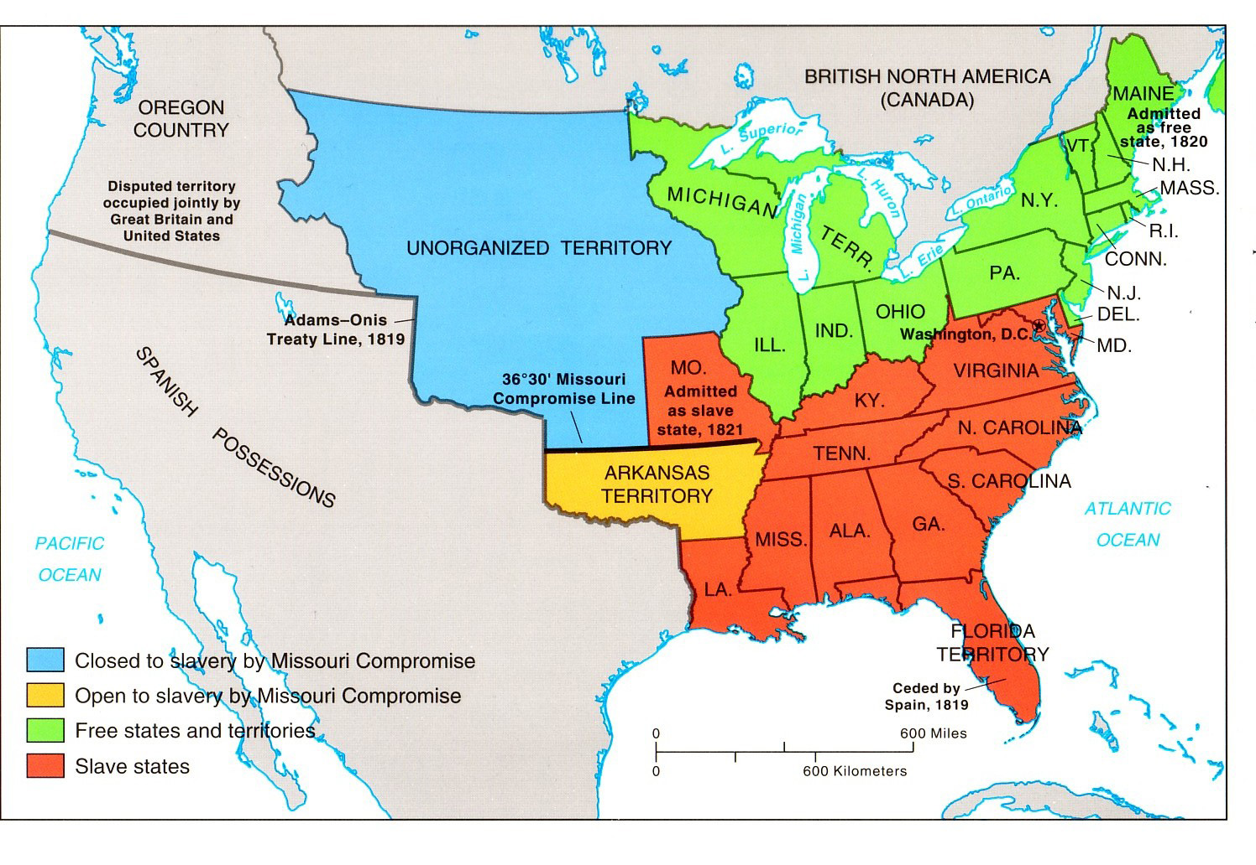

Slide 5
SECTION 4 – GROWING SECTIONALISM
Election of 1824 – “Corrupt Bargain”
“Favorite Sons” – Democratic Republicans
John Quincy Adams - NORTH
William Crawford - SOUTH
Andrew Jackson - WEST (TN)
Henry Clay - WEST (KY)

Slide 6
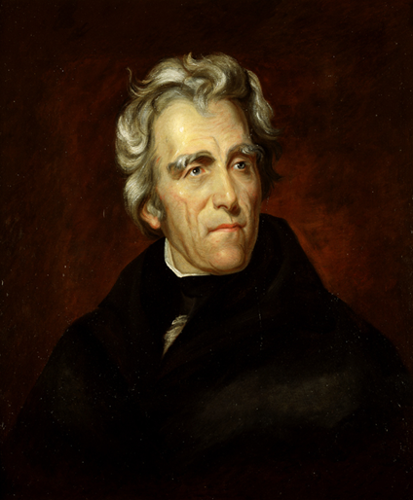
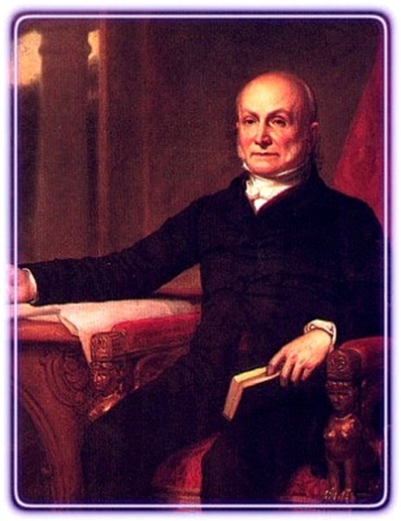
SECTION 4 – GROWING SECTIONALISM
No clear winner
Jackson and Adams
Jackson takes popular vote
Neither wins Electoral Vote
Second time in history
House elects the President

Slide 7
SECTION 4 – GROWING SECTIONALISM
Henry Clay
Had good ideas (American System)… but didn’t get votes
Although eliminated plays key role
When it makes it to Congress for a vote…
Clay petitions against Jackson
Didn’t like him
And he competed politically

Slide 8
SECTION 4 – GROWING SECTIONALISM
Clay’s American System
Roads / Canals
Tariffs
National Bank

Slide 9
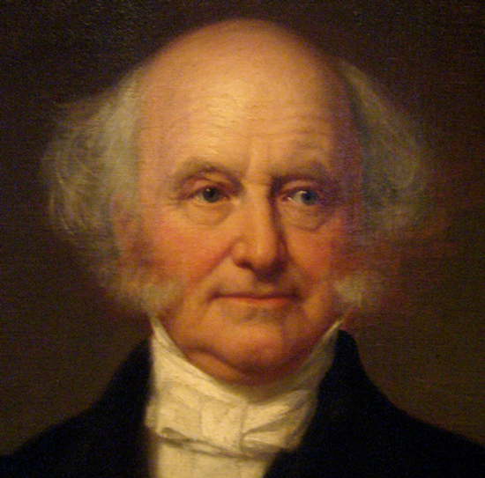
SECTION 4 – GROWING SECTIONALISM
Adams is elected
Corrupt Bargain
Adams elected only because he promises Clay a position in Cabinet
Pushed hard for reform
American System Style ideas
Congress doesn’t give him enough funds
Adams doesn’t accomplish goals

Slide 10
President | Years in Office | Vice President | Political Party | Facts/Accomplishments
6. John Q. Adams | 1825 - 1829 | John C. Calhoun | Republican | 1824 – Corrupt Bargain Wanted American System reform, couldn’t accomplish much – lack of funds

Slide 11
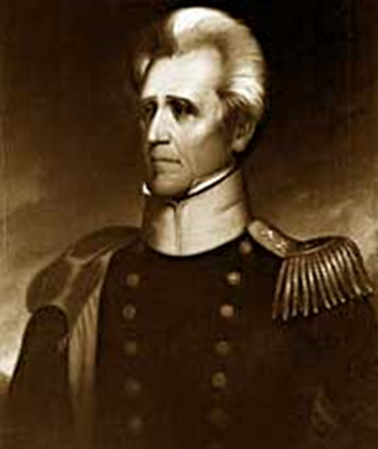
SECTION 4 – GROWING SECTIONALISM
Election of 1828
Campaigning- While Adams is in office
Dirty politics - Mudslinging
Jackson paints himself as “common- man”
Wounded War Vet (1812 vs. Indians)
Log cabin
Orphan
Lawyer
Planter
Candidates for the 1828 Presidency
John Quincy Adams | Andrew Jackson
Reputation as greatest secretary of state | Reputation as hero of Battle of New Orleans
Reputation as being highly intelligent and hardworking | Fiery personality earned him the nickname “Old Hickory” after a tough, hard wood found on the frontier.
Called Jackson “incompetent both by his ignorance and by the fury of his passions.” | Portrayed himself as a common man’s candidate and attacked Adams as an out-of-touch aristocrat.

Slide 12
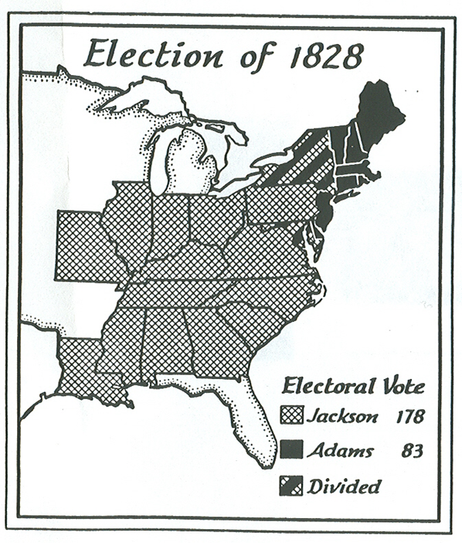
SECTION 4 – GROWING SECTIONALISM
Election of 1828
Jackson wins
New Party “Democrats”
Return to Jeffersonian Ideals
States Stronger
Federal Government less power
No interference (slavery)
Ease regional tensions

