Slide 1
0
16
Development, Stem Cells, and Cancer

Slide 2
Overview: Orchestrating Life’s Processes
The development of a fertilized egg into an adult requires a precisely regulated program of gene expression
Understanding this program has progressed mainly by studying model organisms
Stem cells are key to the developmental process
Orchestrating proper gene expression by all cells is crucial for life
Notes:
2

Slide 3
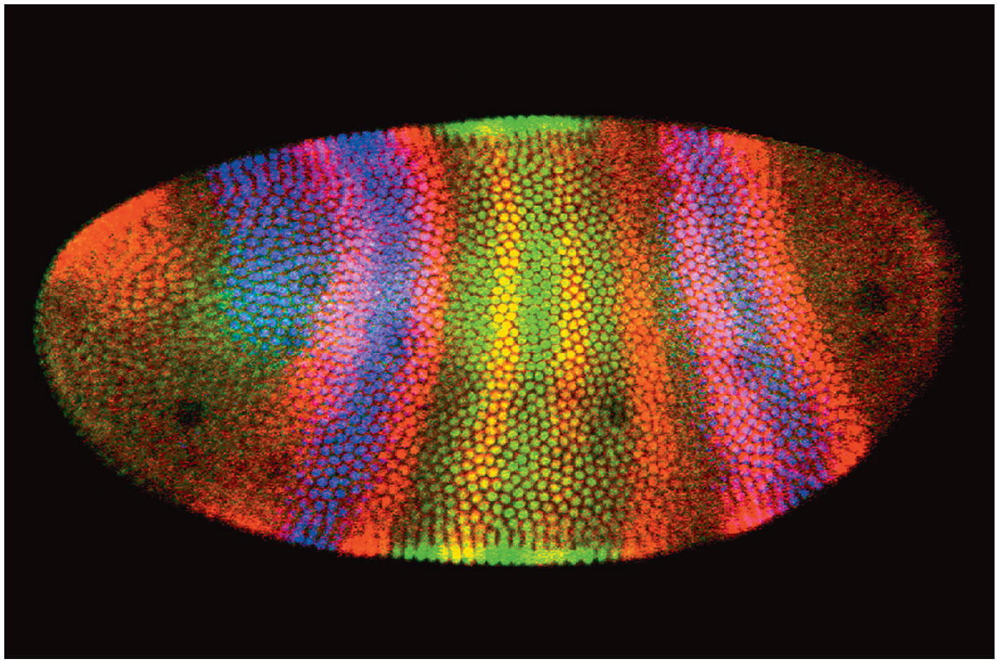
Figure 16.1
Notes:
Figure 16.1 What regulates the precise pattern of gene expression in the developing fly embryo?

Slide 4
Concept 16.1: A program of differential gene expression leads to the different cell types in a multicellular organism
A fertilized egg gives rise to many different cell types
Cell types are organized successively into tissues, organs, organ systems, and the whole organism
Gene expression orchestrates the developmental programs of animals
Notes:
4

Slide 5
A Genetic Program for Embryonic Development
The transformation from zygote to adult results from cell division, cell differentiation, and morphogenesis
Notes:
5

Slide 6
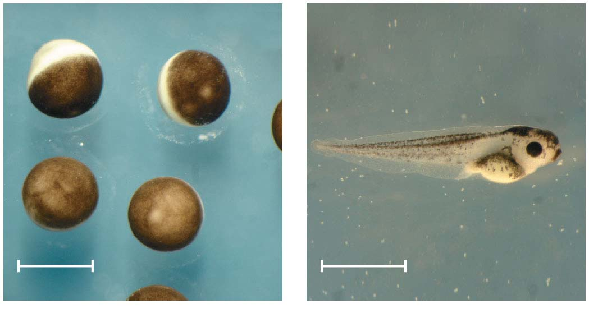
Figure 16.2
1 mm
2 mm
(a) Fertilized eggs of a frog
(b) Newly hatched tadpole
Notes:
Figure 16.2 From fertilized egg to animal: what a difference four days makes

Slide 7
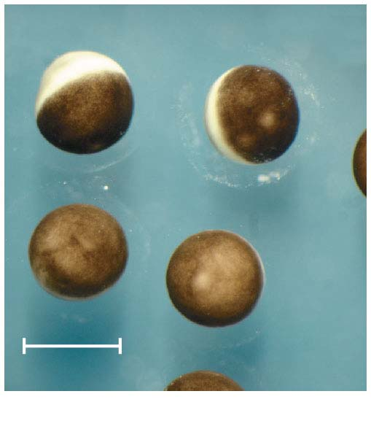
Figure 16.2-1
1 mm
(a) Fertilized eggs of a frog
Notes:
Figure 16.2-1 From fertilized egg to animal: what a difference four days makes (part 1: eggs)

Slide 8
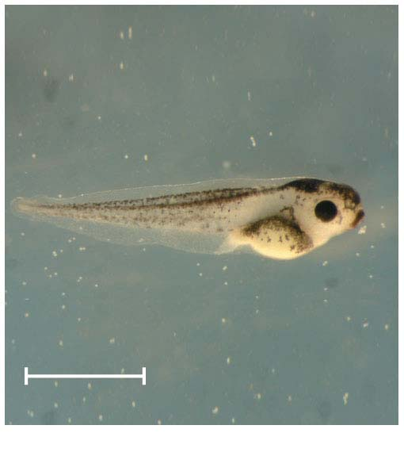
Figure 16.2-2
2 mm
(b) Newly hatched tadpole
Notes:
Figure 16.2-2 From fertilized egg to animal: what a difference four days makes (part 2: tadpole)

Slide 9
Cell differentiation is the process by which cells become specialized in structure and function
The physical processes that give an organism its shape constitute morphogenesis
Differential gene expression results from genes being regulated differently in each cell type
Materials in the egg can set up gene regulation that is carried out as cells divide
Notes:
9

Slide 10
Cytoplasmic Determinants and Inductive Signals
An egg’s cytoplasm contains RNA, proteins, and other substances that are distributed unevenly in the unfertilized egg
Cytoplasmic determinants are maternal substances in the egg that influence early development
As the zygote divides by mitosis, the resulting cells contain different cytoplasmic determinants, which lead to different gene expression
Notes:
10

Slide 11
Animation: Cell Signaling

Slide 12
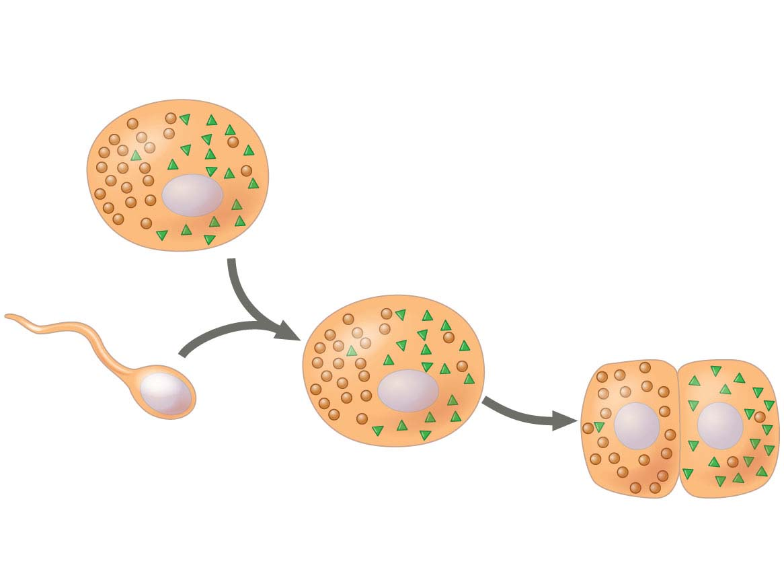
Figure 16.3-1
(a) Cytoplasmic determinants in the egg
Molecules of two different
cytoplasmic determinants
Nucleus
Fertilization
Mitotic
cell
division
Unfertilized
egg
Sperm
Zygote
(fertilized egg)
Two-celled
embryo
Notes:
Figure 16.3-1 Sources of developmental information for the early embryo (part 1: cytoplasmic determinants)

Slide 13
The other major source of developmental information is the environment around the cell
In the process called induction, signal molecules from embryonic cells cause transcriptional changes in nearby target cells
Thus, interactions between embryonic cells induce differentiation of specialized cell types
Notes:
13

Slide 14
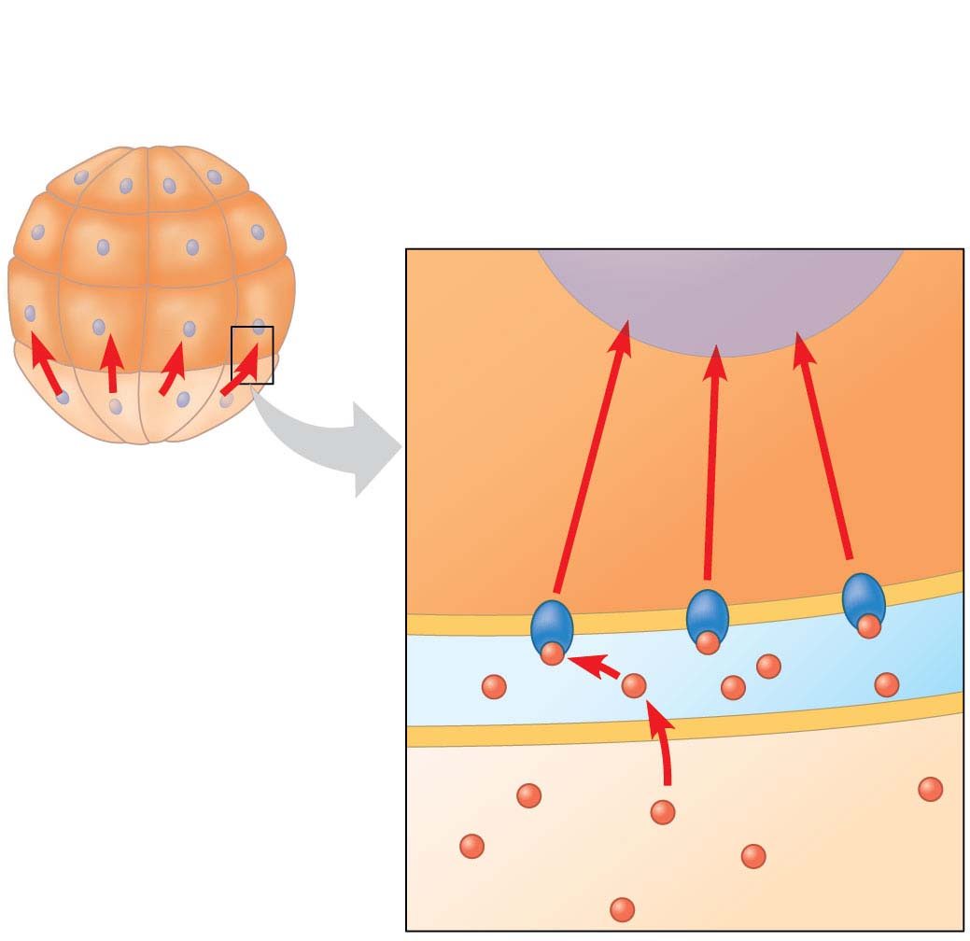
Figure 16.3-2
(b) Induction by nearby cells
Early embryo
(32 cells)
NUCLEUS
Signal
transduction
pathway
Signal
receptor
Signaling
molecule
Notes:
Figure 16.3-2 Sources of developmental information for the early embryo (part 2: induction)

Slide 15
Sequential Regulation of Gene Expression During Cellular Differentiation
Determination commits a cell irreversibly to its final fate
Determination precedes differentiation, the process by which a cell attains its determined fate
Notes:
15

Slide 16
Differentiation of Cell Types
Today, determination is understood in terms of molecular changes, the expression of genes for tissue-specific proteins
The first evidence of differentiation is the production of mRNAs for these proteins
Eventually, differentiation is observed as changes in cellular structure
Notes:
16

Slide 17
To study muscle cell determination, researchers grew embryonic precursor cells in culture and analyzed them
They identified several “master regulatory genes,” the products of which commit the cells to becoming skeletal muscle
One such gene is called myoD
Notes:
17

Slide 18
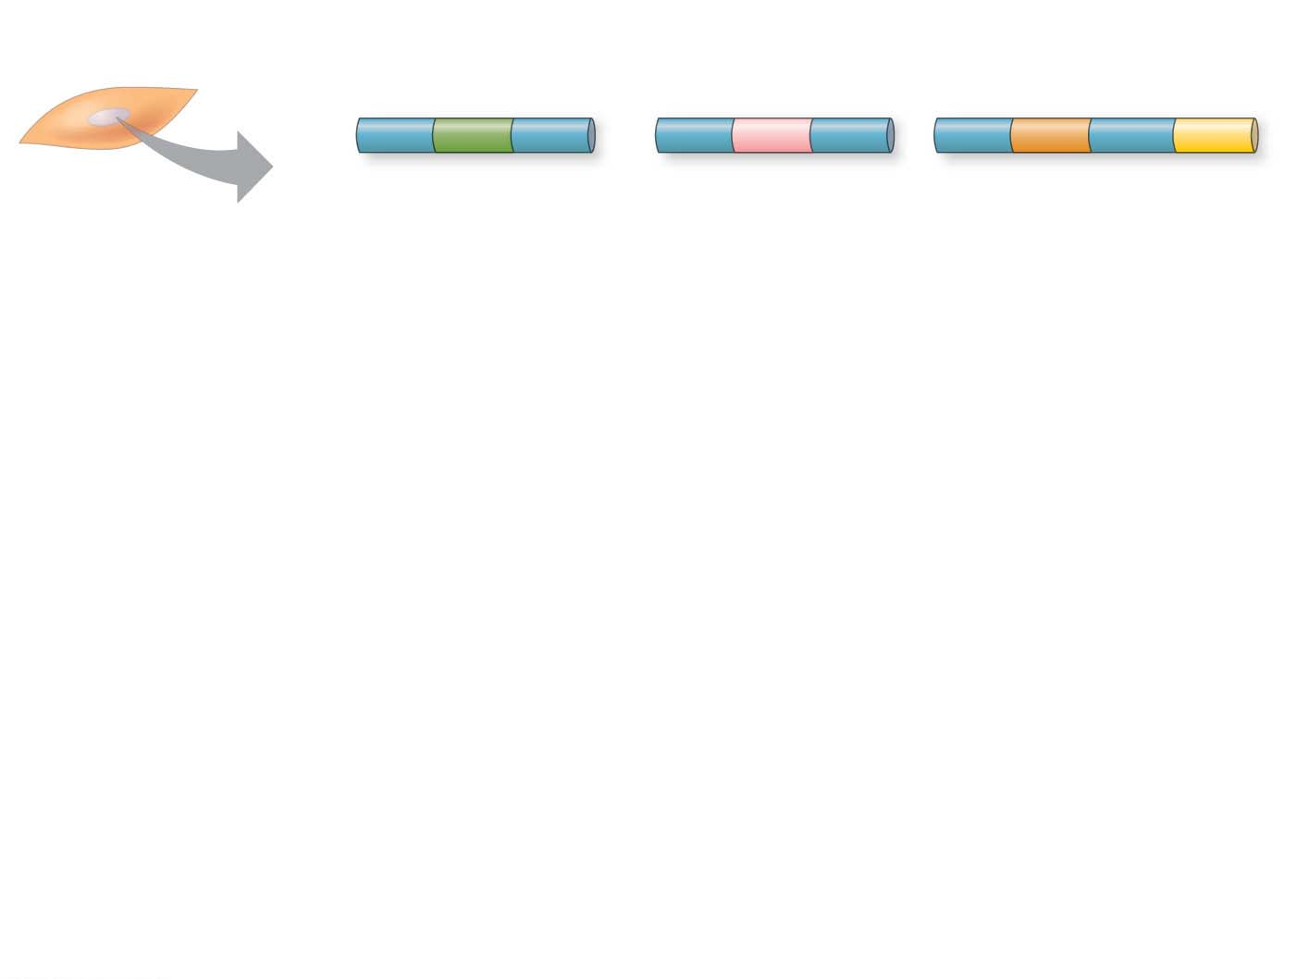
Figure 16.4-s1
Nucleus
Master regulatory
gene myoD
Other muscle-specific genes
DNA
Embryonic
precursor cell
OFF
OFF
Notes:
Figure 16.4-s1 Determination and differentiation of muscle cells (step 1)

Slide 19
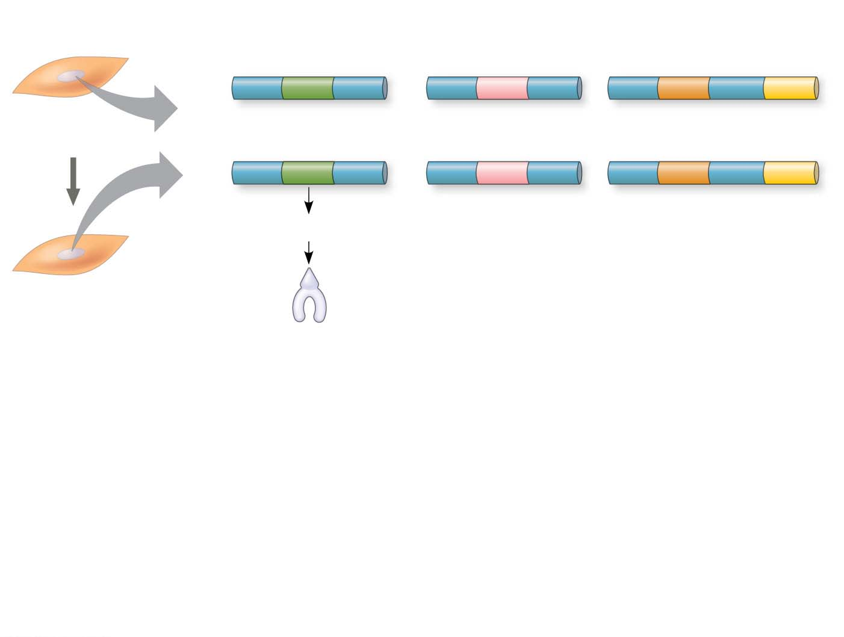
Figure 16.4-s2
Nucleus
Master regulatory
gene myoD
Other muscle-specific genes
DNA
Embryonic
precursor cell
OFF
OFF
OFF
mRNA
MyoD protein
(transcription
factor)
Myoblast
(determined)
Notes:
Figure 16.4-s2 Determination and differentiation of muscle cells (step 2)

Slide 20
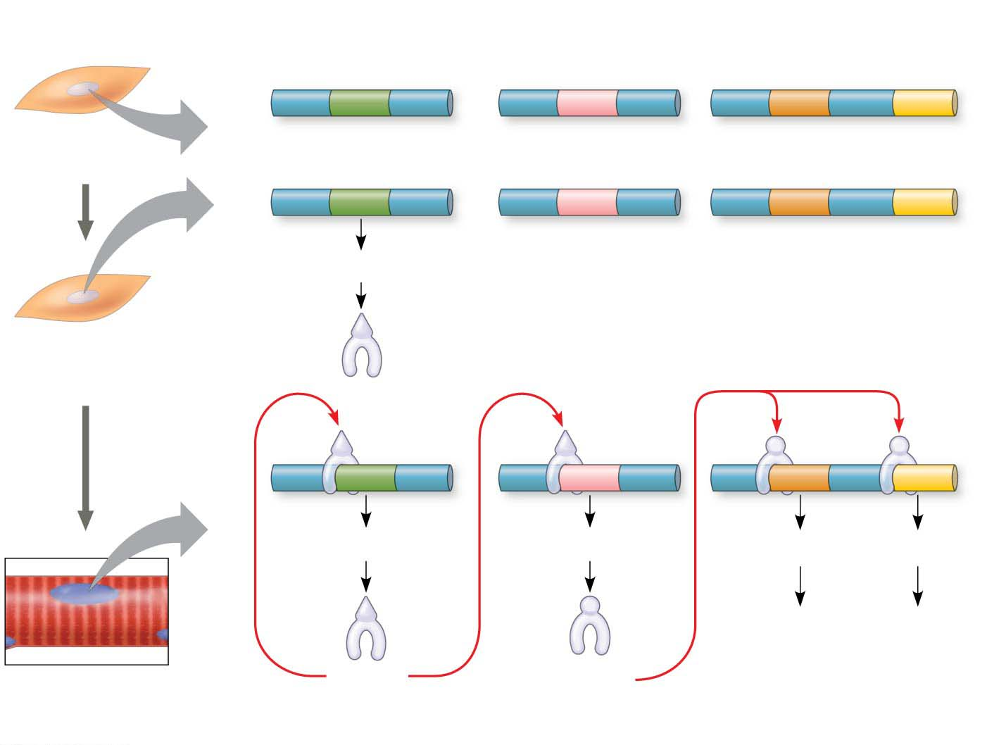
Figure 16.4-s3
Nucleus
Master regulatory
gene myoD
Other muscle-specific genes
DNA
Embryonic
precursor cell
OFF
OFF
OFF
mRNA
MyoD protein
(transcription
factor)
Myoblast
(determined)
mRNA
mRNA
mRNA
mRNA
Myosin, other
muscle proteins,
and cell cycle–
blocking proteins
MyoD
A different
transcription
factor
Part of muscle fiber
(fully differentiated cell)
Notes:
Figure 16.4-s3 Determination and differentiation of muscle cells (step 3)

Slide 21
Apoptosis: A Type of Programmed Cell Death
While most cells are differentiating in a developing organism, some are genetically programmed to die
Apoptosis is the best-understood type of “programmed cell death”
Apoptosis also occurs in the mature organism in cells that are infected, damaged, or at the end of their functional lives
Notes:
21

Slide 22
During apoptosis, DNA is broken up and organelles and other cytoplasmic components are fragmented
The cell becomes multilobed and its contents are packaged up in vesicles
These vesicles are then engulfed by scavenger cells
Apoptosis protects neighboring cells from damage by nearby dying cells
Notes:
22

Slide 23
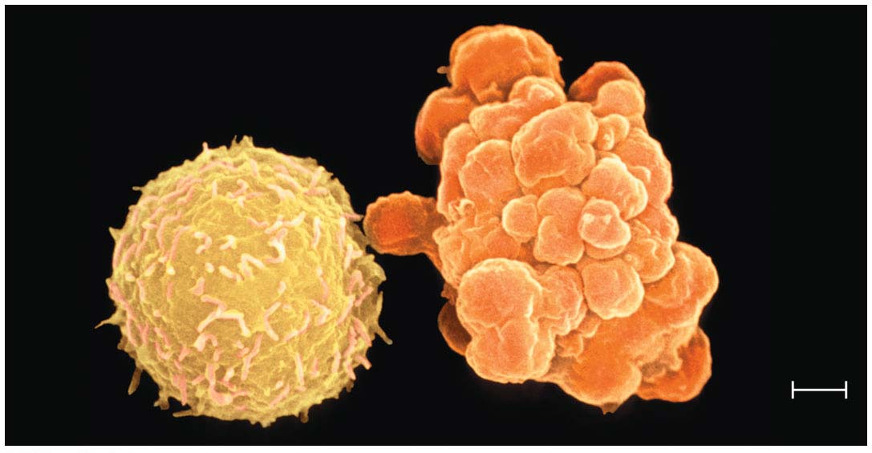
Figure 16.5
2 μm
Notes:
Figure 16.5 Apoptosis of a human white blood cell

Slide 24
Apoptosis is essential to development and maintenance in all animals
It is known to occur also in fungi and yeasts
In vertebrates, apoptosis is essential for normal nervous system development and morphogenesis of hands and feet (or paws)
Notes:
24

Slide 25
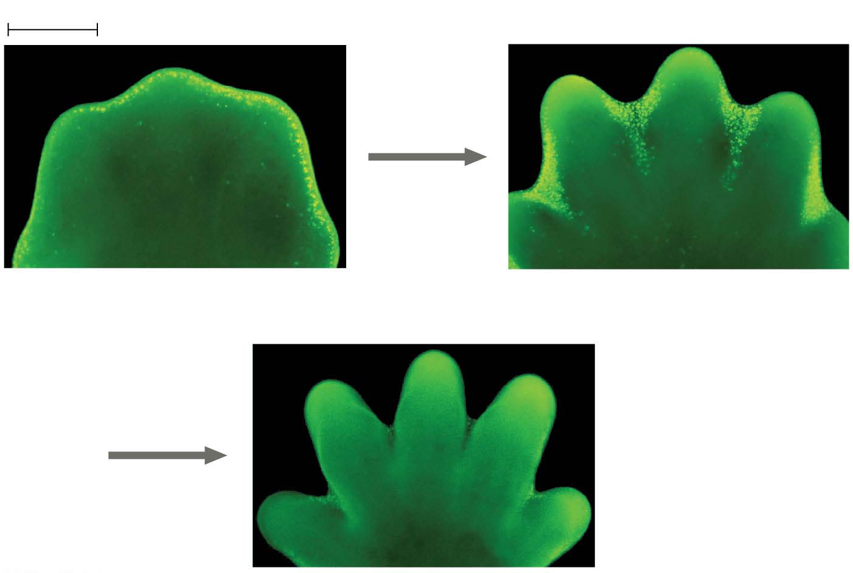
Figure 16.6
1 mm
Interdigital tissue
Cells undergoing apoptosis
Space between digits
Notes:
Figure 16.6 Effect of apoptosis during paw development in the mouse

Slide 26
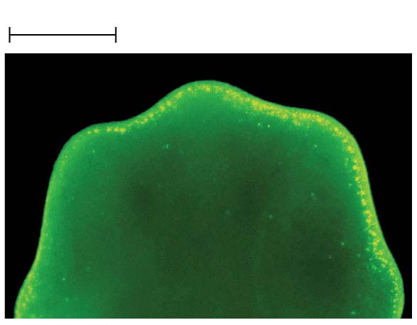
Figure 16.6-1
1 mm
Interdigital tissue
Notes:
Figure 16.6-1 Effect of apoptosis during paw development in the mouse (part 1: interdigital tissue, LM)

Slide 27
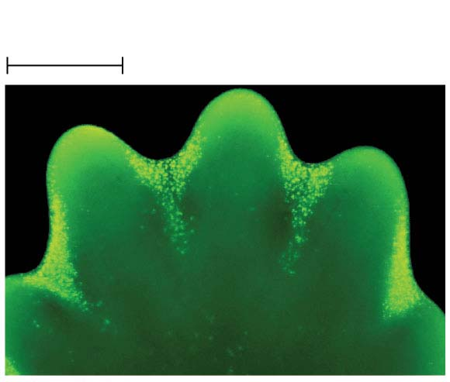
Figure 16.6-2
Cells undergoing
apoptosis
1 mm
Notes:
Figure 16.6-2 Effect of apoptosis during paw development in the mouse (part 2: cells undergoing apoptosis, LM)

Slide 28
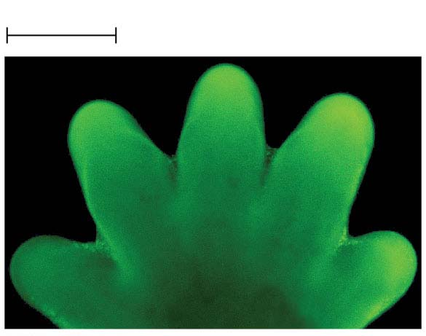
Figure 16.6-3
1 mm
Space between digits
Notes:
Figure 16.6-3 Effect of apoptosis during paw development in the mouse (part 3: space between digits, LM)

Slide 29
Pattern Formation: Setting Up the Body Plan
Pattern formation is the development of a spatial organization of tissues and organs
In animals, pattern formation begins with the establishment of the major axes
Positional information, the molecular cues that control pattern formation, tells a cell its location relative to the body axes and to neighboring cells
Notes:
29

Slide 30
Pattern formation has been extensively studied in the fruit fly Drosophila melanogaster
Combining anatomical, genetic, and biochemical approaches, researchers have discovered developmental principles common to many other species, including humans
Notes:
30

Slide 31
The Life Cycle of Drosophila
Fruit flies and other arthropods have a modular structure, composed of an ordered series of segments
In Drosophila, cytoplasmic determinants in the unfertilized egg determine the axes before fertilization
Notes:
31

Slide 32
Figure 16.7-1
Dorsal
Head
Thorax
Abdomen
Right
Anterior
Posterior
Left
0.5 mm
Ventral
BODY AXES
(a) Adult
Notes:
Figure 16.7-1 Key developmental events in the life cycle of Drosophila (part 1)

Slide 33
The Drosophila eggs develop in the female’s ovary, surrounded by ovarian cells called nurse cells and follicle cells
After fertilization, embryonic development results in a segmented larva, which goes through three stages
Eventually, the larva forms a pupa within which it metamorphoses into an adult fly
Notes:
33

Slide 34
Figure 16.7-2-s1
Developing egg
Follicle
cell
Nucleus
Egg
Nurse cell
(b) Development from egg to larva
Notes:
Figure 16.7-2-s1 Key developmental events in the life cycle of Drosophila (part 2, step 1)

Slide 35
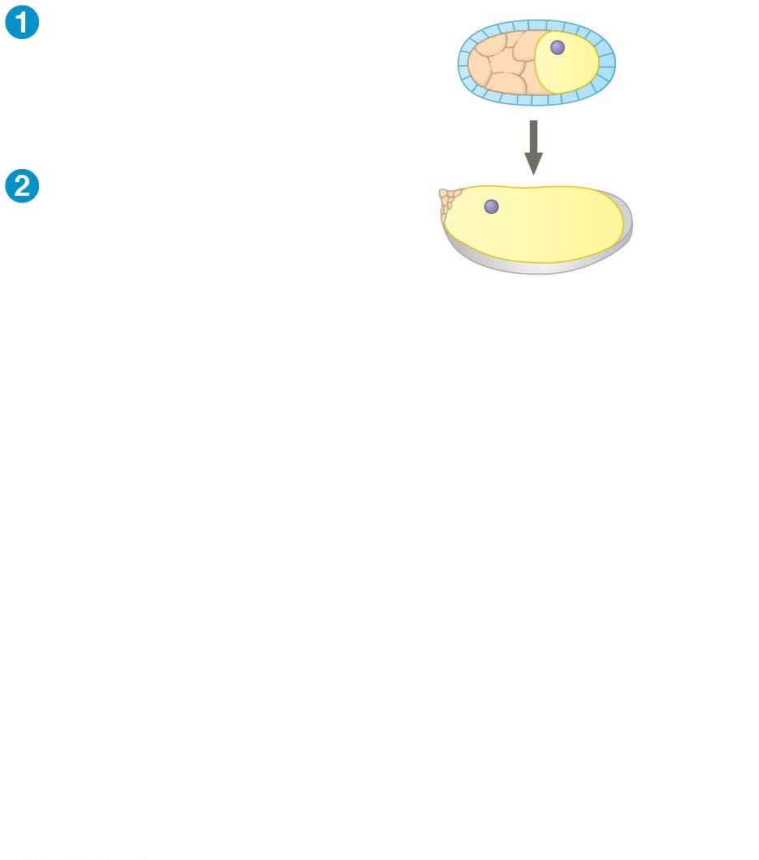
Figure 16.7-2-s2
Developing egg
Follicle
cell
Nucleus
Egg
Nurse cell
Mature,
unfertilized egg
Egg
shell
Depleted
nurse cells
(b) Development from egg to larva
Notes:
Figure 16.7-2-s2 Key developmental events in the life cycle of Drosophila (part 2, step 2)

Slide 36
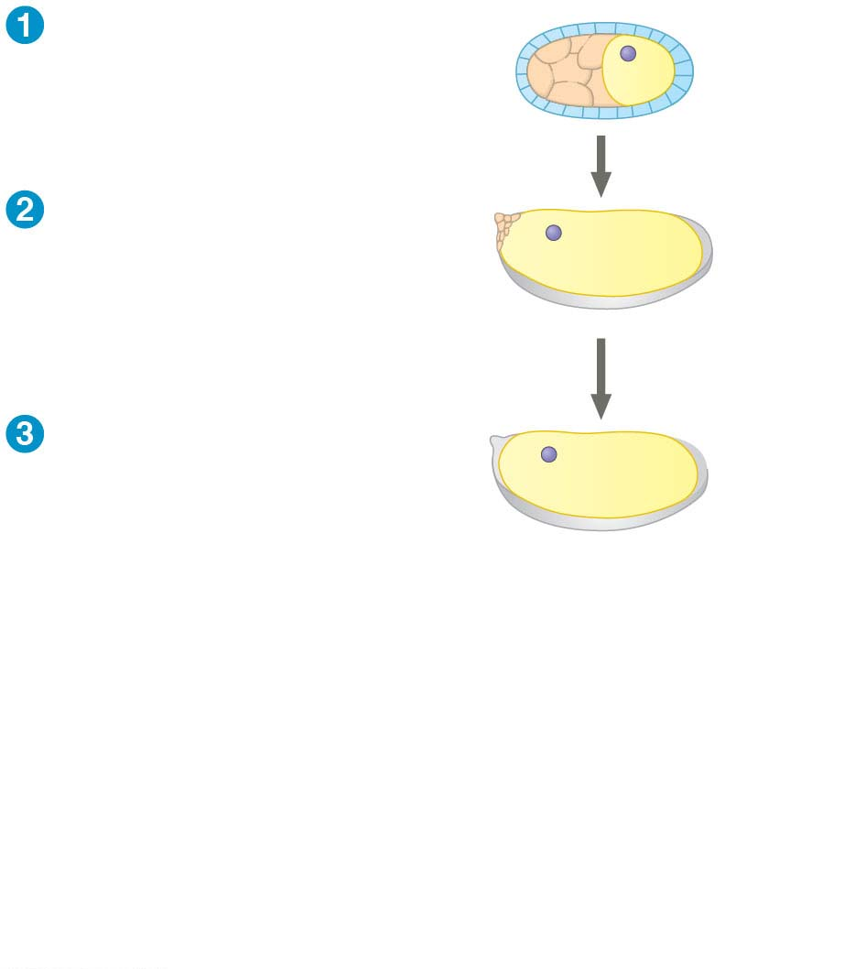
Figure 16.7-2-s3
Developing egg
Follicle
cell
Nucleus
Egg
Nurse cell
Mature,
unfertilized egg
Egg
shell
Depleted
nurse cells
Fertilization
Laying of egg
Fertilized egg
(b) Development from egg to larva
Notes:
Figure 16.7-2-s3 Key developmental events in the life cycle of Drosophila (part 2, step 3)

Slide 37
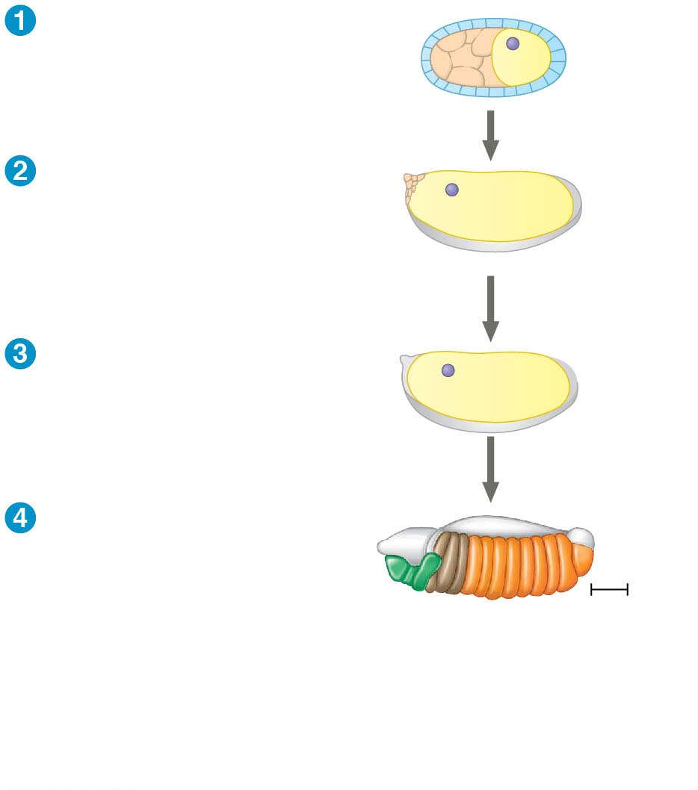
Figure 16.7-2-s4
Developing egg
Follicle
cell
Nucleus
Egg
Nurse cell
Mature,
unfertilized egg
Egg
shell
Depleted
nurse cells
Fertilization
Laying of egg
Fertilized egg
Embryonic
development
Segmented embryo
Body
segments
0.1 mm
(b) Development from egg to larva
Notes:
Figure 16.7-2-s4 Key developmental events in the life cycle of Drosophila (part 2, step 4)

Slide 38
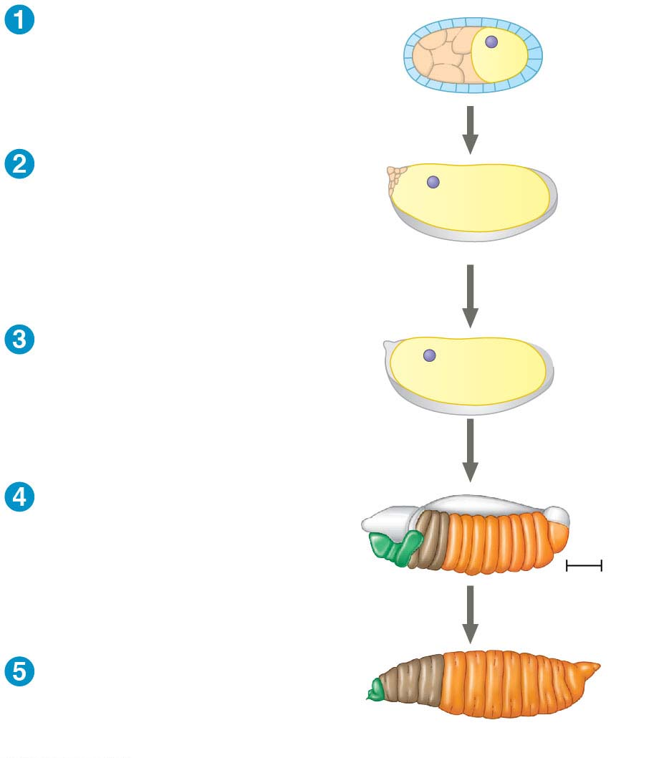
Figure 16.7-2-s5
Developing egg
Follicle
cell
Nucleus
Egg
Nurse cell
Mature,
unfertilized egg
Egg
shell
Depleted
nurse cells
Fertilization
Laying of egg
Fertilized egg
Embryonic
development
Segmented embryo
Body
segments
0.1 mm
Hatching
Larva
(b) Development from egg to larva
Notes:
Figure 16.7-2-s5 Key developmental events in the life cycle of Drosophila (part 2, step 5)

Slide 39
Genetic Analysis of Early Development: Scientific Inquiry
Edward B. Lewis, Christiane Nüsslein-Volhard, and Eric Wieschaus won a Nobel Prize in 1995 for decoding pattern formation in Drosophila
Lewis discovered the homeotic genes, which control pattern formation in late embryo, larva, and adult stages
Notes:
39

Slide 40
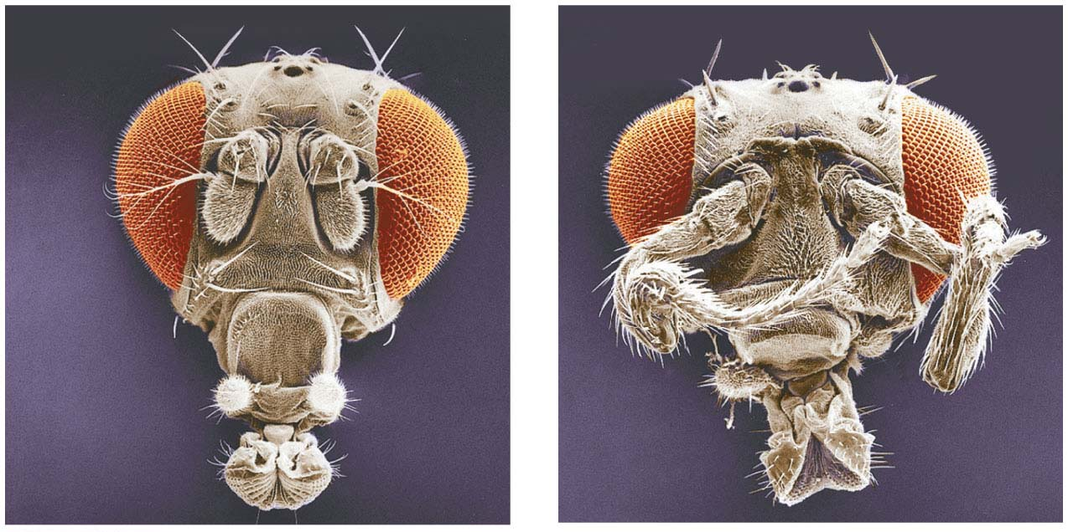
Figure 16.8
Eye
Leg
instead of
antenna
Normal
antenna
Wild
type
Mutant
Notes:
Figure 16.8 Abnormal pattern formation in Drosophila

Slide 41
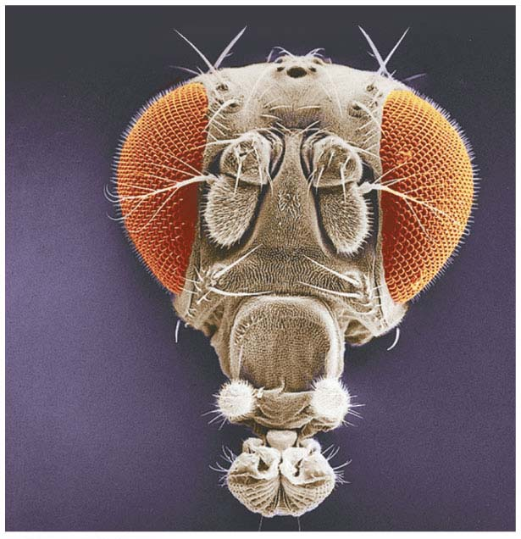
Figure 16.8-1
Eye
Normal
antenna
Wild
type
Notes:
Figure 16.8-1 Abnormal pattern formation in Drosophila (part 1: wild type)

Slide 42
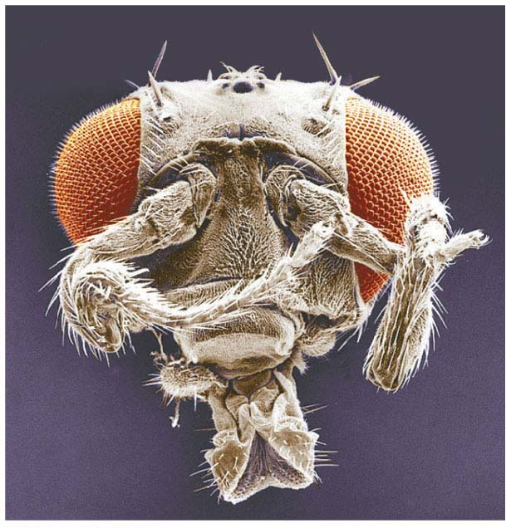
Figure 16.8-2
Leg
instead of
antenna
Mutant
Notes:
Figure 16.8-2 Abnormal pattern formation in Drosophila (part 2: mutant)

Slide 43
Nüsslein-Volhard and Wieschaus set out to identify all genes that affected segment formation in Drosophila
Many of the identified mutations were embryonic lethals, causing death during embryogenesis
They identified 120 genes essential for normal segmentation
Notes:
43

Slide 44
Axis Establishment
Maternal effect genes encode cytoplasmic determinants that initially establish the axes of the body of Drosophila
When these genes are mutant in the mother, the resulting phenotype is seen in the offspring
These maternal effect genes are also called egg-polarity genes because they control orientation of the egg and consequently the fly
Notes:
44
NOTE: C

Slide 45
Bicoid: A Morphogen That Determines Head Structures
One maternal effect gene, bicoid, affects the front half of the body
An embryo whose mother has no functional bicoid gene lacks the front half of its body and has posterior structures at both ends
Notes:
45

Slide 46
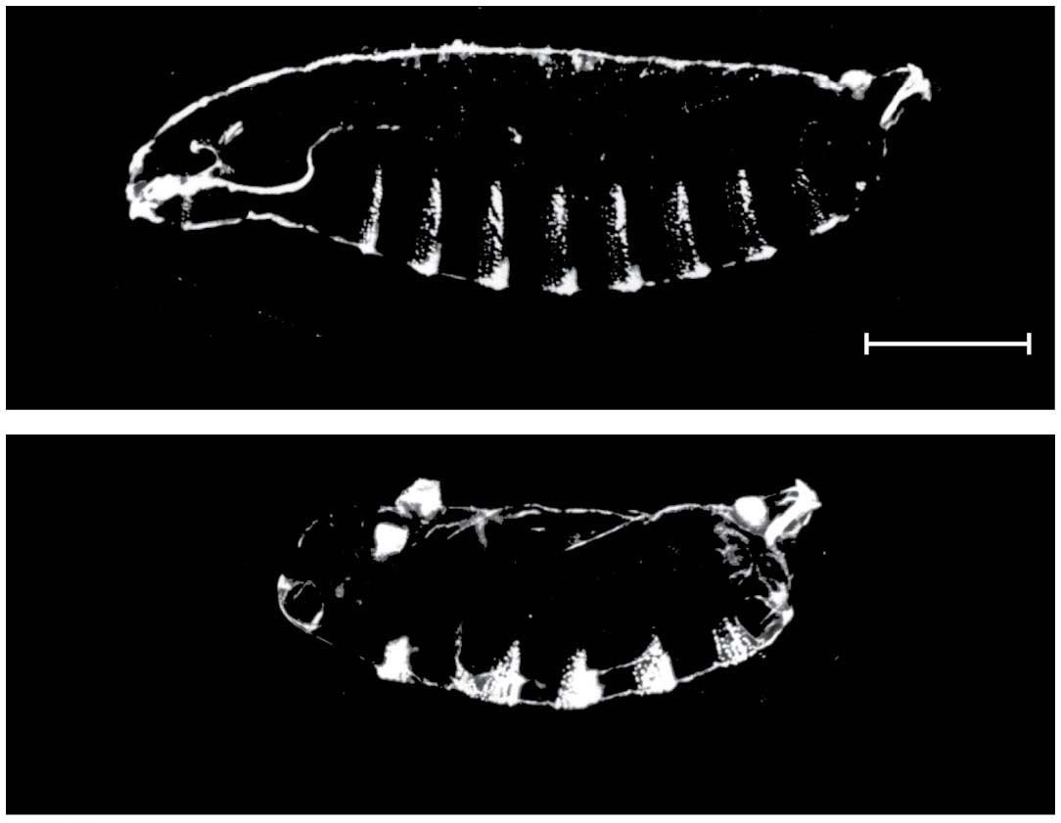
Figure 16.9
Head
Tail
A8
T1
T2
T3
A7
A1
A5
A6
A2
A3
A4
Wild-type larva
250 μm
Tail
Tail
A8
A8
A7
A7
A6
Mutant larva (bicoid)
Notes:
Figure 16.9 Effect of the bicoid gene on Drosophila development

Slide 47
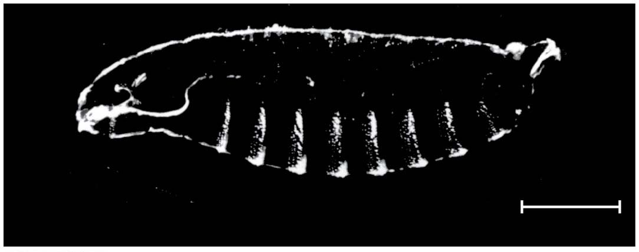
Figure 16.9-1
Head
Tail
A8
T1
T2
T3
A7
A1
A5
A6
A2
A3
A4
Wild-type larva
250 μm
Notes:
Figure 16.9-1 Effect of the bicoid gene on Drosophila development (part 1: wild type)

Slide 48
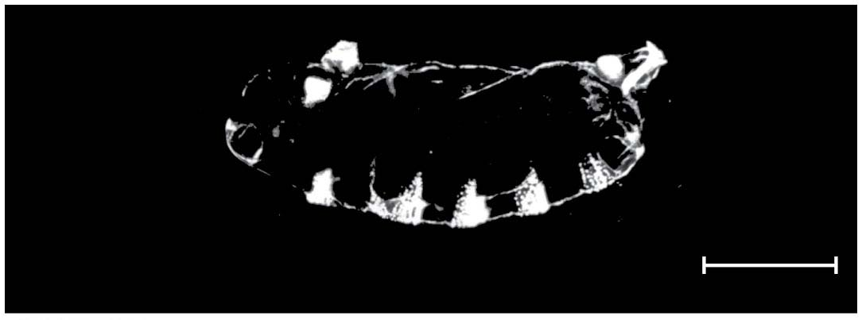
Figure 16.9-2
Tail
Tail
A8
A8
A7
A7
A6
Mutant larva (bicoid)
250 μm
Notes:
Figure 16.9-2 Effect of the bicoid gene on Drosophila development (part 2: mutant)

Slide 49
This phenotype suggested that the product of the mother’s bicoid gene is concentrated at the future anterior end and is required for setting up the anterior end of the fly
This hypothesis is an example of the morphogen gradient hypothesis; gradients of substances called morphogens establish an embryo’s axes and other features
Notes:
49

Slide 50
The bicoid mRNA is highly concentrated at the anterior end of the embryo
After the egg is fertilized, the mRNA is translated into Bicoid protein, which diffuses from the anterior end
The result is a gradient of Bicoid protein
Injection of bicoid mRNA into various regions of an embryo results in the formation of anterior structures at the site of injection
Notes:
50

Slide 51
Animation: Head and Tail Axis of a Fruit Fly

Slide 52
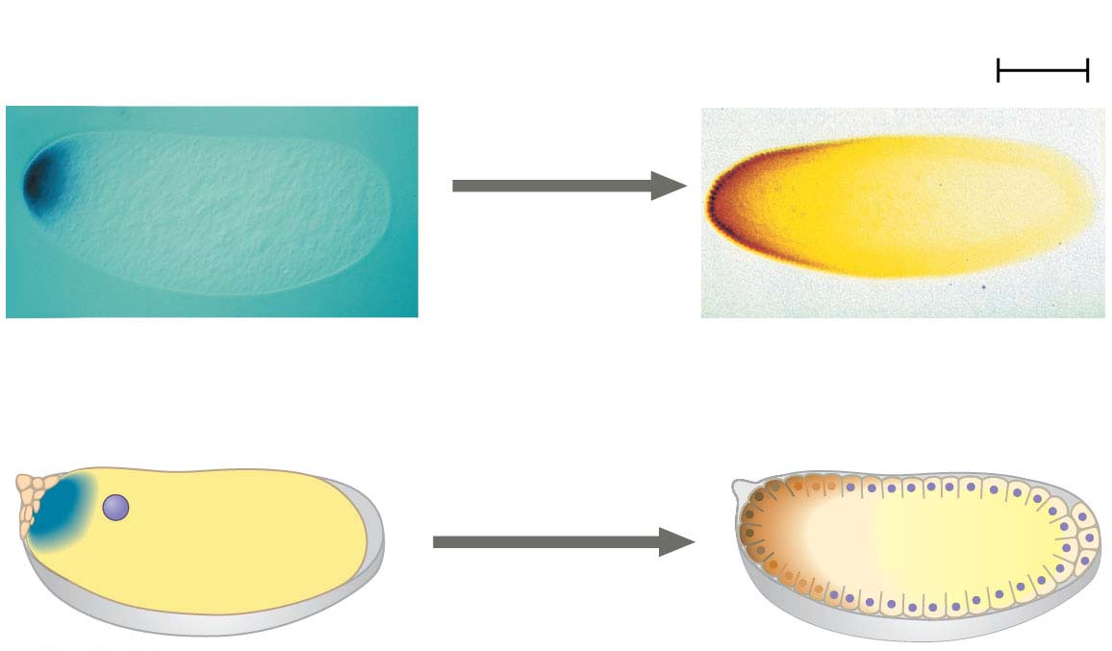
Figure 16.10
Results
100 μm
Anterior end
Anterior end
Fertilization,
translation of
bicoid mRNA
Bicoid mRNA in mature
unfertilized egg
Bicoid protein in
early embryo
Notes:
Figure 16.10 Inquiry: Could Bicoid be a morphogen that determines the anterior end of a fruit fly?

Slide 53
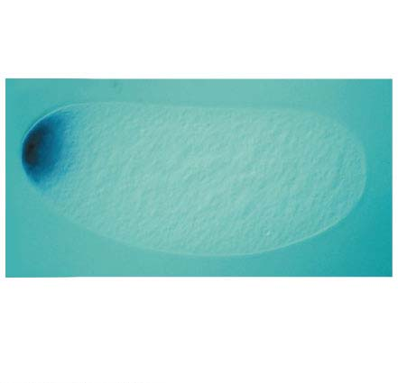
Figure 16.10-1
100 μm
Anterior end
Bicoid mRNA in mature
unfertilized egg
Notes:
Figure 16.10-1 Inquiry: Could Bicoid be a morphogen that determines the anterior end of a fruit fly? (part 1: Bicoid mRNA)

Slide 54
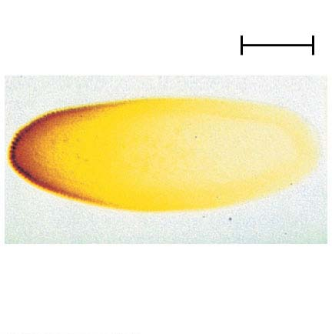
Figure 16.10-2
100 μm
Anterior end
Bicoid protein in
early embryo
Notes:
Figure 16.10-2 Inquiry: Could Bicoid be a morphogen that determines the anterior end of a fruit fly? (part 2: Bicoid protein)

Slide 55
The bicoid research is important for three reasons
It identified a specific protein required for some early steps in pattern formation
It increased understanding of the mother’s critical role in embryo development
It demonstrated a key developmental principle that a gradient of morphogens can determine polarity and position in the embryo
Notes:
55

Slide 56
Concept 16.2: Cloning organisms showed that differentiated cells could be reprogrammed and ultimately led to the production of stem cells
In organismal cloning one or more organisms develop from a single cell without meiosis or fertilization
The cloned individuals are genetically identical to the “parent” that donated the single cell
The current interest in organismal cloning arises mainly from its potential to generate stem cells
Notes:
56

Slide 57
Cloning Plants: Single-Cell Culture
F. C. Steward and his students first cloned whole carrot plants in the 1950s
Single differentiated cells from the root incubated in culture medium were able to grow into complete adult plants
This work showed that differentiation is not necessarily irreversible
Cells that can give rise to all the specialized cell types in the organism are called totipotent
Notes:
57

Slide 58
Cloning Animals: Nuclear Transplantation
In cloning of animals, the nucleus of an unfertilized egg cell or zygote is replaced with the nucleus of a differentiated cell, called nuclear transplantation
Experiments with frog embryos showed that a transplanted nucleus can often support normal development of the egg
The older the donor nucleus, the lower the percentage of normally developing tadpoles
John Gurdon concluded from this work that nuclear potential is restricted as development and differentiation proceed
Notes:
58

Slide 59
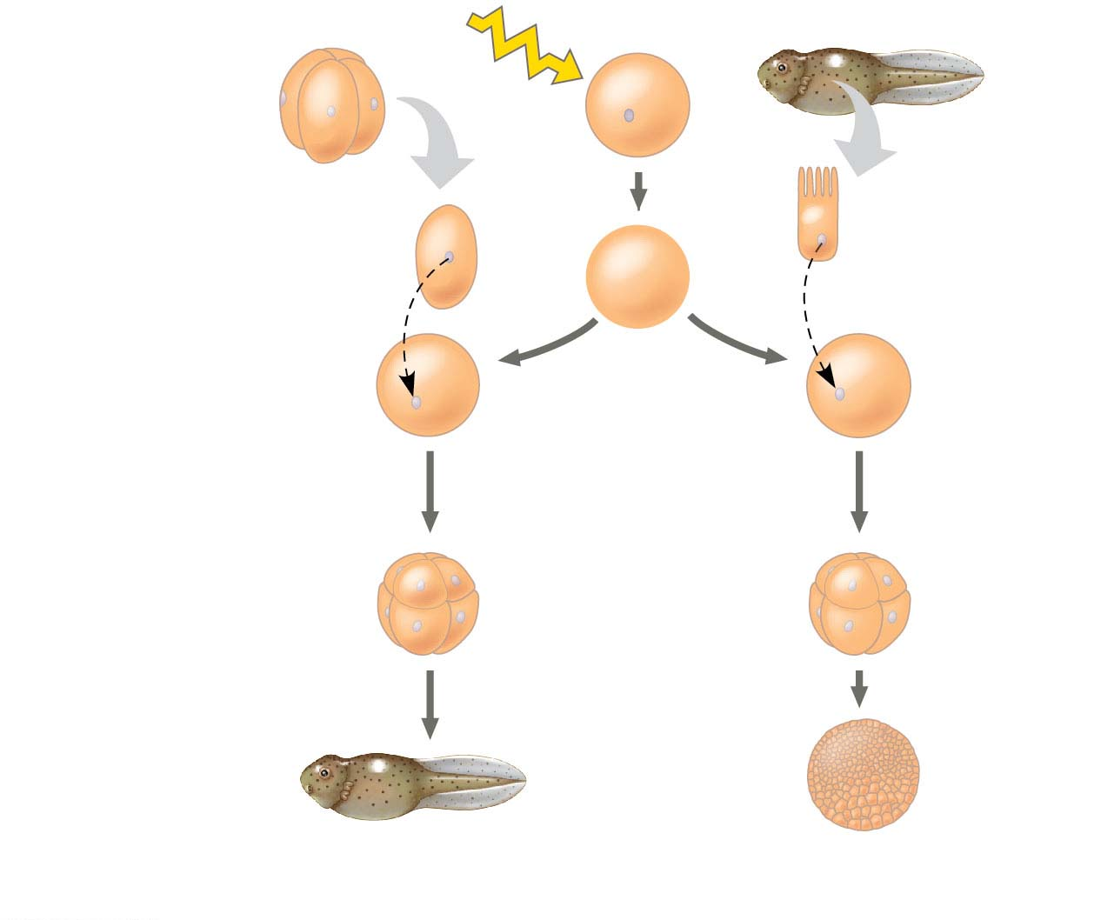
Figure 16.11
Experiment
Frog embryo
Frog egg cell
Frog tadpole
UV
Fully differ-
entiated
(intestinal) cell
Less differ-
entiated cell
Donor
nucleus
trans-
planted
Donor
nucleus
trans-
planted
Enucleated
egg cell
Egg with donor nucleus
activated to begin
development
Results
Most develop
into tadpoles.
Most stop developing
before tadpole stage.
Notes:
Figure 16.11 Inquiry: Can the nucleus from a differentiated animal cell direct development of an organism?

Slide 60
Reproductive Cloning of Mammals
In 1997, Scottish researchers announced the birth of Dolly, a lamb cloned from an adult sheep by nuclear transplantation from a differentiated cell
Dolly’s premature death in 2003, and her arthritis, led to speculation that her cells were not as healthy as those of a normal sheep, possibly reflecting incomplete reprogramming of the original transplanted nucleus
Notes:
60

Slide 61
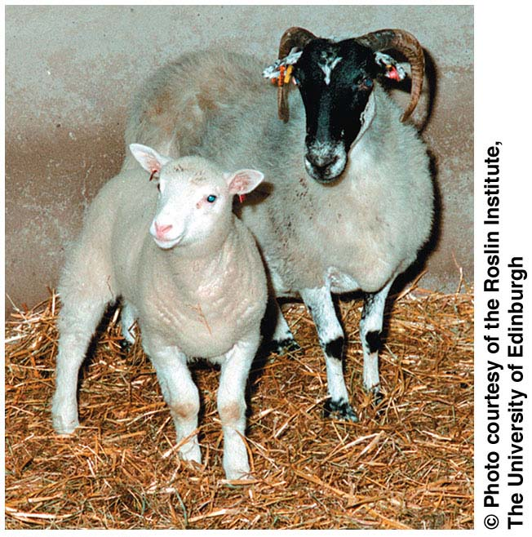
Figure 16.12
Notes:
Figure 16.12 Dolly, the first mammal cloned by nuclear transplantation

Slide 62
Since 1997, cloning has been demonstrated in many mammals, including mice, cats, cows, horses, pigs, dogs, and monkeys
CC (for Carbon Copy) was the first cat cloned; however, CC differed somewhat from her female “parent”
Cloned animals do not always look or behave exactly the same as their “parent”
Notes:
62

Slide 63
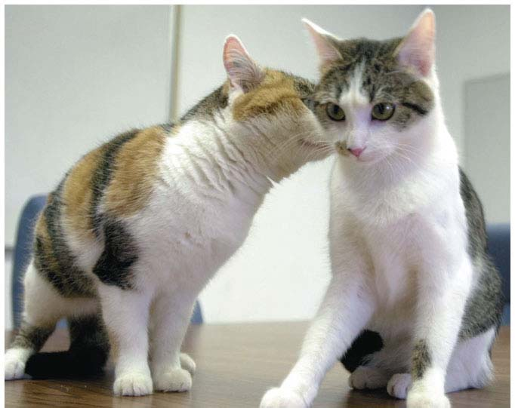
Figure 16.13
Notes:
Figure 16.13 CC, (“Carbon Copy”), the first cloned cat (right), and her single parent

Slide 64
Faulty Gene Regulation in Cloned Animals
In most nuclear transplantation studies, only a small percentage of cloned embryos have developed normally to birth
Many cloned animals exhibit defects
Epigenetic changes must be reversed in the nucleus from a donor animal in order for genes to be expressed or repressed appropriately for early stages of development
Notes:
64

Slide 65
Stem Cells of Animals
A stem cell is a relatively unspecialized cell that can reproduce itself indefinitely and differentiate into specialized cells of one or more types
Notes:
65

Slide 66
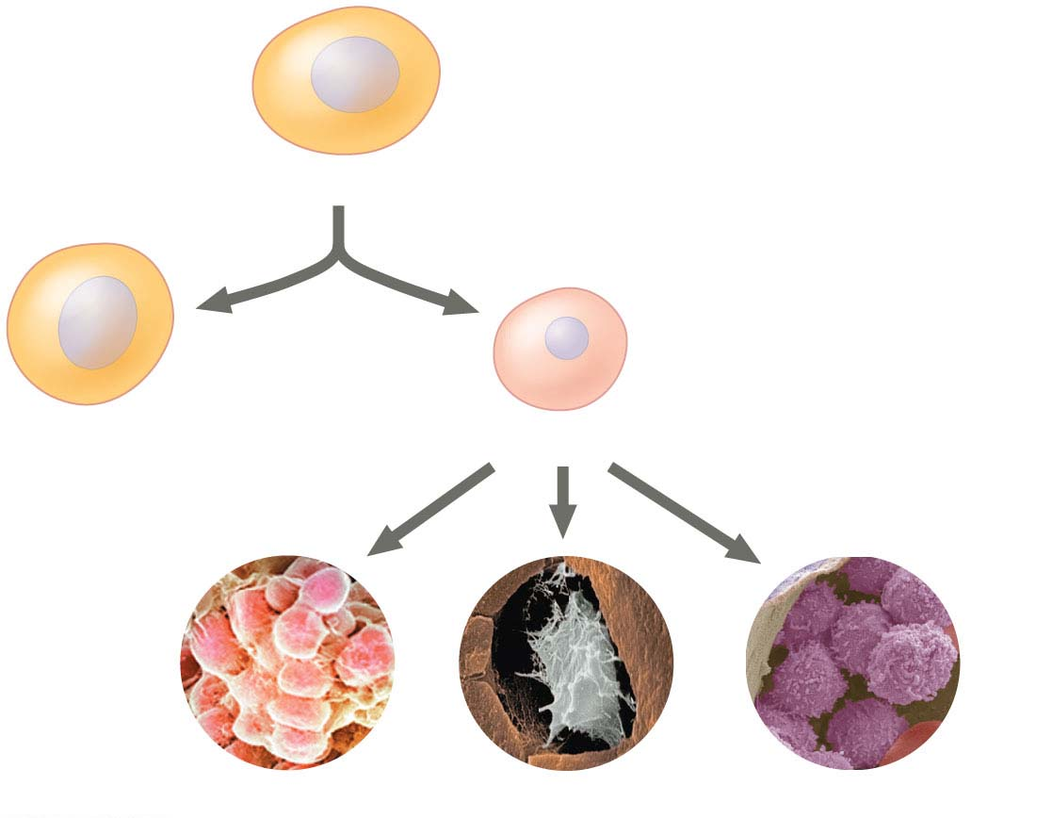
Figure 16.14
Stem cell
Cell division
Stem cell
and
Precursor cell
Fat cells
OR
Bone cells
OR
White blood cells
Notes:
Figure 16.14 How stem cells maintain their own population and generate differentiated cells

Slide 67
Embryonic and Adult Stem Cells
Many early animal embryos contain stem cells, able to differentiate into any cell type (pluripotent)
These embryonic stem (ES) cells can reproduce indefinitely
The adult body also has stem cells, which replace nonreproducing specialized cells as needed
Notes:
67

Slide 68
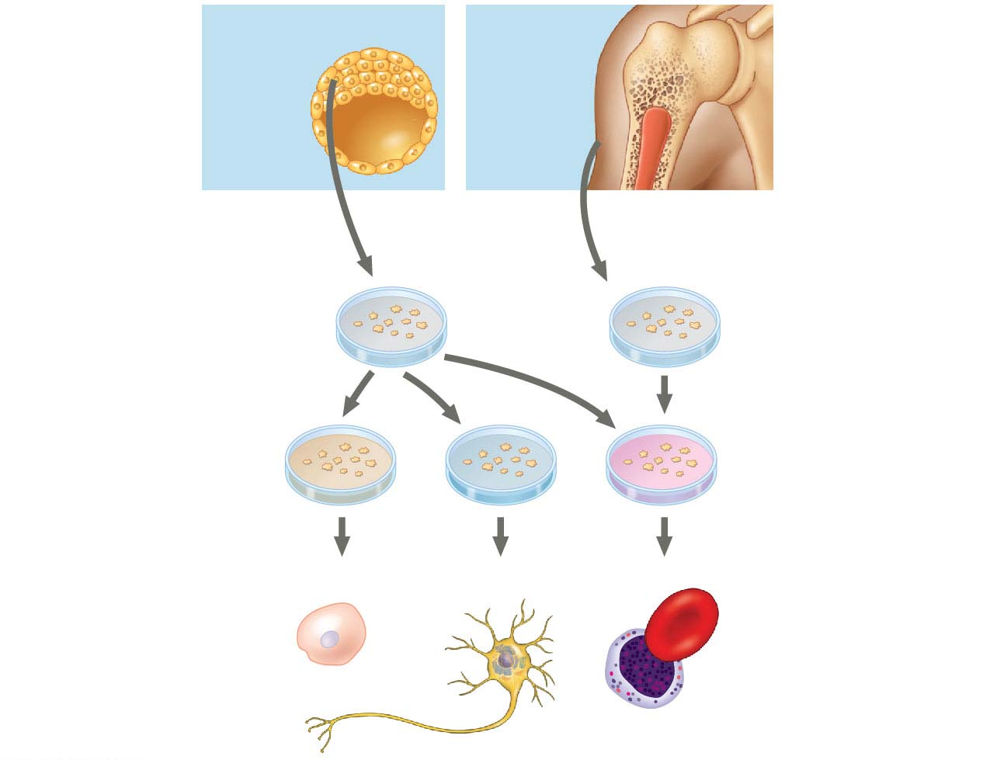
Figure 16.15
Embryonic
stem
cells
Adult
stem
cells
Cells that can generate
all embryonic cell types
Cells that generate a limited
number of cell types
Cultured
stem cells
Different
culture
conditions
Different
types of
differentiated
cells
Liver cells
Nerve cells
Blood cells
Notes:
Figure 16.15 Working with stem cells

Slide 69
Induced Pluripotent Stem (iPS) Cells
Researchers are able to “deprogram” fully differentiated cells to act like ES cells using retroviruses
Cells transformed this way are called iPS, or induced pluripotent stem cells
Gurdon and Yamanaka received the Nobel Prize in 2012 for this work
Notes:
69

Slide 70
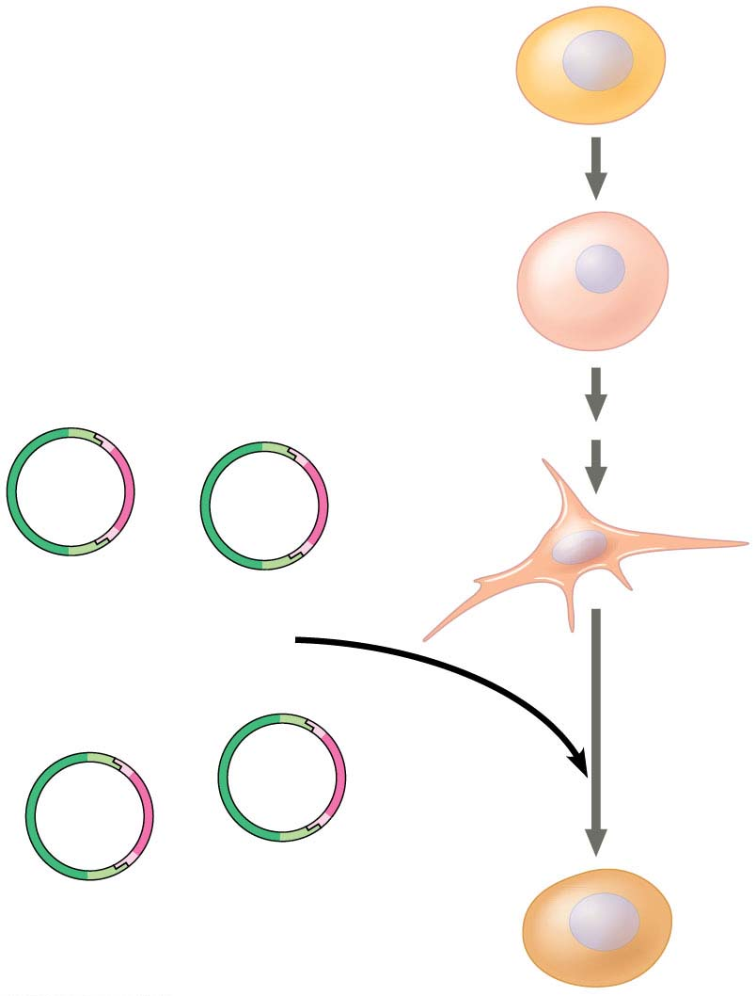
Figure 16.16
Experiment
Stem cell
Precursor cell
Skin
fibroblast
cell
Oct3/4
Sox2
Four “stem cell” master
regulatory genes
introduced
c-Myc
Klf4
Induced pluripotent
stem (iPS) cell
Notes:
Figure 16.16 Inquiry: Can a fully differentiated human cell be “deprogrammed” to become a stem cell?

Slide 71
Cells of patients suffering from certain diseases can be reprogrammed into iPS cells for use in studying the disease and potential treatments
In the field of regenerative medicine, a patient’s own cells might be reprogrammed into iPS cells to potentially replace nonfunctional (diseased) cells
Notes:
71

Slide 72
Concept 16.3: Abnormal regulation of genes that affect the cell cycle can lead to cancer
The gene regulation systems that go wrong during cancer are the same systems involved in embryonic development
Notes:
72

Slide 73
Types of Genes Associated with Cancer
Cancer research led to the discovery of cancer-causing genes called oncogenes in certain types of viruses
The normal version of such genes, called proto-oncogenes, code for proteins that stimulate normal cell growth and division
An oncogene arises from a genetic change leading to an increase in either the amount or the activity of the protein product of the gene
Notes:
73

Slide 74
Proto-oncogenes can be converted to oncogenes by
Movement of the oncogene to a position near an active promoter, which may increase transcription
Amplification, increasing the number of copies of a proto-oncogene
Point mutations in the proto-oncogene or its control elements, causing an increase in gene expression
Notes:
74

Slide 75
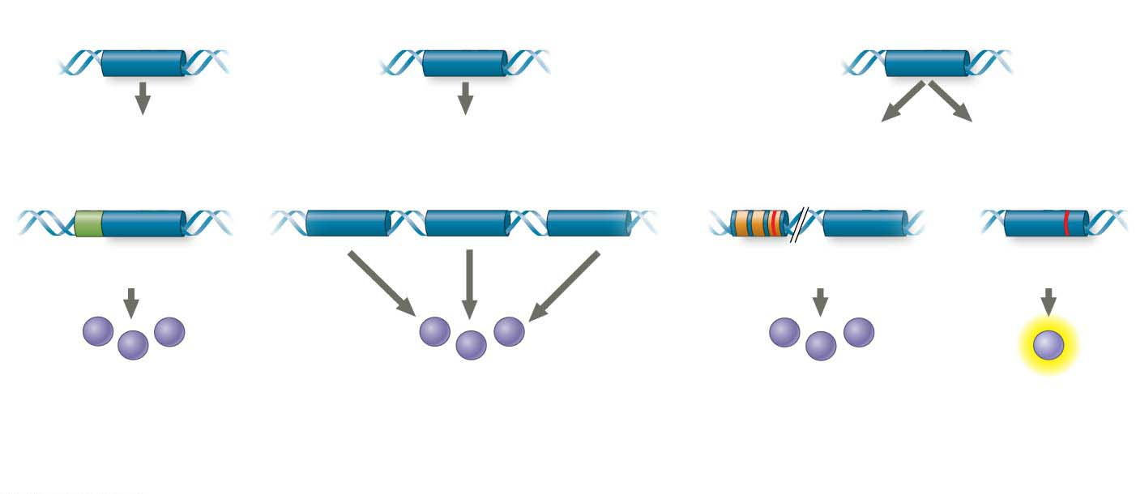
Figure 16.17
Proto-oncogene
Proto-oncogene
Proto-oncogene
Translocation or
transposition
Gene amplification
Point mutation
within a control element
Point mutation
within the gene
New
promoter
Oncogene
Oncogene
Oncogene
Normal growth-stimulating
protein in excess
Normal growth-stimulating
protein in excess
Normal growth-
stimulating
protein in excess
Hyperactive or
degradation-
resistant
protein
Notes:
Figure 16.17 Genetic changes that can turn proto-oncogenes into oncogenes

Slide 76
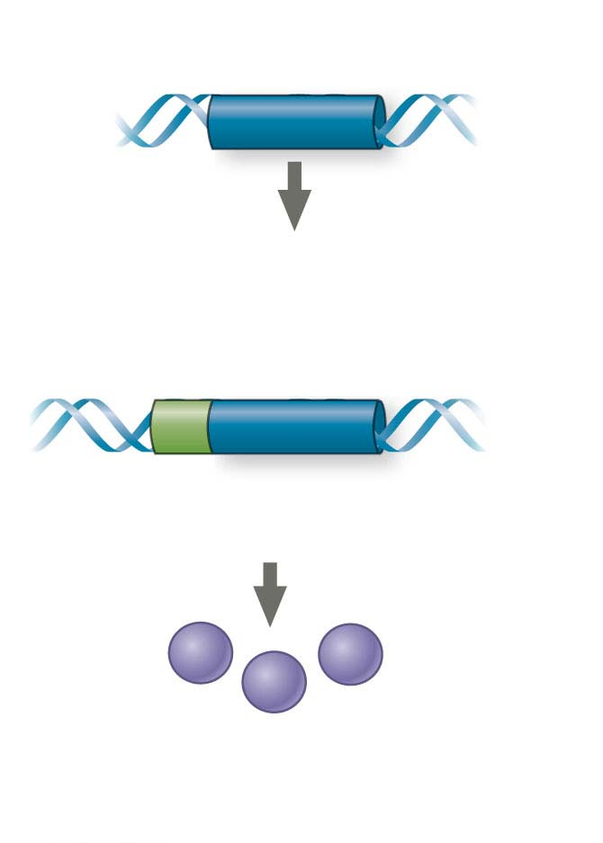
Figure 16.17-1
Proto-oncogene
Translocation or transposition
New
promoter
Oncogene
Normal growth-stimulating
protein in excess
Notes:
Figure 16.17-1 Genetic changes that can turn proto-oncogenes into oncogenes (part 1: translocation or transposition)

Slide 77
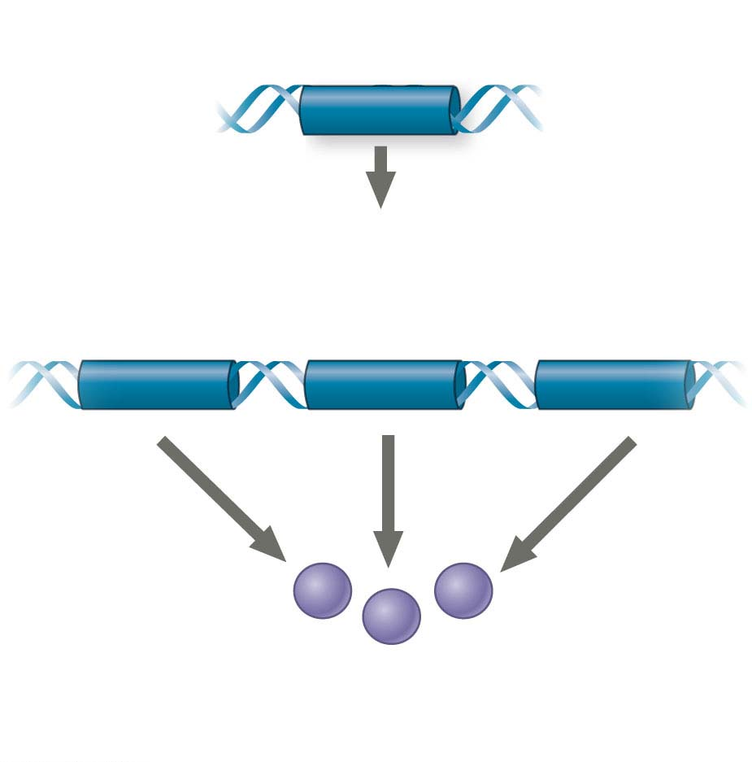
Figure 16.17-2
Proto-oncogene
Gene amplification
Normal growth-stimulating
protein in excess
Notes:
Figure 16.17-2 Genetic changes that can turn proto-oncogenes into oncogenes (part 2: gene amplification)

Slide 78
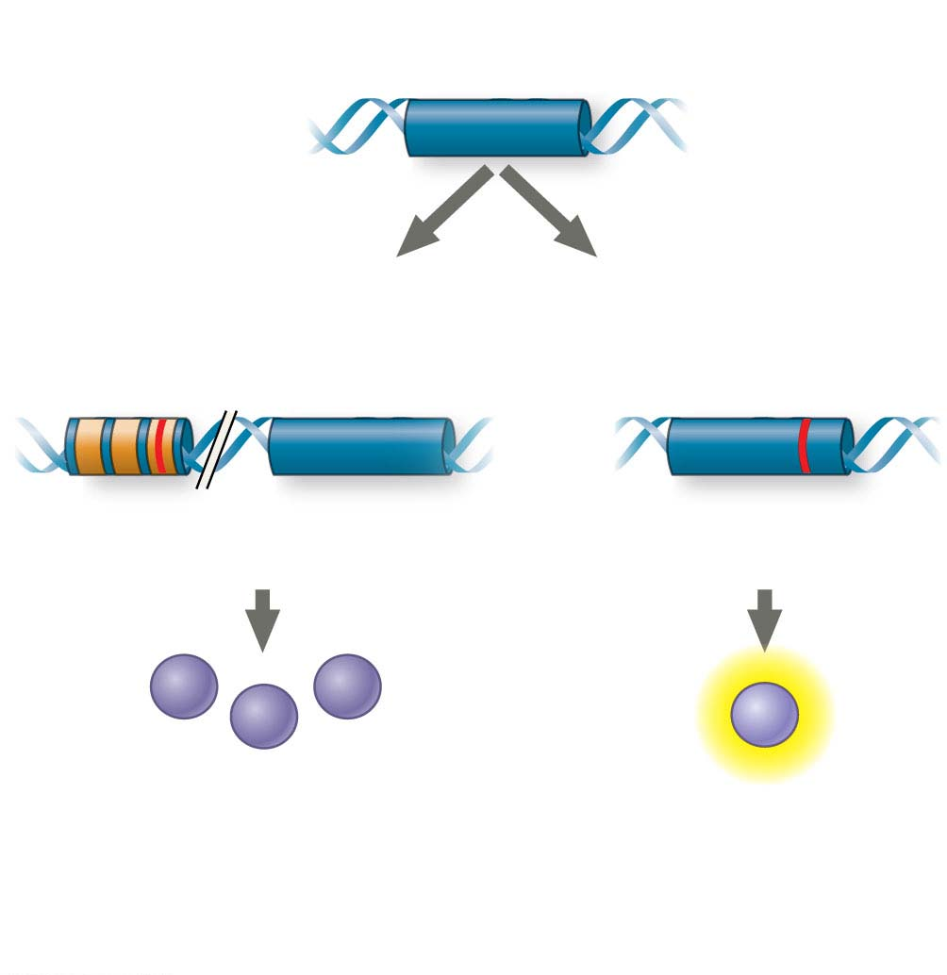
Figure 16.17-3
Proto-oncogene
Point mutation
within a control element
Point mutation
within the gene
Oncogene
Oncogene
Normal growth-stimulating
protein in excess
Hyperactive or
degradation-
resistant
protein
Notes:
Figure 16.17-3 Genetic changes that can turn proto-oncogenes into oncogenes (part 3: point mutation)

Slide 79
Tumor-suppressor genes encode proteins that help prevent uncontrolled cell growth
Mutations that decrease protein products of tumor-suppressor genes may contribute to cancer onset
Tumor-suppressor proteins
Repair damaged DNA
Control cell adhesion
Inhibit the cell cycle
Notes:
79

Slide 80
Interference with Cell-Signaling Pathways
Mutations in the ras proto-oncogene and p53 tumor-suppressor gene are common in human cancers
Mutations in the ras gene can lead to production of a hyperactive Ras protein and increased cell division
Notes:
80

Slide 81
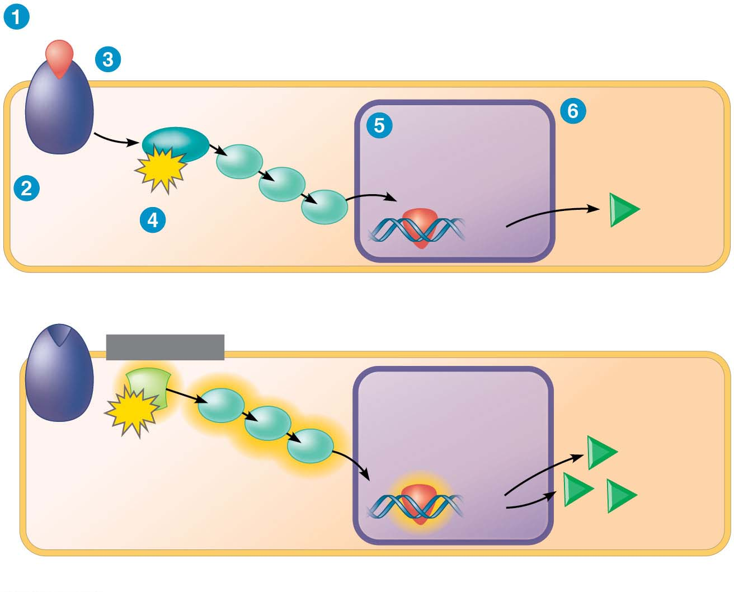
Figure 16.18
Growth factor
G protein
NUCLEUS
Protein that
stimulates
the cell cycle
Ras
Transcription
factor (activator)
GTP
Receptor
Protein
kinases
(a) Normal cell cycle–stimulating pathway
MUTATION
Ras
NUCLEUS
Overexpression
of protein
GTP
Transcription
factor (activator)
Ras protein active with
or without growth factor
(b) Mutant cell cycle–stimulating pathway
Notes:
Figure 16.18 Normal and mutant cell cycle–stimulating pathway

Slide 82
Suppression of the cell cycle can be important in the case of damage to a cell’s DNA; p53 prevents a cell from passing on mutations due to DNA damage
Mutations in the p53 gene prevent suppression of the cell cycle
Notes:
82

Slide 83
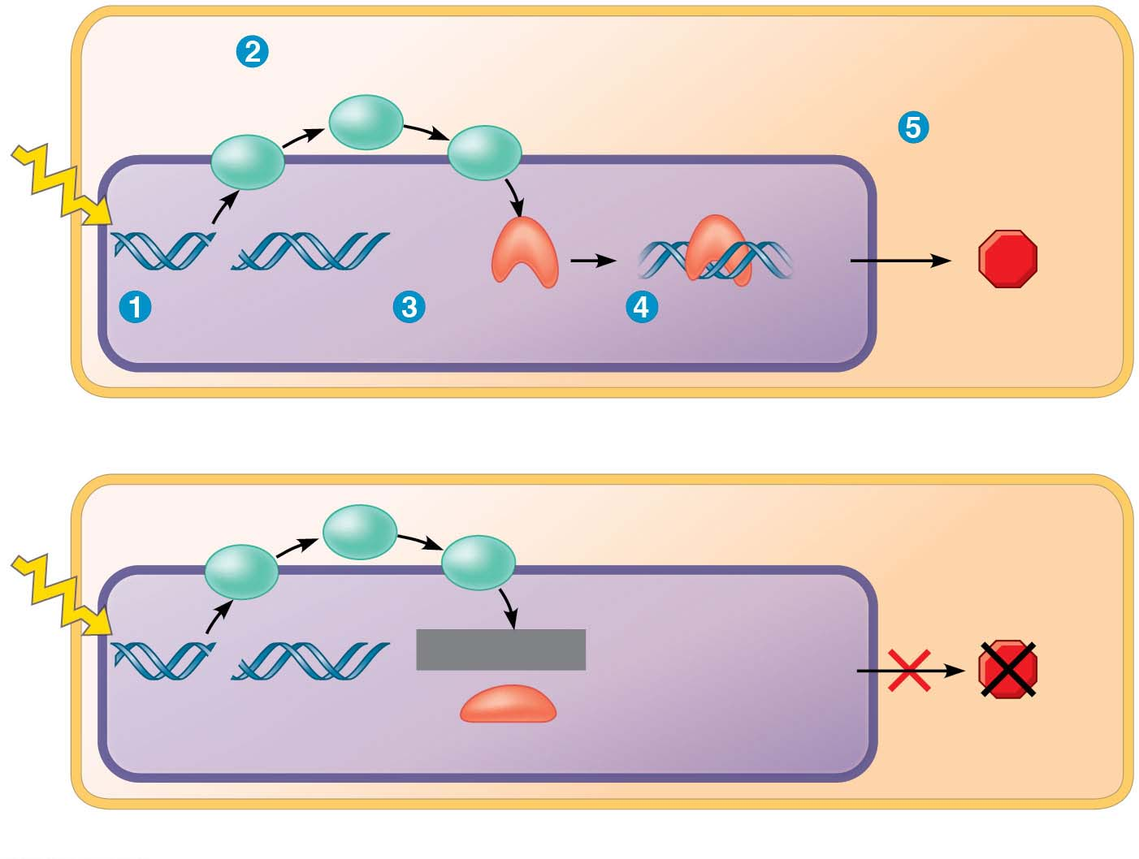
Figure 16.19
Protein kinases
Protein that
inhibits the
cell cycle
NUCLEUS
UV
light
DNA damage
in genome
Active form
of p53
Transcription
(a) Normal cell cycle–inhibiting pathway
Inhibitory
protein
absent
Defective
or missing
transcription
factor
UV
light
MUTATION
DNA damage
in genome
(b) Mutant cell cycle–inhibiting pathway
Notes:
Figure 16.19 Normal and mutant cell cycle–inhibiting pathway

Slide 84
The Multistep Model of Cancer Development
Multiple somatic mutations are generally needed for full-fledged cancer; thus the incidence increases with age
The multistep path to cancer is well supported by studies of human colorectal cancer, one of the best-understood types of cancer
The first sign of colorectal cancer is often a polyp, a small benign growth in the colon lining
Notes:
84

Slide 85
About half a dozen changes must occur at the DNA level for a cell to become fully cancerous
These changes generally include at least one active oncogene and the mutation or loss of several tumor-suppressor genes
Notes:
85

Slide 86
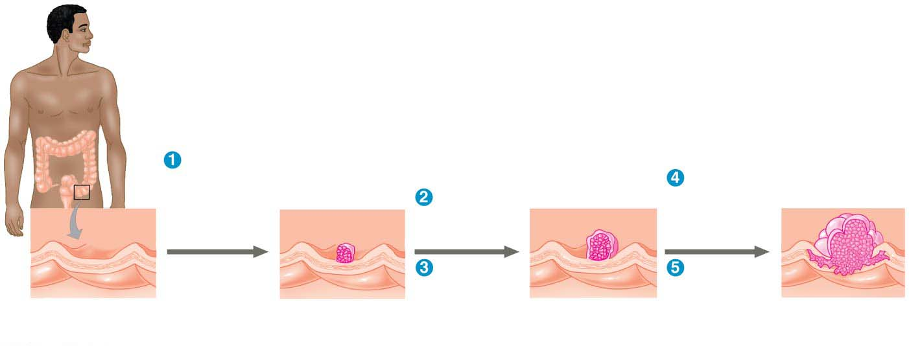
Figure 16.20
Colon
Loss of
tumor-
suppressor
gene APC
(or other)
Loss of
tumor-
suppressor
gene p53
Activation
of ras
oncogene
Loss of
tumor-
suppressor
gene SMAD4
Additional
mutations
Colon wall
Normal colon
epithelial cells
Small benign
growth (polyp)
Larger benign
growth (adenoma)
Malignant tumor
(carcinoma)
Notes:
Figure 16.20 A multistep model for the development of colorectal cancer

Slide 87
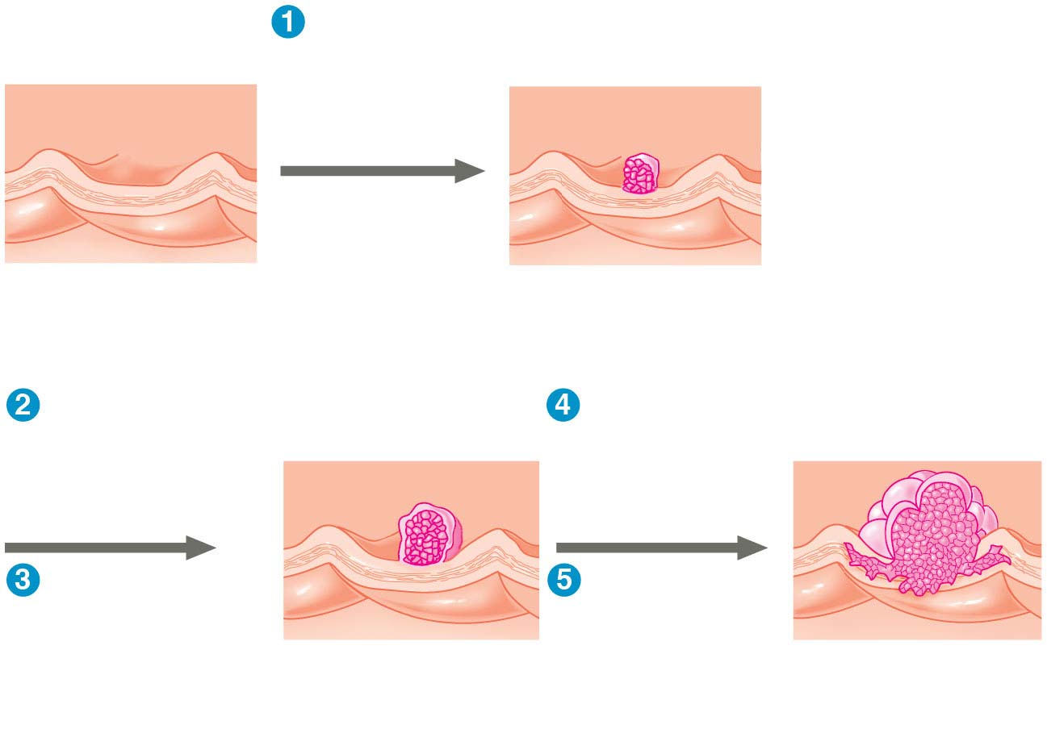
Figure 16.20-1
Loss of tumor-
suppressor gene
APC (or other)
Colon wall
Normal colon
epithelial cells
Small benign
growth (polyp)
Activation of
ras oncogene
Loss of
tumor-suppressor
gene p53
Loss of
tumor-suppressor
gene SMAD4
Additional
mutations
Larger benign
growth (adenoma)
Malignant tumor
(carcinoma)
Notes:
Figure 16.20-1 A multistep model for the development of colorectal cancer (part 1: detail)

Slide 88
Breast cancer is the second most common form of cancer in the United States and the most common form among women
In 2012, the Cancer Genome Atlas Network published results of a genomics approach to profiling types of breast cancer
Four major types were identified based on their molecular signatures
Notes:
88

Slide 89
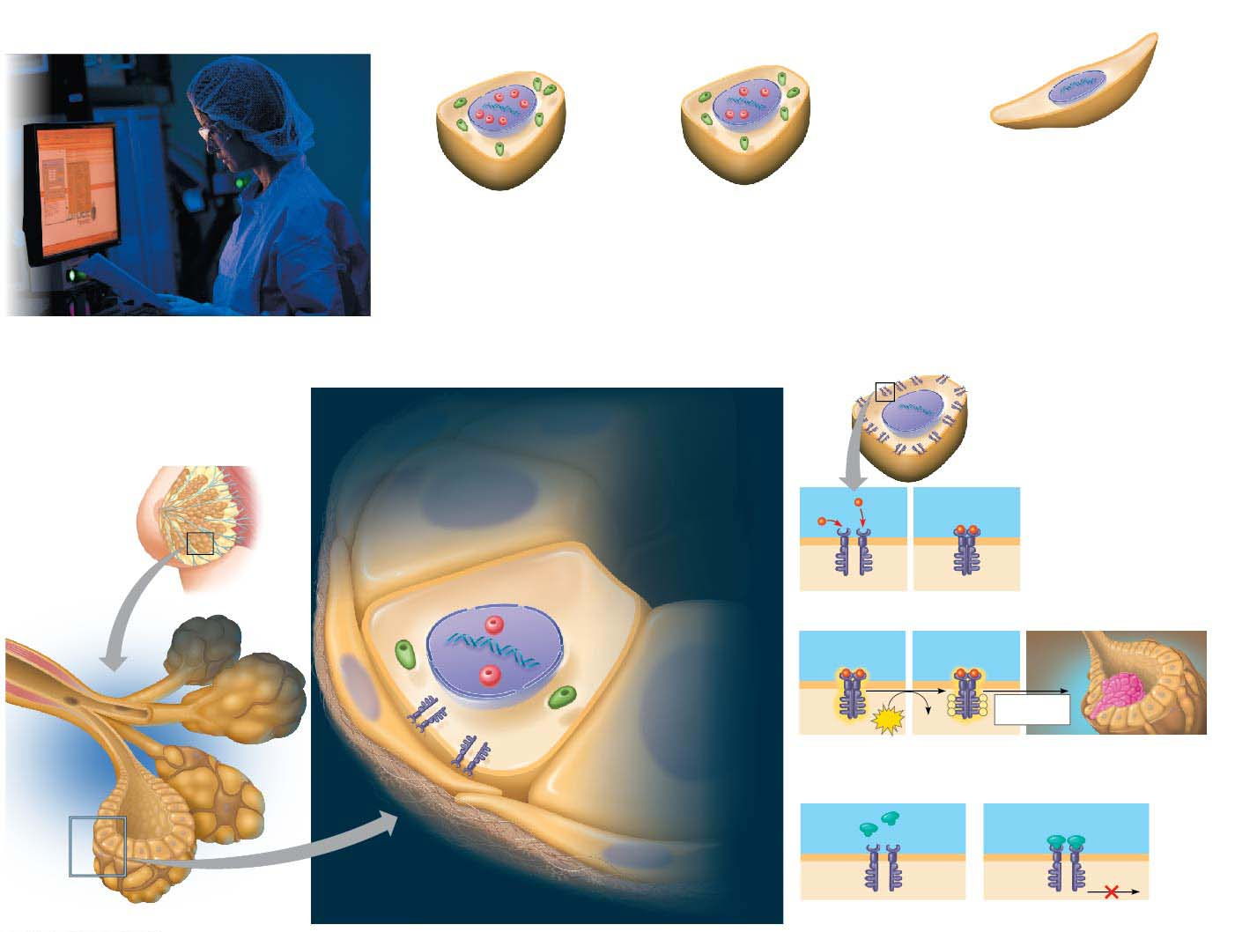
Figure 16.21
MAKE CONNECTIONS: Genomics, Cell Signaling, and Cancer
Luminal A
Luminal B
Basal-like
ERα
PR
• ERα−
• PR−
• HER2−
• ERα+++
• ERα++
• 15–20% of breast cancers
• PR++
• PR++
• More aggressive; poorer prognosis than other subtypes
• HER2−
• HER2− (shown here); some HER2++
• 40% of breast cancers
• 15–20% of breast cancers
• Best prognosis
• Poorer prognosis than luminal A subtype
A research scientist examines DNA
sequencing data from breast cancer
samples.
HER2
HER2
Normal Breast Cells in a Milk Duct
• ERα−
• PR−
In a normal breast cell, the three signal receptors
are at normal levels (indicated by +):
HER2
receptor
• HER2++
• 10–15% of breast cancers
• ERα+
Duct
interior
Dimer
• Poorer prognosis than luminal
• PR+
• HER2+
Estrogen
receptor
alpha (ERα)
A subtype
Milk
duct
Signaling molecule
Progesterone
receptor (PR)
P
P
Response
(cell division)
P
P
HER2
receptor
ATP
ADP
P
P
Mammary
gland
lobule
Epithelial
milk-secreting
cell
Epithelial
milk-secreting
cell
Treatment with Herceptin for the HER2 subtype
Herceptin molecule
Support
cell
Extracellular
matrix
HER2 receptors
Notes:
Figure 16.21 Make connections: genomics, cell signaling, and cancer

Slide 90
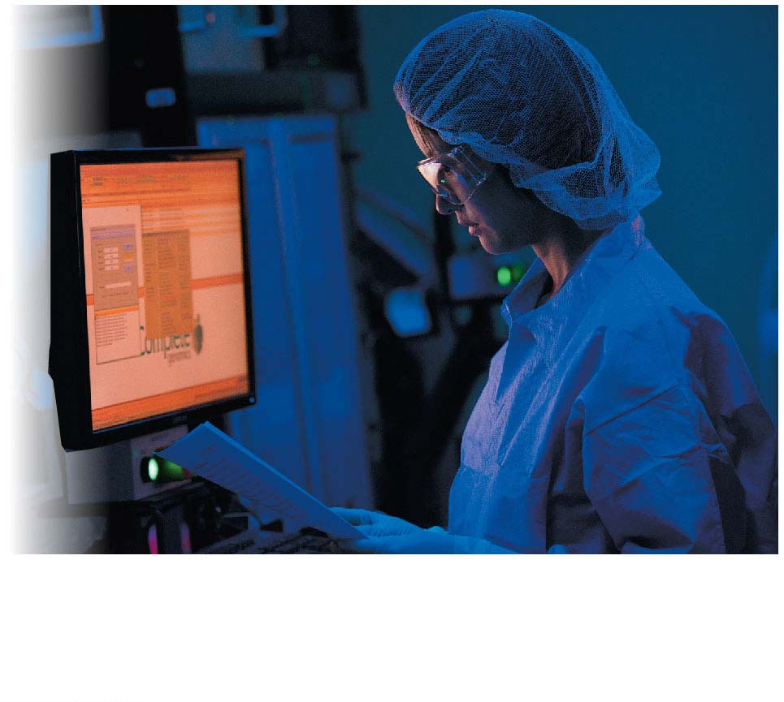
Figure 16.21-1
A research scientist examines DNA
sequencing data from breast cancer
samples.
Notes:
Figure 16.21-1 Make connections: genomics, cell signaling, and cancer (part 1)

Slide 91
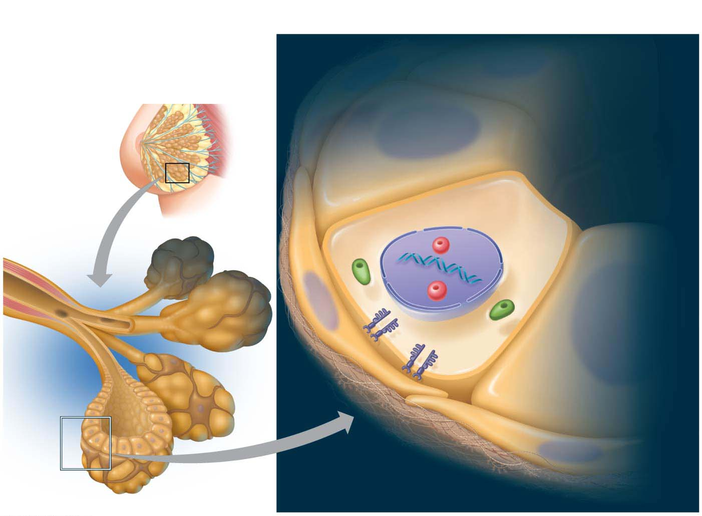
Figure 16.21-2
MAKE CONNECTIONS: Genomics, Cell Signaling, and Cancer
Normal Breast Cells in a Milk Duct
In a normal breast cell, the three signal receptors
are at normal levels (indicated by +):
• ERα+
Duct
interior
• PR+
Estrogen
receptor
alpha (ERα)
• HER2+
Milk
duct
Progesterone
receptor (PR)
HER2
receptor
Mammary
gland
lobule
Epithelial
milk-secreting
cell
Epithelial
milk-secreting
cell
Support
cell
Extracellular
matrix
Notes:
Figure 16.21-2 Make connections: genomics, cell signaling, and cancer (part 2)

Slide 92
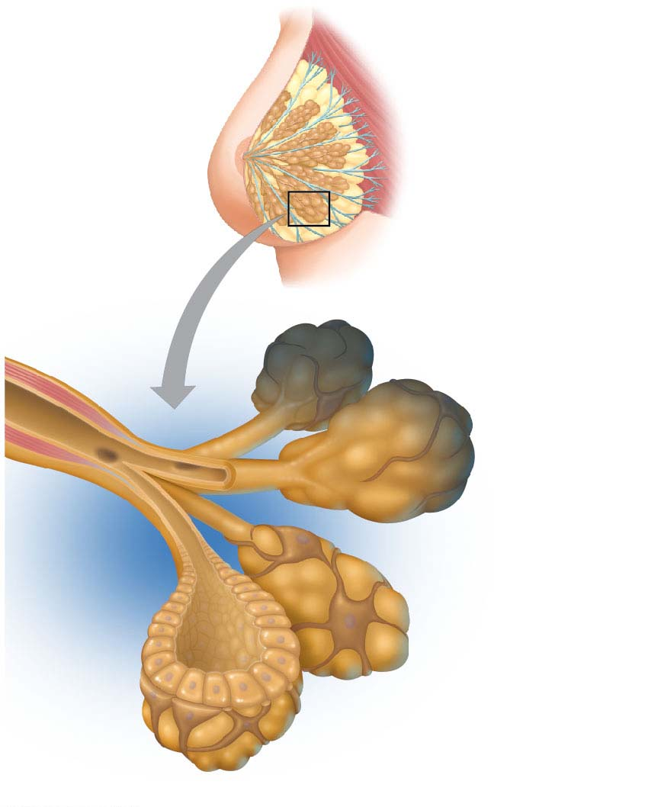
Figure 16.21-2a
Milk
duct
Mammary
gland
lobule
Epithelial
milk-secreting cell
Support
cell
Notes:
Figure 16.21-2a Make connections: genomics, cell signaling, and cancer (part 2a)

Slide 93
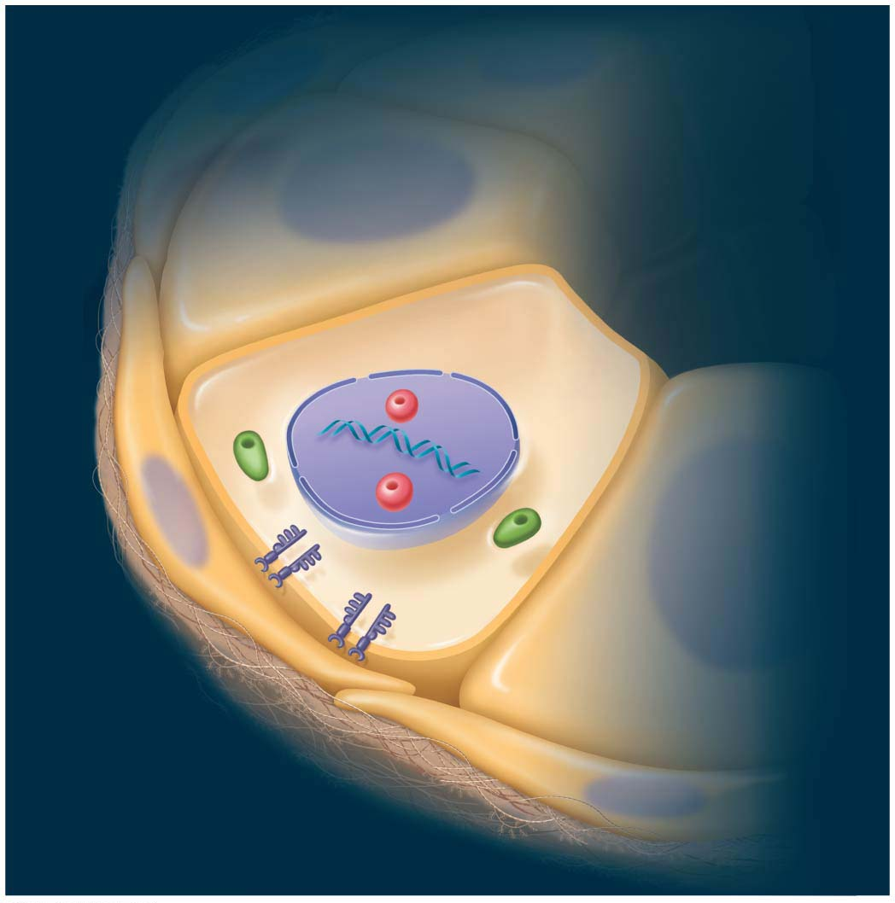
Figure 16.21-2b
Normal Breast Cells in a Milk Duct
In a normal breast cell, the three signal receptors
are at normal levels (indicated by +):
• ERα+
Duct
interior
• PR+
• HER2+
Estrogen
receptor
alpha (ERα)
Support
cell
Progesterone
receptor (PR)
HER2
receptor
Extracellular
matrix
Notes:
Figure 16.21-2b Make connections: genomics, cell signaling, and cancer (part 2b)

Slide 94
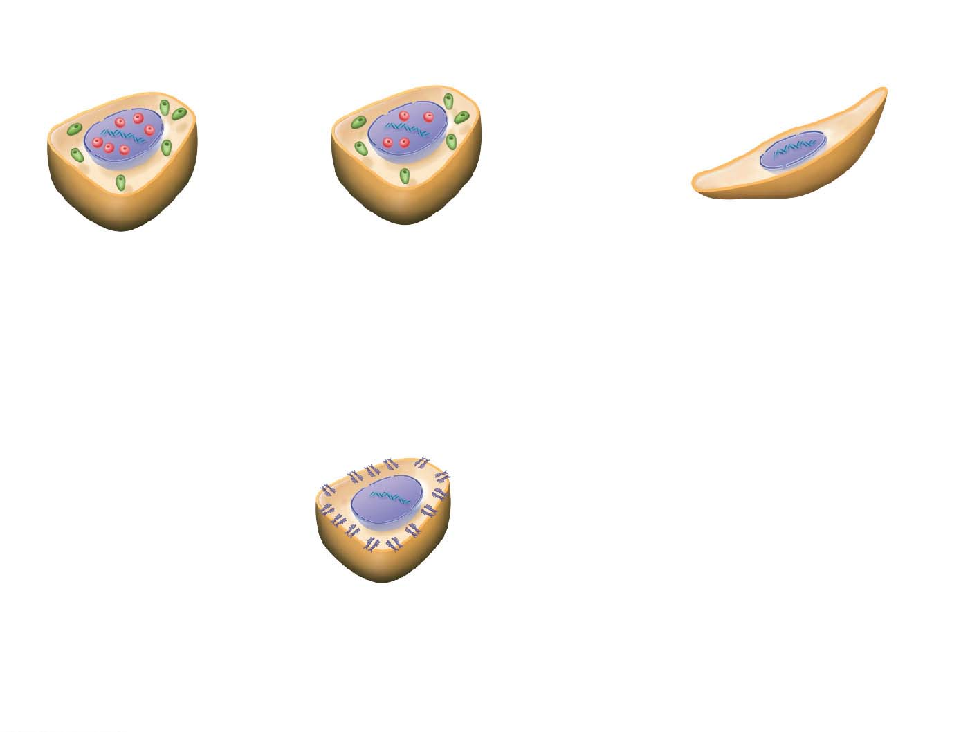
Figure 16.21-3
MAKE CONNECTIONS: Genomics, Cell Signaling, and Cancer
Luminal A
Luminal B
Basal-like
ERα
PR
• ERα−
• ERα+++
• ERα++
• PR−
• PR++
• PR++
• HER2−
• HER2−
• HER2− (shown here); some HER2++
• 15–20% of breast cancers
• 40% of breast cancers
• More aggressive; poorer prognosis than other subtypes
• Best prognosis
• 15–20% of breast cancers
• Poorer prognosis than luminal A subtype
HER2
HER2
• ERα−
• PR−
• HER2++
• 10–15% of breast cancers
• Poorer prognosis than luminal A subtype
Notes:
Figure 16.21-3 Make connections: genomics, cell signaling, and cancer (part 3)

Slide 95
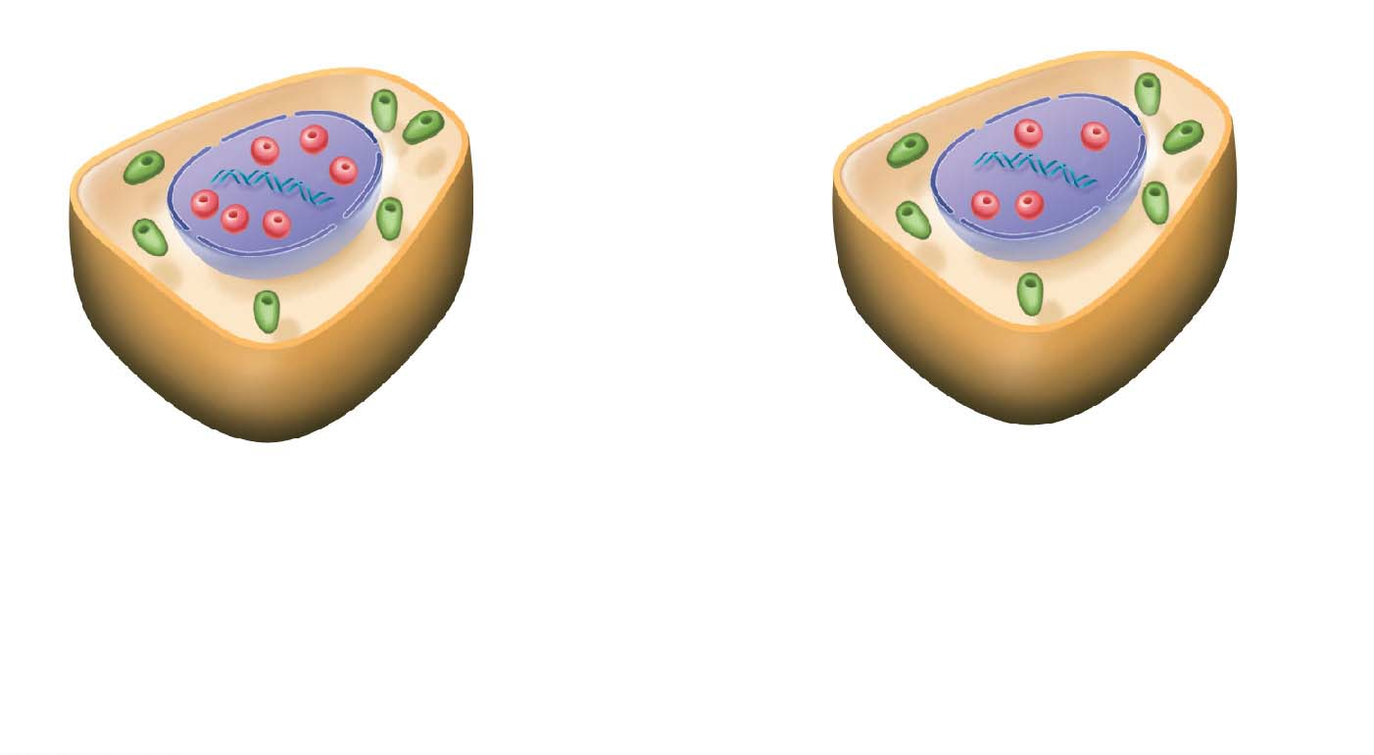
Figure 16.21-3a
Luminal A
Luminal B
ERα
PR
• ERα+++
• ERα++
• PR+
• PR++
• HER2−
• HER2− (shown here); some HER2++
• 40% of breast cancers
• 15–20% of breast cancers
• Best prognosis
• Poorer prognosis than luminal A subtype
Notes:
Figure 16.21-3a Make connections: genomics, cell signaling, and cancer (part 3a)

Slide 96
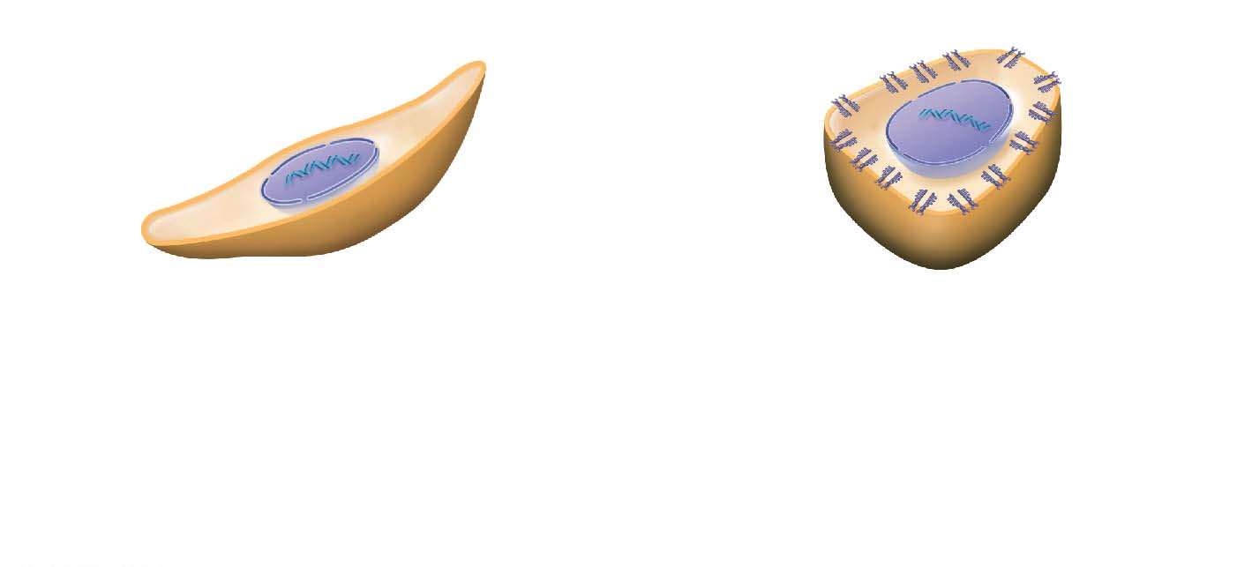
Figure 16.21-3b
Basal-like
HER2
HER2
• ERα−
• ERα−
• PR−
• PR−
• HER2−
• HER2++
• 15–20% of breast cancers
• 10–15% of breast cancers
• More aggressive; poorer prognosis than other subtypes
• Poorer prognosis than luminal A subtype
Notes:
Figure 16.21-3b Make connections: genomics, cell signaling, and cancer (part 3b)

Slide 97
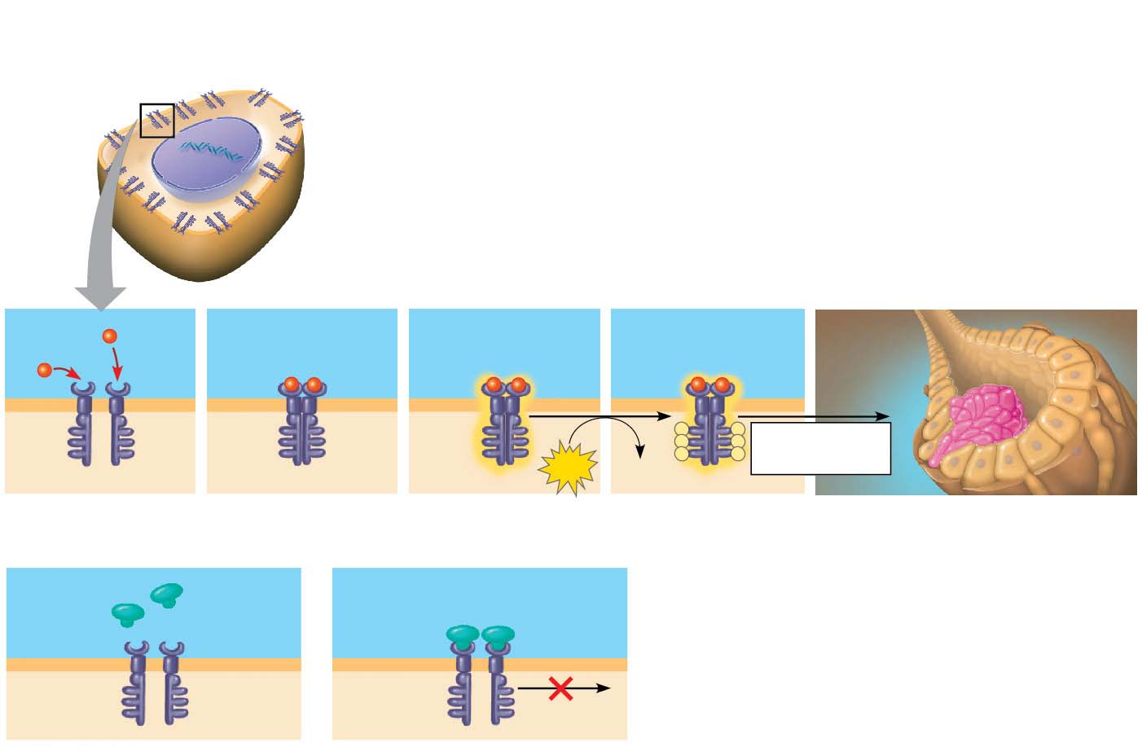
Figure 16.21-4
MAKE CONNECTIONS: Genomics, Cell Signaling, and Cancer
HER2
HER2
• ERα−
• PR−
• HER2++
• 10–15% of breast cancers
• Poorer prognosis than luminal A subtype
Signaling
molecule
HER2
receptor
Dimer
P
P
Response
(cell division)
P
P
ATP
ADP
P
P
Treatment with Herceptin for the HER2 subtype
Herceptin
molecule
HER2
receptors
Notes:
Figure 16.21-4 Make connections: genomics, cell signaling, and cancer (part 4)

Slide 98
Figure 16.21-4a
HER2
Signaling
molecule
HER2
receptor
Dimer
P
P
Response
(cell division)
P
P
ATP
P
P
ADP
Notes:
Figure 16.21-4a Make connections: genomics, cell signaling, and cancer (part 4a)

Slide 99
Figure 16.21-4b
Treatment with Herceptin for the HER2 subtype
Herceptin
molecule
HER2
receptors
Notes:
Figure 16.21-4b Make connections: genomics, cell signaling, and cancer (part 4b)

Slide 100
Inherited Predisposition and Other Factors Contributing to Cancer
Individuals can inherit oncogenes or mutant alleles of tumor-suppressor genes
Inherited mutations in the tumor-suppressor gene adenomatous polyposis coli (APC) are common in individuals with colorectal cancer
Mutations in the BRCA1 or BRCA2 gene are found in at least half of inherited breast cancers, and tests using DNA sequencing can detect these mutations
Notes:
100

Slide 101
DNA breakage can contribute to cancer, thus the risk of cancer can be lowered by minimizing exposure to agents that damage DNA, such as ultraviolet radiation and chemicals found in cigarette smoke
Also, viruses play a role in about 15% of human cancers by donating an oncogene to a cell, disrupting a tumor-suppressor gene, or converting a proto-oncogene into an oncogene
Notes:
101

Slide 102
Figure 16.3
(a) Cytoplasmic determinants in the egg
(b) Induction by nearby cells
Molecules of two different
cytoplasmic determinants
Early embryo
(32 cells)
Nucleus
NUCLEUS
Unfertilized
egg
Fertilization
Mitotic
cell
division
Signal
transduction
pathway
Sperm
Zygote
(fertilized egg)
Two-celled
embryo
Signal
receptor
Signaling
molecule
Notes:
Figure 16.3 Sources of developmental information for the early embryo

Slide 103
Figure 16.7
Developing egg
Follicle cell
Nucleus
Egg
Nurse cell
Mature,
unfertilized egg
Egg
shell
Depleted
nurse cells
Fertilization
Laying of egg
Fertilized egg
Head
Thorax
Abdomen
Embryonic
development
0.5 mm
Segmented embryo
0.1 mm
Dorsal
Body
segments
Hatching
Right
BODY
AXES
Anterior
Posterior
Left
Larva
Ventral
(a) Adult
(b) Development from egg to larva
Notes:
Figure 16.7 Key developmental events in the life cycle of Drosophila

Slide 104
Figure 16.UN01-1
Regulatory region
Promoter
Gene
Hoxd13 mRNA
A
B
C
Hoxd13
Treatments
A
B
C
Segments being tested
A
B
C
A
B
C
A
B
C
0
20
40
60
80
100
Blue = Hoxd13
mRNA; white
triangles = future
thumb location
Relative amount of
Hoxd13 mRNA (%)
Data from T. Montavon et al., A regulatory archipelago controls Hox genes
transcription in digits, Cell 147:1132–1145 (2011). doi 10.1016/j.cell.2011.10.023
Notes:
Figure 16.UN01-1 Skills exercise: analyzing quantitative and spatial gene expression data (part 1)

Slide 105
Figure 16.UN01-2
Notes:
Figure 16.UN01-2 Skills exercise: analyzing quantitative and spatial gene expression data (part 2)

Slide 106
Figure 16.UN02
Cytoplasmic determinants
Notes:
Figure 16.UN02 Summary of key concepts: cytoplasmic determinants

Slide 107
Figure 16.UN03
Induction
Notes:
Figure 16.UN03 Summary of key concepts: induction

Slide 108
Figure 16.UN04
EFFECTS OF MUTATIONS
Protein overexpressed
(such as Ras)
Protein absent
(such as p53)
Cell cycle
overstimulated
Increased cell
division
Cell cycle not
inhibited
Notes:
Figure 16.UN04 Summary of key concepts: abnormal regulation

Slide 109
Figure 16.UN05
Notes:
Figure 16.UN05 Test your understanding, question 9 (stem cell skin creams)

