Slide 1
0
15
Regulation of Gene Expression

Slide 2
Overview: Beauty in the Eye of the Beholder
Prokaryotes and eukaryotes alter gene expression in response to their changing environment
Multicellular eukaryotes also develop and maintain multiple cell types
Notes:
2

Slide 3
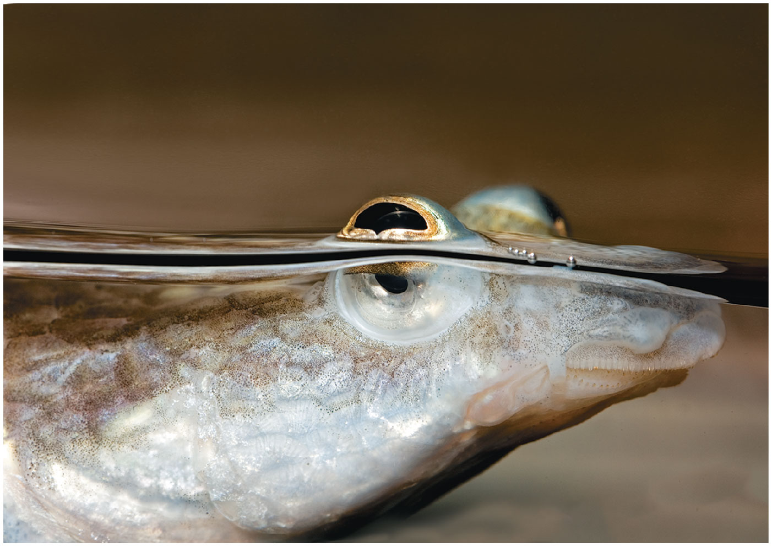
Figure 15.1
Notes:
Figure 15.1 How can this fish’s eyes see equally well in both air and water?

Slide 4
Concept 15.1: Bacteria often respond to environmental change by regulating transcription
Natural selection has favored bacteria that produce only the gene products needed by the cell
A cell can regulate the production of enzymes by feedback inhibition or by gene regulation
Gene expression in bacteria is controlled by a mechanism described as the operon model
Notes:
4

Slide 5
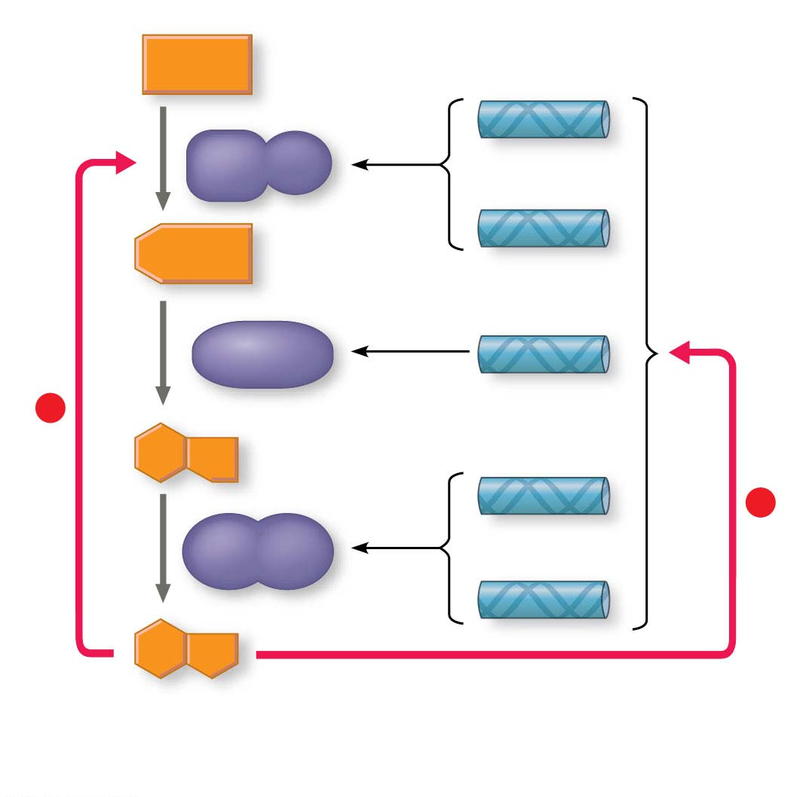
Figure 15.2
Precursor
Genes that
encode enzymes
1, 2, and 3
Feedback
inhibition
trpE
Enzyme 1
trpD
Regulation
of gene
expression
Enzyme 2
trpC
–
trpB
–
Enzyme 3
trpA
Tryptophan
(a) Regulation of enzyme activity
(b) Regulation of enzyme production
Notes:
Figure 15.2 Regulation of a metabolic pathway

Slide 6
Operons: The Basic Concept
A group of functionally related genes can be coordinately controlled by a single “on-off switch”
The regulatory “switch” is a segment of DNA called an operator, usually positioned within the promoter
An operon is the entire stretch of DNA that includes the operator, the promoter, and the genes that they control
Notes:
6

Slide 7
The operon can be switched off by a protein repressor
The repressor prevents gene transcription by binding to the operator and blocking RNA polymerase
The repressor is the product of a separate regulatory gene
Notes:
7

Slide 8
The repressor can be in an active or inactive form, depending on the presence of other molecules
A corepressor is a molecule that cooperates with a repressor protein to switch an operon off
The trp (tryptophan) operon is an example of such an operon
Notes:
8

Slide 9
By default, the trp operon is on and the genes for tryptophan synthesis are transcribed
When tryptophan is present, it binds to the trp repressor protein, which then turns the operon off
The repressor is active only in the presence of its corepressor tryptophan; thus the trp operon is turned off (repressed) if tryptophan levels are high
Notes:
9

Slide 10
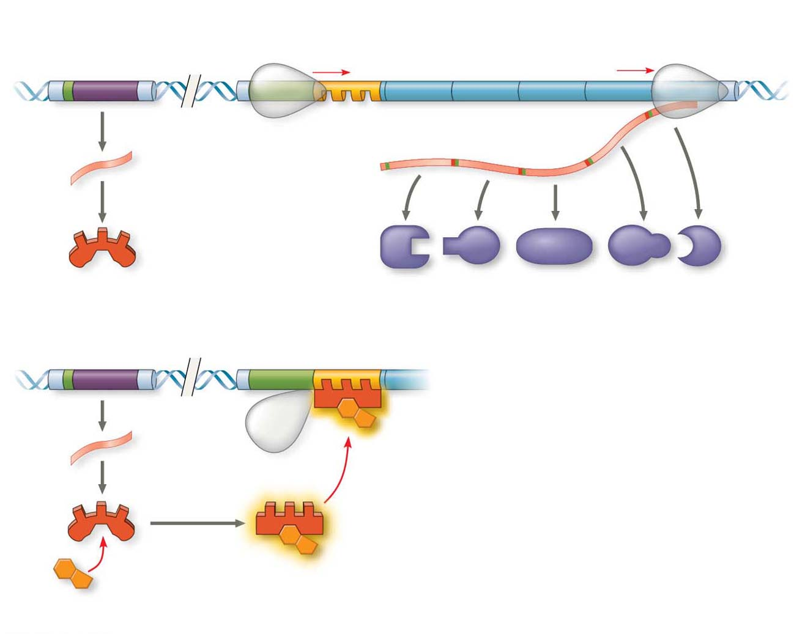
Figure 15.3
trp operon
DNA
trp promoter
Promoter
Regulatory gene
Genes of operon
trpR
trpE
trpD
trpC
trpB
trpA
RNA
polymerase
trp operator
Start codon
Stop codon
mRNA
3′
mRNA 5′
5′
Protein
Inactive trp
repressor
E
D
C
B
A
(a) Tryptophan absent, repressor inactive, operon on
Polypeptide subunits that make up
enzymes for tryptophan synthesis
DNA
trpR
trpE
No
RNA
made
mRNA
3′
5′
Protein
Active trp
repressor
Tryptophan
(corepressor)
(b) Tryptophan present, repressor active, operon off
Notes:
Figure 15.3 The trp operon in E. coli: regulated synthesis of repressible enzymes

Slide 11
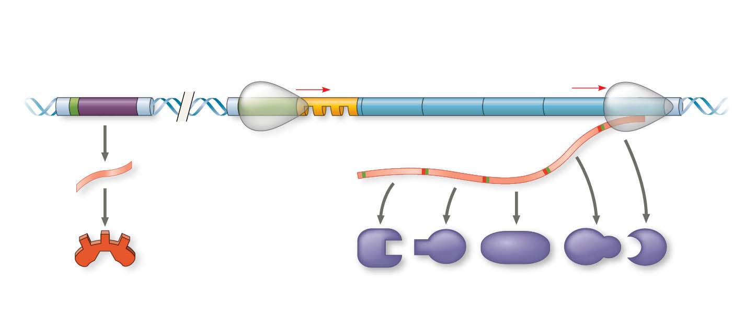
Figure 15.3-1
trp operon
DNA
Regulatory
gene
trp promoter
Promoter
Genes of operon
trpR
trpE
trpD
trpC
trpB
trpA
RNA
polymerase
trp operator
3′
Start codon
Stop codon
mRNA
mRNA 5′
5′
Protein
Inactive trp
repressor
E
D
C
B
A
(a) Tryptophan absent, repressor inactive, operon on
Polypeptide subunits that make up
enzymes for tryptophan synthesis
Notes:
Figure 15.3-1 The trp operon in E. coli: regulated synthesis of repressible enzymes (part 1: tryptophan absent)

Slide 12
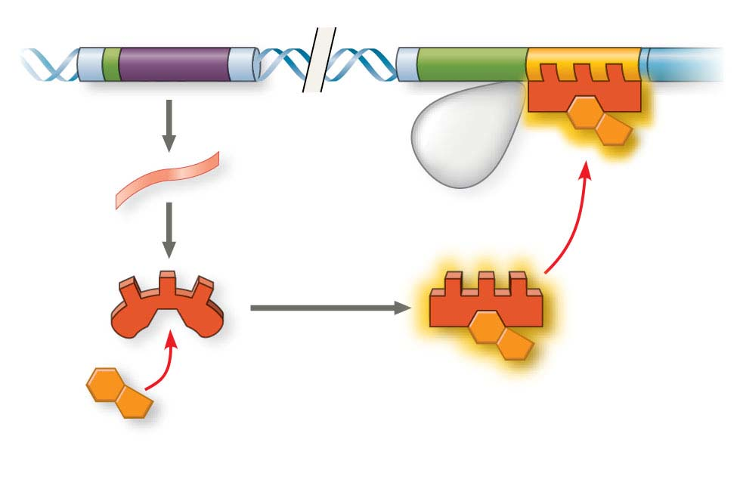
Figure 15.3-2
DNA
trpR
trpE
No
RNA
made
3′
mRNA
5′
Protein
Active trp
repressor
Tryptophan
(corepressor)
(b) Tryptophan present, repressor active, operon off
Notes:
Figure 15.3-2 The trp operon in E. coli: regulated synthesis of repressible enzymes (part 2: tryptophan present)

Slide 13
Repressible and Inducible Operons: Two Types of Negative Gene Regulation
A repressible operon is one that is usually on; binding of a repressor to the operator shuts off transcription
The trp operon is a repressible operon
An inducible operon is one that is usually off; a molecule called an inducer inactivates the repressor and turns on transcription
Notes:
13

Slide 14
The lac operon is an inducible operon and contains genes that code for enzymes that function in the use of lactose
By itself, the lac repressor is active and switches the lac operon off
A molecule called an inducer inactivates the repressor to turn the lac operon on
Notes:
14

Slide 15
For the lac operon, the inducer is allolactose, formed from lactose that enters the cell
Enzymes of the lactose pathway are called inducible enzymes
Analogously, the enzymes for tryptophan synthesis are said to be repressible enzymes
Notes:
15

Slide 16
Video: lac Repressor Model

Slide 17
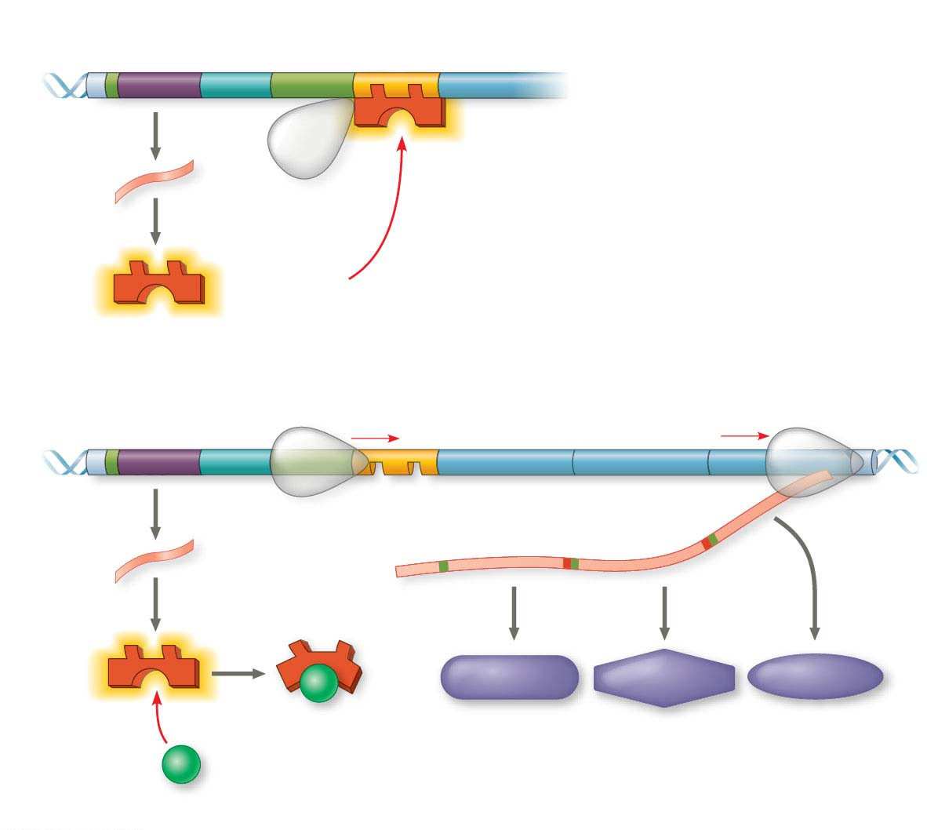
Figure 15.4
Regulatory
gene
lac promoter
DNA
lac operator
lacI
lacZ
No
RNA
made
mRNA
3′
5′
RNA
polymerase
Protein
Active lac
repressor
(a) Lactose absent, repressor active, operon off
lac operon
DNA
lacI
lacZ
lacY
lacA
RNA polymerase
Start codon
Stop codon
mRNA
3′
5′
mRNA 5′
Protein
β-Galactosidase
Permease
Transacetylase
Inactive lac
repressor
Allolactose
(inducer)
Enzymes for using lactose
(b) Lactose present, repressor inactive, operon on
Notes:
Figure 15.4 The lac operon in E. coli: regulated synthesis of inducible enzymes

Slide 18
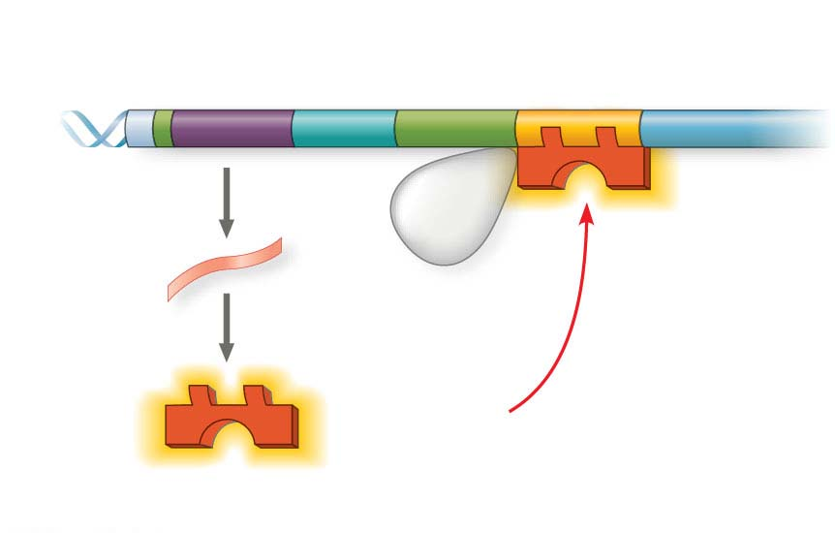
Figure 15.4-1
Regulatory
gene
lac promoter
DNA
lac operator
lacI
lacZ
No
RNA
made
3′
mRNA
5′
RNA
polymerase
Protein
Active lac
repressor
(a) Lactose absent, repressor active, operon off
Notes:
Figure 15.4-1 The lac operon in E. coli: regulated synthesis of inducible enzymes (part 1: lactose absent)

Slide 19
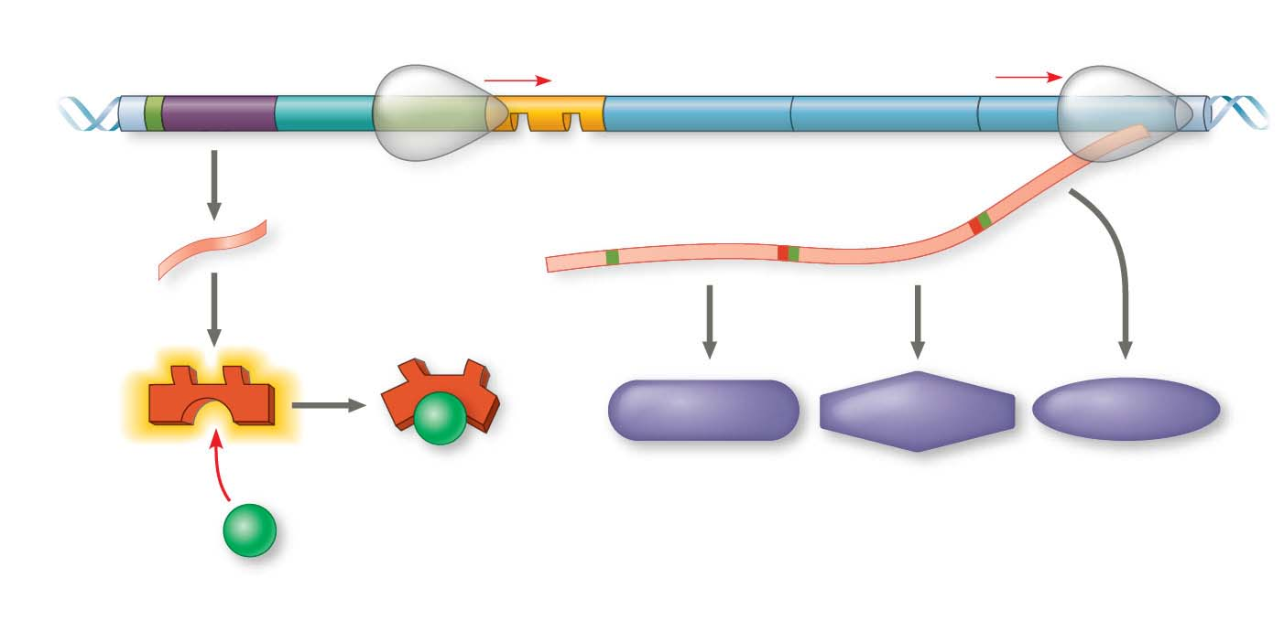
Figure 15.4-2
lac operon
DNA
lacI
lacZ
lacY
lacA
RNA polymerase
Start codon
Stop codon
mRNA
3′
5′
mRNA 5′
Protein
β-Galactosidase
Permease
Transacetylase
Inactive lac
repressor
Allolactose
(inducer)
Enzymes for using lactose
(b) Lactose present, repressor inactive, operon on
Notes:
Figure 15.4-2 The lac operon in E. coli: regulated synthesis of inducible enzymes (part 2: lactose present)

Slide 20
Inducible enzymes usually function in catabolic pathways; their synthesis is induced by a chemical signal
Repressible enzymes usually function in anabolic pathways; their synthesis is repressed by high levels of the end product
Regulation of the trp and lac operons involves negative control of genes because operons are switched off by the active form of the repressor
Notes:
20

Slide 21
Positive Gene Regulation
E. coli will preferentially use glucose when it is present in the environment
When glucose is scarce, CRP (cAMP receptor protein) acts as an activator of transcription
CRP is activated by binding with cyclic AMP (cAMP)
Activated CRP attaches to the promoter of the lac operon and increases the affinity of RNA polymerase, thus accelerating transcription
Notes:
21

Slide 22
When glucose levels increase, CRP detaches from the lac operon, and transcription proceeds at a very low rate, even if lactose is present
CRP helps regulate other operons that encode enzymes used in catabolic pathways
Notes:
22

Slide 23
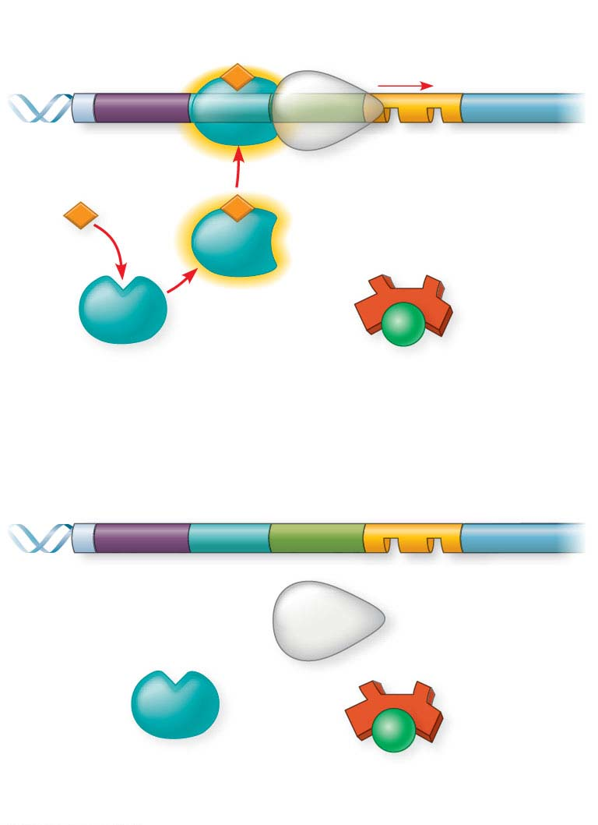
Figure 15.5
lac promoter
DNA
lac operator
lacI
lacZ
CRP-binding site
RNA
polymerase
binds and
transcribes
Active
CRP
cAMP
Inactive lac
repressor
Inactive
CRP
Allolactose
(a) Lactose present, glucose scarce (cAMP level high): abundant lac mRNA synthesized
DNA
lac promoter
lac operator
lacI
lacZ
CRP-binding site
RNA polymerase
less likely to bind
Inactive
CRP
Inactive lac
repressor
(b) Lactose present, glucose present (cAMP level low): little lac mRNA synthesized
Notes:
Figure 15.5 Positive control of the lac operon by cAMP receptor protein (CRP)

Slide 24
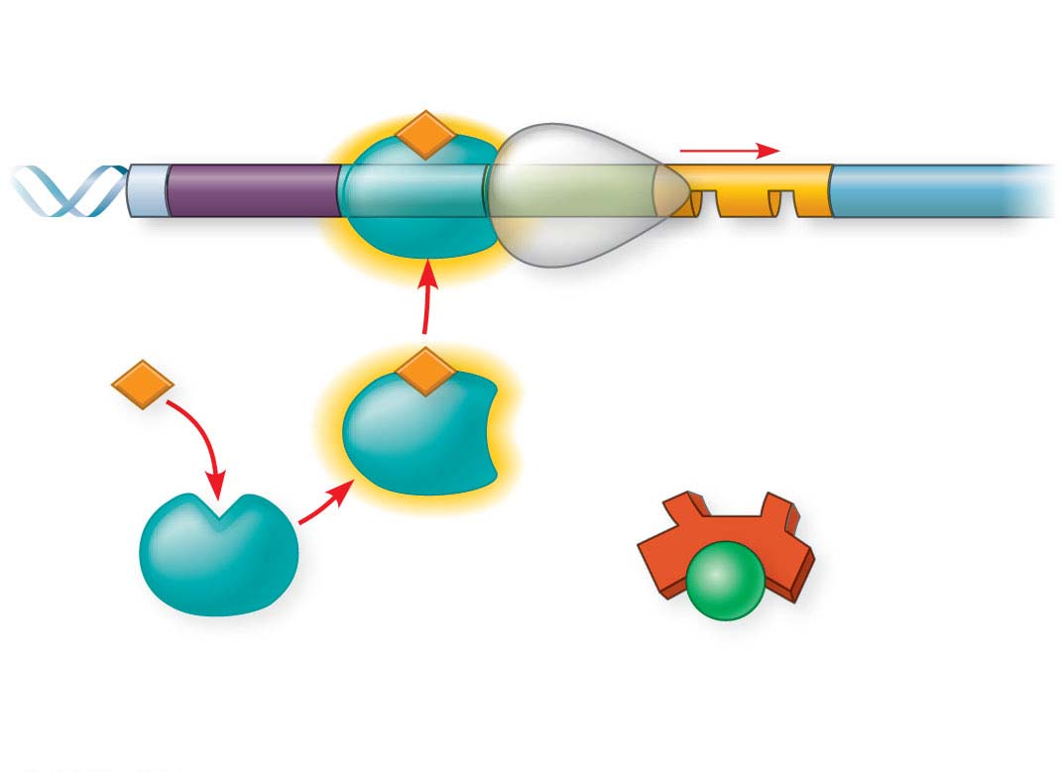
Figure 15.5-1
lac promoter
lac operator
DNA
lacI
lacZ
CRP-binding site
RNA
polymerase
binds and
transcribes
Active
CRP
cAMP
Inactive lac
repressor
Inactive
CRP
Allolactose
(a) Lactose present, glucose scarce (cAMP level high): abundant lac mRNA synthesized
Notes:
Figure 15.5-1 Positive control of the lac operon by cAMP receptor protein (CRP) (part 1: glucose scarce)

Slide 25
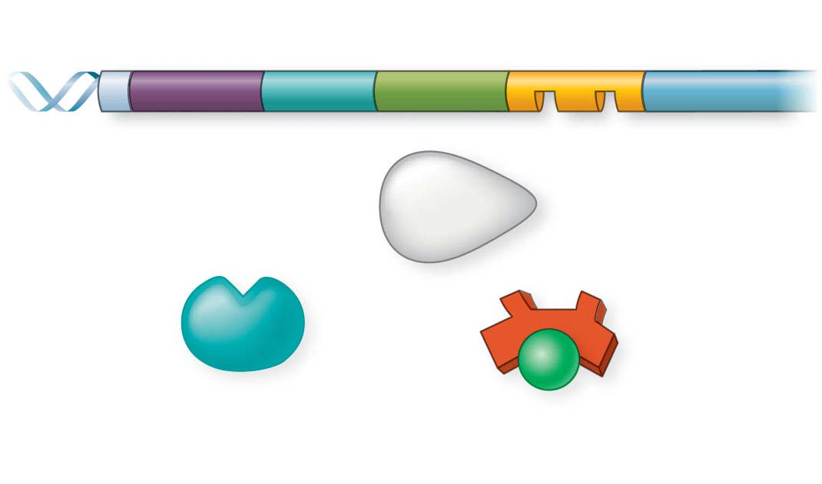
Figure 15.5-2
lac promoter
lac operator
DNA
lacI
lacZ
CRP-binding site
RNA polymerase
less likely to bind
Inactive
CRP
Inactive lac
repressor
(b) Lactose present, glucose present (cAMP level low): little lac mRNA synthesized
Notes:
Figure 15.5-2 Positive control of the lac operon by cAMP receptor protein (CRP) (part 2: glucose present)

Slide 26
Concept 15.2: Eukaryotic gene expression is regulated at many stages
All organisms must regulate which genes are expressed at any given time
In multicellular organisms, regulation of gene expression is essential for cell specialization
Notes:
26

Slide 27
Differential Gene Expression
Almost all the cells in an organism contain an identical organism
Differences between cell types result from differential gene expression, the expression of different genes by cells with the same genome
Abnormalities in gene expression can lead to imbalances and diseases, including cancer
Gene expression is regulated at many stages
Notes:
27

Slide 28
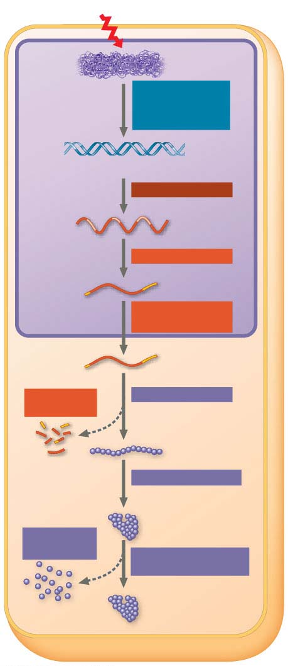
Figure 15.6
Signal
Chromatin
Chromatin
modification:
DNA unpacking
DNA
Gene available for transcription
Transcription
RNA
Exon
Primary
transcript
Intron
RNA processing
Tail
Cap
mRNA in nucleus
Transport to
cytoplasm
NUCLEUS
CYTOPLASM
mRNA in cytoplasm
Degradation
of mRNA
Translation
Polypeptide
Protein processing
Degradation
of protein
Active protein
Transport to cellular
destination
Cellular function
(such as enzymatic
activity or structural
support)
Notes:
Figure 15.6 Stages in gene expression that can be regulated in eukaryotic cells

Slide 29
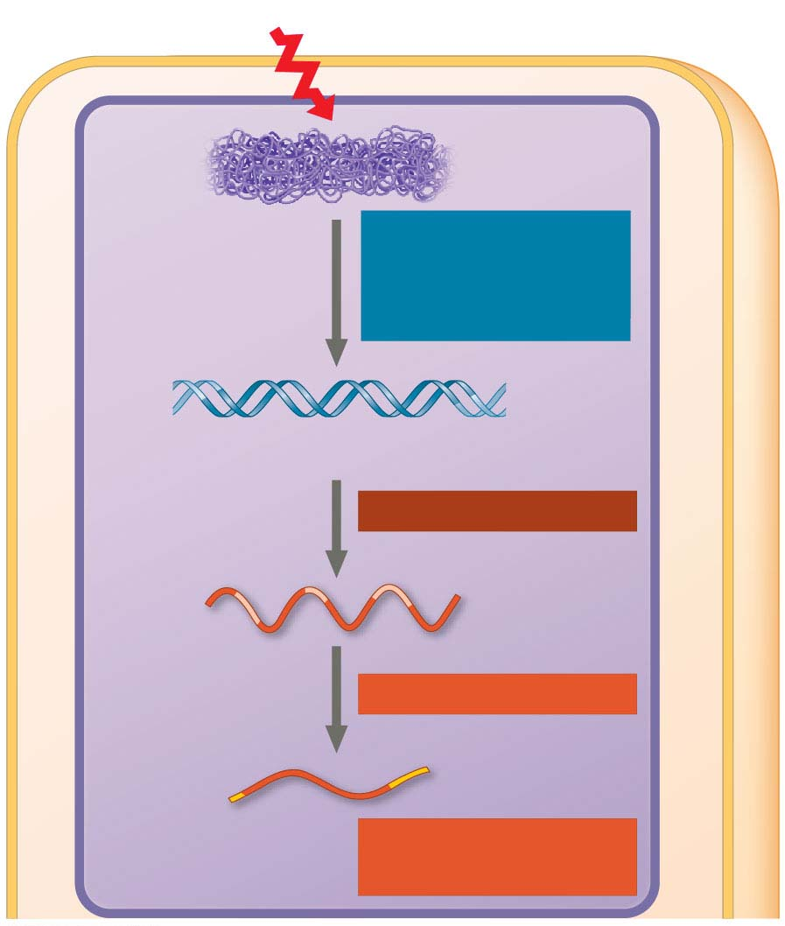
Figure 15.6-1
Signal
Chromatin
Chromatin
modification:
DNA unpacking
DNA
Gene available for transcription
Transcription
RNA
Exon
Primary
transcript
Intron
RNA processing
Tail
Cap
mRNA in nucleus
Transport to
cytoplasm
NUCLEUS
Notes:
Figure 15.6-1 Stages in gene expression that can be regulated in eukaryotic cells (part 1: nucleus)

Slide 30
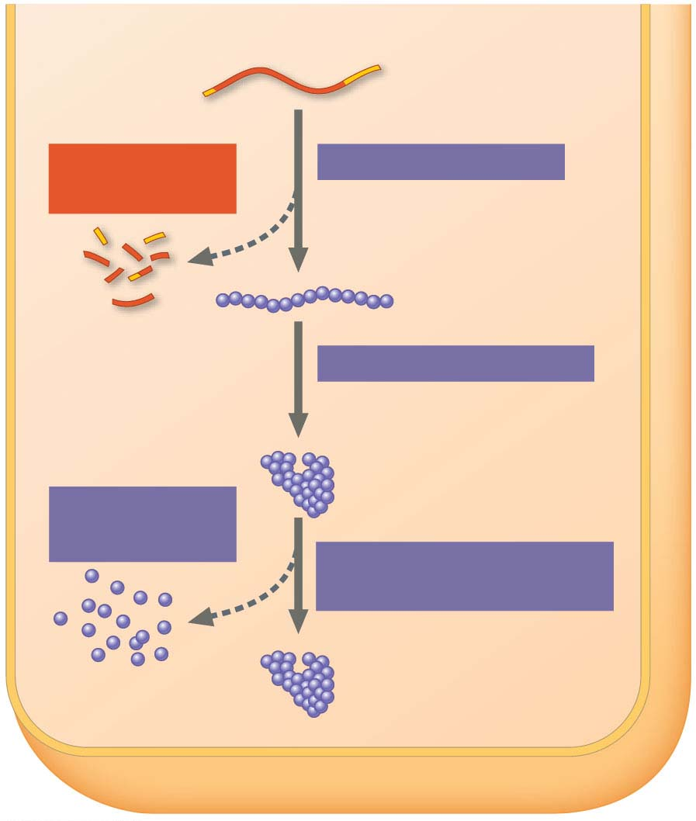
Figure 15.6-2
CYTOPLASM
mRNA in cytoplasm
Degradation
of mRNA
Translation
Polypeptide
Protein processing
Active protein
Degradation
of protein
Transport to cellular
destination
Cellular function
(such as enzymatic
activity or structural
support)
Notes:
Figure 15.6-2 Stages in gene expression that can be regulated in eukaryotic cells (part 2: cytoplasm)

Slide 31
In all organisms, gene expression is commonly controlled at transcription
The greater complexity of eukaryotic cell structure and function provides opportunities for regulating gene expression at many additional stages
Notes:
31

Slide 32
Regulation of Chromatin Structure
The structural organization of chromatin packs DNA into a compact form and helps regulate gene expression in several ways
The location of a gene promoter relative to nucleosomes and scaffold attachment sites can influence gene transcription
Notes:
32

Slide 33
Genes within highly condensed heterochromatin are usually not expressed
Chemical modifications to histone proteins and DNA can influence chromatin structure and gene expression
Notes:
33

Slide 34
Histone Modifications and DNA Methylation
In histone acetylation, acetyl groups are attached to positively charged lysines in histone tails
This generally loosens chromatin structure, promoting the initiation of transcription
The addition of methyl groups (methylation) can condense chromatin and lead to reduced transcription
Notes:
34

Slide 35
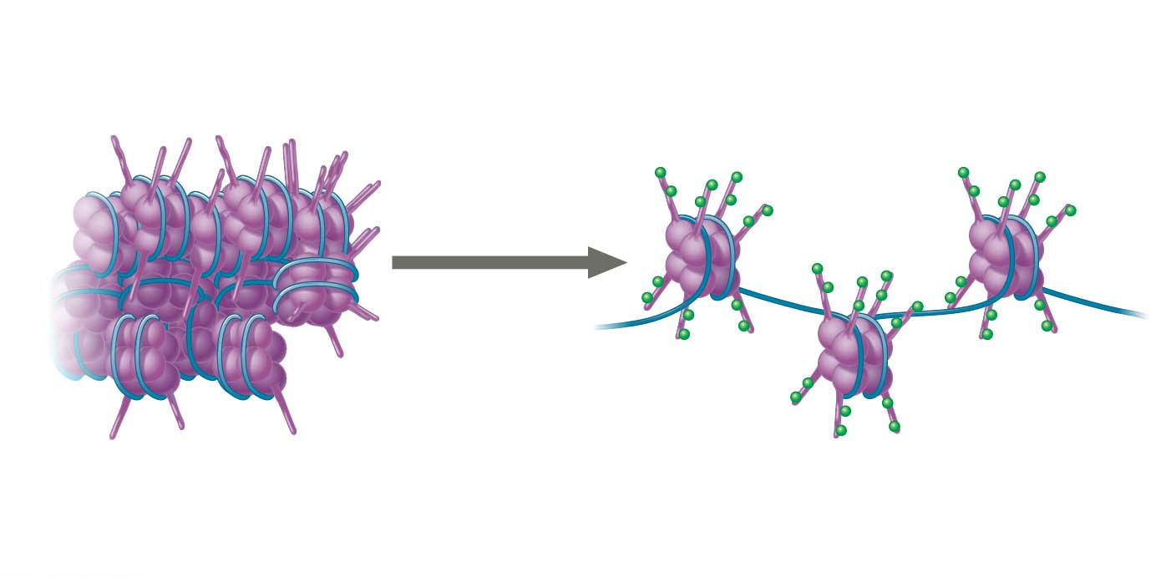
Figure 15.7
Unacetylated histone tails
Acetylated
histone tails
Nucleosome
DNA
Acetylation
DNA
Compact: DNA not
accessible for transcription
Looser: DNA accessible
for transcription
Notes:
Figure 15.7 A simple model of the effect of histone acetylation

Slide 36
DNA methylation is the addition of methyl groups to certain bases in DNA, usually cytosine
Individual genes are usually more heavily methylated in cells where they are not expressed
Once methylated, genes usually remain so through successive cell divisions
After replication, enzymes methylate the correct daughter strand so that the methylation pattern is inherited
Notes:
36

Slide 37
Epigenetic Inheritance
Though chromatin modifications do not alter DNA sequence, they may be passed to future generations of cells
The inheritance of traits transmitted by mechanisms not directly involving the nucleotide sequence is called epigenetic inheritance
Epigenetic modifications can be reversed, unlike mutations in DNA sequence
Notes:
37

Slide 38
Regulation of Transcription Initiation
Chromatin-modifying enzymes provide initial control of gene expression by making a region of DNA either more or less able to bind the transcription machinery
Notes:
38

Slide 39
Organization of a Typical Eukaryotic Gene
Associated with most eukaryotic genes are multiple control elements, segments of noncoding DNA that serve as binding sites for transcription factors that help regulate transcription
Control elements and the transcription factors they bind are critical for precise regulation of gene expression in different cell types
Notes:
39

Slide 40
Animation: mRNA Degradation

Slide 41
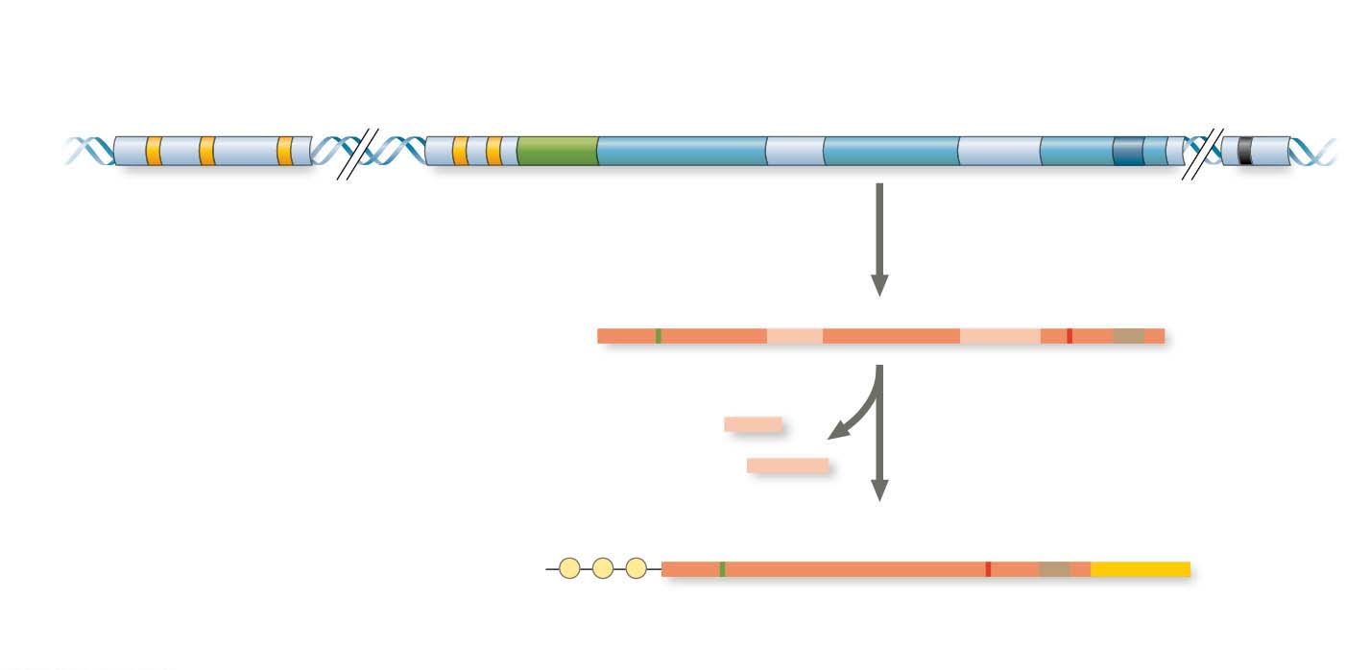
Figure 15.8
Enhancer (group of
distal control
elements)
Proximal
control
elements
Poly-A signal
sequence
Transcription
termination
region
Transcription
start site
Exon
Intron Exon
Intron Exon
DNA
Upstream
Promoter
Down-
stream
Transcription
Poly-A
signal
Primary RNA
transcript
(pre-mRNA)
Exon
Intron Exon
Intron Exon
Cleaved 3′
end of
primary
transcript
5′
RNA processing
Intron RNA
Coding segment
mRNA
G
P
P
P
AAA… AAA
3′
Start
codon
Stop
codon
5′ Cap
5′ UTR
3′ UTR
Poly-A
tail
Notes:
Figure 15.8 A eukaryotic gene and its transcript

Slide 42
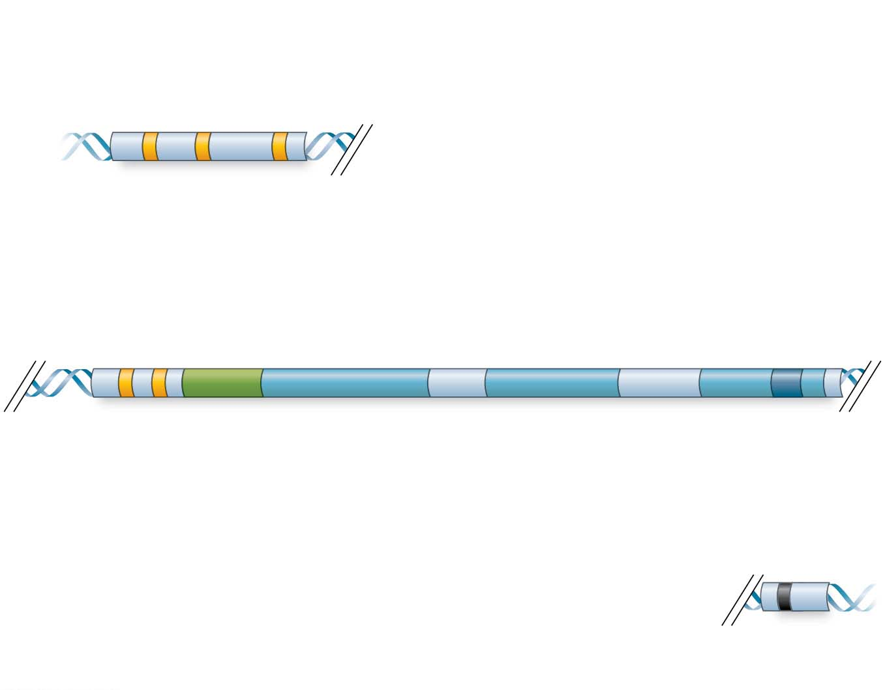
Figure 15.8-1
Enhancer (group of
distal control
elements)
Upstream
Proximal
control
elements
Poly-A signal
sequence
Transcription
start site
Exon
Intron
Exon
Intron Exon
Promoter
Transcription
termination
region
Down-
stream
Notes:
Figure 15.8-1 A eukaryotic gene and its transcript (part 1)

Slide 43
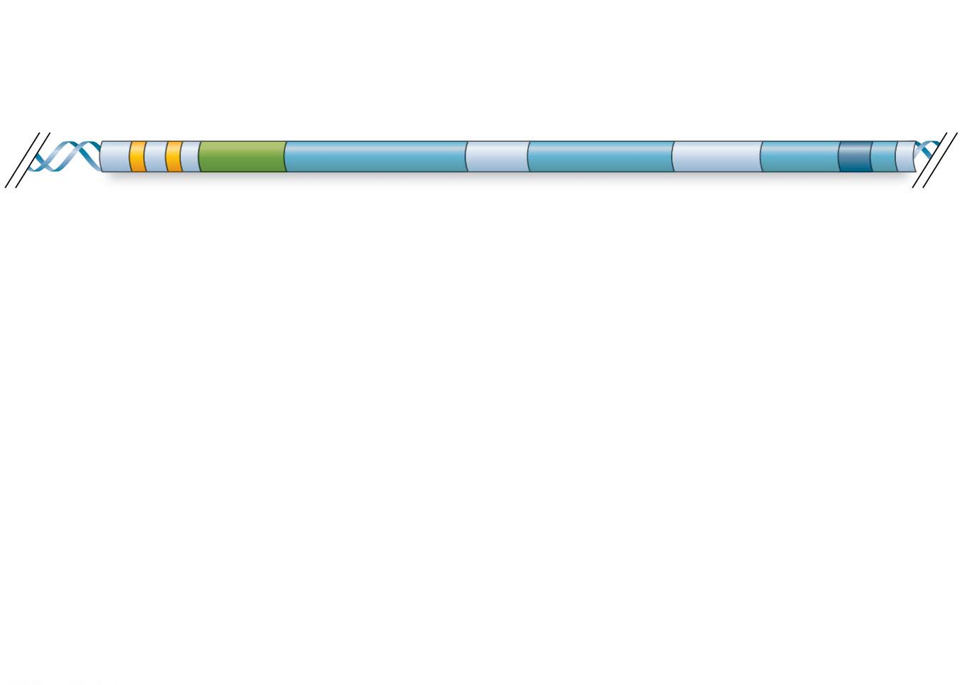
Figure 15.8-2-s1
Proximal
control
elements
Poly-A signal
sequence
Transcription
start site
Exon
Intron Exon
Intron Exon
DNA
Promoter
Notes:
Figure 15.8-2-s1 A eukaryotic gene and its transcript (part 2, step 1)

Slide 44
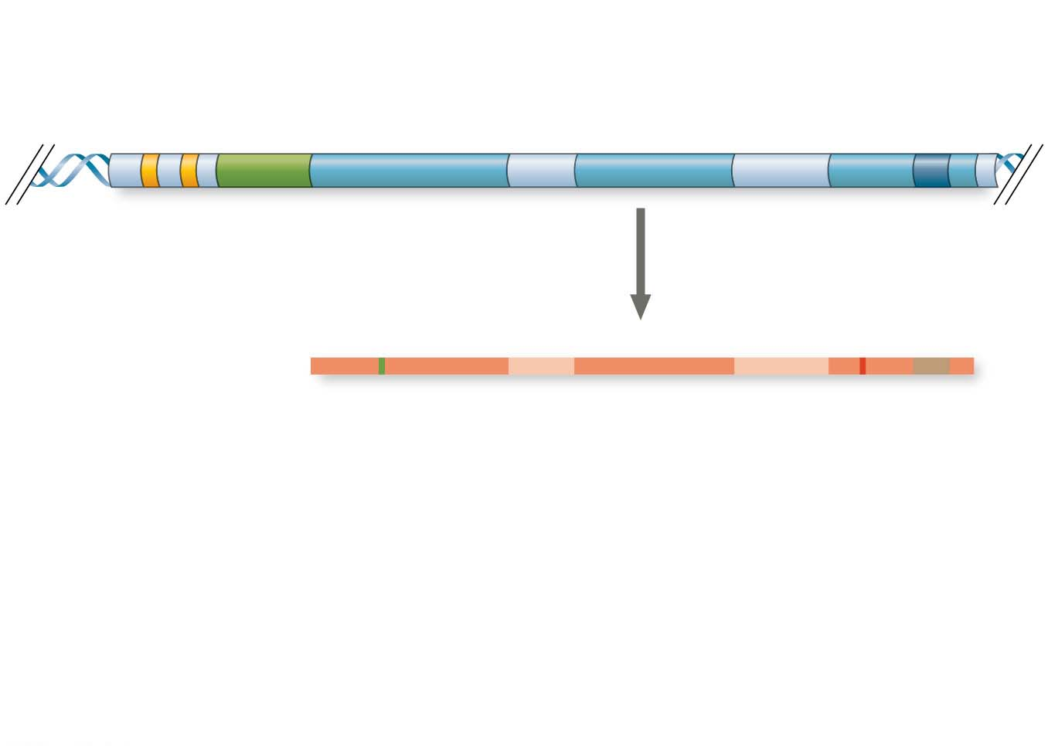
Figure 15.8-2-s2
Proximal
control
elements
Poly-A signal
sequence
Transcription
start site
Exon
Intron Exon
Intron Exon
DNA
Promoter
Poly-A
signal
Transcription
Primary RNA
transcript
(pre-mRNA)
Exon
Intron Exon
Intron Exon
5′
Cleaved 3′
end of
primary
transcript
Notes:
Figure 15.8-2-s2 A eukaryotic gene and its transcript (part 2, step 2)

Slide 45
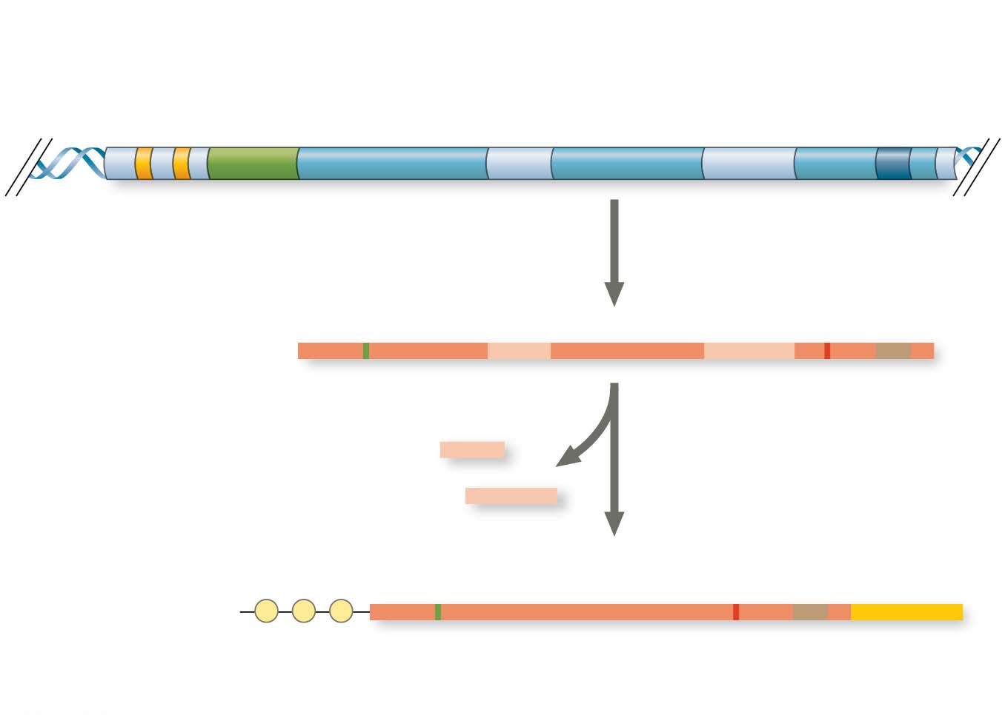
Figure 15.8-2-s3
Proximal
control
elements
Poly-A signal
sequence
Transcription
start site
Exon
Intron Exon
Intron Exon
DNA
Promoter
Poly-A
signal
Transcription
Primary RNA
transcript
(pre-mRNA)
Exon
Intron Exon
Intron Exon
5′
Cleaved 3′
end of
primary
transcript
RNA
processing
Intron RNA
Coding segment
mRNA
G
P
P
P
AAA. . .AAA
3′
Start
codon
Stop
codon
5′ Cap
5′ UTR
3′ UTR
Poly-A
tail
Notes:
Figure 15.8-2-s3 A eukaryotic gene and its transcript (part 2, step 3)

Slide 46
The Roles of General and Specific Transcription Factors
General transcription factors act at the promoter of all genes
Some genes require specific transcription factors that bind to control elements close to or farther away from the promoter
Notes:
46

Slide 47
General Transcription Factors at the Promoter
To initiate transcription, eukaryotic RNA polymerase requires the assistance of transcription factors
A few transcription factors bind to a DNA sequence, but many bind to proteins
The interaction of general transcription factors and RNA polymerase II with a promoter usually leads to only a low rate of initiation
Notes:
47

Slide 48
Enhancers and Specific Transcription Factors
Proximal control elements are located close to the promoter
Distal control elements, groupings of which are called enhancers, may be far away from a gene or even located in an intron
Notes:
48

Slide 49
An activator is a protein that binds to an enhancer and stimulates transcription of a gene
Activators have two domains, one that binds DNA and a second that activates transcription
Bound activators facilitate a sequence of protein-protein interactions that result in transcription of a given gene
Notes:
49

Slide 50
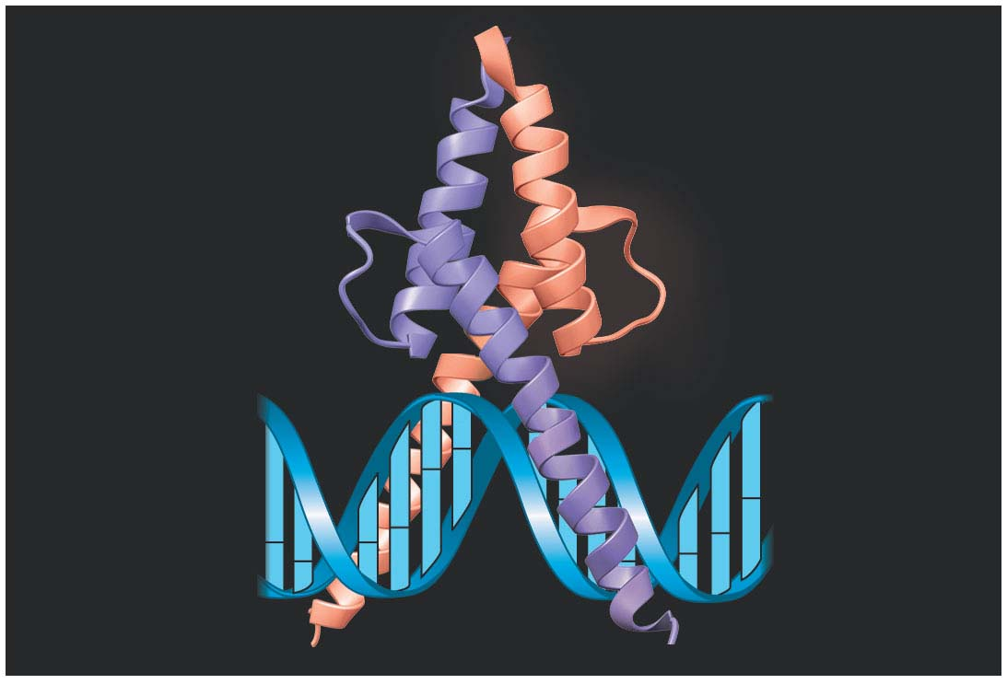
Figure 15.9
Activation
domain
DNA-binding
domain
DNA
Notes:
Figure 15.9 MyoD, a transcription activator

Slide 51
Bound activators are brought into contact with a group of mediator proteins through DNA bending
The mediator proteins in turn interact with proteins at the promoter
These protein-protein interactions help to assemble and position the initiation complex on the promoter
Notes:
51

Slide 52
Animation: Transcription Initiation

Slide 53
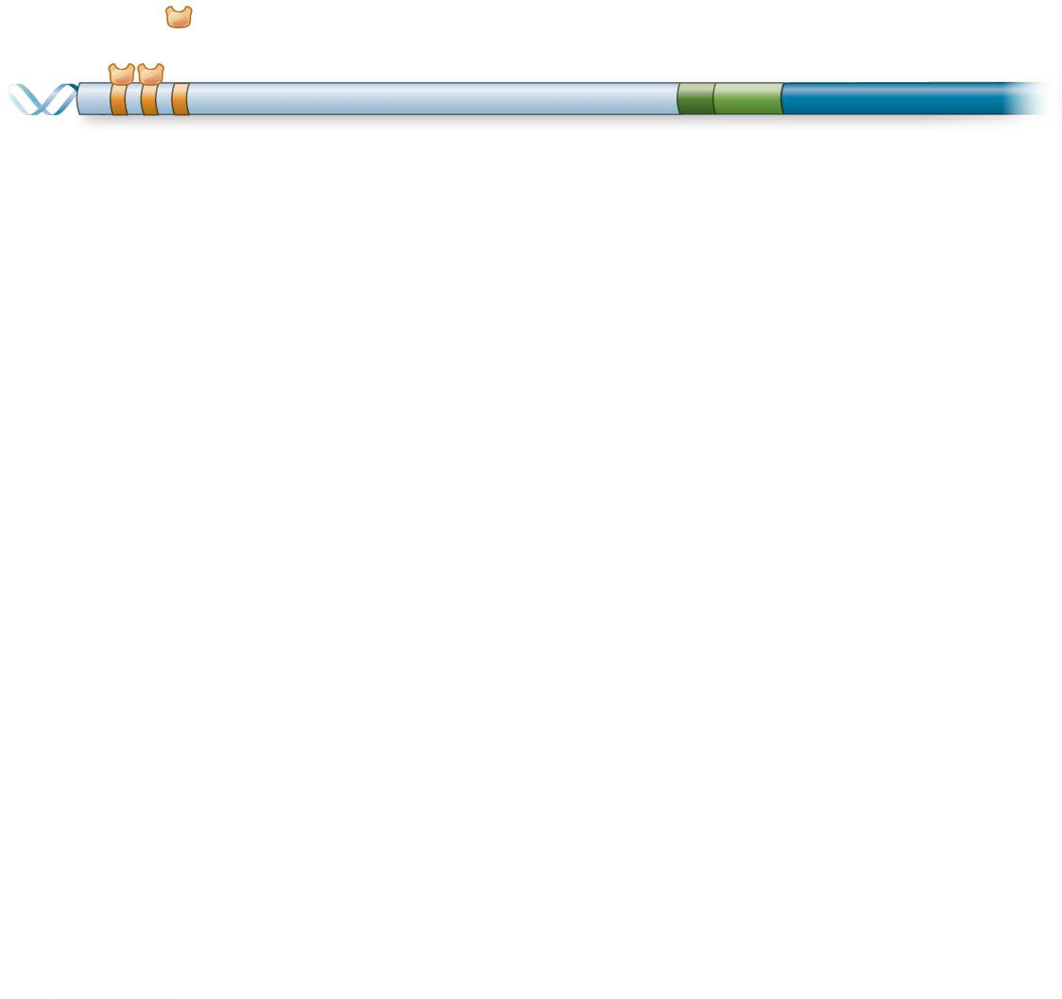
Figure 15.10-s1
Activators
Promoter
Gene
Enhancer
Distal control
element
TATA box
Notes:
Figure 15.10-s1 A model for the action of enhancers and transcription activators (step 1)

Slide 54
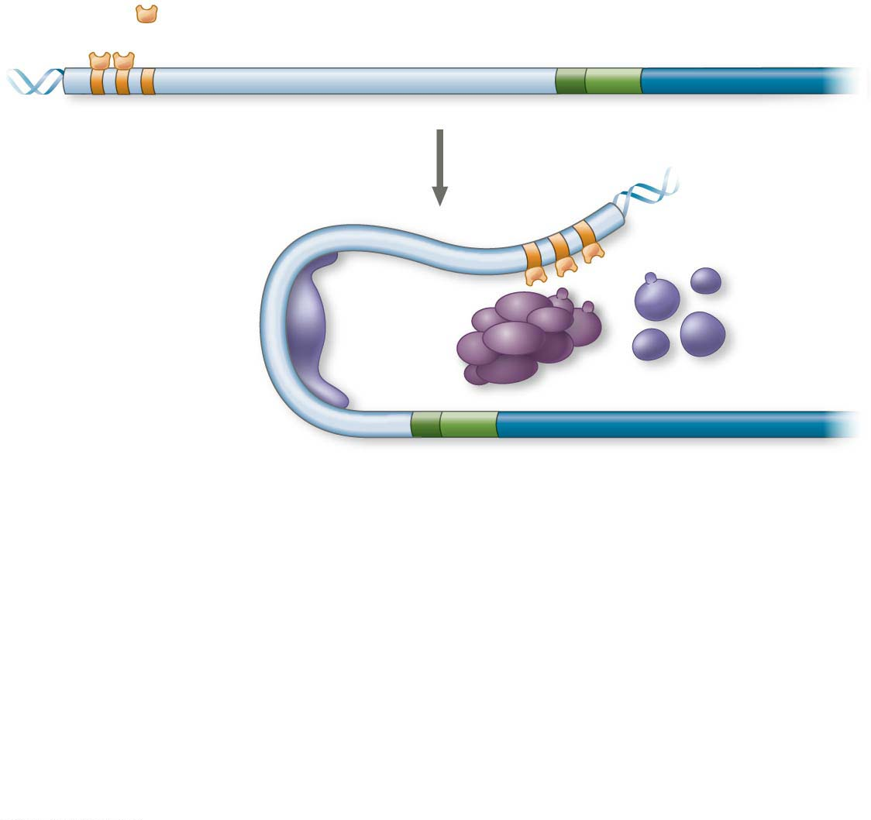
Figure 15.10-s2
Activators
Promoter
Gene
Enhancer
Distal control
element
TATA box
General
trans-
cription
factors
DNA-bending
protein
Group of
mediator
proteins
Notes:
Figure 15.10-s2 A model for the action of enhancers and transcription activators (step 2)

Slide 55
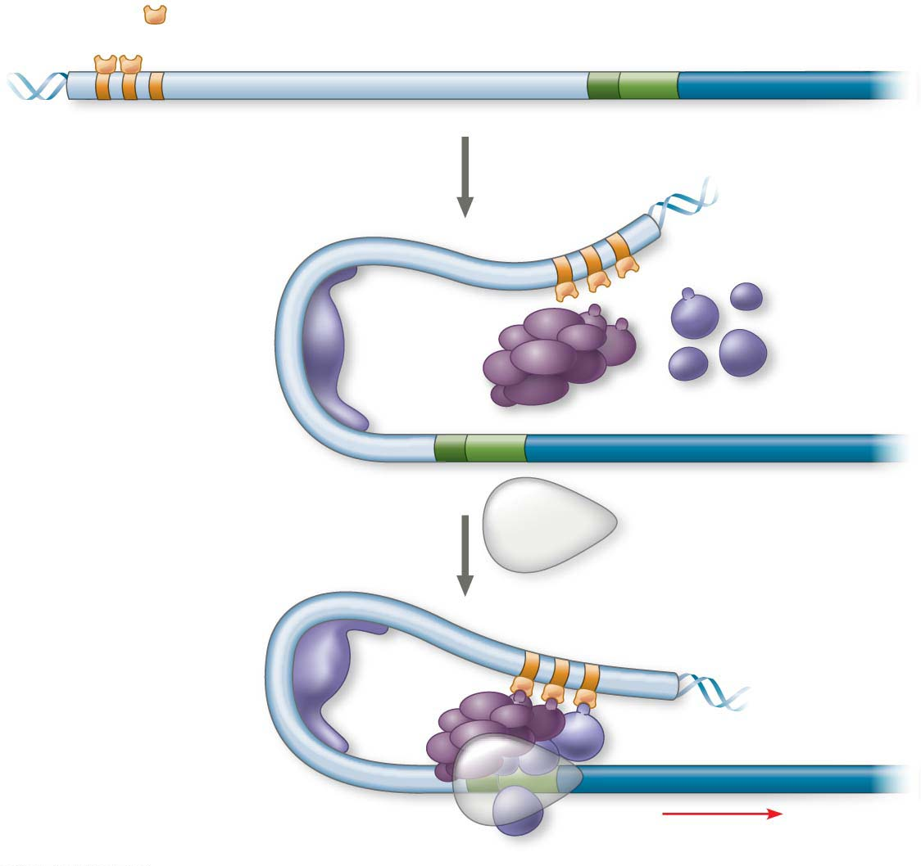
Figure 15.10-s3
Activators
Promoter
Gene
Enhancer
Distal control
element
TATA box
General
trans-
cription
factors
DNA-bending
protein
Group of
mediator
proteins
RNA
polymerase II
Transcription
initiation
complex
RNA synthesis
Notes:
Figure 15.10-s3 A model for the action of enhancers and transcription activators (step 3)

Slide 56
Some transcription factors function as repressors, inhibiting expression of a particular gene by a variety of methods
Some activators and repressors act indirectly by influencing chromatin structure to promote or silence transcription
Notes:
56

Slide 57
Combinatorial Control of Gene Activation
A particular combination of control elements can activate transcription only when the appropriate activator proteins are present
Notes:
57

Slide 58
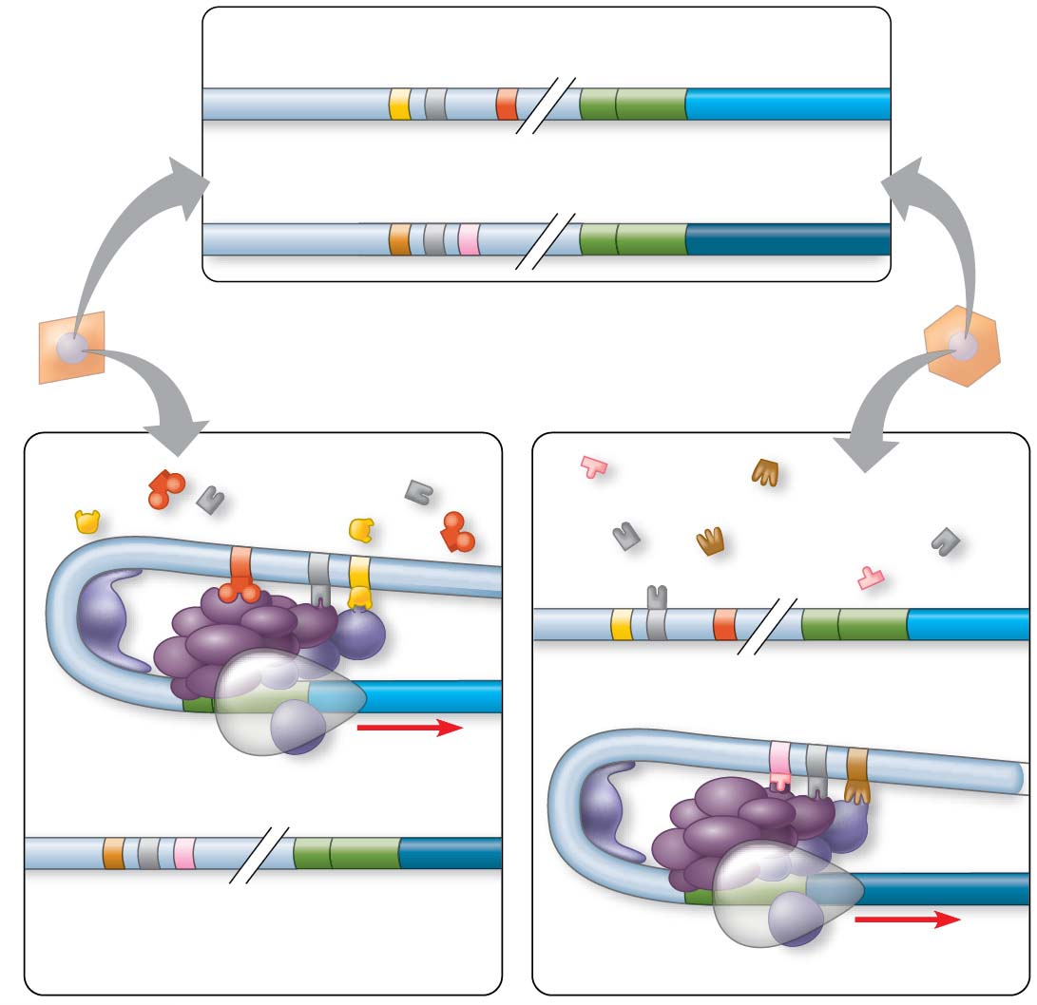
Figure 15.11
DNA in both
cells
(activators
not shown)
Enhancer for
albumin gene
Albumin
gene
Promoter
Control
elements
Enhancer for
crystallin gene
Crystallin
gene
Promoter
DNA in liver cell,
showing available
activators
DNA in lens cell,
showing available
activators
Liver cell
Lens cell
Available
activators
Available
activators
Albumin gene
not expressed
Albumin gene
expressed
Crystallin gene not expressed
LENS CELL
NUCLEUS
Crystallin gene
expressed
LIVER CELL NUCLEUS
Notes:
Figure 15.11 Cell type–specific transcription

Slide 59
Figure 15.11-1
DNA in both
cells
(activators
not shown)
Enhancer for
albumin gene
Albumin
gene
Promoter
Control
elements
Enhancer for
crystallin gene
Crystallin
gene
Promoter
Notes:
Figure 15.11-1 Cell type–specific transcription (part 1: control elements)

Slide 60
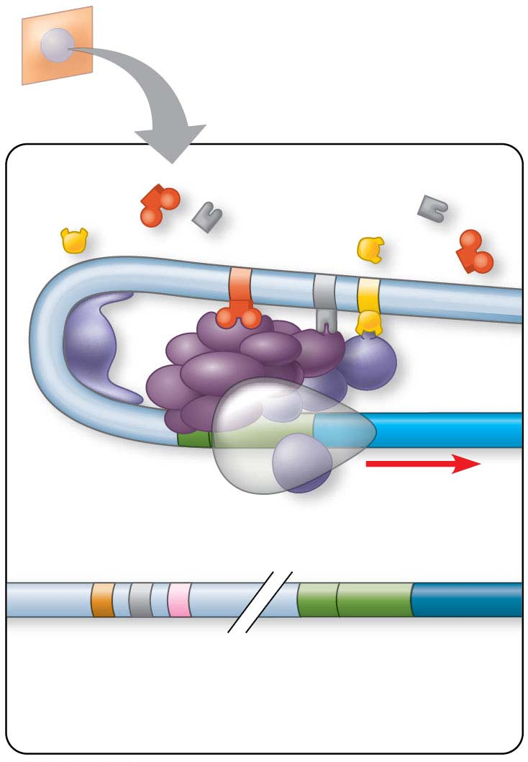
Figure 15.11-2
DNA in liver cell,
showing available
activators
Liver cell
Available
activators
Albumin gene
expressed
Crystallin gene not expressed
LIVER CELL NUCLEUS
Notes:
Figure 15.11-2 Cell type–specific transcription (part 2: liver cell)

Slide 61
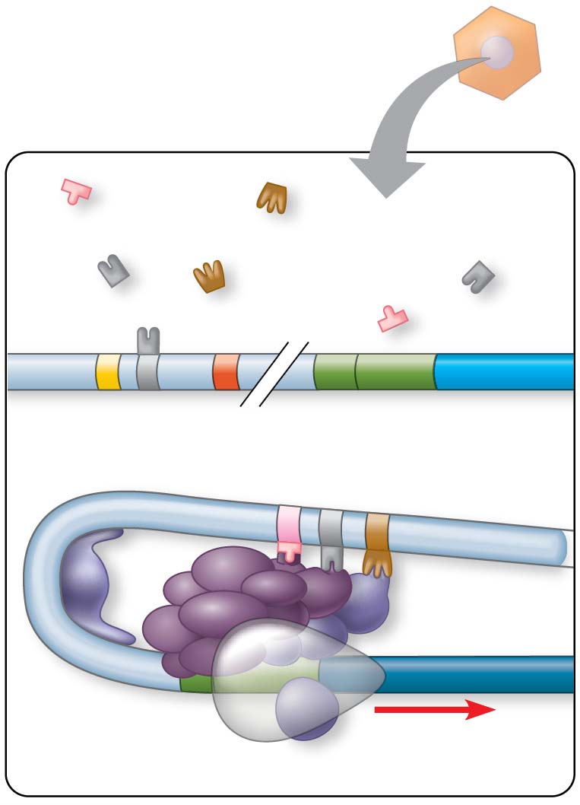
Figure 15.11-3
DNA in lens cell,
showing available
activators
Lens cell
Available
activators
Albumin gene
not expressed
LENS CELL
NUCLEUS
Crystallin gene
expressed
Notes:
Figure 15.11-3 Cell type–specific transcription (part 3: lens cell)

Slide 62
Coordinately Controlled Genes in Eukaryotes
Eukaryotic genes that are co-expressed are, for the most part, not organized into operons
These genes can be scattered over different chromosomes, but each has the same combination of control elements
Copies of the activators recognize specific control elements and promote simultaneous transcription of the genes
Notes:
62

Slide 63
Mechanisms of Post-Transcriptional Regulation
Transcription alone does not account for gene expression
Regulatory mechanisms can operate at various stages after transcription
Such mechanisms allow a cell to fine-tune gene expression rapidly in response to environmental changes
Notes:
63

Slide 64
RNA Processing
In alternative RNA splicing, different mRNA molecules are produced from the same primary transcript, depending on which RNA segments are treated as exons and which as introns
Alternative splicing can significantly expand the repertoire of a eukaryotic genome
Notes:
64

Slide 65
Animation: RNA Processing

Slide 66
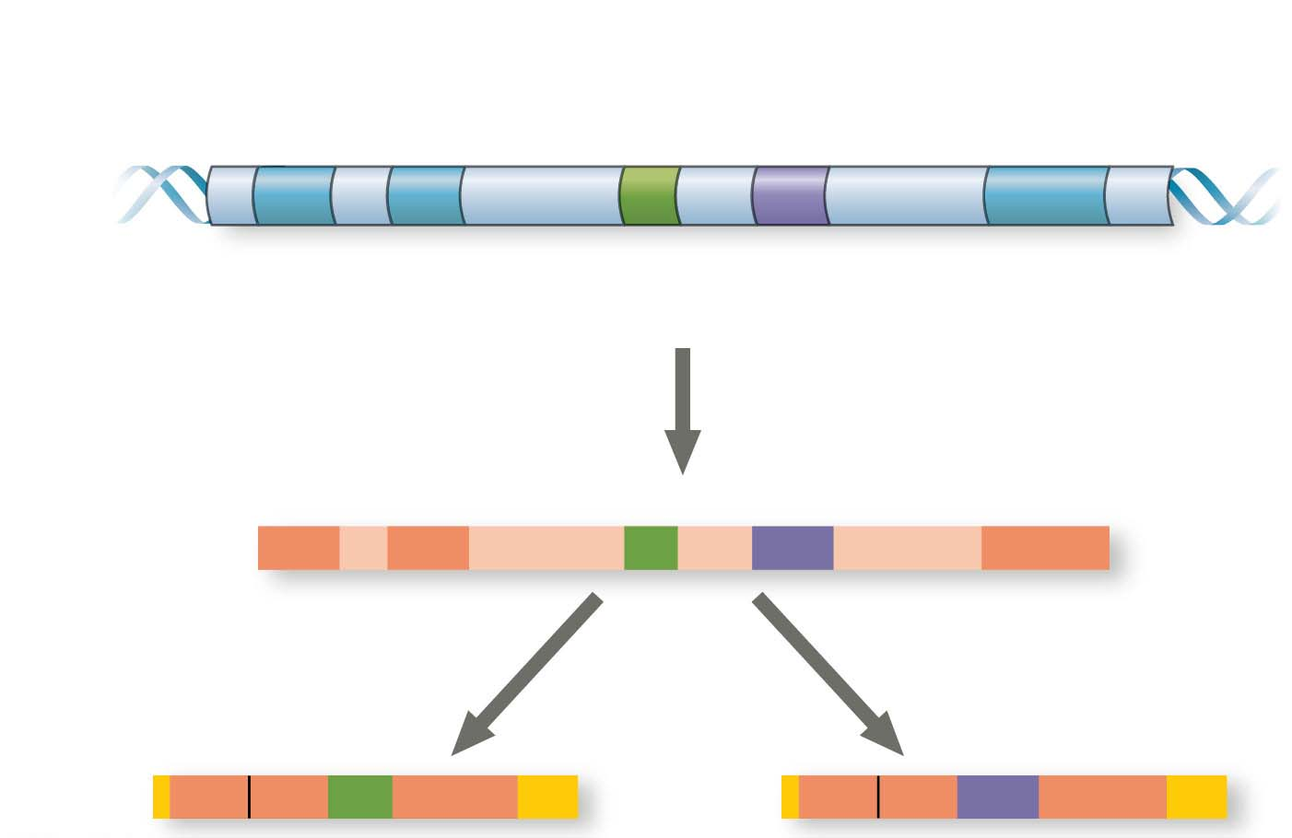
Figure 15.12
Exons
DNA
1
2
3
4
5
Troponin T gene
Primary
RNA
transcript
1
2
3
4
5
RNA splicing
mRNA
1
2
3
5
OR
1
2
4
5
Notes:
Figure 15.12 Alternative RNA splicing of the troponin T gene

Slide 67
Initiation of Translation and mRNA Degradation
The initiation of translation of selected mRNAs can be blocked by regulatory proteins that bind to sequences or structures of the mRNA
Alternatively, translation of all mRNAs in a cell may be regulated simultaneously
For example, translation initiation factors are simultaneously activated in an egg following fertilization
Notes:
67

Slide 68
The life span of mRNA molecules in the cytoplasm is important in determining the pattern of protein synthesis in a cell
Eukaryotic mRNA generally survives longer than prokaryotic mRNA
Nucleotide sequences that influence the life span of mRNA in eukaryotes reside in the untranslated region (UTR) at the 3′ end of the molecule
Notes:
68

Slide 69
Protein Processing and Degradation
After translation, various types of protein processing, including cleavage and chemical modification, are subject to control
The length of time each protein functions in a cell is regulated by means of selective degradation
To mark a particular protein for destruction, the cell commonly attaches molecules of ubiquitin to the protein, which triggers its destruction
Notes:
69

Slide 70
Concept 15.3: Noncoding RNAs play multiple roles in controlling gene expression
Only a small fraction of DNA encodes proteins, and a very small fraction of the non-protein-coding DNA consists of genes for RNAs such as rRNA and tRNA
A significant amount of the genome may be transcribed into noncoding RNAs (ncRNAs)
A large and diverse population of RNA molecules in the cell play crucial roles in regulating gene expression
Notes:
70

Slide 71
Effects on mRNAs by MicroRNAs and Small Interfering RNAs
MicroRNAs (miRNAs) are small, single-stranded RNA molecules that can bind to complementary mRNA sequences
These can degrade the mRNA or block its translation
Notes:
71

Slide 72
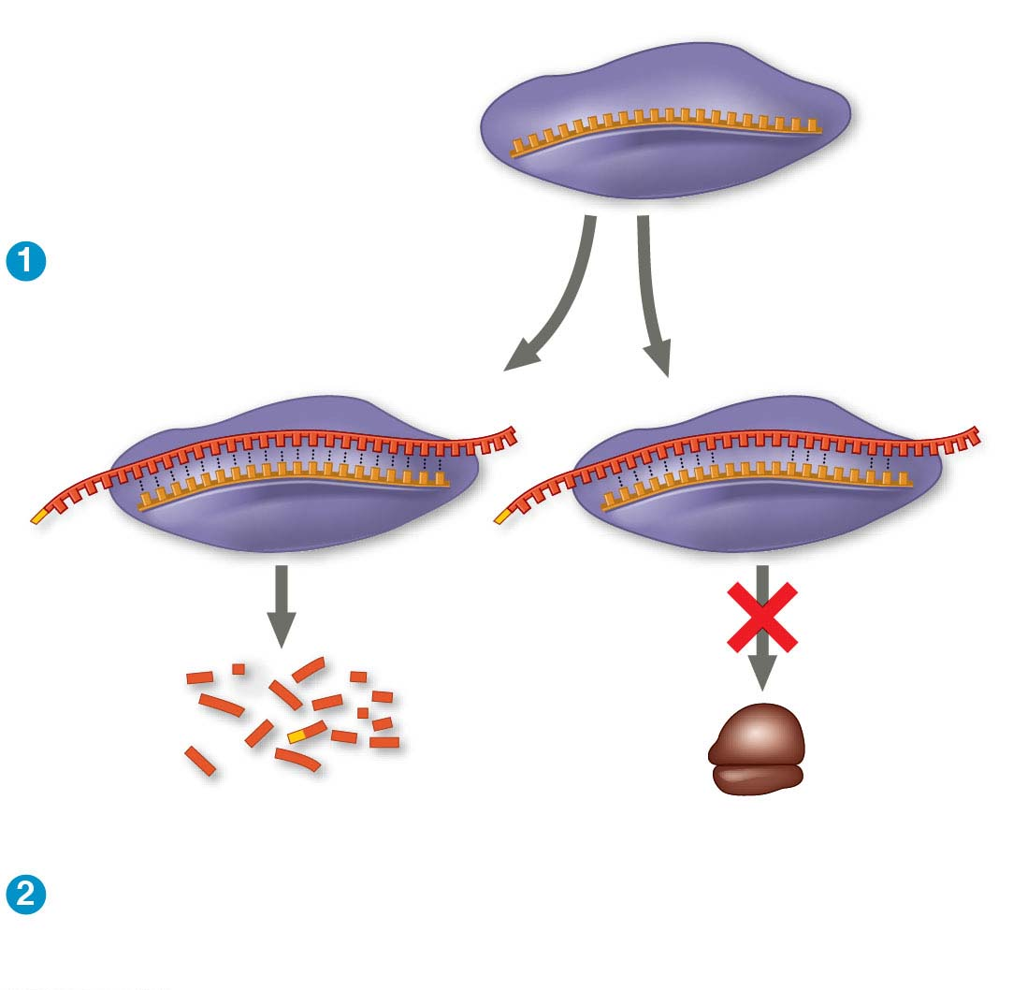
Figure 15.13
miRNA
miRNA-
protein
complex
The miRNA binds to
a target mRNA.
OR
mRNA degraded
Translation blocked
If bases are completely complementary, mRNA is
degraded. If match is less complete, translation
is blocked.
Notes:
Figure 15.13 Regulation of gene expression by microRNAs (miRNAs)

Slide 73
Another class of small RNAs are called small interfering RNAs (siRNAs)
siRNAs and miRNAs are similar but form from different RNA precursors
The phenomenon of inhibition of gene expression by siRNAs is called RNA interference (RNAi)
Notes:
73

Slide 74
Chromatin Remodeling and Effects on Transcription by ncRNAs
In some yeasts, siRNAs are required for the formation of heterochromatin at the centromeres of chromosomes
The siRNA system interacts with other noncoding RNAs and with chromatin-modifying enzymes
This leads to condensation of centromere chromatin into heterochromatin
Notes:
74

Slide 75
A class of small ncRNAs called piwi-associated RNAs (piRNAs) also induces formation of heterochromatin
They block expression of transposons, parasitic DNA elements in the genome
The role of ncRNAs adds to the complexity of the processes involved in regulation of gene expression
Notes:
75

Slide 76
Concept 15.4: Researchers Can Monitor Expression of Specific Genes
Cells of a given multicellular organism differ from each other because they express different genes from an identical genome
The most straightforward way to discover which genes are expressed by cells of interest is to identify the mRNAs being made
Notes:
76

Slide 77
Studying the Expression of Single Genes
We can detect mRNA in a cell using nucleic acid hybridization, the base pairing of a strand of nucleic acid to its complementary sequence
The complementary molecule in this case is a short, single-stranded DNA or RNA called a nucleic acid probe
Each probe is labeled with a fluorescent tag to allow visualization
Notes:
77

Slide 78
The technique allows us to see the mRNA in place (in situ) in the intact organism and is thus called in situ hybridization
Notes:
78

Slide 79
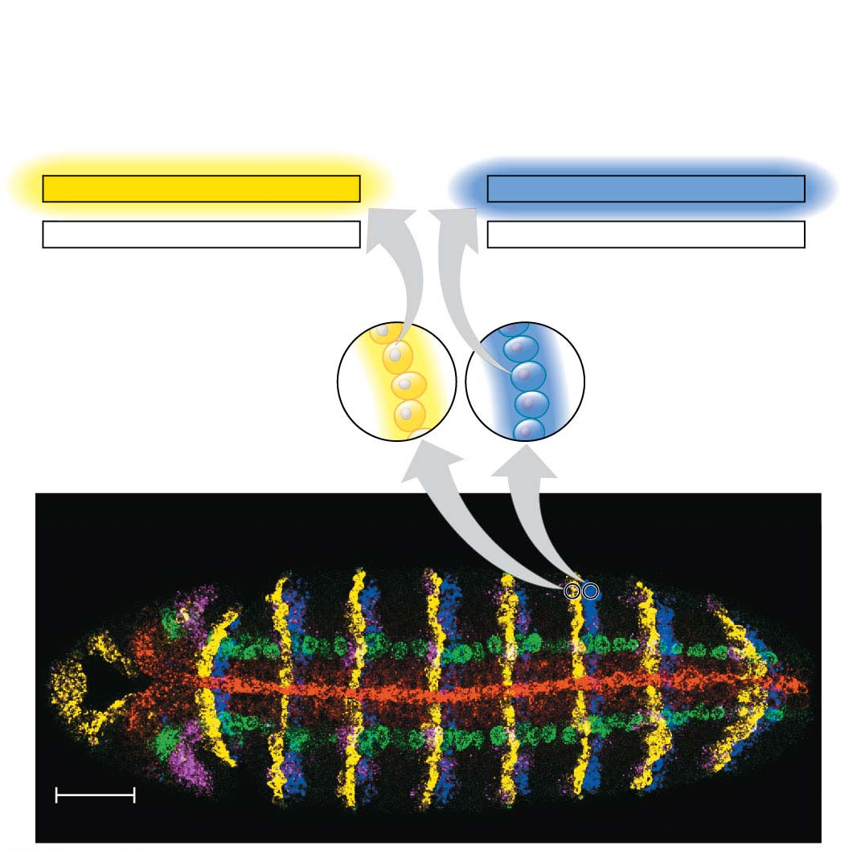
Figure 15.14
Yellow probe hybridizes
with mRNAs in cells
expressing wingless
(wg) gene
Blue probe hybridizes
with mRNAs in cells
expressing engrailed
(en) gene
3′
5′
3′
5′
TAACGGTTCCAGC
CTCAAGTTGCTCT
AUUGCCAAGGUCG
GAGUUCAACGAGA
5′
3′
5′
3′
wg mRNA
en mRNA
Cells expressing
the wg gene
Cells expressing
the en gene
Head
Thorax
Abdomen
50 μm
Notes:
Figure 15.14 Determining where genes are expressed by in situ hybridization analysis

Slide 80
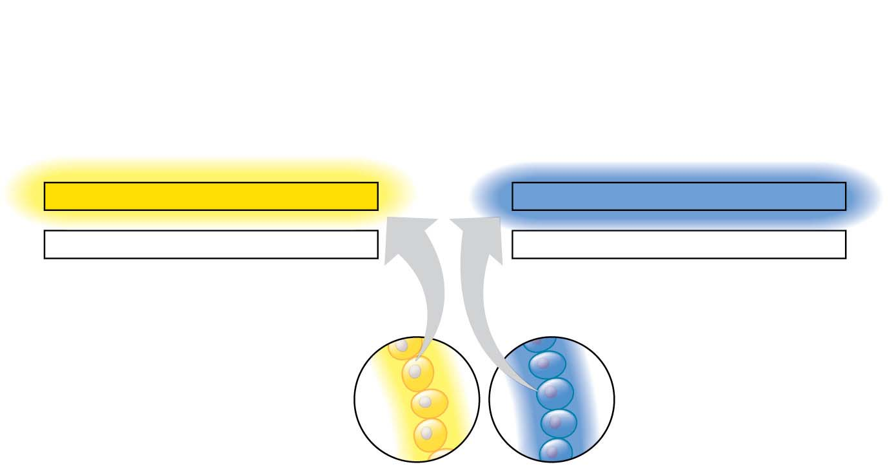
Figure 15.14-1
Yellow probe hybridizes
with mRNAs in cells
expressing wingless
(wg) gene
Blue probe hybridizes
with mRNAs in cells
expressing engrailed
(en) gene
3′
5′
3′
5′
UAACGGUUCCAGC
CUCAAGUUGCUCU
AUUGCCAAGGUCG
GAGUUCAACGAGA
5′
3′
5′
3′
wg mRNA
en mRNA
Cells expressing
the wg gene
Cells expressing
the en gene
Notes:
Figure 15.14-1 Determining where genes are expressed by in situ hybridization analysis (part 1: art)

Slide 81
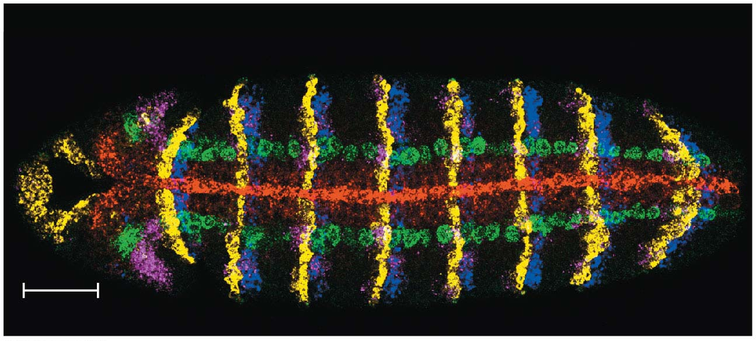
Figure 15.14-2
Head
Thorax
Abdomen
50 μm
Notes:
Figure 15.14-2 Determining where genes are expressed by in situ hybridization analysis (part 2: micrograph)

Slide 82
Another widely used method for comparing the amounts of specific mRNAs in several different samples is reverse transcriptase–polymerase chain reaction (RT-PCR)
RT-PCR turns sample sets of mRNAs into double- stranded DNAs with the corresponding sequences
Notes:
82

Slide 83
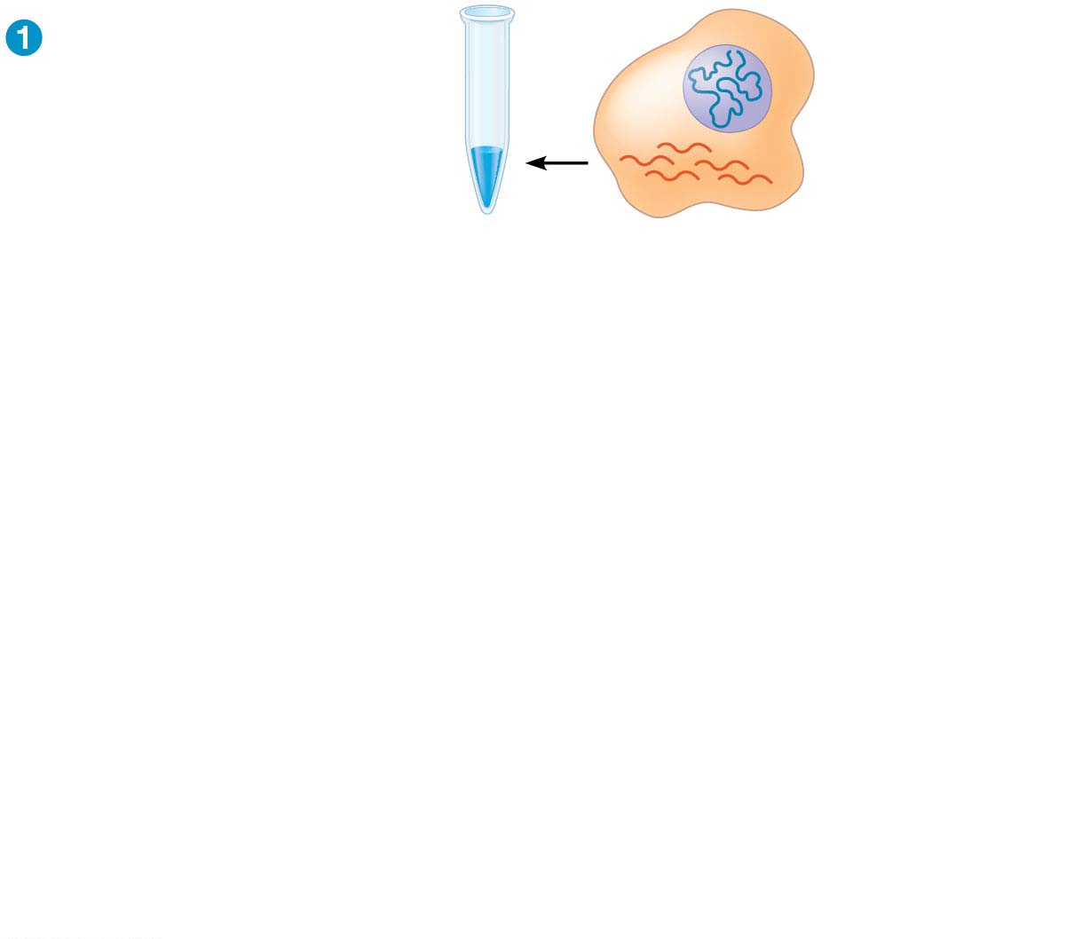
Figure 15.15-s1
Test tube containing
reverse transcriptase
and mRNA
DNA in nucleus
mRNAs in
cytoplasm
Notes:
Figure 15.15-s1 Making complementary DNA (cDNA) from eukaryotic genes (step 1)

Slide 84
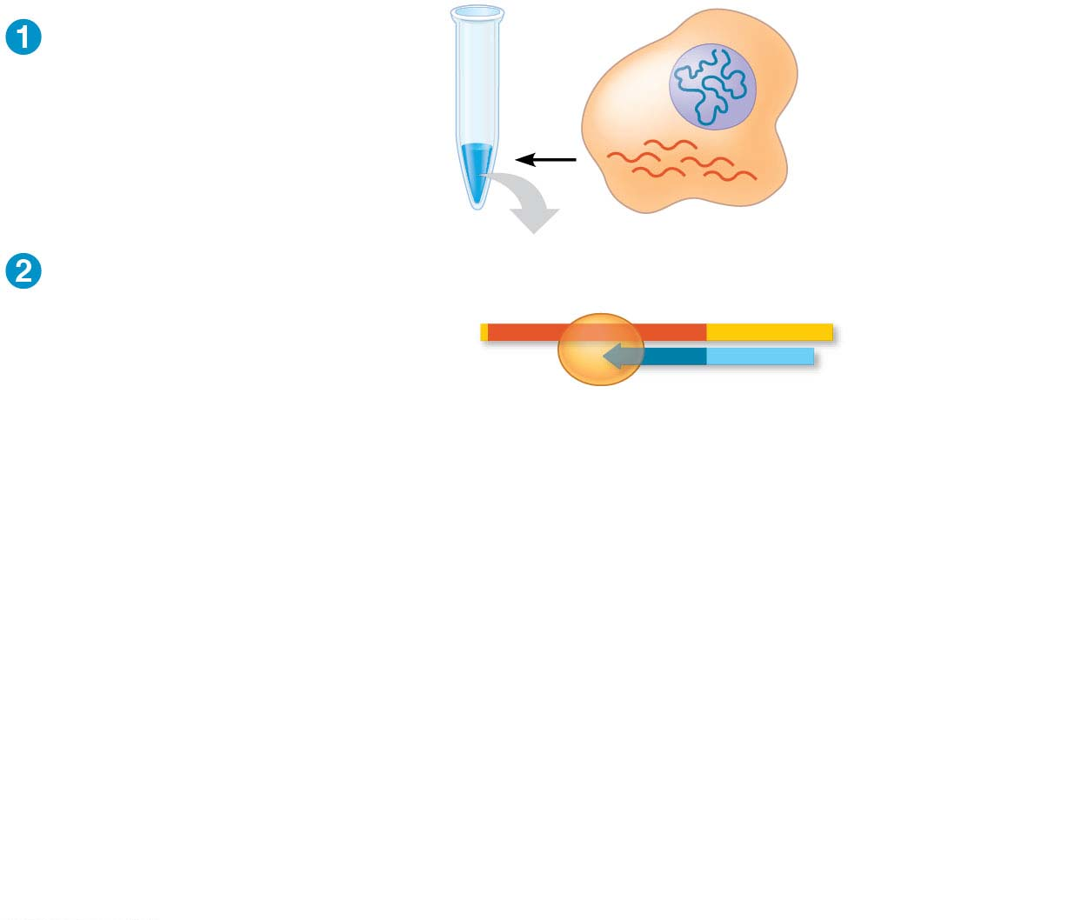
Figure 15.15-s2
Test tube containing
reverse transcriptase
and mRNA
DNA in nucleus
mRNAs in
cytoplasm
Reverse
transcriptase
Reverse transcriptase
makes the first
DNA strand.
Poly-A tail
mRNA
5′
A A A A A A
3′
3′
T T T T T
5′
DNA
strand
Primer
(poly-dT)
Notes:
Figure 15.15-s2 Making complementary DNA (cDNA) from eukaryotic genes (step 2)

Slide 85
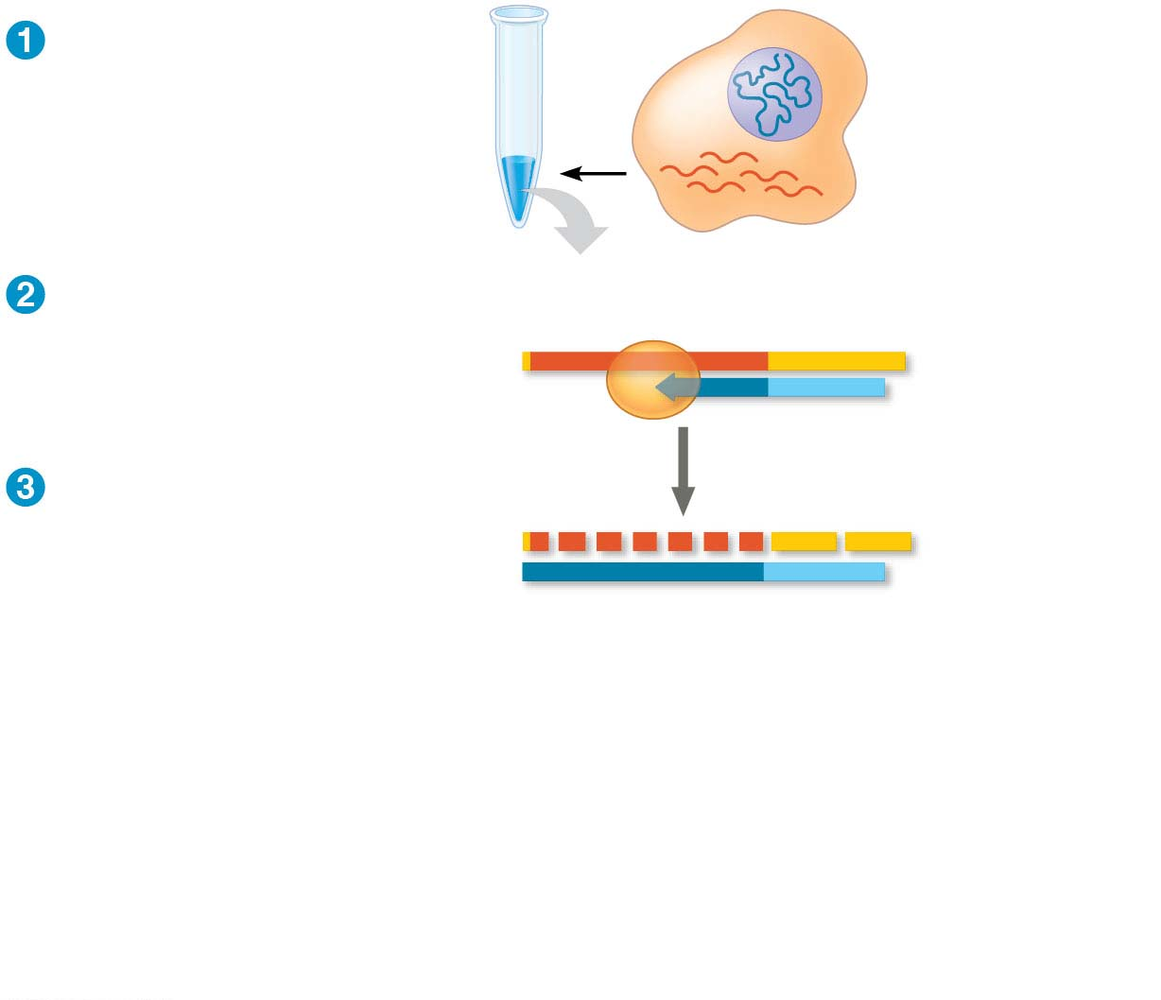
Figure 15.15-s3
Test tube containing
reverse transcriptase
and mRNA
DNA in nucleus
mRNAs in
cytoplasm
Reverse
transcriptase
Reverse transcriptase
makes the first
DNA strand.
Poly-A tail
mRNA
5′
A A A A A A
3′
3′
T T T T T
5′
DNA
strand
Primer
(poly-dT)
mRNA is degraded.
5′
A A A A A A
3′
3′
T T T T T
5′
Notes:
Figure 15.15-s3 Making complementary DNA (cDNA) from eukaryotic genes (step 3)

Slide 86
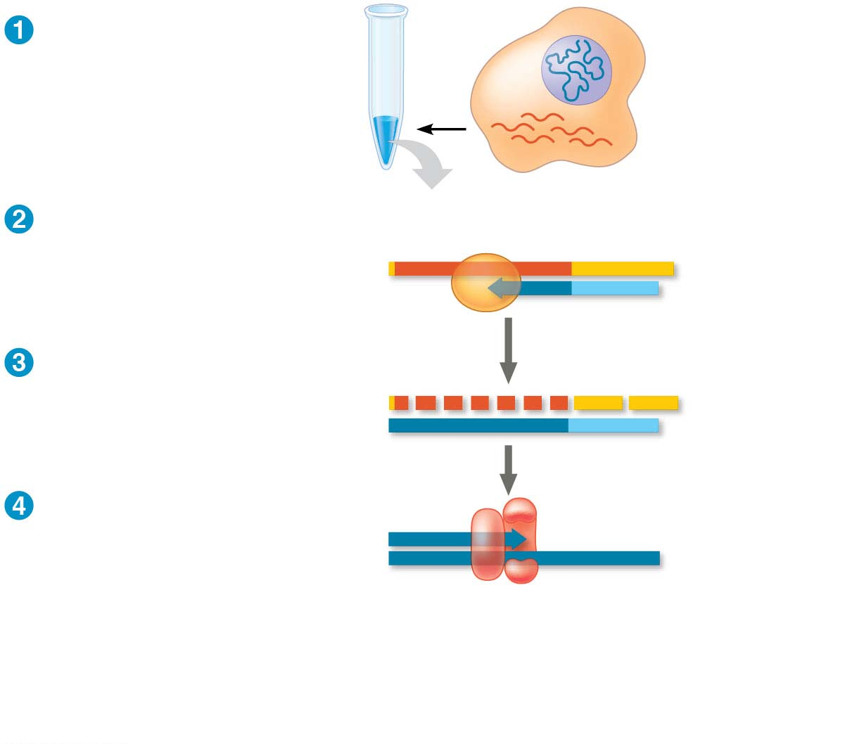
Figure 15.15-s4
Test tube containing
reverse transcriptase
and mRNA
DNA in nucleus
mRNAs in
cytoplasm
Reverse
transcriptase
Reverse transcriptase
makes the first
DNA strand.
Poly-A tail
mRNA
5′
A A A A A A
3′
3′
T T T T T
5′
DNA
strand
Primer
(poly-dT)
mRNA is degraded.
5′
A A A A A A
3′
3′
T T T T T
5′
DNA polymerase
synthesizes the
second strand.
5′
3′
3′
5′
DNA
polymerase
Notes:
Figure 15.15-s4 Making complementary DNA (cDNA) from eukaryotic genes (step 4)

Slide 87
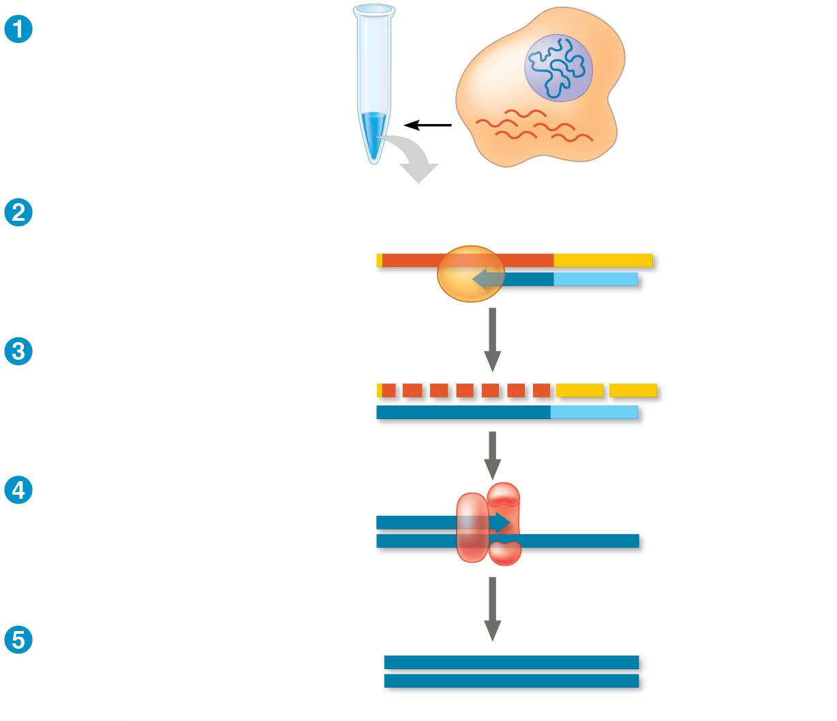
Figure 15.15-s5
Test tube containing
reverse transcriptase
and mRNA
DNA in nucleus
mRNAs in
cytoplasm
Reverse
transcriptase
Reverse transcriptase
makes the first
DNA strand.
Poly-A tail
mRNA
5′
A A A A A A
3′
3′
T T T T T
5′
DNA
strand
Primer
(poly-dT)
mRNA is degraded.
5′
A A A A A A
3′
3′
T T T T T
5′
DNA polymerase
synthesizes the
second strand.
5′
3′
3′
5′
DNA
polymerase
cDNA carries complete
coding sequence
without introns.
5′
3′
3′
5′
cDNA
Notes:
Figure 15.15-s5 Making complementary DNA (cDNA) from eukaryotic genes (step 5)

Slide 88
RT-PCR relies on the activity of reverse transcriptase, which can synthesize a DNA copy of an mRNA, called a complementary DNA (cDNA)
Once the cDNA is produced, PCR is used to make many copies of the sequence of interest, using primers specific to that sequence
Notes:
88

Slide 89
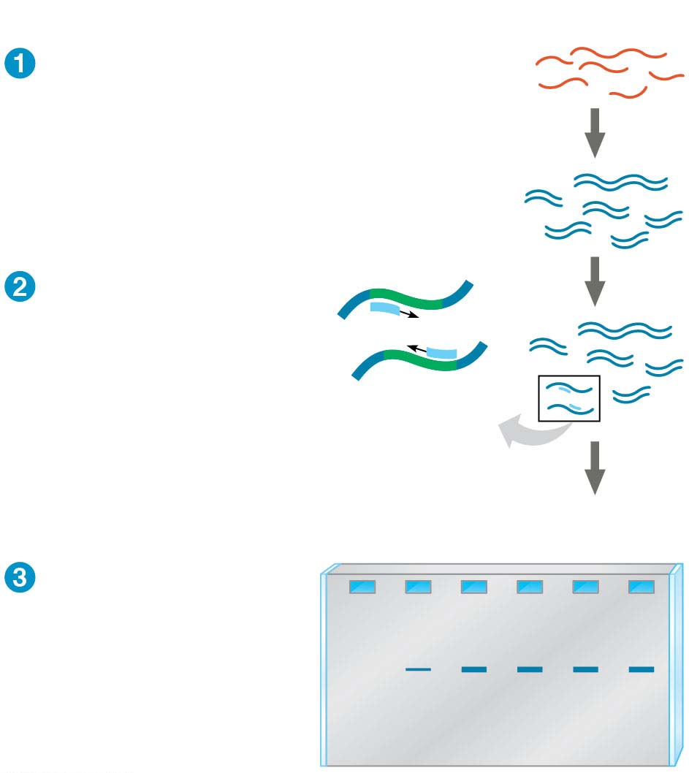
Figure 15.16
Technique
cDNA synthesis
mRNAs
cDNAs
Primers
PCR amplification
Specific
gene
Results
Embryonic stages
1
2
3
4
5
6
Gel electrophoresis
Notes:
Figure 15.16 Research method: RT-PCR analysis of the expression of single genes

Slide 90
Studying the Expression of Groups of Genes
A major goal of biologists is to learn how genes act together to produce and maintain a functioning organism
Large groups of genes are studied by a systems approach
The aim is to identify networks of gene expression across an entire genome
Notes:
90

Slide 91
Genome-wide expression studies can be carried out using DNA microarray assays
A microarray—also called a DNA chip—contains tiny amounts of many single-stranded DNA fragments affixed to the slide in a grid
mRNAs from cells of interest are isolated and made into cDNAs labeled with fluorescent molecules
Notes:
91

Slide 92
Usually, cDNAs from two different samples are labeled with different fluorescent tags and tested on the same microarray
The experiment can identify subsets of genes that are being expressed differently in one sample compared to another
Notes:
92

Slide 93
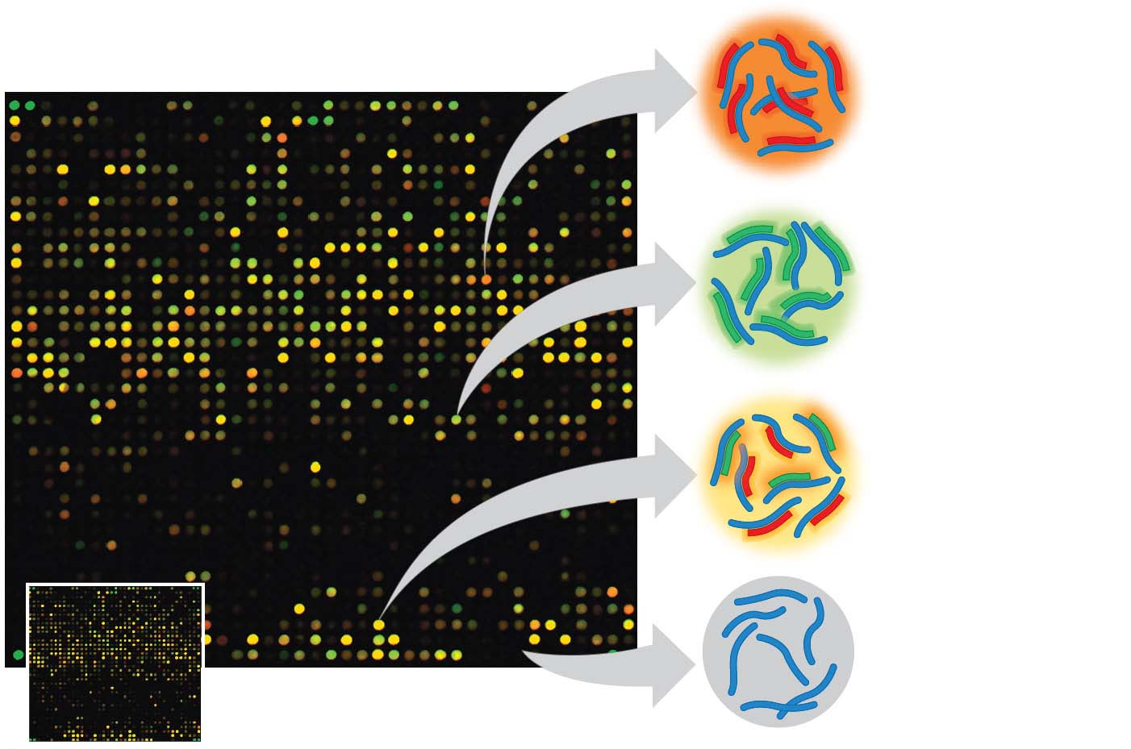
Figure 15.17
Genes in red
wells expressed
in first tissue.
Genes in green
wells expressed
in second tissue.
Genes in yellow
wells expressed
in both tissues.
Genes in black
wells not
expressed in
either tissue.
DNA microarray
Notes:
Figure 15.17 DNA microarray assay of gene expression levels

Slide 94
An alternative to microarray analysis is simply to sequence cDNA samples from different tissues or stages to discover which genes are expressed
This is called RNA sequencing, or RNA-seq
This method is becoming more widespread as the cost of sequencing decreases
Notes:
94

Slide 95
Studies of genes that are expressed together in some tissues but not others may contribute to a better understanding of diseases and suggest new diagnostic tests or therapies
Notes:
95

Slide 96
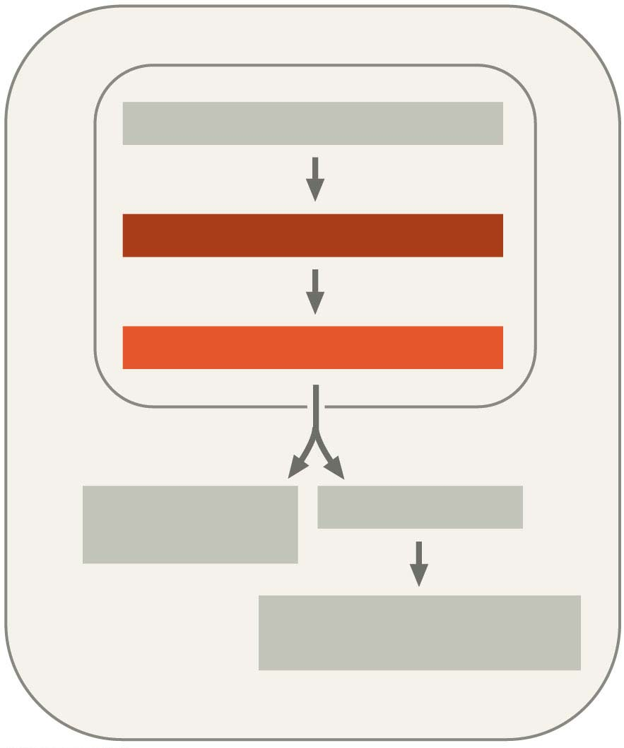
Figure 15.UN01
CHROMATIN MODIFICATION
TRANSCRIPTION
RNA PROCESSING
mRNA
DEGRADATION
TRANSLATION
PROTEIN PROCESSING
AND DEGRADATION
Notes:
Figure 15.UN01 In-text figure, regulation at the levels of transcription and RNA processing, p. 310

Slide 97
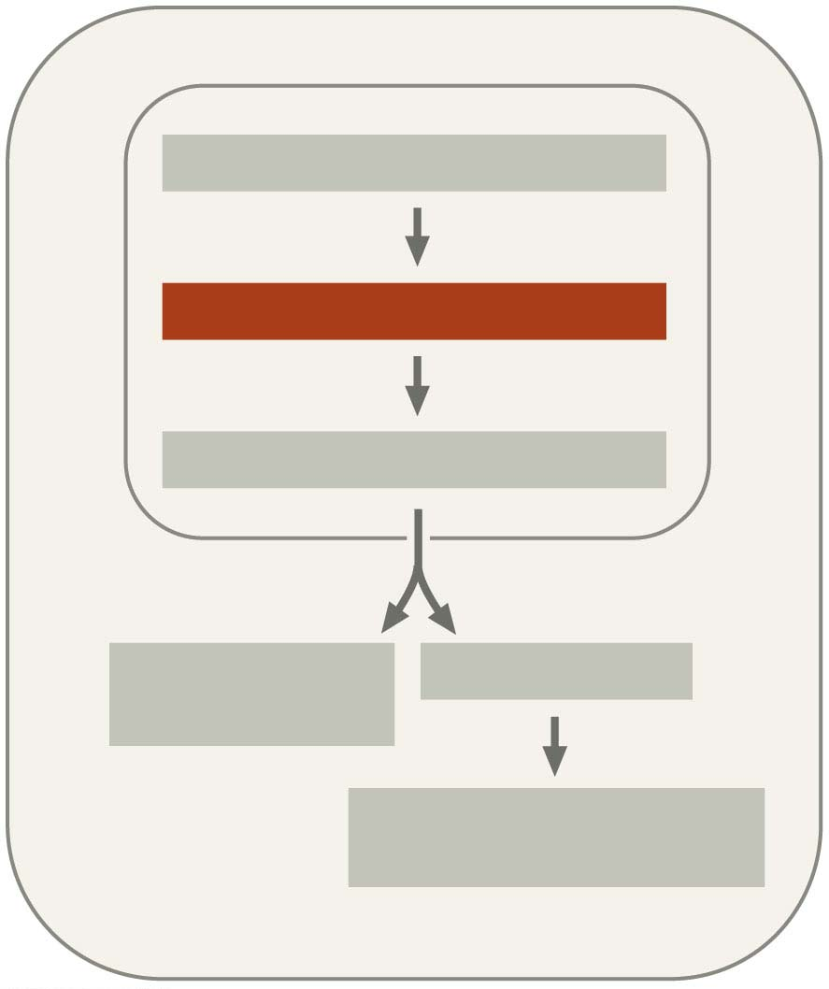
Figure 15.UN02
CHROMATIN MODIFICATION
TRANSCRIPTION
RNA PROCESSING
mRNA
DEGRADATION
TRANSLATION
PROTEIN PROCESSING
AND DEGRADATION
Notes:
Figure 15.UN02 In-text figure, regulation at the level of transcription, p. 311

Slide 98
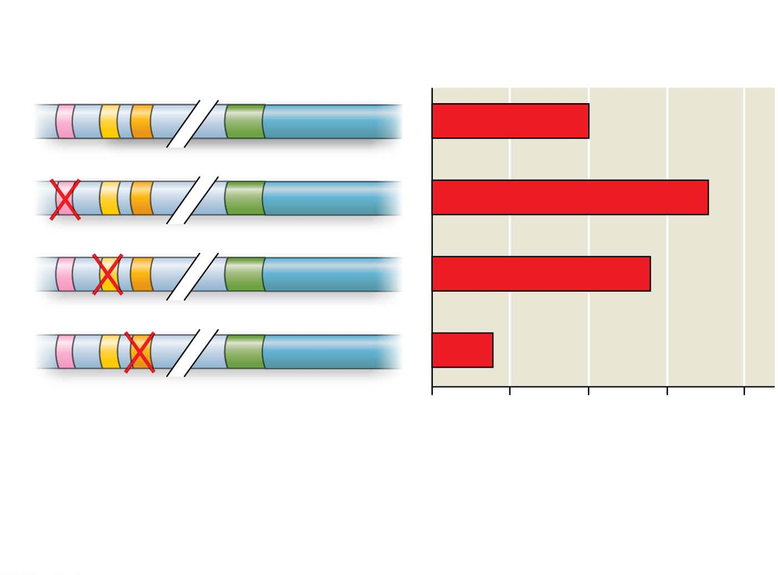
Figure 15.UN03-1
Enhancer with possible
control elements
Reporter
gene
Promoter
1
2
3
0
50
100
150
200
Relative level of reporter
mRNA (% of control)
Data from J. N. Walters et al., Regulation of human microsomal prostaglandin
E synthase-1 by IL-1β requires a distal enhancer element with a unique role for
C/EBPβ, Biochemical Journal 443:561–571 (2012).
Notes:
Figure 15.UN03-1 Skills exercise: analyzing DNA deletion experiments (part 1)

Slide 99
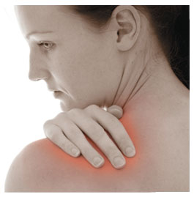
Figure 15.UN03-2
Notes:
Figure 15.UN03-2 Skills exercise: analyzing DNA deletion experiments (part 2)

Slide 100
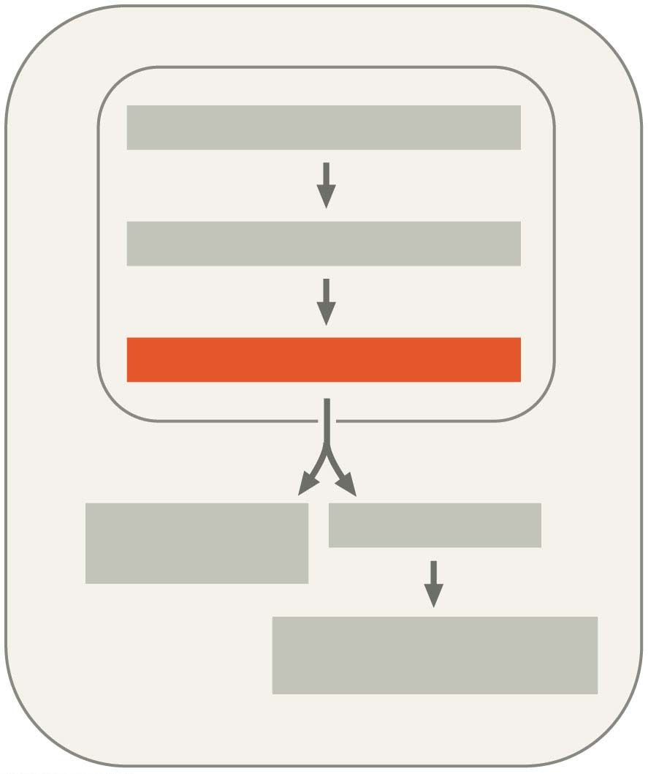
Figure 15.UN04
CHROMATIN MODIFICATION
TRANSCRIPTION
RNA PROCESSING
mRNA
DEGRADATION
TRANSLATION
PROTEIN PROCESSING
AND DEGRADATION
Notes:
Figure 15.UN04 In-text figure, regulation at the level of RNA processing, p. 314

Slide 101
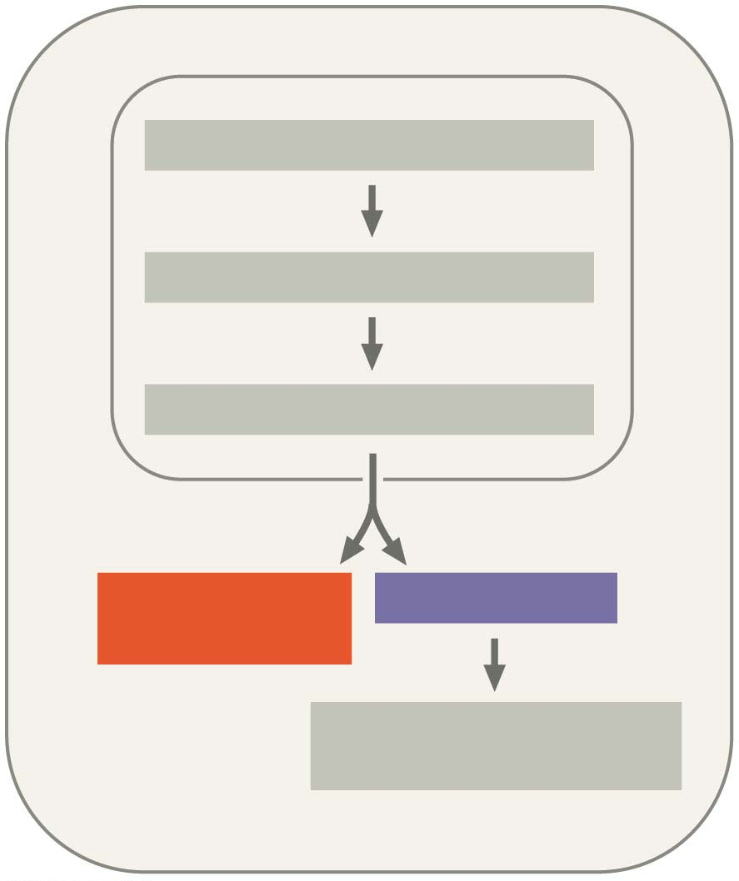
Figure 15.UN05
CHROMATIN MODIFICATION
TRANSCRIPTION
RNA PROCESSING
mRNA
DEGRADATION
TRANSLATION
PROTEIN PROCESSING
AND DEGRADATION
Notes:
Figure 15.UN05 In-text figure, regulation at the level of translation, p. 315

Slide 102
Figure 15.UN06
5′
… CUCAUCACCGGC …
3′
3′
GAGTAGTGGCCG
5′
Notes:
Figure 15.UN06 In-text figure, synthesis of a DNA probe, p. 317

Slide 103
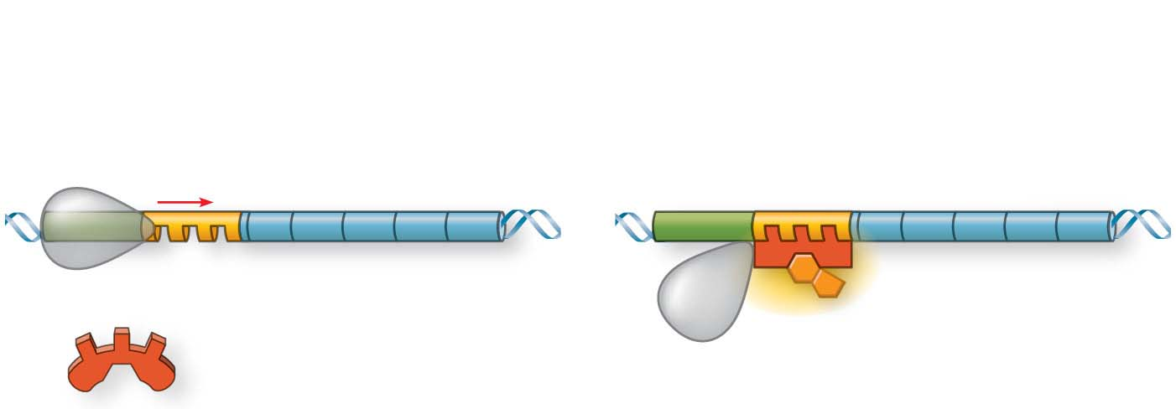
Figure 15.UN07
Repressible operon:
Genes expressed
Genes not expressed
Promoter
Genes
Operator
Active repressor:
corepressor bound
Inactive repressor:
no corepressor present
Corepressor
Notes:
Figure 15.UN07 Summary of key concepts: transcription regulation

Slide 104
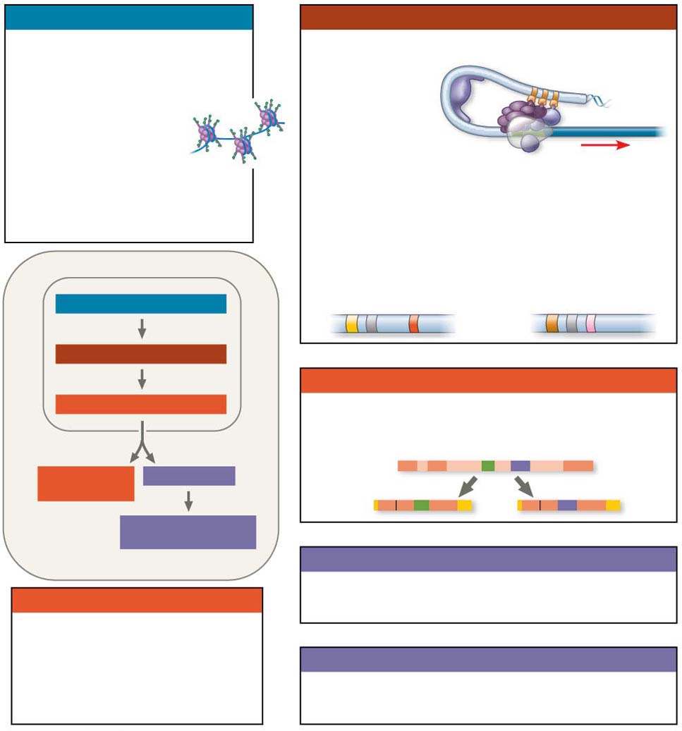
Figure 15.UN08
Chromatin modification
Transcription
• Genes in highly compacted
chromatin are generally not
transcribed.
• Regulation of transcription initiation:
DNA control
elements in
enhancers bind
specific tran-
scription factors.
• Histone acetylation
seems to loosen
chromatin structure,
enhancing transcription.
Bending of the DNA enables activators
to contact proteins at the promoter,
initiating transcription.
• DNA methylation generally
reduces transcription.
• Coordinate regulation:
Enhancer for
liver-specific genes
Enhancer for
lens-specific genes
CHROMATIN MODIFICATION
TRANSCRIPTION
RNA processing
RNA PROCESSING
• Alternative RNA splicing:
Primary RNA
transcript
mRNA
DEGRADATION
TRANSLATION
mRNA
OR
PROTEIN PROCESSING
AND DEGRADATION
Translation
mRNA degradation
• Initiation of translation can be controlled
via regulation of initiation factors.
• Each mRNA has a
characteristic life span,
determined in part by
sequences in the 5′ and 3′
UTRs.
Protein processing and degradation
• Protein processing and degradation are
subject to regulation.
Notes:
Figure 15.UN08 Summary of key concepts: eukaryotic regulation of gene expression

Slide 105
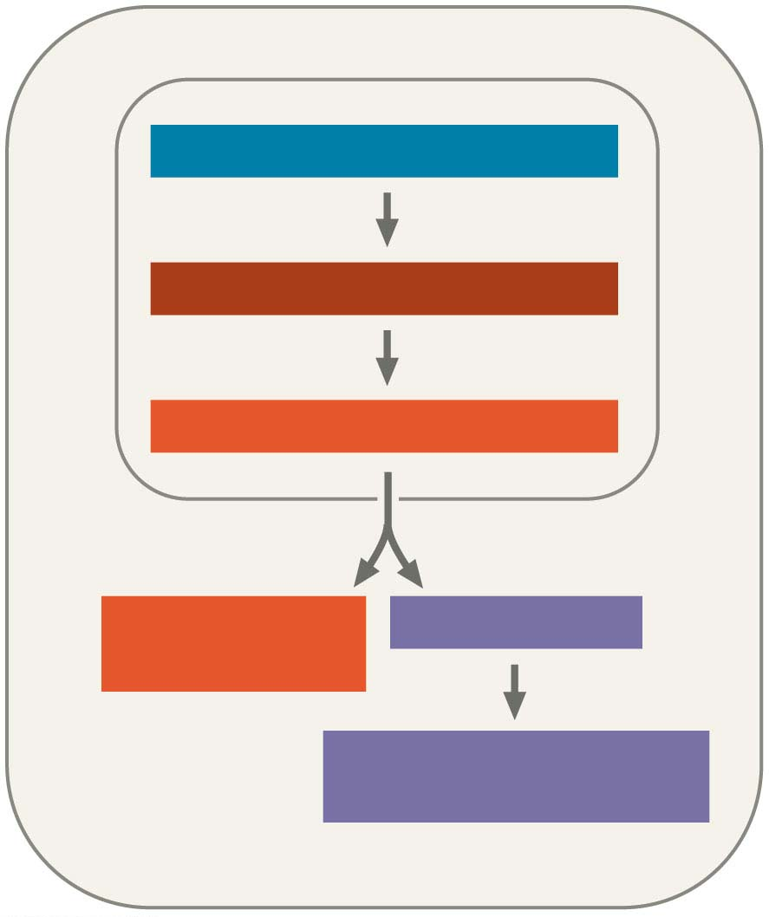
Figure 15.UN08-1
CHROMATIN MODIFICATION
TRANSCRIPTION
RNA PROCESSING
mRNA
DEGRADATION
TRANSLATION
PROTEIN PROCESSING
AND DEGRADATION
Notes:
Figure 15.UN08-1 Summary of key concepts: eukaryotic regulation of gene expression (part 1)

Slide 106
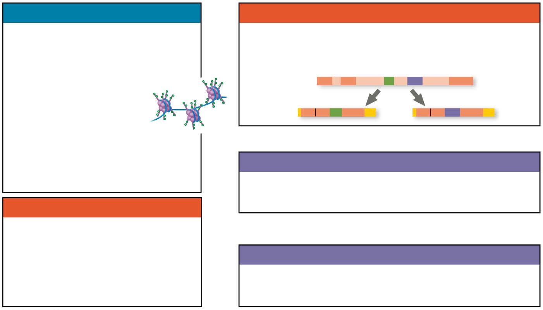
Figure 15.UN08-2
Chromatin modification
RNA processing
• Genes in highly compacted
chromatin are generally not
transcribed.
• Alternative RNA splicing:
Primary RNA
transcript
• Histone acetylation
seems to loosen
chromatin structure,
enhancing transcription.
mRNA
OR
• DNA methylation generally
reduces transcription.
Translation
• Initiation of translation can be controlled
via regulation of initiation factors.
mRNA degradation
• Each mRNA has a
characteristic life span,
determined in part by
sequences in the 5′ and 3′
UTRs.
Protein processing and degradation
• Protein processing and degradation are
subject to regulation.
Notes:
Figure 15.UN08-2 Summary of key concepts: eukaryotic regulation of gene expression (part 2)

Slide 107
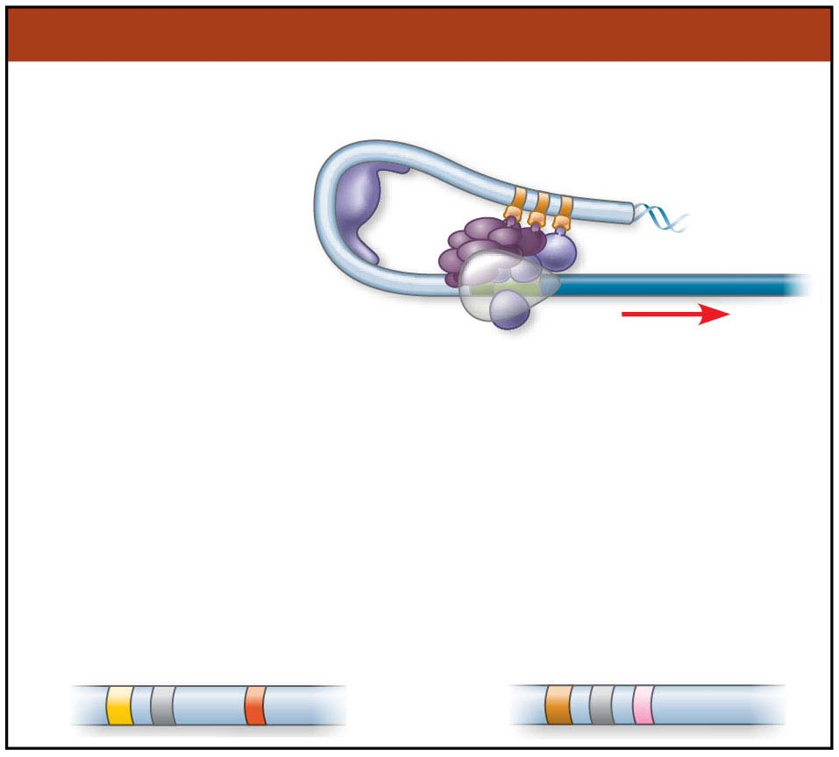
Figure 15.UN08-3
Transcription
• Regulation of transcription initiation:
DNA control
elements in
enhancers bind
specific tran-
scription factors.
Bending of the DNA
enables activators to contact
proteins at the promoter,
initiating transcription.
• Coordinate regulation:
Enhancer for
liver-specific genes
Enhancer for
lens-specific genes
Notes:
Figure 15.UN08-3 Summary of key concepts: eukaryotic regulation of gene expression (part 3)

Slide 108
Figure 15.UN09
Enhancer
Promoter
Gene 1
Gene 2
Gene 3
Gene 4
Gene 5
Notes:
Figure 15.UN09 Test your understanding, question 7 (activator proteins)

Slide 109
Figure 15.UN10
Notes:
Figure 15.UN10 Test your understanding, question 11 (flashlight fish)

