Slide 1
0
14
Gene Expression: From Gene to Protein

Slide 2
Overview: The Flow of Genetic Information
The information content of genes is in the form of specific sequences of nucleotides in DNA
The DNA inherited by an organism leads to specific traits by dictating the synthesis of proteins
Proteins are the links between genotype and phenotype
Gene expression, the process by which DNA directs protein synthesis, includes two stages: transcription and translation
Notes:
2
2

Slide 3
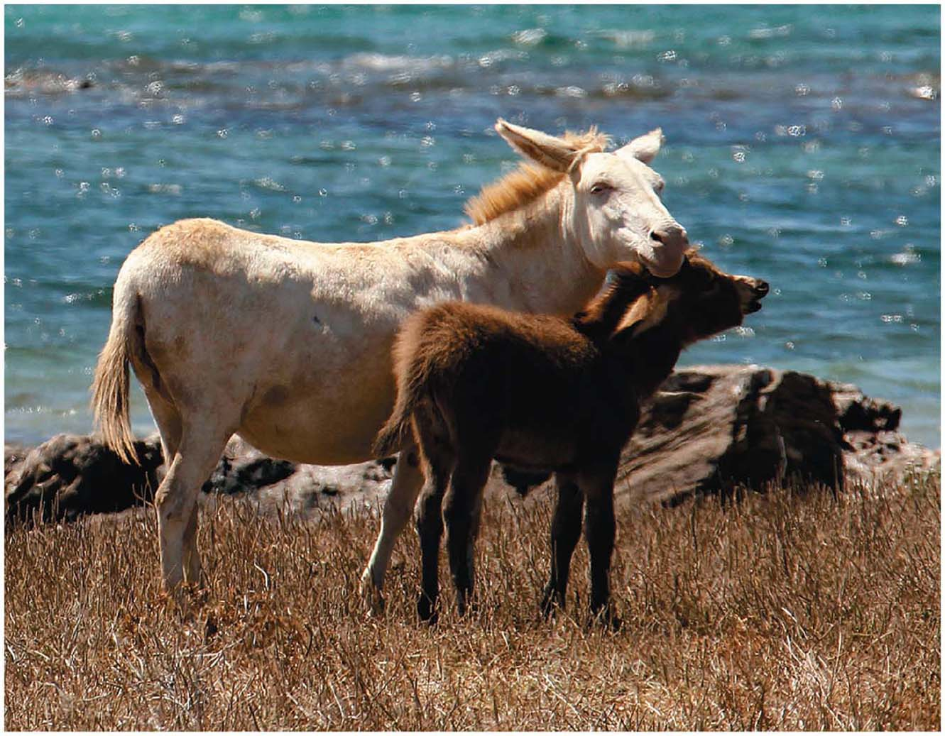
Figure 14.1
Notes:
Figure 14.1 How does a single faulty gene result in the dramatic appearance of an albino donkey?

Slide 4
Concept 14.1: Genes specify proteins via transcription and translation
How was the fundamental relationship between genes and proteins discovered?
Notes:
4
4

Slide 5
Evidence from the Study of Metabolic Defects
In 1902, British physician Archibald Garrod first suggested that genes dictate phenotypes through enzymes that catalyze specific chemical reactions
He thought symptoms of an inherited disease reflect an inability to synthesize a certain enzyme
Cells synthesize and degrade molecules in a series of steps, a metabolic pathway
Notes:
5
5

Slide 6
Nutritional Mutants: Scientific Inquiry
Beadle and Tatum disabled genes in bread mold one by one and looked for phenotypic changes
They studied the haploid bread mold because it would be easier to detect recessive mutations
They studied mutations that altered the ability of the fungus to grow on minimal medium
Notes:
6
6

Slide 7
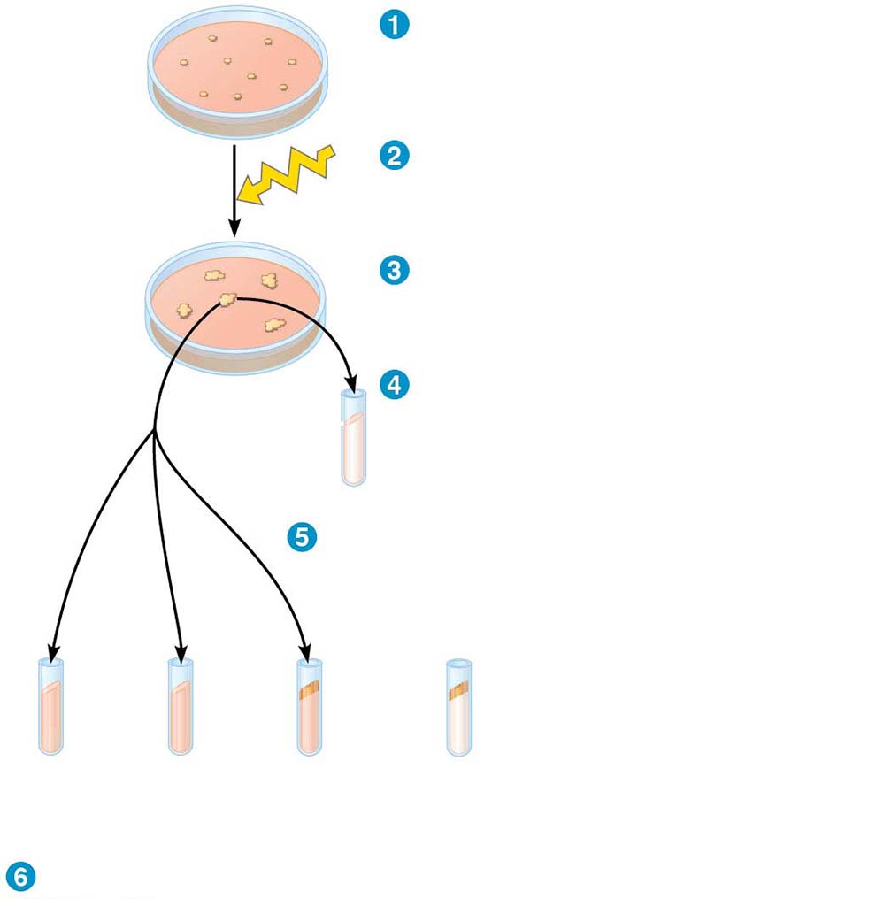
Figure 14.2
Individual Neurospora cells
placed on complete
medium.
Cells subjected to X-rays.
Each surviving cell formed a colony
of genetically identical cells.
Cells from each colony placed in a
vial with minimal medium. Cells
that did not grow identified as
nutritional mutants.
No
growth
Cells from one nutritional mutant
colony placed in a series of vials.
Growth
Minimal
medium
+ valine
Minimal
medium
+ lysine
Minimal
medium
+ arginine
Control: Wild-type cells
growing on
minimal medium
Vials observed for growth.
Notes:
Figure 14.2 The experimental approach of Beadle and Tatum

Slide 8
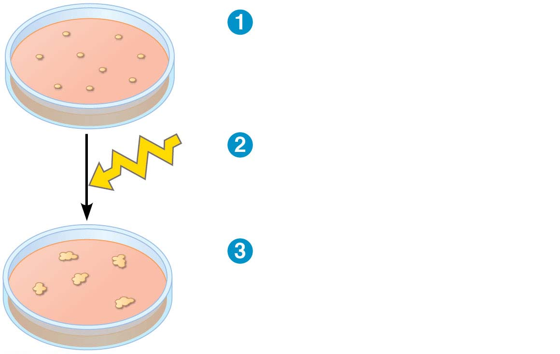
Figure 14.2-1
Individual Neurospora cells
placed on complete medium.
Cells subjected to X-rays.
Each surviving cell
formed a colony of
genetically identical cells.
Notes:
Figure 14.2-1 The experimental approach of Beadle and Tatum (part 1)

Slide 9
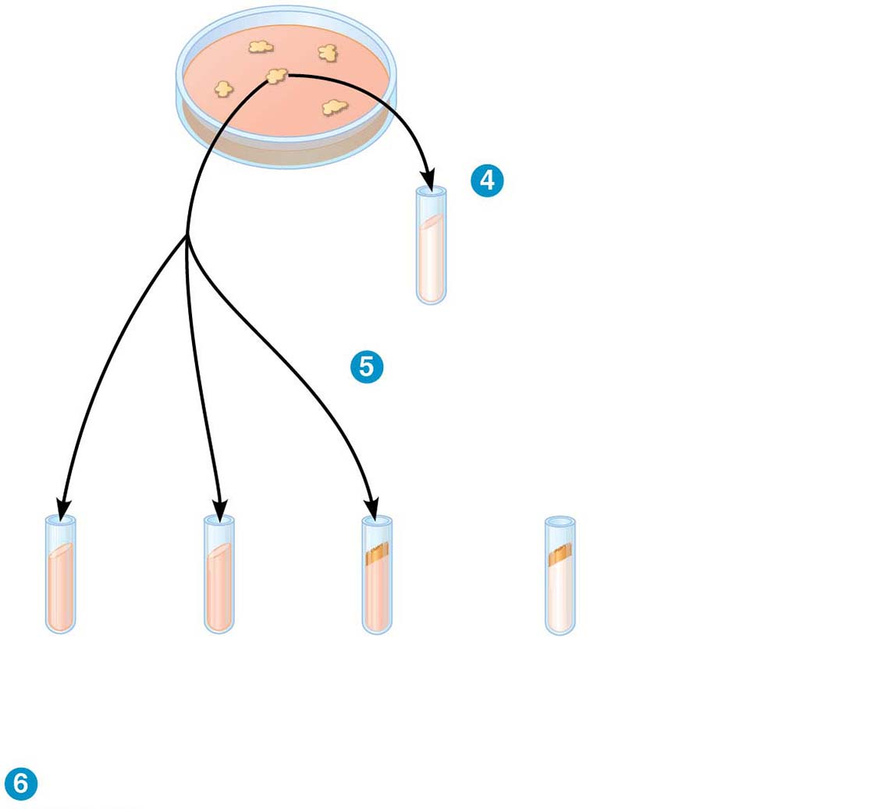
Figure 14.2-2
Cells from each colony
placed in a vial with
minimal medium. Cells that
did not grow identified as
nutritional mutants.
No
growth
Cells from one nutritional mutant
colony placed in a series of vials.
Growth
Minimal
medium
+ valine
Minimal
medium
+ lysine
Minimal
medium
+ arginine
Control: Wild-type cells
growing on
minimal medium
Vials observed for growth.
6
Notes:
Figure 14.2-2 The experimental approach of Beadle and Tatum (part 2)

Slide 10
The researchers amassed a valuable collection of Neurospora mutant strains, catalogued by their defects
For example, one set of mutants all required arginine for growth
It was determined that different classes of these mutants were blocked at a different step in the biochemical pathway for arginine biosynthesis
Notes:
10
10

Slide 11
Figure 14.3
Gene A
Gene B
Gene C
Enzyme A
Enzyme B
Enzyme C
Precursor
Ornithine
Citrulline
Arginine
Notes:
Figure 14.3 The one gene–one protein hypothesis

Slide 12
The Products of Gene Expression: A Developing Story
Some proteins are not enzymes, so researchers later revised the one gene–one enzyme hypothesis to one gene–one protein
Many proteins are composed of several polypeptides, each of which has its own gene
Therefore, Beadle and Tatum’s hypothesis is now restated as the one gene–one polypeptide hypothesis
It is common to refer to gene products as proteins rather than polypeptides
Notes:
12
12

Slide 13
Basic Principles of Transcription and Translation
RNA is the bridge between DNA and protein synthesis
RNA is chemically similar to DNA, but RNA has a ribose sugar instead of deoxyribose and the base uracil (U) rather than thymine (T)
RNA is usually single-stranded
Getting from DNA to protein requires two stages: transcription and translation
Notes:
13
13

Slide 14
Transcription is the synthesis of RNA using information in DNA
Transcription produces messenger RNA (mRNA)
Translation is the synthesis of a polypeptide, using information in the mRNA
Ribosomes are the sites of translation
Notes:
14
14

Slide 15
In bacteria, translation of mRNA can begin before transcription has finished
In eukaryotes, the nuclear envelope separates transcription from translation
Eukaryotic RNA transcripts are modified through RNA processing to yield the finished mRNA
Eukaryotic mRNA must be transported out of the nucleus to be translated
Notes:
15
15

Slide 16
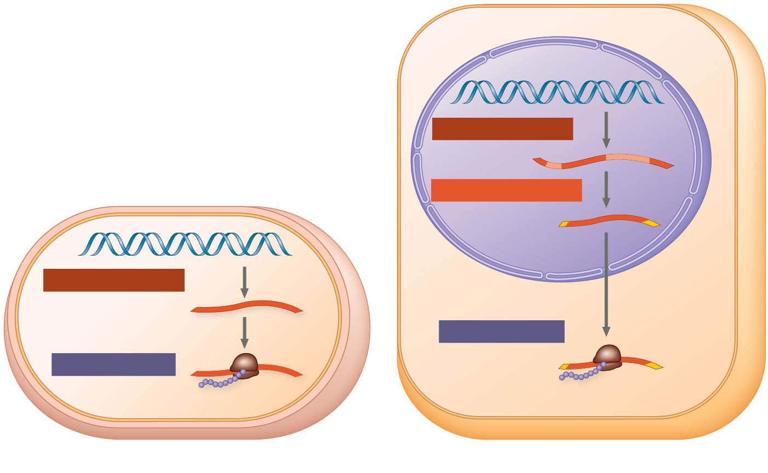
Figure 14.4
Nuclear
envelope
TRANSCRIPTION
DNA
RNA PROCESSING
Pre-mRNA
NUCLEUS
mRNA
TRANSCRIPTION
DNA
CYTOPLASM
CYTOPLASM
mRNA
Ribosome
TRANSLATION
Ribosome
TRANSLATION
Polypeptide
Polypeptide
(a) Bacterial cell
(b) Eukaryotic cell
Notes:
Figure 14.4 Overview: the roles of transcription and translation in the flow of genetic information

Slide 17
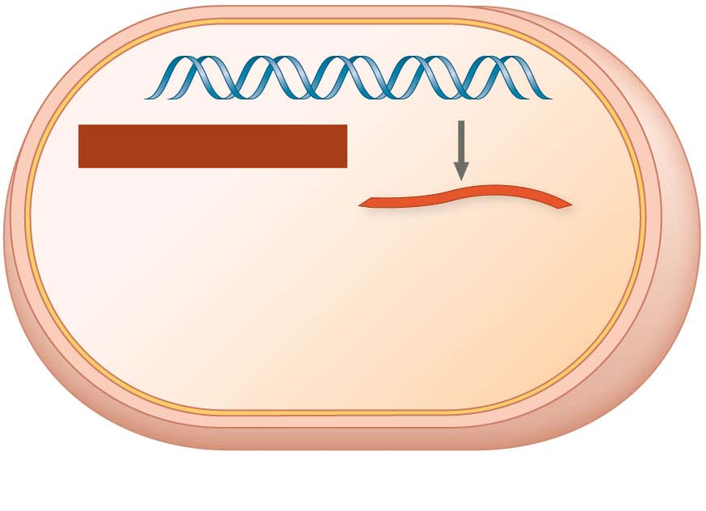
Figure 14.4-1-s1
DNA
TRANSCRIPTION
CYTOPLASM
mRNA
(a) Bacterial cell
Notes:
Figure 14.4-1-s1 Overview: the roles of transcription and translation in the flow of genetic information (part 1, step 1)

Slide 18
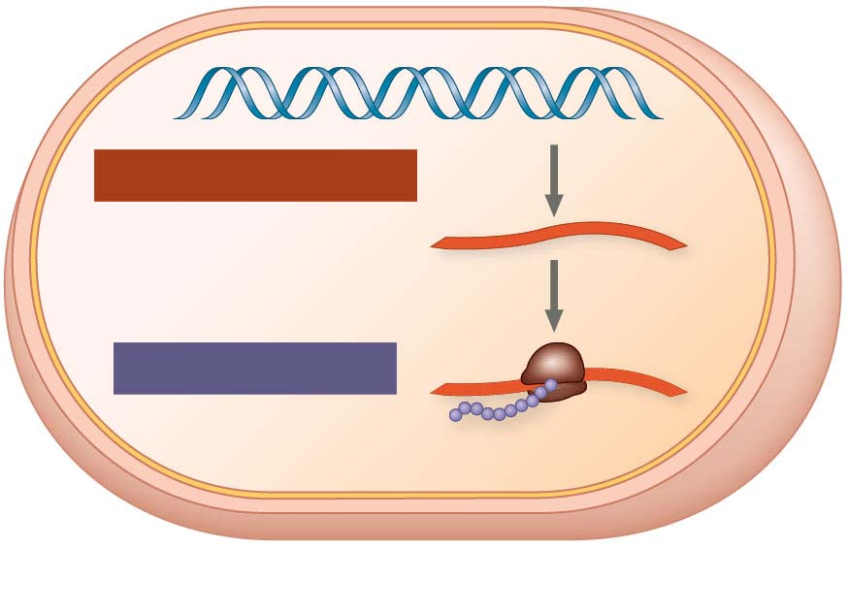
Figure 14.4-1-s2
DNA
TRANSCRIPTION
CYTOPLASM
mRNA
Ribosome
TRANSLATION
Polypeptide
(a) Bacterial cell
Notes:
Figure 14.4-1-s2 Overview: the roles of transcription and translation in the flow of genetic information (part 1, step 2)

Slide 19
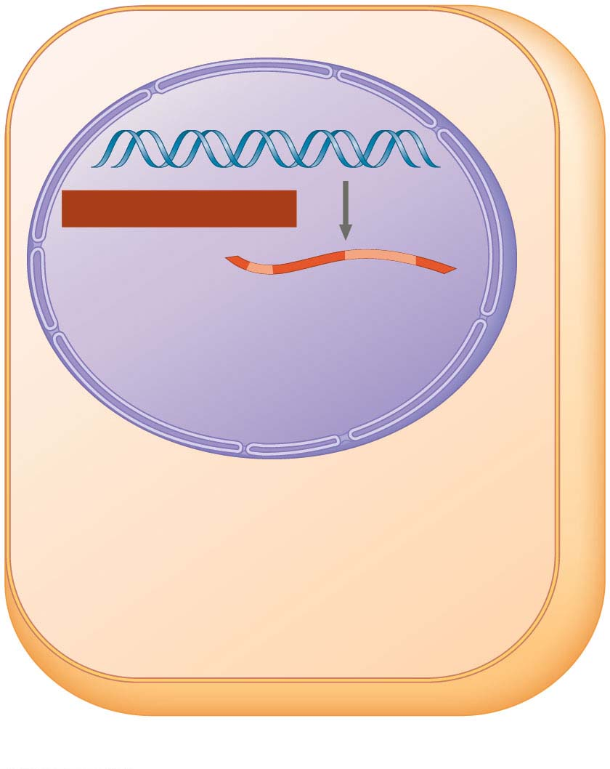
Figure 14.4-2-s1
Nuclear
envelope
TRANSCRIPTION
DNA
Pre-mRNA
NUCLEUS
CYTOPLASM
(b) Eukaryotic cell
Notes:
Figure 14.4-2-s1 Overview: the roles of transcription and translation in the flow of genetic information (part 2, step 1)

Slide 20
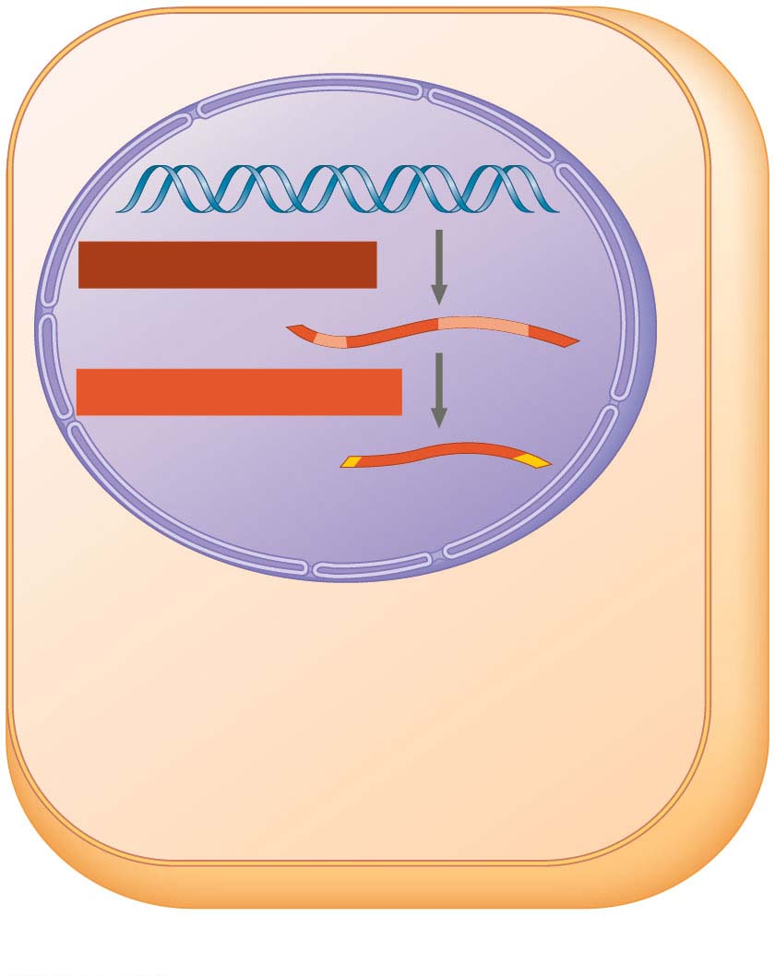
Figure 14.4-2-s2
Nuclear
envelope
TRANSCRIPTION
DNA
Pre-mRNA
RNA PROCESSING
NUCLEUS
mRNA
CYTOPLASM
(b) Eukaryotic cell
Notes:
Figure 14.4-2-s2 Overview: the roles of transcription and translation in the flow of genetic information (part 2, step 2)

Slide 21
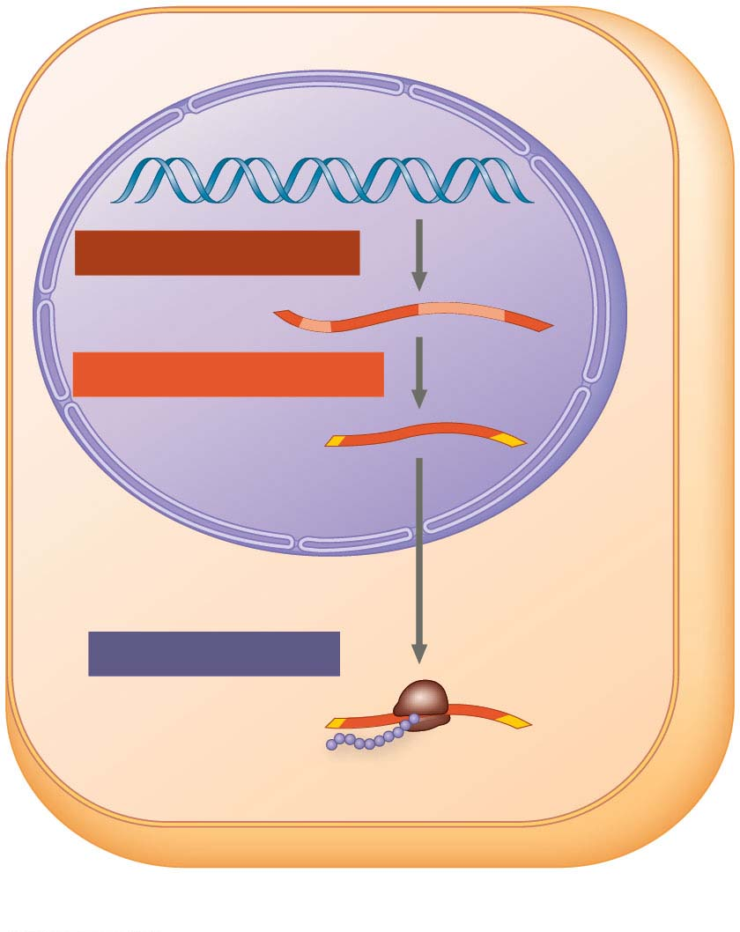
Figure 14.4-2-s3
Nuclear
envelope
TRANSCRIPTION
DNA
Pre-mRNA
RNA PROCESSING
NUCLEUS
mRNA
CYTOPLASM
TRANSLATION
Ribosome
Polypeptide
(b) Eukaryotic cell
Notes:
Figure 14.4-2-s3 Overview: the roles of transcription and translation in the flow of genetic information (part 2, step 3)

Slide 22
A primary transcript is the initial RNA transcript from any gene prior to processing
The central dogma is the concept that cells are governed by a cellular chain of command
Notes:
22
22
NOTE: I’ve just copy-pasted this out of the text file - I like it here. Obviously, feel free to move it to a separate slide or delete if you want to.

Slide 23
Figure 14.UN01
DNA
RNA
Protein
Notes:
Figure 14.UN01 In-text figure, central dogma, p. 281

Slide 24
The Genetic Code
There are 20 amino acids, but there are only four nucleotide bases in DNA
How many nucleotides correspond to an amino acid?
Notes:
24
24

Slide 25
Codons: Triplets of Nucleotides
The flow of information from gene to protein is based on a triplet code: a series of nonoverlapping, three-nucleotide words
The words of a gene are transcribed into complementary nonoverlapping three-nucleotide words of mRNA
These words are then translated into a chain of amino acids, forming a polypeptide
Notes:
25
25

Slide 26
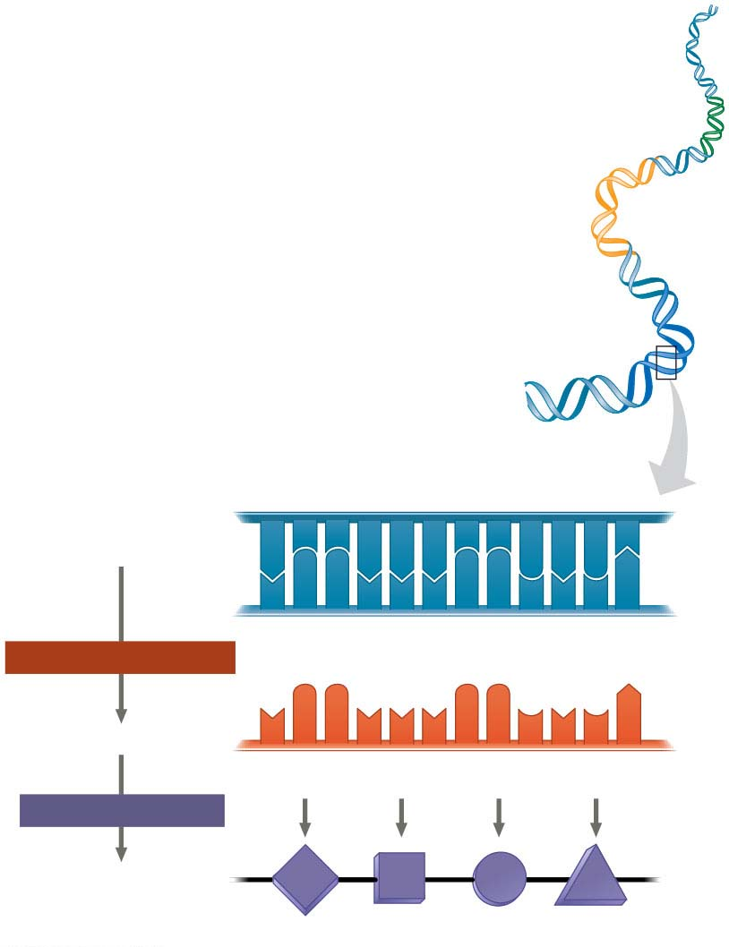
Figure 14.5
DNA
molecule
Gene 1
Gene 2
Gene 3
DNA
template
strand
3′
A
C
C
A
A
A
C
C
G
A
G
T
5′
5′
T
G
G
T
T
T
G
G
C
T
C
A
3′
TRANSCRIPTION
mRNA
5′
U
G
G
U
U
U
G
G
C
U
C
A
3′
Codon
TRANSLATION
Protein
Trp
Phe
Gly
Ser
Amino acid
Notes:
Figure 14.5 The triplet code

Slide 27
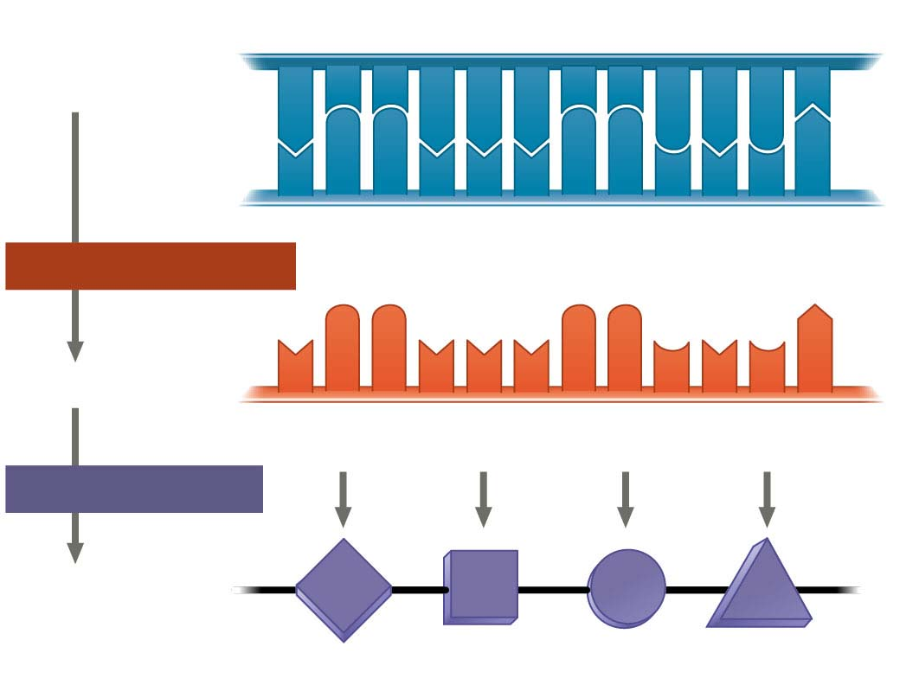
Figure 14.5-1
DNA
template
strand
3′
5′
A
C
C
A
A
A
C
C
G
A
G
T
T
G
G
T
T
T
G
G
C
T
C
A
3′
5′
TRANSCRIPTION
mRNA
5′
U
G
G
U
U
U
G
G
C
U
C
A
3′
Codon
TRANSLATION
Protein
Trp
Phe
Gly
Ser
Amino acid
Notes:
Figure 14.5-1 The triplet code (part 1: detail)

Slide 28
During transcription, one of the two DNA strands, called the template strand, provides a template for ordering the sequence of complementary nucleotides in an RNA transcript
The template strand is always the same strand for any given gene
Notes:
28
28

Slide 29
During translation, the mRNA base triplets, called codons, are read in the 5′ to 3′ direction
Each codon specifies the amino acid (one of 20) to be placed at the corresponding position along a polypeptide
Notes:
29
29

Slide 30
Cracking the Code
All 64 codons were deciphered by the mid-1960s
Of the 64 triplets, 61 code for amino acids; 3 triplets are “stop” signals to end translation
The genetic code is redundant: more than one codon may specify a particular amino acid
But it is not ambiguous: no codon specifies more than one amino acid
Notes:
30
30

Slide 31
Codons must be read in the correct reading frame (correct groupings) in order for the specified polypeptide to be produced
Codons are read one at a time in a nonoverlapping fashion
Notes:
31
31

Slide 32
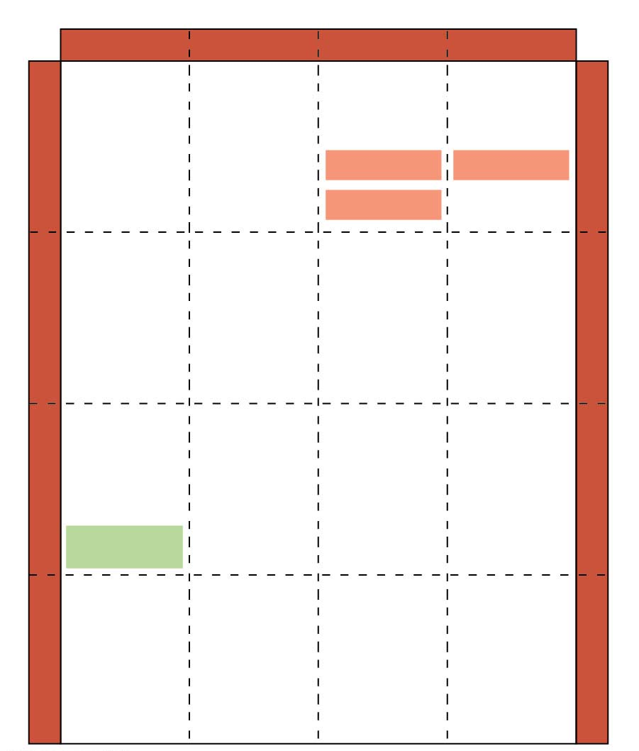
Figure 14.6
Second mRNA base
U
C
A
G
UUU
UCU
UAU
UGU
U
Phe
Tyr
Cys
U
UUC
UCC
UAC
UGC
C
Ser
UUA
UCA
UAA Stop
UGA Stop
A
Leu
UUG
UCG
UAG Stop
UGG Trp
G
First mRNA base (5′ end of codon)
Third mRNA base (3′ end of codon)
CUU
CCU
CAU
CGU
U
His
C
CUC
CCC
CAC
CGC
C
Leu
Pro
Arg
CUA
CCA
CAA
CGA
A
Gln
CUG
CCG
CAG
CGG
G
AUU
ACU
AAU
AGU
U
Asn
Ser
A
AUC
Ile
ACC
AAC
AGC
C
Thr
AUA
ACA
AAA
AGA
A
Lys
Arg
AUG
Met or
start
ACG
AAG
AGG
G
GUU
GCU
GAU
GGU
U
Asp
G
GUC
GCC
GAC
GGC
C
Val
Ala
Gly
GUA
GCA
GAA
GGA
A
Glu
GUG
GCG
GAG
GGG
G
Notes:
Figure 14.6 The codon table for mRNA

Slide 33
Evolution of the Genetic Code
The genetic code is nearly universal, shared by the simplest bacteria and the most complex animals
Genes can be transcribed and translated after being transplanted from one species to another
Notes:
33
33

Slide 34
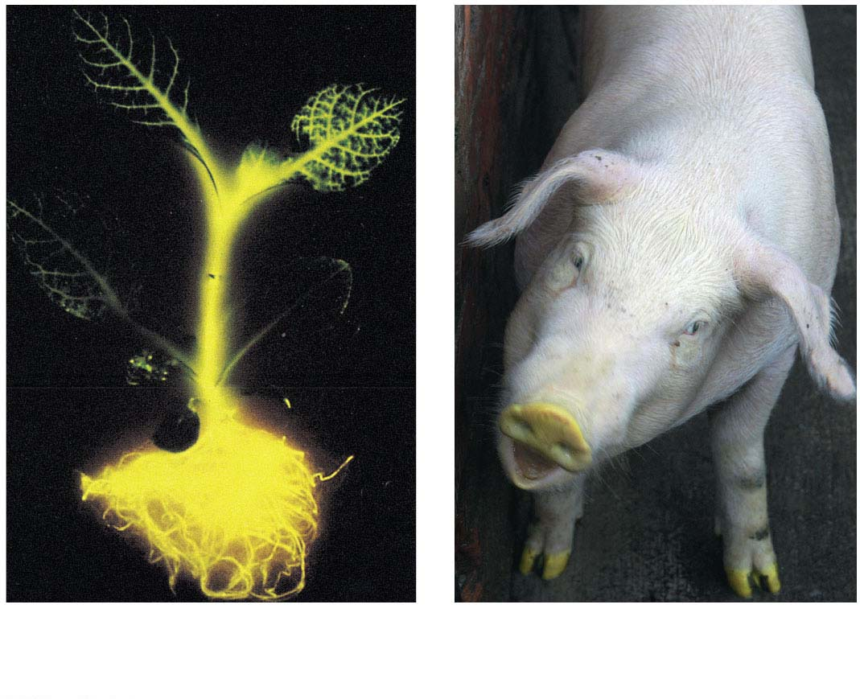
Figure 14.7
(a) Tobacco plant expressing a firefly gene
(b) Pig expressing a jellyfish gene
Notes:
Figure 14.7 Expression of genes from different species

Slide 35
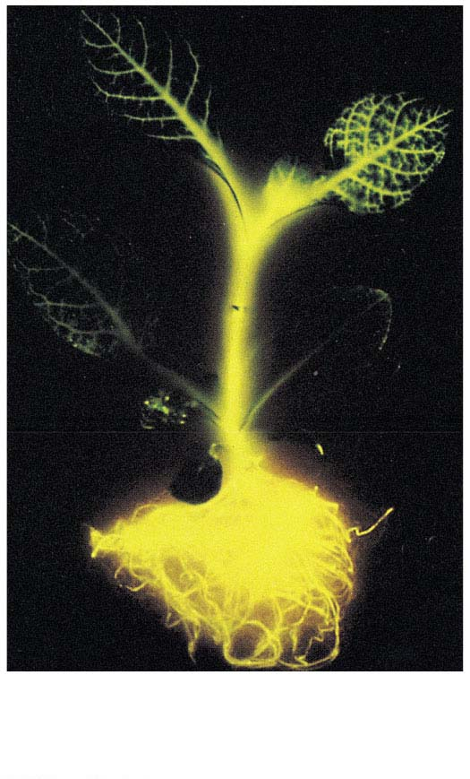
Figure 14.7-1
(a) Tobacco plant expressing a firefly gene
Notes:
Figure 14.7-1 Expression of genes from different species (part 1: tobacco plant)

Slide 36
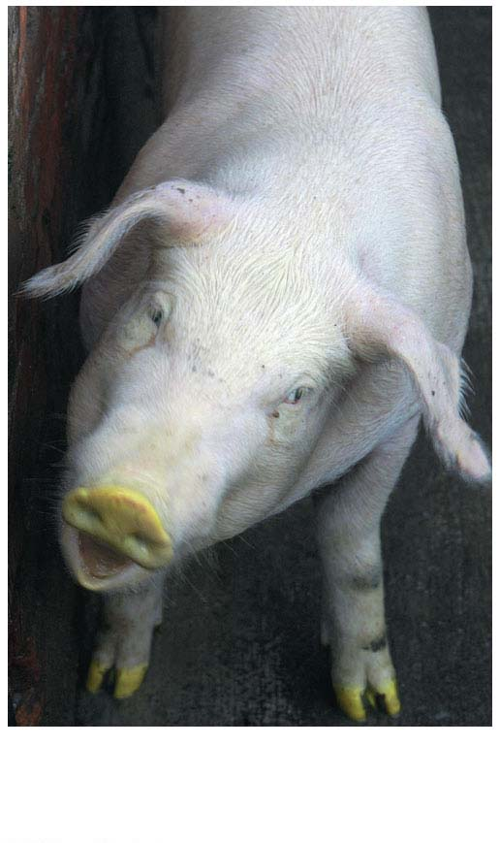
Figure 14.7-2
(b) Pig expressing a jellyfish gene
Notes:
Figure 14.7-2 Expression of genes from different species (part 2: pig)

Slide 37
Concept 14.2: Transcription is the DNA-directed Synthesis of RNA: A Closer Look
Transcription is the first stage of gene expression
Notes:
37
37

Slide 38
Molecular Components of Transcription
RNA synthesis is catalyzed by RNA polymerase, which pries the DNA strands apart and joins together the RNA nucleotides
RNA polymerases assemble polynucleotides in the 5′ to 3′ direction
Unlike DNA polymerases, RNA polymerases can start a chain without a primer
Notes:
38
38

Slide 39
Animation: Transcription Introduction

Slide 40
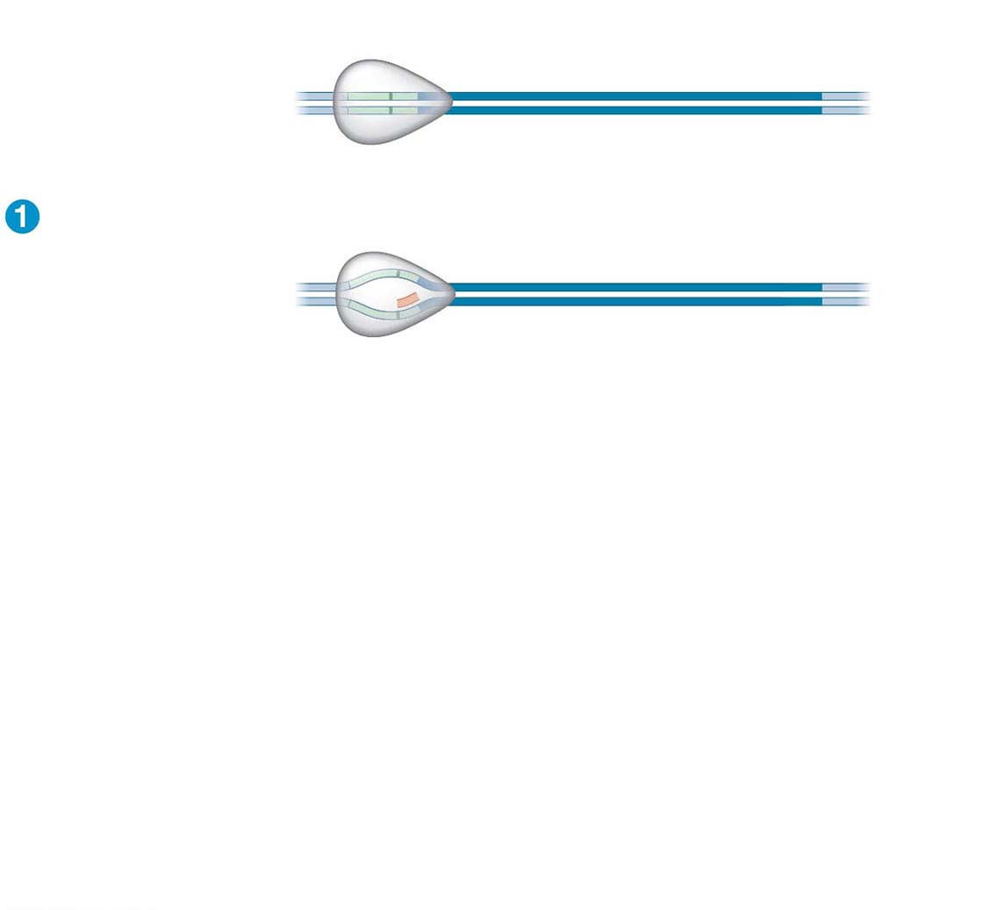
Figure 14.8-s1
Promoter
Transcription unit
5′
3′
3′
DNA
5′
Start point
RNA polymerase
Initiation
5′
3′
3′
5′
Unwound
DNA
RNA
transcript
Template strand of DNA
Notes:
Figure 14.8-s1 The stages of transcription: initiation, elongation, and termination (step 1)

Slide 41
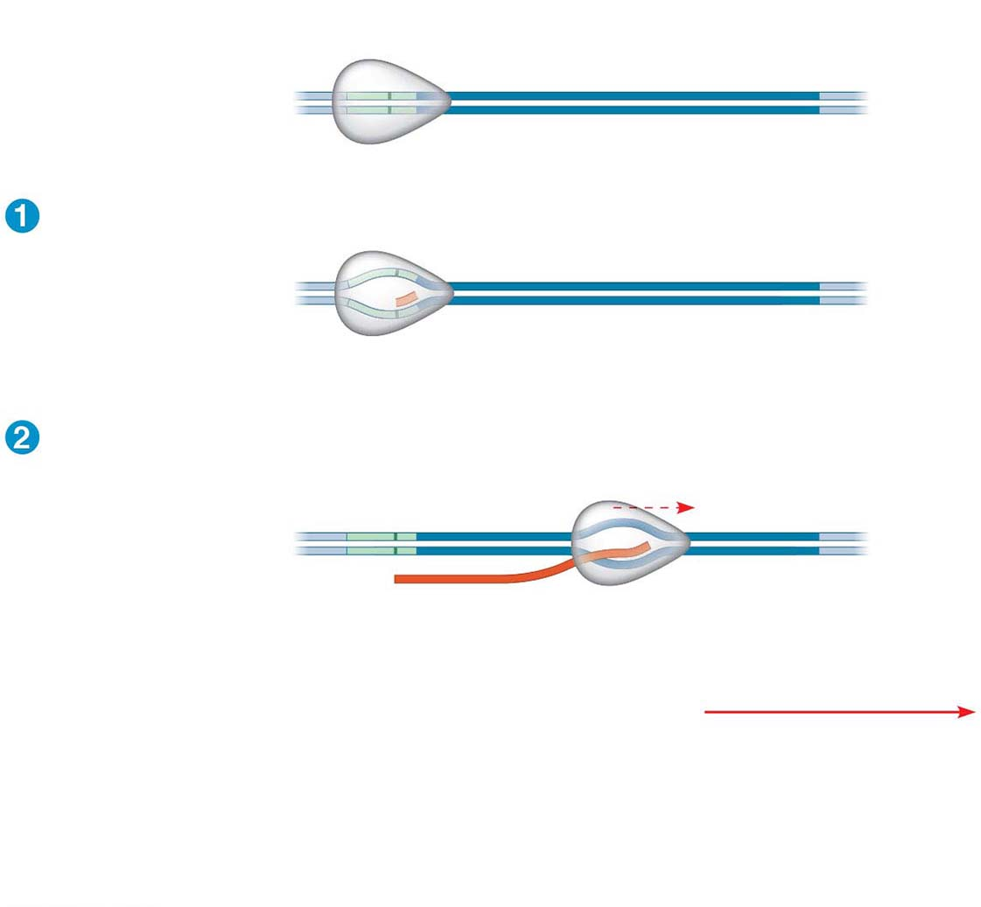
Figure 14.8-s2
Promoter
Transcription unit
5′
3′
3′
DNA
5′
Start point
RNA polymerase
Initiation
5′
3′
3′
5′
Unwound
DNA
RNA
transcript
Template strand of DNA
Elongation
Rewound
DNA
5′
3′
3′
3′
5′
5′
RNA
transcript
Direction of
transcription
(“downstream”)
Notes:
Figure 14.8-s2 The stages of transcription: initiation, elongation, and termination (step 2)

Slide 42
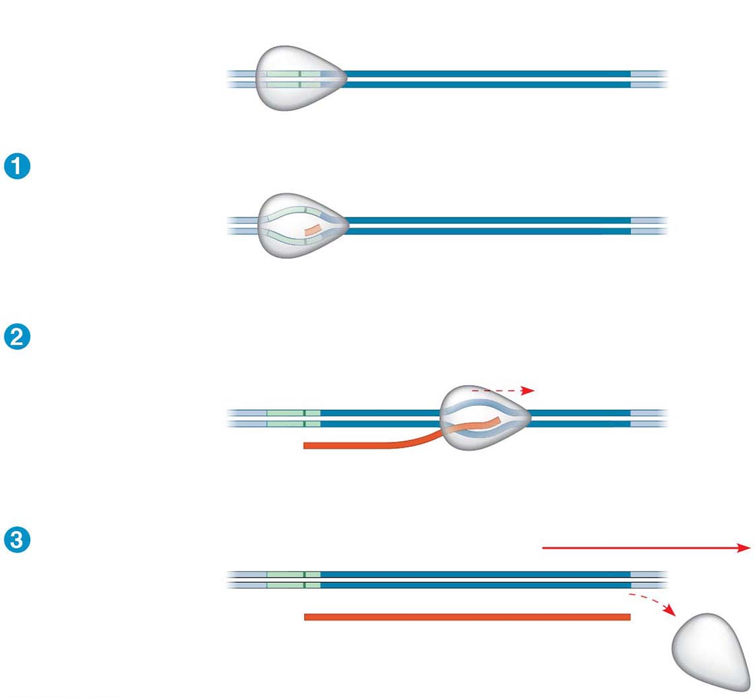
Figure 14.8-s3
Promoter
Transcription unit
5′
3′
3′
DNA
5′
Start point
RNA polymerase
Initiation
5′
3′
3′
5′
Unwound
DNA
RNA
transcript
Template strand of DNA
Elongation
Rewound
DNA
5′
3′
3′
3′
5′
5′
RNA
transcript
Direction of
transcription
(“downstream”)
Termination
5′
3′
3′
5′
5′
3′
Completed RNA transcript
Notes:
Figure 14.8-s3 The stages of transcription: initiation, elongation, and termination (step 3)

Slide 43
The DNA sequence where RNA polymerase attaches is called the promoter; in bacteria, the sequence signaling the end of transcription is called the terminator
The stretch of DNA that is transcribed is called a transcription unit
Notes:
43
43

Slide 44
Synthesis of an RNA Transcript
The three stages of transcription
Initiation
Elongation
Termination
Notes:
44
44

Slide 45
RNA Polymerase Binding and Initiation of Transcription
Promoters signal the transcriptional start point and usually extend several dozen nucleotide pairs upstream of the start point
Transcription factors mediate the binding of RNA polymerase and the initiation of transcription
Notes:
45
45

Slide 46
The completed assembly of transcription factors and RNA polymerase II bound to a promoter is called a transcription initiation complex
A promoter DNA sequence called a TATA box is crucial in forming the initiation complex in eukaryotes
Notes:
46
46

Slide 47
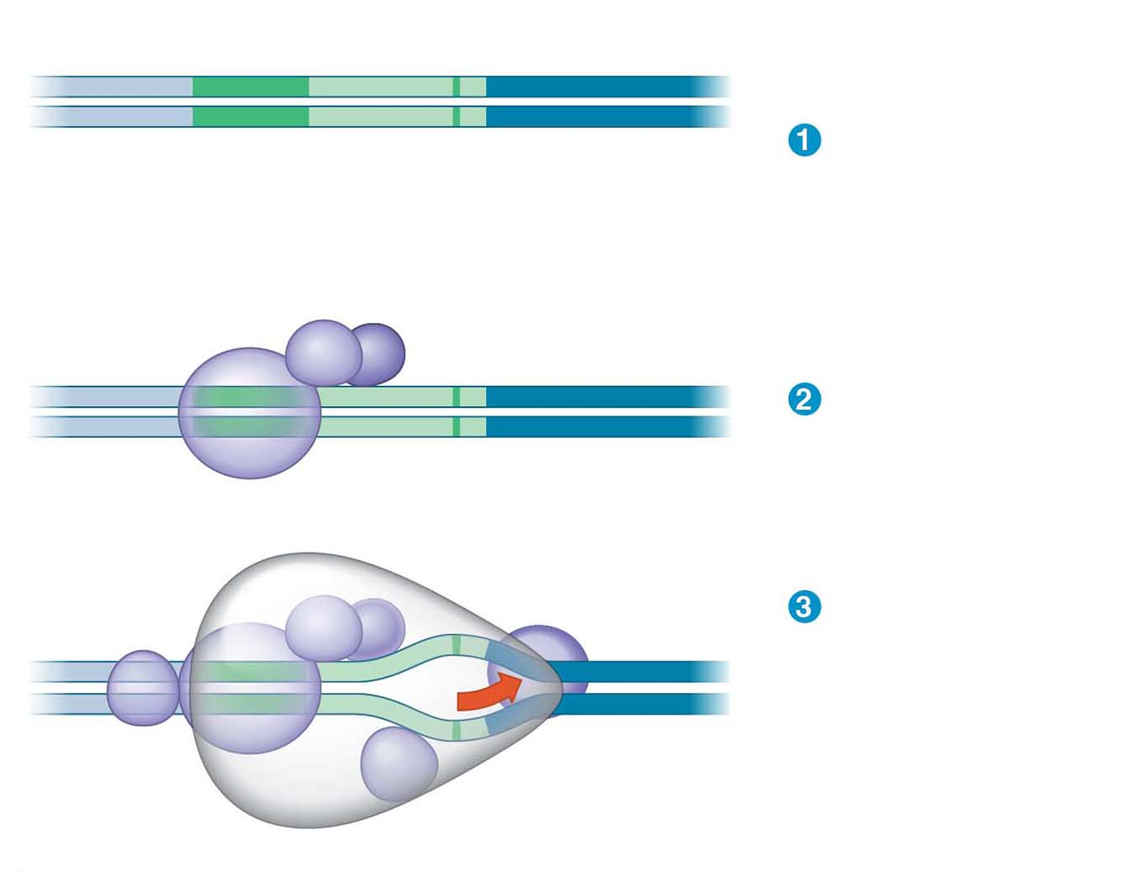
Figure 14.9
Promoter
Nontemplate strand
DNA
5′
T
A
T
A
A
A
A
3′
3′
A
T
A
T
T
T
T
5′
TATA box
A eukaryotic
promoter
Start point
Template
strand
Transcription
factors
5′
3′
Several transcription
factors bind to DNA.
3′
5′
RNA polymerase II
Transcription
factors
Transcription
initiation
complex forms.
5′
3′
3′
3′
5′
5′
RNA transcript
Transcription initiation complex
Notes:
Figure 14.9 The initiation of transcription at a eukaryotic promoter

Slide 48
Elongation of the RNA Strand
As RNA polymerase moves along the DNA, it untwists the double helix, 10 to 20 bases at a time
Transcription progresses at a rate of 40 nucleotides per second in eukaryotes
A gene can be transcribed simultaneously by several RNA polymerases
Notes:
48
48

Slide 49
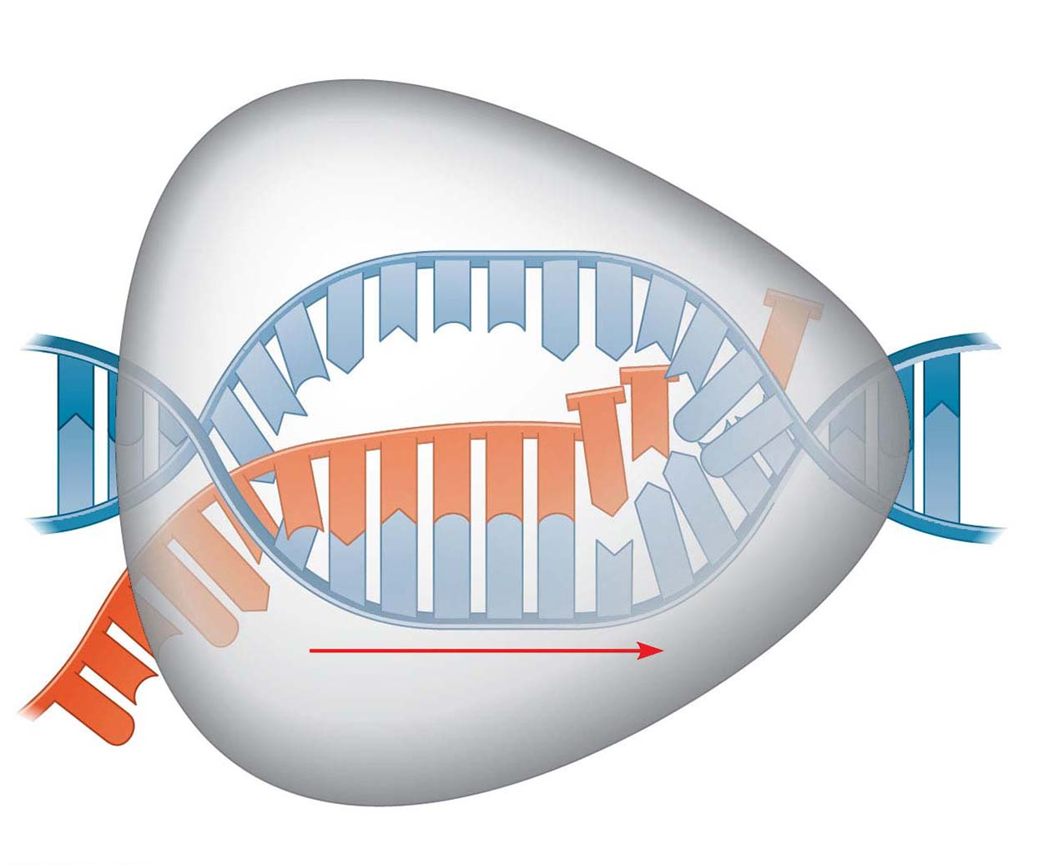
Figure 14.10
Nontemplate
strand of DNA
RNA nucleotides
RNA
polymerase
A
T
C
C
A
A
T
3′
C
T
U
5′
T
3′ end
G
U
A
A
G
A
U
C
C
A
C
C
C
5′
A
3′
T
A
A
G
G
T
T
5′
Direction of transcription
Template
strand of DNA
Newly made
RNA
Notes:
Figure 14.10 Transcription elongation

Slide 50
Termination of Transcription
The mechanisms of termination are different in bacteria and eukaryotes
In bacteria, the polymerase stops transcription at the end of the terminator and the mRNA can be translated without further modification
In eukaryotes, RNA polymerase II transcribes the polyadenylation signal sequence; the RNA transcript is released 10–35 nucleotides past this polyadenylation sequence
Notes:
50
50

Slide 51
Concept 14.3: Eukaryotic cells modify RNA after transcription
Enzymes in the eukaryotic nucleus modify pre-mRNA (RNA processing) before the genetic messages are dispatched to the cytoplasm
During RNA processing, both ends of the primary transcript are altered
Also, usually some interior parts of the molecule are cut out and the other parts spliced together
Notes:
51
51

Slide 52
Alteration of mRNA Ends
Each end of a pre-mRNA molecule is modified in a particular way
The 5′ end receives a modified G nucleotide 5′ cap
The 3′ end gets a poly-A tail
These modifications share several functions
Facilitating the export of mRNA to the cytoplasm
Protecting mRNA from hydrolytic enzymes
Helping ribosomes attach to the 5′ end
Notes:
52
52

Slide 53
Figure 14.11
A modified guanine
nucleotide added
to the 5′ end
50–250 adenine
nucleotides added
to the 3′ end
Region that includes
protein-coding segments
Polyadenylation
signal
5′
3′
G
P
P
P
AAUAAA
AAA
…
AAA
Start
codon
Stop
codon
5′ Cap
5′ UTR
3′ UTR
Poly-A tail
Notes:
Figure 14.11 RNA processing: addition of the 5′ cap and poly-A tail

Slide 54
Split Genes and RNA Splicing
Most eukaryotic mRNAs have long noncoding stretches of nucleotides that lie between coding regions
The noncoding regions are called intervening sequences, or introns
The other regions are called exons and are usually translated into amino acid sequences
RNA splicing removes introns and joins exons, creating an mRNA molecule with a continuous coding sequence
Notes:
54
54

Slide 55
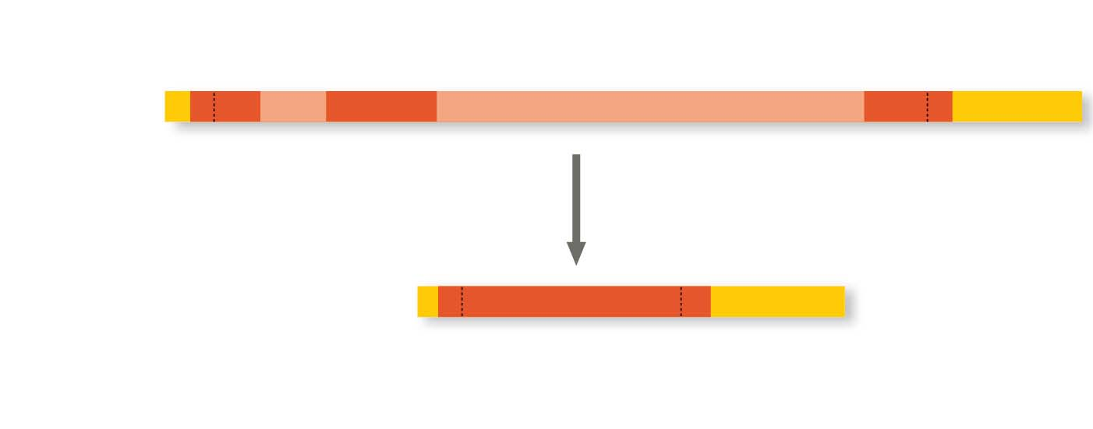
Figure 14.12
Pre-mRNA
5′ Cap
Intron
Intron
3′
Poly-A tail
1–30
31–104
105–146
mRNA
Introns cut out and
exons spliced together
5′ Cap
Poly-A tail
1–146
5′ UTR
3′ UTR
Coding
segment
Notes:
Figure 14.12 RNA processing: RNA splicing

Slide 56
Many genes can give rise to two or more different polypeptides, depending on which segments are used as exons
This process is called alternative RNA splicing
RNA splicing is carried out by spliceosomes
Spliceosomes consist of proteins and small RNAs
Notes:
56
56

Slide 57
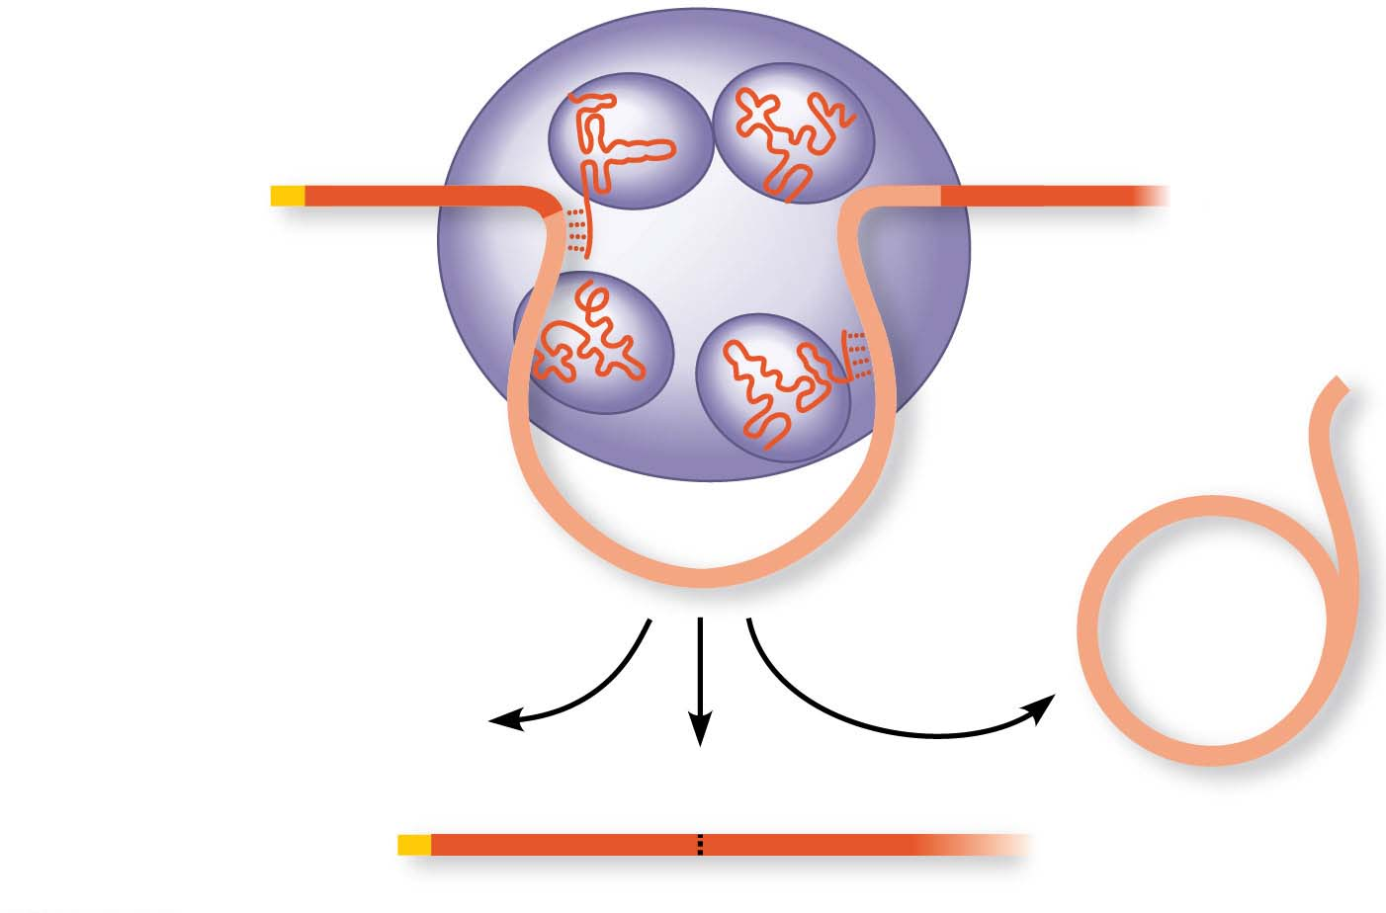
Figure 14.13
Spliceosome
Small RNAs
5′
Pre-mRNA
Exon 1
Exon 2
Intron
Spliceosome
components
mRNA
5′
Cut-out
intron
Exon 1
Exon 2
Notes:
Figure 14.13 A spliceosome splicing a pre-mRNA

Slide 58
Ribozymes
Ribozymes are RNA molecules that function as enzymes
In some organisms, RNA splicing can occur without proteins, or even additional RNA molecules
The introns can catalyze their own splicing
Notes:
58
58

Slide 59
Concept 14.4: Translation is the RNA-directed Synthesis of a Polypeptide: A Closer Look
Genetic information flows from mRNA to protein through the process of translation
Notes:
59
59

Slide 60
Molecular Components of Translation
A cell translates an mRNA message into protein with the help of transfer RNA (tRNA)
tRNAs transfer amino acids to the growing polypeptide in a ribosome
Translation is a complex process in terms of its biochemistry and mechanics
Notes:
60
60

Slide 61
Bioflix Animation: Protein Synthesis

Slide 62
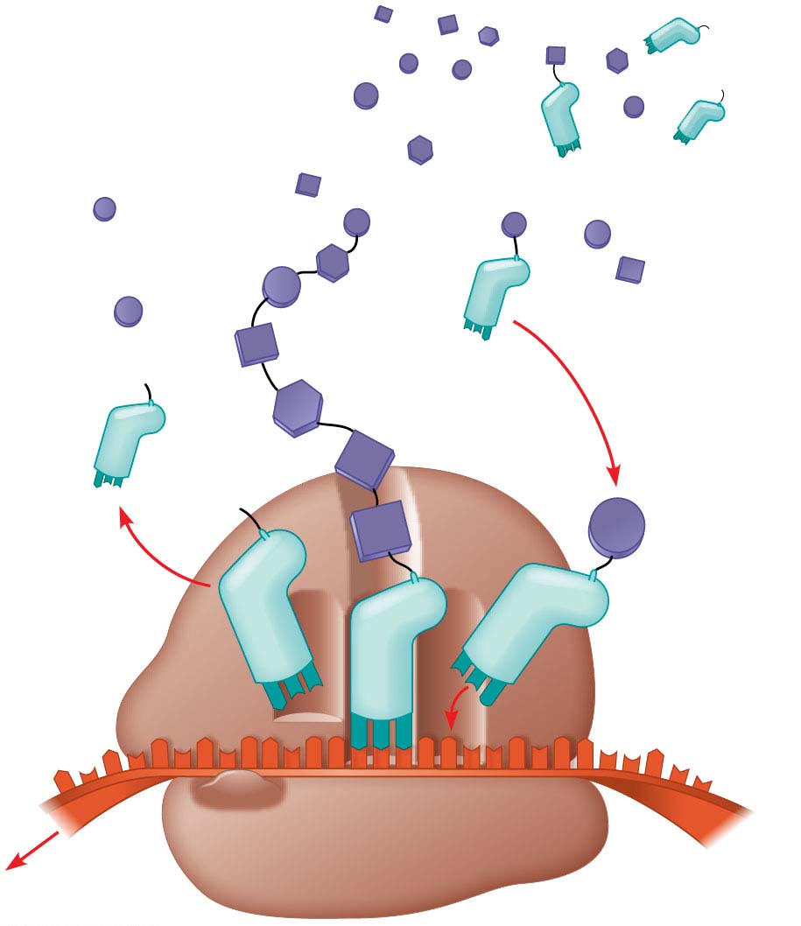
Figure 14.14
Polypeptide
Amino acids
tRNA with
amino acid
attached
Ribosome
Trp
Phe
Gly
tRNA
C
C
C
A
C
G
Anticodon
A A A
U
G
G
U
U
U
G
G
C
5′
Codons
3′
mRNA
Notes:
Figure 14.14 Translation: the basic concept

Slide 63
The Structure and Function of Transfer RNA
Each tRNA can translate a particular mRNA codon into a given amino acid
The tRNA contains an amino acid at one end and at the other end has a nucleotide triplet that can base-pair with the complementary codon on mRNA
Notes:
63
63

Slide 64
A tRNA molecule consists of a single RNA strand that is about 80 nucleotides long
tRNA molecules can base-pair with themselves
Flattened into one plane, a tRNA molecule looks like a cloverleaf
In three dimensions, tRNA is roughly L-shaped, where one end of the L contains the anticodon that base-pairs with an mRNA codon
Notes:
64
64

Slide 65
Video: tRNA Model

Slide 66
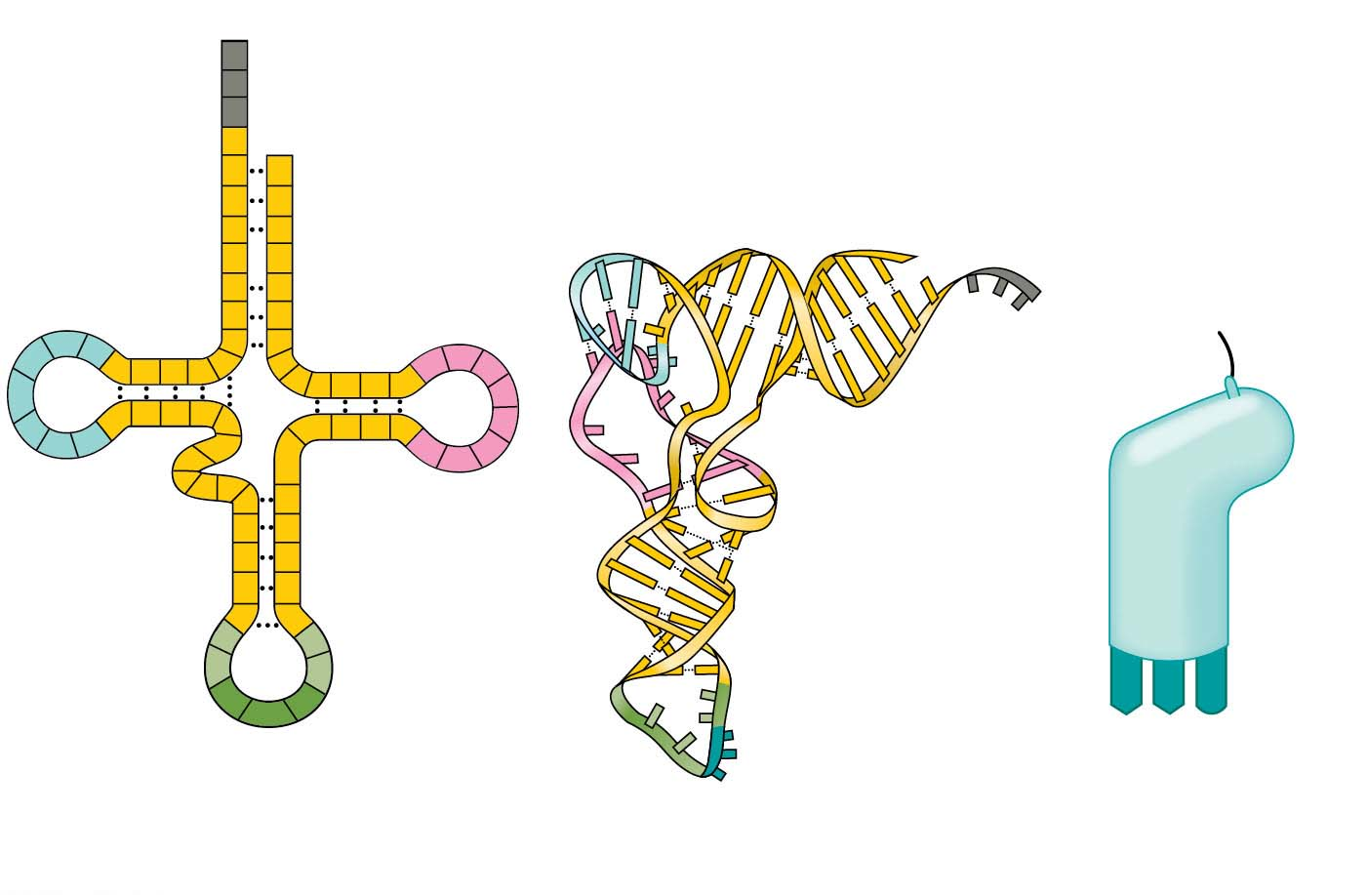
Figure 14.15
3′
Amino acid
attachment
site
A
C
C
5′
A
C
G
Amino acid
attachment site
G
C
C
G
5′
U
G
U
A
3′
A
U
*
U
C
A
U
G
C
A
C
A
G
U
A
U
C
A
*
G
*
C
*
C
G
U
G
U
*
C
G
A
G
G
*
*
C
A
G
Hydrogen
bonds
U
*
G
*
G
A
G
C
Hydrogen
bonds
G
C
U
A
*
G
A
*
A
C
*
U
A
A
G
A
A
G
3′
5′
Anticodon
Anticodon
Anticodon
(a) Two-dimensional structure
(b) Three-dimensional structure
(c) Symbol used in this book
Notes:
Figure 14.15 The structure of transfer RNA (tRNA)

Slide 67
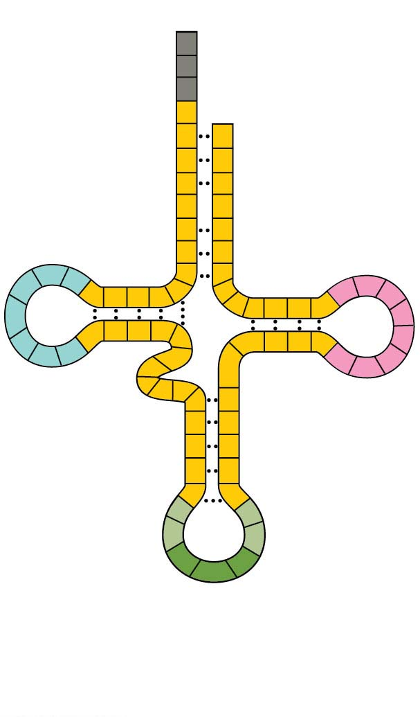
Figure 14.15-1
3′
Amino acid
attachment
site
A
C
C
5′
A
C
G
G
C
C
G
U
G
U
A
A
U
*
U
C
A
U
G
C
A
C
A
G
U
A
A
*
G
*
C
U
C
*
C
G
U
G
U
*
C
G
A
G
G
*
*
C
A
G
U
*
G
*
G
A
C
Hydrogen
bonds
G
G
C
U
A
*
G
*
A
A
C
*
U
A
A
G
Anticodon
(a) Two-dimensional structure
Notes:
Figure 14.15-1 The structure of transfer RNA (tRNA) (part 1: two-dimensional structure)

Slide 68
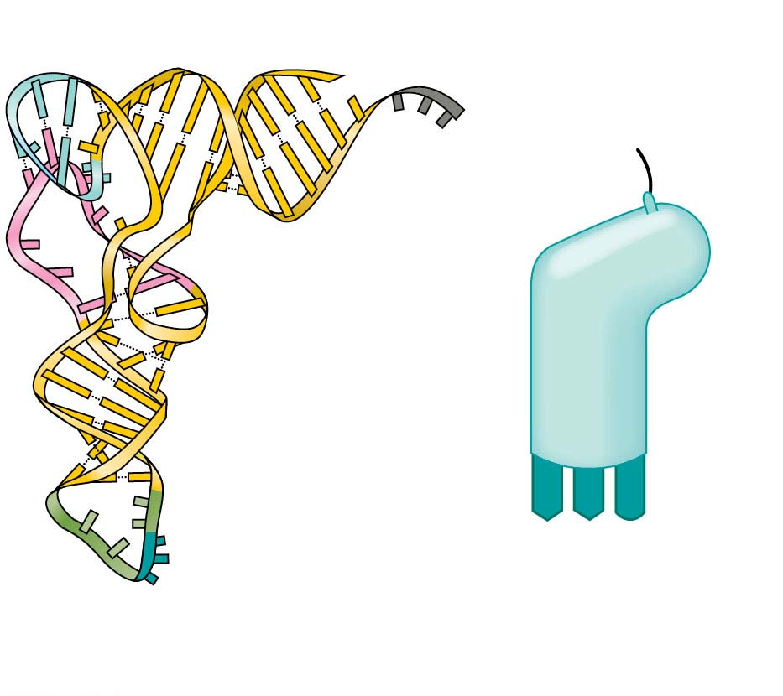
Figure 14.15-2
Amino acid
attachment site
5′
3′
Hydrogen
bonds
A
A
G
3′
5′
Anticodon
Anticodon
(b) Three-dimensional structure
(c) Symbol used in this book
Notes:
Figure 14.15-2 The structure of transfer RNA (tRNA) (part 2: three-dimensional structure)

Slide 69
Accurate translation requires two steps
First, a correct match between a tRNA and an amino acid, done by the enzyme aminoacyl-tRNA synthetase
Second, a correct match between the tRNA anticodon and an mRNA codon
Flexible pairing at the third base of a codon is called wobble and allows some tRNAs to bind to more than one codon
Notes:
69
69

Slide 70
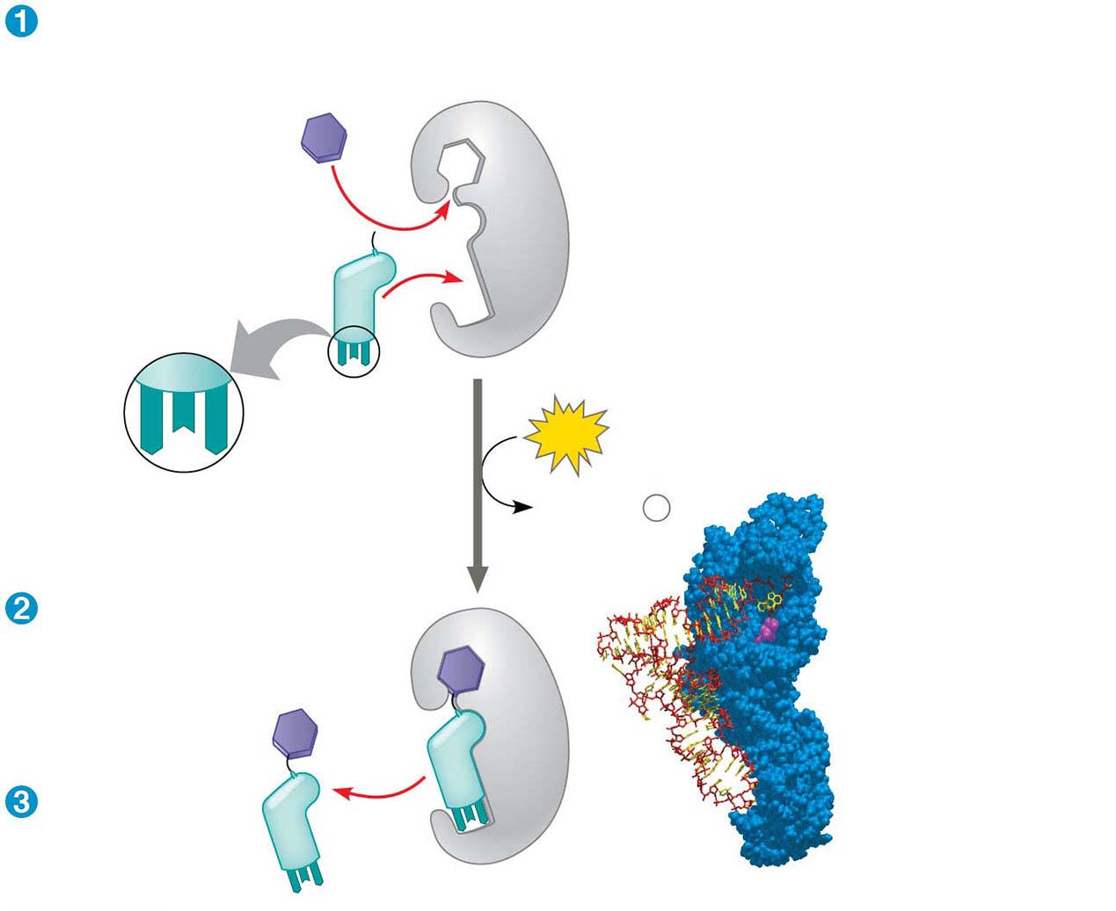
Figure 14.16
Amino acid
and tRNA
enter active
site.
Tyrosine (Tyr)
(amino acid)
Tyrosyl-tRNA
synthetase
Tyr-tRNA
A
U
A
ATP
Aminoacyl-tRNA
synthetase
Complementary
tRNA anticodon
AMP + 2
P
i
tRNA
Using ATP,
synthetase
catalyzes
covalent
bonding.
Amino
acid
Aminoacyl
tRNA
released.
Computer model
Notes:
Figure 14.16 Aminoacyl-tRNA synthetases provide specificity in joining amino acids to their tRNAs.

Slide 71
Ribosomes
Ribosomes facilitate specific coupling of tRNA anticodons with mRNA codons during protein synthesis
The large and small ribosomal are made of proteins and ribosomal RNAs (rRNAs)
In bacterial and eukaryotic ribosomes the large and small subunits join to form a ribosome only when attached to an mRNA molecule
Notes:
71
71

Slide 72
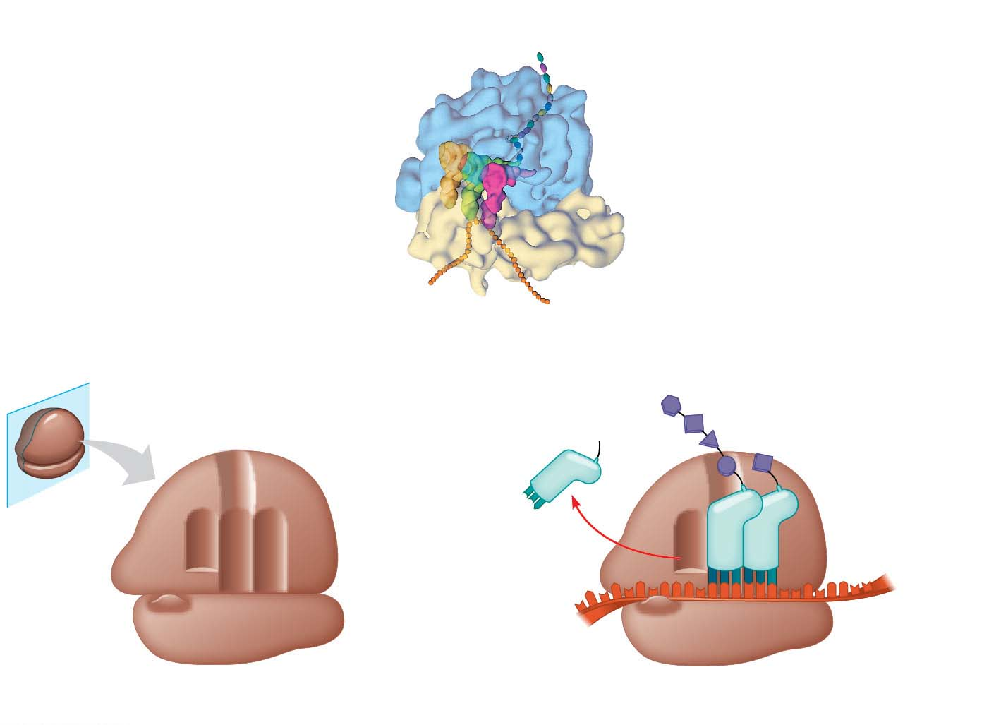
Figure 14.17
Growing polypeptide Exit tunnel
tRNA
molecules
Large
subunit
E
P
A
Small
subunit
5′
3′
mRNA
(a) Computer model of functioning ribosome
Amino end
Growing polypeptide
P site (peptidyl-tRNA
binding site)
_
Next amino acid
to be added to
polypeptide chain
Exit tunnel
A site (aminoacyl-
tRNA binding site)
_
E site
(exit site)
E
E
P A
Large
subunit
tRNA
mRNA
3′
mRNA
binding site
Small
subunit
5′
Codons
(b) Schematic model showing binding sites
(c) Schematic model with mRNA and tRNA
© Pearson Education, Inc.
Notes:
Figure 14.17 The anatomy of a functioning ribosome

Slide 73
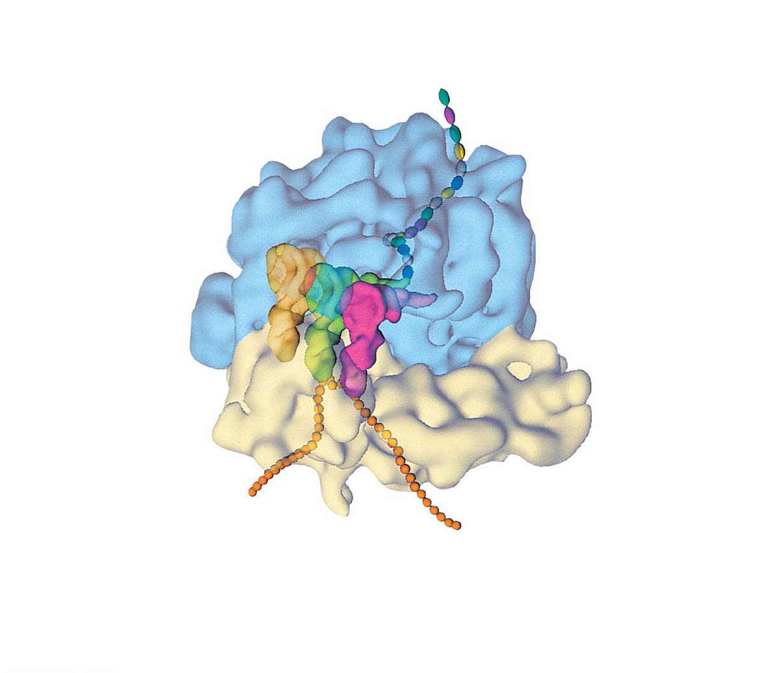
Figure 14.17-1
Growing polypeptide
Exit tunnel
tRNA
molecules
Large
subunit
E
P
A
Small
subunit
5′
mRNA
3′
(a) Computer model of functioning ribosome
© Pearson Education, Inc.
Notes:
Figure 14.17-1 The anatomy of a functioning ribosome (part 1: computer model)

Slide 74
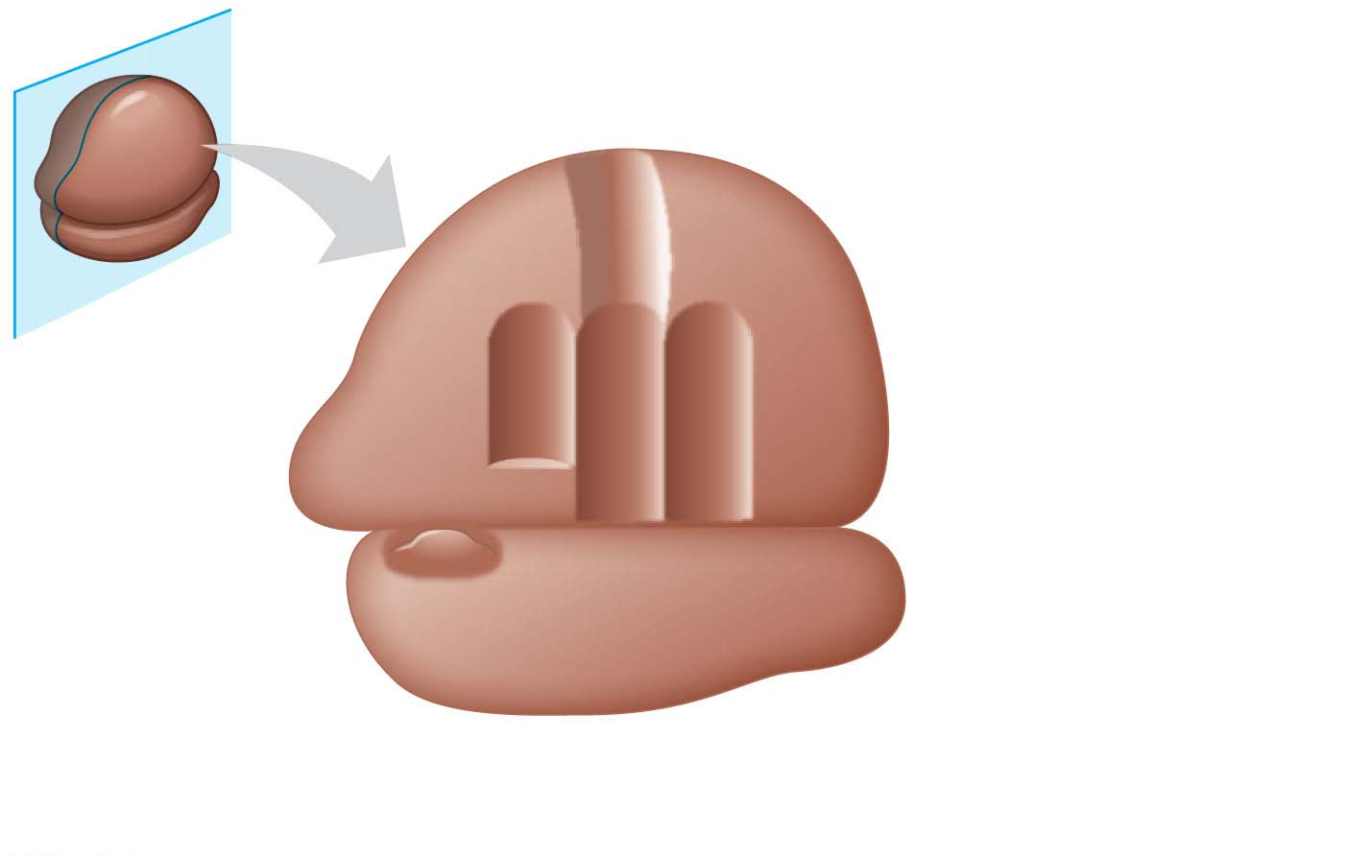
Figure 14.17-2
P site (peptidyl-tRNA
binding site)
Exit tunnel
A site (aminoacyl-
tRNA binding site)
E site
(exit site)
E
P
A
Large
subunit
mRNA
binding site
Small
subunit
(b) Schematic model showing binding sites
© Pearson Education, Inc.
Notes:
Figure 14.17-2 The anatomy of a functioning ribosome (part 2: binding sites)

Slide 75
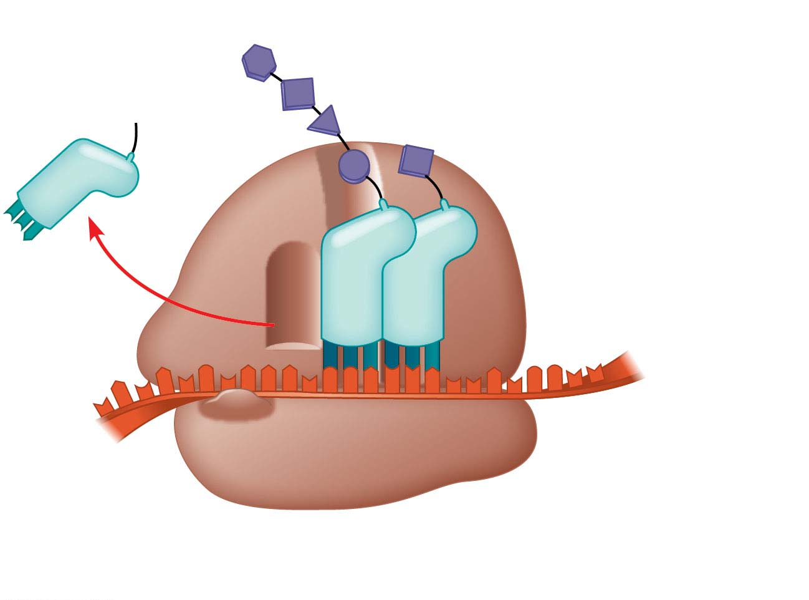
Figure 14.17-3
Growing polypeptide
Amino end
Next amino acid
to be added to
polypeptide chain
E
tRNA
mRNA
3′
5′
Codons
(c) Schematic model with mRNA and tRNA
© Pearson Education, Inc.
Notes:
Figure 14.17-3 The anatomy of a functioning ribosome (part 3: mRNA and tRNA)

Slide 76
A ribosome has three binding sites for tRNA
The P site holds the tRNA that carries the growing polypeptide chain
The A site holds the tRNA that carries the next amino acid to be added to the chain
The E site is the exit site, where discharged tRNAs leave the ribosome
Notes:
76
76

Slide 77
Building a Polypeptide
The three stages of translation
Initiation
Elongation
Termination
All three stages require protein “factors” that aid in the translation process
Energy is provided by hydrolysis of GTP
Notes:
77
77

Slide 78
Ribosome Association and Initiation of Translation
The initiation stage of translation brings together mRNA, a tRNA with the first amino acid, and the two ribosomal subunits
A small ribosomal subunit binds with mRNA and a special initiator tRNA
Then the small subunit moves along the mRNA until it reaches the start codon (AUG)
Notes:
78
78

Slide 79
Animation: Translation Introduction

Slide 80
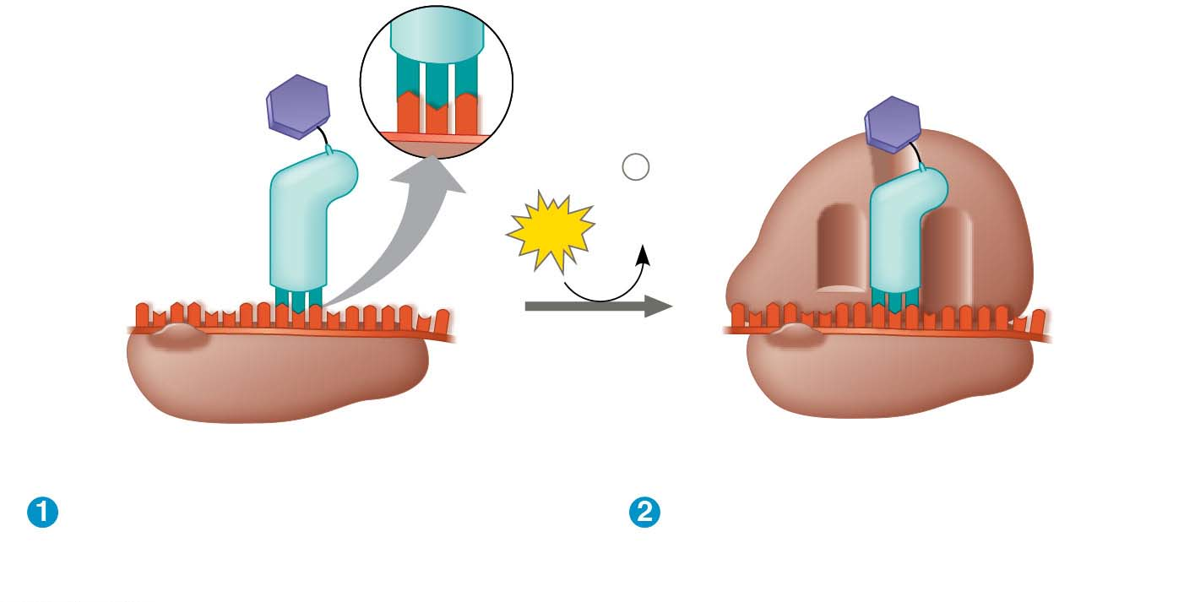
Figure 14.18
3′
U
A
C
5′
P site
Large
ribosomal
subunit
Met
5′
A
U
G
3′
Met
P
i
+
Initiator tRNA
GTP
GDP
E
A
mRNA
5′
3′
5′
3′
Start codon
Small
ribosomal
subunit
mRNA binding site
Translation initiation complex
Small ribosomal subunit binds
to mRNA.
Large ribosomal subunit
completes the initiation
complex.
Notes:
Figure 14.18 The initiation of translation

Slide 81
The start codon is important because it establishes the reading frame for the mRNA
The addition of the large ribosomal subunit is last and completes the formation of the translation initiation complex
Proteins called initiation factors bring all these components together
Notes:
81
81

Slide 82
Elongation of the Polypeptide Chain
During elongation, amino acids are added one by one to the previous amino acid at the C-terminus of the growing chain
Each addition involves proteins called elongation factors and occurs in three steps: codon recognition, peptide bond formation, and translocation
Translation proceeds along the mRNA in a 5′ to 3′ direction
Notes:
82
82

Slide 83
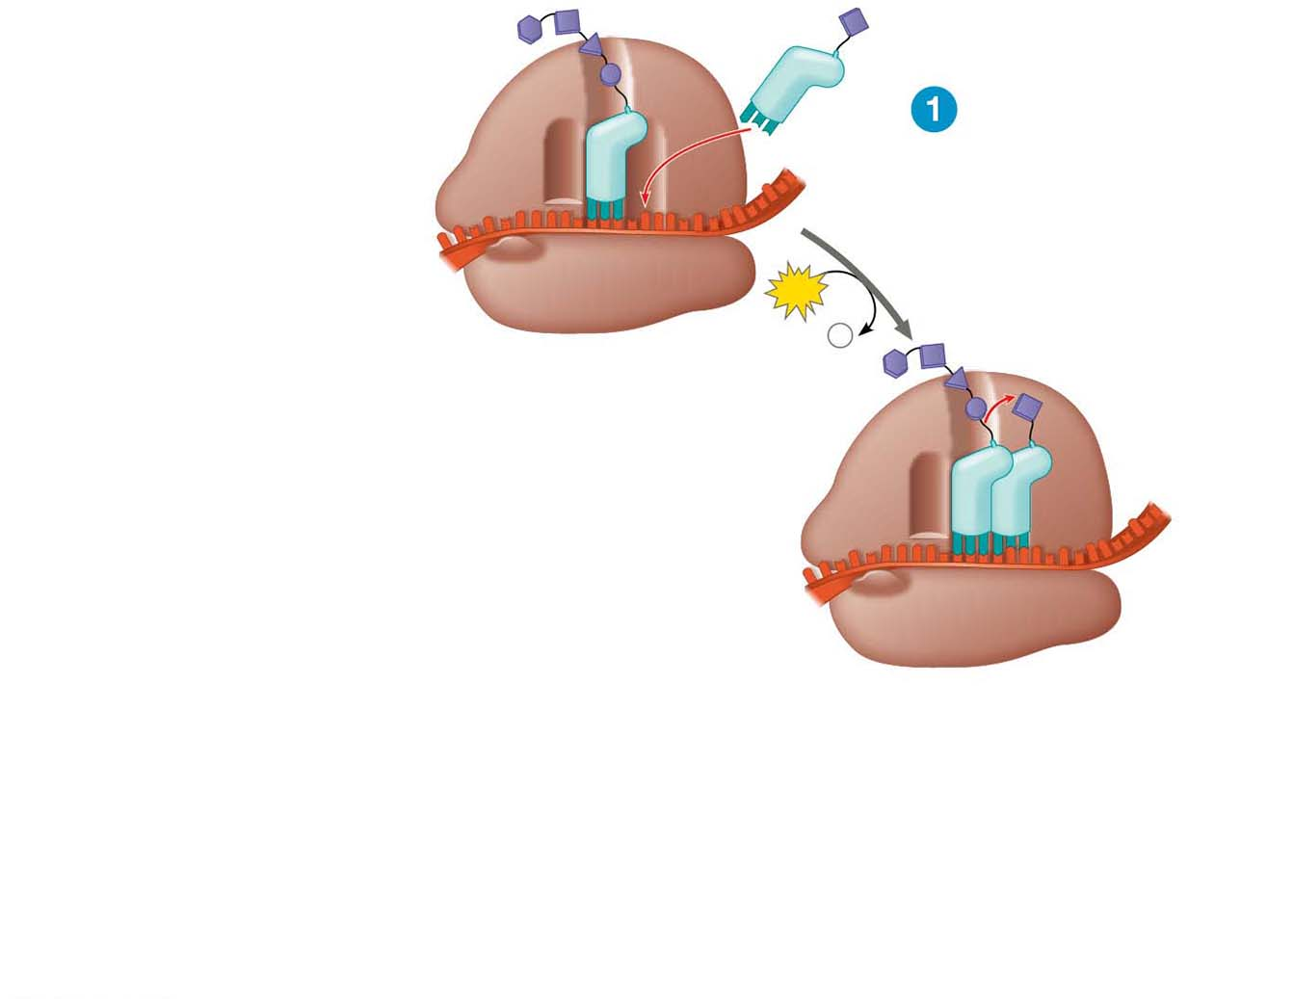
Figure 14.19-s1
Amino end
of polypeptide
Codon recognition
E
3′
mRNA
P
site
A
site
5′
GTP
GDP +
P
i
E
P
A
Notes:
Figure 14.19-s1 The elongation cycle of translation (step 1)

Slide 84
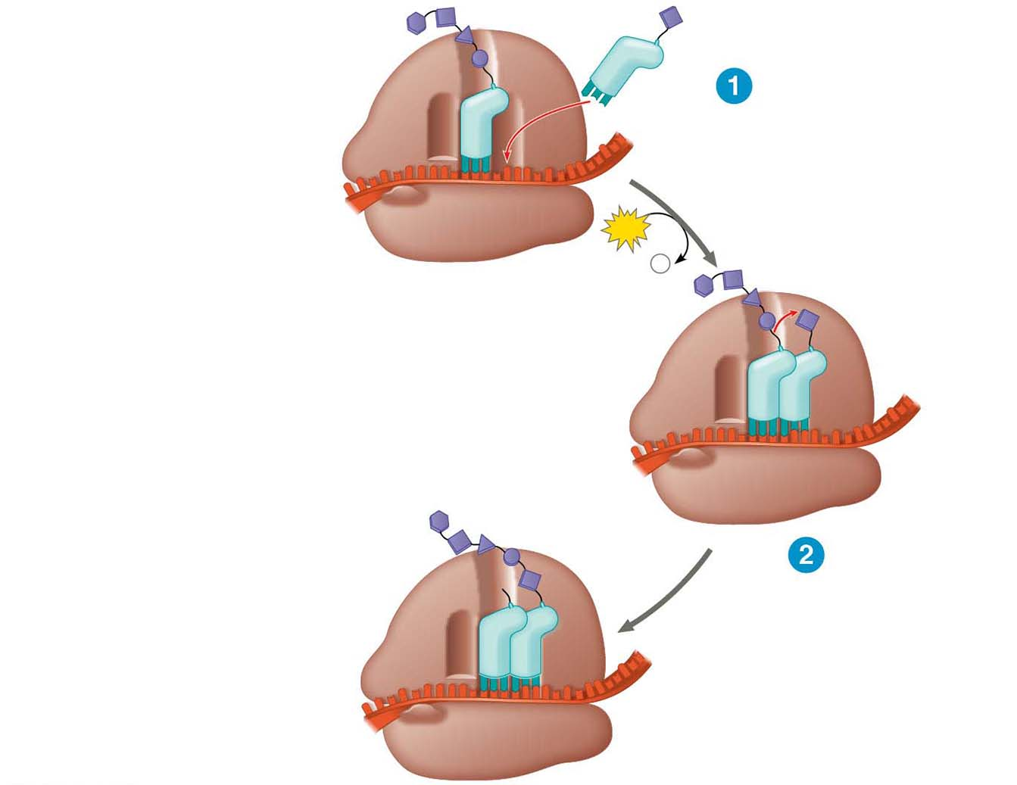
Figure 14.19-s2
Amino end
of polypeptide
Codon recognition
E
3′
mRNA
P
site
A
site
5′
GTP
GDP +
P
i
E
P
A
Peptide bond
formation
E
P
A
Notes:
Figure 14.19-s2 The elongation cycle of translation (step 2)

Slide 85
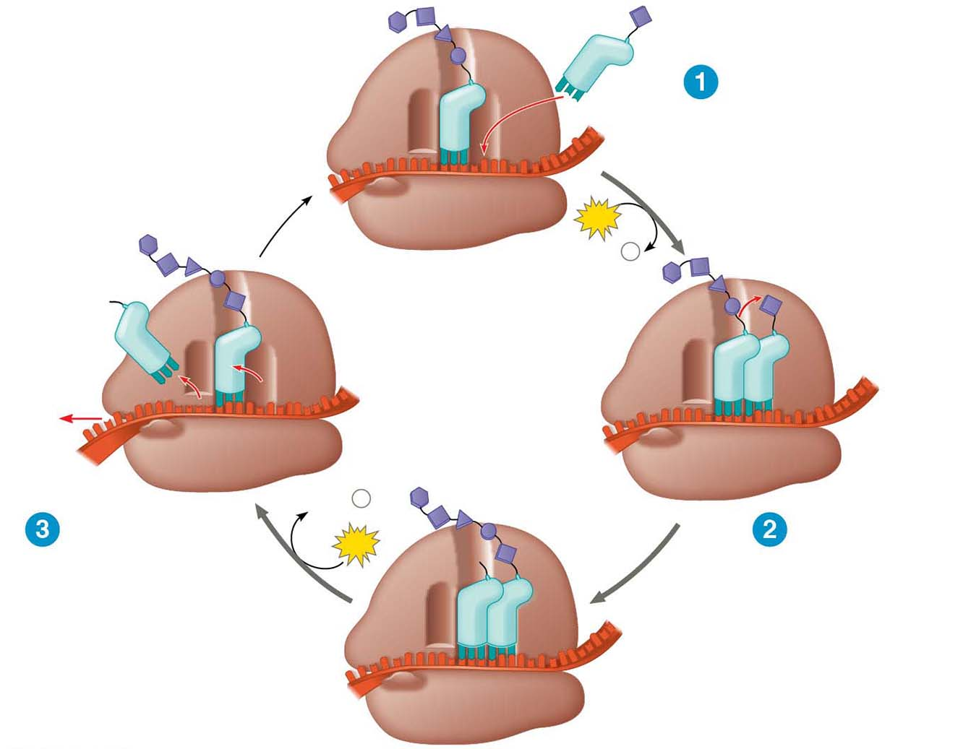
Figure 14.19-s3
Amino end
of polypeptide
Codon recognition
E
3′
mRNA
Ribosome ready for
next aminoacyl tRNA
P
site
A
site
5′
GTP
GDP +
P
i
E
E
P
A
P
A
GDP +
P
i
Translocation
Peptide bond
formation
GTP
E
P
A
Notes:
Figure 14.19-s3 The elongation cycle of translation (step 3)

Slide 86
Termination of Translation
Termination occurs when a stop codon in the mRNA reaches the A site of the ribosome
The A site accepts a protein called a release factor
The release factor causes the addition of a water molecule instead of an amino acid
This reaction releases the polypeptide, and the translation assembly then comes apart
Notes:
86
86

Slide 87
Figure 14.20-s1
Release
factor
3′
5′
Stop codon
(UAG, UAA, or UGA)
Ribosome reaches a
stop codon on mRNA.
Notes:
Figure 14.20-s1 The termination of translation (step 1)

Slide 88
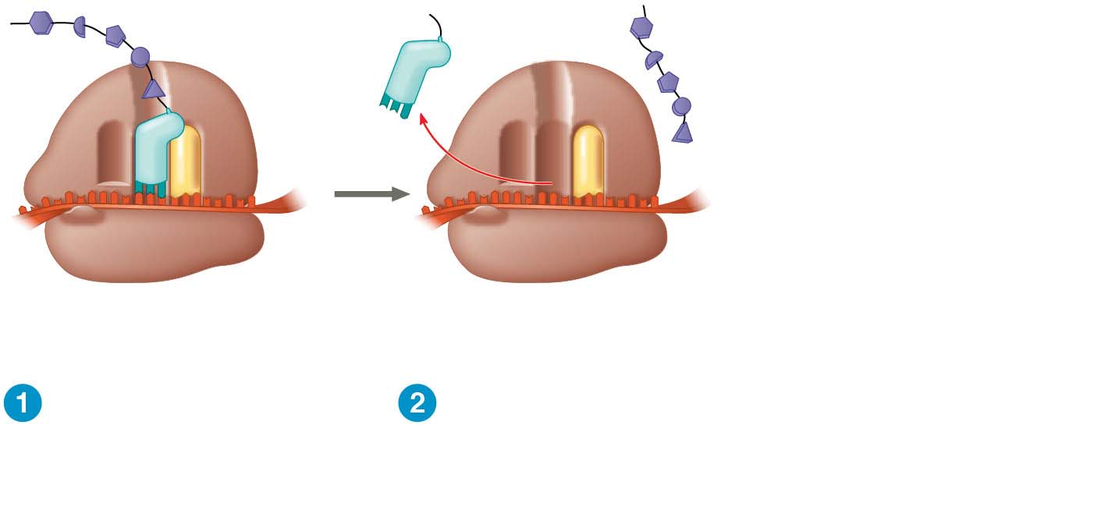
Figure 14.20-s2
Release
factor
Free
polypeptide
3′
3′
5′
5′
Stop codon
(UAG, UAA, or UGA)
Ribosome reaches a
stop codon on mRNA.
Release factor
promotes hydrolysis.
Notes:
Figure 14.20-s2 The termination of translation (step 2)

Slide 89
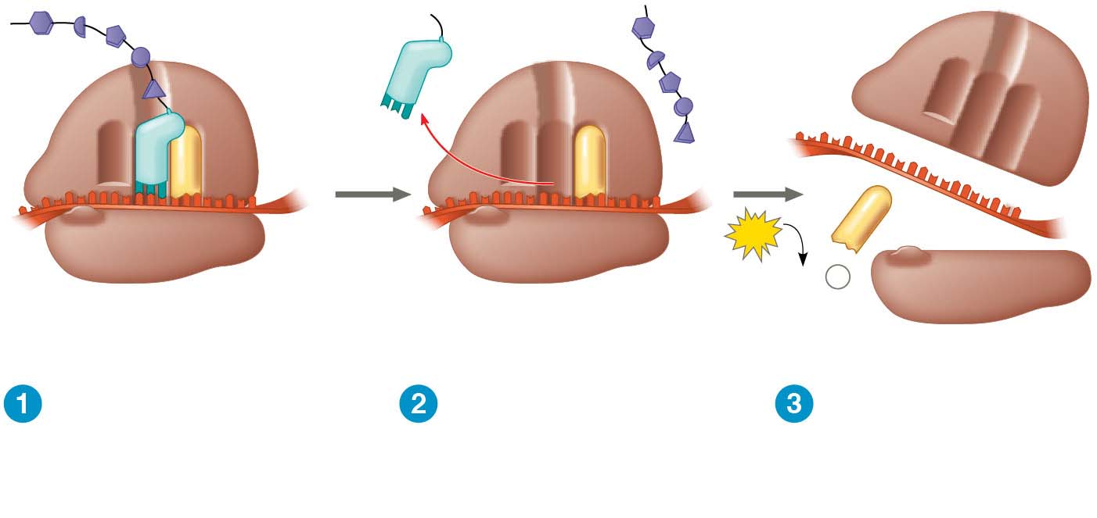
Figure 14.20-s3
Release
factor
Free
polypeptide
5′
3′
3′
5′
5′
2
GTP
3′
2 GDP + 2
P
i
Stop codon
(UAG, UAA, or UGA)
Ribosome reaches a
stop codon on mRNA.
Release factor
promotes hydrolysis.
Ribosomal
subunits and other
components
dissociate.
Notes:
Figure 14.20-s3 The termination of translation (step 3)

Slide 90
Completing and Targeting the Functional Protein
Often translation is not sufficient to make a functional protein
Polypeptide chains are modified after translation or targeted to specific sites in the cell
Notes:
90
90

Slide 91
Protein Folding and Post-Translational Modifications
During synthesis, a polypeptide chain spontaneously coils and folds into its three-dimensional shape
Proteins may also require post-translational modifications before doing their jobs
Notes:
91
91

Slide 92
Targeting Polypeptides to Specific Locations
Two populations of ribosomes are evident in cells: free ribosomes (in the cytosol) and bound ribosomes (attached to the ER)
Free ribosomes mostly synthesize proteins that function in the cytosol
Bound ribosomes make proteins of the endomembrane system and proteins that are secreted from the cell
Notes:
92
92

Slide 93
Polypeptide synthesis always begins in the cytosol
Synthesis finishes in the cytosol unless the polypeptide signals the ribosome to attach to the ER
Polypeptides destined for the ER or for secretion are marked by a signal peptide
Notes:
93
93

Slide 94
A signal-recognition particle (SRP) binds to the signal peptide
The SRP brings the signal peptide and its ribosome to the ER
Notes:
94
94

Slide 95
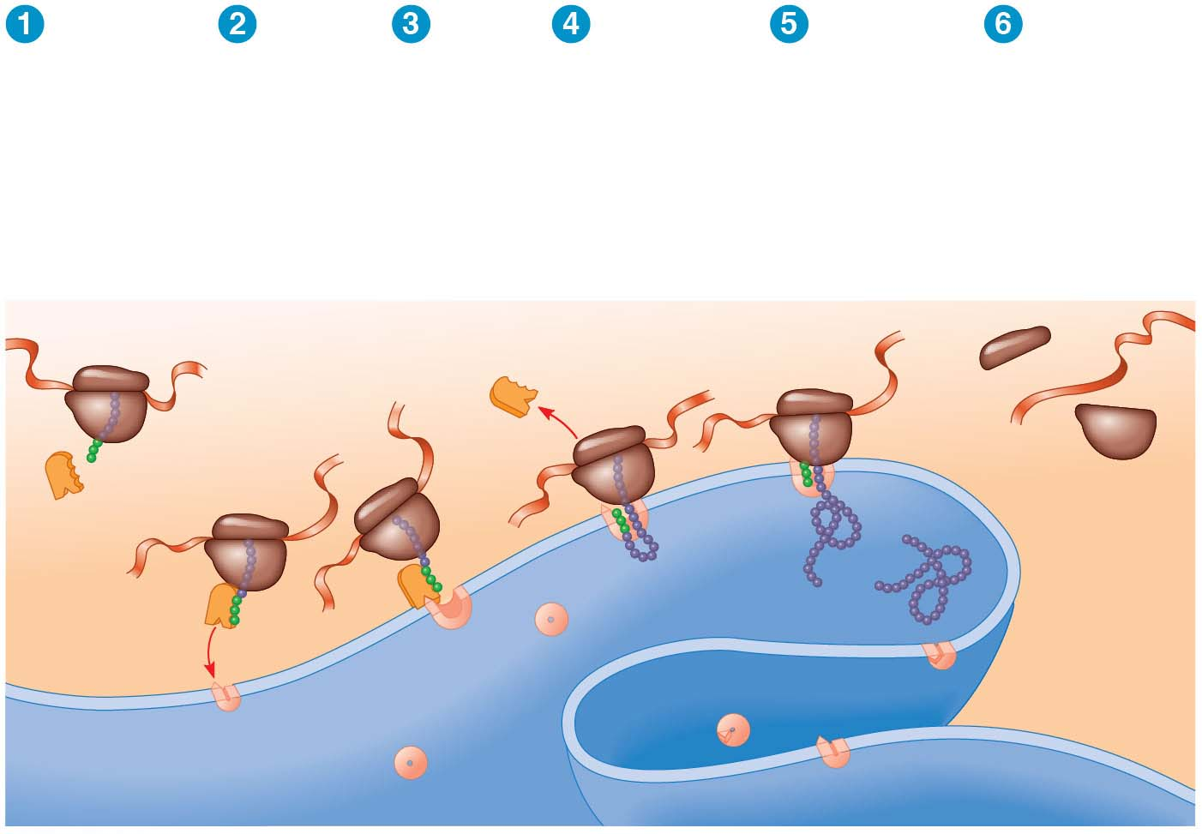
Figure 14.21
Polypeptide
synthesis
begins.
SRP
binds to
signal
peptide.
SRP
binds to
receptor
protein.
SRP
detaches
and
polypeptide
synthesis
resumes.
Signal-
cleaving
enzyme cuts
off signal
peptide.
Completed
polypeptide
folds into
final
conformation.
Ribosome
mRNA
Signal
peptide
ER
membrane
SRP
Signal
peptide
removed
Protein
CYTOSOL
SRP receptor
protein
ER LUMEN
Translocation complex
Notes:
Figure 14.21 The signal mechanism for targeting proteins to the ER

Slide 96
Making Multiple Polypeptides in Bacteria and Eukaryotes
In bacteria and eukaryotes, multiple ribosomes translate an mRNA at the same time
Once a ribosome is far enough past the start codon, another ribosome can attach to the mRNA
Strings of ribosomes called polyribosomes (or polysomes) can be seen with an electron microscope
Notes:
96
96

Slide 97
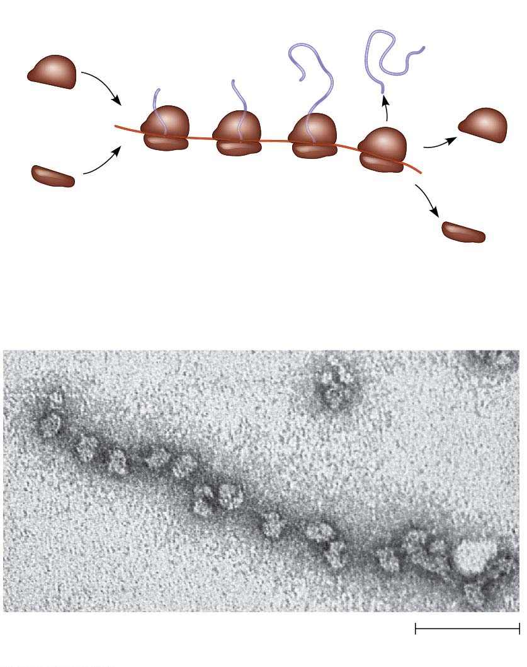
Figure 14.22
Completed
polypeptide
Growing
polypeptides
Incoming
ribosomal
subunits
Polyriboso
me
Start of
mRNA
(5′ end)
End of
mRNA
(3′ end)
(a) An mRNA molecule translated simultaneously by several ribosomes
Ribosomes
mRNA
(b) A large polyribosome in a bacterial cell (TEM)
0.1 μm
Notes:
Figure 14.22 Polyribosomes

Slide 98
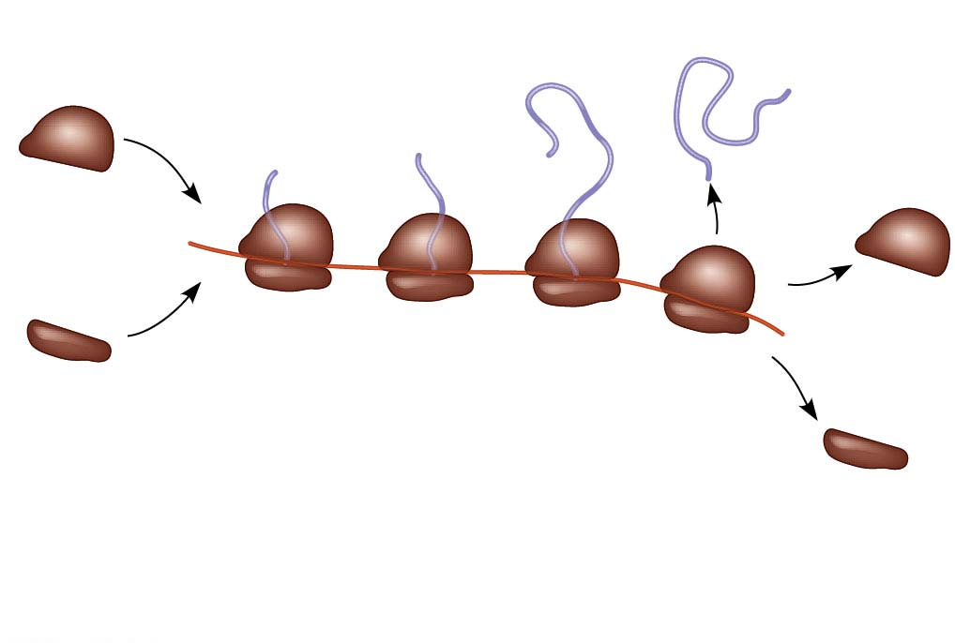
Figure 14.22-1
Completed
polypeptide
Growing
polypeptides
Incoming
ribosomal
subunits
Polyriboso
me
Start of
mRNA
(5′ end)
End of
mRNA
(3′ end)
(a) An mRNA molecule translated simultaneously by several ribosomes
Notes:
Figure 14.22-1 Polyribosomes (part 1: art)

Slide 99
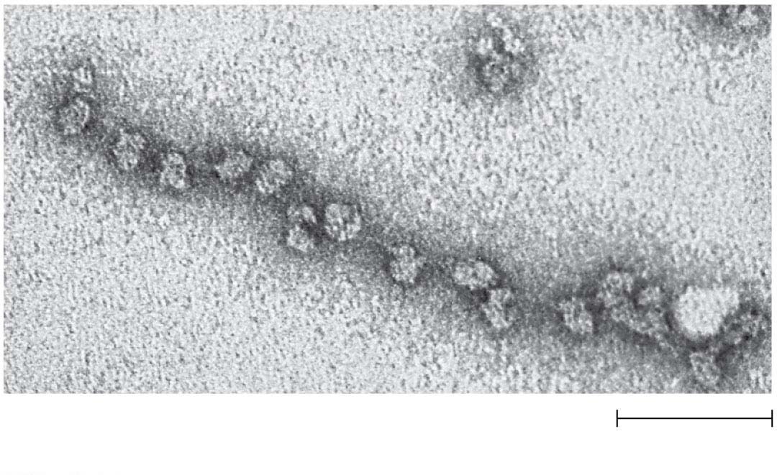
Figure 14.22-2
Ribosomes
mRNA
(b) A large polyribosome in a bacterial cell (TEM)
0.1 μm
Notes:
Figure 14.22-2 Polyribosomes (part 2: TEM)

Slide 100
Bacteria and eukaryotes can also transcribe multiple mRNAs from the same gene
In bacteria, the transcription and translation can take place simultaneously
In eukaryotes, the nuclear envelope separates transcription and translation
Notes:
100
100

Slide 101
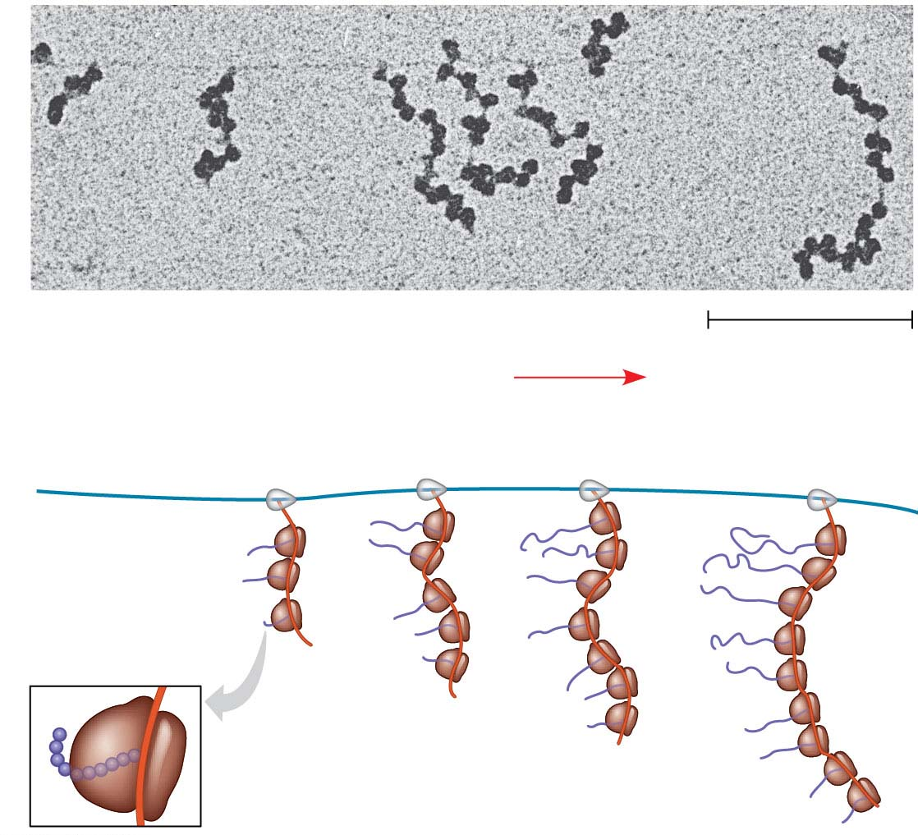
Figure 14.23
RNA polymerase
DNA
mRNA
Polyribosome
Direction of
transcription
0.25 μm
RNA
polymerase
DNA
Polyribosome
Polypeptide
(amino end)
Ribosome
mRNA (5′ end)
Notes:
Figure 14.23 Coupled transcription and translation in bacteria

Slide 102
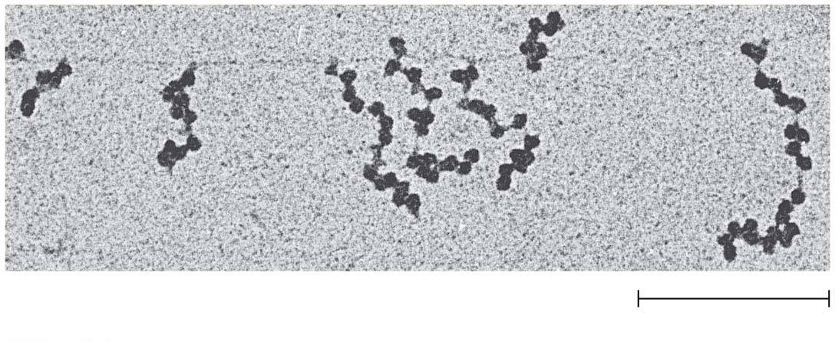
Figure 14.23-1
RNA polymerase
DNA
mRNA
Polyribosome
0.25 μm
Notes:
Figure 14.23-1 Coupled transcription and translation in bacteria (part 1: TEM)

Slide 103
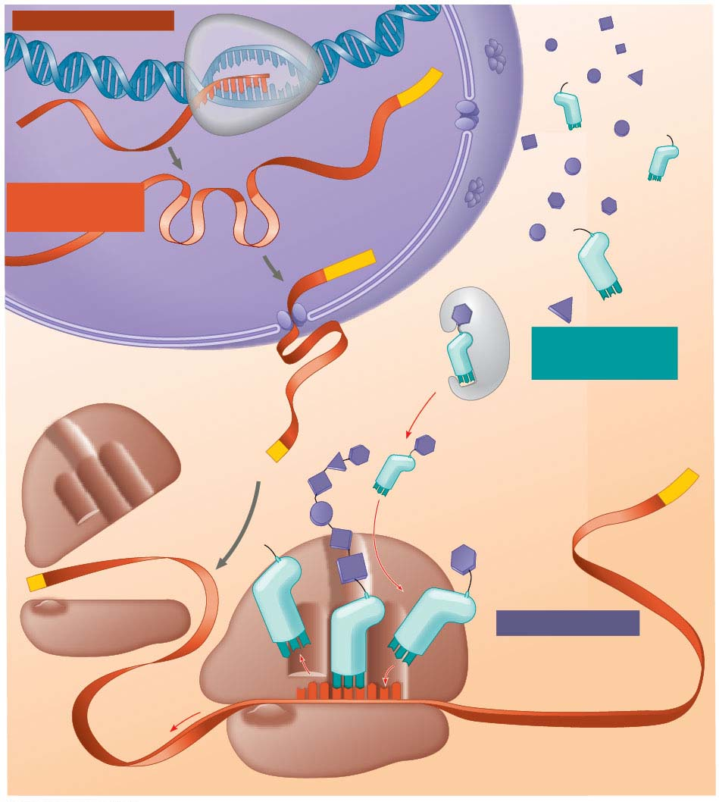
Figure 14.24
TRANSCRIPTION
DNA
3′
Poly-A
5′
RNA
transcript
RNA
polymerase
Exon
RNA
PROCESSING
RNA transcript
(pre-mRNA)
Intron
Poly-A
Aminoacyl-tRNA
synthetase
NUCLEUS
Amino
acid
AMINO ACID
ACTIVATION
CYTOPLASM
tRNA
mRNA
5′ Cap
Aminoacyl
(charged)
tRNA
A
3′
E
P
Poly-A
Ribosomal
subunits
5′ Cap
TRANSLATION
A CC
E
A
UAC
A
A
A
Anticodon
U G G U U U A U G
Codon
Ribosome
Notes:
Figure 14.24 A summary of transcription and translation in a eukaryotic cell

Slide 104
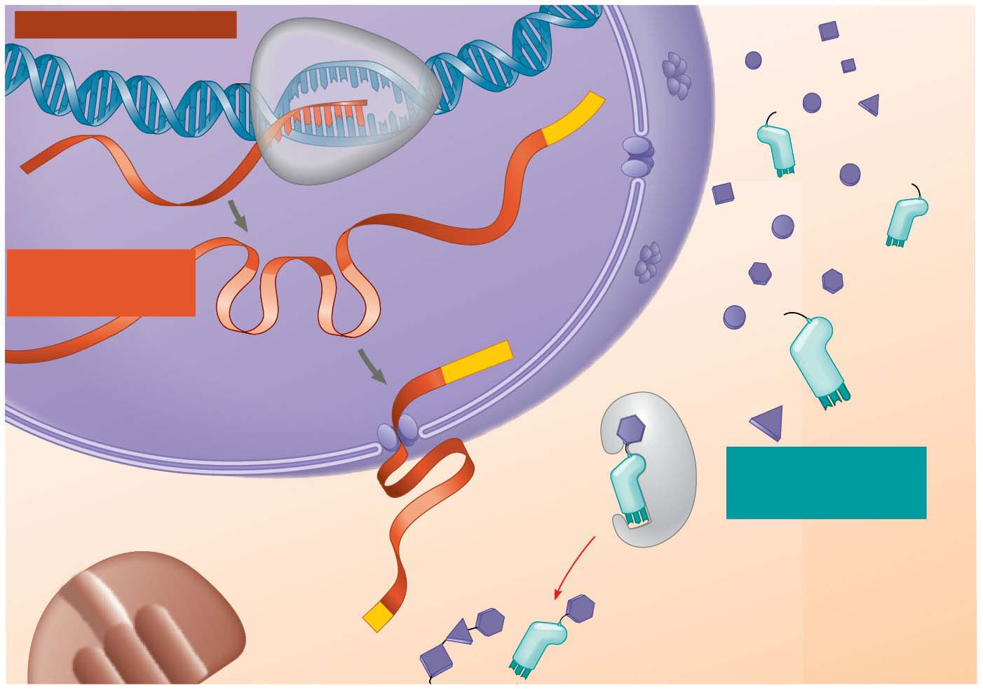
Figure 14.24-1
TRANSCRIPTION
DNA
3′
Poly-A
RNA
polymerase
5′
RNA
transcript
Exon
RNA
PROCESSING
RNA transcript
(pre-mRNA)
Intron
Aminoacyl-tRNA
synthetase
Poly-A
NUCLEUS
Amino
acid
AMINO ACID
ACTIVATION
CYTOPLASM
tRNA
mRNA
5′ Cap
Aminoacyl
(charged)
tRNA
Notes:
Figure 14.24-1 A summary of transcription and translation in a eukaryotic cell (part 1)

Slide 105
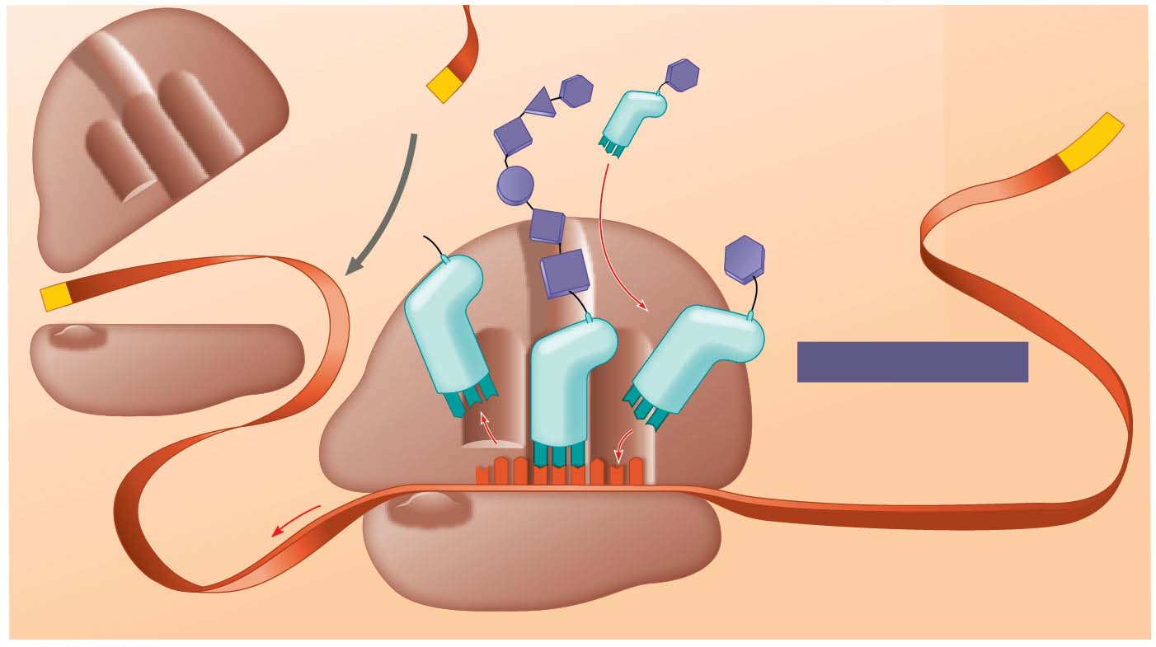
Figure 14.24-2
mRNA
Growing polypeptide
5′ Cap
3′
A
Aminoacyl
(charged)
tRNA
E
P
Poly-A
Ribosomal
subunits
5′ Cap
TRANSLATION
A
C
C
U
E
A
A
C
A
A
A
Anticodon
U
G
G
U
U
U
A
U
G
Codon
Ribosome
Notes:
Figure 14.24-2 A summary of transcription and translation in a eukaryotic cell (part 2)

Slide 106
Concept 14.5: Mutations of one or a few nucleotides can affect protein structure and function
Mutations are changes in the genetic material of a cell or virus
Point mutations are chemical changes in just one nucleotide pair of a gene
The change of a single nucleotide in a DNA template strand can lead to the production of an abnormal protein
If a point mutation occurs in a gamete, it may be transmitted to offspring
Notes:
106
106

Slide 107
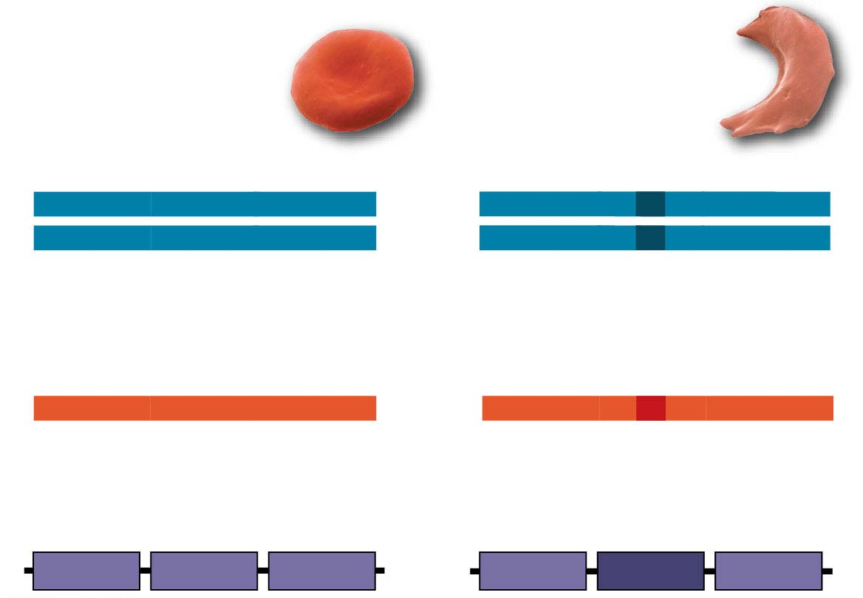
Figure 14.25
Wild-type β-globin
Sickle-cell β-globin
Wild-type β-globin DNA
Mutant β-globin DNA
3′
C T C
5′
3′
C A C
5′
5′
G A G
3′
5′
G T G
3′
mRNA
mRNA
5′
G A G
3′
5′
G U G
3′
Normal hemoglobin
Sickle-cell hemoglobin
Glu
Val
Notes:
Figure 14.25 The molecular basis of sickle-cell disease: a point mutation

Slide 108
Types of Small-Scale Mutations
Point mutations within a gene can be divided into two general categories
Single nucleotide-pair substitutions
Nucleotide-pair insertions or deletions
Notes:
108
108

Slide 109
Substitutions
A nucleotide-pair substitution replaces one nucleotide and its partner with another pair of nucleotides
Silent mutations have no effect on the amino acid produced by a codon because of redundancy in the genetic code
Notes:
109
109

Slide 110
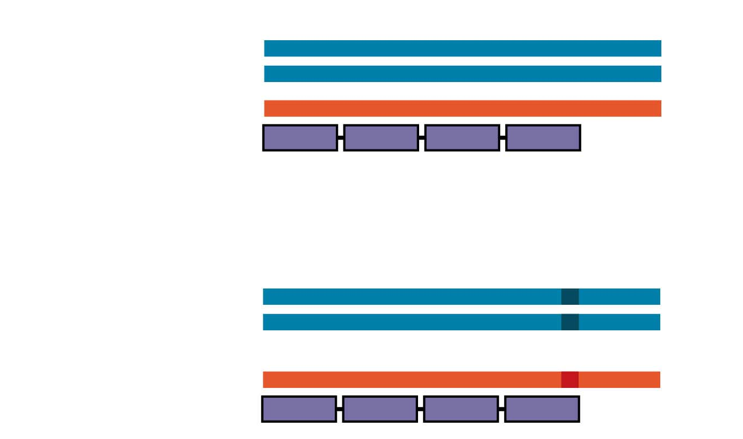
Figure 14.26-1
Wild type
DNA template strand 3′
T
A
C
T
T
C
A
A
A
C
C
G
A
T
T
5′
5′
A
T
G
A
A
G
T
T
T
G
G
C
T
A
A
3′
mRNA 5′
A
U
G
A
A
G
U
U
U
G
G
C
U
A
A
3′
Protein
Met
Lys
Phe
Gly
Stop
Amino end
Carboxyl end
Nucleotide-pair substitution: silent
A instead of G
3′
T
A
C
T
T
C
A
A
A
C
C
A
A
T
T
5′
5′
A
T
G
A
A
G
T
T
T
G
G
T
T
A
A
3′
U instead of C
5′
A
U
G
A
A
G
U
U
U
G
G
U
U
A
A
3′
Met
Lys
Phe
Gly
Stop
Notes:
Figure 14.26-1 Types of small-scale mutations that affect mRNA sequence (part 1: silent)

Slide 111
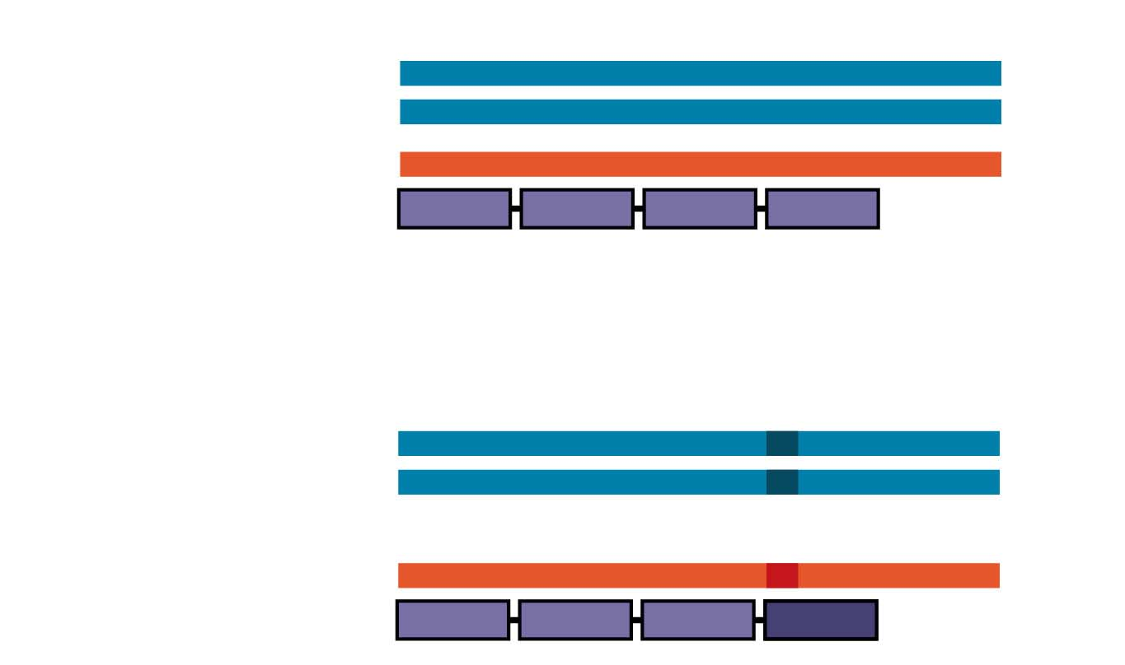
Figure 14.26-2
Wild type
DNA template strand 3′
T
A
C
T
T
C
A
A
A
C
C
G
A
T
T
5′
5′
A
T
G
A
A
G
T
T
T
G
G
C
T
A
A
3′
mRNA 5′
A
U
G
A
A
G
U
U
U
G
G
C
U
A
A
3′
Protein
Met
Lys
Phe
Gly
Stop
Amino end
Carboxyl end
Nucleotide-pair substitution: missense
T instead of C
3′
T
A
C
T
T
C
A
A
A
T
C
G
A
T
T
5′
5′
A
T
G
A
A
G
T
T
T
A
G
C
T
A
A
3′
A instead of G
5′
A
U
G
A
A
G
U
U
U
A
G
C
U
A
A
3′
Met
Lys
Phe
Ser
Stop
Notes:
Figure 14.26-2 Types of small-scale mutations that affect mRNA sequence (part 2: missense)

Slide 112
Figure 14.26-3
Wild type
DNA template strand 3′
T
A
C
T
T
C
A
A
A
C
C
G
A
T
T
5′
5′
A
T
G
A
A
G
T
T
T
G
G
C
T
A
A
3′
mRNA 5′
A
U
G
A
A
G
U
U
U
G
G
C
U
A
A
3′
Protein
Met
Lys
Phe
Gly
Stop
Amino end
Carboxyl end
Nucleotide-pair substitution: nonsense
A instead of T
3′
T
A
C
A
T
C
A
A
A
C
C
G
A
T
T
5′
5′
A
T
G
T
A
G
T
T
T
G
G
C
T
A
A
3′
U instead of A
5′
A
U
G
U
A
G
U
U
U
G
G
U
U
A
A
3′
Met
Stop
Notes:
Figure 14.26-3 Types of small-scale mutations that affect mRNA sequence (part 3: nonsense)

Slide 113
Figure 14.26-4
Wild type
DNA template strand 3′
T
A
C
T
T
C
A
A
A
C
C
G
A
T
T
5′
5′
A
T
G
A
A
G
T
T
T
G
G
C
T
A
A
3′
mRNA 5′
A
U
G
A
A
G
U
U
U
G
G
C
U
A
A
3′
Protein
Met
Lys
Phe
Gly
Stop
Amino end
Carboxyl end
Nucleotide-pair insertion: frameshift causing immediate nonsense
Extra A
3′
T
A
C
A
T
T
C
A
A
A
C
C
G
A
T
T
5′
5′
A
T
G
T
A
A
G
T
T
T
G
G
C
T
A
A
3′
Extra U
5′
A
U
G
U
A
A
G
U
U
U
G
G
C
U
A
A
3′
Met
Stop
Notes:
Figure 14.26-4 Types of small-scale mutations that affect mRNA sequence (part 4: frameshift, nonsense)

Slide 114
Figure 14.26-5
Wild type
DNA template strand 3′
T
A
C
T
T
C
A
A
A
C
C
G
A
T
T
5′
5′
A
T
G
A
A
G
T
T
T
G
G
C
T
A
A
3′
mRNA 5′
A
U
G
A
A
G
U
U
U
G
G
C
U
A
A
3′
Protein
Met
Lys
Phe
Gly
Stop
Amino end
Carboxyl end
Nucleotide-pair deletion: frameshift causing extensive missense
A
missing
3′
T
A
C
T
T
C
A
A
C
C
G
A
T
T
5′
5′
A
T
G
A
A
G
T
T
G
G
C
T
A
A
3′
U
missing
5′
A
U
G
A
A
G
U
U
G
G
C
U
A
A
3′
Met
Lys
Leu
Ala
Notes:
Figure 14.26-5 Types of small-scale mutations that affect mRNA sequence (part 5: frameshift, missense)

Slide 115
Figure 14.26-6
Wild type
DNA template strand 3′
T
A
C
T
T
C
A
A
A
C
C
G
A
T
T
5′
5′
A
T
G
A
A
G
T
T
T
G
G
C
T
A
A
3′
mRNA 5′
A
U
G
A
A
G
U
U
U
G
G
C
U
A
A
3′
Protein
Met
Lys
Phe
Gly
Stop
Amino end
Carboxyl end
3 nucleotide-pair deletion: no frameshift, but one amino acid missing
T T C
missing
3′
T
A
C
A
A
A
C
C
G
A
T
T
5′
5′
A
T
G
T
T
T
G
G
C
T
A
A
3′
A A G
missing
5′
A
U
G
U
U
U
G
G
C
U
A
A
3′
Met
Phe
Gly
Stop
Notes:
Figure 14.26-6 Types of small-scale mutations that affect mRNA sequence (part 6: missing amino acid)

Slide 116
Missense mutations still code for an amino acid, but not the correct amino acid
Substitution mutations are usually missense mutations
Nonsense mutations change an amino acid codon into a stop codon, nearly always leading to a nonfunctional protein
Notes:
116
116

Slide 117
Insertions and Deletions
Insertions and deletions are additions or losses of nucleotide pairs in a gene
These mutations have a disastrous effect on the resulting protein more often than substitutions do
Insertion or deletion of nucleotides may alter the reading frame of the genetic message, producing a frameshift mutation
Notes:
117
117

Slide 118
New Mutations and Mutagens
Spontaneous mutations can occur during DNA replication, recombination, or repair
Mutagens are physical or chemical agents that can cause mutations
Researchers have developed methods to test the mutagenic activity of chemicals
Most cancer-causing chemicals (carcinogens) are mutagenic, and the converse is also true
Notes:
118
118

Slide 119
What Is a Gene? Revisiting the Question
The definition of a gene has evolved through the history of genetics
We have considered a gene as
A discrete unit of inheritance
A region of specific nucleotide sequence in a chromosome
A DNA sequence that codes for a specific polypeptide chain
Notes:
119
119

Slide 120
A gene can be defined as a region of DNA that can be expressed to produce a final functional product, either a polypeptide or an RNA molecule
Notes:
120
120

Slide 121
Figure 14.UN02
DNA
TRANSCRIPTION
RNA PROCESSING
Pre-mRNA
mRNA
TRANSLATION
Ribosome
Polypeptide
Notes:
Figure 14.UN02 In-text figure, transcription, p. 285

Slide 122
Figure 14.UN03
DNA
TRANSCRIPTION
RNA PROCESSING
Pre-mRNA
mRNA
TRANSLATION
Ribosome
Polypeptide
© Pearson Education, Inc.
Notes:
Figure 14.UN03 In-text figure, RNA processing, p. 287

Slide 123
Figure 14.UN04
DNA
TRANSCRIPTION
mRNA
Ribosome
TRANSLATION
Polypeptide
© Pearson Education, Inc.
Notes:
Figure 14.UN04 In-text figure, translation, p. 289

Slide 124
Figure 14.UN05-1
thrA
lacA
lacY
lacZ
lacI
recA
galR
Met J
lexA
trpR
5′
3′
−18
−17
−16
−15
−14
−13
−12
−11
−10
−9
−8
−7
−6
−5
−4
−3
−2
−1
0
1
2
3
4
5
6
7
8
Sequence alignment
Notes:
Figure 14.UN05-1 Skills exercise: interpreting a sequence logo (part 1)

Slide 125
Figure 14.UN05-2
5′
3′
−18
−17
−16
−15
−14
−13
−12
−11
−10
−9
−8
−7
−6
−5
−4
−3
−2
−1
0
1
2
3
4
5
6
7
8
Sequence logo
Notes:
Figure 14.UN05-2 Skills exercise: interpreting a sequence logo (part 2)

Slide 126
Figure 14.UN05-3
5′
3′
−18
−17
−16
−15
−14
−13
−12
−11
−10
−9
−8
−7
−6
−5
−4
−3
−2
−1
0
1
2
3
4
5
6
7
8
Notes:
Figure 14.UN05-3 Skills exercise: interpreting a sequence logo (part 3)

Slide 127
Figure 14.UN05-4
Ribosome binding site on mRNA
5′
3′
Notes:
Figure 14.UN05-4 Skills exercise: interpreting a sequence logo (part 4)

Slide 128
Figure 14.UN06
Transcription unit
Promoter
5′
3′
3′
3′
5′
5′
Template strand
of DNA
RNA
polymerase
RNA transcript
Notes:
Figure 14.UN06 Summary of key concepts: transcription

Slide 129
Figure 14.UN07
5′ Cap
Poly-A tail
5′
Exon Intron Exon
Intron
Exon 3′
Pre-mRNA
RNA splicing
mRNA
5′ UTR
Coding
segment
3′ UTR
Notes:
Figure 14.UN07 Summary of key concepts: RNA processing

Slide 130
Figure 14.UN08
Polypeptide
Amino
acid
tRNA
E
A
Anti-
codon
Codon
mRNA
Ribosome
Notes:
Figure 14.UN08 Summary of key concepts: translation

Slide 131
Figure 14.UN09
Notes:
Figure 14.UN09 Test your understanding, question 9 (types of RNA)

Slide 132
Figure 14.UN10
Notes:
Figure 14.UN10 Test your understanding, question 13 (“temperature-sensitive” mutation)

