Slide 1
0
13
The Molecular Basis of Inheritance

Slide 2
Overview: Life’s Operating Instructions
In 1953, James Watson and Francis Crick introduced an elegant double-helical model for the structure of deoxyribonucleic acid, or DNA
DNA, the substance of inheritance, is the most celebrated molecule of our time
Hereditary information is encoded in DNA and reproduced in all cells of the body (DNA replication)
Notes:
2

Slide 3
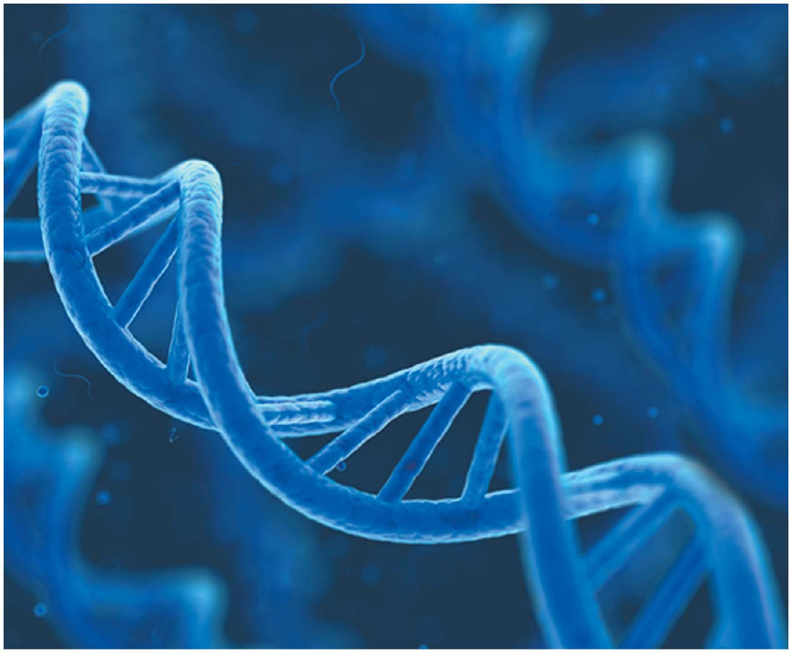
Figure 13.1
Notes:
Figure 13.1 What is the structure of DNA?

Slide 4
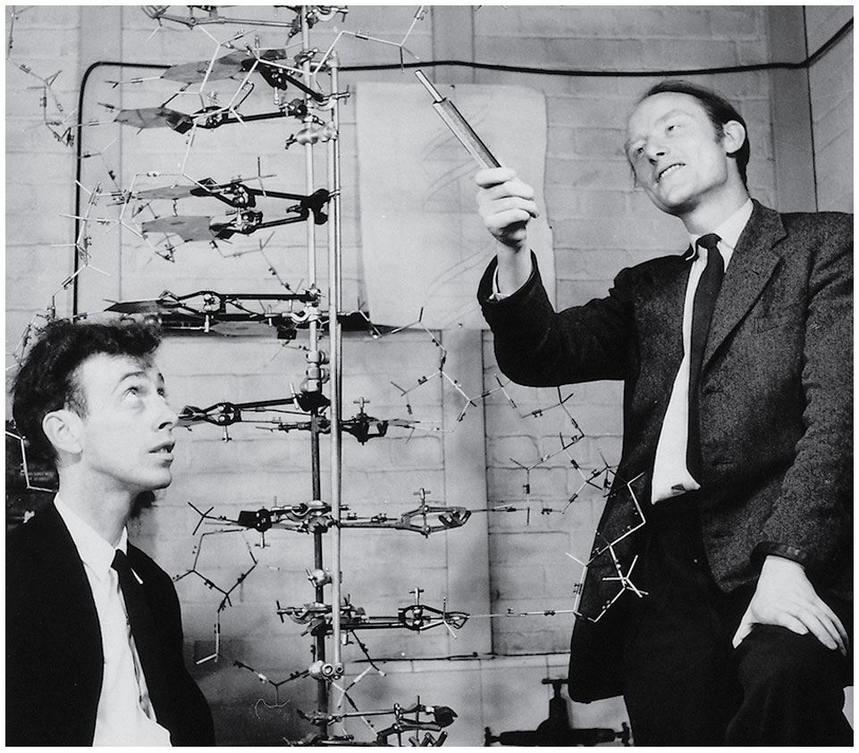
Figure 13.2
Notes:
Figure 13.2 James Watson (left) and Francis Crick with their DNA model

Slide 5
Concept 13.1: DNA is the genetic material
Early in the 20th century, the identification of the molecules of inheritance loomed as a major challenge to biologists
Notes:
5

Slide 6
The Search for the Genetic Material: Scientific Inquiry
When T. H. Morgan’s group showed that genes are located on chromosomes, the two components of chromosomes—DNA and protein—became candidates for the genetic material
The key factor in determining the genetic material was choosing appropriate experimental organisms
The role of DNA in heredity was worked out by studying bacteria and the viruses that infect them
Notes:
6

Slide 7
Evidence That DNA Can Transform Bacteria
The discovery of the genetic role of DNA began with research by Frederick Griffith in 1928
Griffith worked with two strains of a bacterium, one pathogenic and one harmless
Notes:
7

Slide 8
When he mixed heat-killed remains of the pathogenic strain with living cells of the harmless strain, some living cells became pathogenic
He called this phenomenon transformation, now defined as a change in genotype and phenotype due to assimilation of foreign DNA
Notes:
8

Slide 9
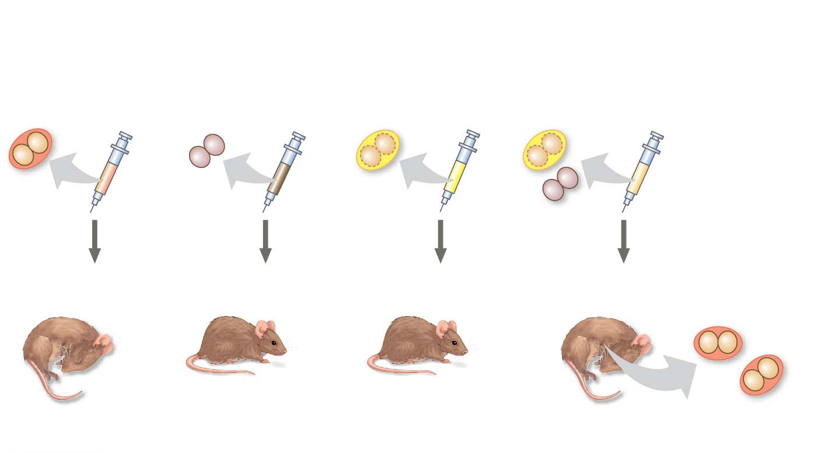
Figure 13.3
Experiment
Living S cells
(control)
Living R cells
(control)
Heat-killed S cells
(control)
Mixture of heat-
killed S cells and
living R cells
Results
Mouse dies
Mouse healthy
Mouse healthy
Mouse dies
Living S cells
Notes:
Figure 13.3 Inquiry: Can a genetic trait be transferred between different bacterial strains?

Slide 10
Later work by Oswald Avery and others identified the transforming substance as DNA
Many biologists remained skeptical, mainly because little was known about DNA and they thought proteins were better candidates for the genetic material
Notes:
10

Slide 11
Evidence That Viral DNA Can Program Cells
More evidence for DNA as the genetic material came from studies of viruses that infect bacteria
Such viruses, called bacteriophages (or phages), are widely used in molecular genetics research
A virus is DNA (or RNA) enclosed by a protective protein coat
Viruses must infect cells and take over the cells’ metabolic machinery in order to reproduce
Notes:
11

Slide 12
Animation: Phage T2 Reproduction

Slide 13
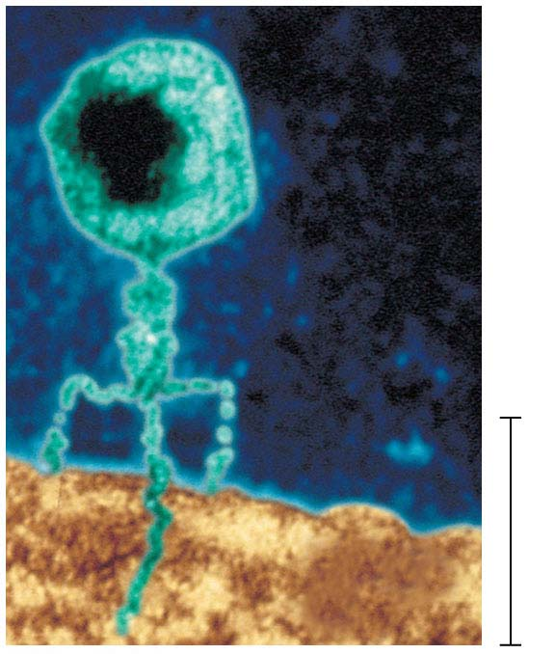
Figure 13.4
Phage
head
DNA
Tail
sheath
Tail fiber
Genetic
material
100 nm
Bacterial
cell
Notes:
Figure 13.4 A virus infecting a bacterial cell

Slide 14
In 1952, Alfred Hershey and Martha Chase showed that DNA is the genetic material of a phage known as T2
To determine this, they designed an experiment showing that only the DNA of the T2 phage, and not the protein, enters an E. coli cell during infection
They concluded that the injected DNA of the phage provides the genetic information
Notes:
14

Slide 15
Animation: Hershey-Chase Experiment

Slide 16
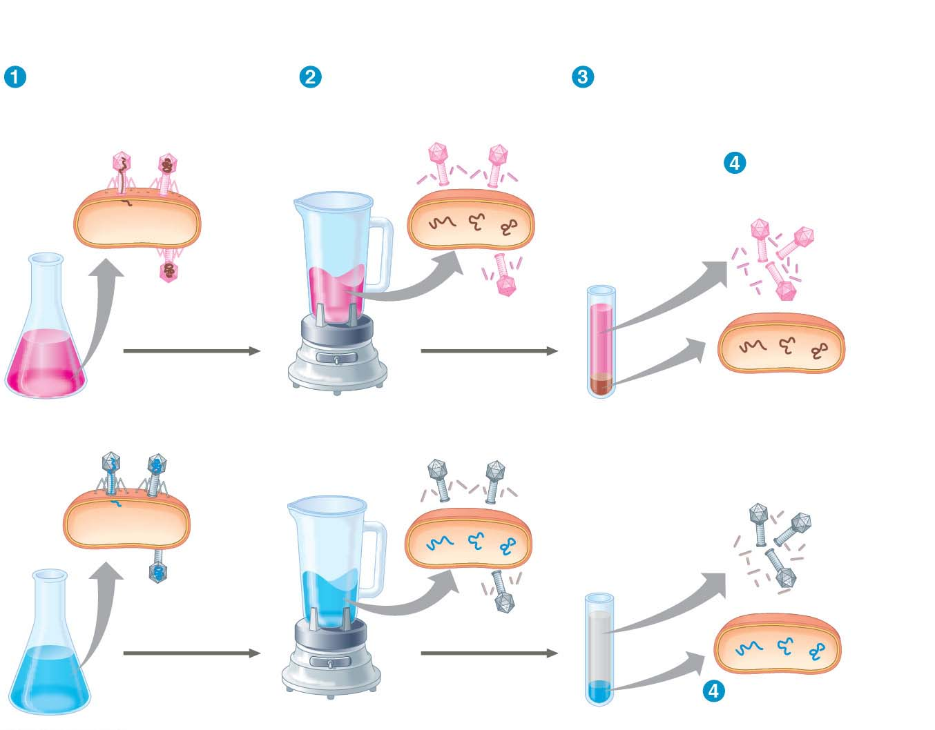
Figure 13.5
Experiment
Batch 1: Radioactive sulfur (³⁵S) in phage protein
Labeled phages
infect cells.
Agitation frees outside
phage parts from cells.
Centrifuged cells form
a pellet. Free phages
and phage parts remain
in liquid.
Radioactive
protein
Radioactivity
(phage protein)
found in liquid
DNA
Centrifuge
Batch 2: Radioactive phosphorus (³²P) in phage DNA
Pellet
Radioactive
DNA
Centrifuge
Radioactivity (phage
DNA) found in pellet
Pellet
Notes:
Figure 13.5 Inquiry: Is protein or DNA the genetic material of phage T2?

Slide 17
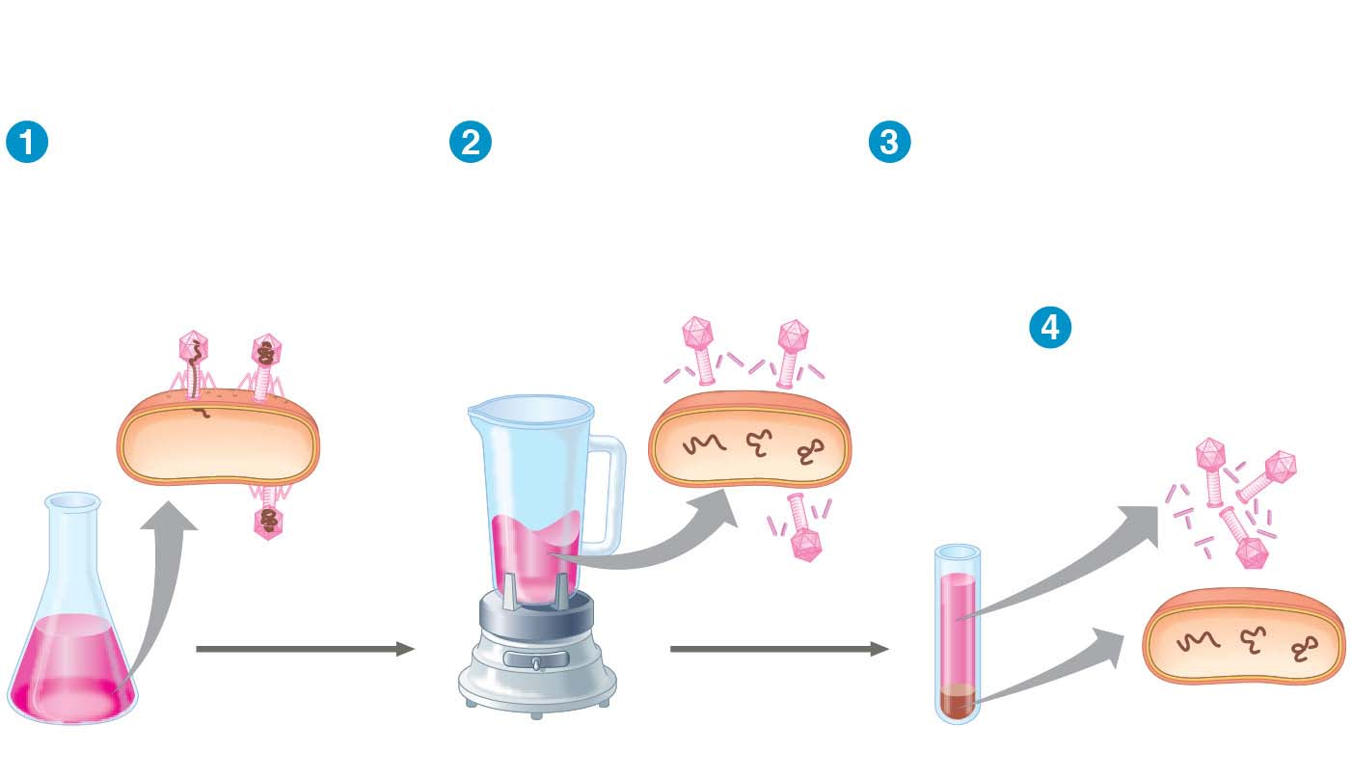
Figure 13.5-1
Experiment
Batch 1: Radioactive sulfur (³⁵S) in phage protein
Labeled phages
infect cells.
Agitation frees
outside phage
parts from cells.
Centrifuged cells form
a pellet. Free phages
and phage parts remain
in liquid.
Radioactivity
(phage protein)
found in liquid
Radioactive
protein
DNA
Centrifuge
Pellet
Notes:
Figure 13.5-1 Inquiry: Is protein or DNA the genetic material of phage T2? (part 1: protein)

Slide 18
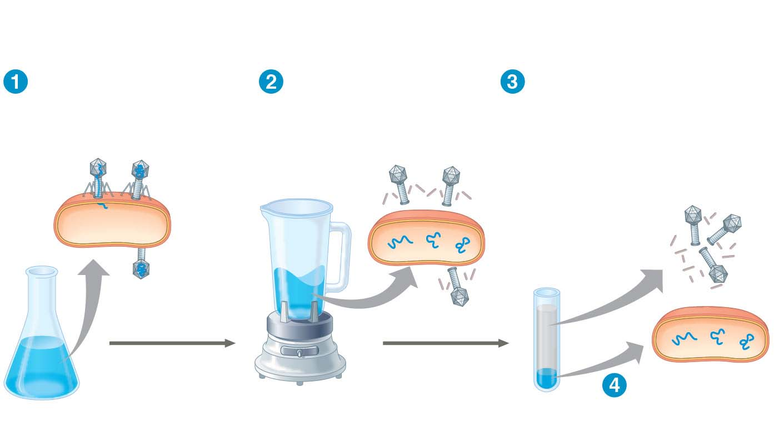
Figure 13.5-2
Experiment
Batch 2: Radioactive phosphorus (³²P) in phage DNA
Labeled phages
infect cells.
Agitation frees
outside phage
parts from cells.
Centrifuged cells form
a pellet. Free phages
and phage parts remain
in liquid.
Radioactive
DNA
Centrifuge
Pellet
Radioactivity
(phage DNA)
found in pellet
Notes:
Figure 13.5-2 Inquiry: Is protein or DNA the genetic material of phage T2? (part 2: DNA)

Slide 19
Additional Evidence That DNA Is the Genetic Material
It was known that DNA is a polymer of nucleotides, each consisting of a nitrogenous base, a sugar, and a phosphate group
In 1950, Erwin Chargaff reported that DNA composition varies from one species to the next
This evidence of diversity made DNA a more credible candidate for the genetic material
Notes:
19

Slide 20
Animation: DNA and RNA Structure

Slide 21
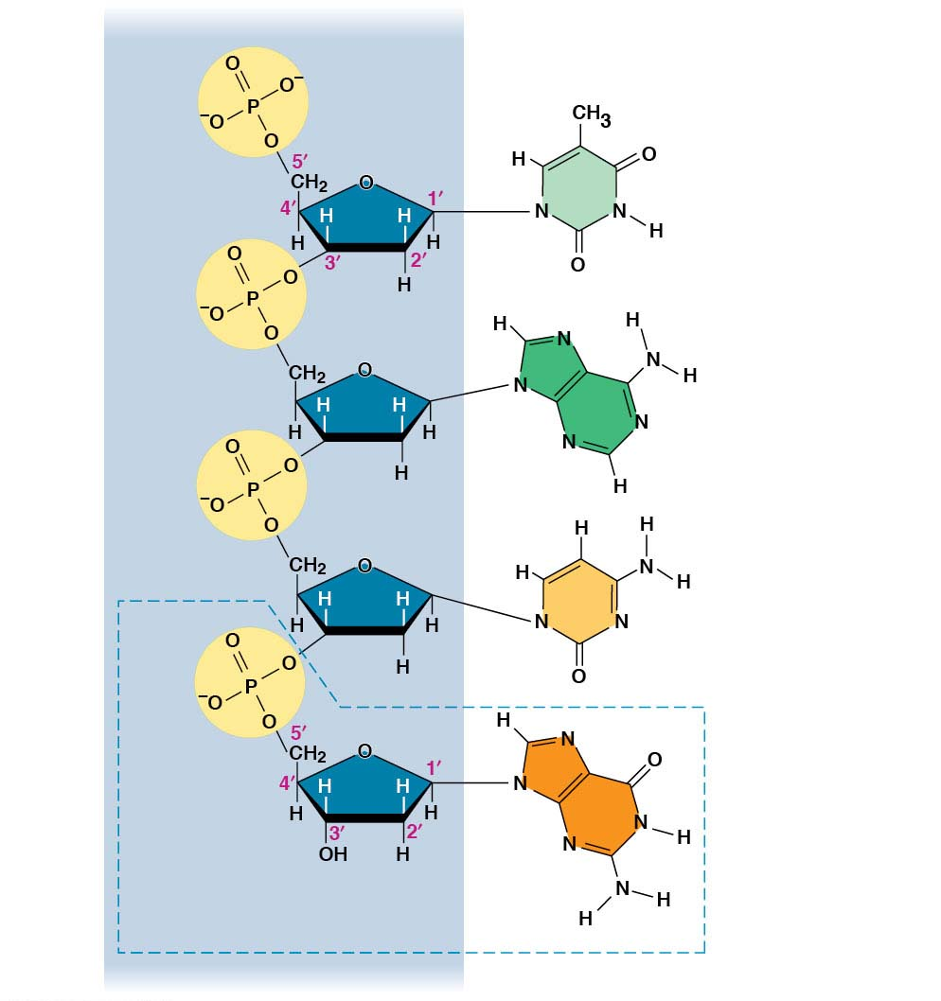
Figure 13.6
Sugar−
phosphate
backbone
5′ end
Nitrogenous bases
Thymine (T)
Adenine (A)
Cytosine (C)
3′ end
Guanine (G)
DNA
nucleotide
Notes:
Figure 13.6 The structure of a DNA strand

Slide 22
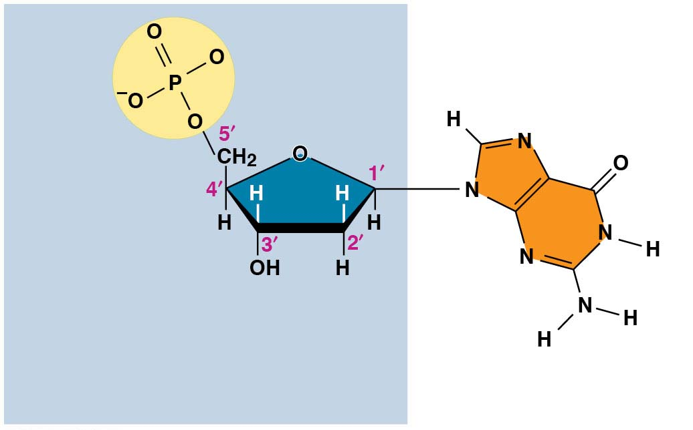
Figure 13.6-1
Phosphate
3′ end
Sugar
(deoxyribose)
DNA
nucleotide
Nitrogenous base
Notes:
Figure 13.6-1 The structure of a DNA strand (part 1: nucleotide)

Slide 23
Two findings became known as Chargaff’s rules
The base composition of DNA varies between species
In any species the percentages of A and T bases are equal and the percentages of G and C bases are equal
The basis for these rules was not understood until the discovery of the double helix
Notes:
23

Slide 24
Building a Structural Model of DNA: Scientific Inquiry
James Watson and Francis Crick were first to determine the structure of DNA
Maurice Wilkins and Rosalind Franklin were using a technique called X-ray crystallography to study molecular structure
Franklin produced a picture of the DNA molecule using this technique
Notes:
24

Slide 25
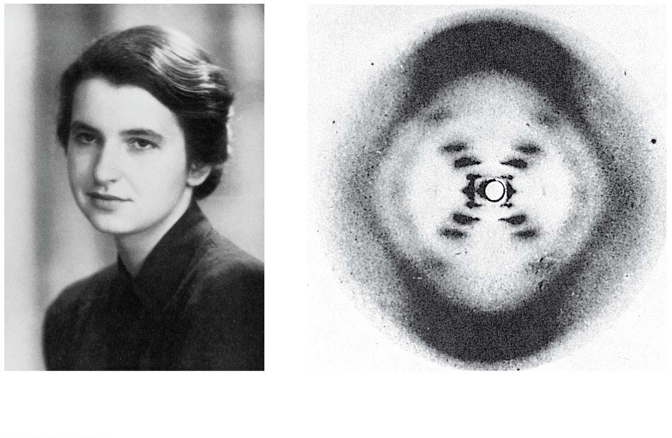
Figure 13.7
(a) Rosalind Franklin
(b) Franklin’s X-ray diffraction photograph of DNA
Notes:
Figure 13.7 Rosalind Franklin and her X-ray diffraction photo of DNA

Slide 26
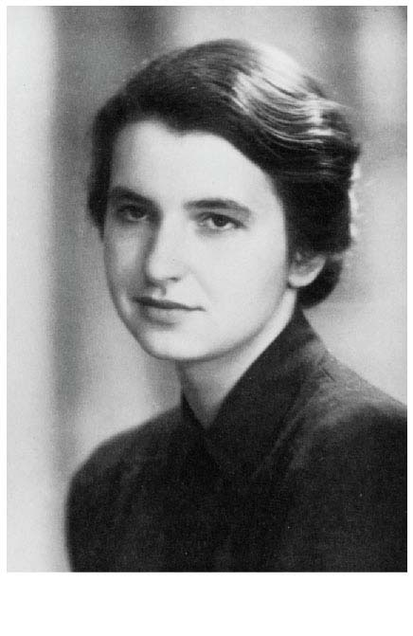
Figure 13.7-1
(a) Rosalind Franklin
Notes:
Figure 13.7-1 Rosalind Franklin and her X-ray diffraction photo of DNA (part 1: Franklin)

Slide 27
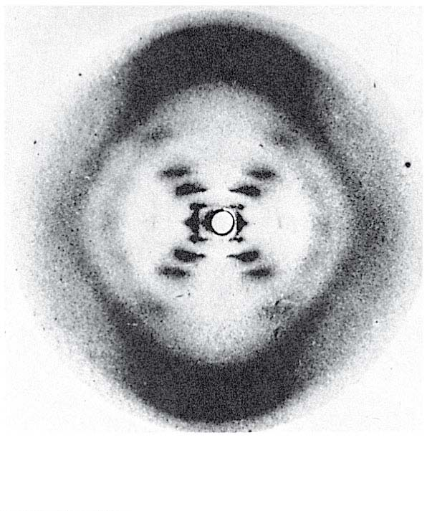
Figure 13.7-2
(b) Franklin’s X-ray diffraction photograph of DNA
Notes:
Figure 13.7-2 Rosalind Franklin and her X-ray diffraction photo of DNA (part 2: photo)

Slide 28
Franklin’s X-ray crystallographic images of DNA enabled Watson to deduce that DNA was helical
The X-ray images also enabled Watson to deduce the width of the helix and the spacing of the nitrogenous bases
The pattern in the photo suggested that the DNA molecule was made up of two strands, forming a double helix
Notes:
28

Slide 29
Animation: DNA Double Helix

Slide 30
Video: DNA Surface Model

Slide 31
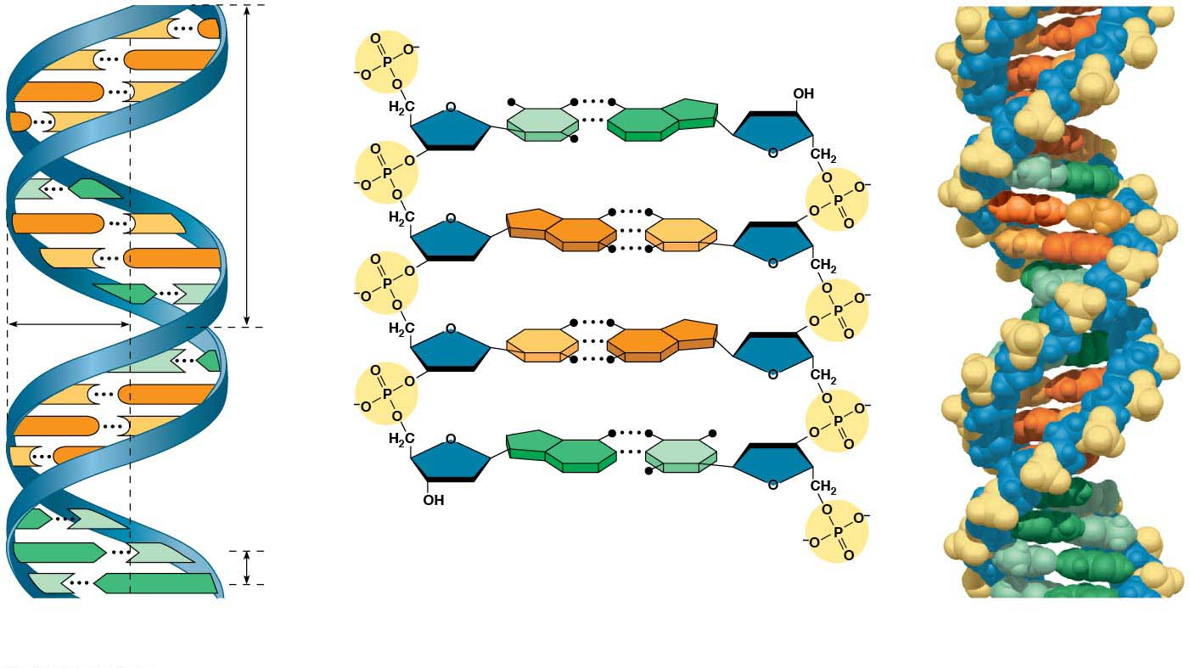
Figure 13.8
C
G
5′ end
C
G
Hydrogen bond
3′ end
G
C
G
C
T
A
3.4 nm
T
A
G
C
G
C
C
G
A
T
1 nm
C
G
T
A
C
G
G
C
C
G
A
T
A
T
3′ end
A
T
0.34 nm
T
A
5′ end
(a) Key features of DNA structure
(b) Partial chemical structure
(c) Space-filling model
Notes:
Figure 13.8 The structure of the double helix

Slide 32
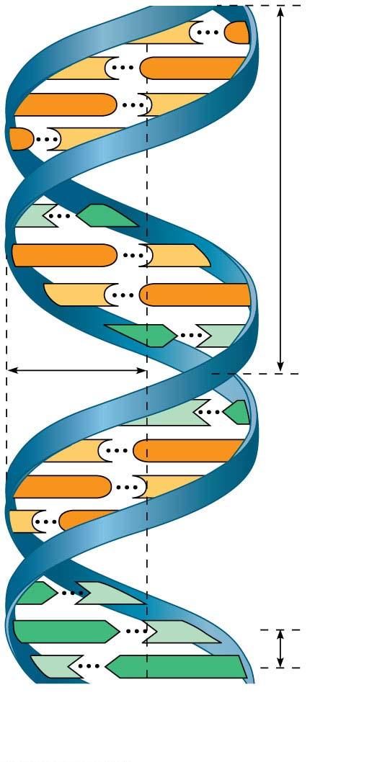
Figure 13.8-1
C
G
C
G
G
C
G
C
3.4 nm
T
A
G
C
C
G
A
T
1 nm
T
A
C
G
G
C
C
G
A
T
A
T
0.34 nm
T
A
(a) Key features of DNA structure
Notes:
Figure 13.8-1 The structure of the double helix (part 1: key features)

Slide 33
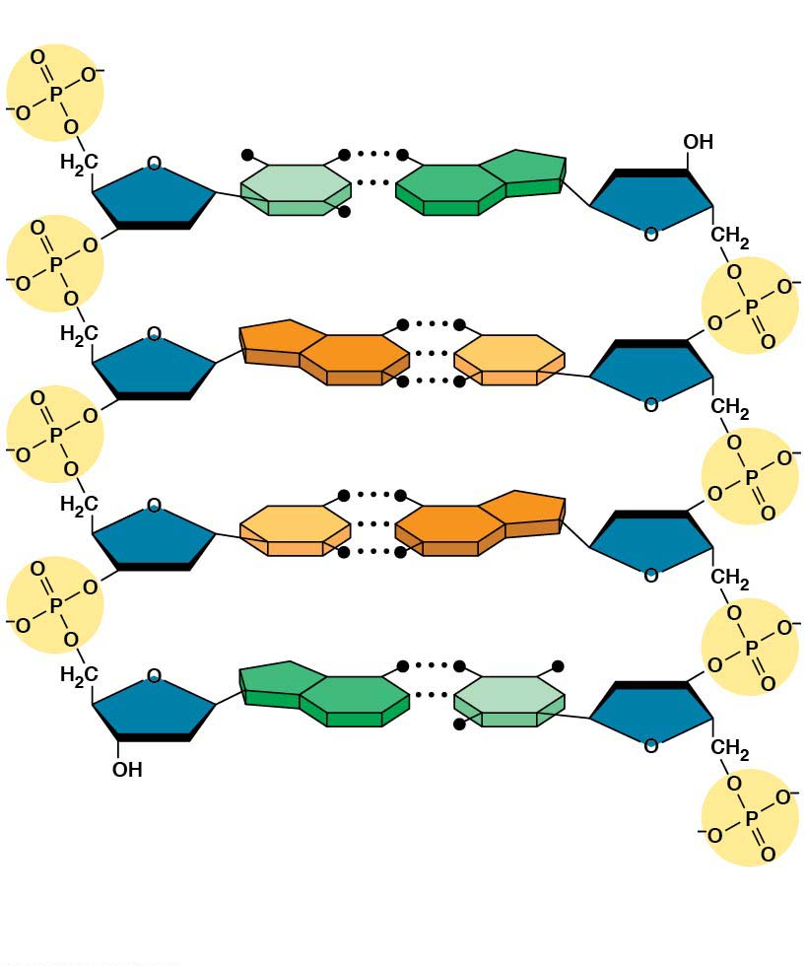
Figure 13.8-2
5′ end
Hydrogen bond
3′ end
T
A
G
C
C
G
A
T
3′ end
5′ end
(b) Partial chemical structure
Notes:
Figure 13.8-2 The structure of the double helix (part 2: chemical structure)

Slide 34
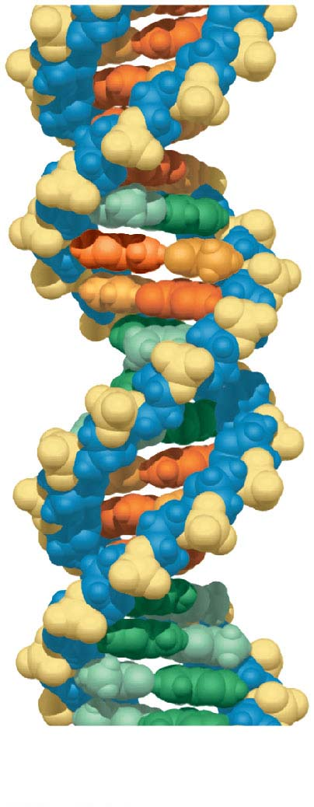
Figure 13.8-3
(c) Space-filling model
Notes:
Figure 13.8-3 The structure of the double helix (part 3: space-filling model)

Slide 35
Watson and Crick built models of a double helix to conform to the X-ray measurements and the chemistry of DNA
Franklin had concluded that there were two outer sugar-phosphate backbones, with the nitrogenous bases paired in the molecule’s interior
Watson built a model in which the backbones were antiparallel (their subunits run in opposite directions)
Notes:
35

Slide 36
At first, Watson and Crick thought the bases paired like with like (A with A, and so on), but such pairings did not result in a uniform width
Instead, pairing a purine with a pyrimidine resulted in a uniform width consistent with the X-ray data
Notes:
36

Slide 37
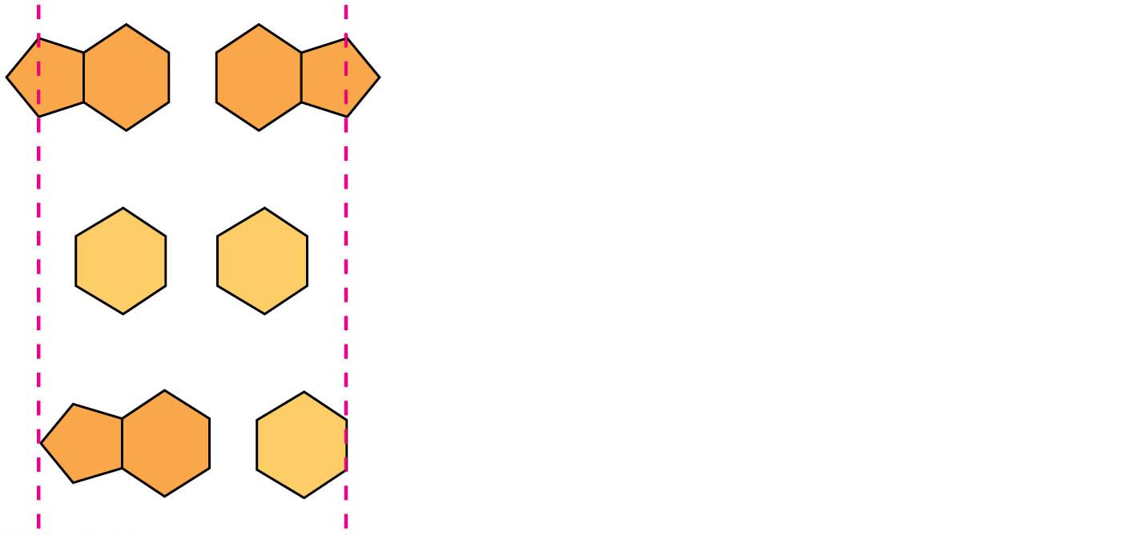
Figure 13.9
Purine + purine: too wide
Pyrimidine + pyrimidine: too narrow
Purine + pyrimidine: width
consistent with X-ray data
Notes:
Figure 13.9 Possible base pairings in the DNA double helix

Slide 38
Watson and Crick reasoned that the pairing was more specific, dictated by the base structures
They determined that adenine (A) paired only with thymine (T), and guanine (G) paired only with cytosine (C)
The Watson-Crick model explains Chargaff’s rules: in any organism the amount of A = the amount of T, and the amount of G = the amount of C
Notes:
38

Slide 39
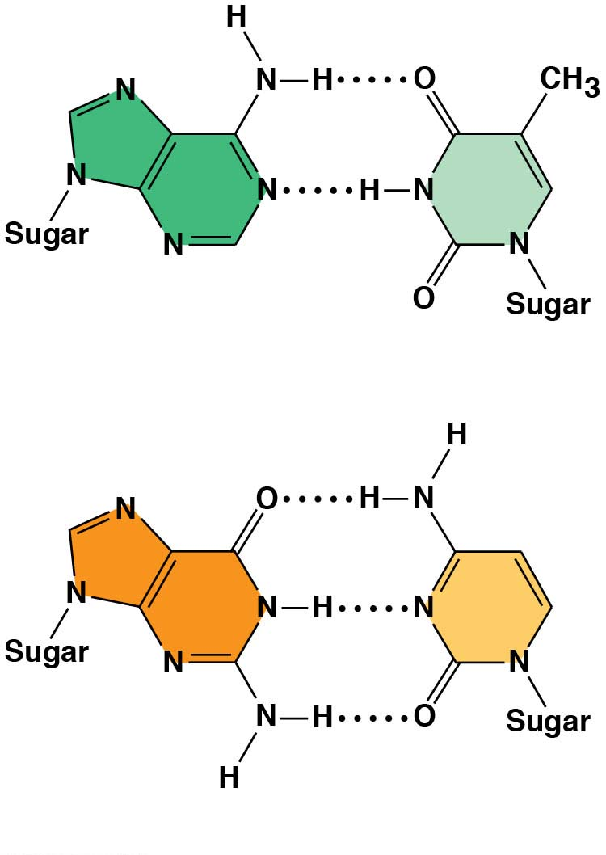
Figure 13.10
Adenine (A)
Thymine (T)
Guanine (G)
Cytosine (C)
Notes:
Figure 13.10 Base pairing in DNA

Slide 40
Concept 13.2: Many proteins work together in DNA replication and repair
The relationship between structure and function is manifest in the double helix
Watson and Crick noted that the specific base pairing suggested a possible copying mechanism for genetic material
Notes:
40

Slide 41
Figure 13.11-s1
5′
3′
A
T
C
G
T
A
A
T
G
C
3′
5′
(a) Parental molecule
Notes:
Figure 13.11-s1 A model for DNA replication: the basic concept (step 1)

Slide 42
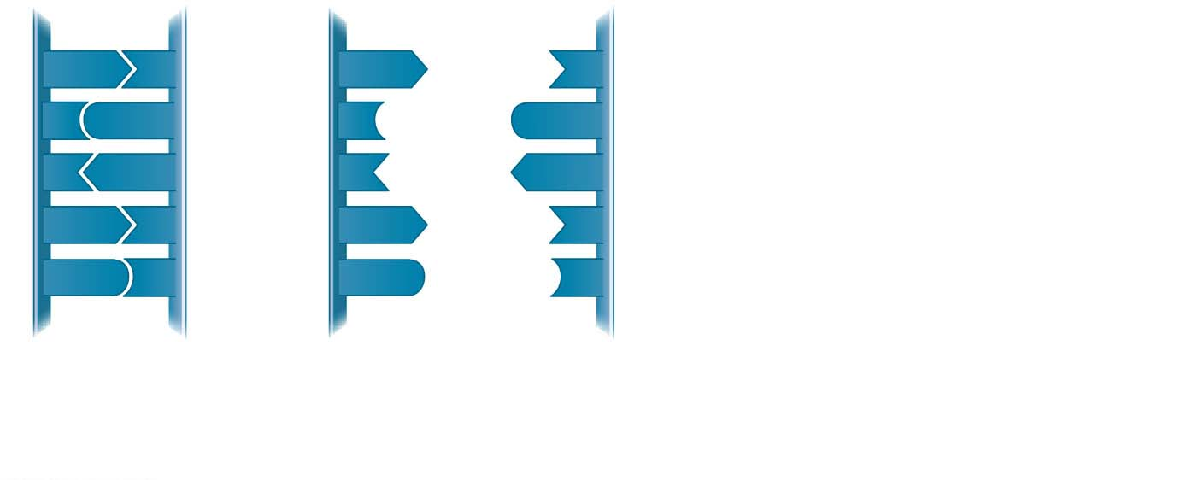
Figure 13.11-s2
5′
3′
5′
3′
A
T
A
T
C
G
C
G
T
A
T
A
A
T
A
T
G
C
G
C
3′
5′
3′
5′
(a) Parental molecule
(b) Separation of parental strands into templates
Notes:
Figure 13.11-s2 A model for DNA replication: the basic concept (step 2)

Slide 43
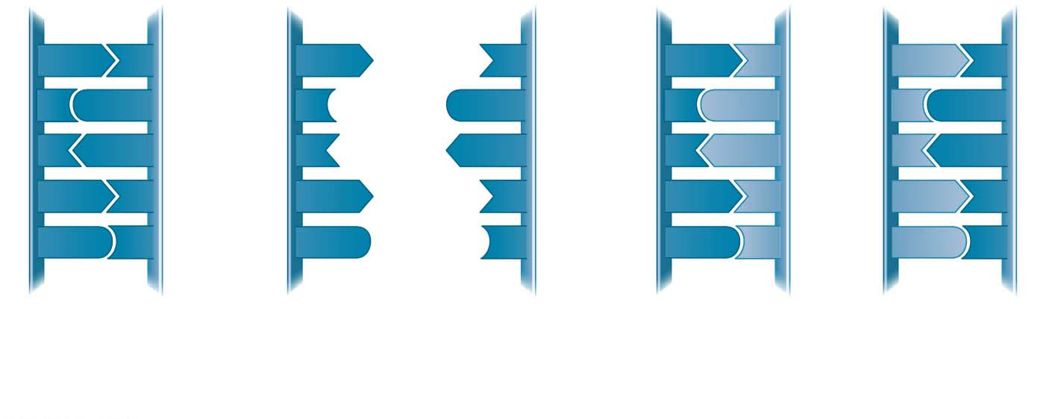
Figure 13.11-s3
5′
3′
5′
3′
5′
3′
5′
3′
A
T
A
T
A
T
A
T
C
G
C
G
C
G
C
G
T
A
T
A
T
A
T
A
A
T
A
T
A
T
A
T
G
C
G
C
G
C
G
C
3′
5′
3′
5′
3′
5′
3′
5′
(a) Parental molecule
(b) Separation of parental strands into templates
(c) Formation of new strands complementary to template strands
Notes:
Figure 13.11-s3 A model for DNA replication: the basic concept (step 3)

Slide 44
The Basic Principle: Base Pairing to a Template Strand
Since the two strands of DNA are complementary, each strand acts as a template for building a new strand in replication
In DNA replication, the parent molecule unwinds, and two new daughter strands are built based on base-pairing rules
Notes:
44

Slide 45
Watson and Crick’s semiconservative model of replication predicts that when a double helix replicates, each daughter molecule will have one old strand (derived or “conserved” from the parent molecule) and one newly made strand
Competing models were the conservative model (the two parent strands rejoin) and the dispersive model (each strand is a mix of old and new)
Notes:
45

Slide 46
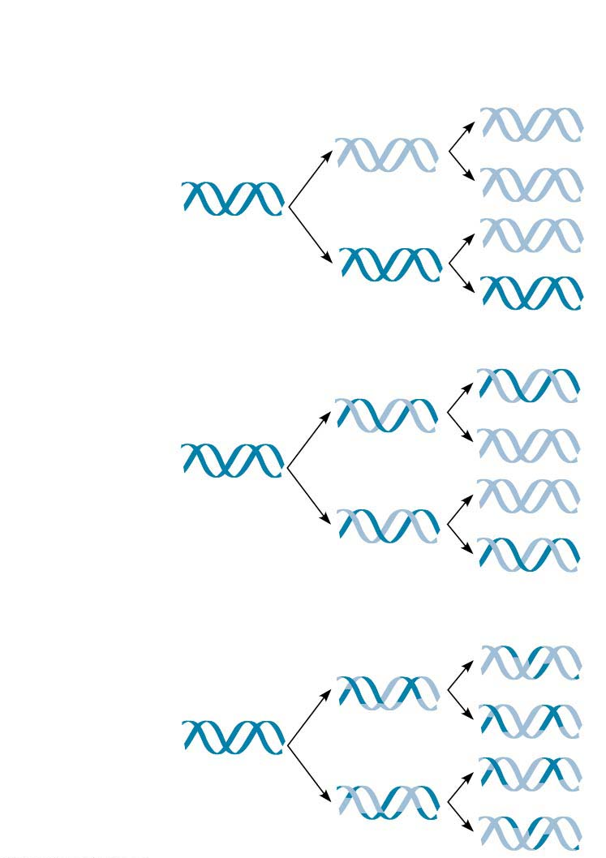
Figure 13.12
First
replication
Second
replication
Parent cell
(a) Conservative model
(b) Semiconservative model
(c) Dispersive model
Notes:
Figure 13.12 Three alternative models of DNA replication

Slide 47
Experiments by Matthew Meselson and Franklin Stahl supported the semiconservative model
Notes:
47

Slide 48
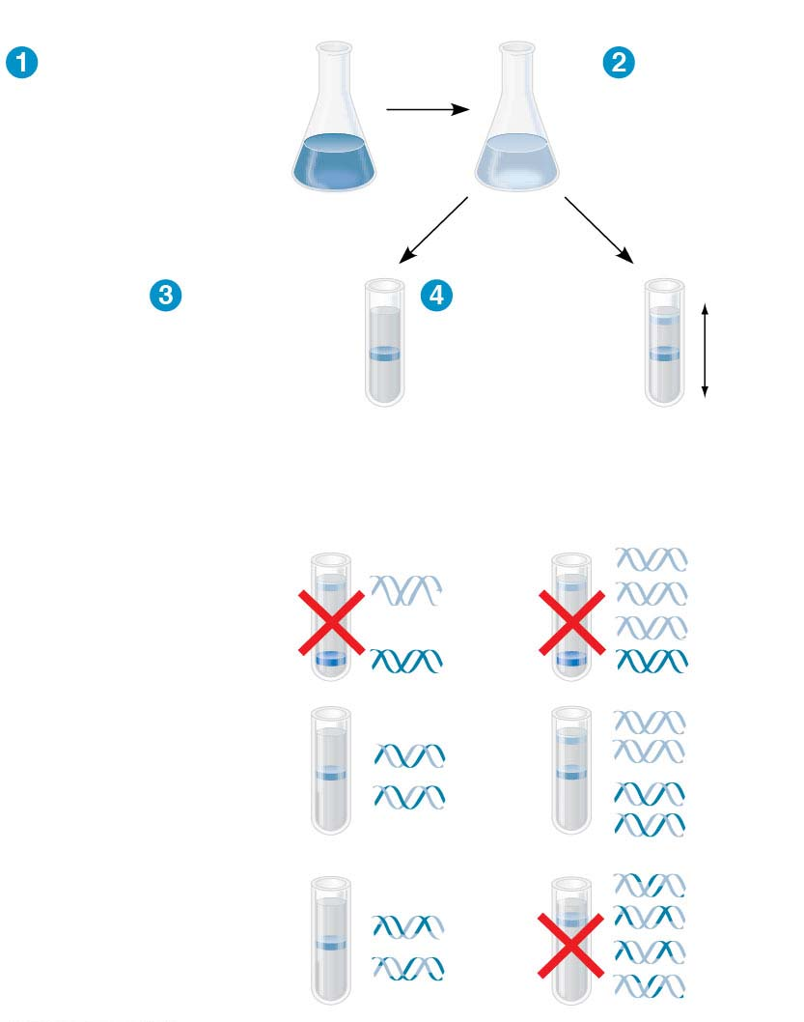
Figure 13.13
Experiment
Bacteria
cultured in
medium
with¹⁵N
(heavy
isotope)
Bacteria
transferred
to medium
with¹⁴N
(lighter
isotope)
Results
DNA sample
centrifuged
after first
replication
DNA sample
centrifuged
after second
replication
Less
dense
More
dense
Conclusion
Predictions:
First replication
Second replication
Conservative
model
Semiconservative
model
Dispersive
model
Notes:
Figure 13.13 Inquiry: Does DNA replication follow the conservative, semiconservative, or dispersive model?

Slide 49
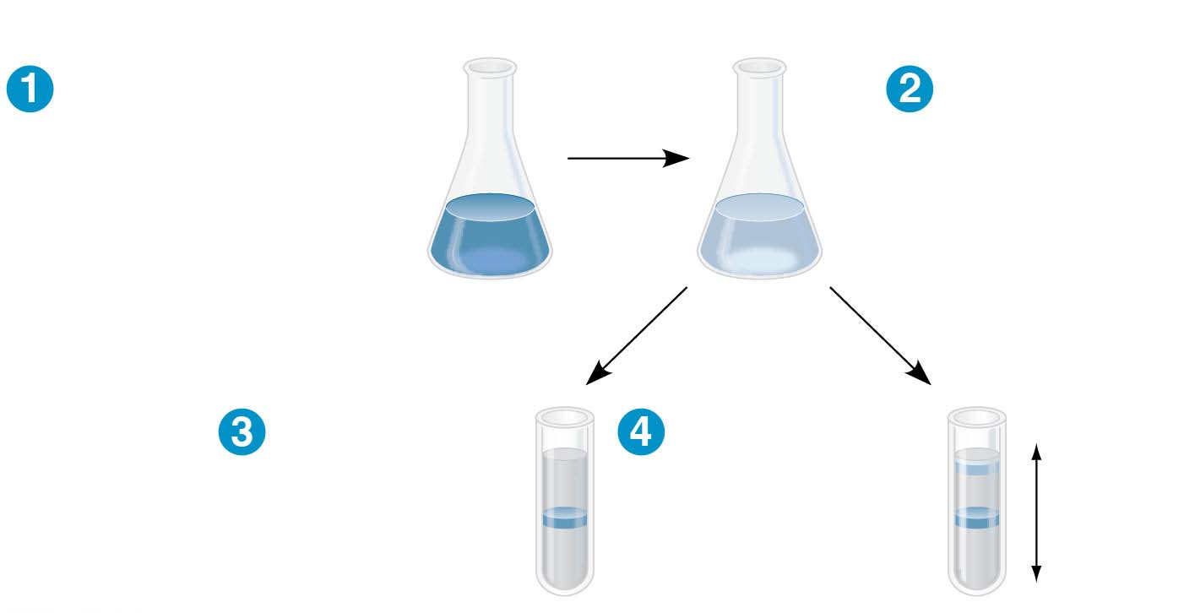
Figure 13.13-1
Experiment
Bacteria
cultured in
medium
with¹⁵N
(heavy
isotope)
Bacteria
transferred
to medium
with¹⁴N
(lighter
isotope)
Results
DNA sample
centrifuged
after first
replication
DNA sample
centrifuged
after second
replication
Less
dense
More
dense
Notes:
Figure 13.13-1 Inquiry: Does DNA replication follow the conservative, semiconservative, or dispersive model? (part 1: experiment and results)

Slide 50
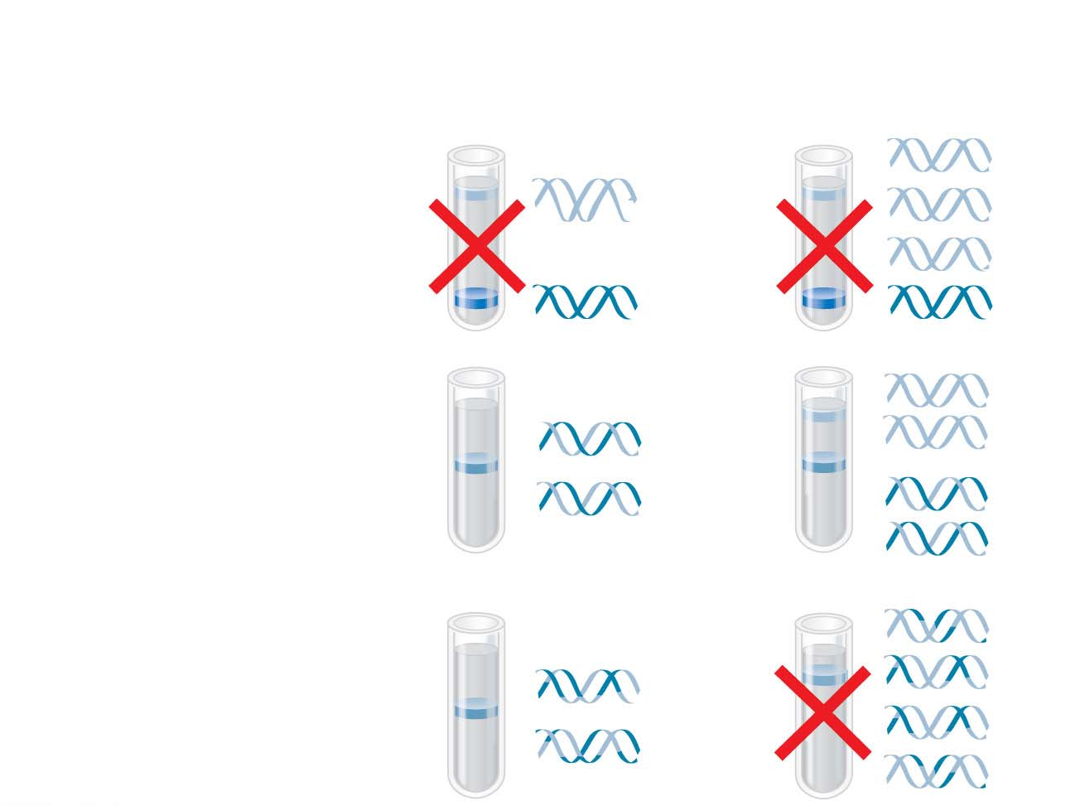
Figure 13.13-2
Conclusion
Predictions:
First replication
Second replication
Conservative
model
Semiconservative
model
Dispersive
model
Notes:
Figure 13.13-2 Inquiry: Does DNA replication follow the conservative, semiconservative, or dispersive model? (part 2: conclusion)

Slide 51
DNA Replication: A Closer Look
The copying of DNA is remarkable in its speed and accuracy
More than a dozen enzymes and other proteins participate in DNA replication
Much more is known about how this “replication machine” works in bacteria than in eukaryotes
Most of the process is similar between prokaryotes and eukaryotes
Notes:
51

Slide 52
Getting Started
Replication begins at sites called origins of replication, where the two DNA strands are separated, opening up a replication “bubble”
At each end of a bubble is a replication fork, a Y-shaped region where the parental strands of DNA are being unwound
Notes:
52

Slide 53
Animation: DNA Replication Overview

Slide 54
Animation: Origins of Replication

Slide 55
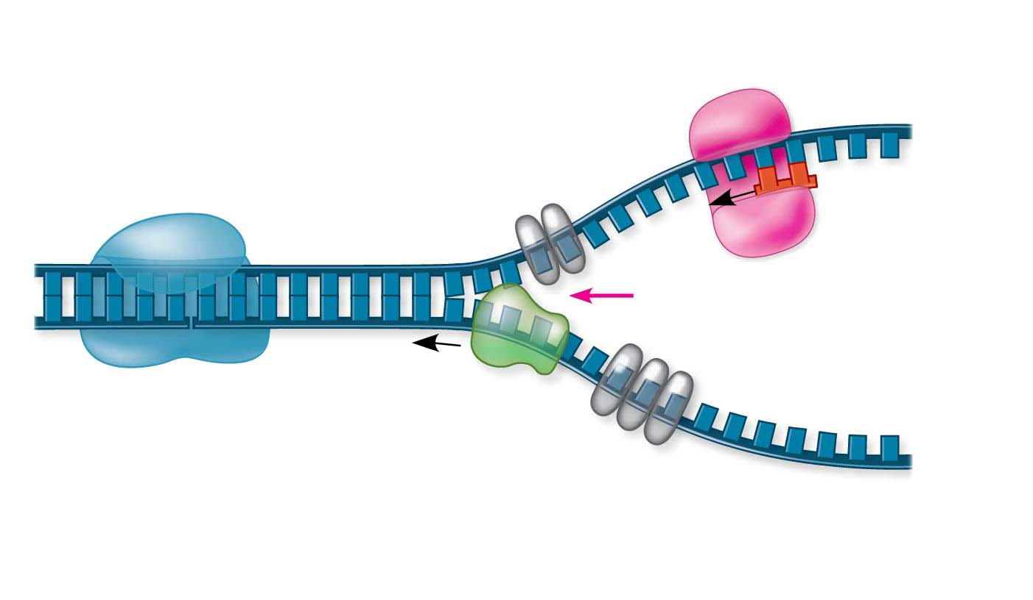
Figure 13.14
Primase
Topoisomerase
3′
RNA
primer
5′
3′
5′
Replication
fork
3′
5′
Helicase
Single-strand binding
proteins
Notes:
Figure 13.14 Some of the proteins involved in the initiation of DNA replication

Slide 56
Helicases are enzymes that untwist the double helix at the replication forks
Single-strand binding proteins bind to and stabilize single-stranded DNA
Topoisomerase relieves the strain caused by tight twisting ahead of the replication fork by breaking, swiveling, and rejoining DNA strands
Notes:
56

Slide 57
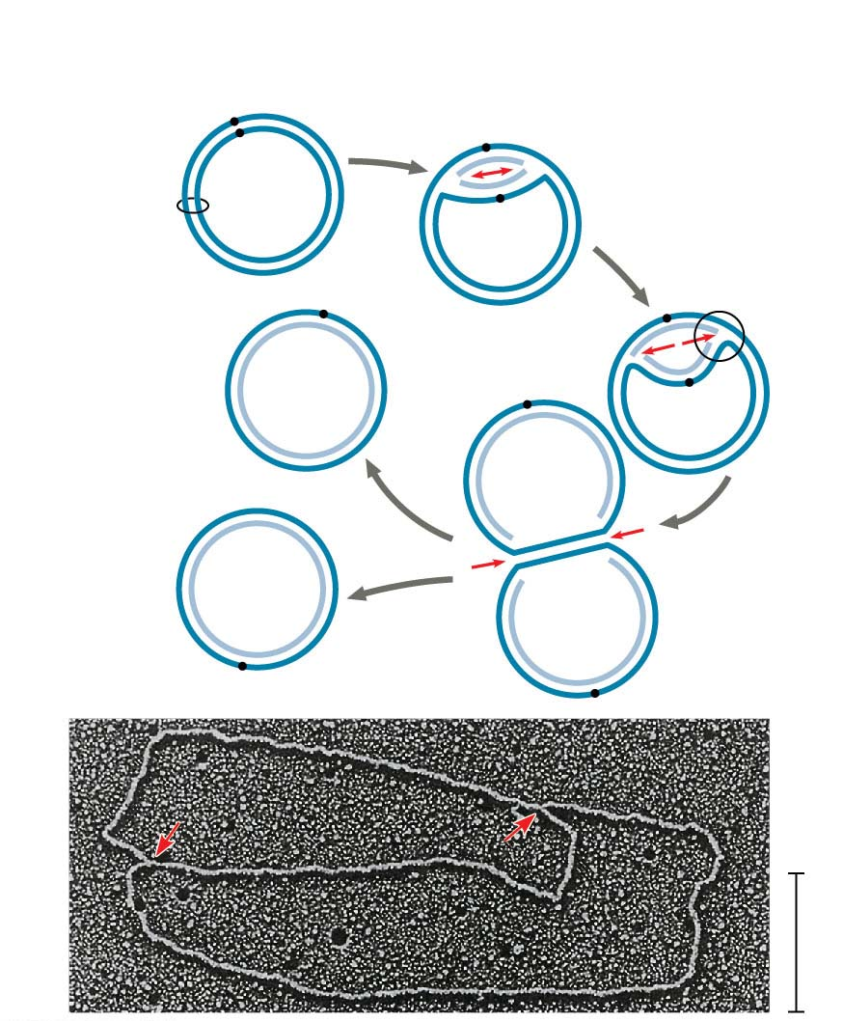
Figure 13.15-1
(a) Origin of replication in an E. coli cell
Parental (template) strand
Origin of
replication
Daughter (new)
strand
Replication
fork
Double-
stranded
DNA
molecule
Replication
bubble
Two daughter
DNA molecules
0.5 μm
Notes:
Figure 13.15-1 Origins of replication in E. coli and eukaryotes (part 1: E. coli)

Slide 58
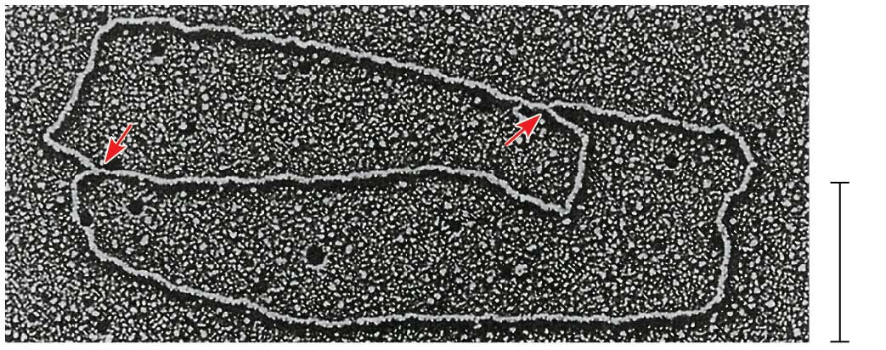
Figure 13.15-1a
0.5 μm
Notes:
Figure 13.15-1a Origins of replication in E. coli and eukaryotes (part 1a: E. coli, TEM)

Slide 59
Multiple replication bubbles form and eventually fuse, speeding up the copying of DNA
Notes:
59

Slide 60
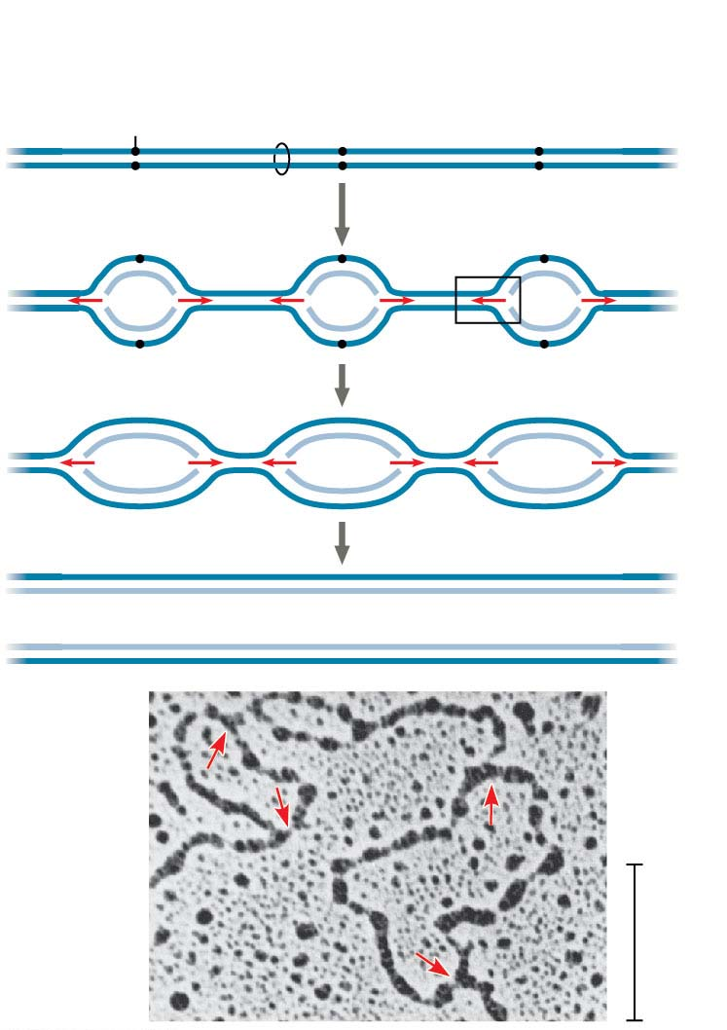
Figure 13.15-2
(b) Origins of replication in a eukaryotic cell
Origin of
replication
Double-stranded
DNA molecule
Parental
(template) strand
Daughter
(new) strand
Bubble
Replication fork
Two daughter DNA molecules
0.25 μm
Notes:
Figure 13.15-2 Origins of replication in E. coli and eukaryotes (part 2: eukaryotes)

Slide 61
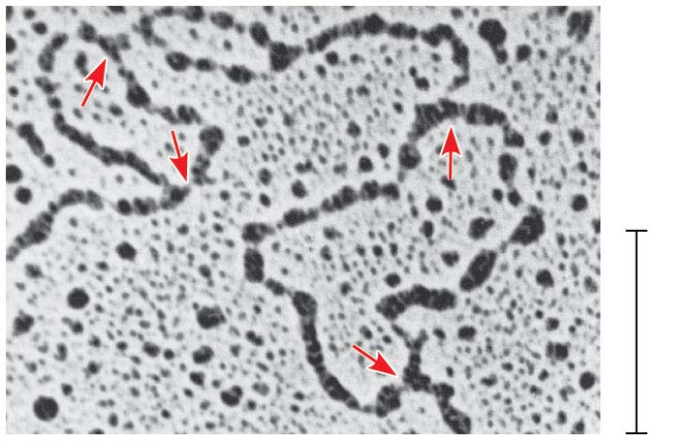
Figure 13.15-2a
0.25 μm
Notes:
Figure 13.15-2a Origins of replication in E. coli and eukaryotes (part 2a: eukaryotes, TEM)

Slide 62
Synthesizing a New DNA Strand
DNA polymerases cannot initiate synthesis of a polynucleotide; they can only add nucleotides to an already existing chain base-paired with the template
The initial nucleotide strand is a short RNA primer
Notes:
62

Slide 63
The enzyme, primase, starts an RNA chain with a single RNA nucleotide and adds RNA nucleotides one at a time using the parental DNA as a template
The primer is short (5–10 nucleotides long)
The new DNA strand will start from the 3′ end of the RNA primer
Notes:
63

Slide 64
Enzymes called DNA polymerases catalyze the elongation of new DNA at a replication fork
Most DNA polymerases require a primer and a DNA template strand
The rate of elongation is about 500 nucleotides per second in bacteria and 50 per second in human cells
Notes:
64

Slide 65
Each nucleotide that is added to a growing DNA consists of a sugar attached to a base and to three phosphate groups
dATP is used to make DNA and is similar to the ATP of energy metabolism
The difference is in the sugars: dATP has deoxyribose, while ATP has ribose
As each monomer nucleotide joins the DNA strand, it loses two phosphate groups as a molecule of pyrophosphate
Notes:
65

Slide 66
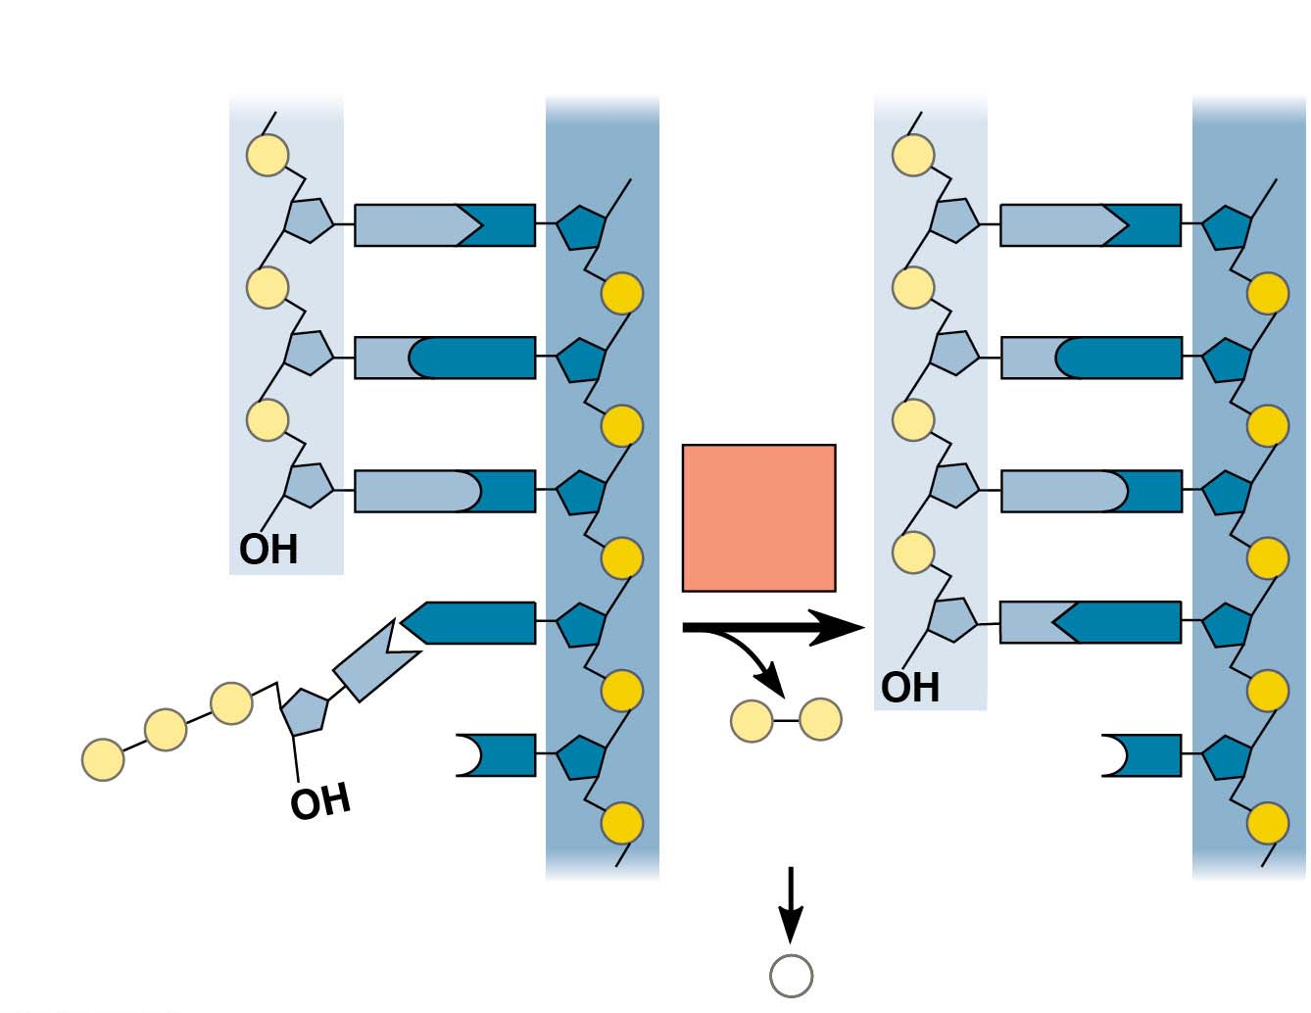
Figure 13.16
New strand
Template strand
5′
3′
5′
3′
Sugar
A
T
A
T
Phosphate
Base
C
G
C
G
G
C
DNA
poly-
merase
G
C
3′
A
T
A
T
P
P
P
P
i
3′
P
C
C
Pyro-
phosphate
Nucleotide
5′
5′
2 P _{i}
Notes:
Figure 13.16 Addition of a nucleotide to a DNA strand

Slide 67
Antiparallel Elongation
Newly replicated DNA strands must be formed antiparallel to the template strand
DNA polymerases add nucleotides only to the free 3′ end of a growing strand; therefore, a new DNA strand can elongate only in the 5′ to 3′ direction
Notes:
67

Slide 68
Along one template strand of DNA, the DNA polymerase synthesizes a leading strand continuously, moving toward the replication fork
Notes:
68

Slide 69
Animation: Leading Strand

Slide 70
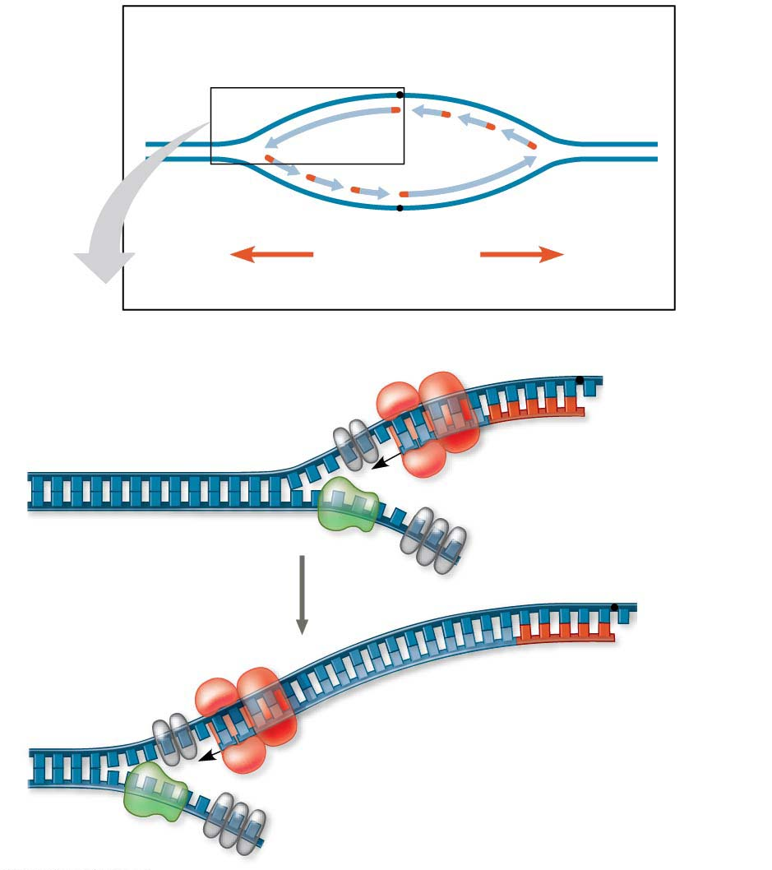
Figure 13.17
Leading
strand
Overview
Origin of replication
Lagging
strand
Primer
Leading
strand
Lagging strand
Overall
directions
of replication
Origin of replication
3′
5′
5′
RNA primer
3′
Sliding clamp
3′
DNA pol III
Parental DNA
5′
3′
5′
5′
Continuous elongation
in the 5′ to 3′ direction
3′
3′
5′
Notes:
Figure 13.17 Synthesis of the leading strand during DNA replication

Slide 71
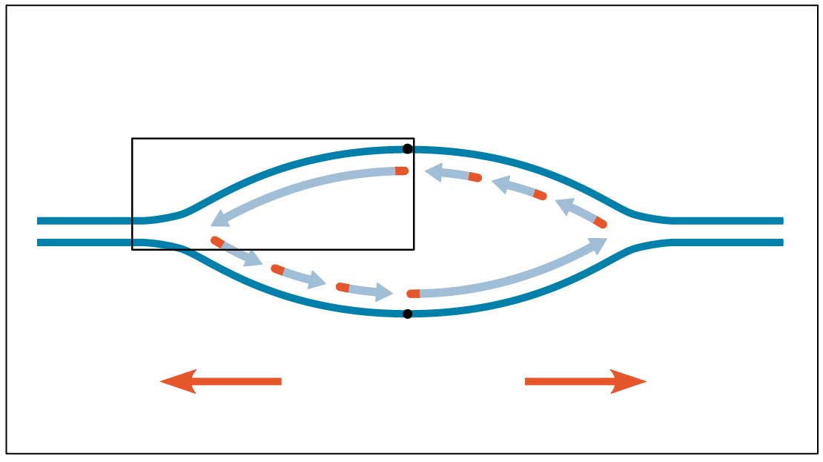
Figure 13.17-1
Overview
Leading
strand
Lagging
strand
Origin of replication
Primer
Leading
strand
Lagging strand
Overall
directions
of replication
Notes:
Figure 13.17-1 Synthesis of the leading strand during DNA replication (part 1)

Slide 72
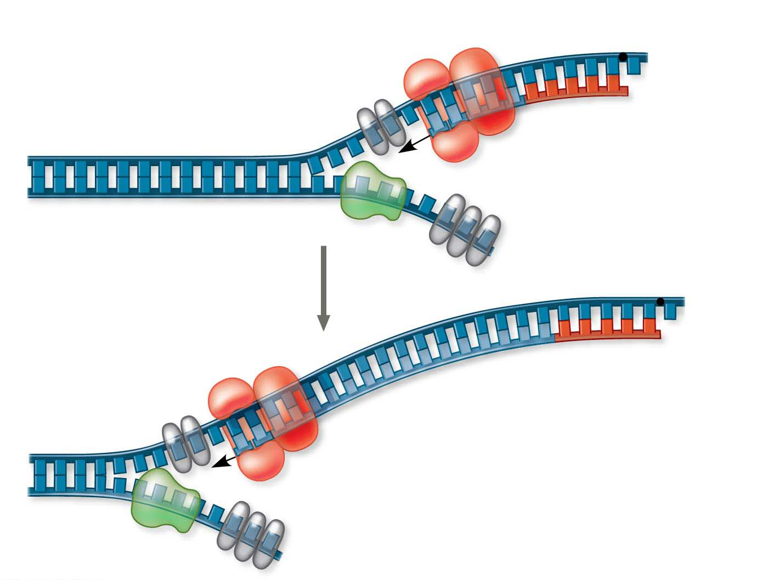
Figure 13.17-2
Origin of replication
3′
5′
RNA primer
5′
3′
Sliding clamp
3′
DNA pol III
5′
Parental DNA
3′
5′
5′
Continuous elongation
in the 5′ to 3′ direction
3′
3′
5′
Notes:
Figure 13.17-2 Synthesis of the leading strand during DNA replication (part 2)

Slide 73
To elongate the other new strand, the lagging strand, DNA polymerase must work in the direction away from the replication fork
The lagging strand is synthesized as a series of segments called Okazaki fragments
Notes:
73

Slide 74
After formation of Okazaki fragments, DNA polymerase I removes the RNA primers and replaces the nucleotides with DNA
The remaining gaps are joined together by DNA ligase
Notes:
74

Slide 75
Animation: Lagging Strand

Slide 76
Animation: DNA Replication Review

Slide 77
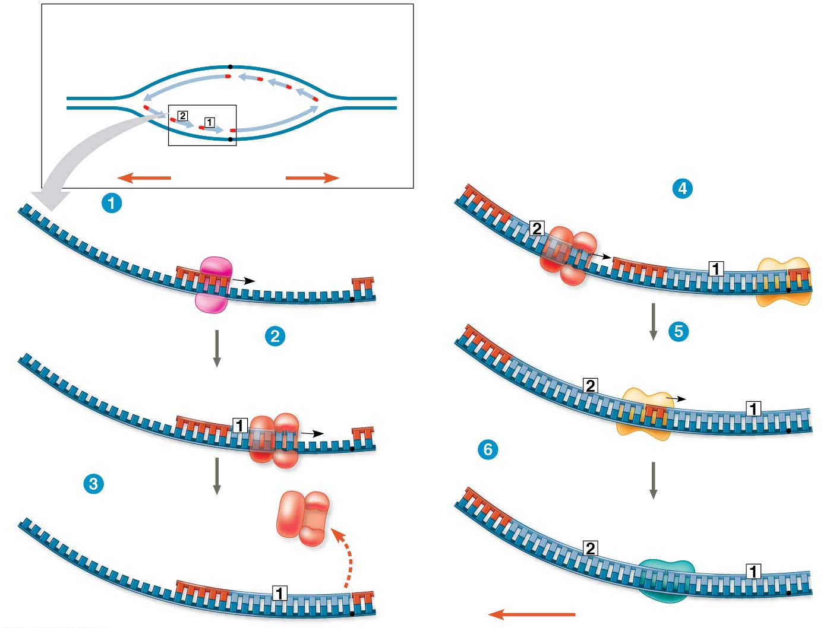
Figure 13.18
Overview
Lagging
strand
Origin of replication
Leading
strand
Lagging
strand
Leading
strand
RNA primer
for fragment 2
Overall directions
of replication
5′
Okazaki
fragment 2
DNA pol III
makes Okazaki
fragment 2.
3′
Primase makes
RNA primer.
Primer for
leading
strand
3′
Origin of
replication
Template
strand
5′
3′
5′
3′
3′
5′
5′
5′
DNA pol III
makes Okazaki
fragment 1.
3′
DNA pol I
replaces RNA
with DNA.
3′
RNA primer
for fragment 1
5′
3′
3′
5′
3′
5′
5′
DNA ligase forms
bonds between
DNA fragments.
DNA pol III
detaches.
5′
3′
3′
Okazaki
fragment 1
5′
3′
3′
5′
5′
Overall direction of replication
Notes:
Figure 13.18 Synthesis of the lagging strand

Slide 78
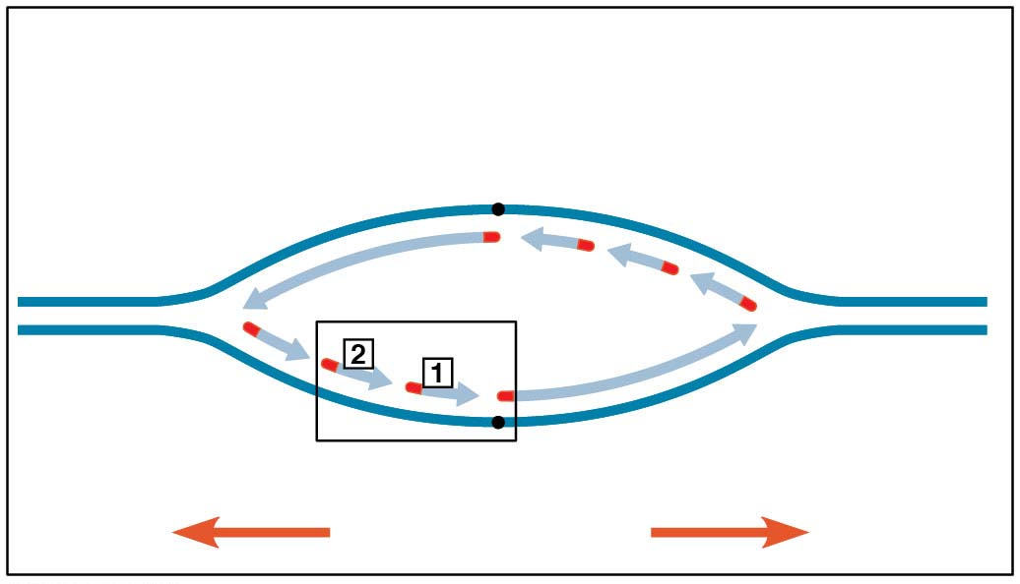
Figure 13.18-1
Overview
Lagging
strand
Origin of replication
Leading
strand
Lagging
strand
Leading
strand
Overall directions
of replication
Notes:
Figure 13.18-1 Synthesis of the lagging strand (part 1)

Slide 79
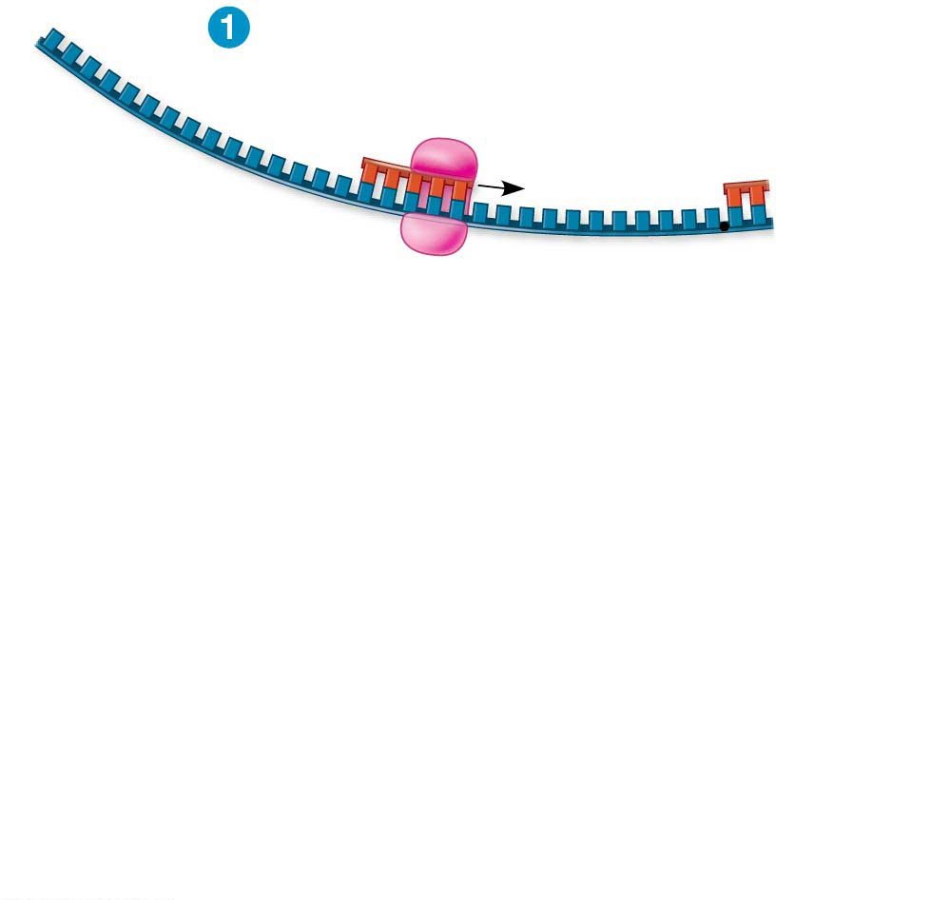
Figure 13.18-2-s1
3′
Primase makes
RNA primer.
Primer for
leading
strand
Origin of
replication
5′
3′
Template
strand
5′
3′
5′
Notes:
Figure 13.18-2-s1 Synthesis of the lagging strand (part 2, step 1)

Slide 80
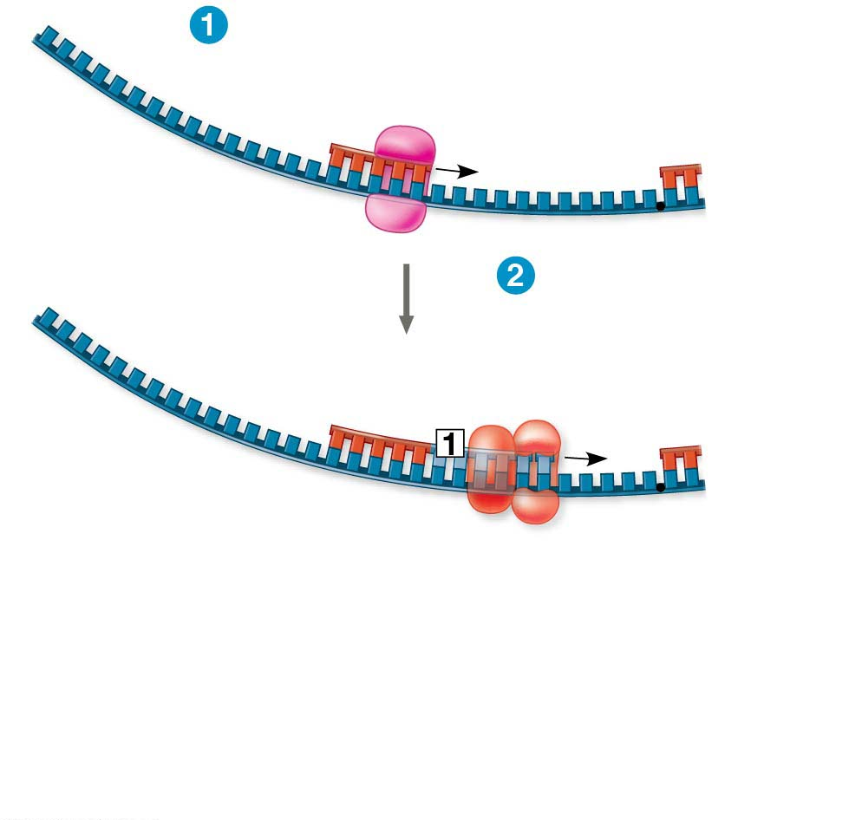
Figure 13.18-2-s2
3′
Primase makes
RNA primer.
Primer for
leading
strand
Origin of
replication
5′
3′
Template
strand
5′
3′
5′
DNA pol III
makes Okazaki
fragment 1.
3′
RNA primer
for fragment 1
5′
3′
5′
3′
5′
Notes:
Figure 13.18-2-s2 Synthesis of the lagging strand (part 2, step 2)

Slide 81
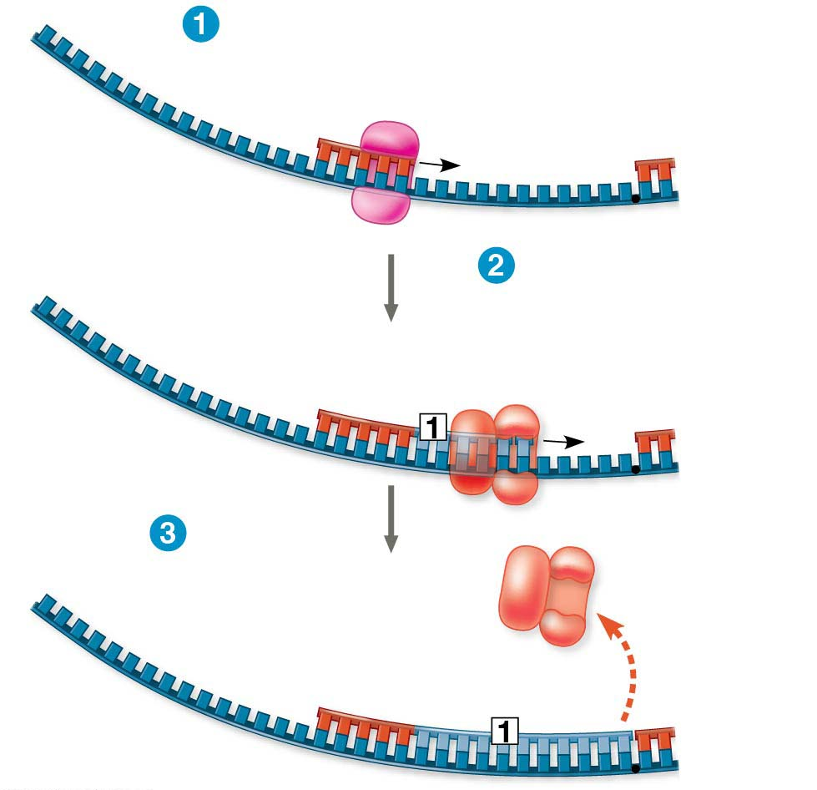
Figure 13.18-2-s3
3′
Primase makes
RNA primer.
Primer for
leading
strand
Origin of
replication
5′
3′
Template
strand
5′
3′
5′
DNA pol III
makes Okazaki
fragment 1.
3′
RNA primer
for fragment 1
5′
3′
5′
3′
5′
DNA pol III
detaches.
3′
Okazaki
fragment 1
5′
3′
5′
Notes:
Figure 13.18-2-s3 Synthesis of the lagging strand (part 2, step 3)

Slide 82
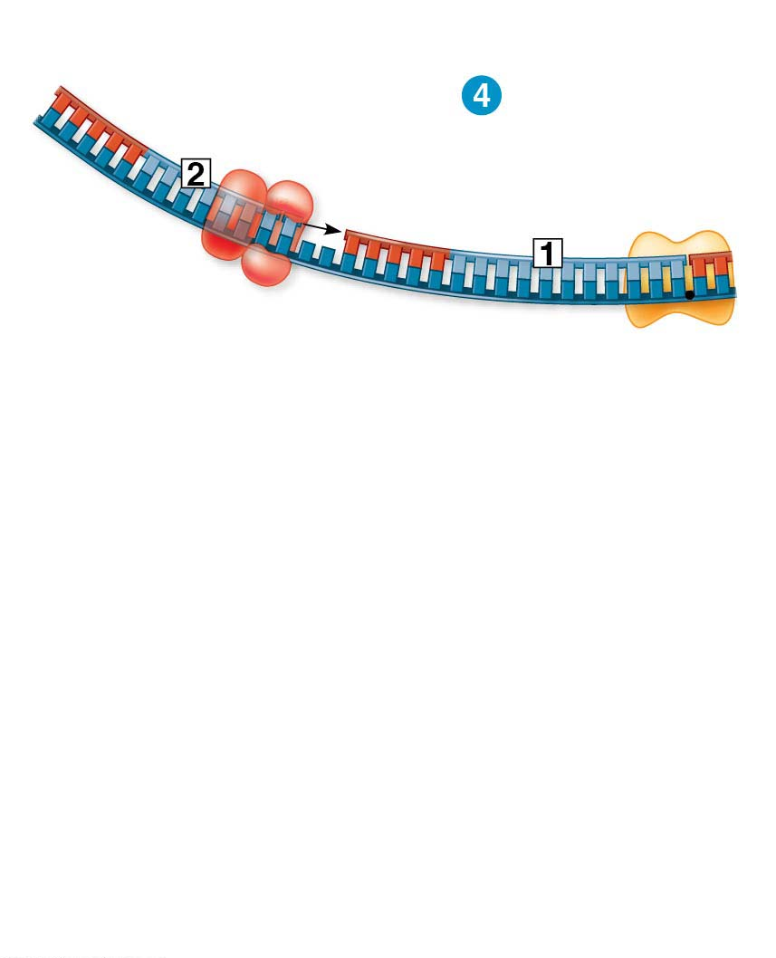
Figure 13.18-3-s1
RNA primer for fragment 2
5′
Okazaki
fragment 2
3′
DNA pol III
makes Okazaki
fragment 2.
3′
5′
Notes:
Figure 13.18-3-s1 Synthesis of the lagging strand (part 3, step 1)

Slide 83
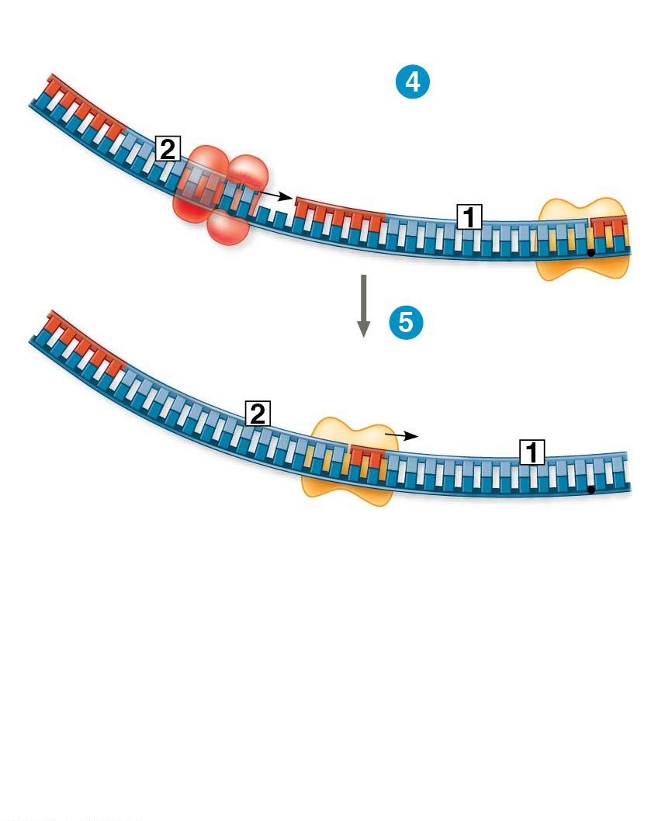
Figure 13.18-3-s2
RNA primer for fragment 2
5′
Okazaki
fragment 2
3′
DNA pol III
makes Okazaki
fragment 2.
3′
5′
5′
3′
DNA pol I
replaces RNA
with DNA.
3′
5′
Notes:
Figure 13.18-3-s2 Synthesis of the lagging strand (part 3, step 2)

Slide 84
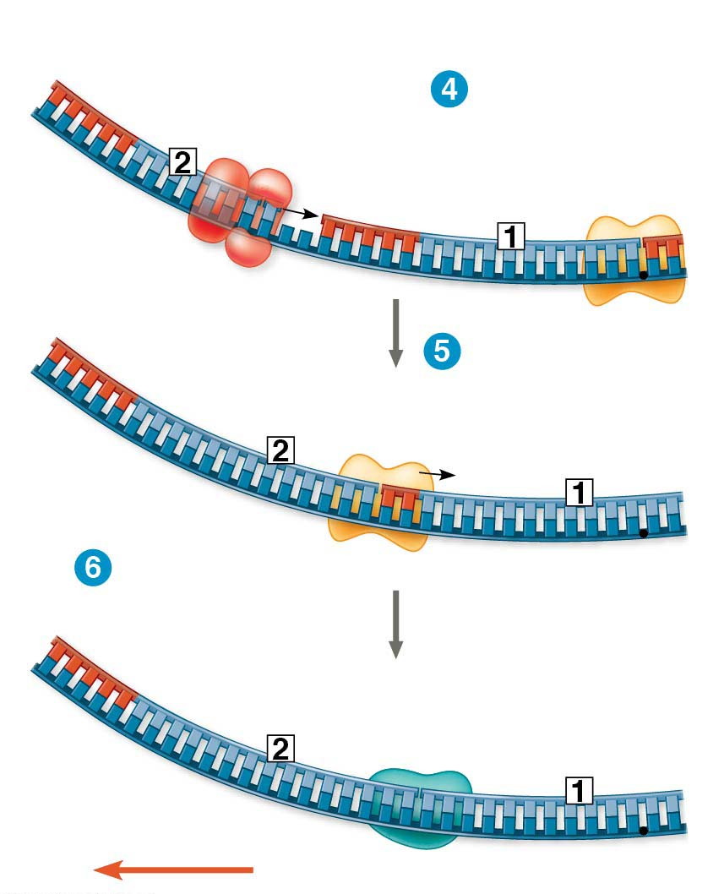
Figure 13.18-3-s3
RNA primer for fragment 2
5′
Okazaki
fragment 2
3′
DNA pol III
makes Okazaki
fragment 2.
3′
5′
5′
3′
DNA pol I
replaces RNA
with DNA.
3′
5′
DNA ligase forms
bonds between
DNA fragments.
5′
3′
3′
5′
Overall direction of replication
Notes:
Figure 13.18-3-s3 Synthesis of the lagging strand (part 3, step 3)

Slide 85
The DNA Replication Complex
The proteins that participate in DNA replication form a large complex, a “DNA replication machine”
The DNA replication machine may be stationary during the replication process
Recent studies support a model in which two DNA polymerase molecules “reel in” parental DNA and “extrude” newly made daughter DNA molecules
Notes:
85

Slide 86
Animation: DNA Replication

Slide 87
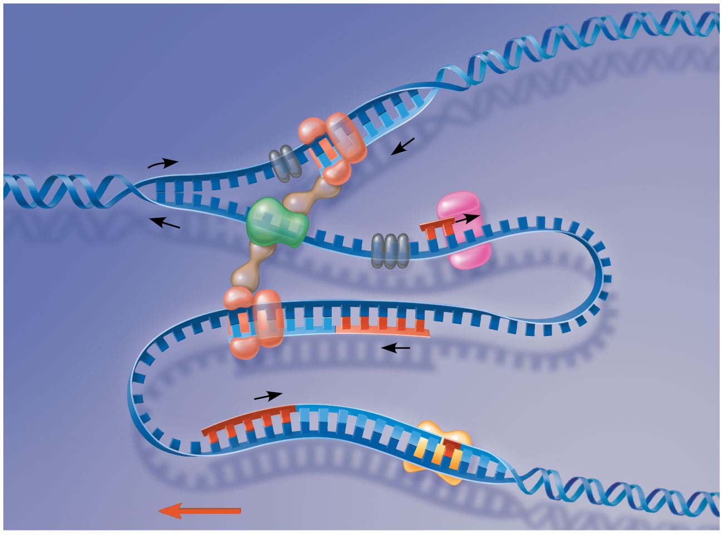
Figure 13.20
Leading strand template
DNA pol III
Parental DNA
Leading strand
5′
5′
3′
3′
3′
3′
5′
5′
Connecting protein
DNA pol III
Helicase
Lagging
strand
template
3′
5′
3′
Lagging strand
5′
Overall direction of replication
Notes:
Figure 13.20 The “trombone” model of the DNA replication complex

Slide 88
Proofreading and Repairing DNA
DNA polymerases proofread newly made DNA, replacing any incorrect nucleotides
In mismatch repair of DNA, other enzymes correct errors in base pairing
A hereditary defect in one such enzyme is associated with a form of colon cancer
This defect allows cancer-causing errors to accumulate in DNA faster than normal
Notes:
88

Slide 89
DNA can be damaged by exposure to harmful chemical or physical agents such as cigarette smoke and X-rays
It can also undergo spontaneous changes
In nucleotide excision repair, a nuclease cuts out and replaces damaged stretches of DNA
Notes:
89

Slide 90
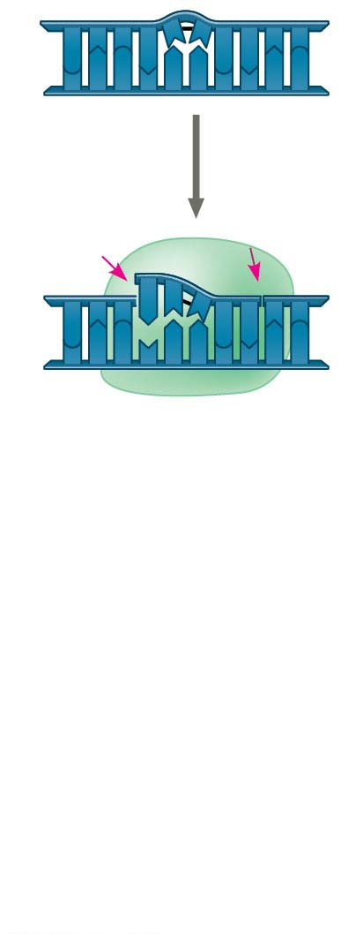
Figure 13.21-s1
5′
3′
3′
5′
Nuclease
5′
3′
3′
5′
Notes:
Figure 13.21-s1 Nucleotide excision repair of DNA damage (step 1)

Slide 91
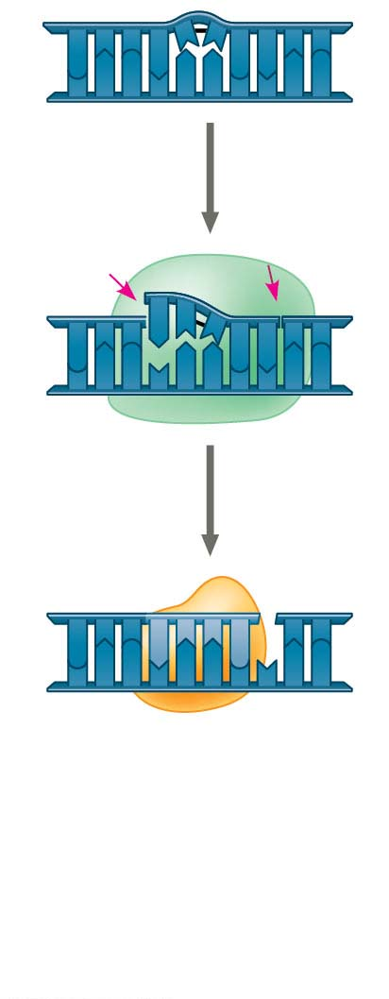
Figure 13.21-s2
5′
3′
3′
5′
Nuclease
5′
3′
3′
5′
DNA
polymerase
5′
3′
3′
5′
Notes:
Figure 13.21-s2 Nucleotide excision repair of DNA damage (step 2)

Slide 92
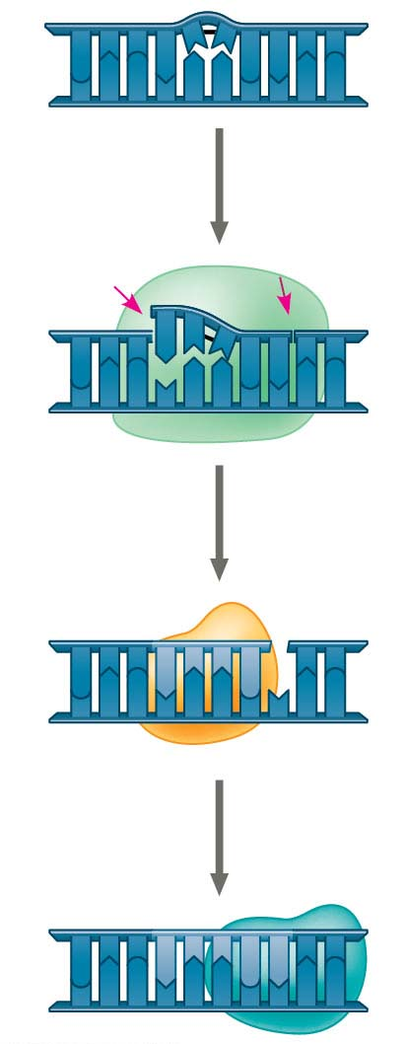
Figure 13.21-s3
5′
3′
3′
5′
Nuclease
5′
3′
3′
5′
DNA
polymerase
5′
3′
3′
5′
DNA
ligase
5′
3′
3′
5′
Notes:
Figure 13.21-s3 Nucleotide excision repair of DNA damage (step 3)

Slide 93
Evolutionary Significance of Altered DNA Nucleotides
The error rate after proofreading repair is low but not zero
Sequence changes may become permanent and can be passed on to the next generation
These changes (mutations) are the source of the genetic variation upon which natural selection operates
Notes:
93

Slide 94
Replicating the Ends of DNA Molecules
For linear DNA, the usual replication machinery cannot complete the 5′ ends of daughter strands
Repeated rounds of replication produce shorter DNA molecules with uneven ends
Eukaryotic chromosomal DNA molecules have special nucleotide sequences at their ends called telomeres
Notes:
94

Slide 95
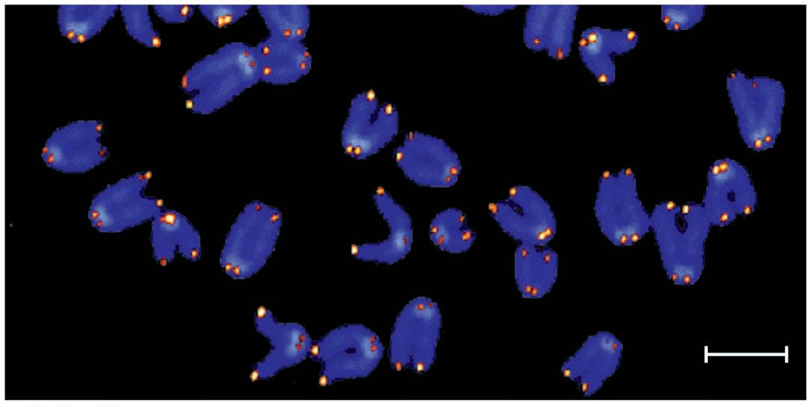
Figure 13.22
1 μm
Notes:
Figure 13.22 Telomeres

Slide 96
Telomeres typically consist of multiple repetitions of one short nucleotide sequence
Telomeres do not prevent the shortening of DNA molecules, but they do postpone it
It has been proposed that the shortening of telomeres is connected to aging
Notes:
96

Slide 97
If chromosomes of germ cells became shorter in every cell cycle, essential genes would eventually be missing from the gametes they produce
An enzyme called telomerase catalyzes the lengthening of telomeres in germ cells
Notes:
97

Slide 98
Telomerase is not active in most human somatic cells
However, it does show inappropriate activity in some cancer cells
Telomerase is currently under study as a target for cancer therapies
Notes:
98

Slide 99
Concept 13.3: A chromosome consists of a DNA molecule packed together with proteins
The bacterial chromosome is a double-stranded, circular DNA molecule associated with a small amount of protein
Eukaryotic chromosomes have linear DNA molecules associated with a large amount of protein
In a bacterium, the DNA is “supercoiled” and found in a region of the cell called the nucleoid
Notes:
99

Slide 100
Chromatin, a complex of DNA and protein, is found in the nucleus of eukaryotic cells
Chromosomes fit into the nucleus through an elaborate, multilevel system of packing
Chromatin undergoes striking changes in the degree of packing during the course of the cell cycle
Notes:
100

Slide 101
Proteins called histones are responsible for the first level of DNA packing in chromatin
Four types of histones are most common in chromatin: H2A, H2B, H3, and H4
A nucleosome consists of DNA wound twice around a protein core of eight histones, two of each of the main histone types
Notes:
101

Slide 102
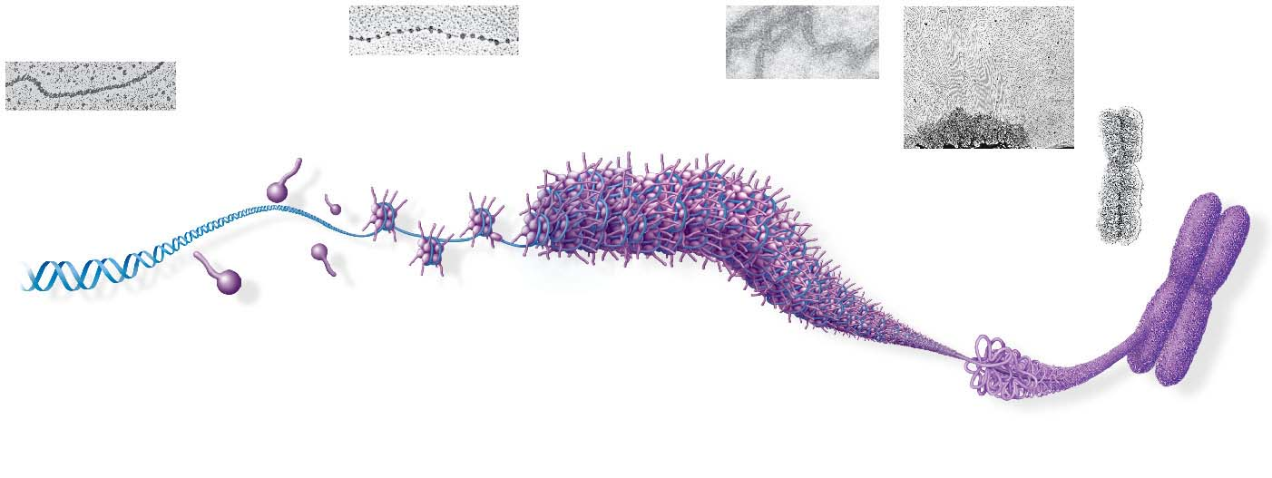
Figure 13.23
Chromatid
(700 nm)
Nucleosome
(10 nm in diameter)
DNA
double helix
(2 nm in diameter)
30-nm
fiber
Looped
domain
Scaffold
Histone tail
H1
300-nm
fiber
Histones
Replicated chromosome
(1,400 nm)
Notes:
Figure 13.23 Exploring chromatin packing in a eukaryotic chromosome

Slide 103
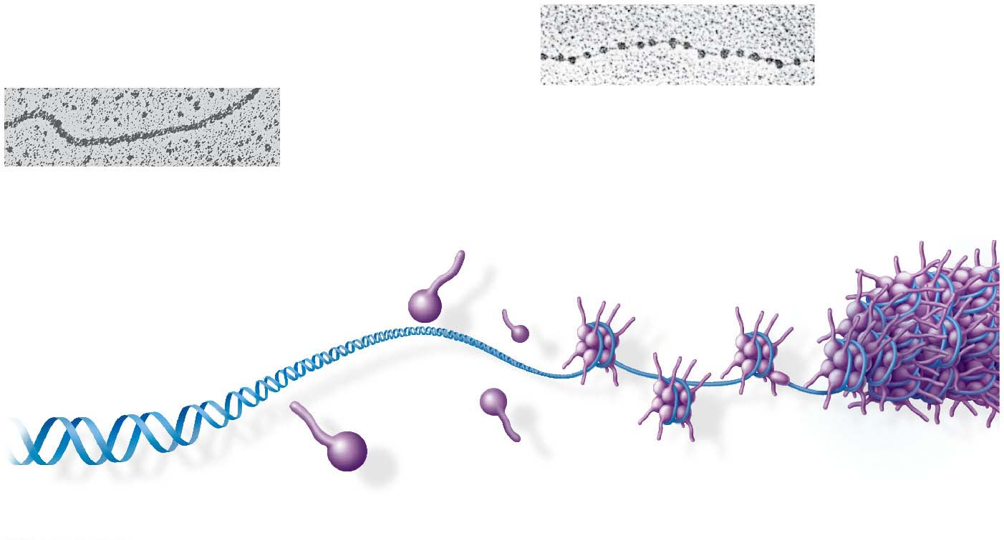
Figure 13.23-1
Nucleosome
(10 nm in diameter)
DNA
double helix
(2 nm in diameter)
H1
Histone tail
Histones
Notes:
Figure 13.23-1 Exploring chromatin packing in a eukaryotic chromosome (part 1)

Slide 104
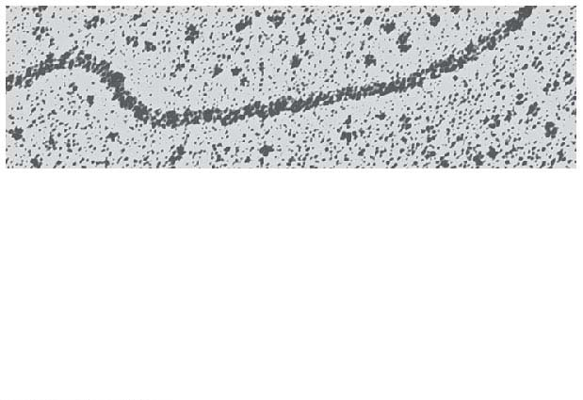
Figure 13.23-1a
DNA
double helix
(2 nm in diameter)
Notes:
Figure 13.23-1a Exploring chromatin packing in a eukaryotic chromosome (part 1a: DNA strand, TEM)

Slide 105
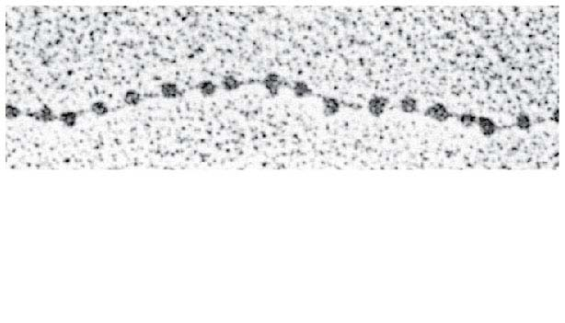
Figure 13.23-1b
Nucleosome
(10 nm in diameter)
Notes:
Figure 13.23-1b Exploring chromatin packing in a eukaryotic chromosome (part 1b: nucleosomes, TEM)

Slide 106
Figure 13.23-2
Chromatid
(700 nm)
30-nm
fiber
Looped
domain
Scaffold
300-nm
fiber
Replicated chromosome
(1,400 nm)
Notes:
Figure 13.23-2 Exploring chromatin packing in a eukaryotic chromosome (part 2)

Slide 107
Figure 13.23-2a
30-nm fiber
Notes:
Figure 13.23-2a Exploring chromatin packing in a eukaryotic chromosome (part 2a: 30-nm fiber, TEM)

Slide 108
Figure 13.23-2b
Looped
domain
Scaffold
Notes:
Figure 13.23-2b Exploring chromatin packing in a eukaryotic chromosome (part 2b: looped domains, TEM)

Slide 109
Figure 13.23-2c
Chromatid
(700 nm)
Notes:
Figure 13.23-2c Exploring chromatin packing in a eukaryotic chromosome (part 2c: metaphase chromosome, TEM)

Slide 110
Animation: DNA Packing

Slide 111
Video: Nucleosome Model

Slide 112
At interphase, most of the chromatin is compacted into a 30-nm fiber, which is folded further in some areas by looping
Even during interphase, centromeres and some other parts of chromosomes are highly condensed, similar to metaphase chromosomes
This condensed chromatin is called heterochromatin; the more dispersed, less compacted chromatin is called euchromatin
Notes:
112

Slide 113
Dense packing of the heterochromatin makes it largely inaccessible to the machinery responsible for transcribing genetic information
Chromosomes are dynamic in structure; a condensed region may be loosened or modified as needed for various cell processes
For example, histones can undergo chemical modifications that result in changes in chromatin organization
Notes:
113

Slide 114
Concept 13.4: Understanding DNA structure and replication makes genetic engineering possible
Complementary base pairing of DNA is the basis for nucleic acid hybridization, the base pairing of one strand of a nucleic acid to another, complementary sequence
Nucleic acid hybridization forms the foundation of virtually every technique used in genetic engineering, the direct manipulation of genes for practical purposes
Notes:
114

Slide 115
DNA Cloning: Making Multiple Copies of a Gene or Other DNA Segment
To work directly with specific genes, scientists prepare well-defined segments of DNA in identical copies, a process called DNA cloning
Most methods for cloning pieces of DNA in the laboratory share general features
Notes:
115

Slide 116
Many bacteria contain plasmids, small circular DNA molecules that replicate separately from the bacterial chromosome
To clone pieces of DNA, researchers first obtain a plasmid and insert DNA from another source (“foreign DNA”) into it
The resulting plasmid is called recombinant DNA
Notes:
116

Slide 117
Figure 13.24
Bacterium
Gene inserted into plasmid
(a cloning vector)
Cell containing gene
of interest
Bacterial
chromosome
Plasmid
DNA of chromosome
(“foreign” DNA)
Recombinant
DNA (plasmid)
Gene of interest
Plasmid put into
bacterial cell
Recombinant
bacterium
Host cell grown in culture to form a clone of
cells containing the “cloned” gene of interest
Gene of
interest
Protein expressed
from gene of interest
Copies of gene
Protein harvested
Basic
research
and various
applications
Gene for pest resistance
inserted into plants
Human growth hormone
treats stunted growth
Gene used to alter bacteria
for cleaning up toxic waste
Protein dissolves blood clots
in heart attack therapy
Notes:
Figure 13.24 An overview of gene cloning and some uses of cloned genes

Slide 118
Figure 13.24-1
Bacterium
Gene inserted into plasmid
(a cloning vector)
Cell containing
gene of interest
Bacterial
chromosome
Plasmid
DNA of
chromosome
(“foreign” DNA)
Recombinant
DNA (plasmid)
Gene of interest
Plasmid put into
bacterial cell
Recombinant
bacterium
Host cell grown in culture to
form a clone of cells containing
the “cloned” gene of interest
Gene of
interest
Protein expressed
from gene of interest
Notes:
Figure 13.24-1 An overview of gene cloning and some uses of cloned genes (part 1: steps)

Slide 119
Figure 13.24-2
Gene of
interest
Protein expressed
from gene of interest
Copies of gene
Protein harvested
Basic
research
and various
applications
Gene for pest resistance
inserted into plants
Human growth hormone
treats stunted growth
Gene used to alter bacteria
for cleaning up toxic waste
Protein dissolves blood clots
in heart attack therapy
Notes:
Figure 13.24-2 An overview of gene cloning and some uses of cloned genes (part 2: applications)

Slide 120
The production of multiple copies of a single gene is called gene cloning
The plasmid that carries the cloned DNA is called a cloning vector
Gene cloning is used to make many copies of a gene and to produce a protein product
The ability to amplify many copies of a gene is crucial for applications involving a single gene
Notes:
120

Slide 121
Using Restriction Enzymes to Make Recombinant DNA
Bacterial restriction enzymes cut DNA molecules at specific DNA sequences called restriction sites
A restriction enzyme usually makes many cuts, yielding restriction fragments
Notes:
121

Slide 122
Animation: Restriction Enzymes

Slide 123
Figure 13.25
Bacterial
plasmid
Restriction site
5′
3′
DNA
GA ATTC
3′
C.T TAAG
5′
Restriction enzyme cuts
the sugar-phosphate
backbones at each arrow.
5′
3′
5′
3′
G
AATT C
CTTAA
5′
G
3′
3′
5′
Sticky
end
5′
3′
AATTC
G
5′
DNA fragment from another
source is added. Base pairing
of sticky ends produces
various combinations.
G
CTTAA
3′
Fragment from different
DNA molecule cut by the
same restriction enzyme
5′
3′5′
3′5′
3′
G AAT T C
G AATT C
3′
C T TAA G
C TTAA G
5′3′
5′3′
5′
One possible combination
DNA ligase
seals the strands.
5′
3′
3′
Recombinant DNA molecule
5′
Recombinant
plasmid
Notes:
Figure 13.25 Using a restriction enzyme and DNA ligase to make a recombinant DNA plasmid

Slide 124
Figure 13.25-1
Bacterial
plasmid
Restriction site
5′
3′
DNA
G A A T T C
C T T AAG
3′
5′
Restriction enzyme cuts
the sugar-phosphate
backbones at each arrow.
3′
5′
5′
A
A
3′
G
T
T
C
C
T
T
A
A
G
5′
3′
3′
5′
Sticky
end
Notes:
Figure 13.25-1 Using a restriction enzyme and DNA ligase to make a recombinant DNA plasmid (part 1)

Slide 125
Figure 13.25-2
3′
5′
5′
A
A
T
3′
G
T
C
C
T
T
A
A
G
5′
3′
3′
5′
Sticky
end
5′
A
A
T
T
3′
C
G
5′
G
C
DNA fragment from another
source is added. Base pairing
of sticky ends produces
various combinations.
3′
T
T
A
A
Fragment from different
DNA molecule cut by the
same restriction enzyme
5′
3′ 5′
3′ 5′
3′
G
AAT T
C
G
AAT T
C
C
T TA A
G
C
T TA A
G
3′
5′3′
5′3′
5′
One possible combination
Notes:
Figure 13.25-2 Using a restriction enzyme and DNA ligase to make a recombinant DNA plasmid (part 2)

Slide 126
Figure 13.25-3
5′
3′ 5′
3′ 5′
3′
G AAT T C
G AAT T C
C T T AA G
C T T AA G
3′
5′3′
5′3′
5′
One possible combination
DNA ligase
seals the strands.
5′
3′
3′
Recombinant DNA molecule
5′
Recombinant
plasmid
Notes:
Figure 13.25-3 Using a restriction enzyme and DNA ligase to make a recombinant DNA plasmid (part 3)

Slide 127
The most useful restriction enzymes cleave the DNA in a staggered manner to produce sticky ends
Sticky ends can bond with complementary sticky ends of other fragments
DNA ligase can close the sugar-phosphate backbones of DNA strands
Notes:
127

Slide 128
To see the fragments produced by cutting DNA molecules with restriction enzymes, researchers use gel electrophoresis
This technique separates a mixture of nucleic acid fragments based on length
Notes:
128

Slide 129
Figure 13.26
Mixture of
DNA mol-
ecules of
different
lengths
Power
source
Cathode
Anode
Wells
Gel
(a) Negatively charged DNA molecules will move toward the positive electrode.
Restriction fragments
of known lengths
(b) Shorter molecules are slowed down less than longer ones, so they move faster through the gel.
Notes:
Figure 13.26 Gel electrophoresis

Slide 130
Figure 13.26-1
Mixture of
DNA mol-
ecules of
different
lengths
Power
source
Cathode
Anode
Wells
Gel
(a) Negatively charged DNA molecules will move toward the positive electrode.
Notes:
Figure 13.26-1 Gel electrophoresis (part 1: technique)

Slide 131
Figure 13.26-2
Restriction fragments
of known lengths
(b) Shorter molecules are slowed down less than longer ones, so they move faster through the gel.
Notes:
Figure 13.26-2 Gel electrophoresis (part 2: photo)

Slide 132
Amplifying DNA in Vitro: The Polymerase Chain Reaction (PCR) and Its Use in Cloning
The polymerase chain reaction (PCR) can produce many copies of a specific target segment of DNA
A three-step cycle brings about a chain reaction that produces an exponentially growing population of identical DNA molecules
The key to PCR is an unusual, heat-stable DNA polymerase called Taq polymerase.
Notes:
132

Slide 133
Figure 13.27
Technique
5′
3′
Target sequence
Genomic DNA
3′
5′
Denaturation
5′
3′
3′
5′
Annealing
Cycle 1
yields 2 molecules
Primers
Extension
New
nucleotides
Cycle 2
yields 4 molecules
Cycle 3
2 of the 8 molecules
(in white boxes)
match target sequence
and are the right length
Notes:
Figure 13.27 Research method: the polymerase chain reaction (PCR)

Slide 134
Figure 13.27-1
Technique
5′
3′
Target sequence
Genomic DNA
3′
5′
Notes:
Figure 13.27-1 Research method: the polymerase chain reaction (PCR) (part 1)

Slide 135
Figure 13.27-2-s1
Denaturation
5′
3′
3′
5′
Cycle 1
yields 2
molecules
Notes:
Figure 13.27-2-s1 Research method: the polymerase chain reaction (PCR) (part 2, step 1)

Slide 136
Figure 13.27-2-s2
Denaturation
5′
3′
3′
5′
Annealing
Cycle 1
yields 2
molecules
Primers
Notes:
Figure 13.27-2-s2 Research method: the polymerase chain reaction (PCR) (part 2, step 2)

Slide 137
Figure 13.27-2-s3
Denaturation
5′
3′
3′
5′
Annealing
Cycle 1
yields 2
molecules
Primers
Extension
New
nucleotides
Notes:
Figure 13.27-2-s3 Research method: the polymerase chain reaction (PCR) (part 2, step 3)

Slide 138
Figure 13.27-3
Cycle 2
yields 4 molecules
Cycle 3
2 of the 8 molecules
(in white boxes)
match target sequence
and are the right length
Results
After 30 more cycles, over 1 billion (10⁹) molecules
match the target sequence.
Notes:
Figure 13.27-3 Research method: the polymerase chain reaction (PCR) (part 3)

Slide 139
PCR amplification alone cannot substitute for gene cloning in cells
Instead, PCR is used to provide the specific DNA fragment to be cloned
PCR primers are synthesized to include a restriction site that matches the site in the cloning vector
The fragment and vector are cut and ligated together
Notes:
139

Slide 140
Figure 13.28
Cloning
vector
(bacterial
plasmid)
DNA fragment obtained
by PCR (cut by same
restriction enzyme used
on cloning vector)
Mix and ligate
Recombinant
DNA plasmid
Notes:
Figure 13.28 Use of restriction enzymes and PCR in gene cloning

Slide 141
DNA Sequencing
Once a gene is cloned, complementary base pairing can be exploited to determine the gene’s complete nucleotide sequence
This process is called DNA sequencing
Notes:
141

Slide 142
“Next-generation” sequencing techniques, developed in the last 15 years, are rapid and inexpensive
They sequence by synthesizing the complementary strand of a single, immobilized template strand
A chemical technique enables electronic monitors to identify which nucleotide is being added at each step
Notes:
142

Slide 143
Figure 13.29
(a) Next-generation sequencing machines
4-mer
A
T
3-mer
G
TTCT GCG AA
C
2-mer
1-mer
(b) A “flow-gram” from a next-generation sequencing machine
Notes:
Figure 13.29 Next-generation sequencing

Slide 144
Figure 13.29-1
(a) Next-generation sequencing machines
Notes:
Figure 13.29-1 Next-generation sequencing (part 1: sequencing machines)

Slide 145
Figure 13.29-2
4-mer
A
T
3-mer
G
TTC TGCG AA
C
2-mer
1-mer
(b) A “flow-gram” from a next-generation sequencing machine
Notes:
Figure 13.29-2 Next-generation sequencing (part 2: a “flow-gram”)

Slide 146
Next-generation methods are being complemented or replaced by third-generation methods
These newer techniques are faster and less expensive
Several groups are working on “nanopore” methods, which involve moving a single DNA strand through a tiny pore in a membrane
Nucleotides are identified by slight differences in the amount of time that they interrupt an electrical current across the pore
Notes:
146

Slide 147
Figure 13.30
Notes:
Figure 13.30 An example of a third-generation sequencing technique

Slide 148
Editing Genes and Genomes
Over the past five years, biologists have developed a powerful new technique called the CRISPR-Cas9 system
Cas9 is a nuclease that cuts double-stranded DNA molecules as directed by a guide RNA that is complementary to the target gene
Researchers have used this system to “knock out” (disable) a given gene in order to determine its function
Notes:
148

Slide 149
Researchers have also modified the CRISPR-Cas9 system to repair a gene that has a mutation
In 2014 a group of researchers reported using this system to successfully correct a mutated gene in mice
CRISPR technology is sparking widespread excitement among researchers and physicians
Notes:
149

Slide 150
Figure 13.31
Cas9 active sites
NUCLEUS
Guide RNA
complementary
sequence
Cas9 protein
Guide RNA engineered to
“guide” the Cas9 protein
to a target gene
5′
3′
3′
5′
5′
5′
Part of the
target gene
3′
Complementary
sequence that can
bind to a target gene
Active sites that
can cut DNA
Resulting cut
in target gene
Cas9−guide RNA complex
Normal
(functional)
gene for use as
a template by
repair enzymes
(a) Scientists can disable
(“knock out”) the target gene
to study its normal function.
(b) If the target gene has a
mutation, it can be repaired.
CYTOPLASM
NUCLEUS
Random nucleotides
Normal nucleotides
Notes:
Figure 13.31 Gene editing using the CRISPR-Cas9 system

Slide 151
Figure 13.31-1
Cas9 protein
Guide RNA engineered to
“guide” the Cas9 protein
to a target gene
5′
3′
Complementary
sequence that can
bind to a target gene
Active sites that
can cut DNA
Cas9−guide RNA complex
Notes:
Figure 13.31-1 Gene editing using the CRISPR-Cas9 system (part 1: formation of Cas9 RNA complex)

Slide 152
Figure 13.31-2
CYTOPLASM
Cas9 active sites
NUCLEUS
Guide RNA
complementary
sequence
5′
3′
5′
3′
5′
Part of the
target gene
Resulting cut
in target gene
Notes:
Figure 13.31-2 Gene editing using the CRISPR-Cas9 system (part 2: binding of Cas9 guide RNA to target gene)

Slide 153
Figure 13.31-3
Normal
(functional)
gene for use as
a template by
repair enzymes
(a) Scientists can disable
(“knock out”) the target gene
to study its normal function.
(b) If the target gene has a
mutation, it can be repaired.
Random nucleotides
Normal nucleotides
Notes:
Figure 13.31-3 Gene editing using the CRISPR-Cas9 system (part 3: repair of broken DNA strands)

Slide 154
Figure 13.15
(a) Origin of replication in an E. coli cell
(b) Origins of replication in a eukaryotic cell
Parental (template) strand
Origin of
replication
Double-stranded
DNA molecule
Origin of
replication
Daughter (new)
strand
Parental
(template) strand
Daughter
(new) strand
Replication
fork
Double-
stranded
DNA
molecule
Replication
bubble
Bubble
Replication fork
Two daughter
DNA molecules
Two daughter DNA molecules
0.5 μm
0.25 μm
Notes:
Figure 13.15 Origins of replication in E. coli and eukaryotes

Slide 155
Figure 13.19
Overview
Origin of replication
Leading strand
template
Leading strand
Lagging
strand
Single-strand
binding proteins
Leading
strand
3′
Lagging strand
Overall directions
of replication
5′
Leading strand
Helicase
5′
DNA pol III
3′
Primer
3′
5′
3′
Primase
Lagging strand
Parental DNA
DNA pol III
Lagging strand
template
5′
3′
DNA pol I
DNA ligase
5′
3′
5′
Notes:
Figure 13.19 A summary of bacterial DNA replication

Slide 156
Figure 13.19-1
Overview
Origin of replication
Leading strand
Lagging
strand
Leading
strand
Lagging strand
Overall directions
of replication
Notes:
Figure 13.19-1 A summary of bacterial DNA replication (part 1)

Slide 157
Figure 13.19-2
Leading strand
template
Single-strand
binding proteins
Helicase
Leading strand
5′
DNA pol III
3′
Primer
3′
5′
Primase
3′
Parental DNA
Lagging strand
template
Notes:
Figure 13.19-2 A summary of bacterial DNA replication (part 2)

Slide 158
Figure 13.19-3
Lagging strand
DNA pol III
5′
DNA pol I
3′
DNA ligase
5′
3′
Lagging strand template
5′
Notes:
Figure 13.19-3 A summary of bacterial DNA replication (part 3)

Slide 159
Figure 13.UN01-1
Notes:
Figure 13.UN01-1 Skills exercise: working with data in a table (part 1)

Slide 160
Figure 13.UN01-2
Sea urchin
Notes:
Figure 13.UN01-2 Skills exercise: working with data in a table (part 2)

Slide 161
Figure 13.UN02
G
C
C
G
Nitrogenous bases
A
T
Sugar-phosphate backbone
T
A
C
G
G
C
C
G
Hydrogen bond
A
T
Notes:
Figure 13.UN02 Summary of key concepts: double helix

Slide 162
Figure 13.UN03
DNA pol III synthesizes
leading strand continuously
3′
5′
Parental
DNA
DNA pol III starts DNA
synthesis at 3′ end of primer,
continues in 5′ → 3′ direction
Origin of
replication
5′
3′
Lagging strand synthesized
in short Okazaki fragments,
later joined by DNA ligase
Helicase
3′
Primase synthesizes
a short RNA primer
5′
DNA pol I replaces the RNA
primer with DNA nucleotides
Notes:
Figure 13.UN03 Summary of key concepts: DNA replication

Slide 163
Figure 13.UN04
5′
3′
5′
3′
G
A A T T C
C T T A A
G
3′
5′
3′
5′
Sticky end
Notes:
Figure 13.UN04 Summary of key concepts: restriction fragments

Slide 164
Figure 13.UN05
Notes:
Figure 13.UN05 Test your understanding, question 11 (DNA replication complex)

Slide 165
Figure 13.UN06
Notes:
Figure 13.UN06 Test your understanding, question 14 (TAL protein)

