Slide 1
Concept 12.3: Linked genes tend to be inherited together because they are located near each other on the same chromosome
Each chromosome has hundreds or thousands of genes (except the Y chromosome)
Genes located on the same chromosome that tend to be inherited together are called linked genes
© 2016 Pearson Education, Inc.
Notes:
1

Slide 2
How Linkage Affects Inheritance
Morgan did experiments with fruit flies that show how linkage affects inheritance of two characters
Morgan crossed flies that differed in traits of body color and wing size
© 2016 Pearson Education, Inc.
Notes:
2

Slide 3
Morgan found that body color and wing size are usually inherited together in specific combinations (parental phenotypes)
He reasoned that since these genes did not assort independently, they were on the same chromosome
© 2016 Pearson Education, Inc.
Notes:
3

Slide 4
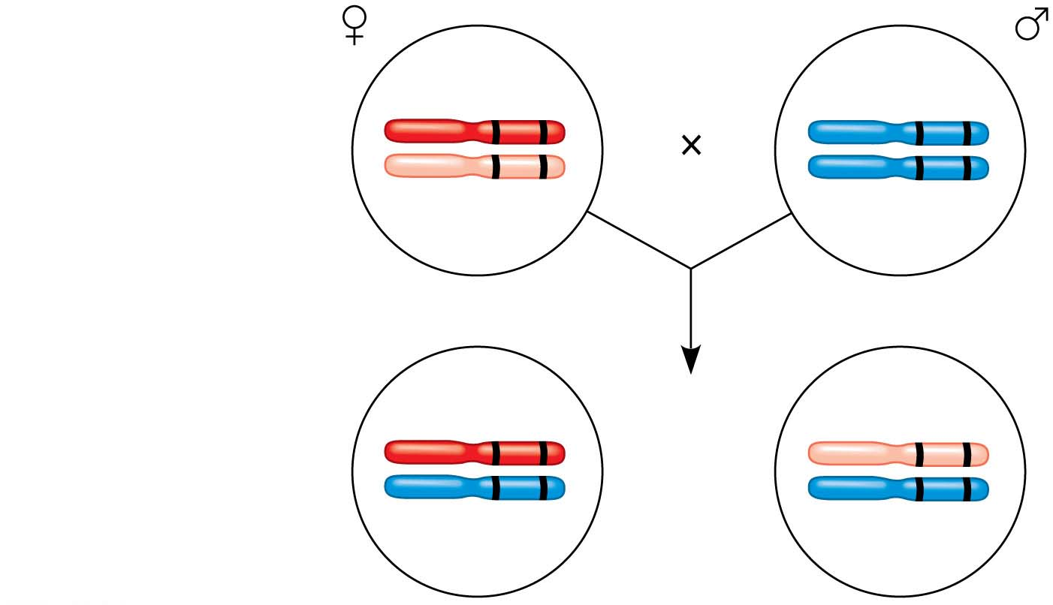
Figure 12.UN01
F₁ dihybrid female
and homozygous
recessive male
in testcross
b⁺
vg ⁺
b
vg
b
vg
b
vg
b⁺
vg ⁺
b
vg
Most offspring
or
b
vg
b
vg
© 2016 Pearson Education, Inc.
Notes:
Figure 12.UN01 In-text figure, testcross, p. 242

Slide 5
However, nonparental phenotypes were also produced
Understanding this result involves exploring genetic recombination, the production of offspring with combinations of traits differing from either parent
© 2016 Pearson Education, Inc.
Notes:
5

Slide 6
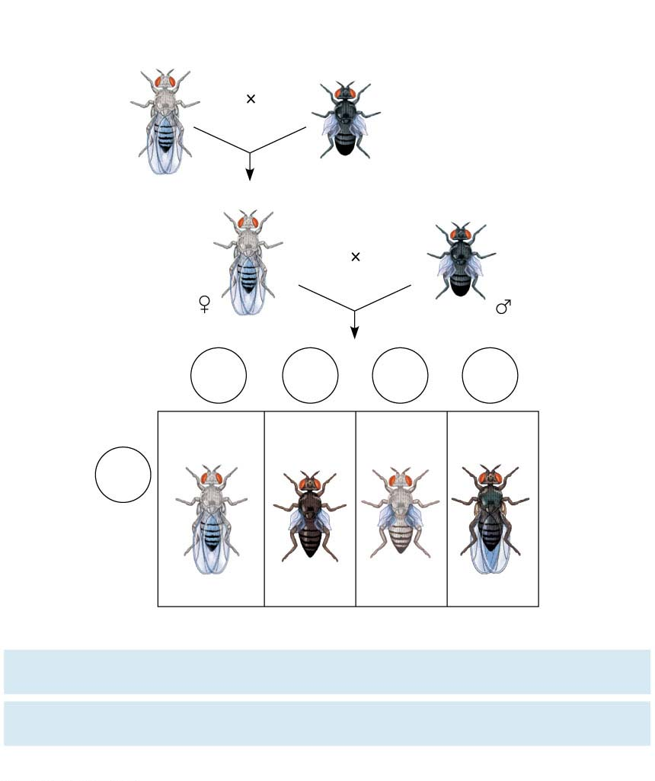
Figure 12.9
Experiment
P Generation
(homozygous)
Wild type
(gray body,
normal wings)
Double mutant
(black body,
vestigial wings)
b⁺
b⁺
vg⁺
vg⁺
b b
vg vg
F1 dihybrid testcross
Homozygous
recessive (black
body, vestigial
wings)
Wild-type F₁ dihybrid
(gray body, normal wings)
b⁺
b
vg⁺
vg
b b
vg vg
Testcross
offspring
Eggs
b⁺
vg⁺
b
vg
b⁺
vg⁺
b
vg⁺
Wild type
(gray normal)
Black
vestigial
Gray
vestigial
Black
normal
b vg
Sperm
b⁺
b
vg⁺
vg
b b vg vg
b⁺
b
vg
vg
b
b
vg⁺
vg
PREDICTED RATIOS
Genes on different
chromosomes:
1
:
1
:
1
:
1
Genes on same
chromosome:
1
:
1
:
0
:
0
Results
965
:
944
:
206
:
185
© 2016 Pearson Education, Inc.
Notes:
Figure 12.9 Inquiry: How does linkage between two genes affect inheritance of characters?

Slide 7
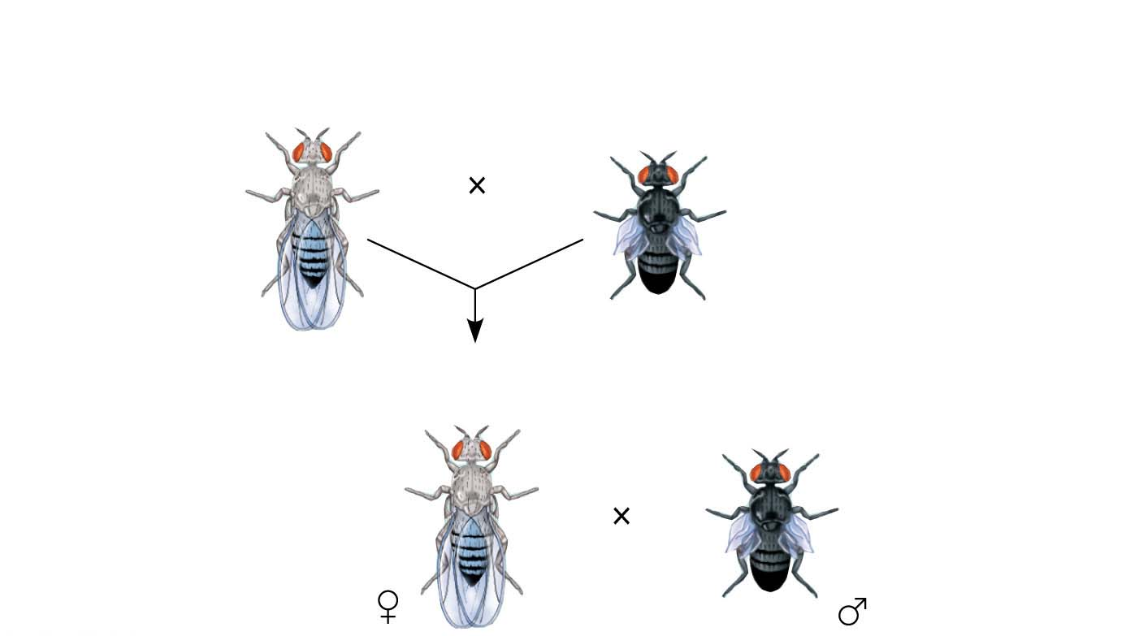
Figure 12.9-1
Experiment
P Generation
(homozygous)
Wild type
(gray body,
normal wings)
Double mutant
(black body,
vestigial wings)
b⁺
b⁺
vg⁺
vg⁺
b b
vg vg
F₁ dihybrid testcross
Wild-type F₁ dihybrid
(gray body, normal wings)
Homozygous
recessive (black
body, vestigial
wings)
b⁺
b
vg⁺
vg
b b
vg vg
© 2016 Pearson Education, Inc.
Notes:
Figure 12.9-1 Inquiry: How does linkage between two genes affect inheritance of characters? (part 1: experiment)

Slide 8
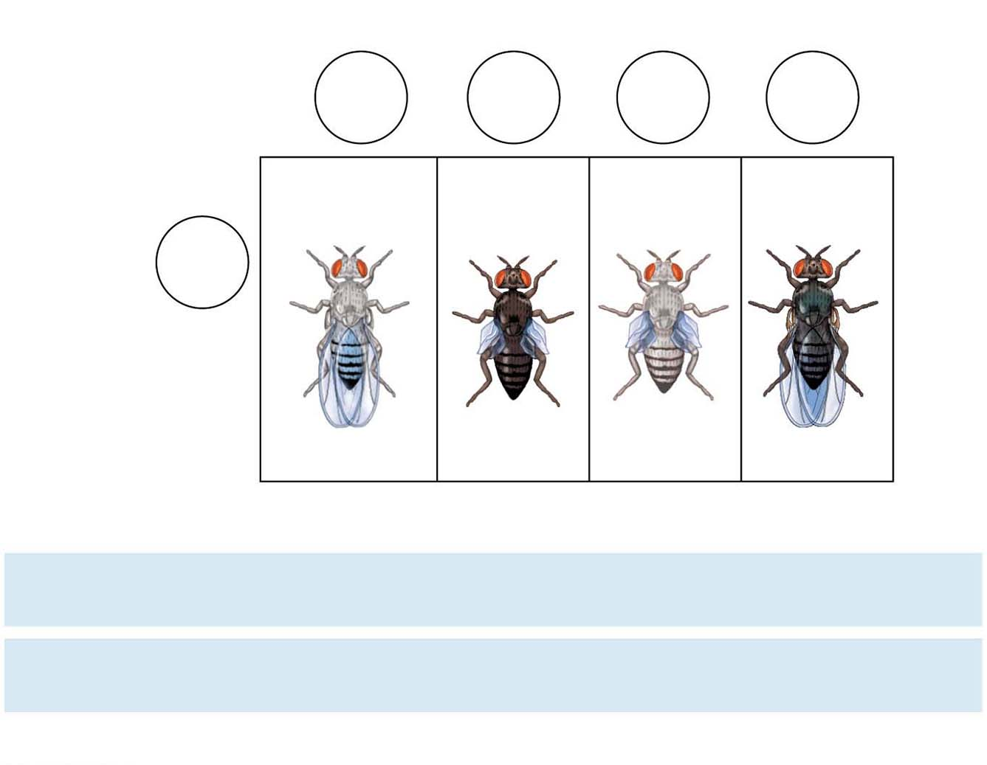
Figure 12.9-2
Experiment
Testcross
offspring
Eggs
b⁺
vg⁺
b
vg
b⁺
vg
b
vg⁺
Wild type
(gray normal)
Black
vestigial
Gray
vestigial
Black
normal
b vg
Sperm
b⁺
b
vg⁺
vg
b
b
vg
vg
b⁺
b
vg
vg
b
b
vg⁺
vg
PREDICTED RATIOS
Genes on different
chromosomes:
1
:
1
:
1
:
1
Genes on same
chromosome:
1
:
1
:
0
:
0
Results
965
:
944
:
206
:
185
© 2016 Pearson Education, Inc.
Notes:
Figure 12.9-2 Inquiry: How does linkage between two genes affect inheritance of characters? (part 2: results)

Slide 9
Genetic Recombination and Linkage
The genetic findings of Mendel and Morgan relate to the chromosomal basis of recombination
© 2016 Pearson Education, Inc.
Notes:
9

Slide 10
Recombination of Unlinked Genes: Independent Assortment of Chromosomes
Mendel observed that combinations of traits in some offspring differ from either parent
Offspring with a phenotype matching one of the parental phenotypes are called parental types
Offspring with nonparental phenotypes (new combinations of traits) are called recombinant types, or recombinants
A 50% frequency of recombination is observed for any two genes on different chromosomes
© 2016 Pearson Education, Inc.
Notes:
10

Slide 11
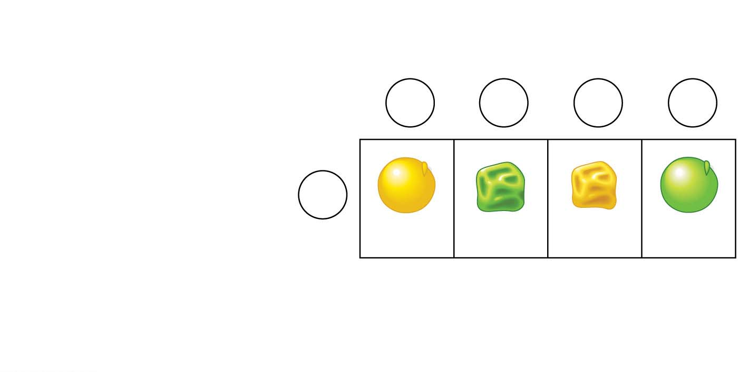
Figure 12.UN02
Gametes from yellow round
dihybrid parent (YyRr )
YR
yr
Yr
yR
Gametes from green
wrinkled homozygous
recessive parent (yyrr)
yr
YyRr
yyrr
Yyrr
yyRr
Parental-
type
offspring
Recombinant
offspring
© 2016 Pearson Education, Inc.
Notes:
Figure 12.UN02 In-text figure, Punnett square, p. 244

Slide 12
Recombination of Linked Genes: Crossing Over
Morgan discovered that even when two genes were on the same chromosome, some recombinant phenotypes were observed
He proposed that some process must occasionally break the physical connection between genes on the same chromosome
That mechanism was the crossing over between homologous chromosomes
© 2016 Pearson Education, Inc.
Notes:
12

Slide 13
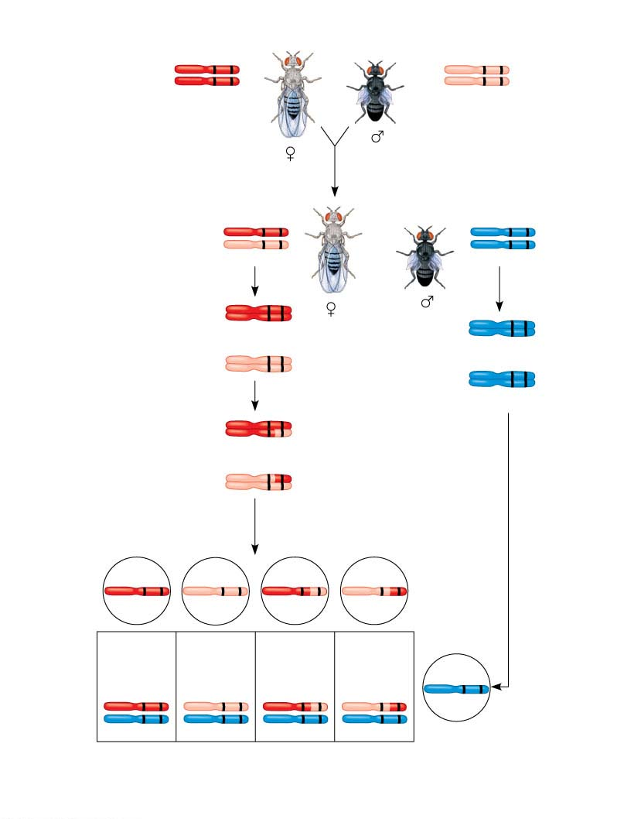
Figure 12.10
P generation
(homozygous)
Wild type
(gray body,
normal wings)
Double mutant
(black body,
vestigial wings)
b⁺
vg⁺
b
vg
b⁺
vg⁺
b
vg
F₁ dihybrid testcross
Wild-type F1 dihybrid
(gray body,
normal wings)
Homozygous recessive
(black body,
vestigial wings)
b⁺
vg⁺
b vg
b
vg
b vg
Replication
of chromosomes
Replication
of chromosomes
b⁺
vg⁺
b vg
b⁺
vg⁺
b vg
b vg
b vg
b vg
b vg
Meiosis I
b⁺
vg⁺
b⁺
vg
Meiosis I and II
b
vg⁺
Meiosis II
b
vg
Recombinant
chromosomes
Eggs
b⁺
vg⁺
b
vg
b⁺
vg
b
vg⁺
Testcross
offspring
965
Wild type
(gray normal)
944
Black
vestigial
206
Gray
vestigial
185
Black
normal
b⁺
vg⁺
b
vg
b vg
b⁺
vg
b
vg⁺
b
vg
b
vg
b
vg
b
vg
Sperm
Parental-type offspring
Recombinant offspring
Recombination
frequency
=
391 recombinants
×100 = 17%
© 2016 Pearson Education, Inc.
2,300 total offspring
Notes:
Figure 12.10 Chromosomal basis for recombination of linked genes

Slide 14
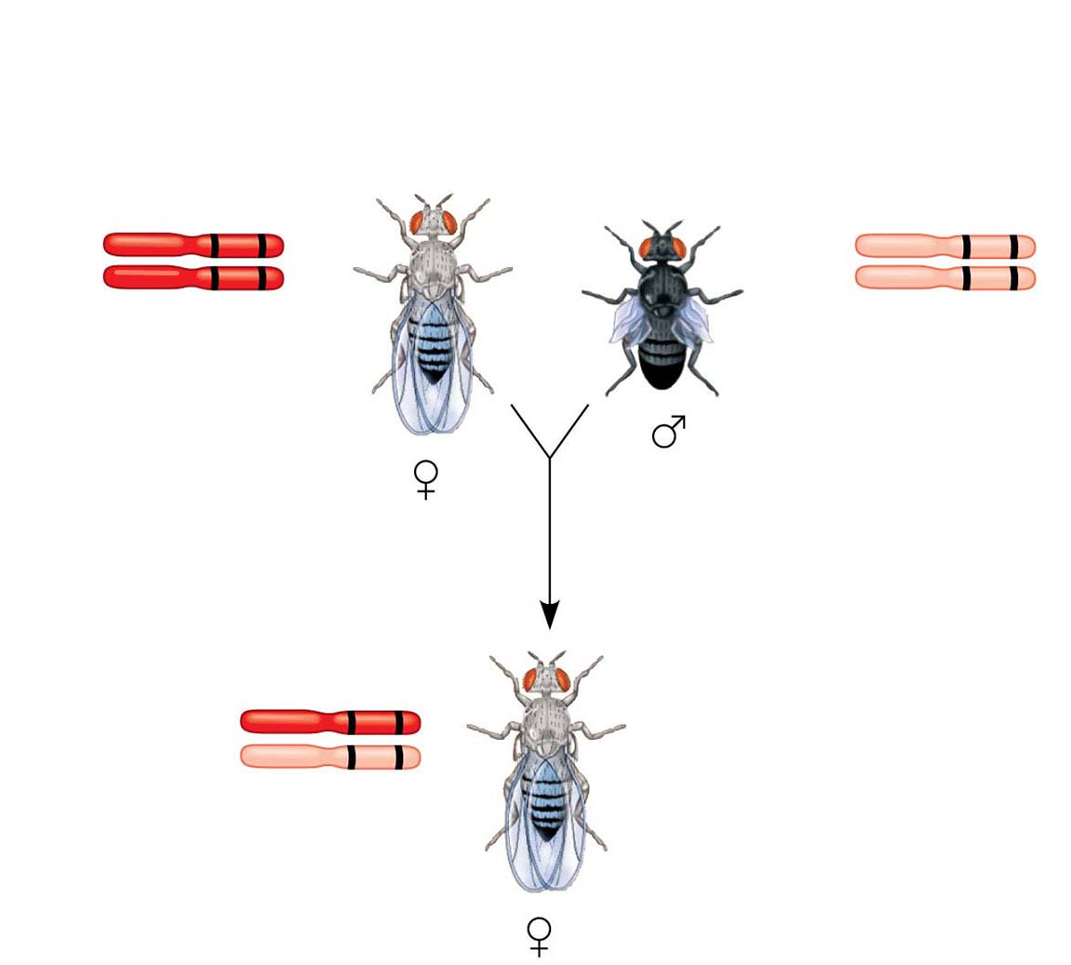
Figure 12.10-1
P generation (homozygous)
Wild type
(gray body,
normal wings)
Double mutant
(black body,
vestigial wings)
b⁺
vg⁺
b
vg
b⁺
vg⁺
b
vg
Wild-type F₁ dihybrid
(gray body,
normal wings)
b⁺
vg⁺
b
vg
© 2016 Pearson Education, Inc.
Notes:
Figure 12.10-1 Chromosomal basis for recombination of linked genes (part 1: F₁ dihybrid)

Slide 15
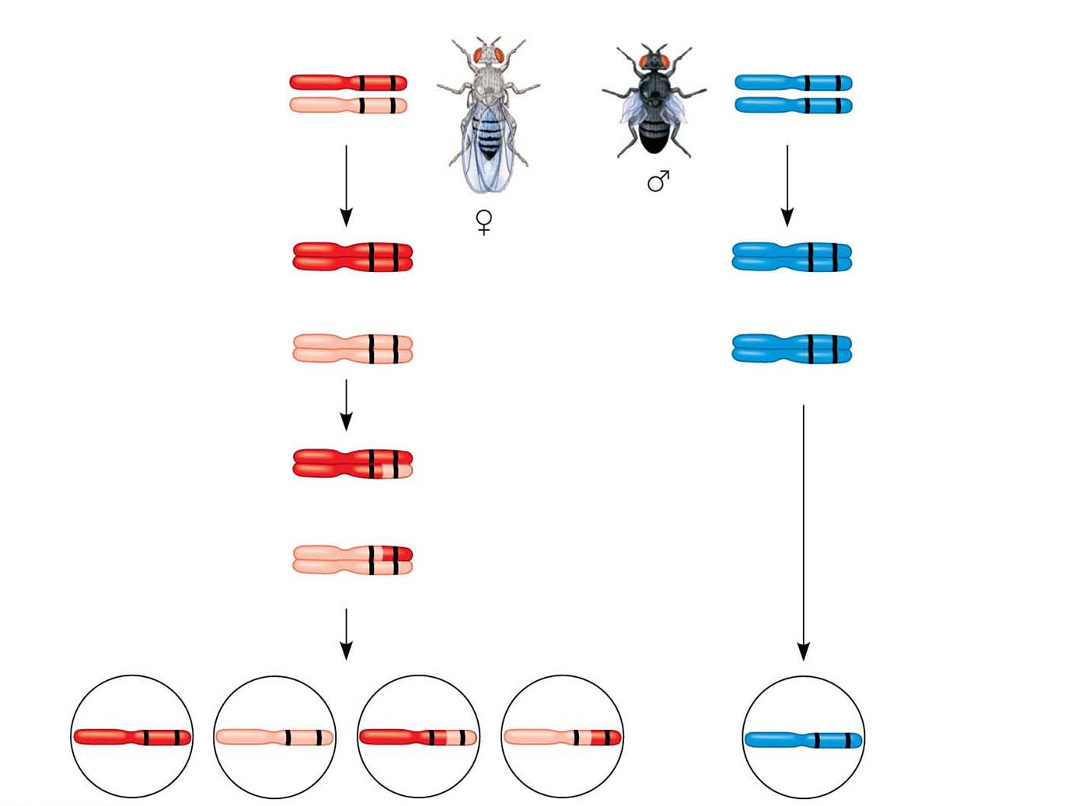
Figure 12.10-2
F₁ dihybrid testcross
b⁺
vg⁺
b
vg
Wild-type F₁
dihybrid
(gray body,
normal wings)
Homozygous
recessive
(black body,
vestigial wings)
b
vg
b
vg
b⁺
vg⁺
b
vg
b⁺
vg⁺
b
vg
b
vg
b
vg
b
vg
b
vg
Meiosis I
b⁺
vg⁺
Meiosis I and II
b⁺
vg
b
vg⁺
b
vg
Recombinant
chromosomes
Meiosis II
b⁺
vg⁺
b
vg
b⁺
vg
b
vg⁺
b
vg
Eggs
Sperm
© 2016 Pearson Education, Inc.
Notes:
Figure 12.10-2 Chromosomal basis for recombination of linked genes (part 2: testcross)

Slide 16
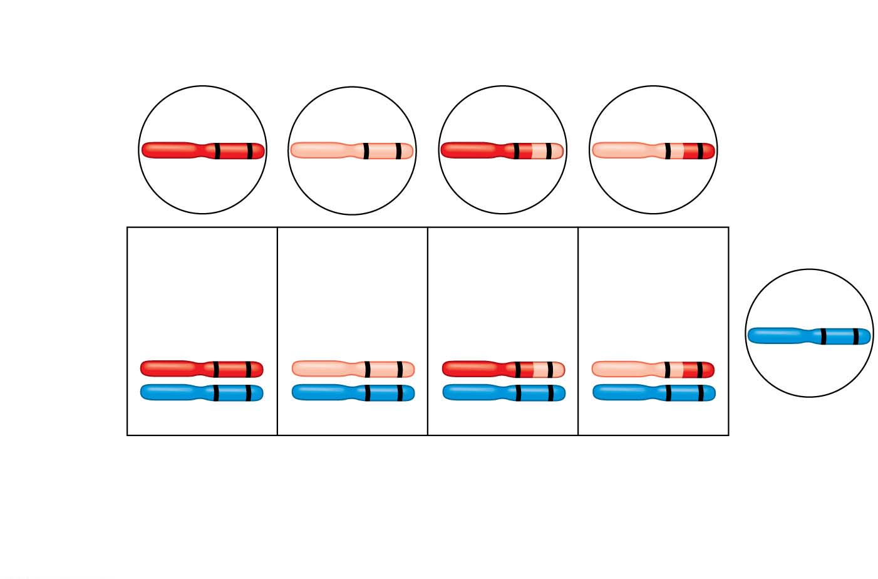
Figure 12.10-3
Recombinant
chromosomes
b⁺
vg⁺
b
vg
b⁺
vg
b
vg⁺
Eggs
Testcross
offspring
965
Wild type
(gray normal)
944
Black
vestigial
206
Gray
vestigial
185
Black
normal
b vg
b⁺
vg⁺
b
vg
b⁺
vg
b
vg⁺
b
vg
b
vg
b
vg
b
vg
Sperm
Parental-type offspring
Recombinant offspring
Recombination
frequency
=
391 recombinants
×100 = 17%
2,300 total offspring
© 2016 Pearson Education, Inc.
Notes:
Figure 12.10-3 Chromosomal basis for recombination of linked genes (part 3: testcross offspring)

Slide 17
New Combinations of Alleles: Variation for Natural Selection
Recombinant chromosomes bring alleles together in new combinations in gametes
Random fertilization increases even further the number of variant combinations that can be produced
This abundance of genetic variation is the raw material upon which natural selection works
© 2016 Pearson Education, Inc.
Notes:
17

Slide 18
Mapping the Distance Between Genes Using Recombination Data: Scientific Inquiry
Alfred Sturtevant, one of Morgan’s students, constructed a genetic map, an ordered list of the genetic loci along a particular chromosome
Sturtevant predicted that the farther apart two genes are, the higher the probability that a crossover will occur between them and therefore the higher the recombination frequency
© 2016 Pearson Education, Inc.
Notes:
18

Slide 19
A linkage map is a genetic map of a chromosome based on recombination frequencies
Distances between genes can be expressed as map units; one map unit represents a 1% recombination frequency
© 2016 Pearson Education, Inc.
Notes:
19

Slide 20
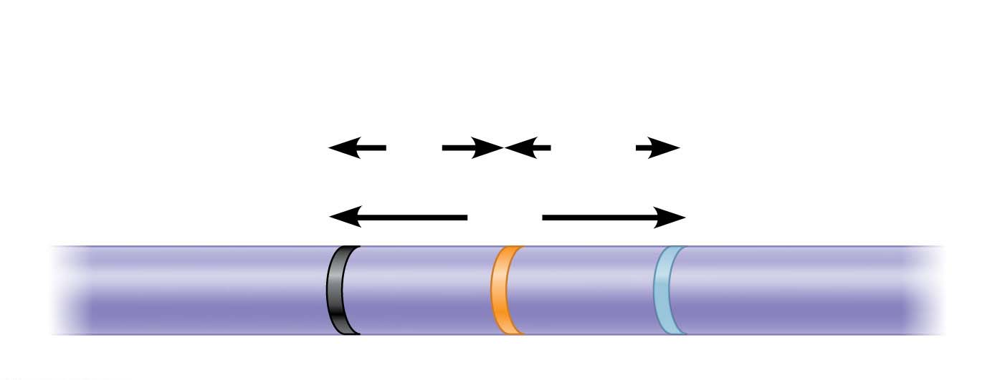
Figure 12.11
Results
Recombination
frequencies
9%
9.5%
Chromosome
17%
b
cn
vg
© 2016 Pearson Education, Inc.
Notes:
Figure 12.11 Research method: constructing a linkage map

Slide 21
Genes that are far apart on the same chromosome can have a recombination frequency near 50%
Such genes are physically connected, but genetically unlinked
© 2016 Pearson Education, Inc.
Notes:
21

Slide 22
Sturtevant used recombination frequencies to make linkage maps of fruit fly genes
Using methods like chromosomal banding, geneticists can develop cytogenetic maps of chromosomes
Cytogenetic maps indicate the positions of genes with respect to chromosomal features
© 2016 Pearson Education, Inc.
Notes:
22

Slide 23
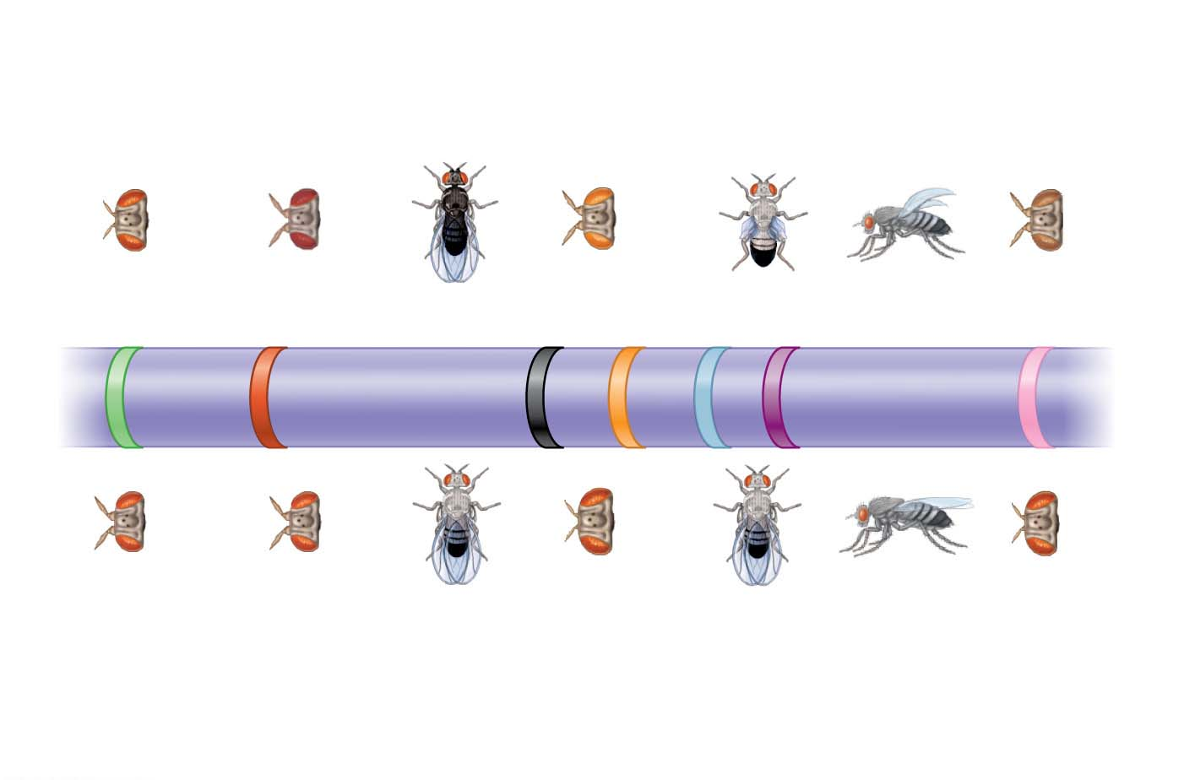
Figure 12.12
Mutant phenotypes
Short
aristae
Maroon
eyes
Black body
Cinnabar
eyes
Vestigial
wings
Down-
curved
wings
Brown
eyes
0
16.5
48.5
57.5
67.0
75.5
104.5
Long
aristae
(appendages
on head)
Red
eyes
Gray
body
Red
eyes
Normal
wings
Normal
wings
Red
eyes
Wild-type phenotypes
© 2016 Pearson Education, Inc.
Notes:
Figure 12.12 A partial genetic (linkage) map of a Drosophila chromosome

