Slide 1
0
12
The Chromosomal Basis of Inheritance

Slide 2
Overview: Locating Genes Along Chromosomes
Mendel’s “hereditary factors” were genes
Today we know that genes are located on chromosomes
The location of a particular gene can be seen by tagging isolated chromosomes with a fluorescent dye that highlights the gene
© 2016 Pearson Education, Inc.
Notes:
2

Slide 3
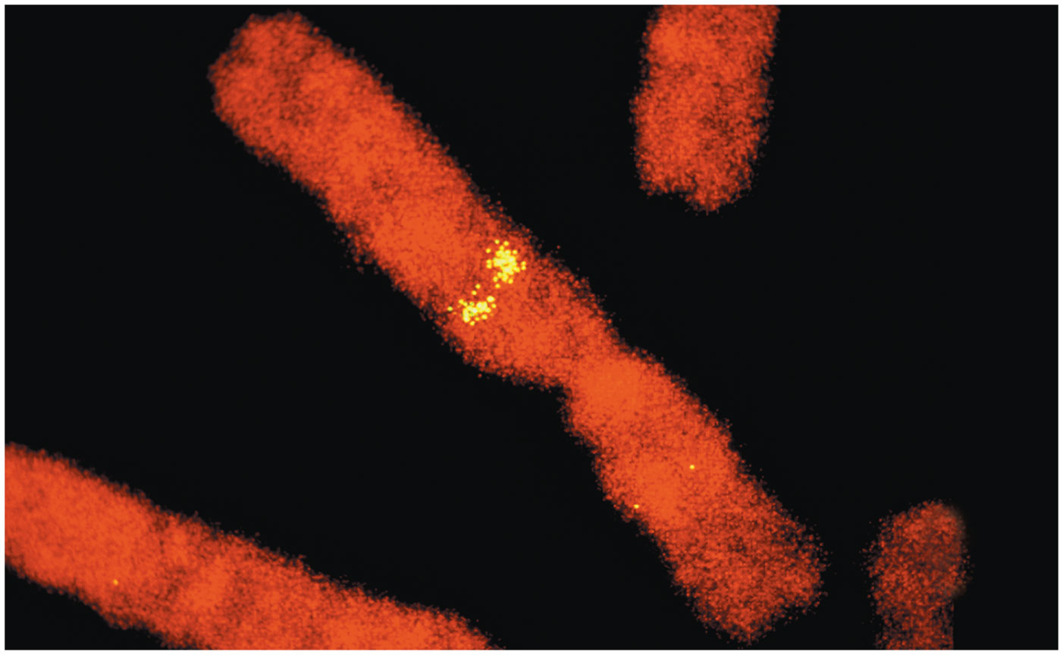
Figure 12.1
© 2016 Pearson Education, Inc.
Notes:
Figure 12.1 Where in the cell are Mendel’s hereditary factors located?

Slide 4
Mitosis and meiosis were first described in the late 1800s
The chromosome theory of inheritance states
Mendelian genes have specific loci (positions) on chromosomes
Chromosomes undergo segregation and independent assortment
The behavior of chromosomes during meiosis can account for Mendel’s laws of segregation and independent assortment
© 2016 Pearson Education, Inc.
Notes:
4

Slide 5
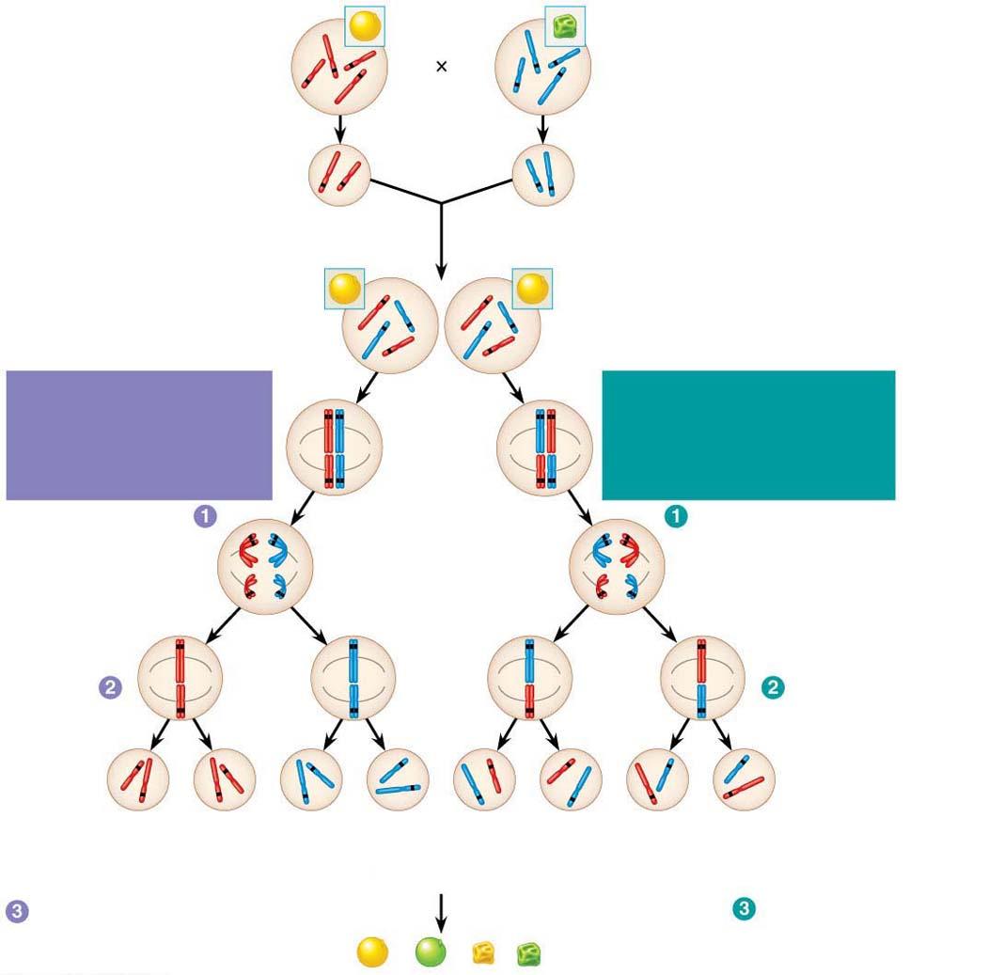
Figure 12.2
P Generation
Yellow round
seeds (YYRR)
Green wrinkled
seeds (yyrr)
Y
r
y
Y
R
R
y
r
Meiosis
Fertilization
y
r
Gametes
R
Y
All F₁ plants produce
yellow round seeds (YyRr).
F₁ Generation
R
R
r
y
r
y
Y
Y
LAW OF SEGREGATION
The two alleles for each
gene separate.
Meiosis
LAW OF INDEPENDENT
ASSORTMENT Alleles of
genes on nonhomologous
chromosomes assort
independently.
R
r
Metaphase
r
R
I
Y
y
Y
y
R
r
r
R
Anaphase I
Y
y
Y
y
R
r
Metaphase
II
r
R
Y
y
Y
y
Y
Y
y
y
Y
Y
y
y
R
R
r
r
r
r
R
R
1
4
YR
1
4
yr
1
4
Yr
1
4
yR
F₂ Generation
An F₁ × F₁ cross-fertilization
Fertilization
recombines the R and
r alleles at random.
Fertilization results in the
9:3:3:1 phenotypic ratio
in the F₂ generation.
© 2016 Pearson Education, Inc.
9
: 3
: 3
: 1
Notes:
Figure 12.2 The chromosomal basis of Mendel’s laws

Slide 6
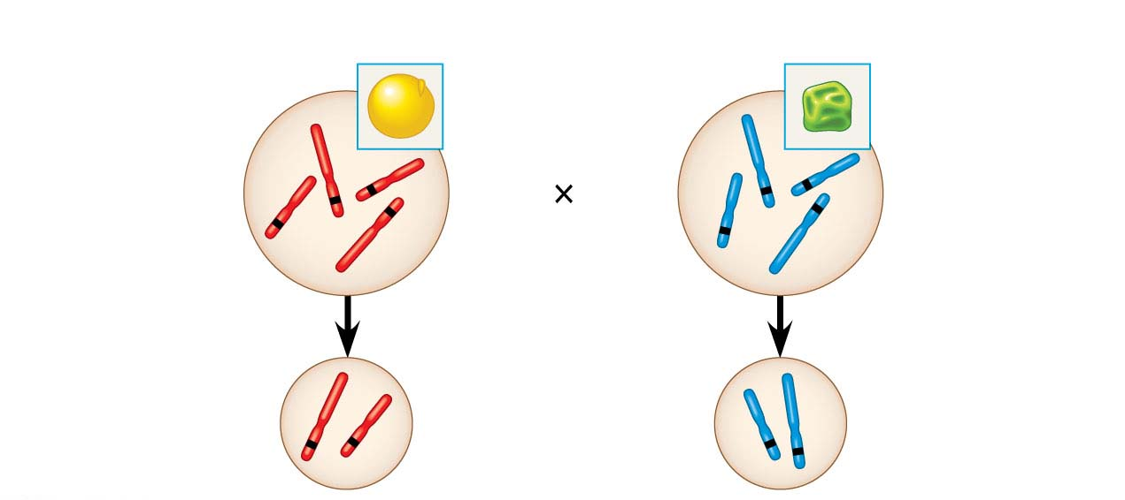
Figure 12.2-1
P Generation
Yellow round
seeds (YYRR)
Green wrinkled
seeds (yyrr)
Y
y
r
Y
R
R
r
y
Meiosis
Fertilization
R
Y
y
r
Gametes
© 2016 Pearson Education, Inc.
Notes:
Figure 12.2-1 The chromosomal basis of Mendel’s laws (part 1: P generation)

Slide 7
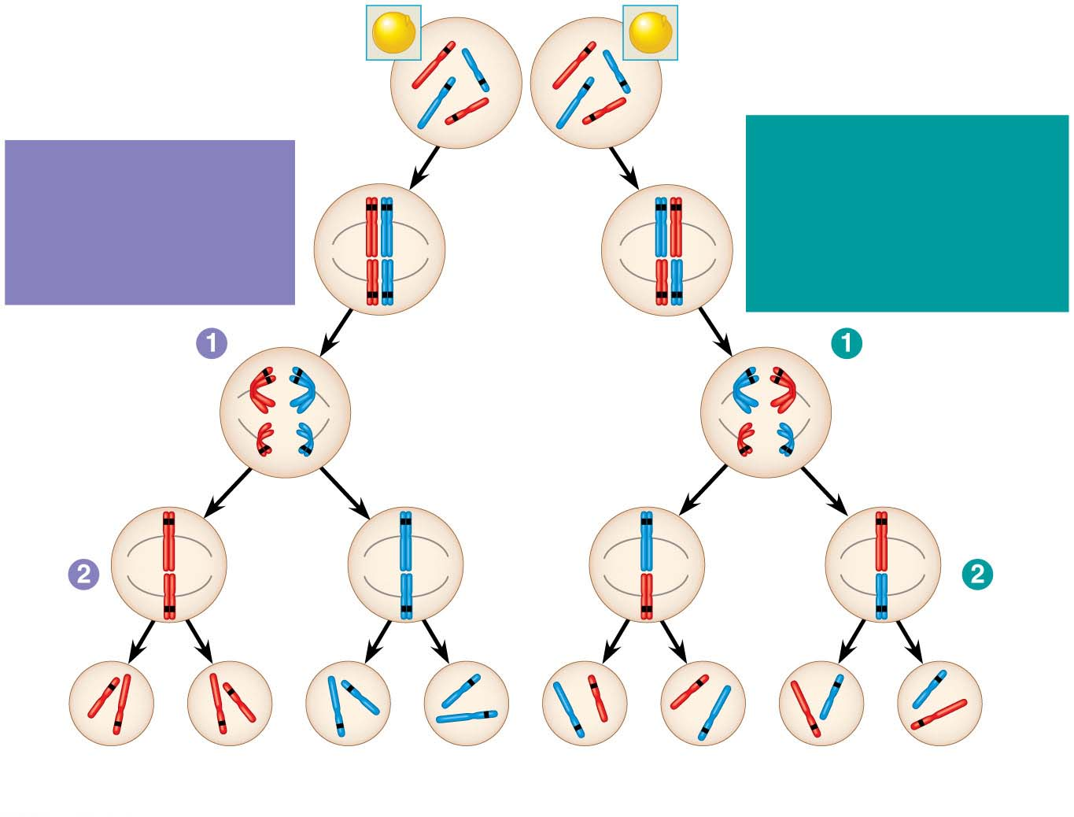
Figure 12.2-2
F₁ Generation
All F₁ plants produce
yellow round seeds (YyRr).
R
y
R
r
r
y
Y
Y
LAW OF INDEPENDENT
ASSORTMENT
Alleles of genes on
nonhomologous
chromosomes assort
independently.
LAW OF
SEGREGATION
The two alleles for
each gene separate.
Meiosis
R
r
Metaphase
I
r
R
Y
y
Y
y
R
r
r
R
Anaphase I
Y
y
Y
y
R
r
Metaphase
II
r
R
Y
y
Y
y
Y
Y
y
y
Y
Y
y
y
R
R
r
r
r
r
R
R
1
4
YR
1
4
yr
1
4
Yr
1
4
yR
© 2016 Pearson Education, Inc.
Notes:
Figure 12.2-2 The chromosomal basis of Mendel’s laws (part 2: F₁ generation)

Slide 8
Figure 12.2-3
LAW OF
SEGREGATION
LAW OF
INDEPENDENT
ASSORTMENT
F₂ Generation
Fertilization
recombines the
R and r alleles
at random.
An F₁ F₁ cross-fertilization
Fertilization results
in the 9:3:3:1
phenotypic ratio in
the F₂ generation.
9
: 3
: 3
: 1
© 2016 Pearson Education, Inc.
Notes:
Figure 12.2-3 The chromosomal basis of Mendel’s laws (part 3: F₂ generation)

Slide 9
Concept 12.1: Morgan showed that Mendelian inheritance has its physical basis in the behavior of chromosomes: scientific inquiry
The first solid evidence associating a specific gene with a specific chromosome came from the work of Thomas Hunt Morgan in the early 1900s
© 2016 Pearson Education, Inc.
Notes:
9

Slide 10
Morgan’s Choice of Experimental Organism
Morgan selected a species of fruit fly, Drosophila melanogaster, as his research organism
Several characteristics make fruit flies a convenient organism for genetic studies
They produce many offspring
A generation can be bred every two weeks
They have only four pairs of chromosomes
© 2016 Pearson Education, Inc.
Notes:
10

Slide 11
Morgan noted wild-type, or normal, phenotypes that were common in the fly populations
Traits alternative to the wild type are called mutant phenotypes
The first mutant phenotype he discovered was a fly with white eyes instead of the wild type red
© 2016 Pearson Education, Inc.
Notes:
11

Slide 12
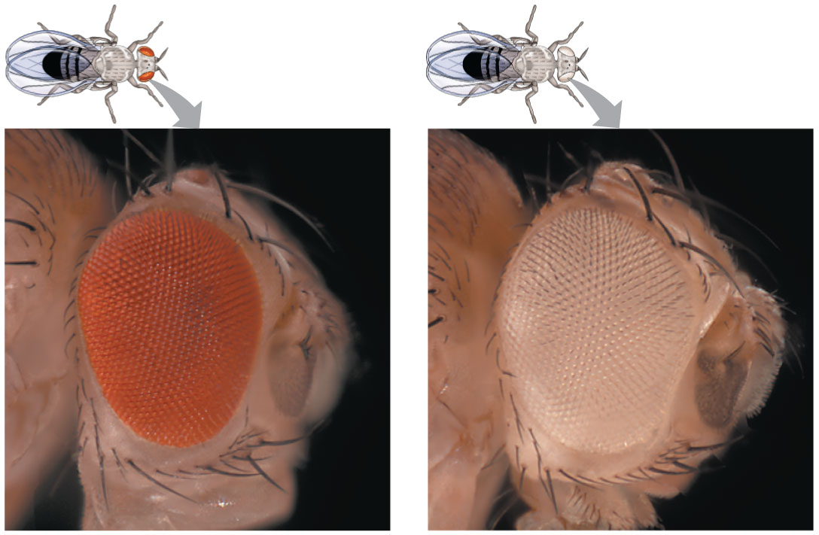
Figure 12.3
© 2016 Pearson Education, Inc.
Notes:
Figure 12.3 Morgan’s first mutant

Slide 13
Correlating Behavior of a Gene’s Alleles with Behavior of a Chromosome Pair
In one experiment, Morgan mated male flies with white eyes (mutant) with female flies with red eyes (wild type)
The F₁ generation all had red eyes
The F₂ generation showed the classical 3:1 red:white ratio, but only males had white eyes
Morgan concluded that the eye color was related to the sex of the fly
© 2016 Pearson Education, Inc.
Notes:
13

Slide 14
Morgan determined that the white-eyed mutant allele must be located on the X chromosome
Morgan’s finding supported the chromosome theory of inheritance
© 2016 Pearson Education, Inc.
Notes:
14

Slide 15
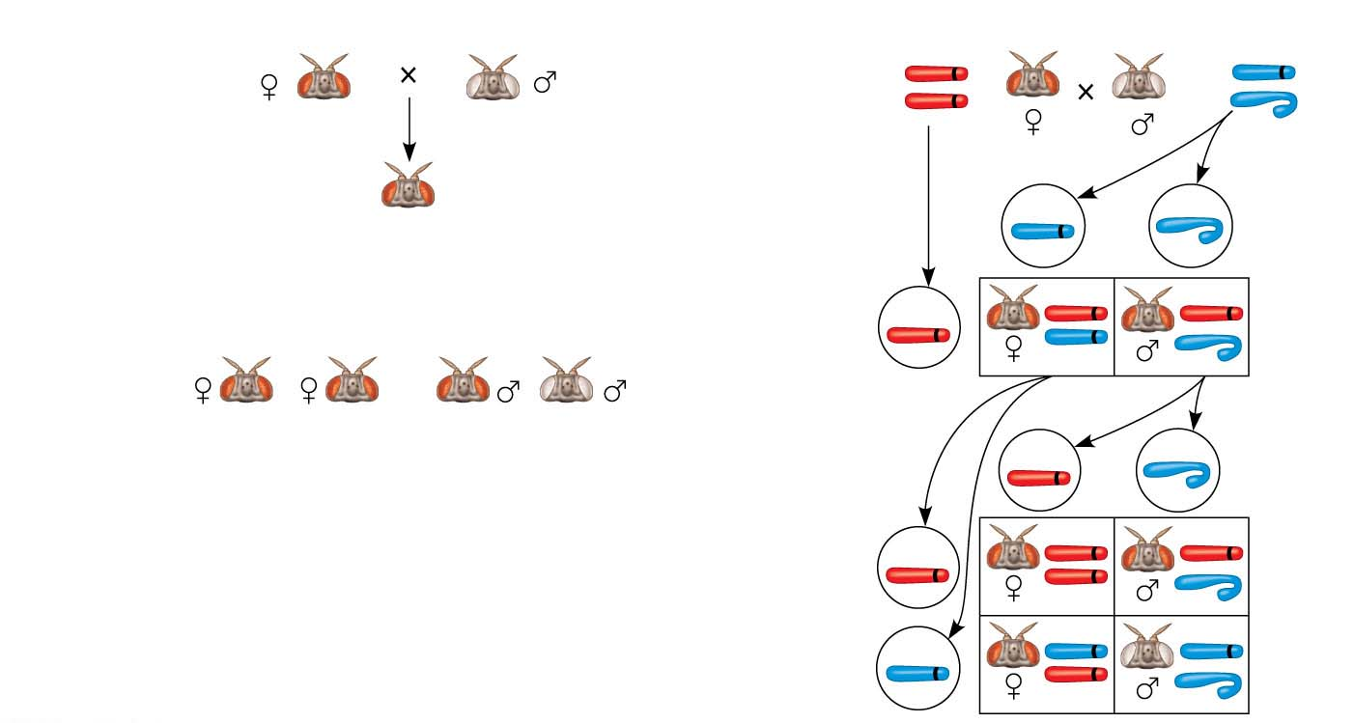
Figure 12.4
Experiment
Conclusion
P
Generation
P
Generation
X
w⁺
X
w
X
Y
w⁺
F₁
Generation
All offspring
had red eyes.
w
Sperm
Eggs
F₁
Generation
w⁺
w⁺
w⁺
Results
F₂
Generation
w
w⁺
Sperm
Eggs
w⁺
w⁺
w⁺
F₂
Generation
w⁺
w
w
w
w⁺
© 2016 Pearson Education, Inc.
Notes:
Figure 12.4 Inquiry: In a cross between a wild-type female fruit fly and a mutant white-eyed male, what color eyes will the F₁ and F₂ offspring have?

Slide 16
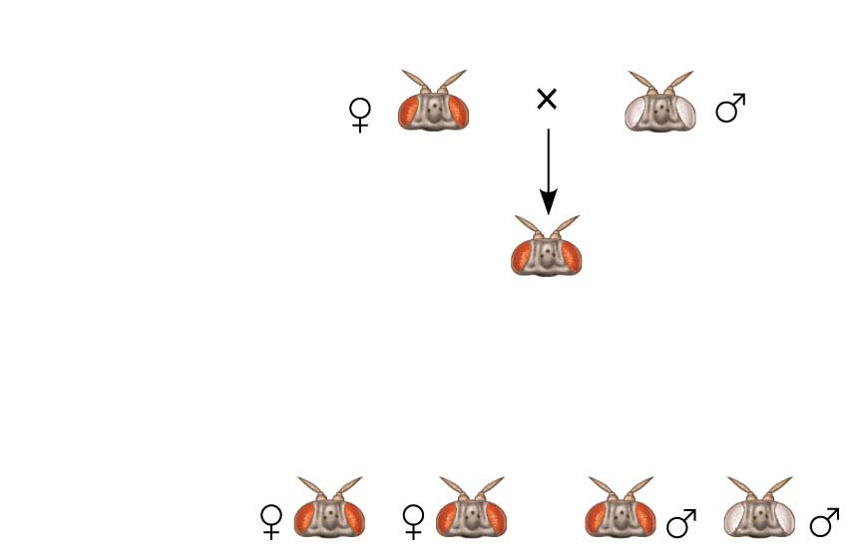
Figure 12.4-1
Experiment
P
Generation
F₁
Generation
All offspring
had red eyes.
Results
F₂
Generation
© 2016 Pearson Education, Inc.
Notes:
Figure 12.4-1 Inquiry: In a cross between a wild-type female fruit fly and a mutant white-eyed male, what color eyes will the F₁ and F₂ offspring have? (part 1: experiment and results)

Slide 17
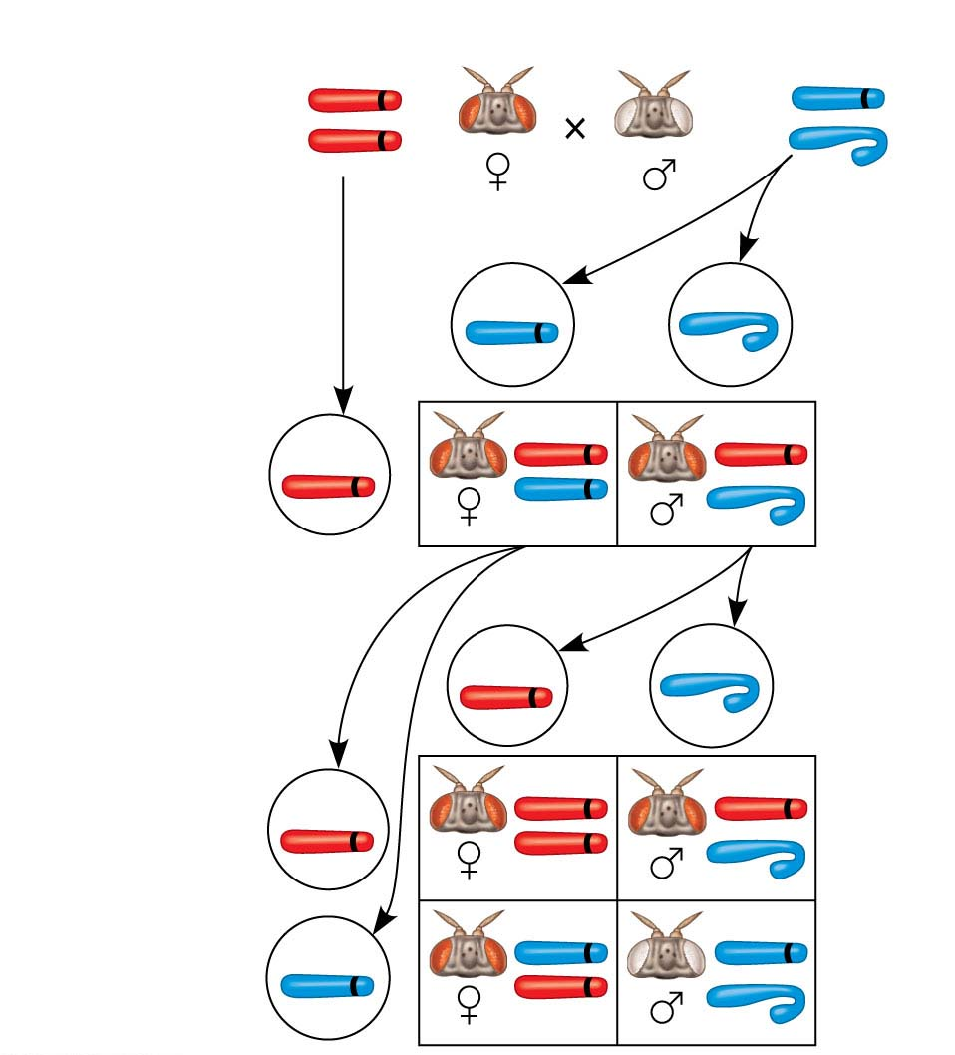
Figure 12.4-2
Conclusion
P
Generation
X
w⁺
w
X
X
Y
w⁺
w
Sperm
Eggs
F₁
Generation
w⁺
w⁺
w⁺
w
w⁺
Sperm
Eggs
w⁺
w⁺
F₂
Generation
w⁺
w⁺
w
w
w
w⁺
© 2016 Pearson Education, Inc.
Notes:
Figure 12.4-2 Inquiry: In a cross between a wild-type female fruit fly and a mutant white-eyed male, what color eyes will the F₁ and F₂ offspring have? (part 2: conclusion)

Slide 18
Concept 12.2: Sex-linked genes exhibit unique patterns of inheritance
The behavior of the members of the pair of sex chromosomes can be correlated with the behavior of the two alleles of the eye-color gene white
© 2016 Pearson Education, Inc.
Notes:
18

Slide 19
The Chromosomal Basis of Sex
Humans and other mammals have two types of sex chromosomes: a larger X chromosome and a smaller Y chromosome
Only the ends of the Y chromosome have regions that are homologous with corresponding regions of the X chromosome
The SRY gene on the Y chromosome is required for the developments of testes
© 2016 Pearson Education, Inc.
Notes:
19

Slide 20
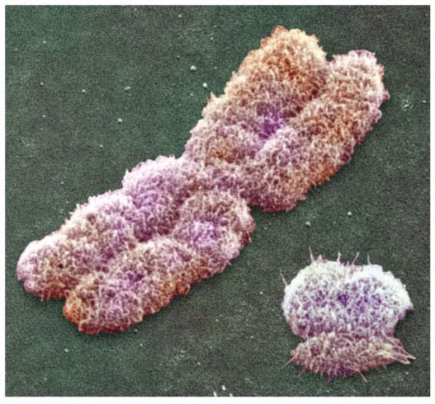
Figure 12.5
X
Y
© 2016 Pearson Education, Inc.
Notes:
Figure 12.5 Human sex chromosomes

Slide 21
Females are XX, and males are XY
Each ovum contains an X chromosome, while a sperm may contain either an X or a Y chromosome
Other animals have different methods of sex determination
© 2016 Pearson Education, Inc.
Notes:
21

Slide 22
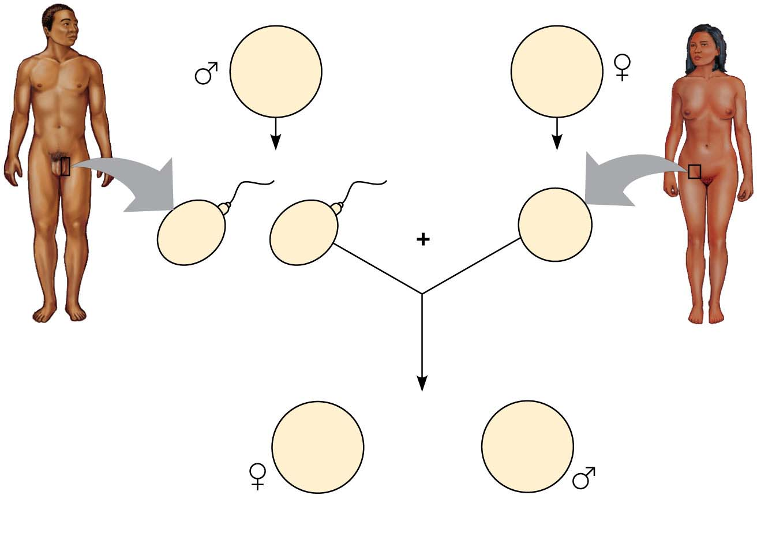
Figure 12.6
44 +
XY
Parents
44 +
XX
22 +
X
22 +
Y
22 +
X
or
Sperm
Egg
44 +
XX
44 +
XY
or
Zygotes (offspring)
© 2016 Pearson Education, Inc.
Notes:
Figure 12.6 The mammalian X-Y chromosomal system of sex determination

Slide 23
A gene that is located on either sex chromosome is called a sex-linked gene
Genes on the Y chromosome are called Y-linked genes; there are few of these
Genes on the X chromosome are called X-linked genes
© 2016 Pearson Education, Inc.
Notes:
23

Slide 24
Inheritance of X-Linked Genes
Most Y-linked genes help determine sex
The X chromosomes have genes for many characters unrelated to sex
© 2016 Pearson Education, Inc.
Notes:
24

Slide 25
X-linked genes follow specific patterns of inheritance
For a recessive X-linked trait to be expressed
A female needs two copies of the allele (homozygous)
A male needs only one copy of the allele (hemizygous)
X-linked recessive disorders are much more common in males than in females
© 2016 Pearson Education, Inc.
Notes:
25

Slide 26
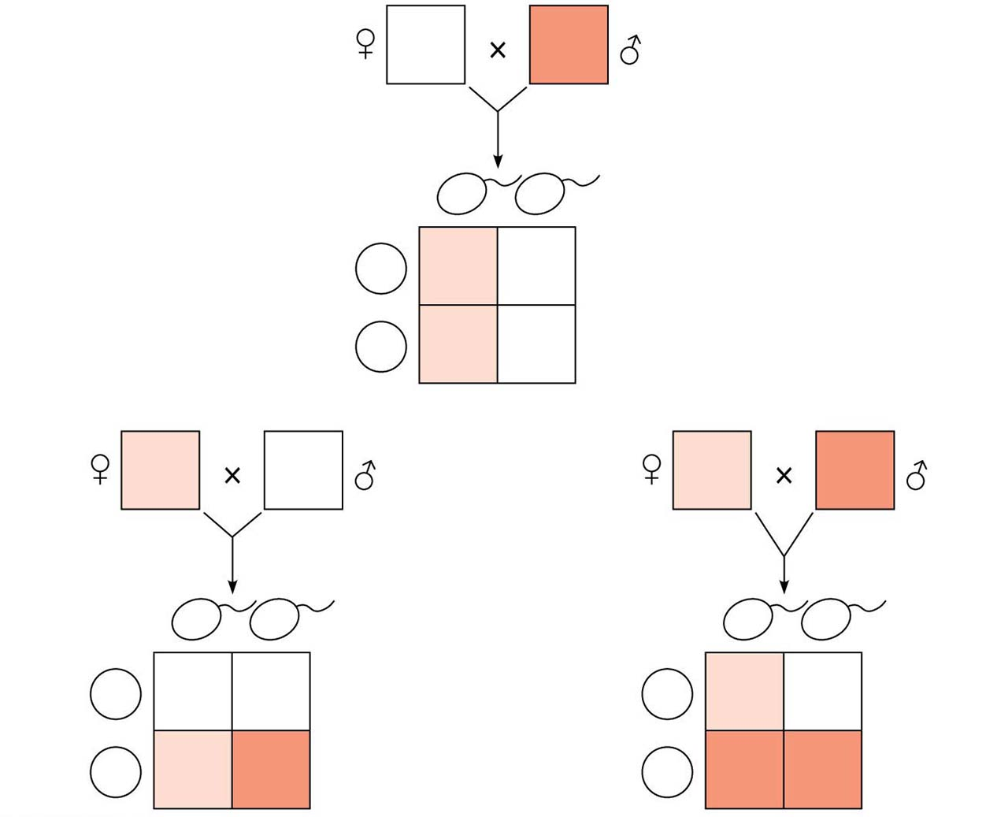
Figure 12.7
X^{N}X^{N}
X^{n}Y
X^{n}
Y
Sperm
Eggs
X^{N}
X^{N}X^{n}
X^{N}Y
X^{N}
X^{N}X^{n}
X^{N}Y
(a)
X^{N}X^{n}
X^{N}Y
X^{N}X^{n}
X^{n}Y
X^{N}
Y
Sperm
X^{n}
Y
Sperm
Eggs
X^{N}
X^{N}X^{N}
X^{N}Y
Eggs
X^{N}
X^{N}X^{n}
X^{N}Y
X^{n}
X^{N}X^{n}
X^{n}Y
X^{n}
X^{n}X^{n}
X^{n}Y
(b)
(c)
© 2016 Pearson Education, Inc.
Notes:
Figure 12.7 The transmission of X-linked recessive traits

Slide 27
Some disorders caused by recessive alleles on the X chromosome in humans:
Color blindness (mostly X-linked)
Duchenne muscular dystrophy
Hemophilia
© 2016 Pearson Education, Inc.
Notes:
27

Slide 28
X Inactivation in Female Mammals
In mammalian females, one of the two X chromosomes in each cell is randomly inactivated during embryonic development
The inactive X condenses into a Barr body
If a female is heterozygous for a particular gene located on the X chromosome, she will be a mosaic for that character
© 2016 Pearson Education, Inc.
Notes:
28

Slide 29
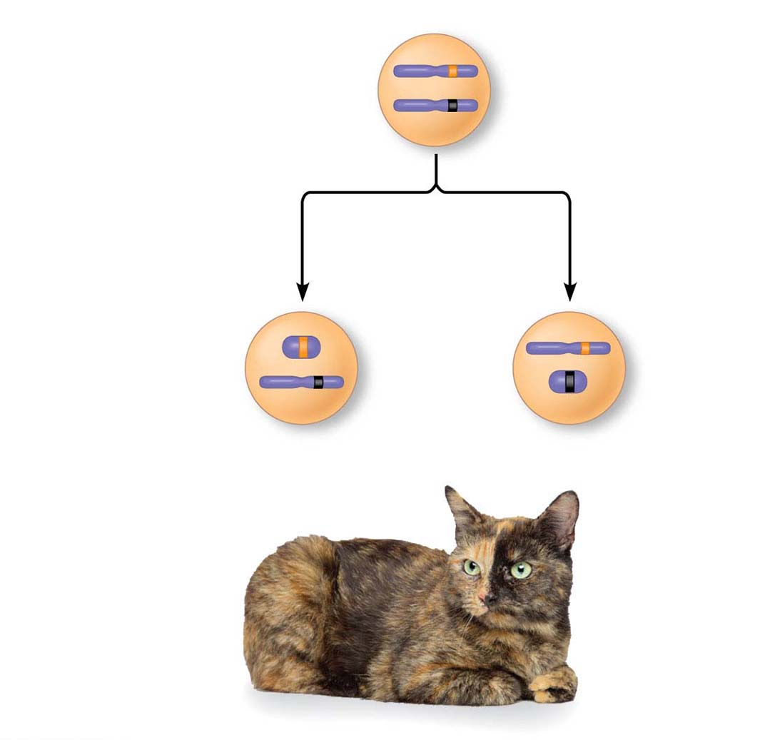
Figure 12.8
X chromosomes
Allele for
orange fur
Early embryo:
Allele for
black fur
Cell division and
X chromosome
inactivation
Two cell
populations
in adult cat:
Active X
Inactive X
Active X
Black fur
Orange fur
© 2016 Pearson Education, Inc.
Notes:
Figure 12.8 X inactivation and the tortoiseshell cat

