Slide 1
Chi Squared Test

Slide 2
What is Chi Squared?
Chi squared is a statistical analysis of data that tells you whether or not numbers are significant or not.
Example: You flip a coin 100 times. You would expect to flip 50 heads and 50 tails. You flip 51 heads and 49 tails. Is something wrong with the coin? No. What if you flipped 98 heads and only 2 tails? Something must be wrong.
Where is the line? At what point do you go from insignificant (51/49) to significant (98/2)?

Slide 3
Chi Squared
Chi squared takes into account several things…
  What would you ideally expect?
  What was the outcome?
  How many options were there?
    These are called the ‘degrees of freedom’

Slide 4
Degrees of Freedom
df, or Degrees of Freedom, is how many options were available OTHER than the expected.
In other words, you take the total number of options and subtract one.
For the coin activity, 2 (total sides to a coin) – 1 = 1 degree of freedom
This makes sense because the more degrees of freedom available, the less likely the expected outcome would occur.

Slide 5
Chi Squared Calculations
Possible Outcomes | Expected | Observed | Observed – Expected | (O-E)² | (O-E)²/E
Heads | 50 | 65 | 15 | 225 | 4.5
Tails | 50 | 35 | -15 | 225 | 4.5
 |  |  |  |  | chi squared =9

Slide 6
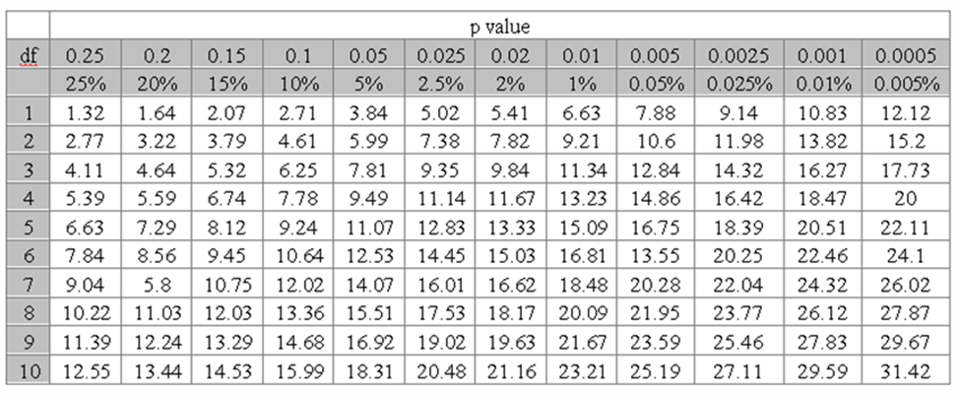
Using a Chi Squared Chart
Chi squared = 9; df = 1; p value between .05% and .025%
Data is significant; something is effecting that coin!

Slide 7
Using the ‘p’ value
The ‘p’ value is a percent likelihood of it occurring on its own.
In science, if there is a 5% or less chance of it occurring on its own, we say it is significant, or something is affecting the results.
If there is a greater than 5% chance of it occurring on its own we say that it is insignificant, or nothing is conclusively affecting the result.

Slide 8
Another example
Possible Outcomes | Expected | Observed | Observed – Expected | (O-E)² | (O-E)²/E
1 | 10 | 12 | 2 | 4 | .4
2 | 10 | 5 | -5 | 25 | 2.5
3 | 10 | 9 | -1 | 1 | .1
4 | 10 | 15 | 5 | 25 | 2.5
5 | 10 | 9 | -1 | 1 | .1
6 | 10 | 10 | 0 | 0 | 0
 |  |  |  |  | 5.6 = x

Slide 9

Was anything affecting that die?
Chi squared = 5.6; df = 5
P value <25%
Data insignificant; nothing is effecting the results

