Slide 1
Concept 11.4: Many human traits follow Mendelian patterns of inheritance
Humans are not good subjects for genetic research
Generation time is too long
Parents produce relatively few offspring
Breeding experiments are unacceptable
However, basic Mendelian genetics endures as the foundation of human genetics
© 2016 Pearson Education, Inc.
Notes:
1

Slide 2
Pedigree Analysis
A pedigree is a family tree that describes the interrelationships of parents and children across generations
Inheritance patterns of particular traits can be traced and described using pedigrees
© 2016 Pearson Education, Inc.
Notes:
2

Slide 4
Pedigrees can also be used to make predictions about future offspring
We can use the multiplication and addition rules to predict the probability of specific phenotypes
© 2016 Pearson Education, Inc.
Notes:
4

Slide 5
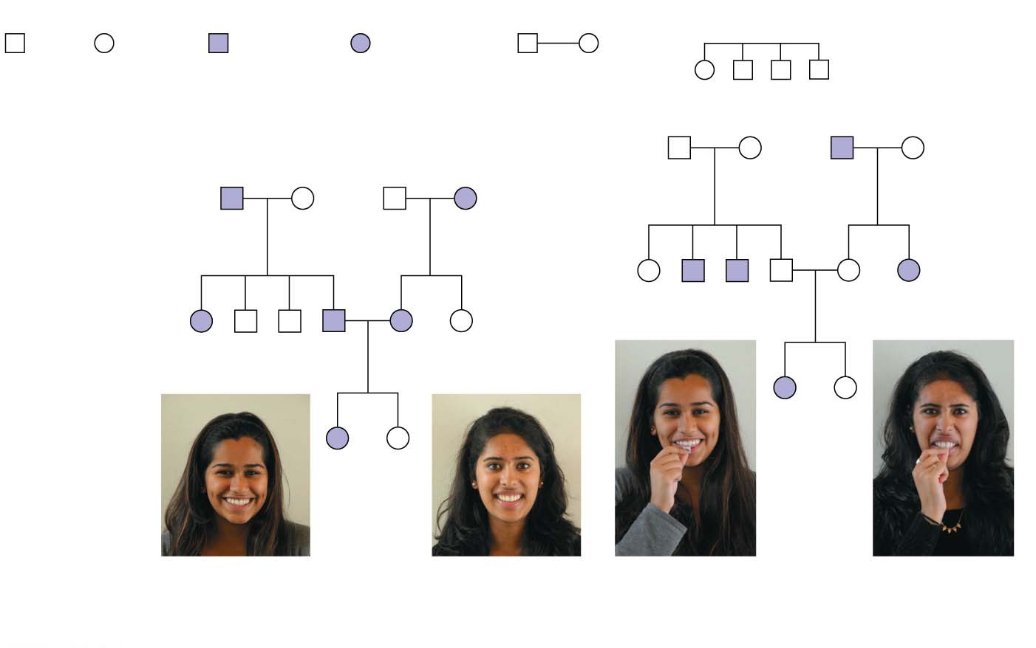
Figure 11.14
Key
Male
Female
Male with
the trait
Female with
the trait
Mating
Offspring, in
birth order
(first-born on left)
Tt
Tt
tt
Tt
1st generation
(grandparents)
Ww
ww
ww
Ww
2nd generation
(parents, aunts,
and uncles)
TT
or
tt
tt
Tt
Tt
tt
Tt
Ww
ww
ww
Ww
Ww
ww
3rd generation
(two sisters)
tt
TT
or
WW
ww
Tt
or
Ww
Widow’s peak
No widow’s peak Cannot taste PTC
Can taste PTC
(a) Is a widow’s peak a dominant or recessive trait?
(b) Is the inability to taste a chemical called PTC a dominant or recessive trait?
© 2016 Pearson Education, Inc.
Notes:
Figure 11.14 Pedigree analysis

Slide 6
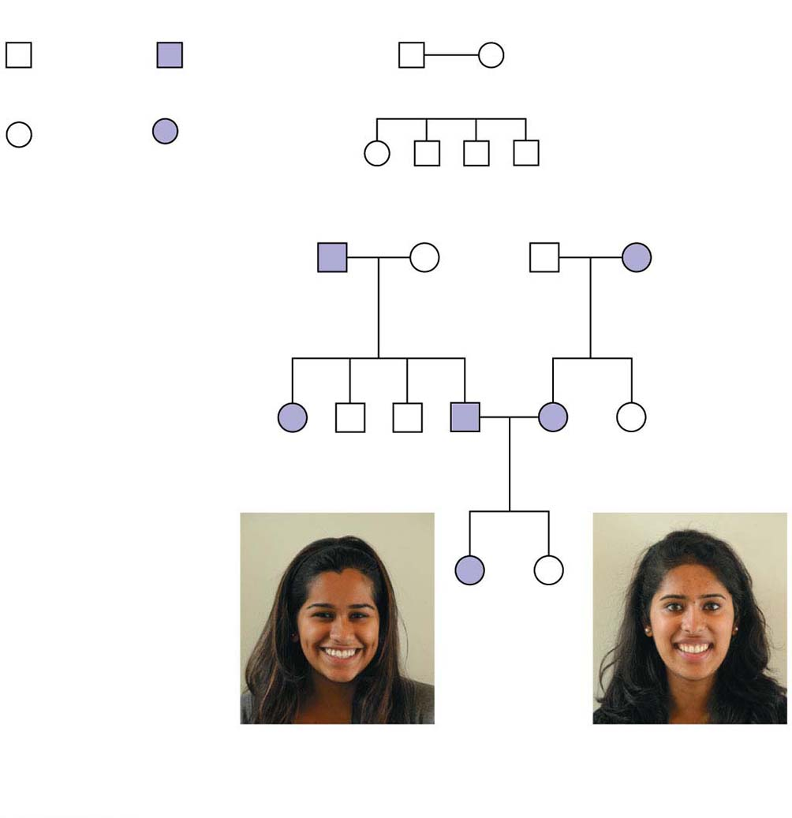
Figure 11.14-1
Key
Male
Male with
the trait
Mating
Female
Female with
the trait
Offspring, in
birth order
(first-born on left)
1st generation
(grandparents)
Ww
ww
ww
Ww
2nd generation
(parents, aunts,
and uncles)
Ww
ww
ww
Ww
Ww
ww
3rd generation
(two sisters)
WW
ww
or
Ww
Widow’s peak
No widow’s peak
(a) Is a widow’s peak a dominant or recessive trait?
© 2016 Pearson Education, Inc.
Notes:
Figure 11.14-1 Pedigree analysis (part 1: widow’s peak)

Slide 7
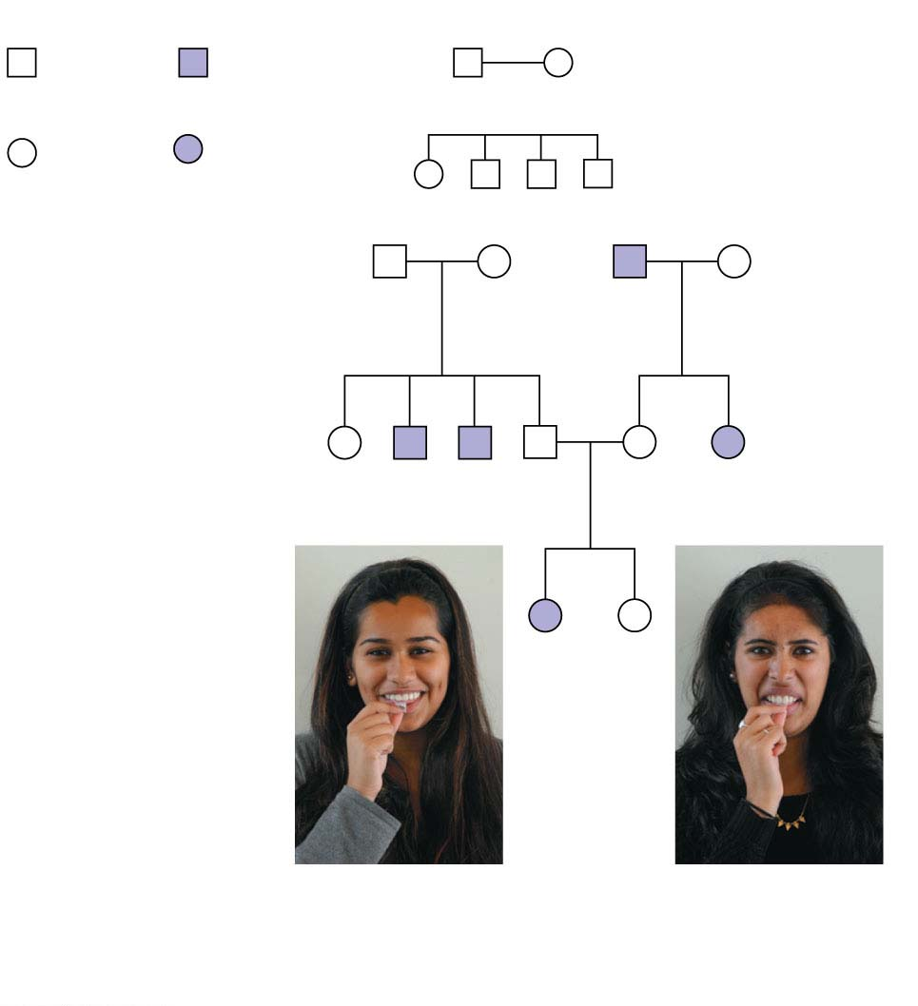
Figure 11.14-2
Key
Male
Male with
the trait
Mating
Female
Female with
the trait
Offspring, in
birth order
(first-born on left)
1st generation
(grandparents)
Tt
Tt
tt
Tt
2nd generation
(parents, aunts,
and uncles)
TT
or
tt
tt
Tt
Tt
tt
Tt
3rd generation
(two sisters)
tt
TT
or
Tt
Cannot taste PTC
Can taste PTC
(b) Is the inability to taste a chemical called PTC a dominant or recessive trait?
© 2016 Pearson Education, Inc.
Notes:
Figure 11.14-2 Pedigree analysis (part 2: ability to taste PTC)

Slide 8
Recessively Inherited Disorders
Many genetic disorders are inherited in a recessive manner
These range from relatively mild to life-threatening
© 2016 Pearson Education, Inc.
Notes:
8

Slide 9
The Behavior of Recessive Alleles
Recessively inherited disorders show up only in individuals homozygous for the allele
Carriers are heterozygous individuals who carry the recessive allele but are phenotypically normal
Most people who have recessive disorders are born to parents who are carriers of the disorder
© 2016 Pearson Education, Inc.
Notes:
9

Slide 10
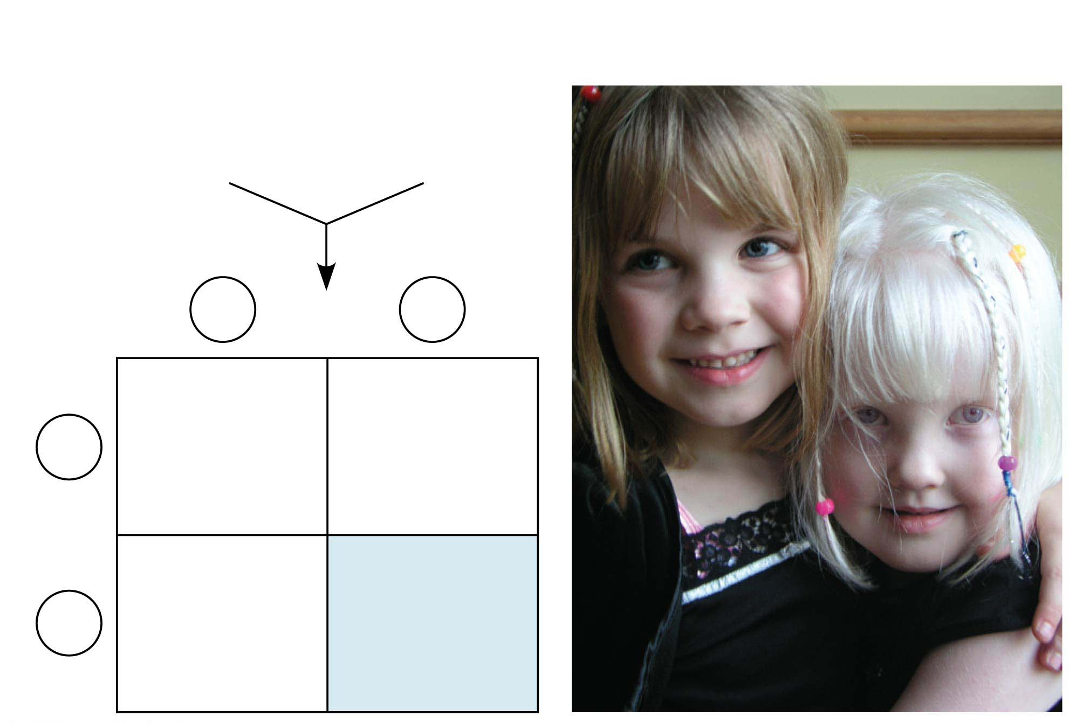
Figure 11.15
Parents
Normal
phenotype
Aa
Normal
phenotype
Aa
⋅
Sperm
A
a
Eggs
Aa
Carrier with
normal
phenotype
AA
Normal
phenotype
A
Aa
Carrier with
normal
phenotype
aa
Albinism
phenotype
a
© 2016 Pearson Education, Inc.
Notes:
Figure 11.15 Albinism: a recessive trait

Slide 11
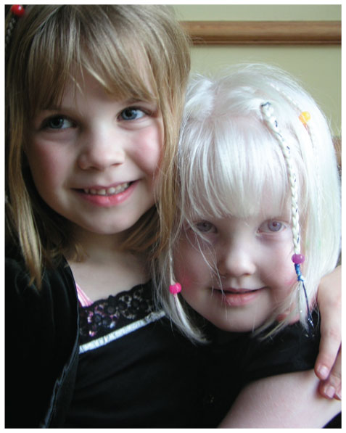
Figure 11.15-1
© 2016 Pearson Education, Inc.
Notes:
Figure 11.15-1 Albinism: a recessive trait (part 1: photo)

Slide 12
If a recessive allele that causes a disease is rare, then the chance of two carriers meeting and mating is low
Consanguineous (between close relatives) matings increase the chance of mating between two carriers of the same rare allele
Most societies and cultures have laws or taboos against marriages between close relatives
© 2016 Pearson Education, Inc.
Notes:
12

Slide 13
Cystic Fibrosis
Cystic fibrosis is the most common lethal genetic disease in the United States, striking one out of every 2,500 people of European descent
The cystic fibrosis allele results in defective or absent chloride transport channels in plasma membranes leading to a buildup of chloride ions outside the cell
Symptoms include mucus buildup in some internal organs and abnormal absorption of nutrients in the small intestine
© 2016 Pearson Education, Inc.
Notes:
13

Slide 14
Sickle-Cell Disease: A Genetic Disorder with Evolutionary Implications
Sickle-cell disease affects one out of 400 African-Americans
The disease is caused by the substitution of a single amino acid in the hemoglobin protein in red blood cells
In homozygous individuals, all hemoglobin is abnormal (sickle-cell)
Symptoms include physical weakness, pain, organ damage, and even stroke and paralysis
© 2016 Pearson Education, Inc.
Notes:
14

Slide 15
Heterozygotes (said to have sickle-cell trait) are usually healthy but may suffer some symptoms
About one out of ten African-Americans has sickle-cell trait, an unusually high frequency of an allele with detrimental effects in homozygotes
Heterozygotes are less susceptible to the malaria parasite, so there is an advantage to being heterozygous
© 2016 Pearson Education, Inc.
Notes:
15

Slide 16
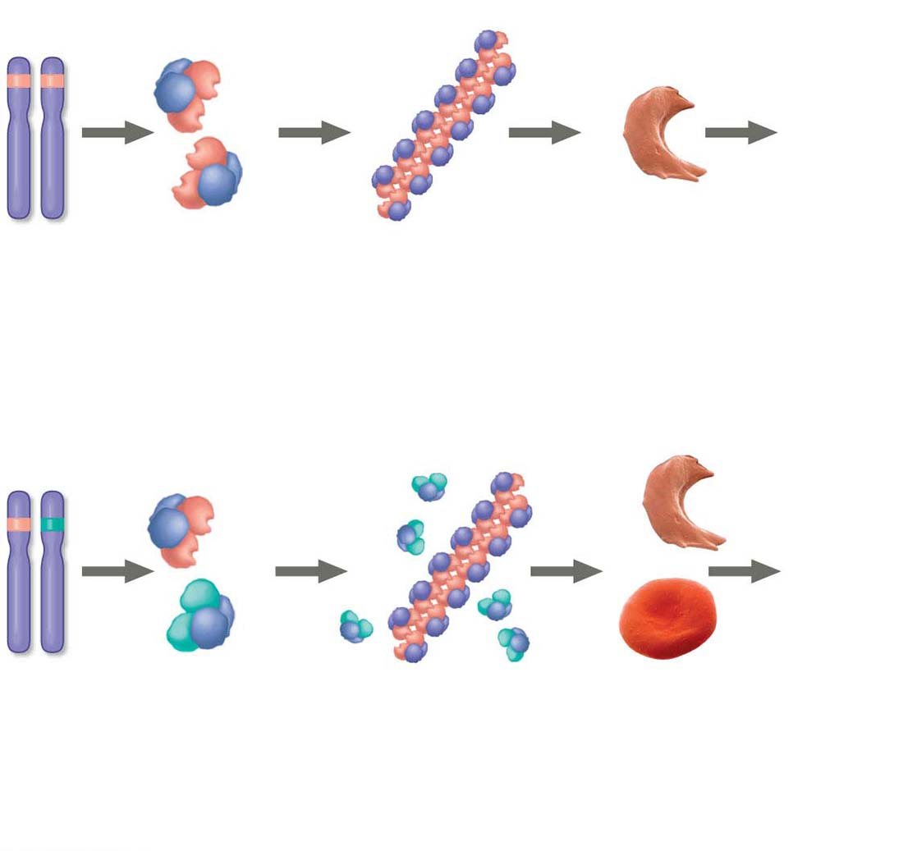
Figure 11.16
Sickle-cell alleles
Low
O₂
Sickle-
cell
disease
Sickle-cell
hemoglobin
proteins
Part of a fiber of
sickle-cell hemo-
globin proteins
Fibers cause sickled
red blood cells
(a) Homozygote with sickle-cell disease
Sickle-cell allele
Normal allele
Very
low
O₂
Sickle-
cell
trait
Sickle-cell
and normal
hemoglobin
proteins
Part of a sickle-cell
fiber and normal
hemoglobin proteins
Sickled
and normal
red blood cells
(b) Heterozygote with sickle-cell trait
© 2016 Pearson Education, Inc.
Notes:
Figure 11.16 Sickle-cell disease and sickle-cell trait

Slide 17
Dominantly Inherited Disorders
Some human disorders are caused by dominant alleles
Dominant alleles that cause a lethal disease are rare and arise by mutation
Achondroplasia is a form of dwarfism caused by a rare dominant allele
© 2016 Pearson Education, Inc.
Notes:
17

Slide 18
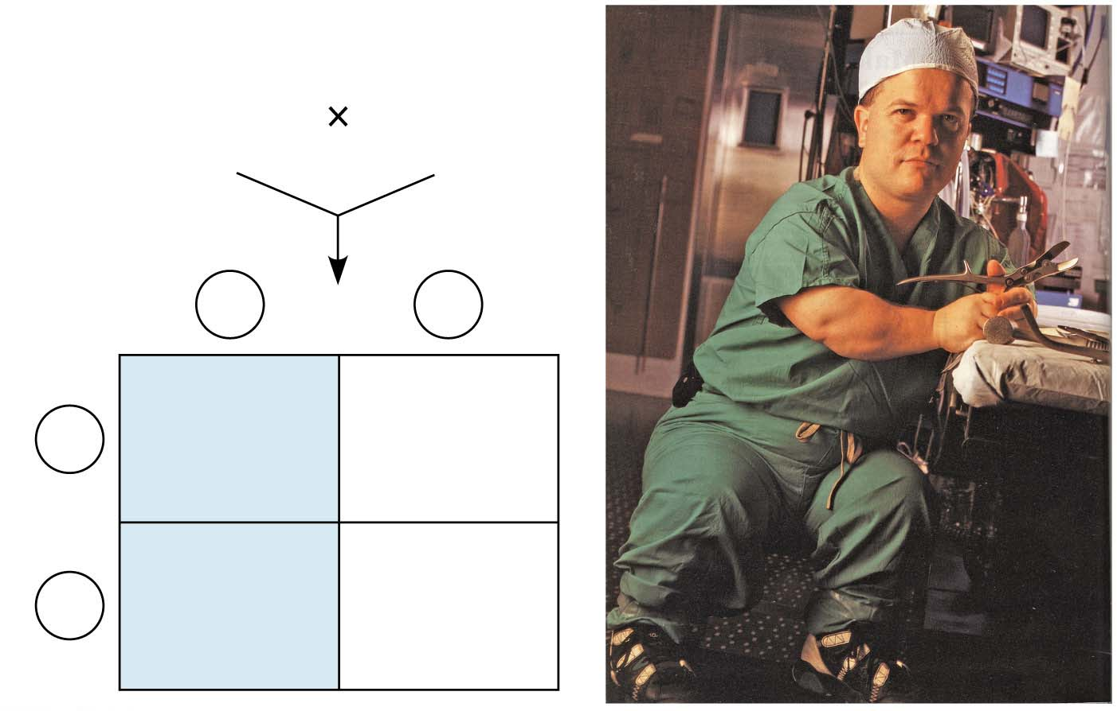
Figure 11.17
Parents
Dwarf
phenotype
Dd
Normal
phenotype
dd
Sperm
D
d
Eggs
Dd
Dwarf
phenotype
dd
Normal
phenotype
d
Dd
Dwarf
phenotype
dd
Normal
phenotype
d
© 2016 Pearson Education, Inc.
Notes:
Figure 11.17 Achondroplasia: a dominant trait

Slide 19
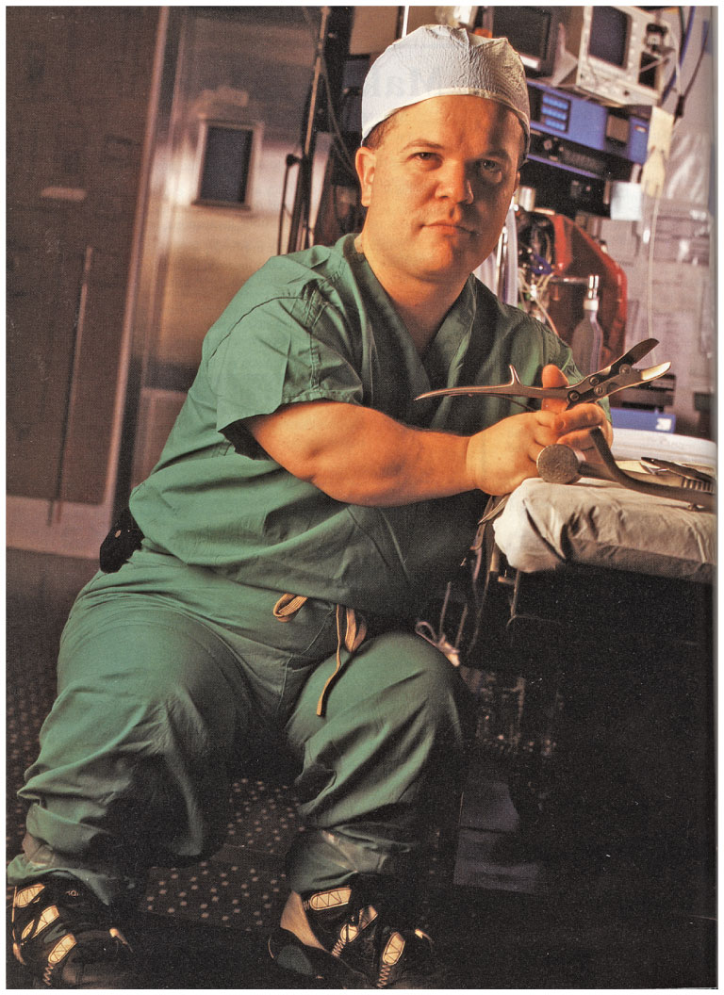
Figure 11.17-1
© 2016 Pearson Education, Inc.
Notes:
Figure 11.17-1 Achondroplasia: a dominant trait (part 1: photo)

Slide 20
The timing of onset of a disease significantly affects its inheritance
Huntington’s disease is a degenerative disease of the nervous system
The disease has no obvious phenotypic effects until the individual is about 35 to 45 years of age
Once the deterioration of the nervous system begins the condition is irreversible and fatal
© 2016 Pearson Education, Inc.
Notes:
20

Slide 21
Multifactorial Disorders
Many diseases, such as heart disease, diabetes, alcoholism, mental illnesses, and cancer, have both genetic and environmental components
Lifestyle has a tremendous effect on phenotype for cardiovascular health and other multifactorial characters
© 2016 Pearson Education, Inc.
Notes:
21

Slide 22
Genetic Counseling Based on Mendelian Genetics
Genetic counselors can provide information to prospective parents concerned about a family history for a specific disease
Each child represents an independent event in the sense that its genotype is unaffected by the genotypes of older siblings
© 2016 Pearson Education, Inc.
Notes:
22

