Slide 1
Concept 11.3: Inheritance patterns are often more complex than predicted by simple Mendelian genetics
Not all heritable characters are determined as simply as the traits Mendel studied
However, the basic principles of segregation and independent assortment apply even to more complex patterns of inheritance
© 2016 Pearson Education, Inc.
Notes:
1

Slide 2
Extending Mendelian Genetics for a Single Gene
Inheritance of characters by a single gene may deviate from simple Mendelian patterns in the following situations
When alleles are not completely dominant or recessive
When a gene has more than two alleles
When a single gene produces multiple phenotypes
© 2016 Pearson Education, Inc.
Notes:
2

Slide 3
Degrees of Dominance
Complete dominance occurs when phenotypes of the heterozygote and dominant homozygote are identical
In incomplete dominance, the phenotype of F₁ hybrids is somewhere between the phenotypes of the two parental varieties
In codominance, two dominant alleles affect the phenotype in separate, distinguishable ways
© 2016 Pearson Education, Inc.
Notes:
3

Slide 4
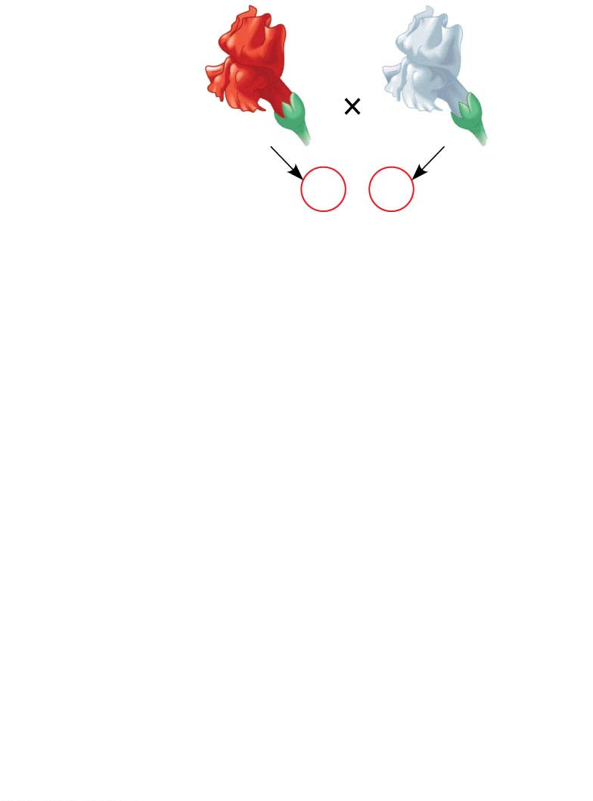
Figure 11.10-s1
P Generation
Red
C^{R}C^{R}
White
C^{W} C^{W}
Gametes
C^{R}
C^{W}
© 2016 Pearson Education, Inc.
Notes:
Figure 11.10-s1 Incomplete dominance in snapdragon color (step 1)

Slide 5
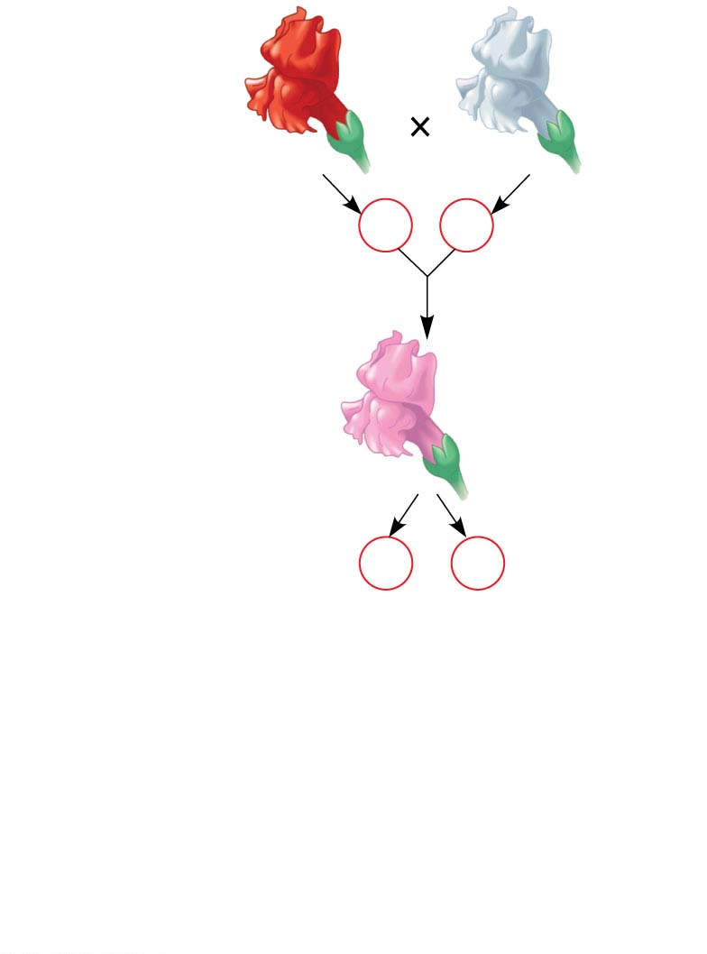
Figure 11.10-s2
P Generation
Red
C^{R}C^{R}
White
C^{W} C^{W}
Gametes
C^{R}
C^{W}
Pink
C^{R} C^{W}
F₁ Generation
Gametes
1
2
C^{R}
1
2
C^{W}
© 2016 Pearson Education, Inc.
Notes:
Figure 11.10-s2 Incomplete dominance in snapdragon color (step 2)

Slide 6
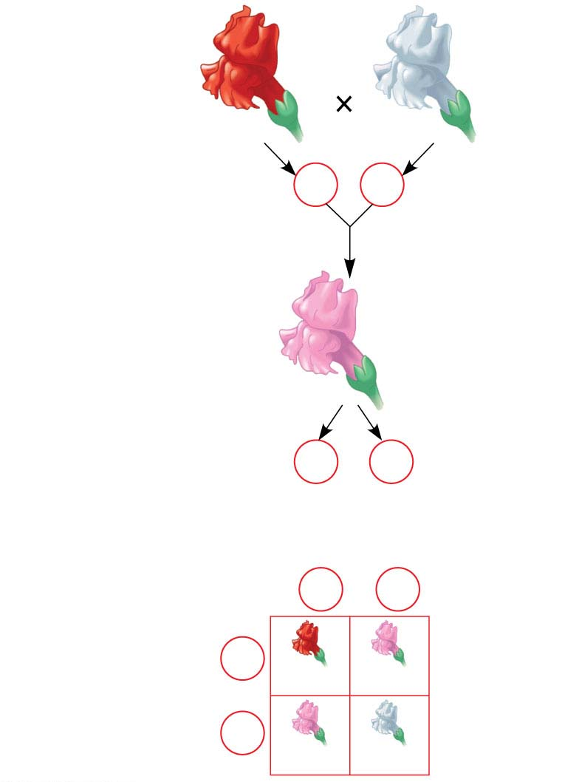
Figure 11.10-s3
P Generation
Red
C^{R}C^{R}
White
C^{W} C^{W}
Gametes
C^{R}
C^{W}
Pink
C^{R} C^{W}
F₁ Generation
Gametes
1
2
C^{R}
1
2
C^{W}
Sperm
F₂ Generation
1
2
C^{R}
1
2
C^{W}
1
2
C^{R}
Eggs
C^{R}C^{R}
C^{R}C^{w}
1
2
C^{W}
C^{R}C^{w}
C^{w}C^{w}
© 2016 Pearson Education, Inc.
Notes:
Figure 11.10-s3 Incomplete dominance in snapdragon color (step 3)

Slide 7
The Relationship Between Dominance and Phenotype
Alleles are simply variations in a gene’s nucleotide sequence
When a dominant allele coexists with a recessive allele in a heterozygote, they do not actually interact at all
For any character, dominant/recessive relationships of alleles depend on the level at which we examine the phenotype
© 2016 Pearson Education, Inc.
Notes:
7

Slide 8
Tay-Sachs disease is fatal; a dysfunctional enzyme causes an accumulation of lipids in the brain
At the organismal level, the allele is recessive
At the biochemical level, the phenotype (i.e., the enzyme activity level) is incompletely dominant
At the molecular level, the alleles are codominant
© 2016 Pearson Education, Inc.
Notes:
8

Slide 9
Frequency of Dominant Alleles
Dominant alleles are not necessarily more common in populations than recessive alleles
For example, one baby out of 400 in the United States is born with extra fingers or toes, a dominant trait called polydactyly
© 2016 Pearson Education, Inc.
Notes:
9

Slide 10
Multiple Alleles
Most genes exist in populations in more than two allelic forms
For example, the four phenotypes of the ABO blood group in humans are determined by three alleles of the gene: I^{A}, I^{B}, and i.
The enzyme (I) adds specific carbohydrates to the surface of blood cells
The enzyme encoded by I^{A} adds the A carbohydrate, and the enzyme encoded by I^{B} adds the B carbohydrate; the enzyme encoded by the i allele adds neither
© 2016 Pearson Education, Inc.
Notes:
10

Slide 11
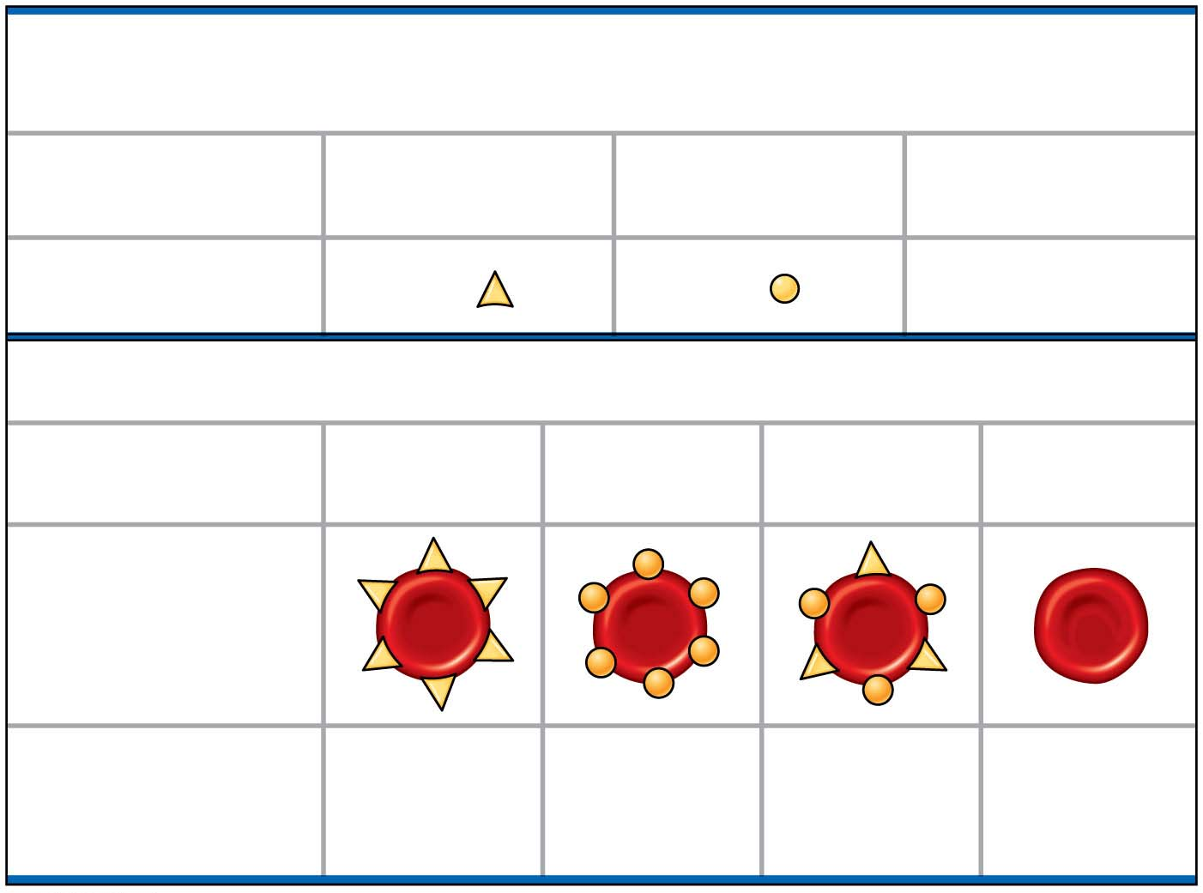
Figure 11.11
(a) The three alleles for the ABO blood groups and their carbohydrates
Allele
I^{A}
I^{B}
i
Carbohydrate
A
B
none
(b) Blood group genotypes and phenotypes
Genotype
I^{A} I^{A}
or
I^{A} i
I^{B} I^{B}
or
I^{B} i
I^{A} I^{B}
ii
Red blood cell
appearance
Phenotype
(blood group)
A
B
AB
O
© 2016 Pearson Education, Inc.
Notes:
Figure 11.11 Multiple alleles for the ABO blood groups

Slide 12
Pleiotropy
Most genes have multiple phenotypic effects, a property called pleiotropy
For example, pleiotropic alleles are responsible for the multiple symptoms of certain hereditary diseases, such as cystic fibrosis and sickle-cell disease
© 2016 Pearson Education, Inc.
Notes:
12

Slide 13
Extending Mendelian Genetics for Two or More Genes
Some traits may be determined by two or more genes
The gene products may interact
Alternatively, multiple genes could independently affect a single trait
© 2016 Pearson Education, Inc.
Notes:
13

Slide 14
Epistasis
In epistasis, a gene at one locus alters the phenotypic expression of a gene at a second locus
For example, in Labrador retrievers and many other mammals, coat color depends on two genes
One gene determines the pigment color (with alleles B for black and b for brown)
The other gene (with alleles C for color and c for no color) determines whether the pigment will be deposited in the hair
© 2016 Pearson Education, Inc.
Notes:
14

Slide 15
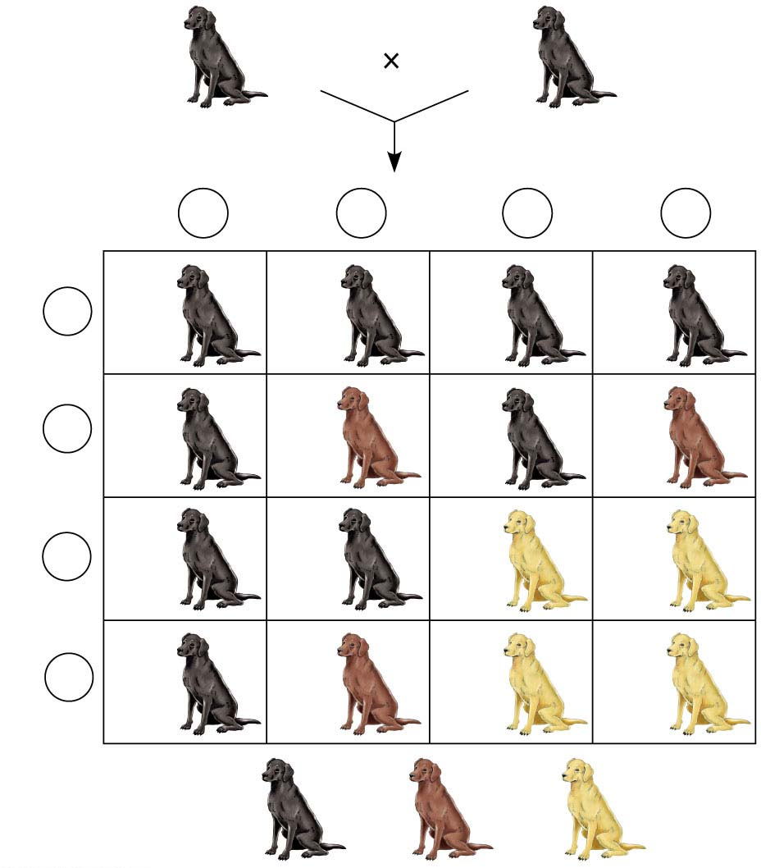
Figure 11.12
BbEe
BbEe
Sperm
1
4
BE
1
4
bE
1
4
Be
1
4
be
Eggs
1
4
BE
BBEE
BbEE
BBEe
BbEe
1
4
bE
BbEE
bbEE
BbEe
bbEe
1
4
Be
BBEe
BbEe
BBee
Bbee
1
4
be
BbEe
bbEe
Bbee
bbee
9
: 3
: 4
© 2016 Pearson Education, Inc.
Notes:
Figure 11.12 An example of epistasis

Slide 16
Polygenic Inheritance
Quantitative characters are those that vary in the population along a continuum
Quantitative variation usually indicates polygenic inheritance, an additive effect of two or more genes on a single phenotype
Skin color in humans is an example of polygenic inheritance
© 2016 Pearson Education, Inc.
Notes:
16

Slide 17
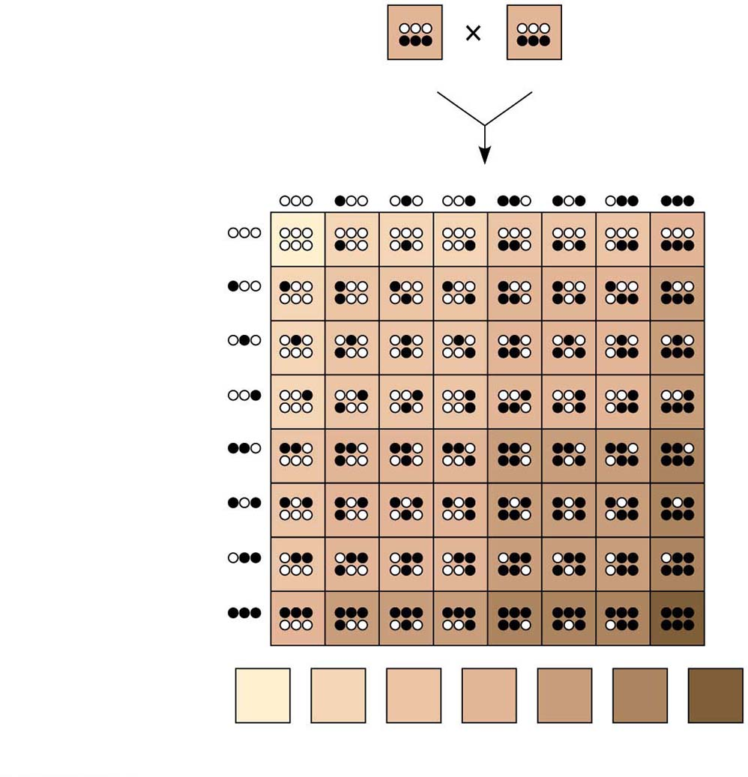
Figure 11.13
AaBbCc AaBbCc
Sperm
1
8
1
8
1
8
1
8
1
8
1
8
1
8
1
8
1
8
1
8
1
8
1
8
Eggs
1
8
1
8
1
8
1
8
Phenotypes:
Number of
dark-skin alleles:
1
64
6
64
15
64
20
64
15
64
6
64
1
64
0
1
2
3
4
5
6
© 2016 Pearson Education, Inc.
Notes:
Figure 11.13 A simplified model for polygenic inheritance of skin color

Slide 18
Nature and Nurture: The Environmental Impact on Phenotype
Another departure from Mendelian genetics arises when the phenotype for a character depends on environment as well as genotype
The norm of reaction is the phenotypic range of a genotype influenced by the environment
© 2016 Pearson Education, Inc.
Notes:
18

Slide 19
The phenotypic range is generally broadest for polygenic characters
Such characters are called multifactorial because genetic and environmental factors collectively influence phenotype
© 2016 Pearson Education, Inc.
Notes:
19

Slide 20
A Mendelian View of Heredity and Variation
An organism’s phenotype includes its physical appearance, internal anatomy, physiology, and behavior
An organism’s phenotype reflects its overall genotype and unique environmental history
© 2016 Pearson Education, Inc.
Notes:
20

