Slide 1
Concept 11.2: Probability laws govern Mendelian inheritance
Mendel’s laws of segregation and independent assortment reflect the rules of probability
The outcome of one coin toss has no impact on the outcome of the next toss
In the same way, the alleles of one gene segregate into gametes independently of another gene’s alleles
© 2016 Pearson Education, Inc.
Notes:
1

Slide 2
The Multiplication and Addition Rules Applied to Monohybrid Crosses
The multiplication rule states that the probability that two or more independent events will occur together is the product of their individual probabilities
This can be applied to an F₁ monohybrid cross
Segregation in a heterozygous plant is like flipping a coin: Each gamete has a ½ chance of carrying the dominant allele and a ½ chance of carrying the recessive allele
© 2016 Pearson Education, Inc.
Notes:
2

Slide 3
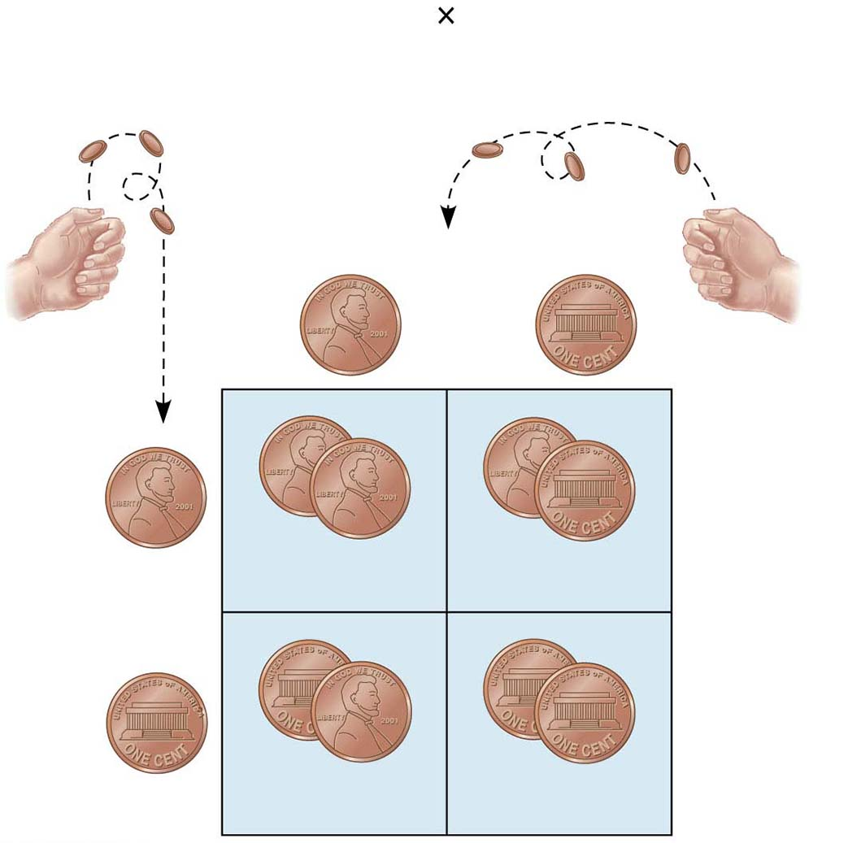
Figure 11.9
Rr
Rr
Segregation of
alleles into eggs
Segregation of
alleles into sperm
Sperm
1
R
1
r
2
2
R
R
1
R
R
r
2
1
4
1
4
Eggs
r
r
1
r
R
r
2
1
4
1
4
© 2016 Pearson Education, Inc.
Notes:
Figure 11.9 Segregation of alleles and fertilization as chance events

Slide 4
The addition rule states that the probability that any one of two or more mutually exclusive events will occur is calculated by adding together their individual probabilities
It can be used to figure out the probability that an F₂ plant from a monohybrid cross will be heterozygous rather than homozygous
© 2016 Pearson Education, Inc.
Notes:
4

Slide 5
Solving Complex Genetics Problems with the Rules of Probability
We can apply the rules of probability to predict the outcome of crosses involving multiple characters
A dihybrid or other multicharacter cross is equivalent to two or more independent monohybrid crosses occurring simultaneously
In calculating the chances for various genotypes, each character is considered separately, and then the individual probabilities are multiplied
© 2016 Pearson Education, Inc.
Notes:
5

Slide 6
For example, if we cross F₁ heterozygotes of genotype YyRr, we can calculate the probability of different genotypes among the F₂ generation
© 2016 Pearson Education, Inc.
Notes:
6

Slide 7
For example, for the cross PpYyRr × Ppyyrr, we can calculate the probability of offspring showing at least two recessive traits
© 2016 Pearson Education, Inc.
Notes:
7

