Slide 1
Concept 11.1: Mendel used the scientific approach to identify two laws of inheritance
Mendel discovered the basic principles of heredity by breeding garden peas in carefully planned experiments
© 2016 Pearson Education, Inc.
Notes:
1

Slide 2
Mendel’s Experimental, Quantitative Approach
Mendel probably chose to work with peas because
There are many varieties with distinct heritable features, or characters (such as flower color); character variants (such as purple or white flowers) are called traits
He could control mating between plants
© 2016 Pearson Education, Inc.
Notes:
2

Slide 3
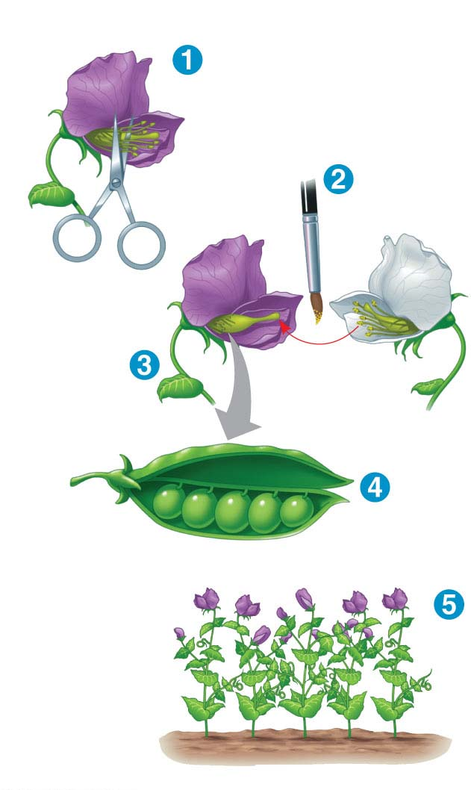
Figure 11.2
Technique
Parental
generation
(P)
Stamens
Carpel
Results
First filial
generation
offspring
(F₁)
© 2016 Pearson Education, Inc.
Notes:
Figure 11.2 Research method: crossing pea plants

Slide 4
Mendel chose to track only characters that occurred in two distinct alternative forms
He also used varieties that were true-breeding (plants that produce offspring of the same variety when they self-pollinate)
© 2016 Pearson Education, Inc.
Notes:
4

Slide 5
In a typical experiment, Mendel mated two contrasting, true-breeding varieties, a process called hybridization
The true-breeding parents are the P generation
The hybrid offspring of the P generation are called the F₁ generation
When F₁ individuals self-pollinate or cross-pollinate with other F₁ hybrids, the F₂ generation is produced
© 2016 Pearson Education, Inc.
Notes:
5

Slide 6
The Law of Segregation
When Mendel crossed contrasting, true-breeding white- and purple-flowered pea plants, all of the F₁ hybrids were purple
When Mendel crossed the F₁ hybrids, many of the F₂ plants had purple flowers, but some had white
Mendel discovered a ratio of about three to one, purple to white flowers, in the F₂ generation
© 2016 Pearson Education, Inc.
Notes:
6

Slide 7
Figure 11.3-s1
Experiment
P Generation
(true-breeding
parents)
Purple
flowers
White
flowers
© 2016 Pearson Education, Inc.
Notes:
Figure 11.3-s1 Inquiry: When F₁ hybrid pea plants self- or cross-pollinate, which traits appear in the F₂ generation? (step 1)

Slide 8
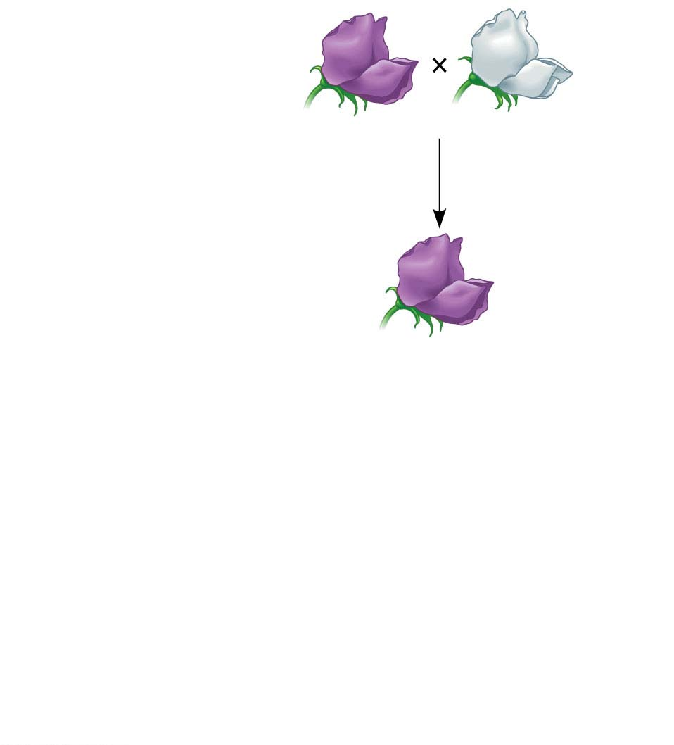
Figure 11.3-s2
Experiment
P Generation
(true-breeding
parents)
Purple
flowers
White
flowers
F₁ Generation
(hybrids)
All plants had purple flowers
© 2016 Pearson Education, Inc.
Notes:
Figure 11.3-s2 Inquiry: When F₁ hybrid pea plants self- or cross-pollinate, which traits appear in the F₂ generation? (step 2)

Slide 9
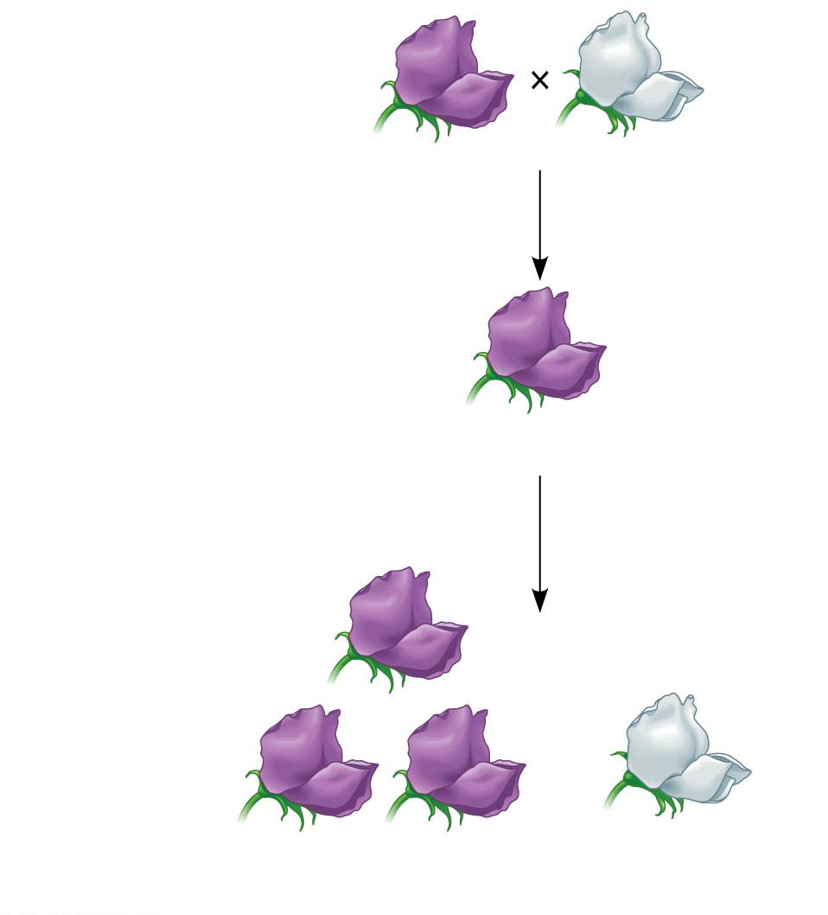
Figure 11.3-s3
Experiment
P Generation
(true-breeding
parents)
Purple
flowers
White
flowers
F₁ Generation
(hybrids)
All plants had purple flowers
Self- or cross-pollination
Results
F₂ Generation
705 purple-flowered
plants
224 white-flowered
plants
© 2016 Pearson Education, Inc.
Notes:
Figure 11.3-s3 Inquiry: When F₁ hybrid pea plants self- or cross-pollinate, which traits appear in the F₂ generation? (step 3)

Slide 10
Mendel reasoned that in the F₁ plants, the heritable factor for white flowers was hidden or masked in the presence of the purple-flower factor
He called the purple flower color a dominant trait and the white flower color a recessive trait
The factor for white flowers was not diluted or destroyed because it reappeared in the F₂ generation
© 2016 Pearson Education, Inc.
Notes:
10

Slide 11
Mendel observed the same pattern of inheritance in six other pea plant characters, each represented by two traits
What Mendel called a “heritable factor” is what we now call a gene
© 2016 Pearson Education, Inc.
Notes:
11

Slide 12
Table 11.1-1
© 2016 Pearson Education, Inc.
Notes:
Table 11.1-1 The results of Mendel’s F₁ crosses for seven characters in pea plants (part 1)

Slide 13
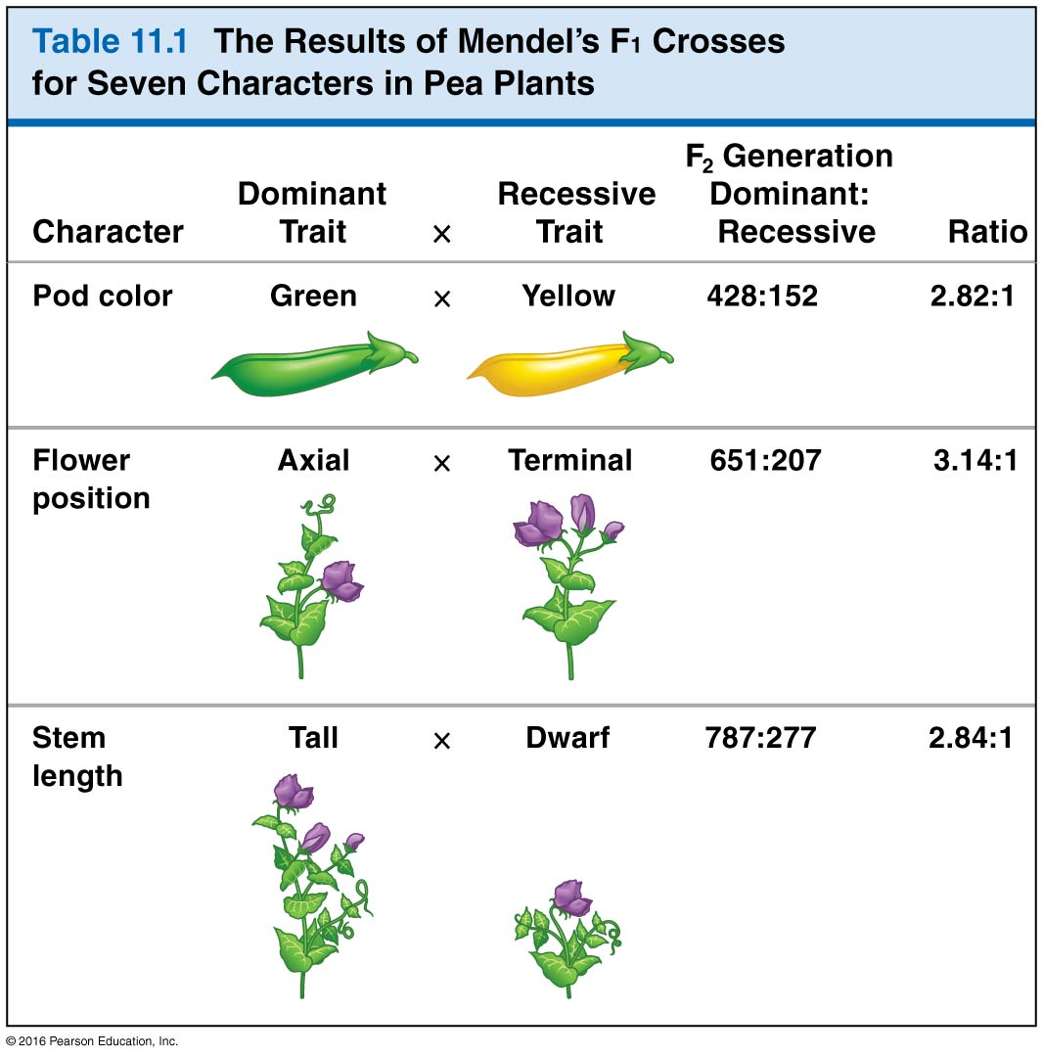
Table 11.1-2
© 2016 Pearson Education, Inc.
Notes:
Table 11.1-2 The results of Mendel’s F₁ crosses for seven characters in pea plants (part 2)

Slide 14
Mendel’s Model
Mendel developed a model to explain the 3:1 inheritance pattern he observed in F₂ offspring
Four related concepts make up this model
© 2016 Pearson Education, Inc.
Notes:
14

Slide 15
First, alternative versions of genes account for variations in inherited characters
For example, the gene for flower color in pea plants exists in two versions, one for purple flowers and the other for white flowers
These alternative versions of a gene are now called alleles
Each gene resides at a specific locus on a specific chromosome
© 2016 Pearson Education, Inc.
Notes:
15

Slide 16
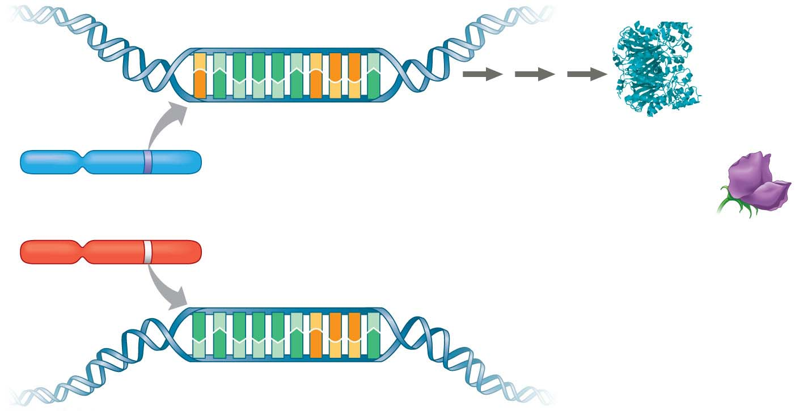
Figure 11.4
DNA with nucleotide
sequence CTAAATCGGT
Enzyme
C
T
A
A
A
T
C
G
G
T
Allele for
purple flowers
G
A
T
T
T
A
G
C
C
A
Pair of
homologous
chromosomes
Locus for flower-
color gene
Allele for
white flowers
A
T
A
A
A
T
C
G
G
T
T
A
T
T
T
A
G
C
C
A
No enzyme
DNA with nucleotide
sequence AT AAATCGGT
© 2016 Pearson Education, Inc.
Notes:
Figure 11.4 Alleles, alternative versions of a gene

Slide 17
Second, for each character, an organism inherits two alleles, one from each parent
Mendel made this deduction without knowing about the existence of chromosomes
Two alleles at a particular locus may be identical, as in the true-breeding plants of Mendel’s P generation
Alternatively, the two alleles at a locus may differ, as in the F₁ hybrids
© 2016 Pearson Education, Inc.
Notes:
17

Slide 18
Third, if the two alleles at a locus differ, then one (the dominant allele) determines the organism’s appearance, and the other (the recessive allele) has no noticeable effect on appearance
In the flower-color example, the F₁ plants had purple flowers because the allele for that trait is dominant
© 2016 Pearson Education, Inc.
Notes:
18

Slide 19
Fourth (the law of segregation), the two alleles for a heritable character separate (segregate) during gamete formation and end up in different gametes
Thus, an egg or a sperm gets only one of the two alleles that are present in the organism
This segregation of alleles corresponds to the distribution of homologous chromosomes to different gametes in meiosis
© 2016 Pearson Education, Inc.
Notes:
19

Slide 20
Mendel’s segregation model accounts for the 3:1 ratio he observed in the F₂ generation of his crosses
Possible combinations of sperm and egg can be shown using a Punnett square to predict the results of a genetic cross between individuals of known genetic makeup
A capital letter represents a dominant allele, and a lowercase letter represents a recessive allele
For example, P is the purple-flower allele and p is the white-flower allele
© 2016 Pearson Education, Inc.
Notes:
20

Slide 21
Figure 11.5-s1
P Generation
Appearance:
Genetic makeup:
Purple flowers
White flowers
PP
pp
Gametes:
P
p
© 2016 Pearson Education, Inc.
Notes:
Figure 11.5-s1 Mendel’s law of segregation (step 1)

Slide 22
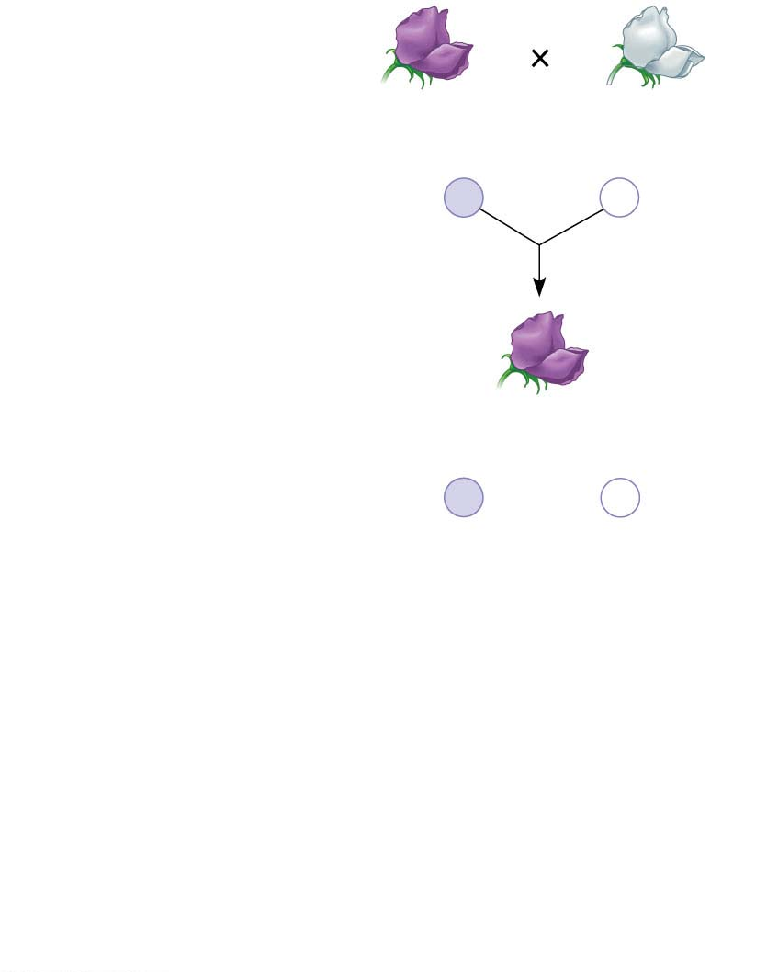
Figure 11.5-s2
P Generation
Appearance:
Genetic makeup:
Purple flowers
White flowers
PP
pp
Gametes:
P
p
F₁ Generation
Appearance:
Genetic makeup:
Purple flowers
Pp
Gametes:
1
2
P
1
2
p
© 2016 Pearson Education, Inc.
Notes:
Figure 11.5-s2 Mendel’s law of segregation (step 2)

Slide 23
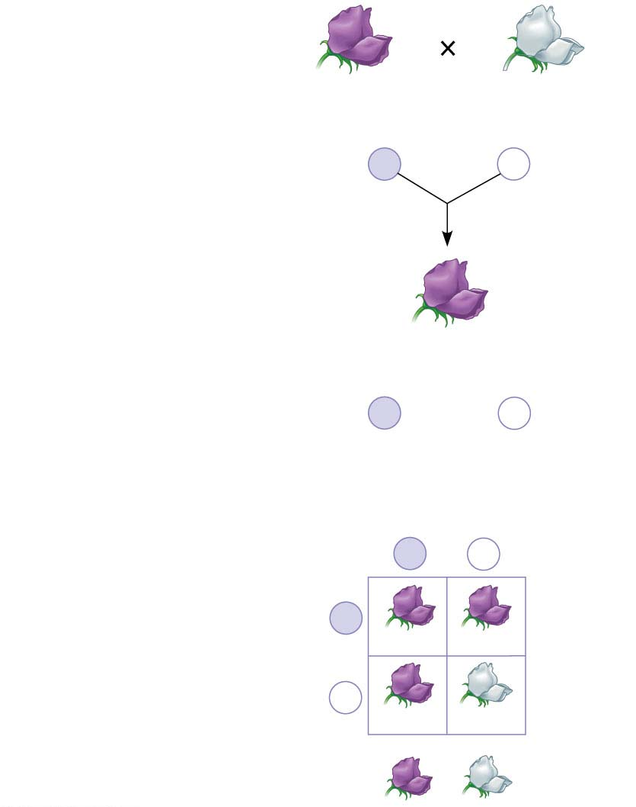
Figure 11.5-s3
P Generation
Appearance:
Genetic makeup:
Purple flowers
White flowers
PP
pp
Gametes:
P
p
F₁ Generation
Appearance:
Genetic makeup:
Purple flowers
Pp
Gametes:
1
2
P
1
2
p
Sperm from
F₁ (Pp) plant
F₂ Generation
P
p
P
Eggs from
F₁ (Pp) plant
PP
Pp
p
Pp
pp
3
: 1
© 2016 Pearson Education, Inc.
Notes:
Figure 11.5-s3 Mendel’s law of segregation (step 3)

Slide 24
Useful Genetic Vocabulary
An organism with two identical alleles for a character is said to be homozygous for the gene controlling that character
An organism that has two different alleles for a gene is said to be heterozygous for the gene controlling that character
Unlike homozygotes, heterozygotes are not true-breeding
© 2016 Pearson Education, Inc.
Notes:
24

Slide 25
Because of the effects of dominant and recessive alleles, an organism’s traits do not always reveal its genetic composition
Therefore, we distinguish between an organism’s phenotype, or physical appearance, and its genotype, or genetic makeup
In the example of flower color in pea plants, PP and Pp plants have the same phenotype (purple) but different genotypes
© 2016 Pearson Education, Inc.
Notes:
25

Slide 26
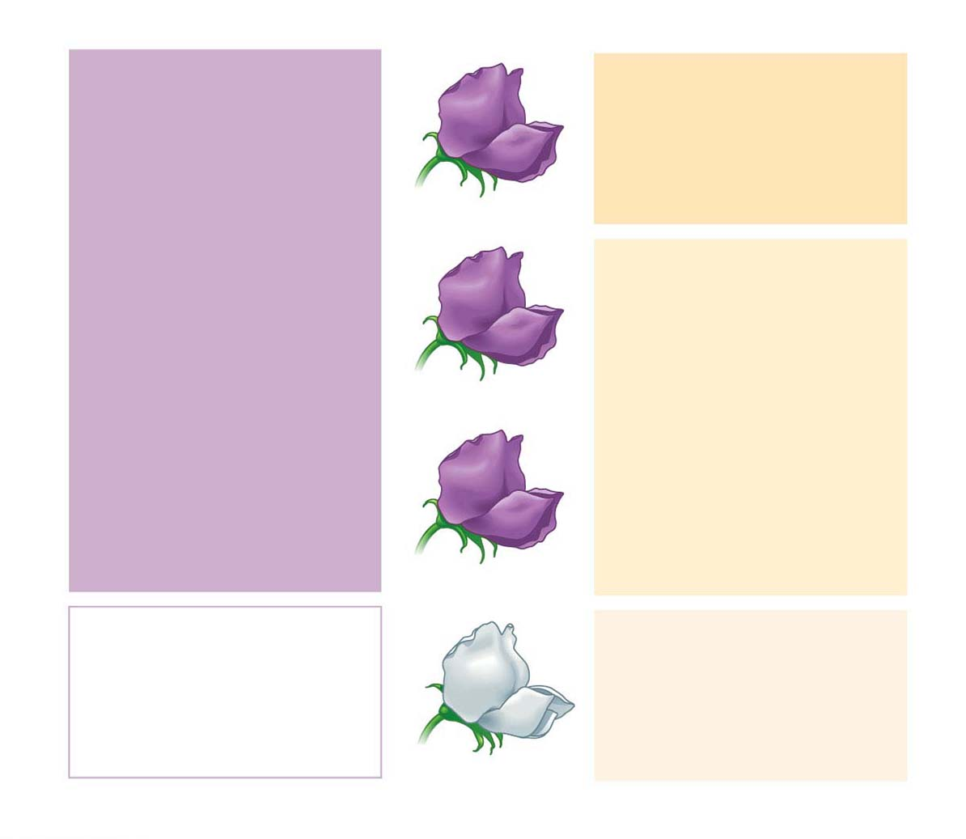
Figure 11.6
Phenotype
Genotype
Purple
PP
(homozygous)
1
3
Purple
Pp
(heterozygous)
2
Purple
Pp
(heterozygous)
1
White
pp
(homozygous)
1
Ratio 3:1
Ratio 1:2:1
© 2016 Pearson Education, Inc.
Notes:
Figure 11.6 Phenotype versus genotype

Slide 27
The Testcross
How can we tell the genotype of an individual with the dominant phenotype?
Such an individual could be either homozygous dominant or heterozygous
The answer is to carry out a testcross: breeding the mystery individual with a homozygous recessive individual
If any offspring display the recessive phenotype, the mystery parent must be heterozygous
© 2016 Pearson Education, Inc.
Notes:
27

Slide 28
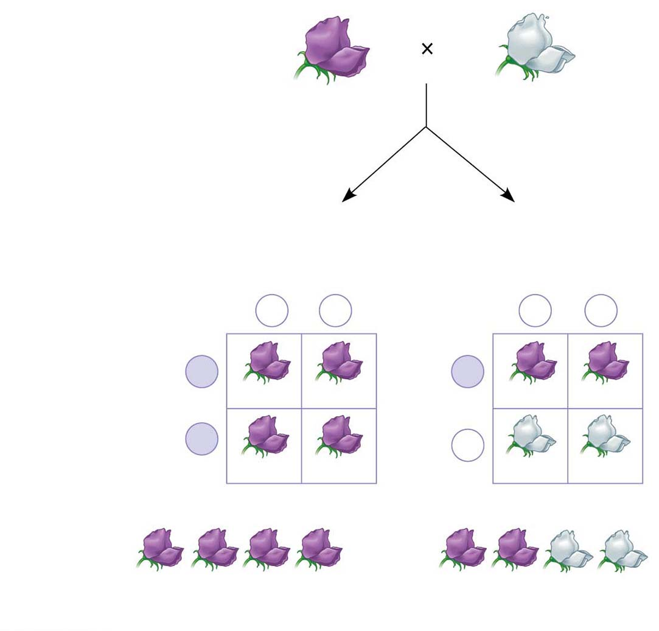
Figure 11.7
Technique
Dominant phenotype,
unknown genotype:
PP or Pp?
Recessive phenotype,
known genotype:
pp
Predictions
If purple-flowered
parent is PP:
or
If purple-flowered
parent is Pp:
Sperm
Sperm
p
p
p
p
P
P
Eggs
Pp
Pp
Eggs
Pp
Pp
P
p
Pp
Pp
pp
pp
Results
or
All offspring purple
1
2
offspring purple and
offspring white
1
2
© 2016 Pearson Education, Inc.
Notes:
Figure 11.7 Research method: the testcross

Slide 29
The Law of Independent Assortment
Mendel derived the law of segregation by following a single character
The F₁ offspring produced in this cross were monohybrids, individuals that are heterozygous for one character
A cross between such heterozygotes is called a monohybrid cross
© 2016 Pearson Education, Inc.
Notes:
29

Slide 30
Mendel identified his second law of inheritance by following two characters at the same time
Crossing two true-breeding parents differing in two characters produces dihybrids in the F₁ generation, heterozygous for both characters
A dihybrid cross, a cross between F₁ dihybrids, can determine whether two characters are transmitted to offspring as a package or independently
© 2016 Pearson Education, Inc.
Notes:
30

Slide 31
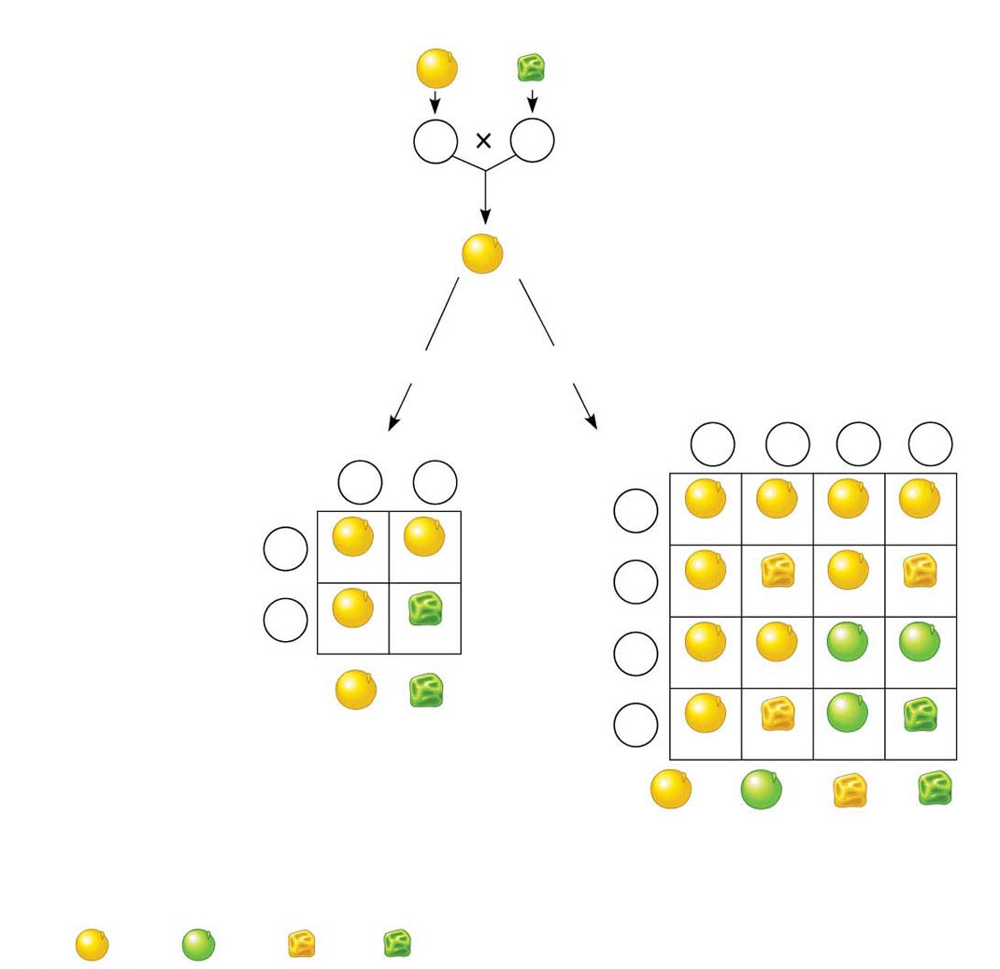
Figure 11.8
Experiment
P Generation
YYRR
yyrr
Gametes
YR
yr
F1 Generation
YyRr
Predictions
Hypothesis of
dependent assortment
Hypothesis of
independent assortment
Predicted
offspring of
F₂ generation
or
Sperm
Sperm
1
4
YR
1
4
Yr
1
4
yR
1
4
yr
1
2
YR
1
2
yr
1
4
YR
YYRR
YYRr
YyRR
YyRr
1
2
YR
Eggs
YYRR
YyRr
1
Yr
Eggs
4
YYRr
YYrr
YyRr
Yyrr
1
2
yr
YyRr
yyrr
1
yR
4
YyRR
YyRr
yyRR
yyRr
3
4
1
4
Phenotypic ratio 3:1
1
4
yr
yyRr
yyrr
YyRr
Yyrr
9
16
3
16
3
16
1
16
Phenotypic ratio 9:3:3:1
Results
315
108
101
32
Phenotypic ratio approximately 9:3:3:1
© 2016 Pearson Education, Inc.
Notes:
Figure 11.8 Inquiry: Do the alleles for one character segregate into gametes dependently or independently of the alleles for a different character?

Slide 32
Figure 11.8-1
Experiment
P Generation
YYRR
yyrr
Gametes
YR
yr
F₁ Generation
YyRr
© 2016 Pearson Education, Inc.
Notes:
Figure 11.8-1 Inquiry: Do the alleles for one character segregate into gametes dependently or independently of the alleles for a different character? (part 1: experiment)

Slide 33
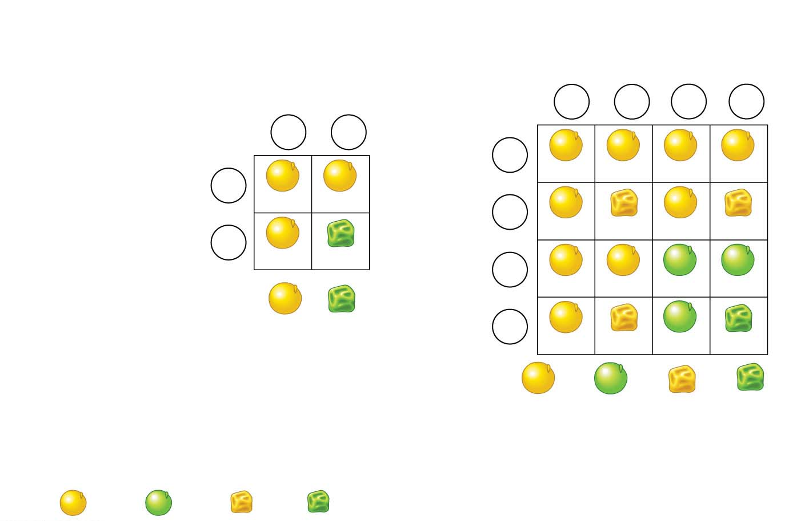
Figure 11.8-2
Hypothesis of
dependent assortment
Hypothesis of
independent assortment
Sperm
Predicted
offspring of
F₂ generation
Sperm
1
YR
1
Yr
1
yR
1
yr
4
4
4
4
1
2
YR
1
2
yr
1
4
YR
YYRR
YYRr
YyRR
YyRr
1
2
YR
Eggs
YYRR
YyRr
Yr
1
4
YYRr
YYrr
YyRr
Yyrr
1
yr
Eggs
2
YyRr
yyrr
1
4
yR
YyRR
YyRr
yyRR
yyRr
3
4
1
4
Phenotypic ratio 3:1
1
4
yr
YyRr
Yyrr
yyRr
yyrr
9
16
3
16
3
16
1
16
Phenotypic ratio 9:3:3:1
Results
315
108
101
32
Phenotypic ratio approximately 9:3:3:1
© 2016 Pearson Education, Inc.
Notes:
Figure 11.8-2 Inquiry: Do the alleles for one character segregate into gametes dependently or independently of the alleles for a different character? (part 2: results)

Slide 34
The results of Mendel’s dihybrid experiments are the basis for the law of independent assortment
It states that each pair of alleles segregates independently of any other pair during gamete formation
This law applies to genes on chromosomes that are not homologous, or those far apart on the same chromosome
Genes located near each other on the same chromosome tend to be inherited together
© 2016 Pearson Education, Inc.
Notes:
34

