Slide 1
Case Study (Notes) on Meiosis
Big Question: How is gender determined? Is it possible for someone to have an external appearance that does not match the chromosomal sex?
Notes:
Case study notes flip the traditional method of lecturing by presenting a question or a problem to solve during the lecture. Student handout: https://docs.google.com/document/d/1llhkNoOPQ4geaCLx1nABZKbwsg3tR1QsHEorK6thMnc/edit?usp=sharing

Slide 2
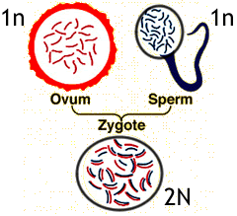
First….some definitions….
Meiosis - the process by which haploid cells are created
-sperm and egg may eventually combine to make a diploid zygote
- alleles on these chromosomes determine the traits and the SEX of the offspring

Slide 3
In 2006, Santhi Soundararajan won the silver medal in the 800-meter race at the Asian Games in Doha, Qatar.
Following her silver medal performance, her sex was officially questioned.
“Indian Athlete Fails Gender Test” http://news.bbc.co.uk/2/hi/world/south_asia/6188775.stm
3
Notes:
This case study is based on a true story, but data included is fictional. Santhi’s medical records are not public, so some aspects have been fabricated.

Slide 4
How do you know if someone is male or female?
Talk to the person next to you and identify characteristics that distinguish males from females.
4

Slide 5
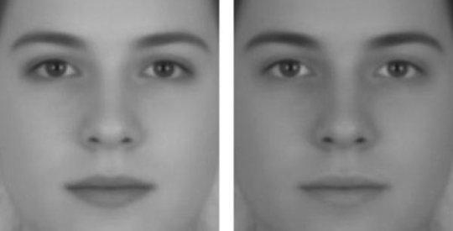
How is sex determined in humans?
Anatomy: Primary and secondary sexual characteristics - genitalia, body hair, pelvis, etc.
Physiology: Function and interaction of the sex organs including concentrations of sex hormones such as estrogen, progesterone, and testosterone.
Contrast also gives us cues when regarding faces.
Which one of these faces is female?
5
See Article in Science Daily on Gender and Perception
Notes:
Answer, both are the same face, the left is perceived as female because of greater contrast. See: https://www.sciencedaily.com/releases/2009/10/091020153100.htm

Slide 6
Imagine you are a member of the committee assigned to determine whether Santhi is female. Here are results of the initial tests.
Female genitalia: Yes
Breasts and pubic hair: Yes
Regular menstrual cycle: Never
*Testosterone Levels: 180 ng/dl
*According to the National Institutes of Health, the normal range of testosterone is 30 to 95 nanograms per deciliter (ng/dL) for women and 300 to 1,200 ng/dL for men
Based on this information, would you determine that Santhi is male or female?
6

Slide 7
Is there another way that sex is determined?
Chromosomes:
Females possess two X chromosomes in each of their cells, whereas males have one X and one Y chromosome.
7

Slide 8
Karyotype (picture of chromosomes in a cell)
AUTOSOMES = chromosomes that are not the X or Y, humans have 22 pairs
8

Slide 9
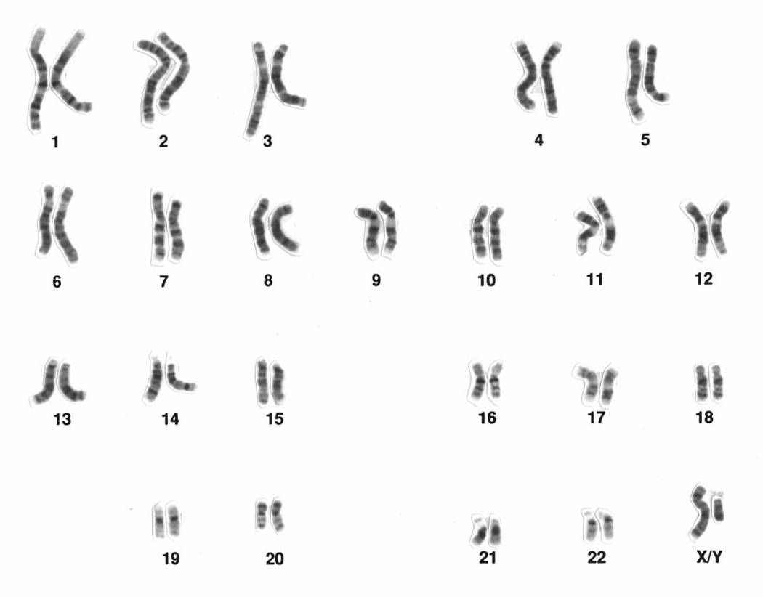
If this were a karyotype from Santhi’s blood cells, would you determine Santhi is male or female?
9

Slide 10
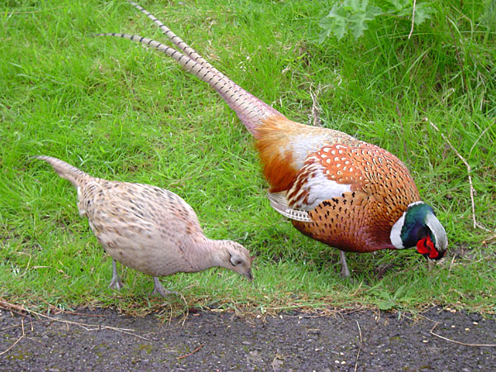
Can the process of meiosis result in a zygote that has Y chromosomes but have an external female appearance?
Can Santhi still be female?
Sexual dimorphism is more obvious in some animals.

Slide 11
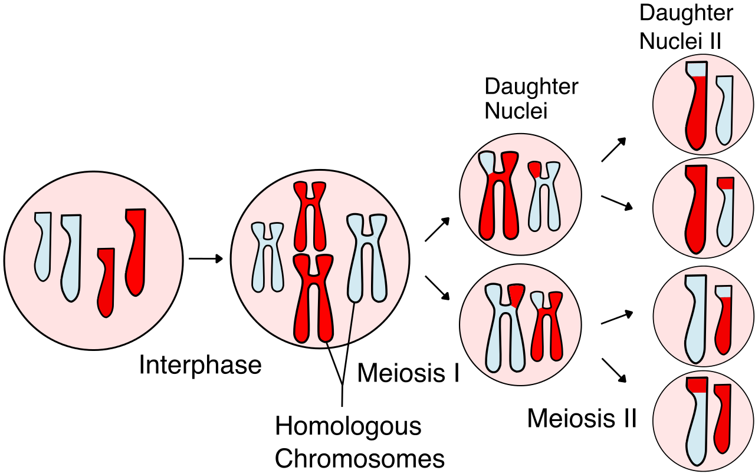
How Sex Cells are Created: Meiosis
Purpose of meiosis: in animals, produce gametes with just half the parents’ genetic material (haploid).
11

Slide 12
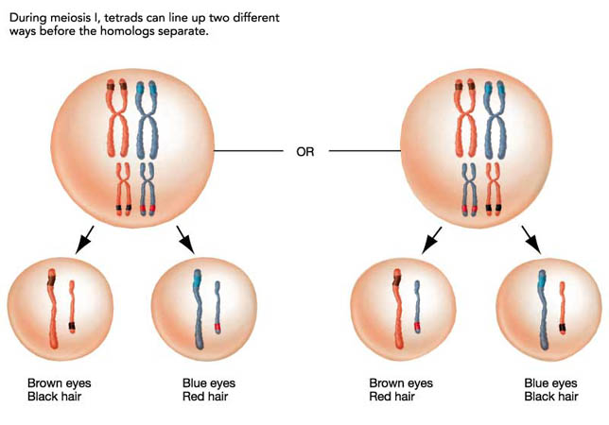
Independent Assortment - during meiosis, homologous pairs are randomly distributed to the four daughter cells.
12

Slide 13
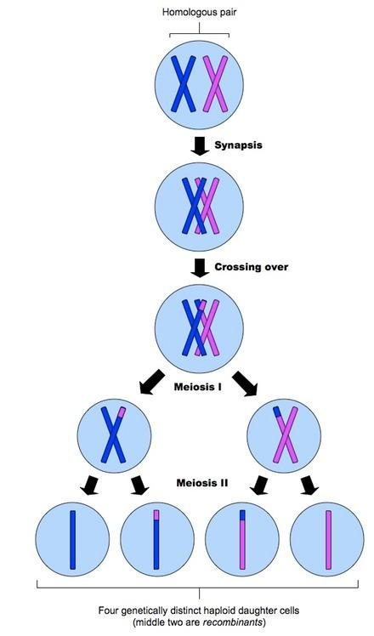
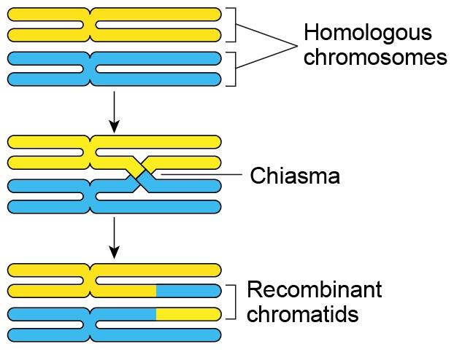
Crossing-Over (Chiasma) increases variability - also known as recombination
13

Slide 14
How is Sex Determined in Humans?
sperm
X
Y
X
XX
XY
egg
XX
XY
X
girls
boys
14

Slide 15
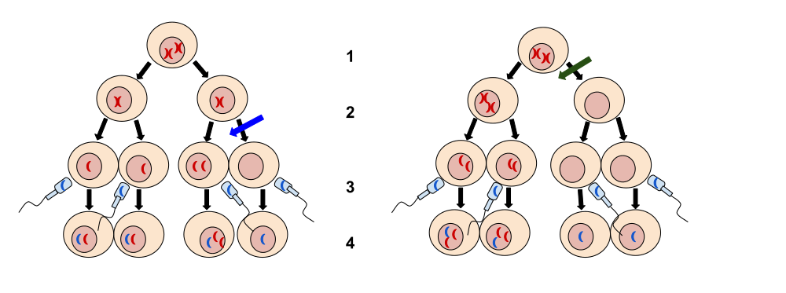
Nondisjunction
Chromatids (or homologs) do not separate during the process.
Daughter cells either have too many or too few.
Could Santhi have an extra Y or an extra X?

Slide 16
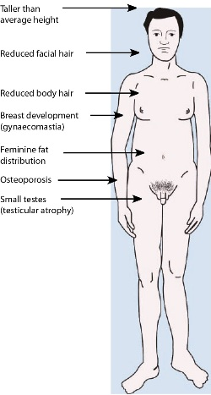
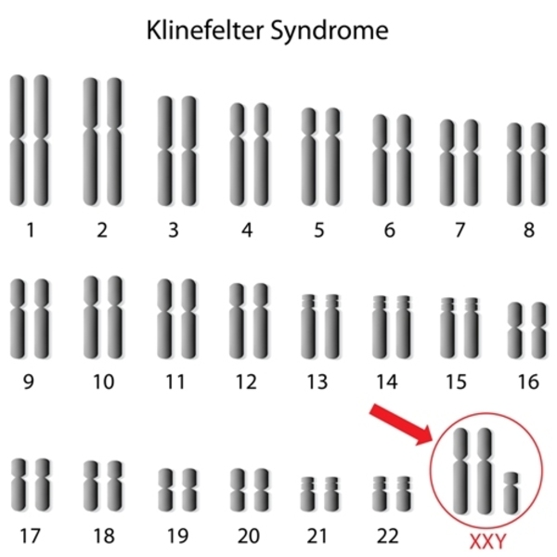
Klinefelter Syndrome
Based on the evidence so far, does Santhi have this syndrome?

Slide 17
How does the Y chromosome determine the development of male characteristics?
The chromosome theory of inheritance is a fundamental theory of genetics which identifies chromosomes as the carriers of genetic material.
Could there be a gene on the Y chromosome that determines male traits?
17

Slide 18
SRY = Sex- Determining Region of the Y chromosome (gene)
Early in development, the immature gonads of males and females are indistinguishable.
Males: In the 7th week of development, the SRY gene on the Y chromosome activates and the gonads develop as testes.
Females: With no SRY gene, gonads develop as ovaries
SRY gene
Y
X
18

Slide 19
Is it possible that Santhi is female even though she has a Y chromosome?
A: No, an XY individual is always male.
B: Yes, if she has an additional X chromosome.
C: Yes, if a SRY gene is located on one of her X chromosomes.
D: Yes, if the SRY gene is missing or broken.
19

Slide 20
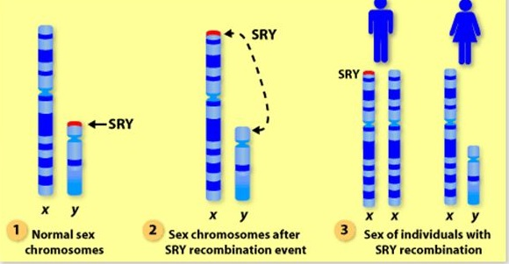
Could the SRY gene end up on the X chromosome during crossing over?
Crossing over can occur anywhere along the autosomes.
Would the individual with XX +SRY be male or female?
Would the individual with XY - SRY be male or female?
20
Notes:
Swyer syndrome = XY females, they’ve either lost the SRY gene or it has malfunctioned

Slide 21
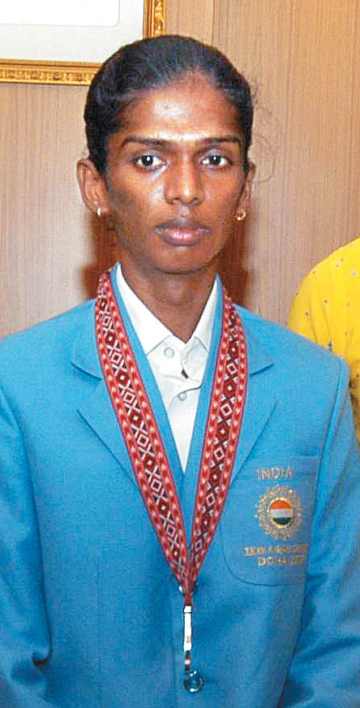
46, XY (SRY-)
SWYER syndrome, also knowns as gonadal dysgenesis.
How would you determine if Santhi had this syndrome?

Slide 22
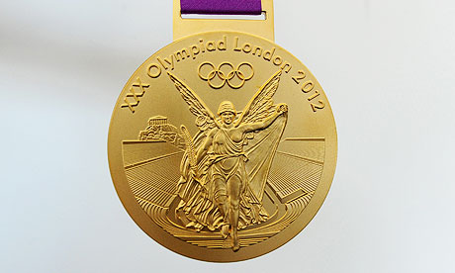
If you were a member of the Asian Games medal committee and Santhi’s karyotype revealed that she is XY and SRY-, what would you do?
A: She has female genitalia, allow her to keep her medal.
B: She is genetically male, take her medal away.
C: She is female, the SRY gene is inactive.
D: [ Insert your own answer]
22

Slide 23
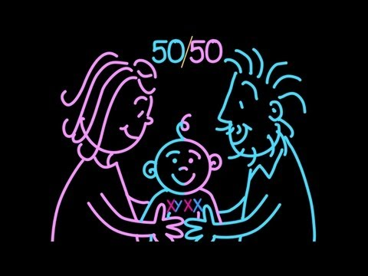
Still confused? Check out this TED-ED Video

Slide 24
In 2016, Santhi disclosed she has androgen insensitivity syndrome.
What do you think that means?

Slide 25
Androgen insensitivity syndrome (AIS) is when a person who is genetically male (who has one X and one Y chromosome) is resistant to male hormones (called androgens). As a result, the person has some or all of the physical traits of a woman, but the genetic makeup of a man.
If Santhi has AIS, should she be allowed to keep her medal and compete?

Slide 26
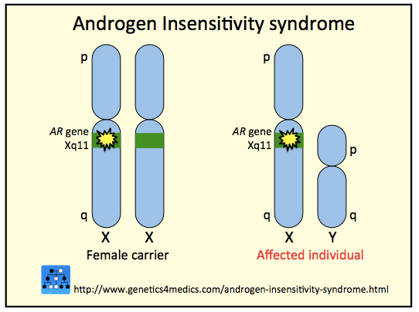
The gene for AIS is located on the X chromosome.

Slide 27
What do you think about requiring gender testing for female athletes in international competition?
A: It should be banned because gender determination is so complex.
B: It is necessary to ensure an even playing field.
C: It should be required for all athletes, both male and female.
27
Notes:
27

