Slide 1
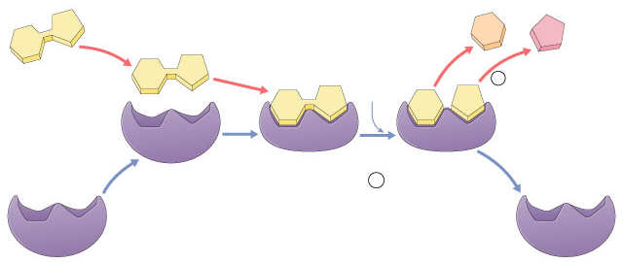
Chapter 6. Metabolism & Enzymes
2005-2006

Slide 2
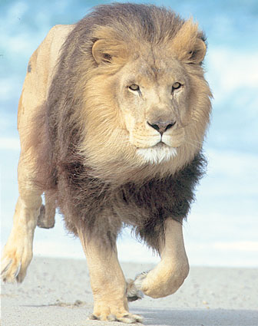
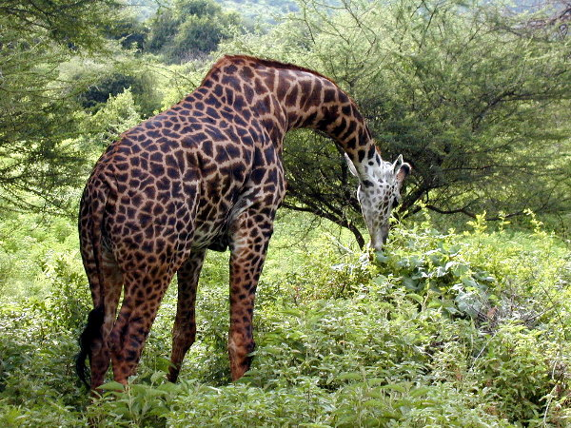
Flow of energy through life
Life is built on chemical reactions
2005-2006

Slide 3
Chemical reactions of life
Metabolism
forming bonds between molecules
dehydration synthesis
anabolic reactions
breaking bonds between molecules
hydrolysis
catabolic reactions
2005-2006

Slide 4
Examples
dehydration synthesis
+
H₂O
hydrolysis
+
H₂O
2005-2006

Slide 5
Examples
dehydration synthesis
hydrolysis
2005-2006

Slide 6
Chemical reactions & energy
Some chemical reactions release energy
exergonic
digesting polymers
hydrolysis = catabolism
Some chemical reactions require input of energy
endergonic
building polymers
dehydration synthesis = anabolism
digesting molecules= less organization= lower energy state
building molecules= more organization= higher energy state
2005-2006

Slide 7
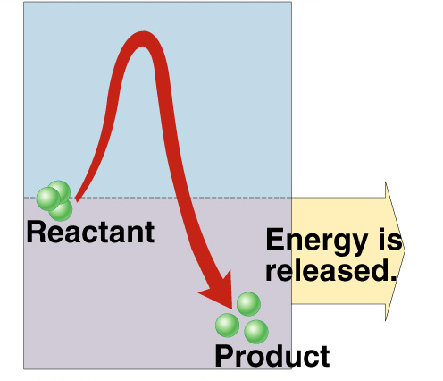
Endergonic vs. exergonic reactions
exergonic
endergonic
energy released
energy invested
ΔG
2005-2006
ΔG = change in free energy = ability to do work

Slide 8
Energy & life
Organisms require energy to live
where does that energy come from?
coupling exergonic reactions (releasing energy) with endergonic reactions (needing energy)
energy
+
+
energy
+
+
2005-2006

Slide 9
Spontaneous reactions?
If reactions are “downhill”, why don’t they just happen spontaneously?
because covalent bonds are stable
Why don’t polymers (carbohydrates, proteins & fats) just spontaneously digest into their monomers
2005-2006

Slide 10
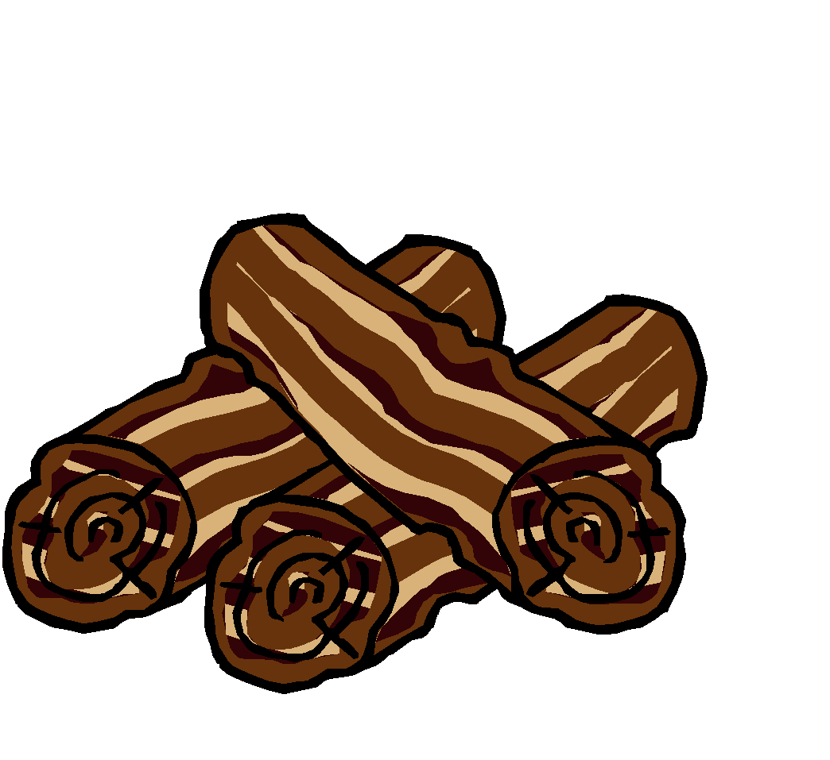
Activation energy
Breaking down large molecules requires an initial input of energy
activation energy
large biomolecules are stable
must absorb energy to break bonds
cellulose
CO₂ + H₂O + heat
energy
2005-2006

Slide 11
Activation energy
the amount of energy needed to destabilize the bonds of a molecule
moves the reaction over an “energy hill”
Got a match? No, that’s too much energy to get the work of life done!
2005-2006

Slide 12
Reducing Activation energy
Catalysts
reducing the amount of energy to start a reaction
Pheew… that takes a lot less energy!
2005-2006

Slide 13
Catalysts
So what’s a cell to do to reduce activation energy?
get help! … chemical help…
ENZYMES
Call in the... ENZYMES!
ΔG
2005-2006

Slide 14
Enzymes
Biological catalysts
proteins (& RNA)
facilitate chemical reactions
increase rate of reaction without being consumed
reduce activation energy
don’t change free energy (ΔG) released or required
required for most biological reactions
highly specific
thousands of different enzymes in cells
control reactions
2005-2006

Slide 15
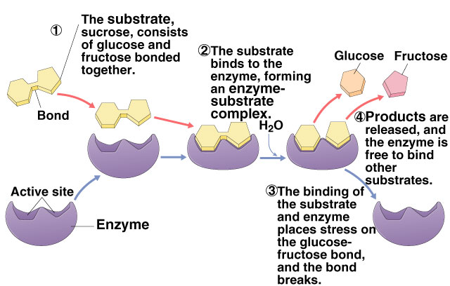
Enzymes & substrates
substrate
reactant which binds to enzyme
enzyme-substrate complex: temporary association
product
end result of reaction
2005-2006

Slide 16
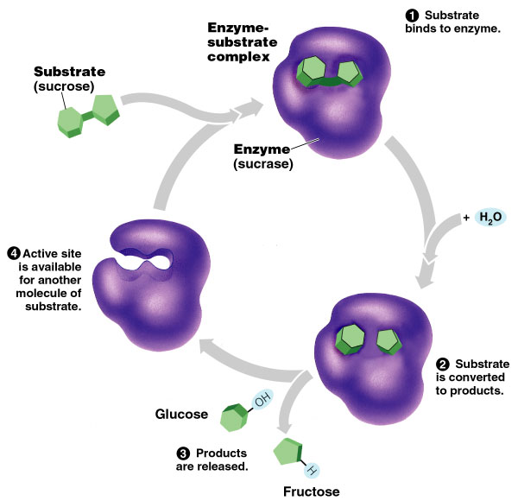
Enzymes & substrates
Enzyme + substrates → products
sucrase
enzyme breaks down sucrose
binds to sucrose & breaks disaccharide into fructose & glucose
DNA polymerase
enzyme builds DNA
adds nucleotides to a growing DNA strand
2005-2006

Slide 17
Lock and Key model
Simplistic model of enzyme action
3-D structure of enzyme fits substrate
Active site
enzyme’s catalytic center
pocket or groove on surface of globular protein
substrate fits into active site
It’s shape that matters!
2005-2006

Slide 18
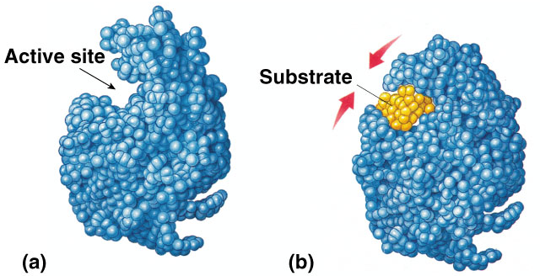
Induced fit model
More accurate model of enzyme action
3-D structure of enzyme fits substrate
as substrate binds, enzyme changes shape leading to a tighter fit
“conformational change”
bring chemical groups in position to catalyze reaction
2005-2006

Slide 19
How does it work?
Variety of mechanisms to lower activation energy & speed up reaction
active site orients substrates in correct position for reaction
enzyme brings substrate closer together
active site binds substrate & puts stress on bonds that must be broken, making it easier to separate molecules
2005-2006

Slide 20
Properties of Enzymes
2005-2006

Slide 21
Specificity of enzymes
Reaction specific
each enzyme is substrate-specific
due to fit between active site & substrate
substrates held in active site by weak interactions
H bonds
ionic bonds
enzymes named for reaction they catalyze
sucrase breaks down sucrose
proteases break down proteins
lipases break down lipids
DNA polymerase builds DNA
pepsin breaks down proteins (polypeptides)
2005-2006

Slide 22
Reusable
Not consumed in reaction
single enzyme molecule can catalyze thousands or more reactions per second
enzymes unaffected by the reaction
2005-2006

Slide 23
Factors that Affect Enzymes
2005-2006

Slide 24
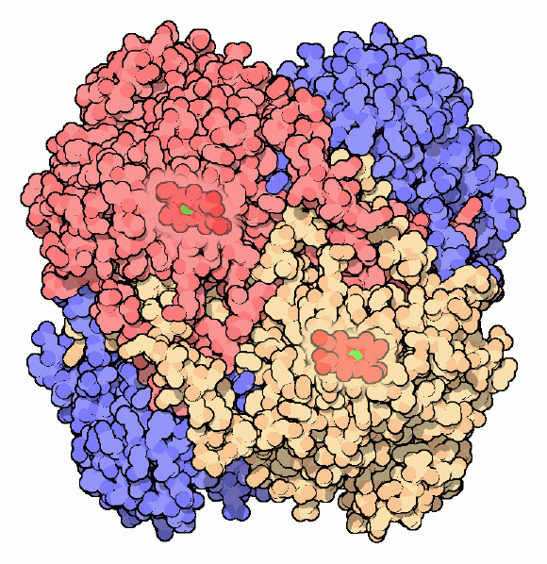
Factors Affecting Enzymes
Enzyme concentration
Substrate concentration
Temperature
pH
Salinity
Activators
Inhibitors
catalase
2005-2006

Slide 25
Enzyme concentration
What’s happening here?!
reaction rate
enzyme concentration
2005-2006

Slide 26
Enzyme concentration
Effect on rates of enzyme activity
as ↑ enzyme = ↑ reaction rate
more enzymes = more frequently collide with substrate
reaction rate levels off
substrate becomes limiting factor
not all enzyme molecules can find substrate
2005-2006

Slide 27
Substrate concentration
What’s happening here?!
reaction rate
substrate concentration
2005-2006

Slide 28
Substrate concentration
Effect on rates of enzyme activity
as ↑ substrate = ↑ reaction rate
more substrate = more frequently collide with enzymes
reaction rate levels off
all enzymes have active site engaged
enzyme is saturated
maximum rate of reaction
2005-2006

Slide 29
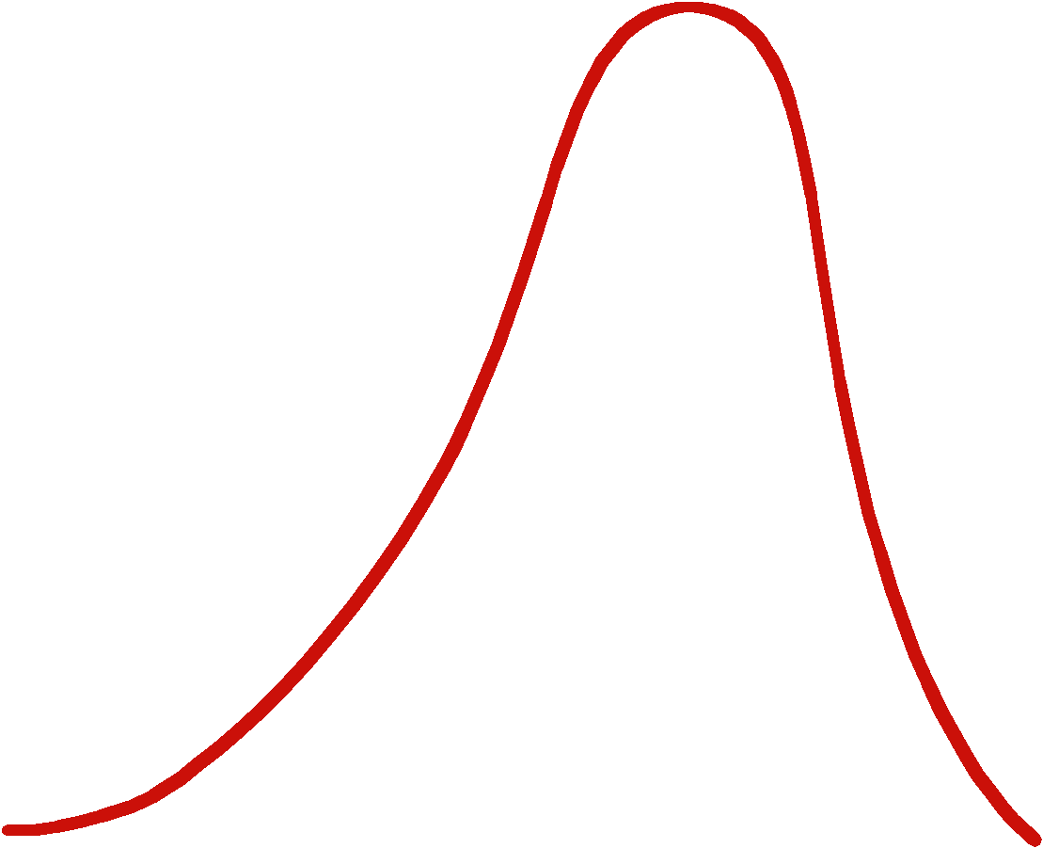
Temperature
What’s happening here?!
reaction rate
37°
temperature
2005-2006

Slide 30
Temperature
Effect on rates of enzyme activity
Optimum T°
greatest number of molecular collisions
human enzymes = 35°- 40°C (body temp = 37°C)
Increase beyond optimum T°
increased agitation of molecules disrupts bonds
H, ionic = weak bonds
denaturation = lose 3D shape (3° structure)
Decrease T°
molecules move slower
decrease collisions
2005-2006

Slide 31
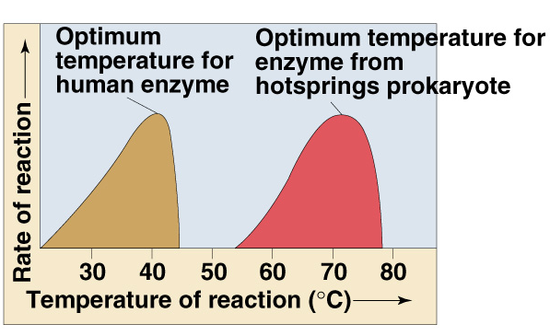
Enzymes and temperature
Different enzymes functional in different organisms
2005-2006

Slide 32
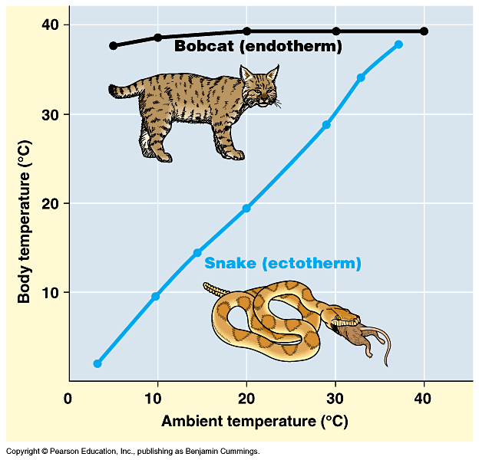
How do ectotherms do it?
2005-2006

Slide 33
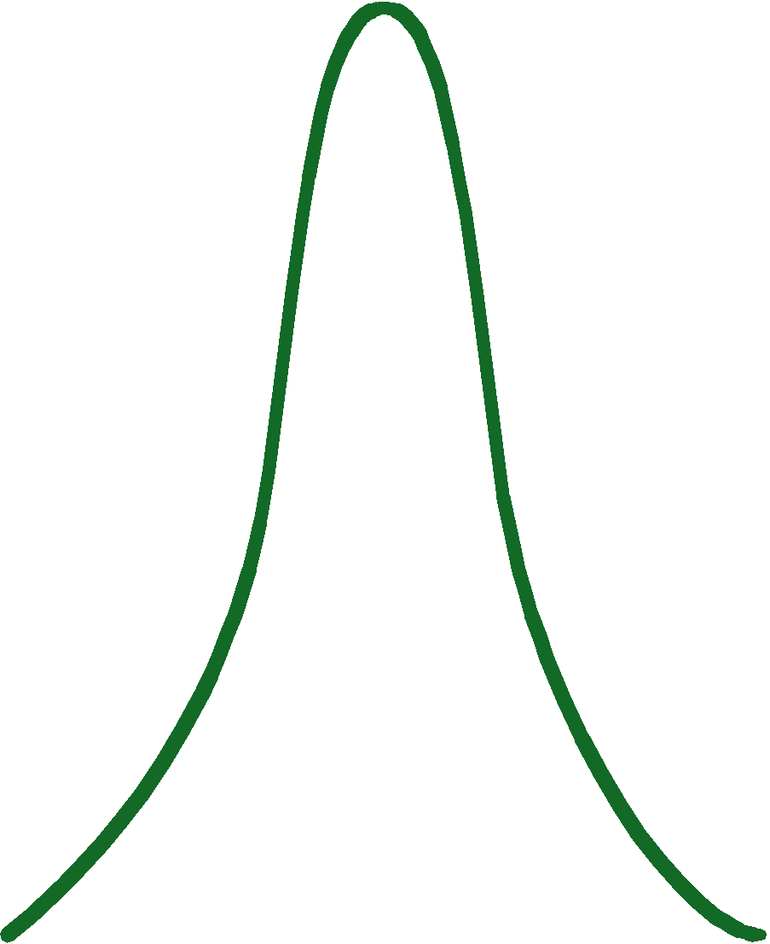
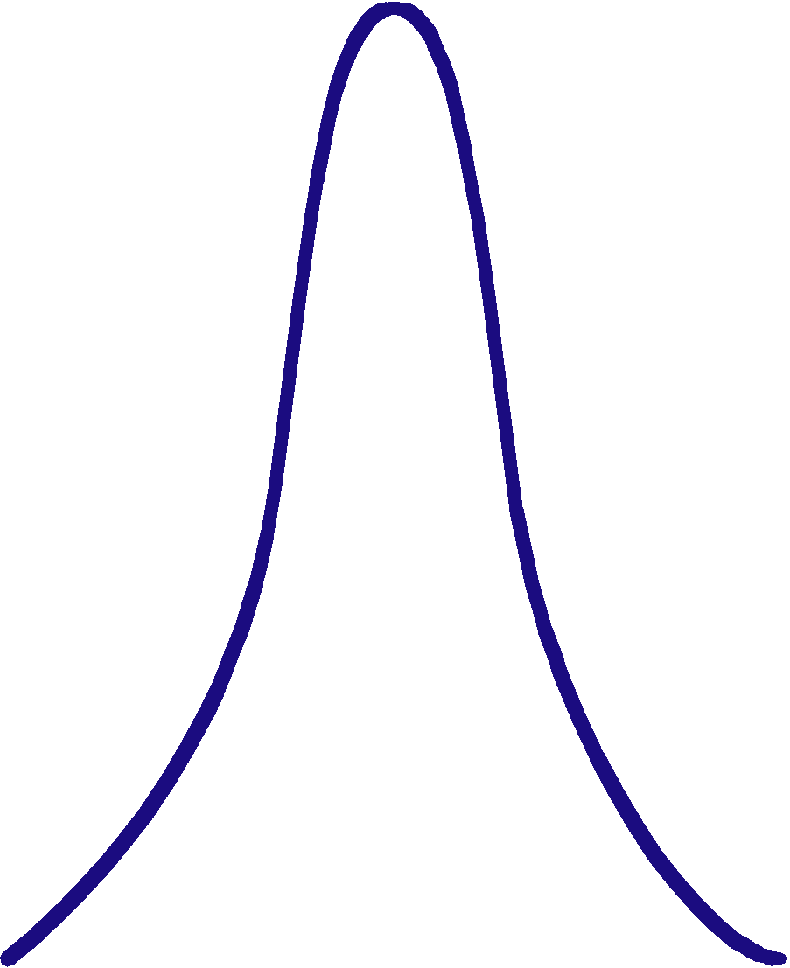
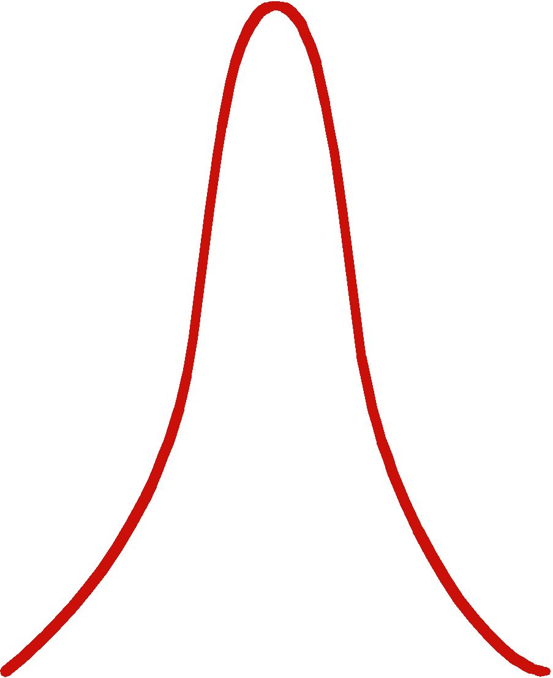
pH
What’s happening here?!
pepsin
trypsin
reaction rate
0
1
2
3
4
5
6
7
8
9
10
pH
2005-2006

Slide 34
pH
Effect on rates of enzyme activity
protein shape (conformation)
attraction of charged amino acids
pH changes
changes charges (add or remove H⁺)
disrupt bonds, disrupt 3D shape
affect 3° structure
most human enzymes = pH 6-8
depends on localized conditions
pepsin (stomach) = pH 3
trypsin (small intestines) = pH 8
2005-2006

Slide 35
Salinity
What’s happening here?!
reaction rate
Salt concentration
2005-2006

Slide 36
Salt concentration
Effect on rates of enzyme activity
protein shape (conformation)
depends on attraction of charged amino acids
salinity changes
change [inorganic ions]
changes charges (add + or –)
disrupt bonds, disrupt 3D shape
affect 3° structure
enzymes intolerant of extreme salinity
Dead Sea is called dead for a reason!
2005-2006

Slide 37
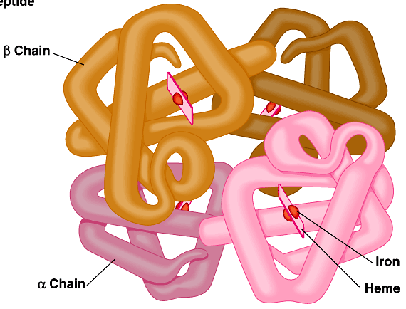
Activators
Compounds which help enzymes
Cofactors
non-protein, small inorganic compounds & ions
Mg, K, Ca, Zn, Fe, Cu
bound in enzyme molecule
Coenzymes
non-protein, organic molecules
bind temporarily or permanently to enzyme near active site
many vitamins
NAD (niacin; B3)
FAD (riboflavin; B2)
Coenzyme A
Fe in hemoglobin
Mg in chlorophyll
2005-2006

Slide 38
Inhibitors
Regulation of enzyme activity
other molecules that affect enzyme activity
Selective inhibition & activation
competitive inhibition
noncompetitive inhibition
irreversible inhibition
feedback inhibition
2005-2006

Slide 39
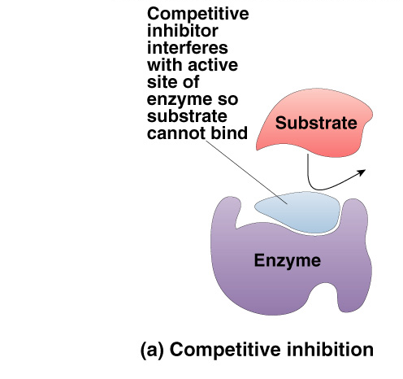
Competitive Inhibitor
Effect
inhibitor & substrate “compete” for active site
ex: penicillin blocks enzyme that bacteria use to build cell walls
ex: disulfiram (Antabuse) to overcome alcoholism
ex: methanol poisoning
overcome by increasing substrate concentration
saturate solution with substrate so it out-competes inhibitor for active site on enzyme
2005-2006

Slide 40
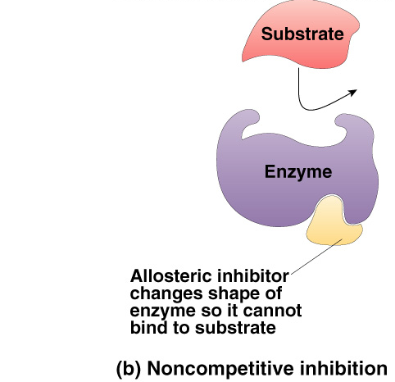
Non-Competitive Inhibitor
Effect
inhibitor binds to site other than active site
allosteric site
called allosteric inhibitor
ex: some anti-cancer drugs inhibit enzymes involved in synthesis of nucleotides & therefore in building of DNA = stop DNA production, stop division of more cancer cells
ex: heavy metal poisoning
ex: cyanide poisoning
causes enzyme to change shape
conformational change
renders active site unreceptive
2005-2006

Slide 41
Irreversible inhibition
Inhibitor permanently binds to enzyme
competitor
permanently binds to active site
allosteric
permanently changes shape of enzyme
ex: nerve gas, sarin, many insecticides (malathion, parathion…)
cholinesterase inhibitors doesn’t breakdown the neurotransmitter, acetylcholine
2005-2006

Slide 42
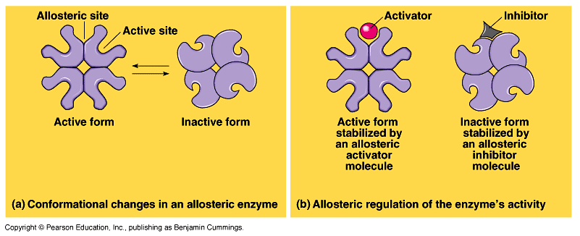
Action of Allosteric control
Inhibitors & activators
regulatory molecules attach to allosteric site causing conformational (shape) change
inhibitor keeps enzyme in inactive form
activator keeps enzyme in active form
2005-2006

Slide 43
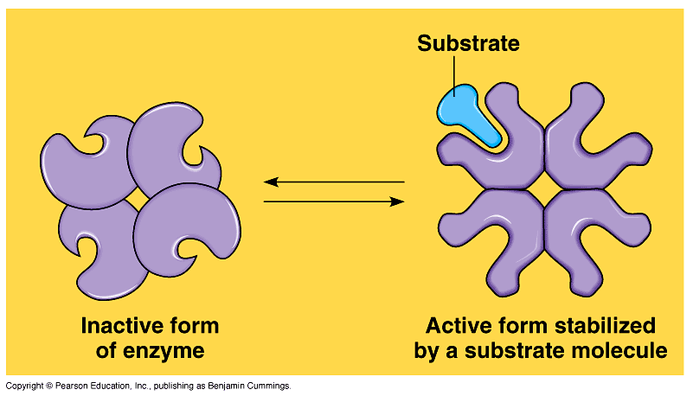
Cooperativity
Substrate acts as an activator
substrate causes conformational change in enzyme
induced fit
favors binding of substrate at 2nd site
makes enzyme more active & effective
ex: hemoglobin
4 polypeptide chains:
bind 4 O₂;
1st O₂ binds
makes it easier for other 3 O₂ to bind
2005-2006

Slide 44
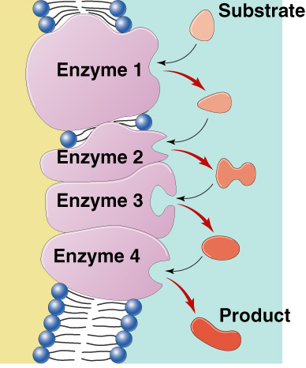
Metabolic pathways
A → B → C → D → E → F → G
A → B → C → D → E → F → G
→
→
→
→
→
→
→
enzyme
1
enzyme
2
enzyme
3
enzyme
4
enzyme
5
enzyme
6
enzyme
Chemical reactions of life are organized in pathways
divide chemical reaction into many small steps
efficiency
control = regulation
2005-2006

Slide 45
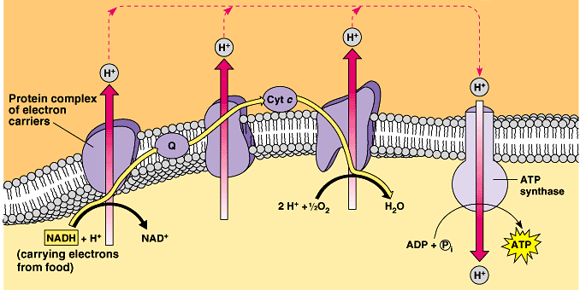
Efficiency
Groups of enzymes organized
if enzymes are embedded in membrane they are arranged sequentially
Link endergonic & exergonic reactions
Whoa!
all that going on in those little mitochodria!
2005-2006

Slide 46
Feedback Inhibition
Regulation & coordination of production
product is used by next step in pathway
final product is inhibitor of earlier step
allosteric inhibitor of earlier enzyme
feedback inhibition
no unnecessary accumulation of product
A → B → C → D → E → F → G
→
→
→
→
→
→
X
enzyme
2
enzyme
3
enzyme
4
enzyme
5
enzyme
6
enzyme
1
allosteric inhibitor of enzyme 1
2005-2006

Slide 47
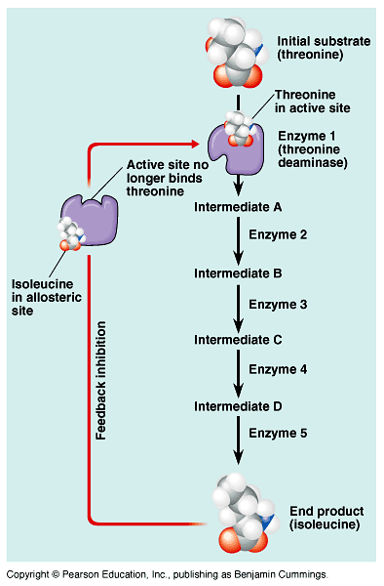
Feedback inhibition
Example
synthesis of amino acid, isoleucine from amino acid, threonine
2005-2006

Slide 48
Any Questions??
2005-2006

