Slide 1
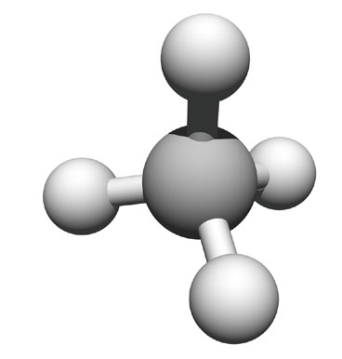
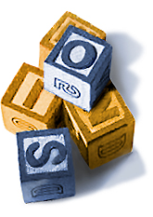
Chemistry of Carbon
Building Blocks of Life

Slide 2
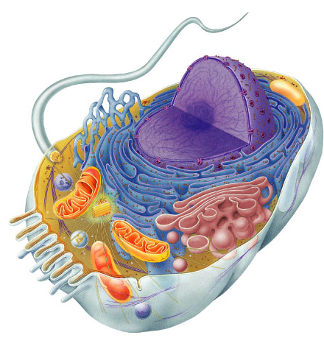
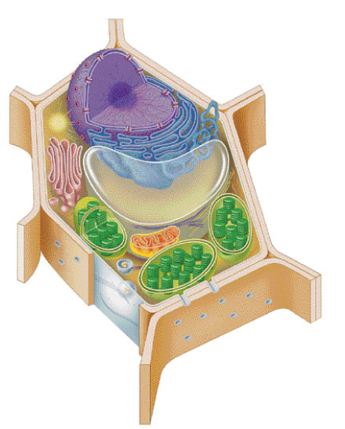

Why study Carbon?
All of life is built on carbon
Cells
  ~72% H₂O
  ~25% carbon compounds
    carbohydrates
    lipids
    proteins
    nucleic acids
  ~3% salts
    Na, Cl, K…
Notes:
Why do we study carbon -- is it the most abundant element in living organisms?
H & O most abundant
C is the next most abundant

Slide 3
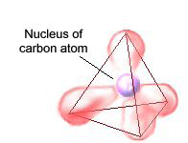
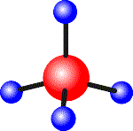
Chemistry of Life
Organic chemistry is the study of carbon compounds
C atoms are versatile building blocks
  bonding properties
  4 stable covalent bonds
H
C
H
H
H
Notes:
Carbon chemistry = organic chemistry
Why is it a foundational atom?
What makes it so important?
Can’t be a good building block if you only form 1 or 2 bonds.

Slide 4
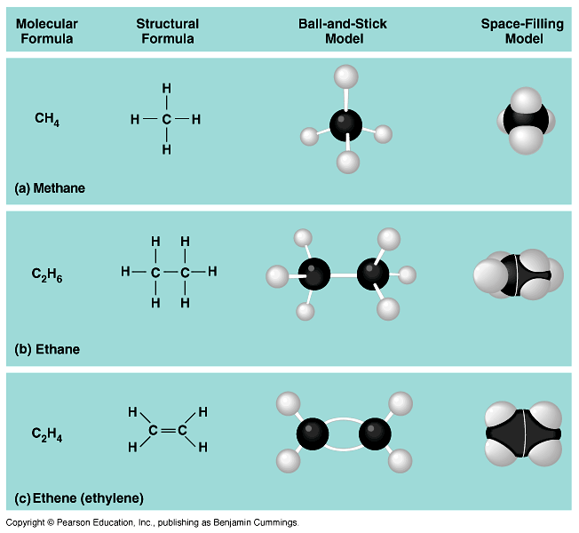
Complex molecules assembled like TinkerToys
Notes:
Like sugars: C₆H₁₂O₆
But can be arranged in different ways
-glucose
-galactose
-dextrose

Slide 5
Hydrocarbons
Combinations of C & H
  non-polar
    not soluble in H₂O
    hydrophobic
  stable
  very little attraction
  between molecules
    a gas at room temperature
methane
(simplest HC)

Slide 6
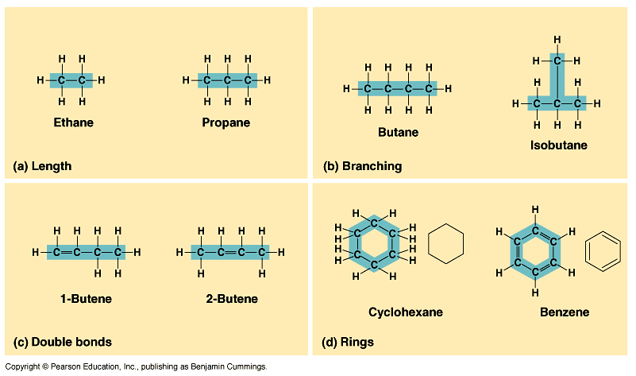
Hydrocarbons can grow

Slide 7

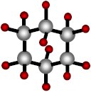
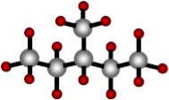
Isomers
Molecules with same molecular formula but different structures (shapes)
  different chemical properties
  different biological functions
6 carbons
6 carbons
6 carbons
Notes:
Same formula but different structurally & therefore different functionally. Molecular shape determines biological properties.
Ex. Isomers may be ineffective as medicines

Slide 8
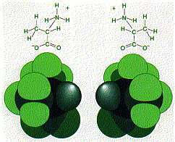
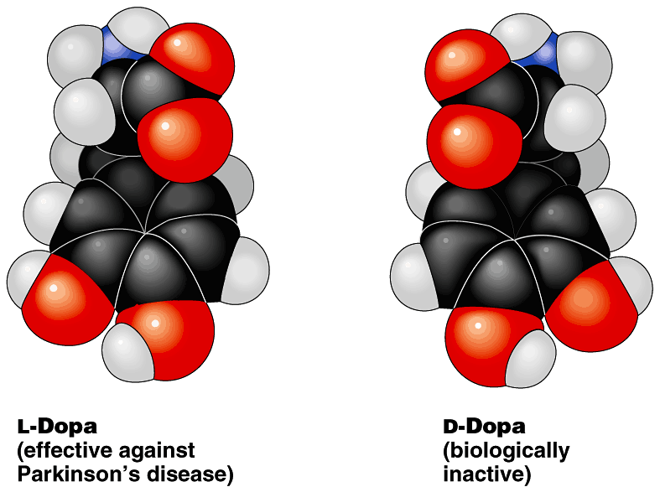
Form affects function
Structural differences create important functional significance
  amino acid alanine
    L-alanine used in proteins
    but not D-alanine
  medicines
    L-version active
    but not D-version
  sometimes with
  tragic results…
stereoisomers

Slide 9
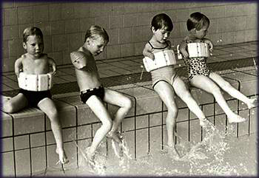

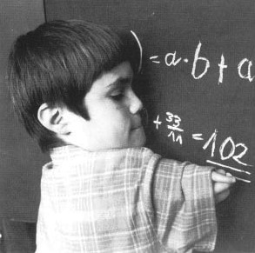
Form affects function
Thalidomide
  prescribed to pregnant women in 50s & 60s
  reduced morning sickness, but…
  stereoisomer caused severe birth defects

Slide 10

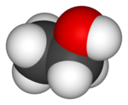


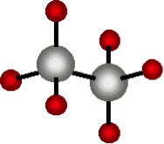

Diversity of molecules
Substitute other atoms or groups around the carbon
  ethane vs. ethanol
    H replaced by an hydroxyl group (–OH)
    nonpolar vs. polar
    gas vs. liquid
    biological effects!
ethane (C₂H₆)
ethanol (C₂H₅OH)

Slide 11
Functional groups
Parts of organic molecules that are involved in chemical reactions
  give organic molecules distinctive properties
    ■ hydroxyl  amino
    ■ carbonyl  sulfhydryl
    ■ carboxyl  phosphate
Affect reactivity
  makes hydrocarbons hydrophilic
  increase solubility in water

Slide 12
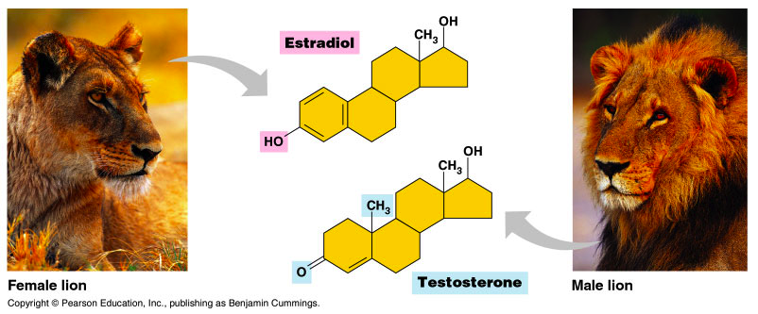
Viva la difference!
Basic structure of male & female hormones is identical
  identical carbon skeleton
  attachment of different functional groups
  interact with different targets in the body
    different effects
Notes:
For example the male and female hormones, testosterone and estradiol, differ from each other only by the attachment of different functional groups to an identical carbon skeleton.

Slide 13
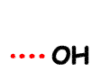
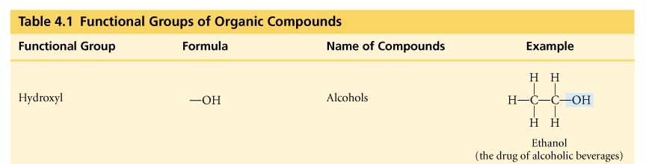
Hydroxyl
–OH
  organic compounds with OH = alcohols
  names typically end in -ol
    ethanol

Slide 14
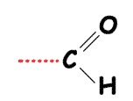
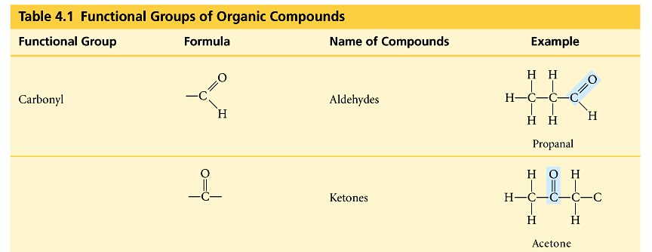
Carbonyl
C=O
  O double bonded to C
    if C=O at end molecule = aldehyde
    if C=O in middle of molecule = ketone

Slide 15
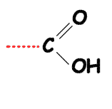
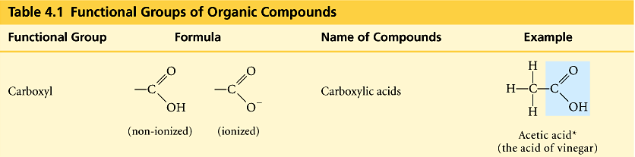
Carboxyl
–COOH
  C double bonded to O & single bonded to OH group
    compounds with COOH = acids
      fatty acids
      amino acids

Slide 16
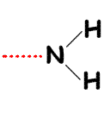
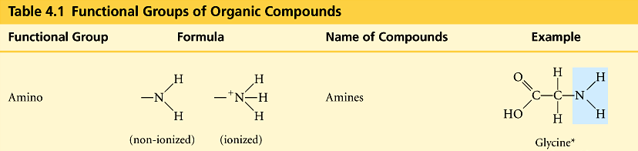
Amino
-NH₂
  N attached to 2 H
    compounds with NH₂ = amines
      amino acids
    NH₂ acts as base
      ammonia picks up H⁺ from solution

Slide 17
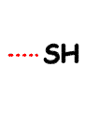
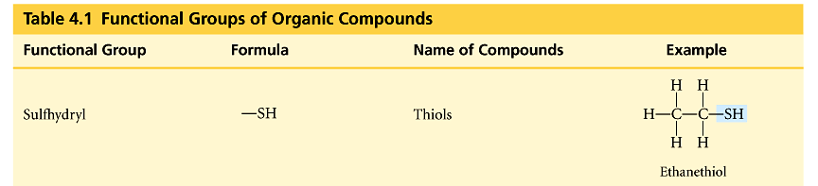
Sulfhydryl
–SH
  S bonded to H
    compounds with SH = thiols
    SH groups stabilize the structure of proteins

Slide 18
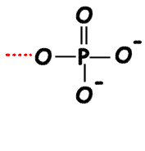
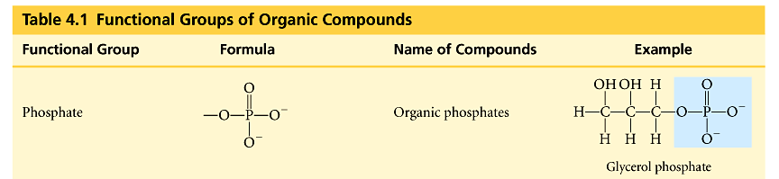
Phosphate
–PO₄
  P bound to 4 O
    connects to C through an O
    lots of O = lots of negative charge
      highly reactive
    transfers energy between organic molecules
      ATP, GTP, etc.

Slide 19

Macromolecules
Building Blocks
of Life

Slide 20

Macromolecules
Smaller organic molecules join together to form larger molecules
  macromolecules
4 major classes of
macromolecules:
  carbohydrates
  lipids
  proteins
  nucleic acids

Slide 21
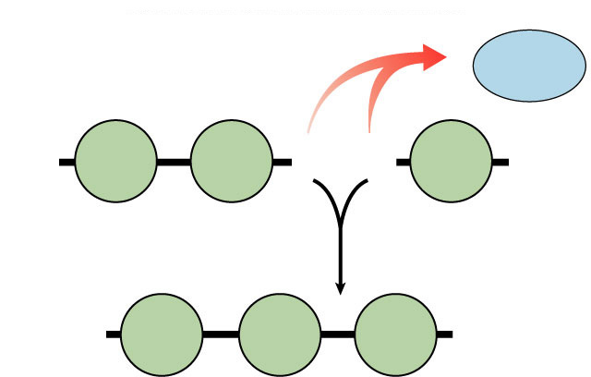
Polymers
Long molecules built by linking repeating building blocks in a chain
  monomers
    building blocks
    repeated small units
  covalent bonds
H₂O
HO
H
HO
H
Dehydration synthesis
HO
H
Notes:
• great variety of polymers can be built from a small set of monomers
• monomers can be connected in many combinations like the 26 letters in the alphabet can be used to create a great diversity of words
• each cell has millions of different macromolecules

Slide 22
How to build a polymer
You gotta
be open to
“bonding!
Synthesis
  joins monomers by “taking” H₂O out
    one monomer donates OH–
    other monomer donates H⁺
    together these form H₂O
  requires energy & enzymes
H₂O
HO
H
HO
H
enzyme
Dehydration synthesis
Condensation reaction
HO
H

Slide 23
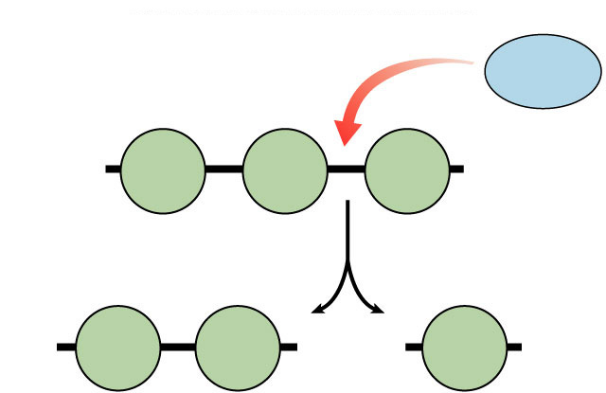
How to break down a polymer
Breaking up
is hard to do!
Digestion
  use H₂O to breakdown polymers
    reverse of dehydration synthesis
    cleave off one monomer at a time
    H₂O is split into H⁺ and OH–
      H⁺ & OH– attach to ends
  requires enzymes
  releases energy
H₂O
HO
enzyme
H
Hydrolysis
Digestion
HO
H
HO
H
Notes:
Most macromolecules are polymers
• build:
condensation (dehydration) reaction
• breakdown:
hydrolysis
An immense variety of polymers can be built from a small set of monomers

