Slide 1
Concept 2.5: Hydrogen bonding gives water properties that help make life possible on Earth
All organisms are made mostly of water and live in an environment dominated by water
Water molecules are polar molecules, with the oxygen region having a partial negative charge (δ−) and the hydrogen region a slight positive charge (δ+)
Two water molecules are held together by a hydrogen bond

Slide 2
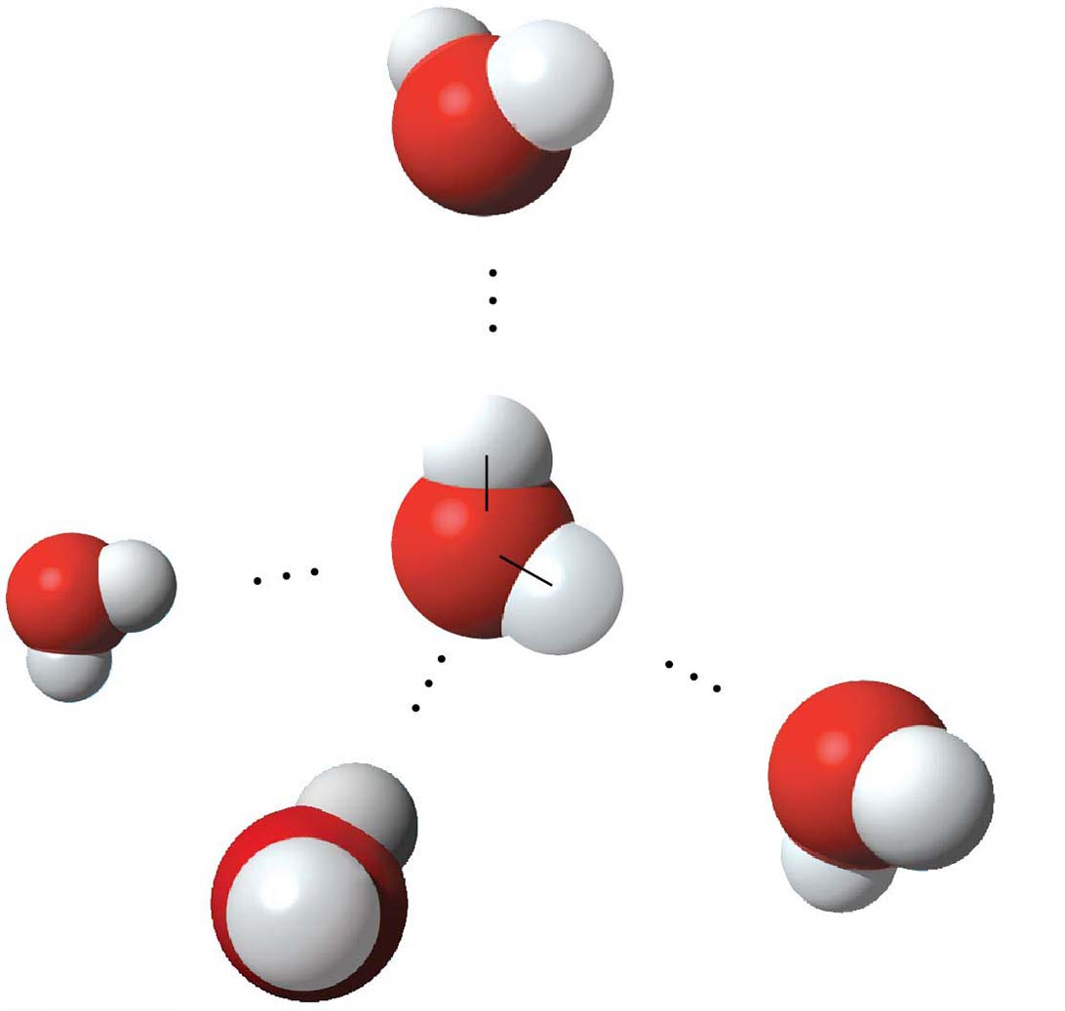
Figure 2.16
δ−
Hydrogen
bond
δ+
H
Polar covalent
bonds
O
δ+
δ−
H
δ−
δ+
δ−
δ+
© 2016 Pearson Education, Inc.
Notes:
Figure 2.16 Hydrogen bonds between water molecules

Slide 3
Four emergent properties of water contribute to Earth’s suitability for life:
Cohesive behavior
Ability to moderate temperature
Expansion upon freezing
Versatility as a solvent

Slide 4
Cohesion of Water Molecules
Water molecules are linked by multiple hydrogen bonds
The molecules stay close together because of this; it is called cohesion

Slide 5
Cohesion due to hydrogen bonding contributes to the transport of water and nutrients against gravity in plants
Adhesion, the clinging of one substance to another, also plays a role

Slide 6
Animation: Water Structure

Slide 7
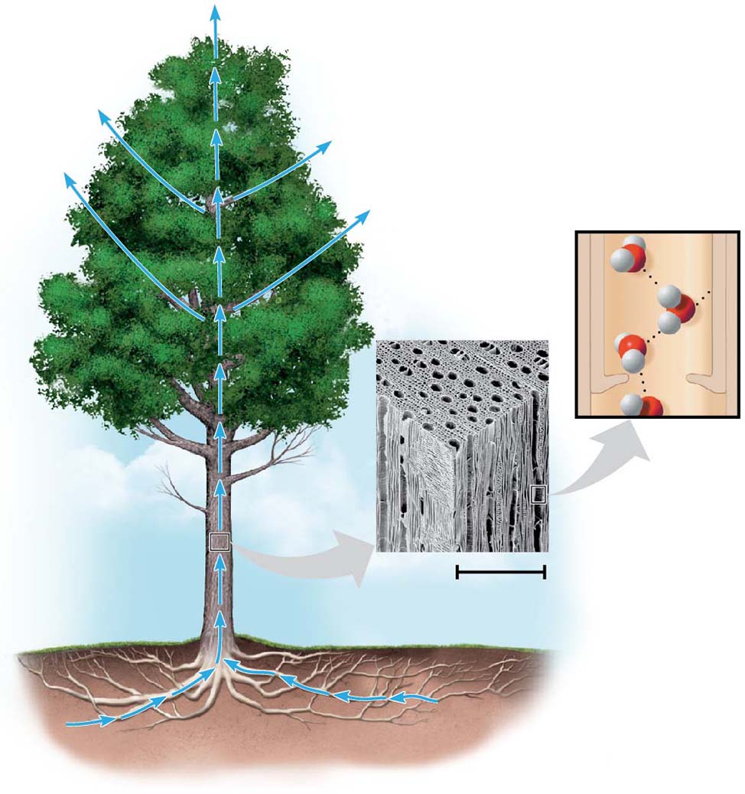
Figure 2.17
H₂O
Adhesion
Two types
of water-
conducting
cells
Cohesion
Direction
of water
movement
300 μm
H₂O
H₂O
© 2016 Pearson Education, Inc.
Notes:
Figure 2.17 Water transport in plants

Slide 8
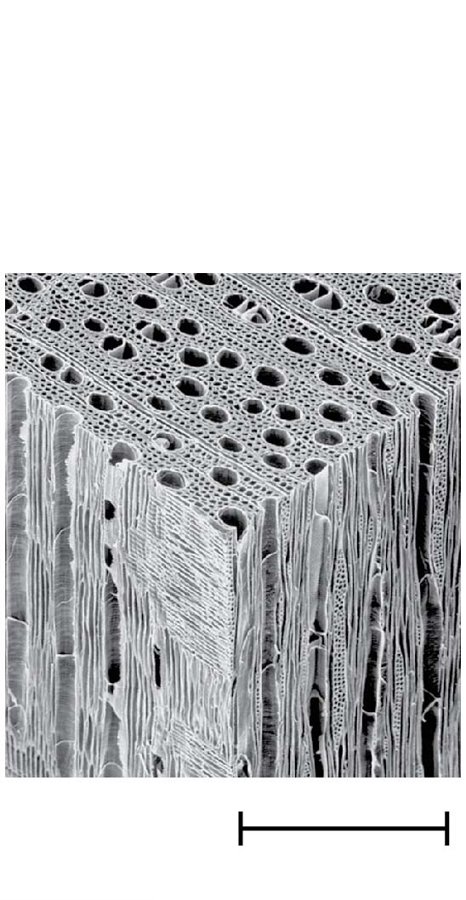
Figure 2.17-1
Two types
of water-
conducting
cells
300 μm
© 2016 Pearson Education, Inc.
Notes:
Figure 2.17-1 Water transport in plants (micrograph)

Slide 9
Surface tension is a measure of how hard it is to break the surface of a liquid
Surface tension is related to cohesion

Slide 10
Animation: Water Transport

Slide 11
BioFlix: Water Transport In Plants

Slide 12
Figure 2.18
© 2016 Pearson Education, Inc.
Notes:
Figure 2.18 Walking on water

Slide 13
Moderation of Temperature by Water
Water absorbs heat from warmer air and releases stored heat to cooler air
Water can absorb or release a large amount of heat with only a slight change in its own temperature

Slide 14
Temperature and Heat
Kinetic energy is the energy of motion
Thermal energy is a measure of the total amount of kinetic energy due to molecular motion
Temperature represents the average kinetic energy of molecules
Thermal energy in transfer from one body of matter to another is defined as heat

Slide 15
A calorie (cal) is the amount of heat required to raise the temperature of 1 g of water by 1°C
The “calories” on food packages are actually kilocalories (kcal), where 1 kcal = 1,000 cal
The joule (J) is another unit of energy, where 1 J = 0.239 cal, or 1 cal = 4.184 J

Slide 16
Water’s High Specific Heat
The specific heat of a substance is the amount of heat that must be absorbed or lost for 1 g of that substance to change its temperature by 1°C
The specific heat of water is 1 cal/(g ⋅ °C)
Water resists changing its temperature because of its high specific heat

Slide 17
Water’s high specific heat can be traced to hydrogen bonding
Heat is absorbed when hydrogen bonds break
Heat is released when hydrogen bonds form
The high specific heat of water keeps temperature fluctuations within limits that permit life

Slide 18
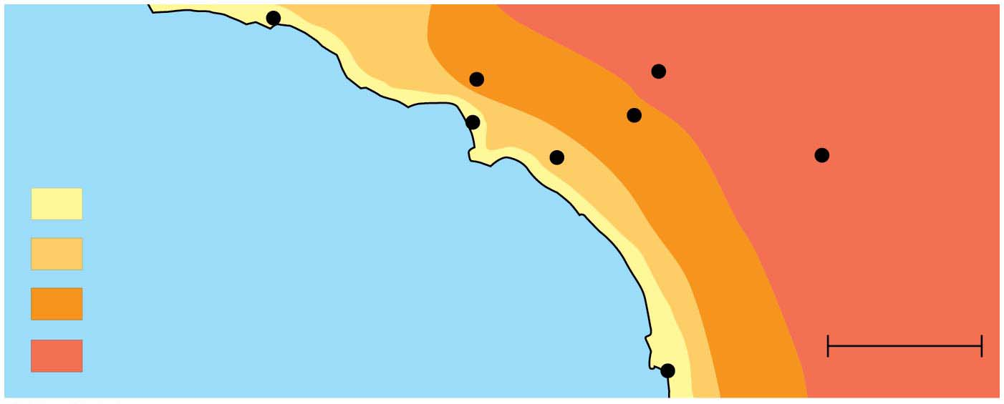
Figure 2.19
Burbank
90°
San Bernardino
100°
Santa Barbara 73°
Los Angeles
(Airport) 75°
Riverside 96°
Santa Ana
84°
Palm Springs
106°
70s (°F)
80s
Pacific Ocean 68°
90s
100s
San Diego 72°
40 miles
© 2016 Pearson Education, Inc.
Notes:
Figure 2.19 Temperatures for the Pacific Ocean and Southern California on an August day

Slide 19
Evaporative Cooling
Evaporation (vaporization) is transformation of a substance from liquid to gas
Heat of vaporization is the heat a liquid must absorb for 1 g to be converted to gas
As a liquid evaporates, its remaining surface cools, a process called evaporative cooling
Evaporative cooling of water helps stabilize temperatures in bodies or water and organisms

Slide 20
Floating of Ice on Liquid Water
Ice floats in liquid water because hydrogen bonds in ice are more “ordered,” making ice less dense
Water reaches its greatest density at 4°C
If ice sank, all bodies of water would eventually freeze solid, making life impossible on Earth

Slide 21
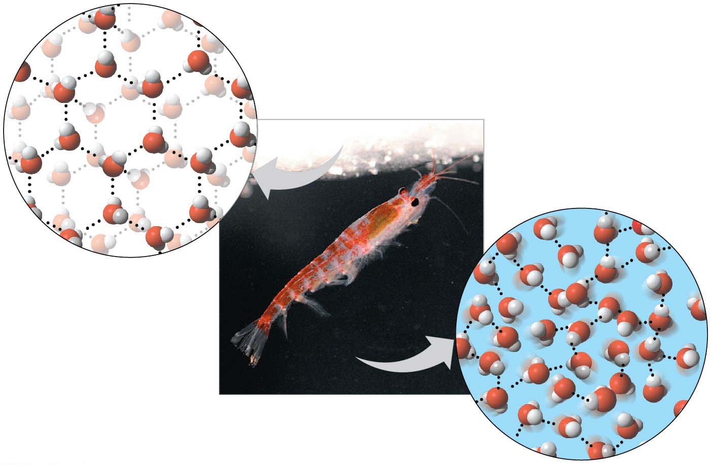
Figure 2.20
Hydrogen bond
Liquid water:
Hydrogen bonds
break and re-form
Ice:
Hydrogen bonds
are stable
© 2016 Pearson Education, Inc.
Notes:
Figure 2.20 Ice: crystalline structure and floating barrier

Slide 22
Water: The Solvent of Life
A solution is a liquid that is a homogeneous mixture of substances
A solvent is the dissolving agent of a solution
The solute is the substance that is dissolved
An aqueous solution is one in which water is the solvent

Slide 23
Water is a versatile solvent due to its polarity, which allows it to form hydrogen bonds easily
When an ionic compound is dissolved in water, each ion is surrounded by a sphere of water molecules called a hydration shell

Slide 24
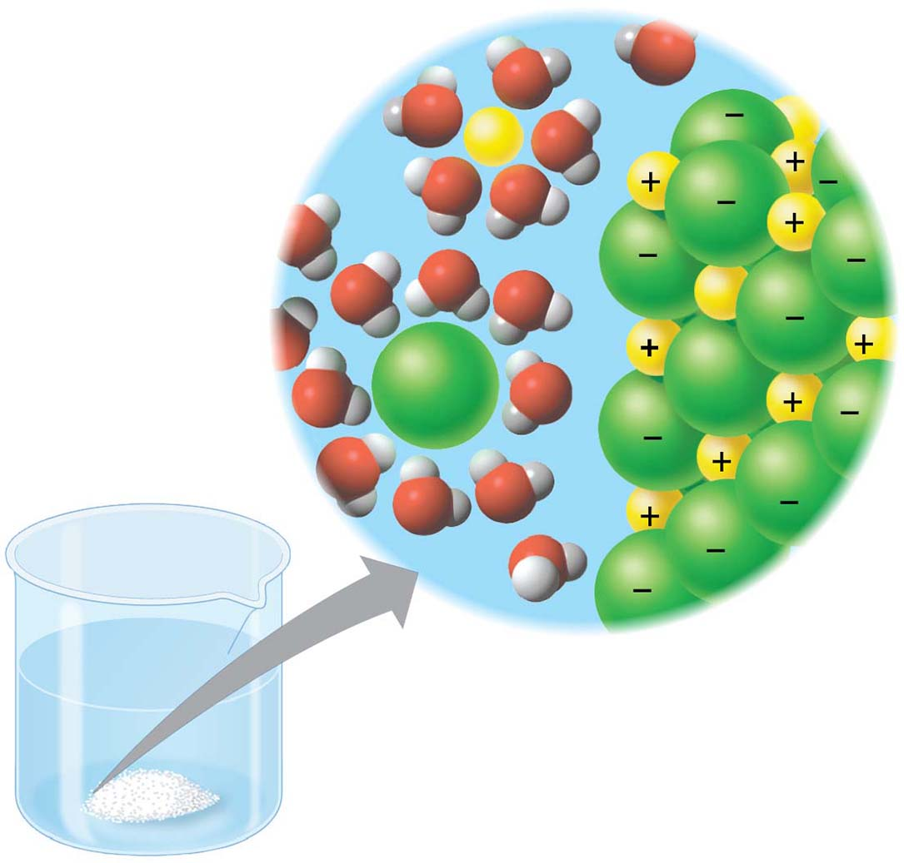
Figure 2.21
Na⁺
Na⁺
Cl⁻
Cl⁻
© 2016 Pearson Education, Inc.
Notes:
Figure 2.21 Table salt dissolving in water

Slide 25
Water can also dissolve compounds made of nonionic polar molecules
Even large polar molecules such as proteins can dissolve in water if they have ionic and polar regions

Slide 26
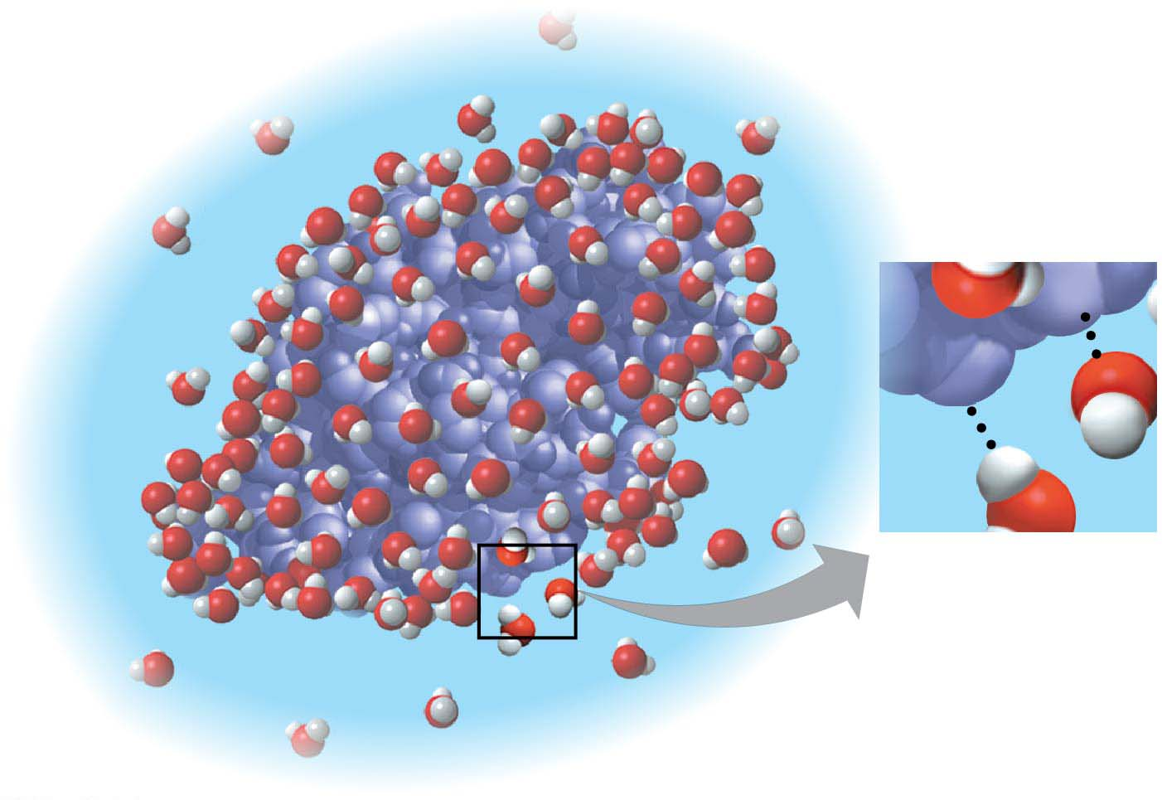
Figure 2.22
δ+
δ−
δ−
δ+
© 2016 Pearson Education, Inc.
Notes:
Figure 2.22 A water-soluble protein

Slide 27
Hydrophilic and Hydrophobic Substances
A hydrophilic substance is one that has an affinity for water
A hydrophobic substance is one that does not have an affinity for water
Oil molecules are hydrophobic because they have relatively nonpolar covalent bonds

Slide 28
Solute Concentration in Aqueous Solutions
Most chemical reactions in organisms involve solutes dissolved in water
Chemical reactions depend on the concentration of solutes, or the number of molecules in a volume of an aqueous solution

Slide 29
Molecular mass is the sum of all masses of all atoms in a molecule
Numbers of molecules are usually measured in moles, where 1 mole (mol) = 6.02 × 10²³ molecules
Avogadro’s number and the unit dalton were defined such that 6.02 × 10²³ daltons = 1 g
Molarity (M) is the number of moles of solute per liter of solution

