Slide 1
Standard Deviation

Slide 2
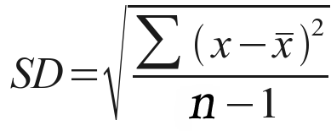
Introduction to Statistics:
Statistical analysis is used to collect a sample size of data which can infer what is occurring in the general population. Standard deviation (often reported as +/-) shows how much variation there is from the average (mean).

Slide 3
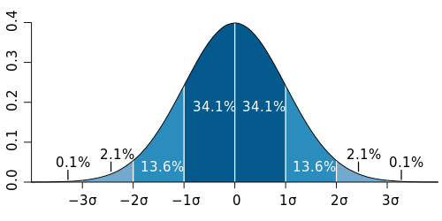
If data points are close together, the standard deviation with be small. If data points are spread out, the standard deviation will be larger.
Typical data will show a normal distribution (bell-shaped curve). In normal distribution, about 68% of values are within one standard deviation of the mean, 95% of values are within two standard deviations of the mean, and 99% of the values are within three standard deviations of the mean x̄.

Slide 4
Practice problem:
The length in millimeters of 6 worms were:
96, 88, 86, 84, 80, 70
Using a graphing calculator: click on “STAT” button, hit enter
Enter into L1 the data points (in this case = worm data = 6)
Click on “STAT” button, hit enter – arrow to right to “CALC”, hit enter

Slide 5
Calculator time….
Mean = 84
Standard Deviation = 8.7
(or 9 if asking for whole #)
Range = 26 (largest # - smallest number)
n = 6 n-1 = 5

Slide 6
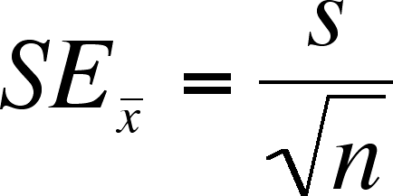
Standard error of the mean:
Standard error of the mean is used to represent uncertainty in an estimation of mean and accounts for both sample size and variability.

Slide 7
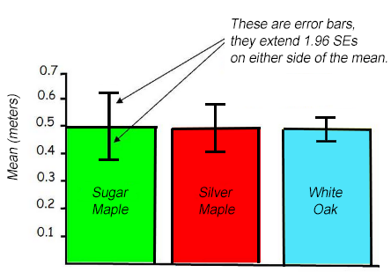
When the range of bars overlaps, this indicates that there is NOT a significant difference in averages and data sets. If the range of bars does not overlap, there may be a significant difference in averages and data sets.
The length of the bars shows the spread around the mean. Shorter bars indicate less variability from the mean.

Slide 8
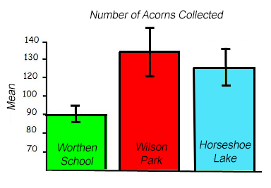
the error bars tell us that we can be 95% confident (2 SEM) that the number of acorns collected at Worthen School is significantly different from the Wilson Park and Horseshoe Lake sites. Things are not as clear-cut between Wilson Park and Horseshoe Lake because the error bars overlap.

Slide 9
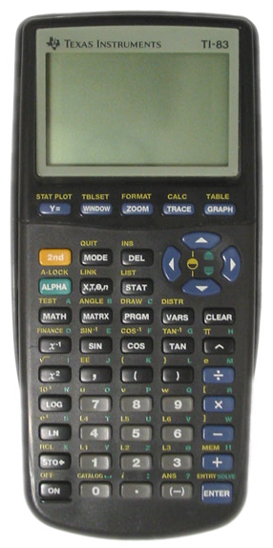
Now let’s practice!
This Photo by Unknown Author is licensed under CC BY-SA

