Slide 1
Investigative Learning
Video Link

Slide 2
Crickets
Kingdom:
Habitat:
Food:
Niche:
Fact:

Slide 3
Crickets
Kingdom: Animalia
Habitat:
Most commonly found in grassy areas. They live on almost every part of the Earth.
Food:
Omnivorous (plants & animals) Leaves, fungi, fruits, & insects or bugs
Niche: crickets are a primary consumer, eats the primary producer. Their scientific name is Gryllus Pennsylvanicus
Fact: Female crickets are larger than the males, and they both have a pair of useless wings.

Slide 4
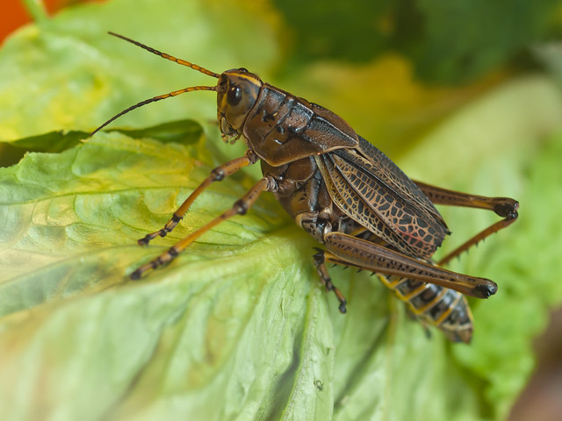
Lab Day:
Your lab group will be given 10 crickets to observe using “choice chambers”
You will choose food or habitat resources to use in the FOUR chambers based on your research about crickets
You will create a Google Doc to type your lab report.
Lab report should include materials, procedures, experiment, data (qualitative and quantitative), graphs, pictures, etc. and a conclusion.
Upload lab report (with TITLE) in Canvas

