Slide 1
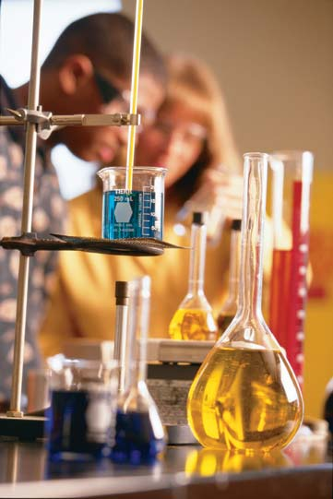
Chapter 1.1
The Process of Science
Essential Questions
1. How does scientific inquiry answer questions about the living world?
2. How do scientific processes lead to a greater understanding of the natural world?
3. How can data be analyzed to determine the outcome of an experiment or set of observations?
4. How do scientists share information and build upon the work of others?
Notes:
Skeleton Notes available: https://docs.google.com/document/d/1EYwOZl-hEfauIM761bqkuCPRKba9t5bsOtXrGBCv2oM/edit?usp=sharing

Slide 2
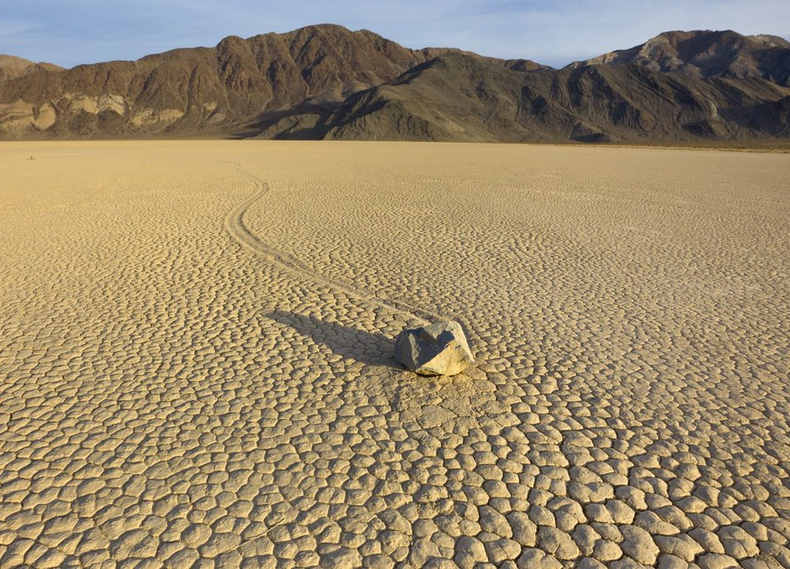
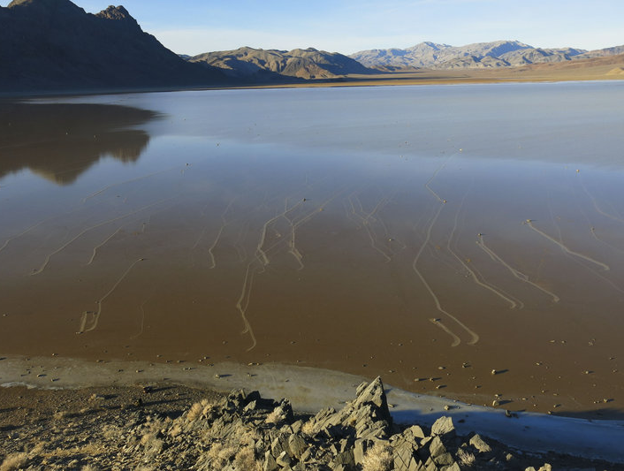
The Case of the Slithering Rocks
These rocks appear to move on their own, leaving “rock trails” behind them. What do you think causes the rocks to move?
Notes:
https://www.npr.org/2014/08/28/343681708/an-icy-solution-to-the-mystery-of-the-slithering-stones

Slide 3
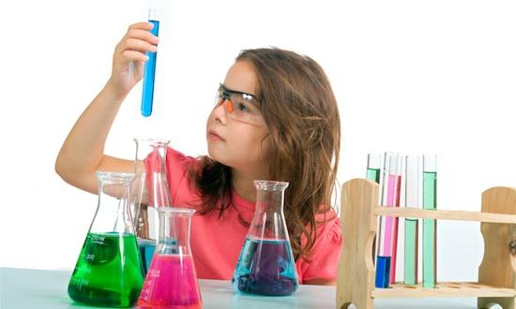
Chapter 1.1 The Science of Biology
Biology is the study of living organisms
What is Science?
Knowledge that covers general truths or the operation of general laws, acquired and tested by scientific method

Slide 4
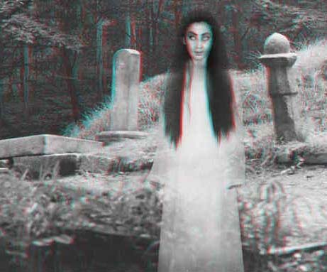
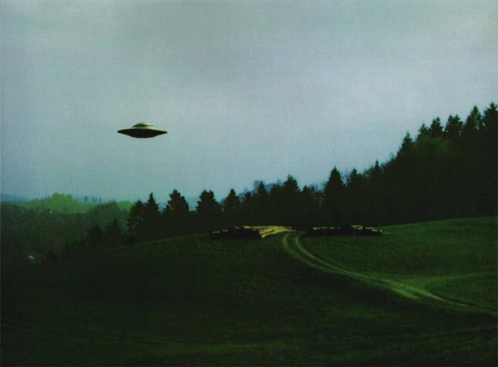
All science assumes that observations have a natural cause, a principle known as
NATURAL CAUSALITY
by its nature it excludes supernatural phenomenon
What are some things that are considered "supernatural" and therefore cannot be studied scientifically?

Slide 5
A hypothesis is a possible explanation for a natural event or a series of observations.
- to be valid, a hypothesis must be testable.
- observations can either confirm or refute hypothesis
*avoid saying you’ve “proved” it
Observations are the main elements of scientific knowledge gathering.
Avoid using the word “fact.” Instead, use the word “observation”
“Facts” depend on the perception of the observer. Is the sky really blue?

Slide 6
Observations → Hypothesis
Observe an object given to you by the teacher for a few minutes and practice writing down specific observations of what you see.
Quantitative - Quantity (numbers)
Qualitative - Quality (words)
Discuss with your lab partner a hypothesis that can be tested with your specimen.

Slide 7
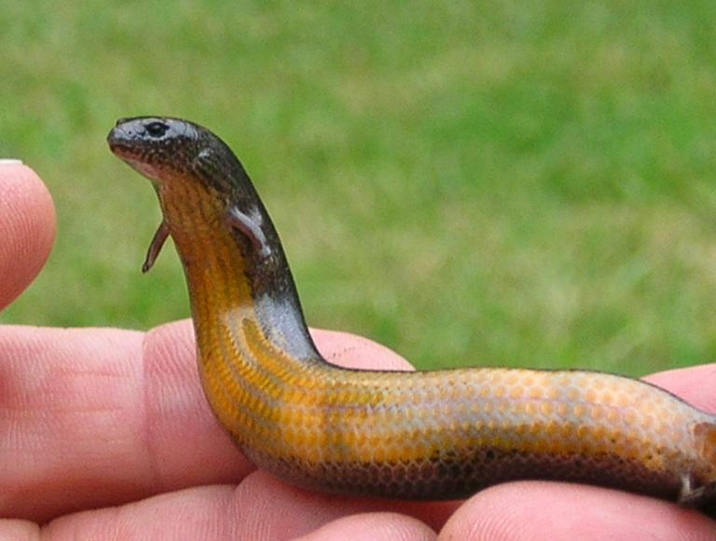
Scientific Reasoning
Inductive reasoning allows a person to combine isolated facts into a cohesive whole, reasoning makes broad generalizations from specific observations.
Observation 1: Snakes have tiny pelvic bones Observation 2: Snakes and lizards have similar DNA sequences Observation 3: Snakes appear after lizards in the fossil record.
Generalization: Snakes are related to lizards / Snakes evolved from lizards
A yellow-bellied three-toed skink carrying embryos, visible as light orbs inside its body.

Slide 8
Deductive reasoning involves “if, then” logic that predicts what will happen based on the hypothesis or theory.
Involves general RULES to make predictions.
Start with a general idea or principle → use that to make predictions.
1. All living things require energy
2. Bacteria are living things
3. Bacteria require energy
Prediction: Bacteria deprived of an energy source will die.

Slide 9
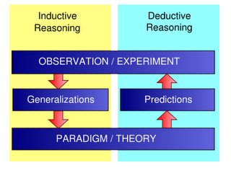
Comparing Inductive and Deductive Reasoning

Slide 10
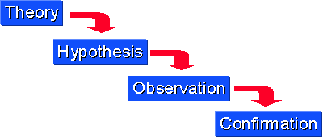
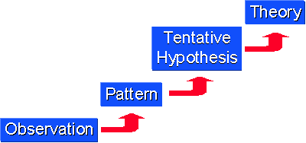
These graphics shows what kind of reasoning?

Slide 11
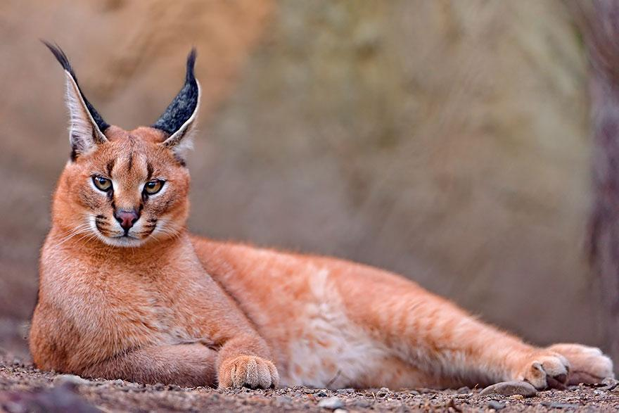
Practice: Indicate Inductive or Deductive Reasoning
A detective gathers clues from a crime scene and writes a report on how the victim died based on those clues.
A fossil is discovered that has a bone that is only found in birds, the paleontologist classifies the specimen as a bird.
3. A new type of animal is discovered and is classified as a cat based on its DNA sequence. Based on this classification, a biologist makes a prediction about how the animal will groom itself.
Caracal

Slide 12
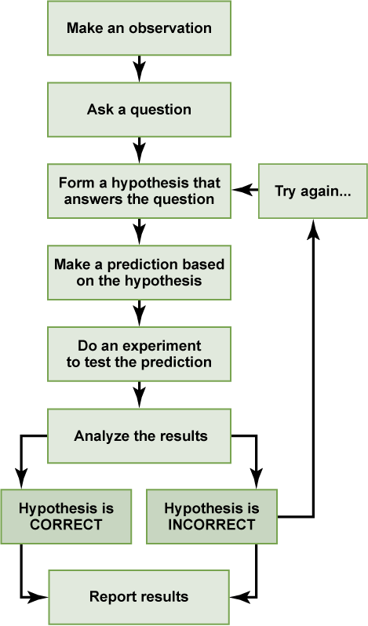
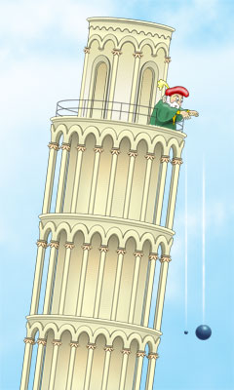
The Scientific Method

Slide 13
The control group is the group that is not changed and is used as a comparison.
Controlled Study
Independent Variable (What you did)
---- Manipulated Variable
---- Graph on X Axis
(this is time on many graphs)
Dependent Variable (What you measure)
----- Responding
----- Graph on Y axis
DRY MIX

Slide 14
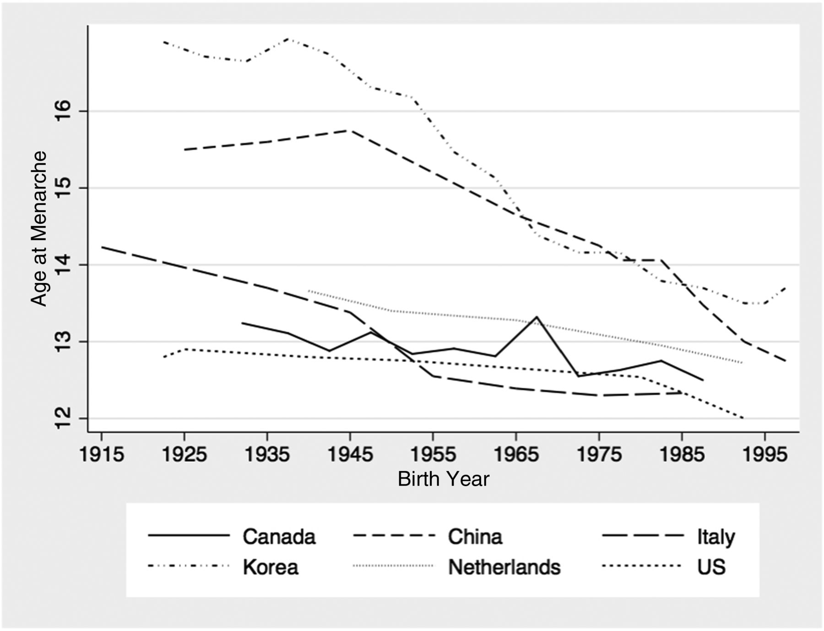
You don’t always need to perform an experiment to analyze trends and data…
1. Identify the independent and dependent variables.
2. What is the (likely) experimental question being answered by this data set?
3. What new questions can be developed from this information?
Notes:
Graph source: http://pediatrics.aappublications.org/content/early/2017/07/14/peds.2017-0085

Slide 15
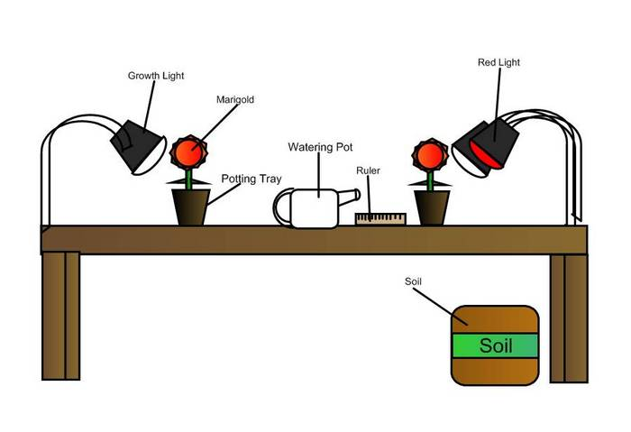
Examples of independent and dependent variables
Question: Does colored light affect plant growth?
What is the experimental variable?
What is the dependent variable?
What variables must be kept constant - or controlled?
How would you graph this?

Slide 16
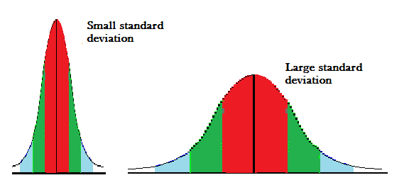
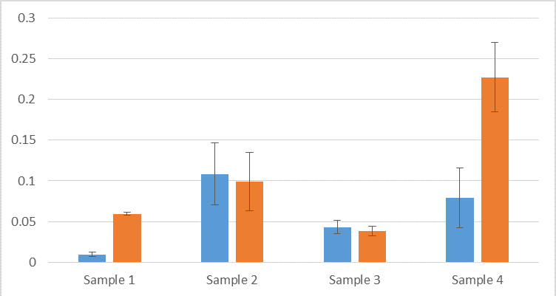
Data Gathering
Organizing Data: Charts, Tables, Graphs
Sample Size
Mean versus Median
Standard Deviation
Standard Error / Error Bars
Notes:
Statistics Assignment (HHMI): https://docs.google.com/document/d/1Y_gqifJcLQT7p0ggb5utJ9sb0ibWtqD35mU-1pXLbZ4/edit?usp=sharing

Slide 17
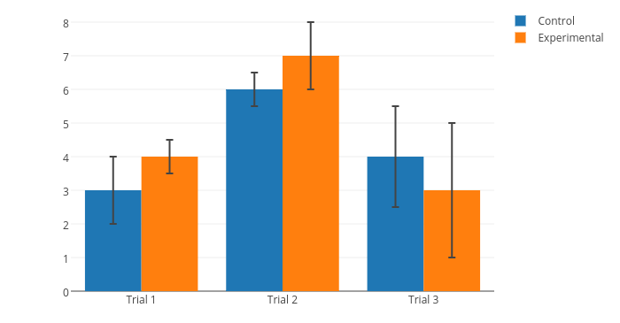
I² Strategy
What I SEE
What It MEANS
I² strategy Practice: Wolbachia and Mosquitoes
Notes:
Handout has graph and a CER, CER is discussed in the next slide.

Slide 18
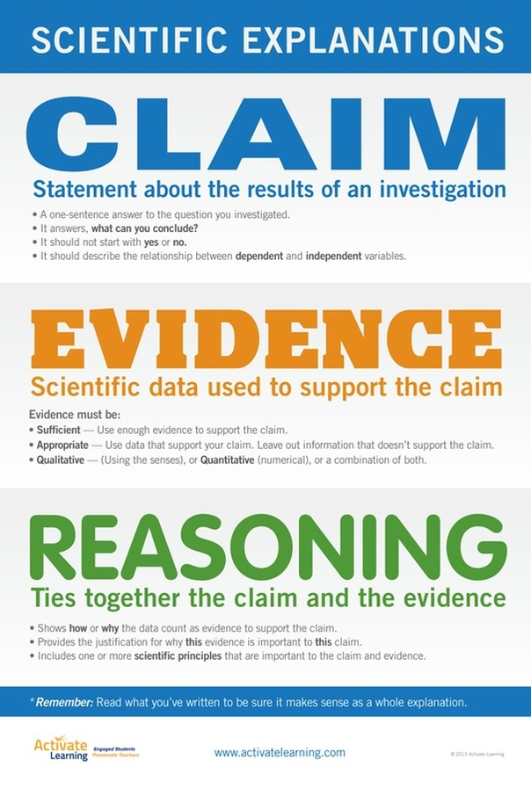
CER Charts
Claim - a sentence that answers a question or draws a conclusion from a data set. It may also describe the relationship between independent and dependent variable.
Evidence - sufficient and appropriate details that support the claim (qualitative or quantitative)
Reasoning - shows how or why the data count as evidence and may include scientific principles linked to the phenomenon.

Slide 19
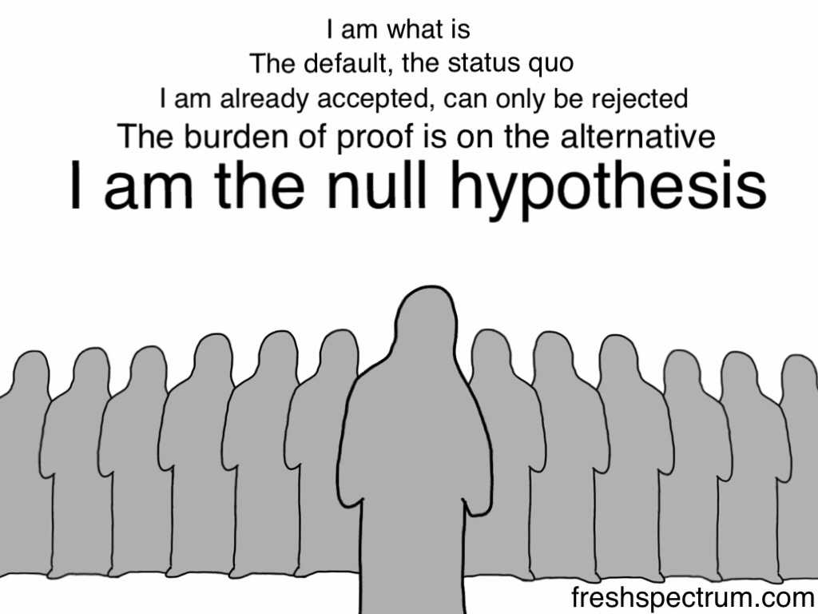
Null Hypothesis
the hypothesis that there is no significant difference between specified populations, or there is NO relationship between two measured variables.

Slide 20
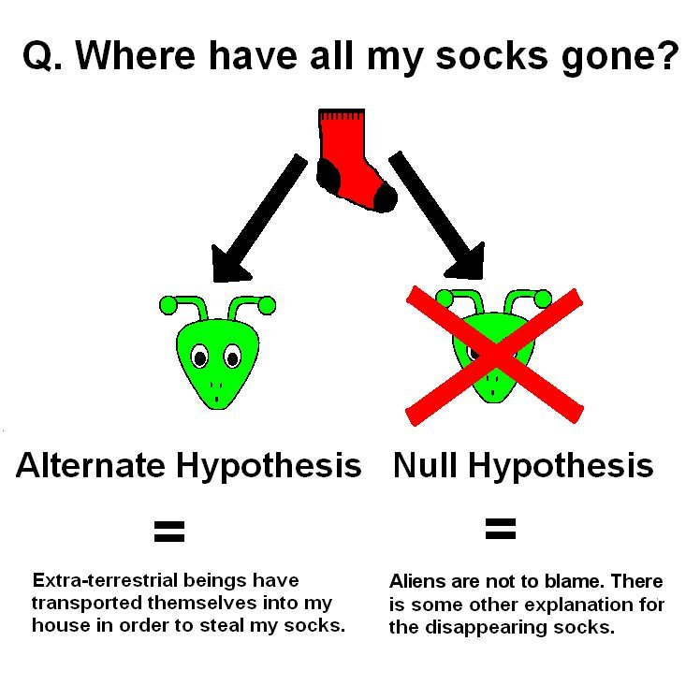
FALSIFIABILITY
It is important than any statement or hypothesis is falsifiable - if there is no evidence out there that would prove the statement wrong, then there is no point in running any tests.

Slide 21
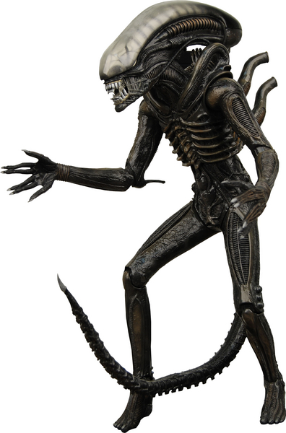
It is bad science to ask someone to PROVE A NEGATIVE.
For example:
Prove that ghosts don’t exist.
Prove that cell phones don’t cause cancer.
Prove that there are no aliens.
Prove that telepathy doesn’t exist.
The burden of proof lies on the claimant. If you make a claim, then you must be the one to provide evidence for that claim. (It is not on other people to show it to be false.)

Slide 22
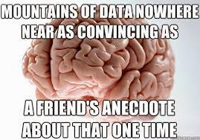
What is an anecdote?
Anecdotes are singular observations, stories people tell, or things someone might have heard.
It is NOT data.

Slide 23
What is confirmation bias?
What are ways scientists can reduce bias?
What is a double blind experiment?

Slide 24
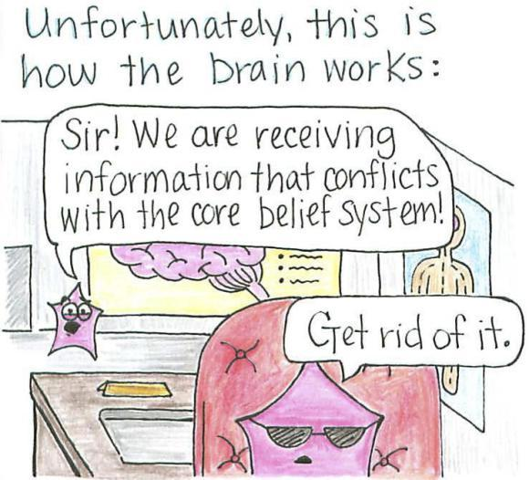
Cognitive dissonance = the state of having inconsistent thoughts, beliefs, or attitudes, especially as relating to behavioral decisions and attitude change.
How might cognitive dissonance make it difficult for scientists to change people’s opinions and behaviors?
See also: Logical Fallacies

Slide 25
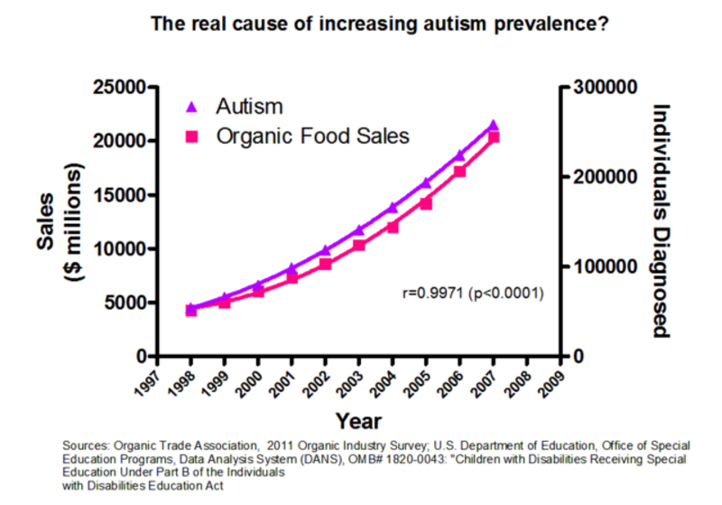
Correlation vs. Causation

Slide 26
The Importance of Publication
After scientists have conducted research, in order for the conclusions to be considered valid, they must publish their findings in a PEER-REVIEWED journal.
Check out PLOS for a source of open-source, peer reviewed science articles.
JAMA - Journal of the American Medical Association
Notes:
Practice CER with article from scientific American: https://drive.google.com/drive/u/0/folders/0Bx72aSXCBO09dmpBc0c0NlZINkU or do this activity on reading scientific journals: https://www.biologycorner.com/worksheets/reading-scientific-journals.html

Slide 27
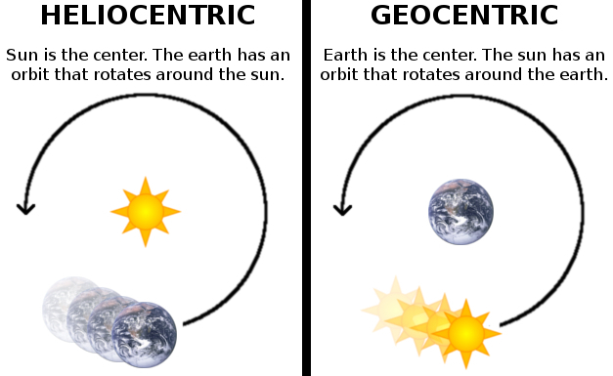
The University of California, Berkeley defines a theory as "a broad, natural explanation for a wide range of phenomena.
Theories are concise, coherent, systematic, predictive, and broadly applicable, often integrating and generalizing many hypotheses."
*A theory explains why something happens*

Slide 28
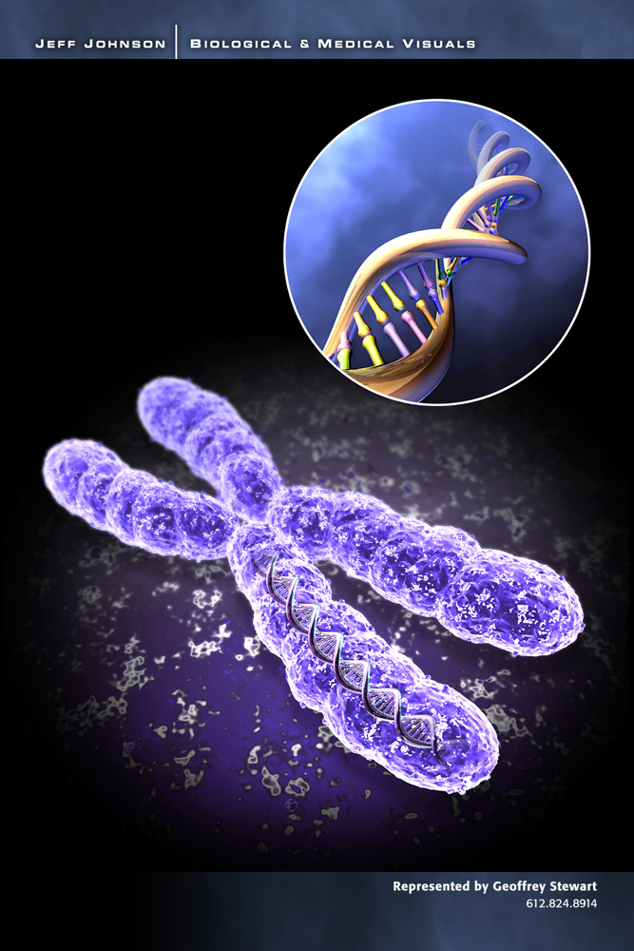
Principles, Laws, Models
The terms “principle” and “law” and “model” are also used for generally accepted theories. Basic theories of biology are:
a. Cell theory
b. Biogenesis theory
c. Evolution theory
d. Gene theory
e. Germ Theory
Other Theories
f. Heliocentric Theory g. Theory of Gravity

Slide 29
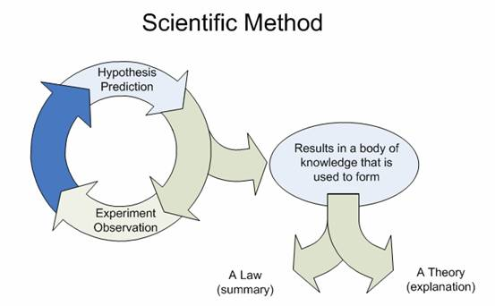
What is the difference between a theory and a law?
Theories do not become LAWS.
Theories explain sets of data. (WHY)
Laws provide general rules for what we expect to happen. (WHAT)

Slide 30
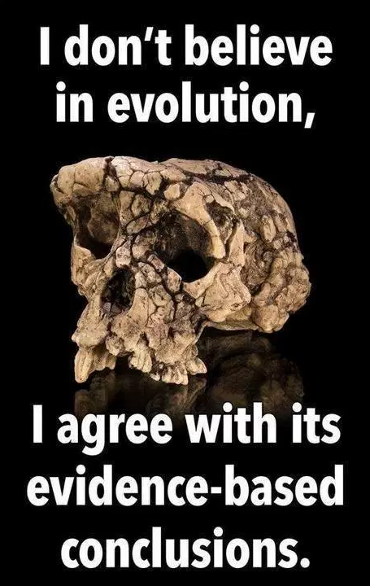
All Scientific Knowledge is Tentative!
When a law, theory, or hypothesis is shown to be wrong, it is modified or removed.
We don’t worry about “PROOF” in science, we look at EVIDENCE and whether the evidence supports or refutes a particular claim. We look at whether our laws and theories are valuable for making predictions.
Theories and Laws are never technically “proven.”

Slide 31
A friend at lunch says “I have a theory about why we have so much more cancer now than we ever did in the past. There’s a lot more pollution now making people sick.” Then she pulls out her phone to show how Doctor Oz was selling a skin lotion that would filter out all the toxic pollution and prevent cancer.
While you attempted to not choke on your chicken nugget, formulate a response to your friend that addresses each of the following.
1. Why is she wrong to use the word “theory?”
2. Which error in reasoning or logical fallacy has she committed? (There may be more than one.) Defend your choice (tell me why).
3. What is the null hypothesis? What data would you need to collect to reject (or support) the claim being made by Dr. Oz?

