Slide 1
Concept 5.6: The plasma membrane plays a key role in most cell signaling
In multicellular organisms, cell-to-cell communication allows the cells of the body to coordinate their activities
Communication between cells is also essential for many unicellular organisms
Notes:
1

Slide 2
Local and Long-Distance Signaling
Eukaryotic cells may communicate by direct contact
Animal and plant cells have junctions that directly connect the cytoplasm of adjacent cells
These are called gap junctions (animal cells) and plasmodesmata (plant cells)
The free passage of substances in the cytosol from one cell to another is a type of local signaling
Notes:
2

Slide 3
In many other cases of local signaling, messenger molecules are secreted by a signaling cell
These messenger molecules, called local regulators, travel only short distances
One class of these, growth factors, stimulates nearby cells to grow and divide
This type of local signaling in animal cells is called paracrine signaling
Notes:
3

Slide 4
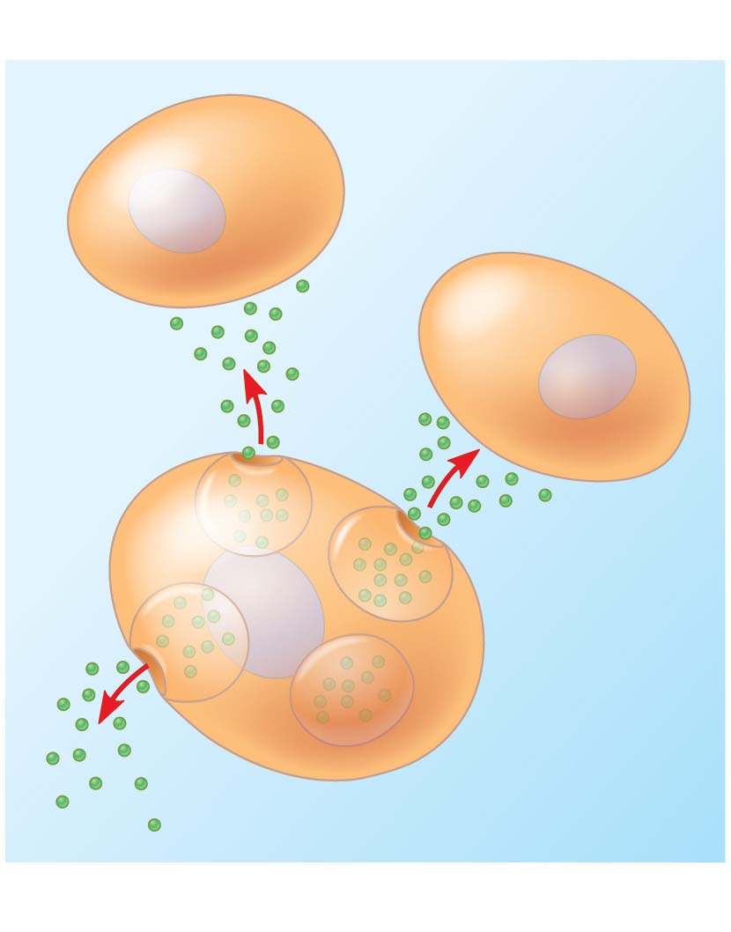
Figure 5.19-1
Local signaling
Target cells
Secreting
cell
Secretory
vesicles
Local regulator
(a) Paracrine signaling
Notes:
Figure 5.19-1 Local and long-distance cell signaling by secreted molecules in animals (part 1: local signaling, paracrine)

Slide 5
Another more specialized type of local signaling occurs in the animal nervous system
This synaptic signaling consists of an electrical signal moving along a nerve cell that triggers secretion of neurotransmitter molecules
These diffuse across the space between the nerve cell and its target, triggering a response in the target cell
Notes:
5

Slide 6
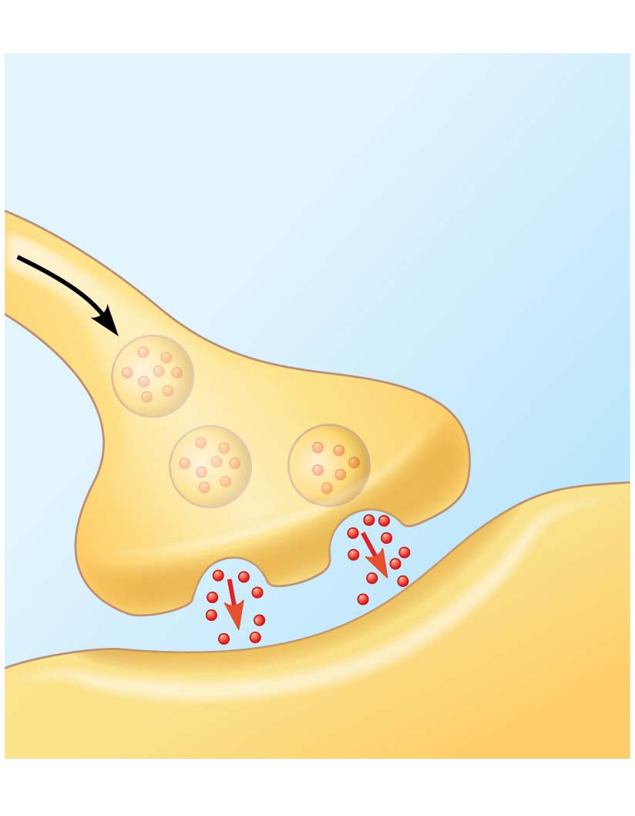
Figure 5.19-2
Local signaling
Electrical signal triggers
release of neurotransmitter.
Neurotransmitter
diffuses across
synapse.
Target cell
(b) Synaptic signaling
Notes:
Figure 5.19-2 Local and long-distance cell signaling by secreted molecules in animals (part 2: local signaling, synaptic)

Slide 7
In long-distance signaling, plants and animals use chemicals called hormones
In hormonal signaling in animals (called endocrine signaling), specialized cells release hormone molecules that travel via the circulatory system
Hormones vary widely in size and shape
Notes:
7

Slide 8
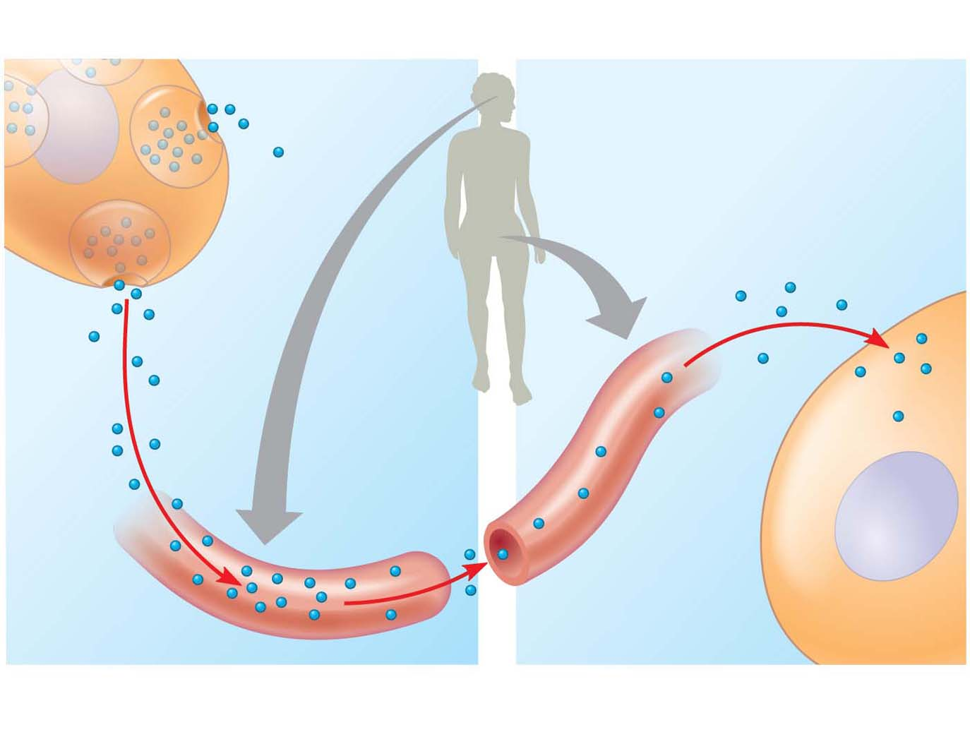
Figure 5.19-3
Long-distance signaling
Endocrine cell
Target cell
specifically
binds
hormone.
Hormone
travels in
bloodstream.
Blood
vessel
(c) Endocrine (hormonal) signaling
Notes:
Figure 5.19-3 Local and long-distance cell signaling by secreted molecules in animals (part 3: long distance signaling, endocrine)

Slide 9
The Three Stages of Cell Signaling: A Preview
Earl W. Sutherland discovered how the hormone epinephrine acts on cells
Sutherland suggested that cells receiving signals undergo three processes
Reception
Transduction
Response
Notes:
9

Slide 10
Animation: Signaling Overview

Slide 11
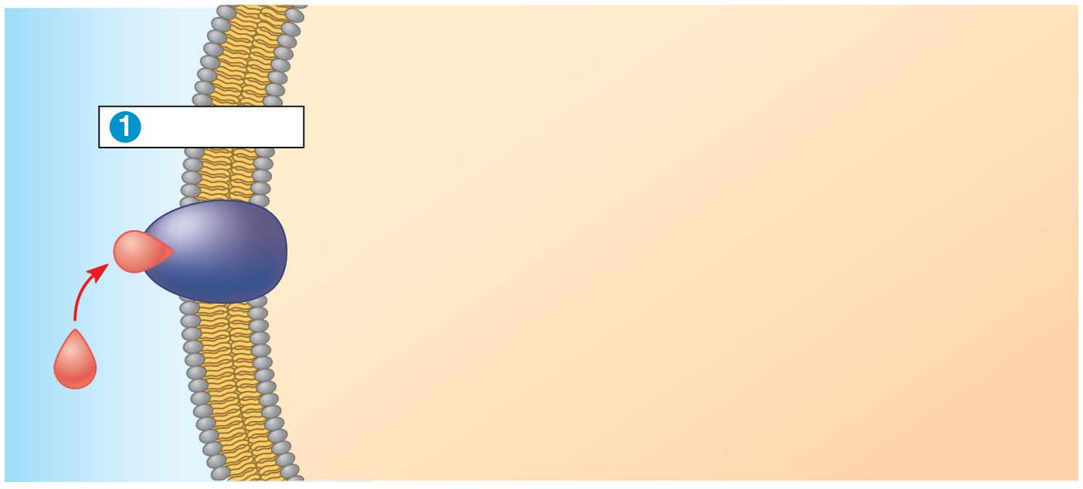
Figure 5.20-s1
EXTRA-
CELLULAR
FLUID
CYTOPLASM
Plasma membrane
Reception
Receptor
Signaling
molecule
Notes:
Figure 5.20-s1 Overview of cell signaling (step 1)

Slide 12
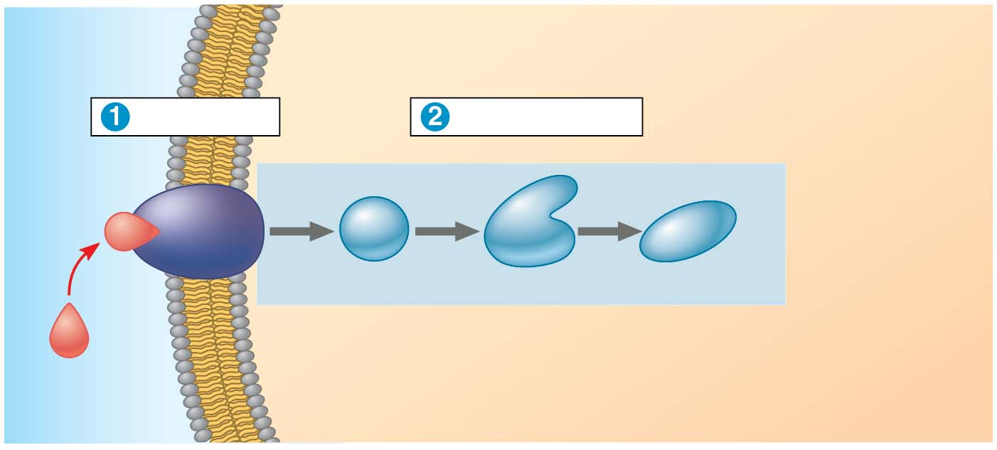
Figure 5.20-s2
EXTRA-
CELLULAR
FLUID
CYTOPLASM
Plasma membrane
Reception
Transduction
Receptor
1
2
3
Relay molecules
Signaling
molecule
Notes:
Figure 5.20-s2 Overview of cell signaling (step 2)

Slide 13
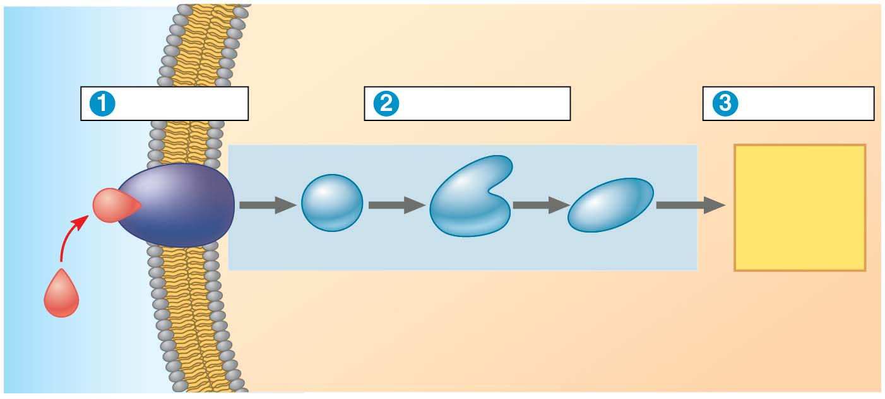
Figure 5.20-s3
EXTRA-
CELLULAR
FLUID
CYTOPLASM
Plasma membrane
Reception
Transduction
Response
Receptor
1
2
3
Activation
Relay molecules
Signaling
molecule
Notes:
Figure 5.20-s3 Overview of cell signaling (step 3)

Slide 14
Reception, the Binding of a Signaling Molecule to a Receptor Protein
The binding between a signal molecule (ligand) and receptor is highly specific
Ligand binding generally causes a shape change in the receptor
Many receptors are directly activated by this shape change
Most signal receptors are plasma membrane proteins
Notes:
14

Slide 15
Receptors in the Plasma Membrane
Most water-soluble signal molecules bind to specific sites on receptor proteins that span the plasma membrane
There are two main types of membrane receptors
G protein-coupled receptors
Ligand-gated ion channels
Notes:
15

Slide 16
G protein-coupled receptors (GPCRs) are plasma membrane receptors that work with the help of a G protein
G proteins bind to the energy-rich molecule GTP
Many G proteins are very similar in structure
GPCR pathways are extremely diverse in function
Notes:
16

Slide 17
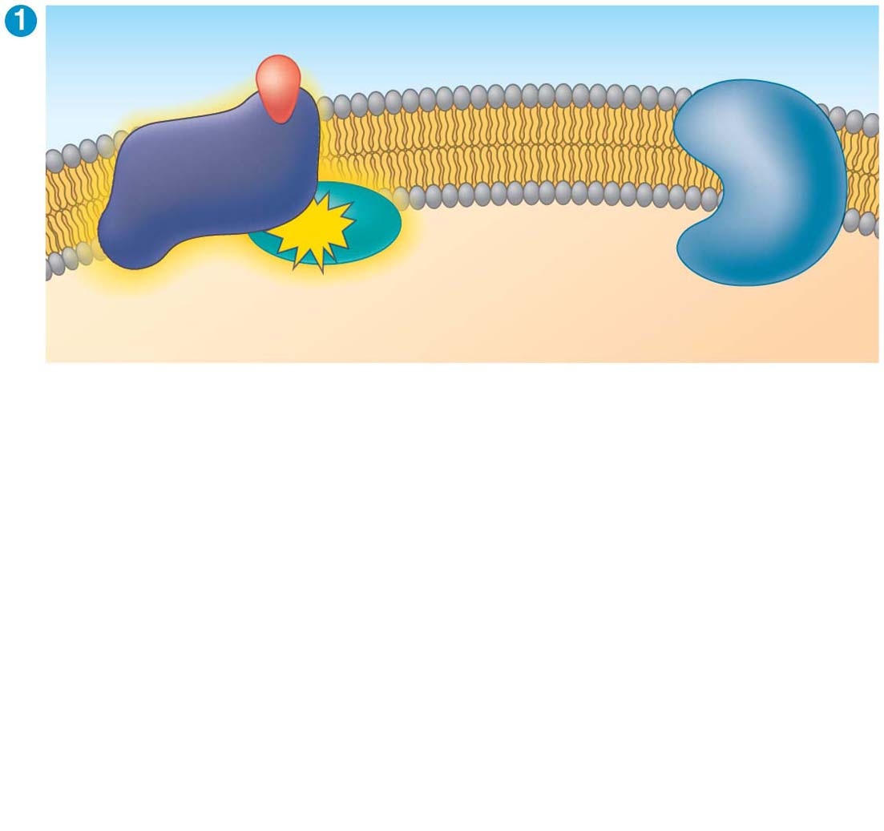
Figure 5.21-s1
Signaling
molecule
Inactive
enzyme
Activated
GPCR
GTP
Plasma
membrane
Activated
G protein
CYTOPLASM
Notes:
Figure 5.21-s1 A G protein-coupled receptor (GPCR) in action (step 1)

Slide 18
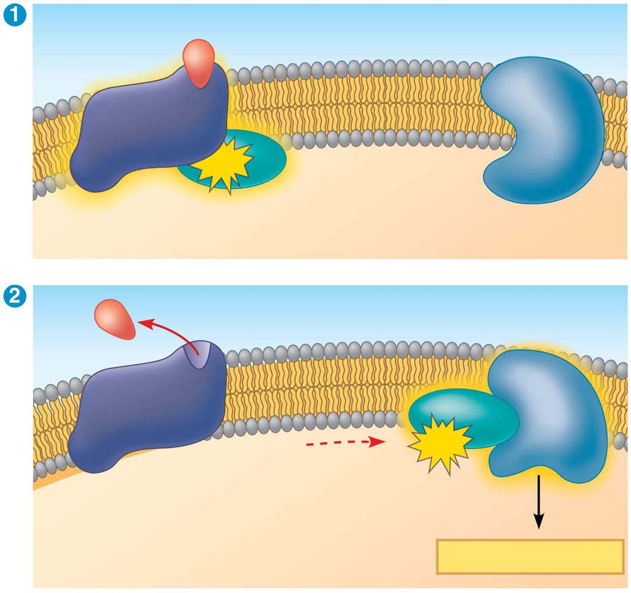
Figure 5.21-s2
Signaling
molecule
Inactive
enzyme
Activated
GPCR
GTP
Plasma
membrane
Activated
G protein
CYTOPLASM
Activated
enzyme
GTP
Cellular response
Notes:
Figure 5.21-s2 A G protein-coupled receptor (GPCR) in action (step 2)

Slide 19
A ligand-gated ion channel receptor acts as a “gate” for ions when the receptor changes shape
When a signal molecule binds as a ligand to the receptor, the gate allows specific ions, such as Na⁺ or Ca²⁺, through a channel in the receptor
Ligand-gated ion channels are very important in the nervous system
The diffusion of ions through open channels may trigger an electric signal
Notes:
19

Slide 20
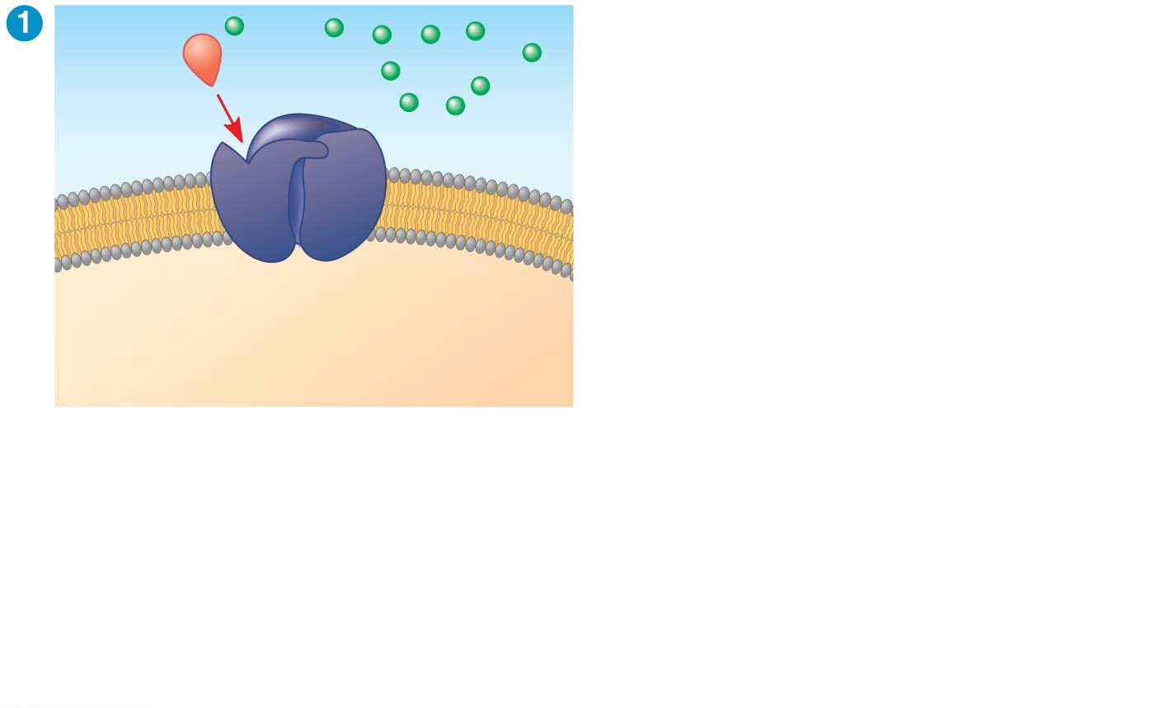
Figure 5.22-s1
Gate
closed
Ions
Signaling
molecule
(ligand)
Ligand-gated
ion channel receptor
Plasma
membrane
Notes:
Figure 5.22-s1 Ion channel receptor (step 1)

Slide 21
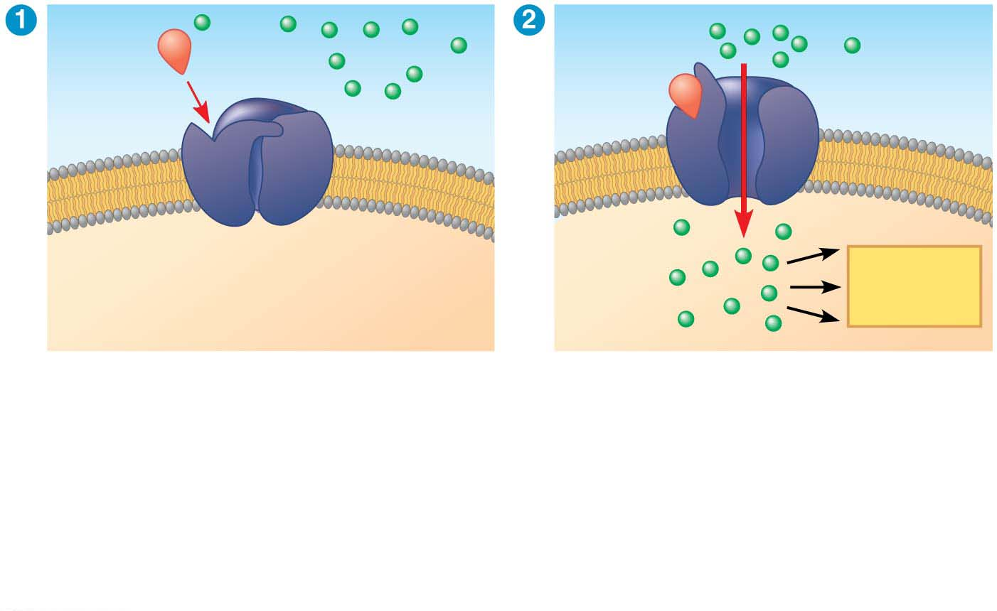
Figure 5.22-s2
Gate
closed
Gate open
Ions
Signaling
molecule
(ligand)
Cellular
response
Ligand-gated
ion channel receptor
Plasma
membrane
Notes:
Figure 5.22-s2 Ion channel receptor (step 2)

Slide 22
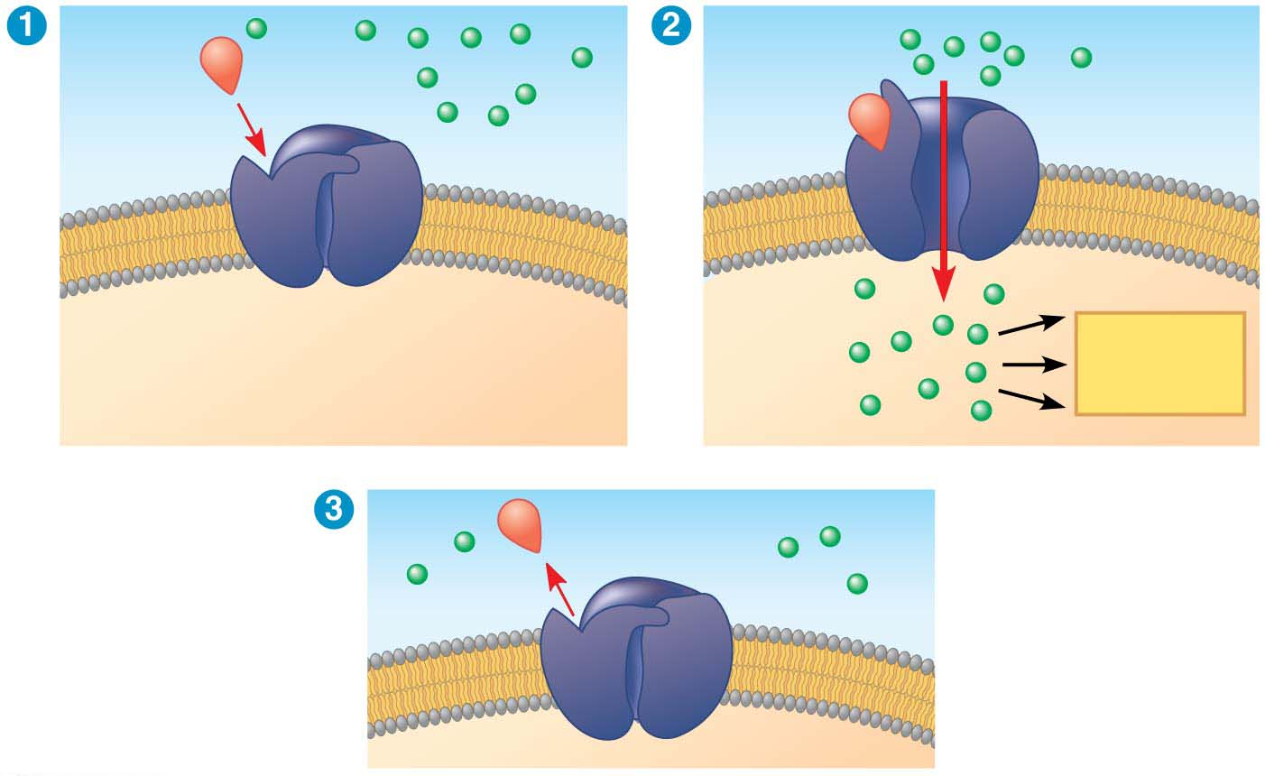
Figure 5.22-s3
Gate
closed
Gate open
Ions
Signaling
molecule
(ligand)
Cellular
response
Ligand-gated
ion channel receptor
Plasma
membrane
Gate closed
Notes:
Figure 5.22-s3 Ion channel receptor (step 3)

Slide 23
Intracellular Receptors
Intracellular receptor proteins are found in the cytosol or nucleus of target cells
Small or hydrophobic chemical messengers can readily cross the membrane and activate receptors
Examples of hydrophobic messengers are the steroid and thyroid hormones of animals and nitric oxide (NO) in both plants and animals
Notes:
23

Slide 24
Aldosterone behaves similarly to other steroid hormones
It is secreted by cells of the adrenal gland and enters cells all over the body, but only kidney cells contain receptor cells for aldosterone
The hormone binds the receptor protein and activates it
The active form of the receptor enters the nucleus, acts as a transcription factor, and activates genes that control water and sodium flow
Notes:
24

Slide 25
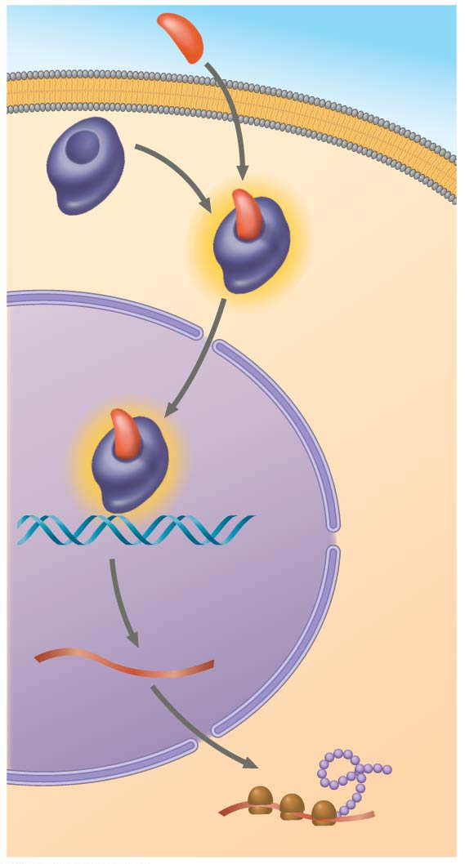
Figure 5.23
Hormone
(aldosterone)
EXTRA-
CELLULAR
FLUID
Plasma
membrane
Receptor
protein
Hormone-
receptor
complex
DNA
mRNA
New
protein
NUCLEUS
CYTOPLASM
Notes:
Figure 5.23 Steroid hormone interacting with an intracellular receptor

Slide 26
Transduction by Cascades of Molecular Interactions
Signal transduction usually involves multiple steps
Multistep pathways can amplify a signal: A few molecules can produce a large cellular response
Multistep pathways provide more opportunities for coordination and regulation of the cellular response than simpler systems do
Notes:
26

Slide 27
The molecules that relay a signal from receptor to response are often proteins
Like falling dominoes, the activated receptor activates another protein, which activates another, and so on, until the protein producing the response is activated
At each step, the signal is transduced into a different form, commonly a shape change in a protein
Notes:
27

Slide 28
Protein Phosphorylation and Dephosphorylation
Phosphorylation and dephosphorylation are a widespread cellular mechanism for regulating protein activity
Protein kinases transfer phosphates from ATP to protein, a process called phosphorylation
A signaling pathway involving phosphorylation and dephosphorylation can be referred to as a phosphorylation cascade
The addition of phosphate groups often changes the form of a protein from inactive to active
Notes:
28

Slide 29
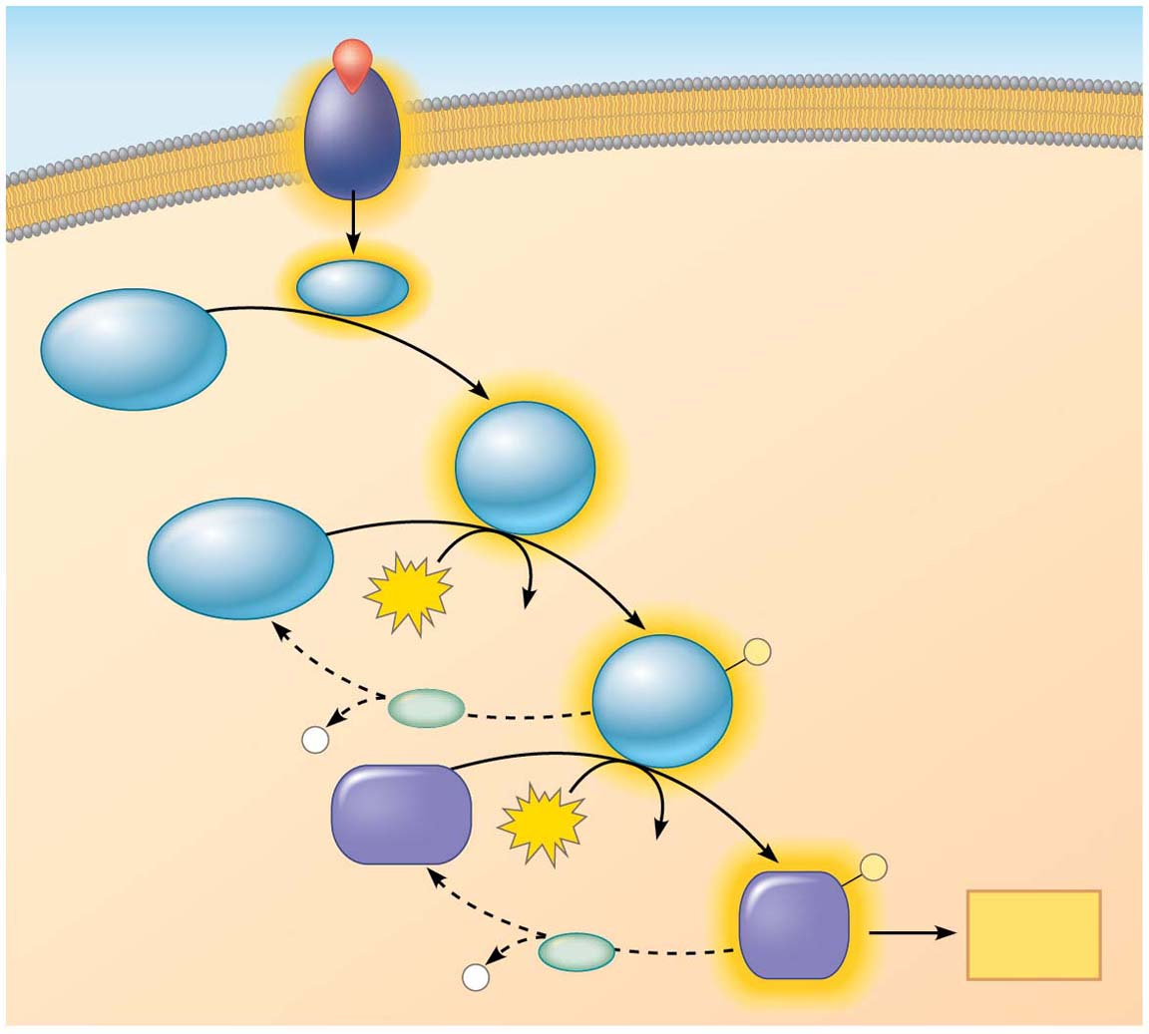
Figure 5.24
Signaling molecule
Activated relay molecule
Receptor
Inactive
protein
kinase 1
Active
protein
kinase 1
Inactive
protein
kinase 2
Phosphorylation cascade
ATP
ADP
P
Active
protein
kinase 2
PP
P
i
Inactive
protein
ATP
ADP
P
Active
protein
Cellular
response
P
PP
i
Notes:
Figure 5.24 A phosphorylation cascade

Slide 30
Protein phosphatases remove the phosphates from proteins, a process called dephosphorylation
Phosphatases provide a mechanism for turning off the signal transduction pathway
They also make protein kinases available for reuse, enabling the cell to respond to the signal again
Notes:
30

Slide 31
Small Molecules and Ions as Second Messengers
The extracellular signal molecule (ligand) that binds to the receptor is a pathway’s “first messenger”
Second messengers are small, nonprotein, water-soluble molecules or ions that spread throughout a cell by diffusion
Cyclic AMP and calcium ions are common second messengers
Notes:
31

Slide 32
Cyclic AMP (cAMP) is one of the most widely used second messengers
Adenylyl cyclase, an enzyme in the plasma membrane, rapidly converts ATP to cAMP in response to a number of extracellular signals
The immediate effect of cAMP is usually the activation of protein kinase A, which then phosphorylates a variety of other proteins
Notes:
32

Slide 33
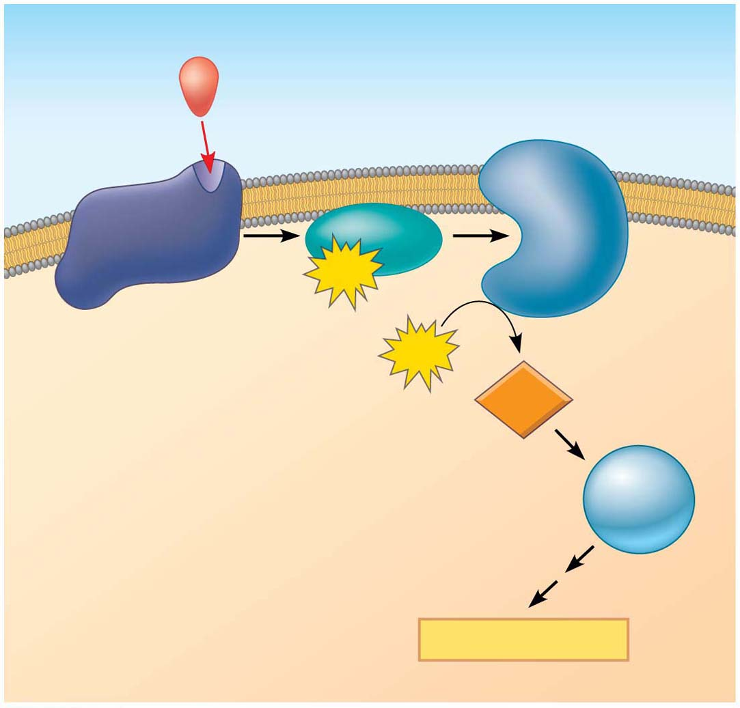
Figure 5.25
First messenger
(signaling molecule
such as epinephrine)
Adenylyl
cyclase
G protein
GTP
G protein-coupled
receptor
ATP
cAMP
Second
messenger
Protein
kinase A
Cellular responses
Notes:
Figure 5.25 cAMP as a second messenger in a G protein signaling pathway

Slide 34
Response: Regulation of Transcription or Cytoplasmic Activities
Ultimately, a signal transduction pathway leads to regulation of one or more cellular activities
The response may occur in the cytoplasm or in the nucleus
Many signaling pathways regulate the synthesis of enzymes or other proteins, usually by turning genes on or off in the nucleus
The final activated molecule in the signaling pathway may function as a transcription factor
Notes:
34

Slide 35
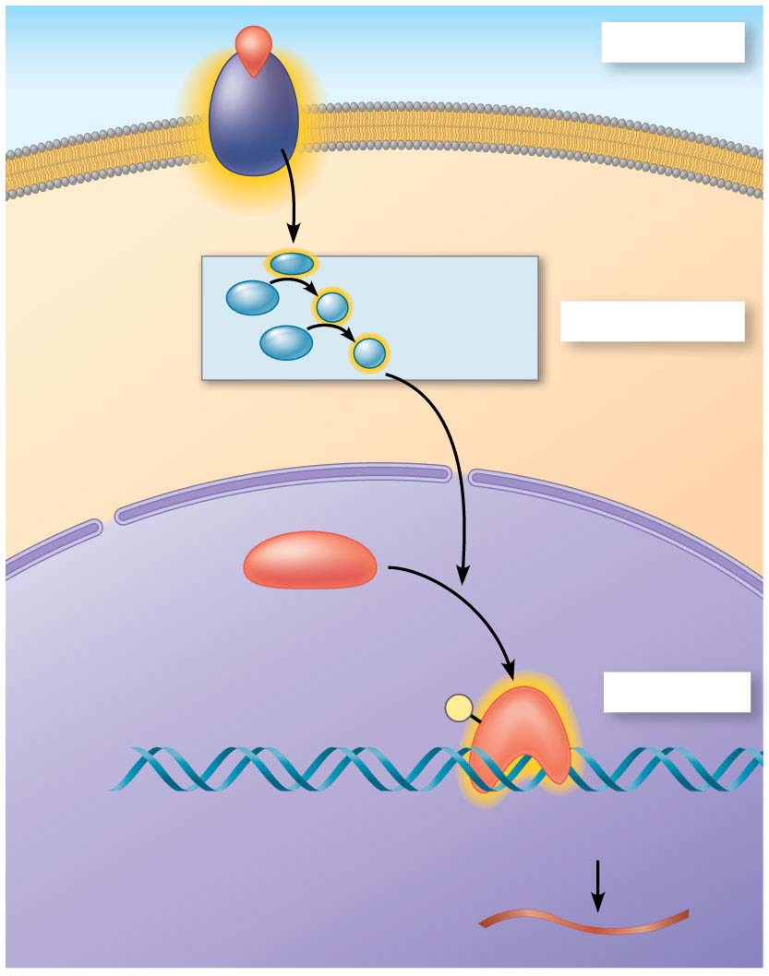
Figure 5.26
Growth factor
Reception
Receptor
Phosphorylation
cascade
Transduction
CYTOPLASM
Inactive
transcription
factor
Active
transcription
factor
P
Response
DNA
Gene
NUCLEUS
mRNA
Notes:
Figure 5.26 Nuclear response to a signal: the activation of a specific gene by a growth factor

Slide 36
Other pathways regulate the activity of enzymes rather than their synthesis, such as the opening of an ion channel or a change in cell metabolism
Notes:
36

