Slide 1
Concept 3.5: Proteins include a diversity of structures, resulting in a wide range of functions
Proteins account for more than 50% of the dry mass of most cells
Protein functions include defense, storage, transport, cellular communication, movement, and structural support
Notes:
1

Slide 2
Animation: Gene Regulatory Proteins

Slide 3
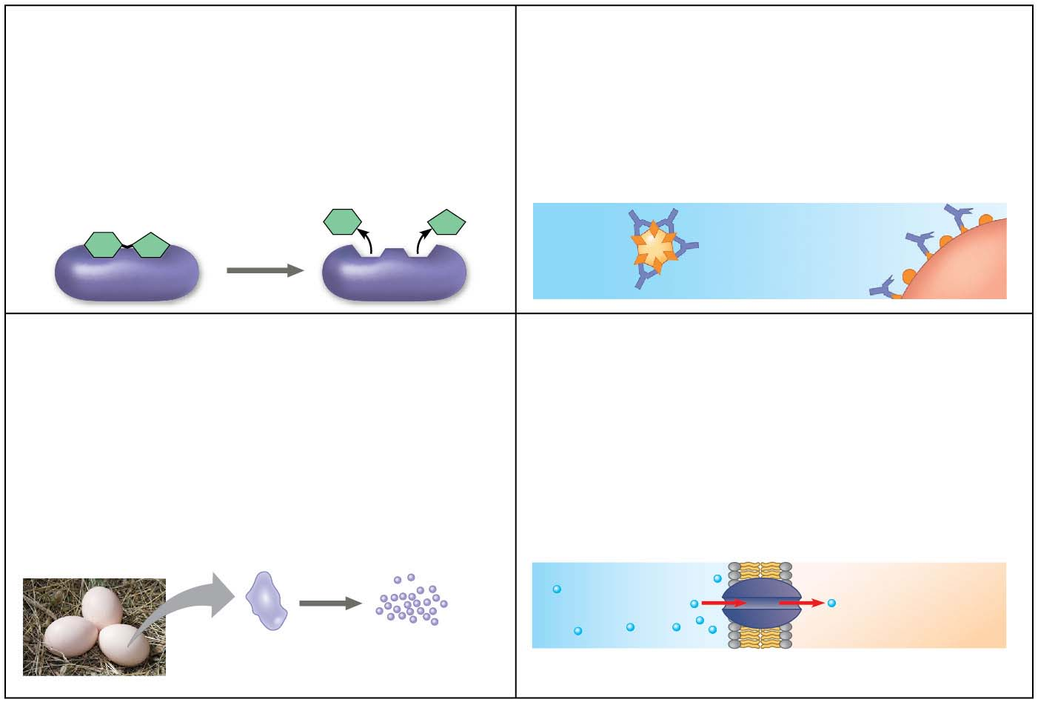
Figure 3.17-1
Enzymatic proteins
Defensive proteins
Function: Selective acceleration of
chemical reactions
Function: Protection against disease
Example: Antibodies inactivate and
help destroy viruses and bacteria.
Example: Digestive enzymes
catalyze the hydrolysis of bonds in
food molecules.
Antibodies
Enzyme
Virus
Bacterium
Storage proteins
Transport proteins
Function: Storage of amino acids
Function: Transport of substances
Examples: Casein, the protein of milk, is
the major source of amino acids for baby
mammals. Plants have storage proteins
in their seeds. Ovalbumin is the protein
of egg white, used as an amino acid
source for the developing embryo.
Examples: Hemoglobin, the iron-containing
protein of vertebrate blood, transports
oxygen from the lungs to other parts of the
body. Other proteins transport molecules
across membranes, as shown here.
Transport
protein
Ovalbumin
Amino acids
for embryo
Cell membrane
Notes:
Figure 3.17-1 An overview of protein functions (part 1)

Slide 4
Animation: Enzymes

Slide 5
Animation: Defensive Proteins

Slide 6
Animation: Storage Proteins

Slide 7
Animation: Transport Proteins

Slide 8
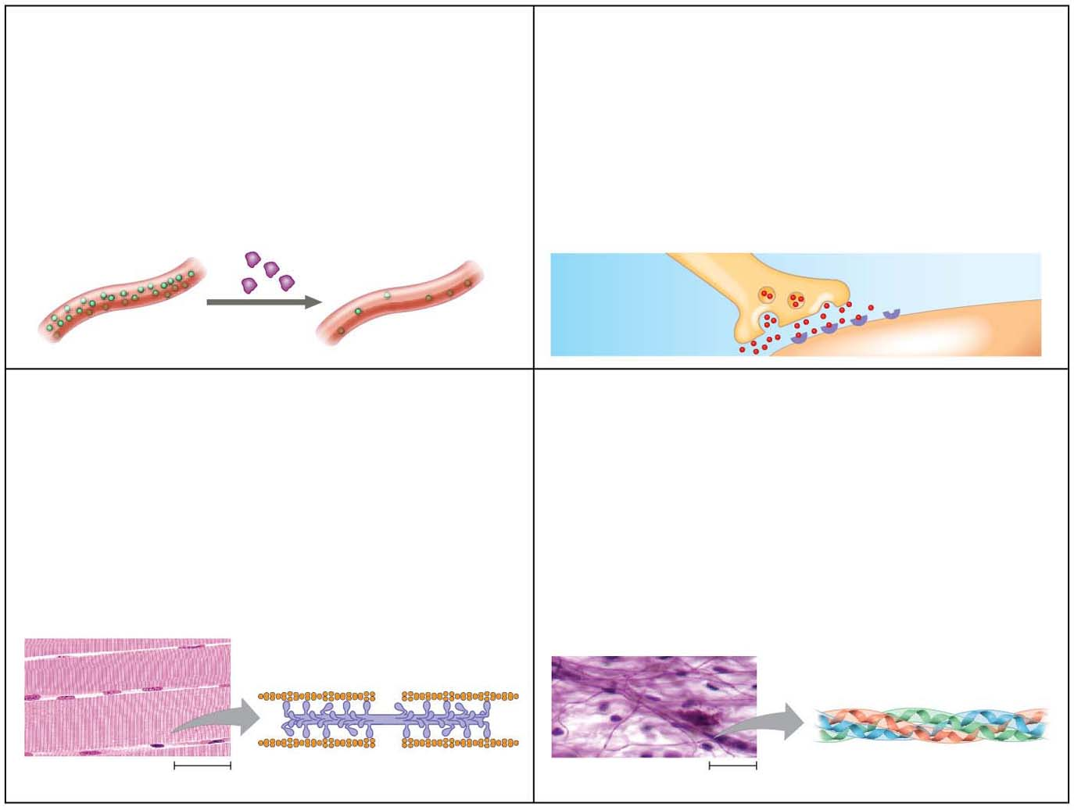
Figure 3.17-2
Hormonal proteins
Receptor proteins
Function: Coordination of an organism’s
activities
Function: Response of cell to chemical
stimuli
Example: Insulin, a hormone secreted by
the pancreas, causes other tissues to
take up glucose, thus regulating blood
sugar concentration.
Example: Receptors built into the
membrane of a nerve cell detect signaling
molecules released by other nerve cells.
Receptor
protein
High
blood sugar
Insulin
secreted
Normal
blood sugar
Signaling
molecules
Contractile and motor proteins
Structural proteins
Function: Movement
Function: Support
Examples: Motor proteins are responsible
for the undulations of cilia and flagella.
Actin and myosin proteins are
responsible for the contraction of
muscles.
Examples: Keratin is the protein of hair,
horns, feathers, and other skin appendages.
Insects and spiders use silk fibers to make
their cocoons and webs, respectively.
Collagen and elastin proteins provide a
fibrous framework in animal connective
tissues.
Actin
Myosin
Collagen
Muscle tissue
30 μm
Connective
tissue
60 μm
Notes:
Figure 3.17-2 An overview of protein functions (part 2)

Slide 9
Animation: Hormonal Proteins

Slide 10
Animation: Receptor Proteins

Slide 11
Animation: Sensory Proteins

Slide 12
Animation: Contractile Proteins

Slide 13
Animation: Structural Proteins

Slide 14
Life would not be possible without enzymes
Enzymatic proteins act as catalysts, to speed up chemical reactions without being consumed in the reaction
Notes:
14

Slide 15
Polypeptides are unbranched polymers built from the same set of 20 amino acids
A protein is a biologically functional molecule that consists of one or more polypeptides
Notes:
15

Slide 16
Animation: Introduction to Protein Structure

Slide 17
Amino Acid Monomers
Amino acids are organic molecules with carboxyl and amino groups
Amino acids differ in their properties due to differing side chains, called R groups
Notes:
17

Slide 18
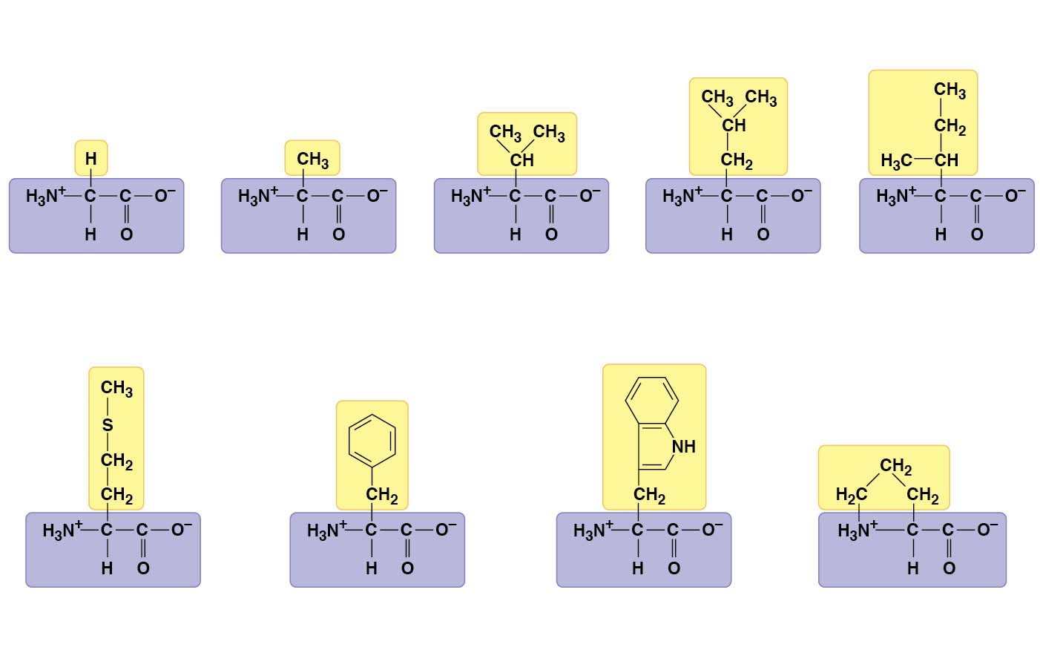
Figure 3.18-1
Nonpolar side chains; hydrophobic
Side chain
(R group)
Glycine
(Gly or G)
Alanine
(Ala or A)
Valine
(Val or V)
Leucine
(Leu or L)
Isoleucine
(Ile or I)
Methionine
(Met or M)
Phenylalanine
(Phe or F)
Tryptophan
(Trp or W)
Proline
(Pro or P)
Notes:
Figure 3.18-1 The 20 amino acids of proteins (part 1: nonpolar)

Slide 19
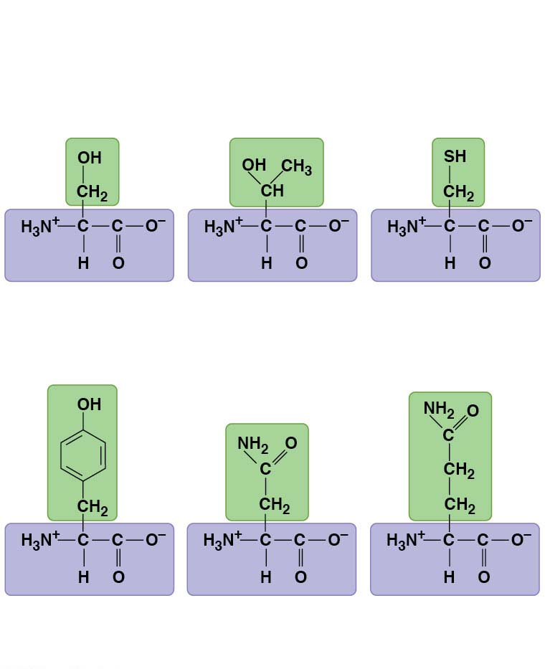
Figure 3.18-2
Polar side chains; hydrophilic
(sometimes
classified as
nonpolar)
Serine
(Ser or S)
Threonine
(Thr or T)
Cysteine
(Cys or C)
Tyrosine
(Tyr or Y)
Asparagine
(Asn or N)
Glutamine
(Gln or Q)
Notes:
Figure 3.18-2 The 20 amino acids of proteins (part 2: polar)

Slide 20
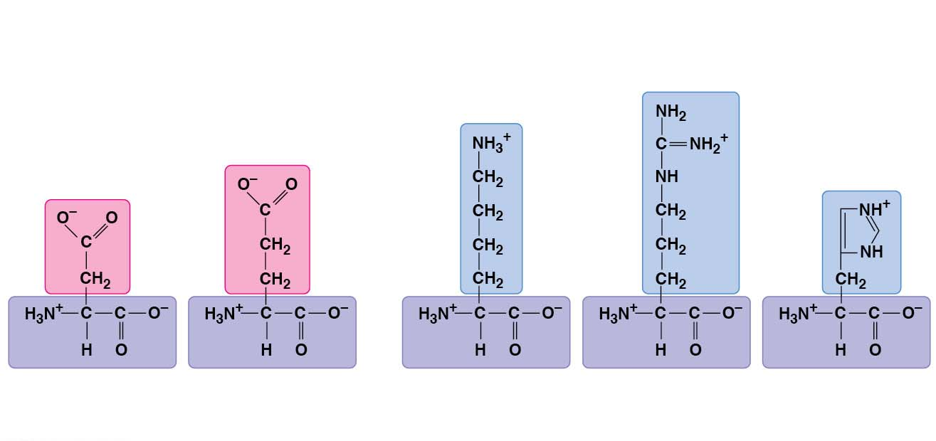
Figure 3.18-3
Electrically charged side chains; hydrophilic
Basic (positively charged)
Acidic (negatively charged)
Aspartic acid
(Asp or D)
Glutamic acid (Glu or E)
Lysine
(Lys or K)
Arginine
(Arg or R)
Histidine
(His or H)
Notes:
Figure 3.18-3 The 20 amino acids of proteins (part 3: charged)

Slide 21
Polypeptides (Amino Acid Polymers)
Amino acids are linked by peptide bonds
A polypeptide is a polymer of amino acids
Polypeptides range in length from a few to more than a thousand monomers
Each polypeptide has a unique linear sequence of amino acids, with a carboxyl end (C-terminus) and an amino end (N-terminus)
Notes:
21

Slide 22
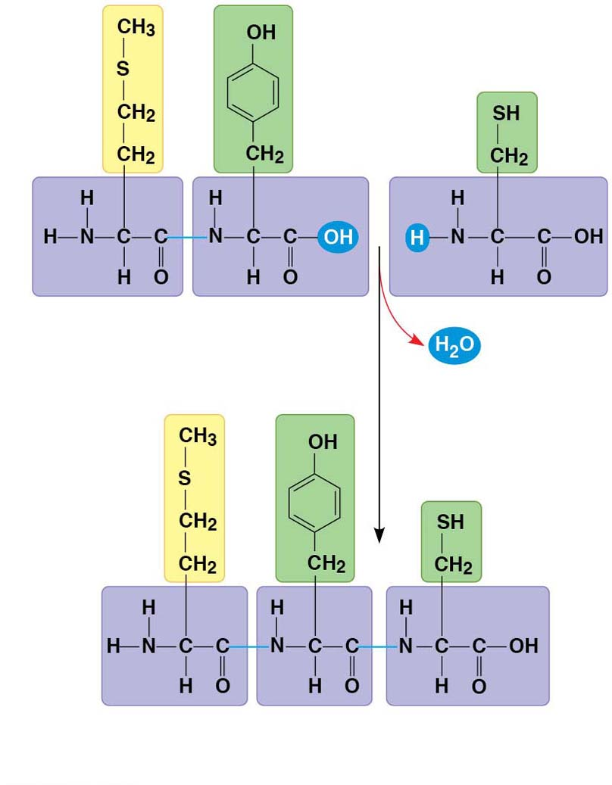
Figure 3.19
Peptide bond
New peptide
bond forming
Side
chains
Back-
bone
Amino end (N-terminus)
Peptide
bond
Carboxyl end
(C-terminus)
Notes:
Figure 3.19 Making a polypeptide chain

Slide 23
Protein Structure and Function
A functional protein consists of one or more polypeptides precisely twisted, folded, and coiled into a unique shape
Notes:
23

Slide 24
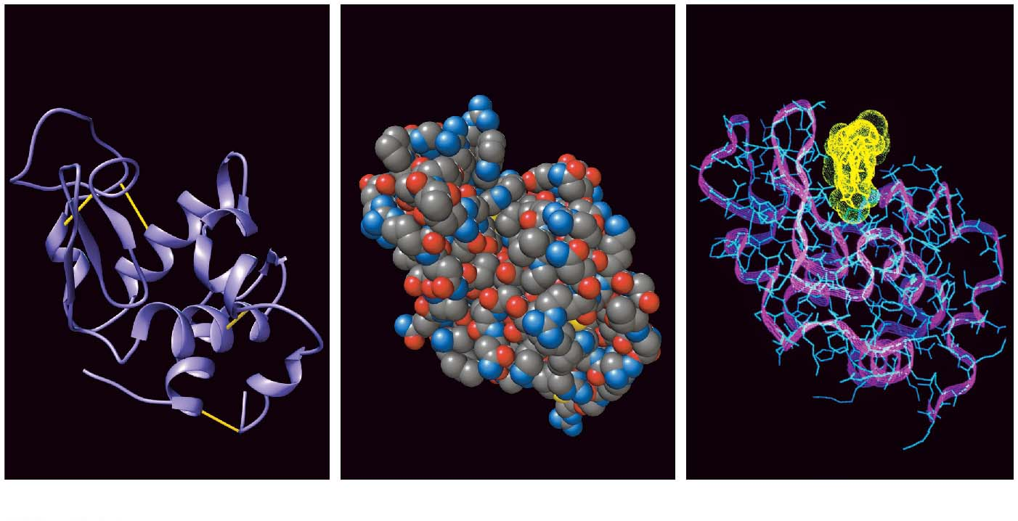
Figure 3.20
Target
molecule
Groove
Groove
(a) A ribbon model
(b) A space-filling model
(c) A wireframe model
Notes:
Figure 3.20 Structure of a protein, the enzyme lysozyme

Slide 25
The amino acid sequence of each polypeptide leads to a protein’s three-dimensional structure
A protein’s structure determines its function
Notes:
25

Slide 26
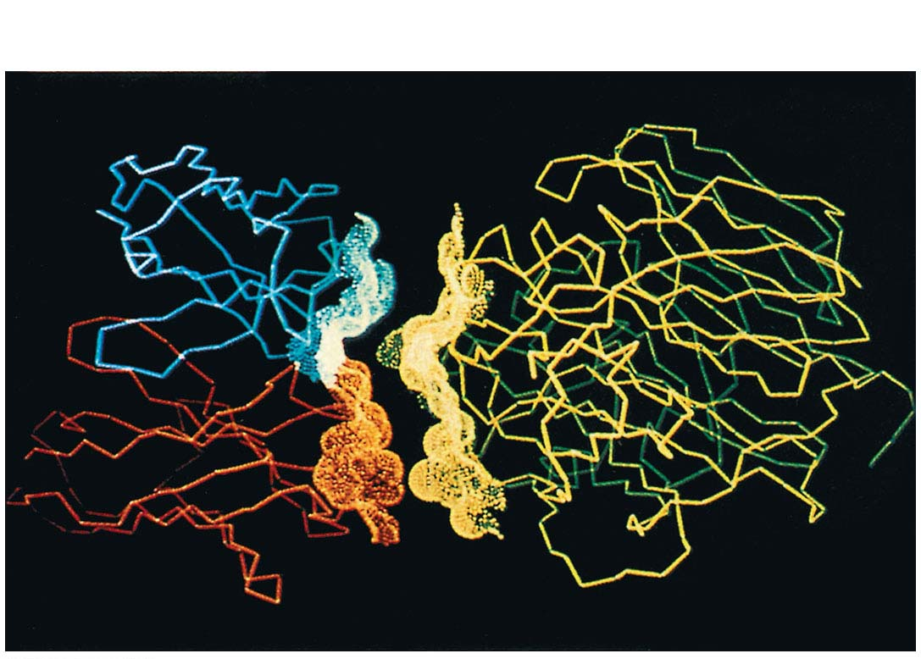
Figure 3.21
Antibody protein
Protein from flu virus
Notes:
Figure 3.21 An antibody binding to a protein from a flu virus

Slide 27
Four Levels of Protein Structure
Proteins are very diverse, but share three superimposed levels of structure called primary, secondary, and tertiary structure
A fourth level, quaternary structure, arises when a protein consists of two or more polypeptide chains
Notes:
27

Slide 28
The primary structure of a protein is its unique sequence of amino acids
Secondary structure, found in most proteins, consists of coils and folds in the polypeptide chain
Tertiary structure is determined by interactions among various side chains (R groups)
Quaternary structure results from interactions between multiple polypeptide chains
Notes:
28

Slide 29
Animation: Primary Structure

Slide 30
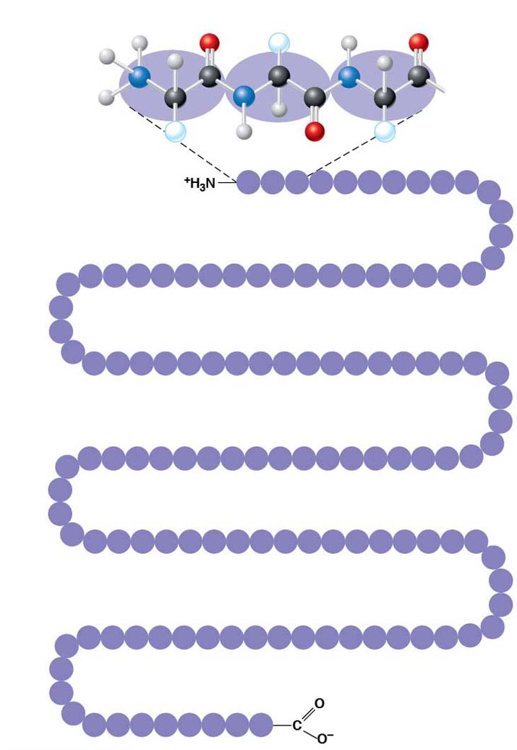
Figure 3.22-1
Primary Structure
Amino
acids
H
H
O
R
H
O
+
N
H
C
C
N
H
C
H
C
N
H
C
C
R
H
O
R
1
5
10
Gly Pro Thr Gly Thr Gly Glu Ser Lys Cys
Pro
Amino end
Leu
30
25
20
15
Met
His Val Ala Val Asn Ile Ala Pro Ser Gly Arg Val Ala AspLeu
Val
Lys
Val
Val
Phe
Arg
35
40
45
50
Lys
Ala Ala Asp AspThr Trp Glu Pro Phe Ala Ser Gly Lys Thr Ser Glu Ser
Gly
Primary structure of transthyretin
Glu
70
65
60
55
Leu
Ile Glu Val Lys Tyr Ile Gly Glu Val Phe Glu Glu Glu Thr Thr Leu Gly
His
Asp
Thr
75
Lys
80
85
90
Ser
Tyr Trp Lys Ala Leu Gly Ile Ser Pro Phe His Glu His Ala Glu Val Val
95
Phe
Thr
115
110
105
100
Ala
Ser Tyr Pro Ser Leu Leu Ala Ala Ile Thr Tyr Arg Arg Pro Gly Ser
Asp
Asn
Tyr
Ser
Thr
120
125
Thr
Ala Val Val Thr Asn Pro Lys Glu
Carboxyl end
Notes:
Figure 3.22-1 Exploring levels of protein structure (part 1: primary)

Slide 31
Animation: Secondary Structure

Slide 32
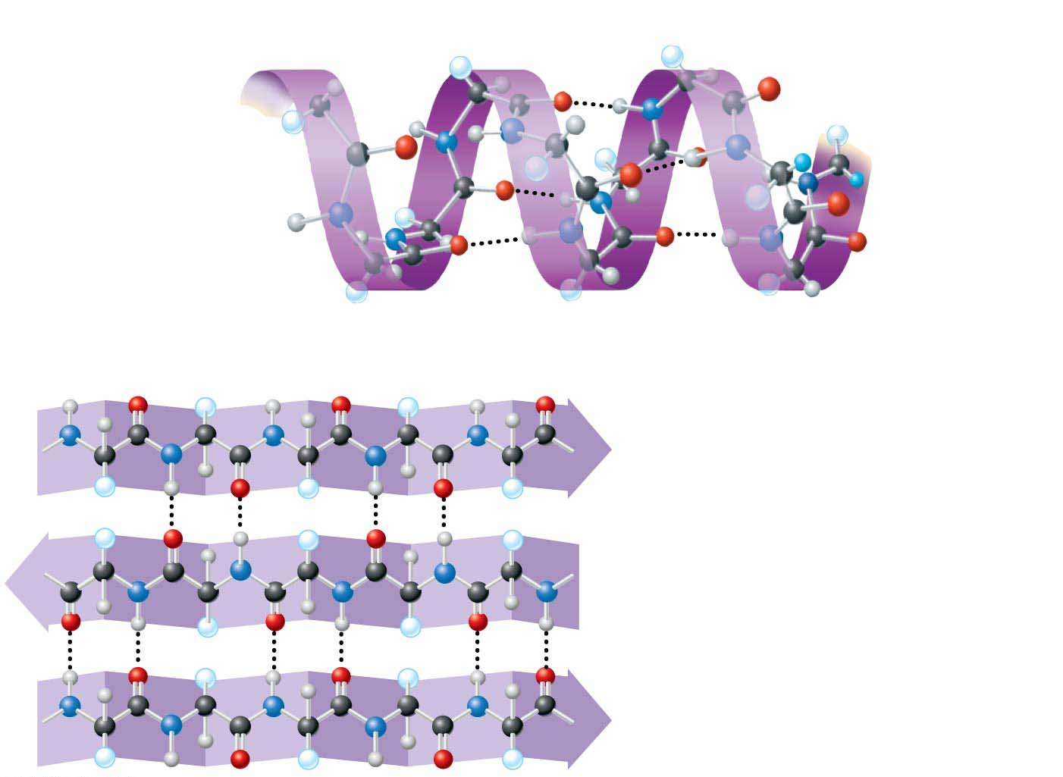
Figure 3.22-2
Secondary Structure
α helix
Hydrogen bond
β pleated sheet
β strand
Hydrogen bond
Notes:
Figure 3.22-2 Exploring levels of protein structure (part 2: secondary)

Slide 33
Animation: Tertiary Structure

Slide 34
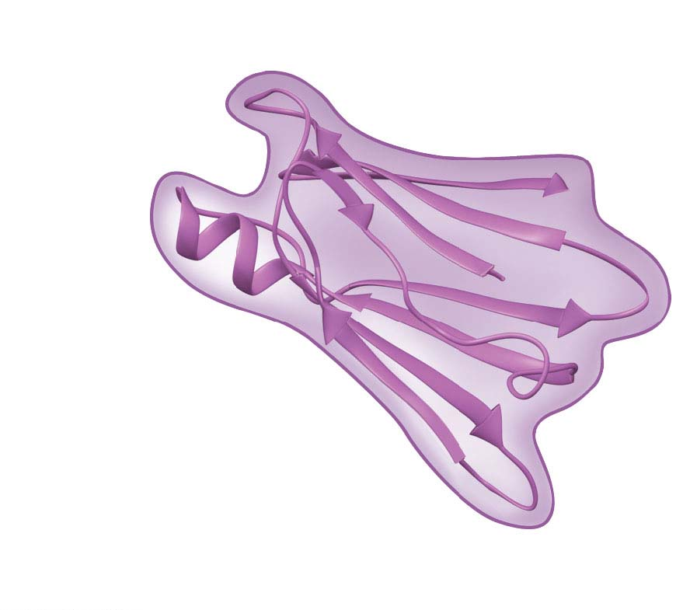
Figure 3.22-3
Tertiary Structure
α helix
β pleated sheet
Transthyretin
polypeptide
Notes:
Figure 3.22-3 Exploring levels of protein structure (part 3: tertiary)

Slide 35
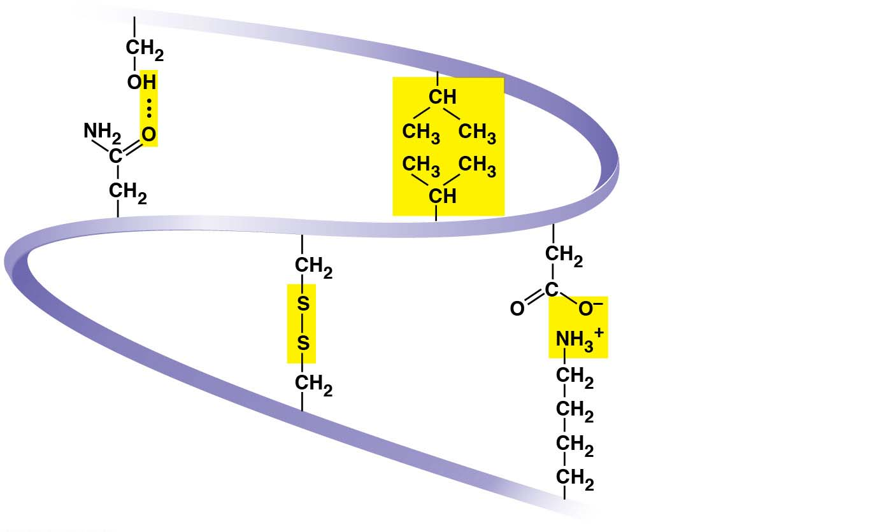
Figure 3.22-3a
Hydrogen
bond
Hydrophobic
interactions and
van der Waals
interactions
Disulfide
bridge
Ionic bond
Polypeptide
backbone
Notes:
Figure 3.22-3a Exploring levels of protein structure (part 3a: side groups)

Slide 36
Animation: Quaternary Structure

Slide 37
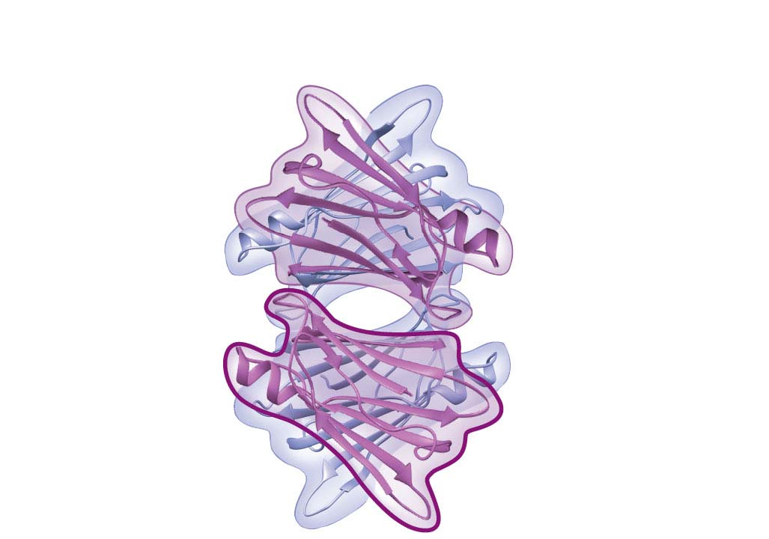
Figure 3.22-4
Quaternary structure
Transthyretin
protein
(four identical
polypeptides)
Single
polypeptide
subunit
Notes:
Figure 3.22-4 Exploring levels of protein structure (part 4: quaternary)

Slide 38
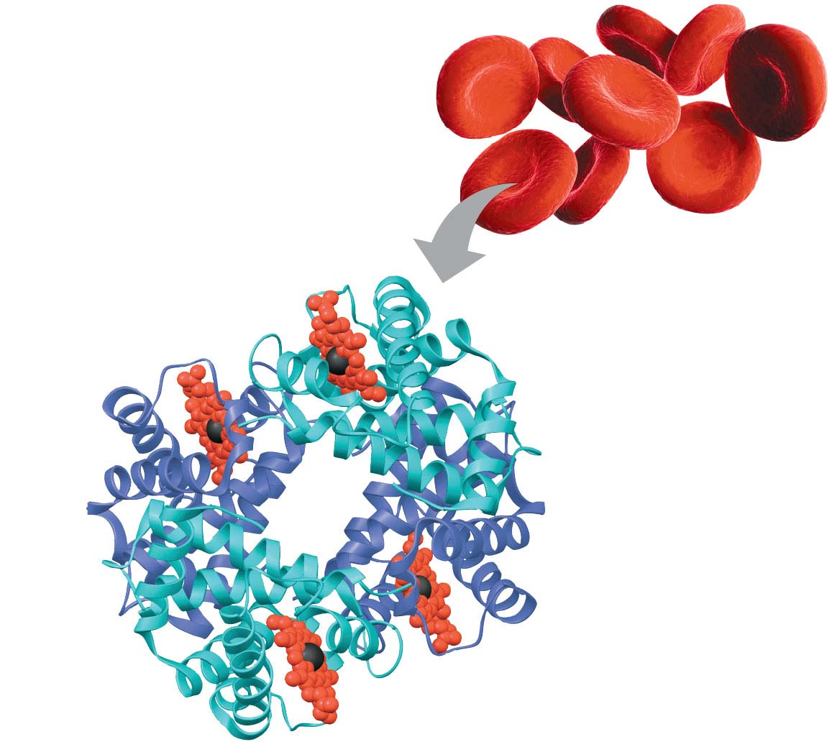
Figure 3.22-4b
Heme
Iron
β subunit
α subunit
α subunit
β subunit
Hemoglobin
Notes:
Figure 3.22-4b Exploring levels of protein structure (part 4b: hemoglobin)

Slide 39
Video: Alpha Helix with No Side Chain

Slide 40
Video: Alpha Helix with Side Chain

Slide 41
Video: Beta Pleated Sheet

Slide 42
Video: Beta Pleated Stick

Slide 43
Sickle-Cell Disease: A Change in Primary Structure
A slight change in primary structure can affect a protein’s structure and ability to function
Sickle-cell disease, an inherited blood disorder, results from a single amino acid substitution in the protein hemoglobin
Notes:
43

Slide 44
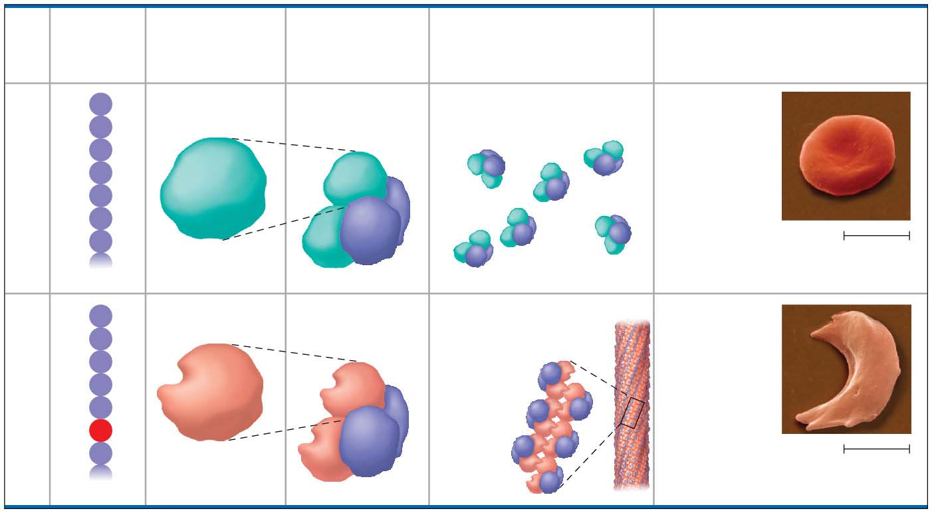
Figure 3.23
Primary
Structure
Secondary
and Tertiary
Structures
Quaternary
Structure
Red Blood Cell
Shape
Function
1
Val
Normal
β subunit
Normal
hemoglobin
Proteins do not associate;
each carries oxygen.
Normal red
blood cells
are full of
individual
hemoglobin
proteins.
2
His
Normal
3
Leu
β
4
Thr
5
Pro
α
6
Glu
7
Glu
5 μm
β
α
1
Val
Sickle-cell
β subunit
Sickle-cell
hemoglobin
Hydrophobic interactions
between proteins
lead to aggregation;
oxygen
carrying
capacity
reduced.
Fibers of
abnormal
hemoglobin
deform red
blood cell
into sickle
shape.
2
His
Sickle-cell
3
Leu
β
4
Thr
5
Pro
α
6
Val
7
Glu
5 μm
β
α
Notes:
Figure 3.23 A single amino acid substitution in a protein causes sickle-cell disease.

Slide 45
What Determines Protein Structure?
In addition to amino acid sequence, physical and chemical conditions can affect protein structure
Alterations in pH, salt concentration, temperature, or other environmental factors can cause a protein to unravel
This loss of a protein’s native structure is called denaturation
A denatured protein is biologically inactive
Notes:
45

Slide 46
Figure 3.24-s1
Normal protein
Notes:
Figure 3.24-s1 Denaturation and renaturation of a protein (step 1)

Slide 47
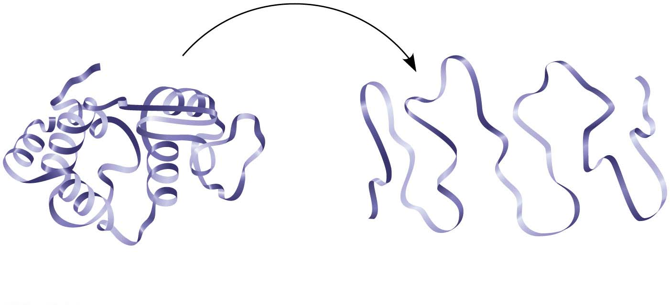
Figure 3.24-s2
e
n
a
t
u
r
a
t
i
D
o
n
Normal protein
Denatured protein
Notes:
Figure 3.24-s2 Denaturation and renaturation of a protein (step 2)

Slide 48
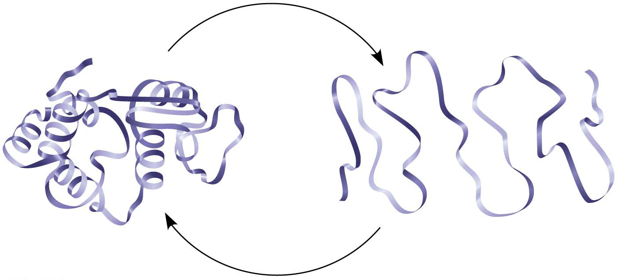
Figure 3.24-s3
e
n
a
t
u
r
a
t
i
D
o
n
Normal protein
R
e
n
on
Denatured protein
a
t
u
r
a
t
i
Notes:
Figure 3.24-s3 Denaturation and renaturation of a protein (step 3)

Slide 49
Protein Folding in the Cell
It is difficult to predict a protein’s structure from its primary structure
Most proteins probably go through several intermediate structures on their way to their final, stable shape
Scientists use X-ray crystallography to determine 3-D protein structure based on diffractions of an X-ray beam by atoms of the crystalized molecule
Notes:
49

Slide 50
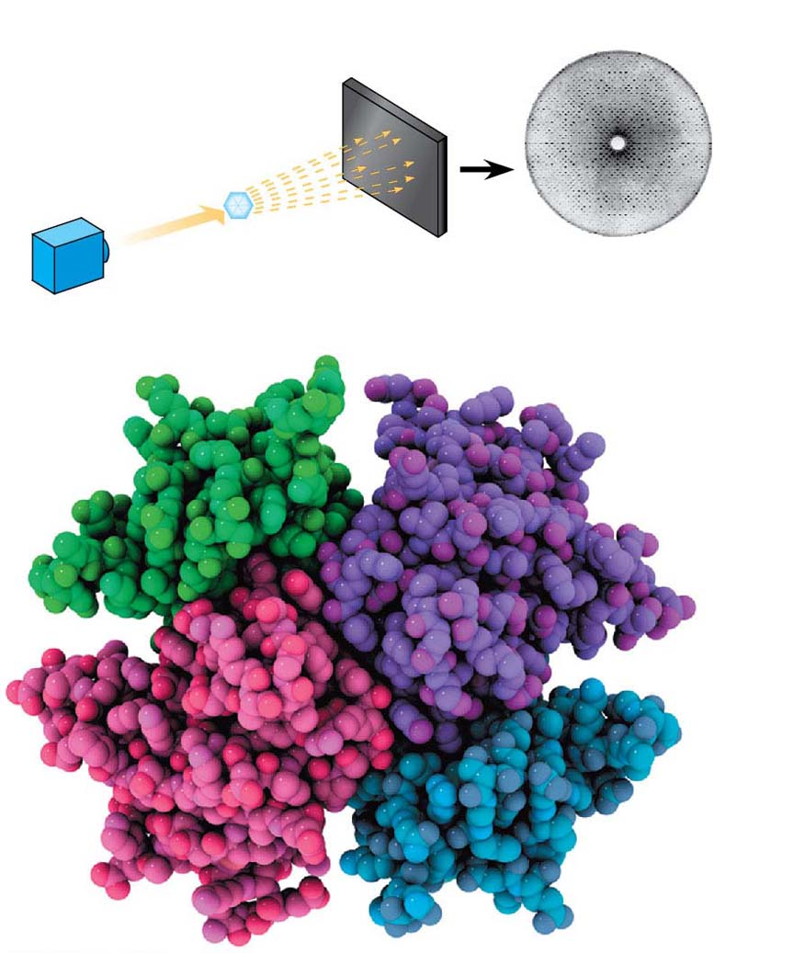
Figure 3.25
Technique
Diffracted
X-rays
X-ray
source
X-ray
beam
Crystal
Digital
detector
X-ray diffraction
pattern
Results
Notes:
Figure 3.25 Research method: X-ray crystallography

