Slide 1
The Process That Feeds the Biosphere
Photosynthesis is the process that converts solar energy into chemical energy
Directly or indirectly, photosynthesis nourishes almost the entire living world
Notes:
1

Slide 2
Autotrophs sustain themselves without eating anything derived from other organisms
Autotrophs are the producers of the biosphere, producing organic molecules from CO₂ and other inorganic molecules
Almost all plants are photoautotrophs, using the energy of sunlight to make organic molecules
Notes:
2

Slide 3
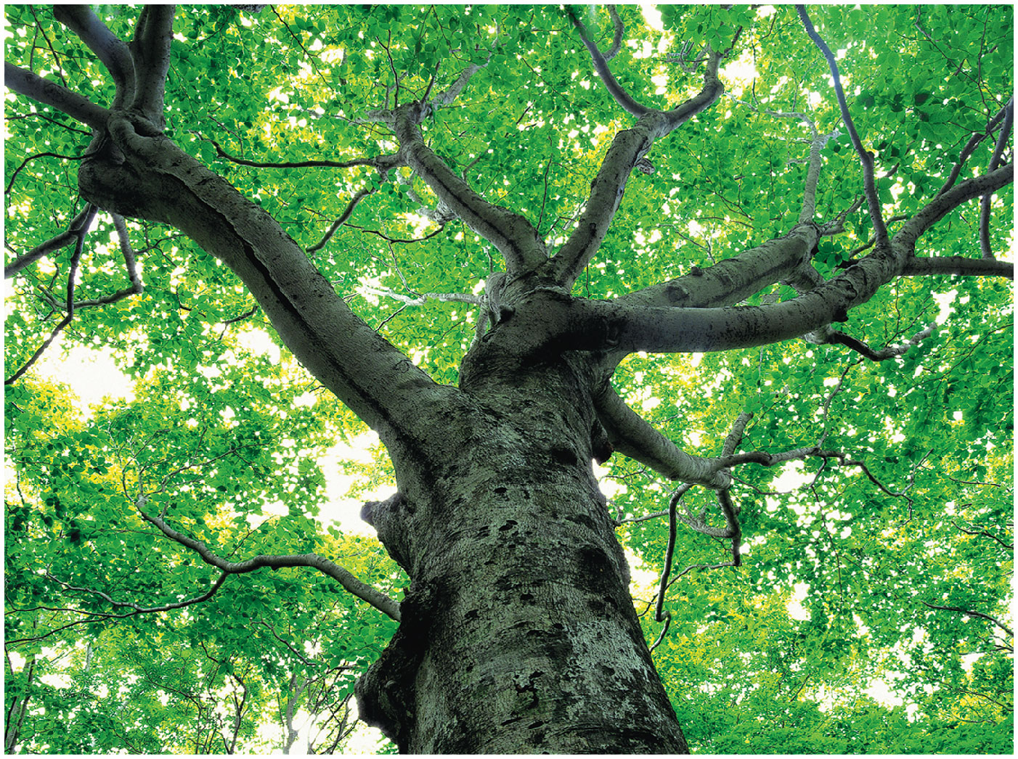
Figure 8.1
Notes:
Figure 8.1 How does sunlight help build the trunk, branches, and leaves of this broadleaf tree?

Slide 4
Heterotrophs obtain their organic material from other organisms
Heterotrophs are the consumers of the biosphere
Almost all heterotrophs, including humans, depend on photoautotrophs for food and O₂
Notes:
4

Slide 5
Photosynthesis occurs in plants, algae, certain other protists, and some prokaryotes
These organisms feed not only themselves but also most of the living world
Notes:
5

Slide 6
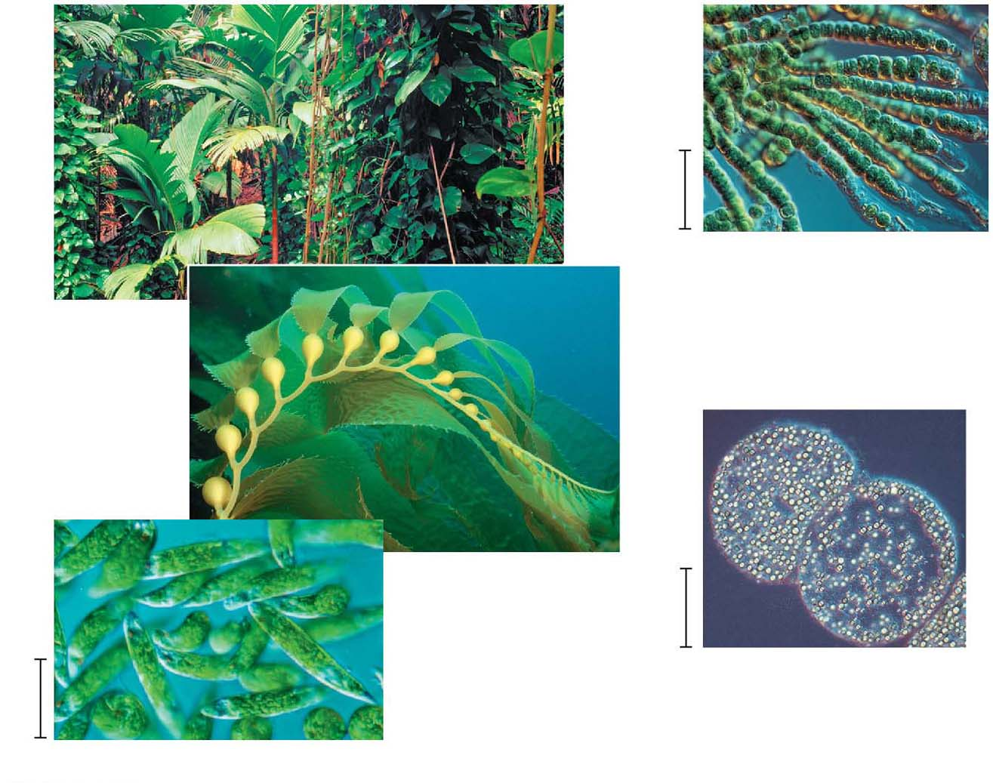
Figure 8.2
40 μm
(d) Cyanobacteria
(a) Plants
(b) Multicellular alga
1 μm
10 μm
(e) Purple sulfur bacteria
(c) Unicellular eukaryotes
Notes:
Figure 8.2 Photoautotrophs

Slide 7
Concept 8.1: Photosynthesis converts light energy to the chemical energy of food
The structural organization of photosynthetic cells includes enzymes and other molecules grouped together in a membrane
This organization allows for the chemical reactions of photosynthesis to proceed efficiently
Chloroplasts are structurally similar to and likely evolved from photosynthetic bacteria
Notes:
7

Slide 8
Chloroplasts: The Sites of Photosynthesis in Plants
Leaves are the major locations of photosynthesis
Their green color is from chlorophyll, the green pigment within chloroplasts
Chloroplasts are found mainly in cells of the mesophyll, the interior tissue of the leaf
Each mesophyll cell contains 30–40 chloroplasts
Notes:
8

Slide 9
CO₂ enters and O₂ exits the leaf through microscopic pores called stomata
The chlorophyll is in the membranes of thylakoids (connected sacs in the chloroplast); thylakoids may be stacked in columns called grana
Chloroplasts also contain stroma, a dense interior fluid
Notes:
9

Slide 10
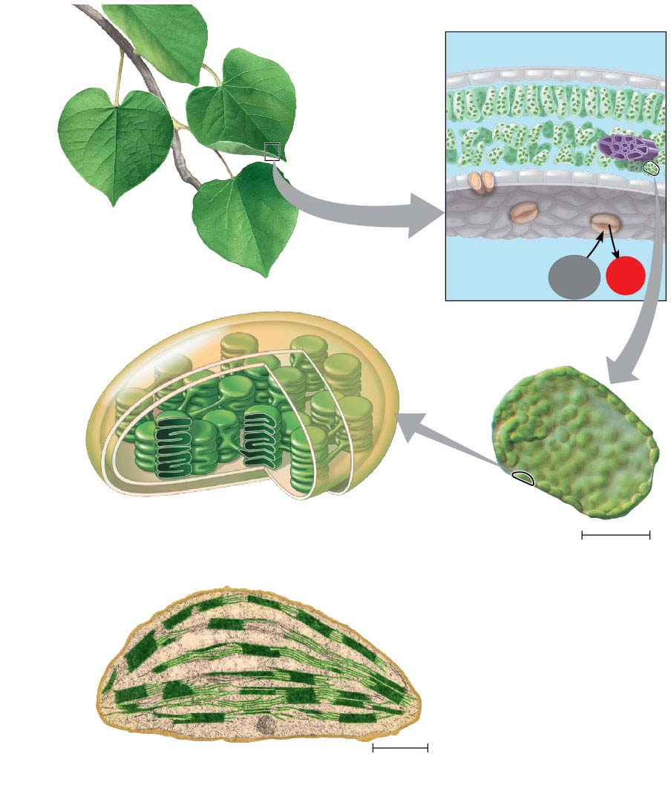
Figure 8.3
Leaf cross section
Chloroplasts
Vein
Mesophyll
Stomata
CO₂
O₂
Chloroplast
Mesophyll
cell
Outer
membrane
Thylakoid
Thylakoid
space
Intermembrane
space
Stroma Granum
20 μm
Inner
membrane
Chloroplast
1 μm
Notes:
Figure 8.3 Zooming in on the location of photosynthesis in a plant

Slide 11
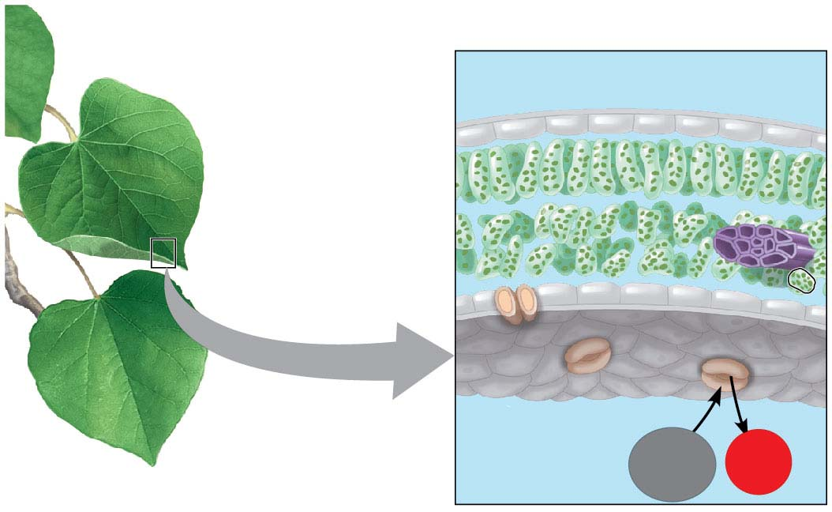
Figure 8.3-1
Leaf cross section
Chloroplasts
Vein
Mesophyll
Stomata
O₂
CO₂
Notes:
Figure 8.3-1 Zooming in on the location of photosynthesis in a plant (part 1: leaf cross section)

Slide 12
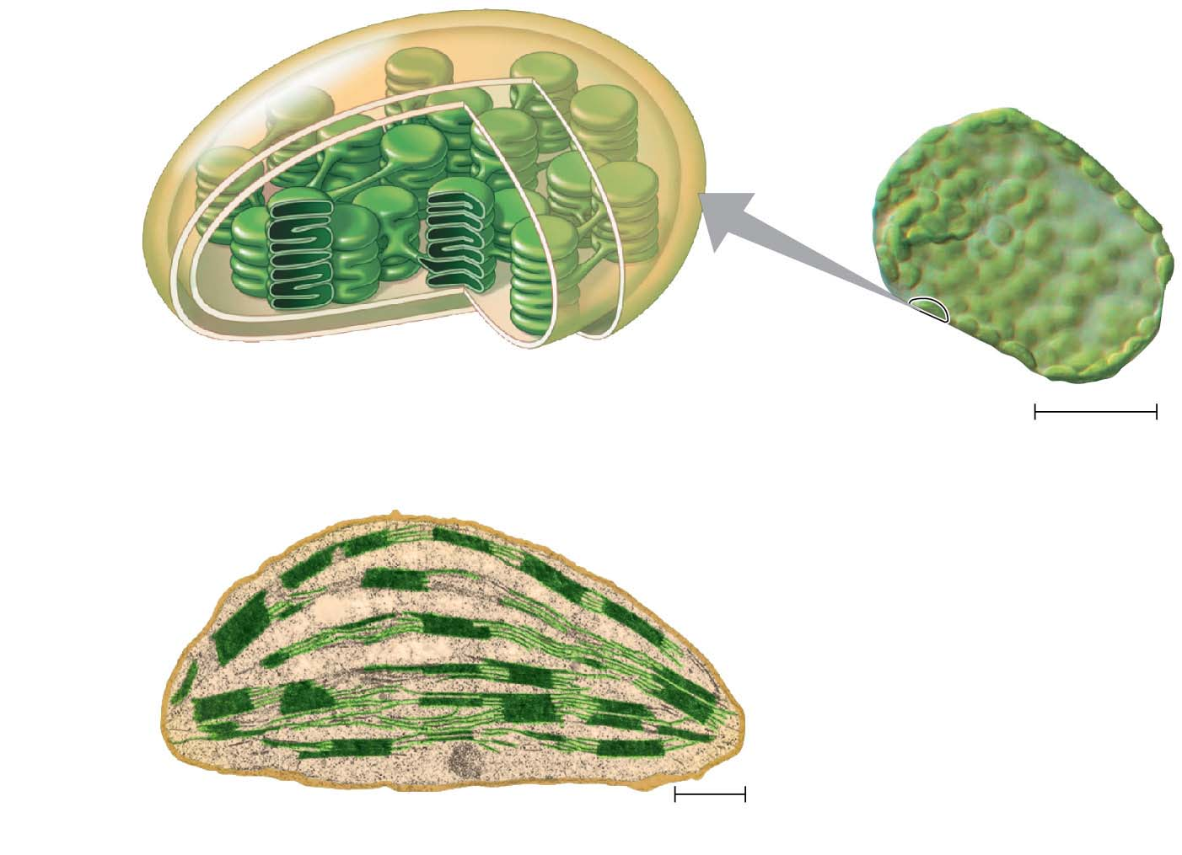
Figure 8.3-2
Chloroplast
Mesophyll cell
Outer
membrane
Thylakoid
Intermembrane
space
Thylakoid
space
Stroma
Granum
20 μm
Inner
membrane
Chloroplast
1 μm
Notes:
Figure 8.3-2 Zooming in on the location of photosynthesis in a plant (part 2: chloroplast)

Slide 13
Tracking Atoms Through Photosynthesis: Scientific Inquiry
Photosynthesis is a complex series of reactions that can be summarized as the following equation
6 CO₂ + 12H₂O + Light energy → C₆H₁₂O₆ + 6 O₂ + 6 H₂O
Notes:
13

Slide 14
The Splitting of Water
Chloroplasts split H₂O into hydrogen and oxygen, incorporating the electrons of hydrogen into sugar molecules and releasing oxygen as a by-product
Notes:
14

Slide 15
Figure 8.4
Reactants:
6 CO₂
12 H₂O
Products:
C₆H₁₂O₆
6 H₂O
6 O₂
Notes:
Figure 8.4 Tracking atoms through photosynthesis

Slide 16
Photosynthesis as a Redox Process
Photosynthesis reverses the direction of electron flow compared to respiration
Photosynthesis is a redox process in which H₂O is oxidized and CO₂ is reduced
Photosynthesis is an endergonic process; the energy boost is provided by light
Notes:
16

Slide 17
Figure 8.UN01
becomes reduced
becomes oxidized
Notes:
Figure 8.UN01 In-text figure, photosynthesis equation, p. 164

Slide 18
The Two Stages of Photosynthesis: A Preview
Photosynthesis consists of the light reactions (the photo part) and Calvin cycle (the synthesis part)
The light reactions (in the thylakoids)
Split H₂O
Release O₂
Reduce the electron acceptor, NADP^{+,} to NADPH
Generate ATP from ADP by adding a phosphate group, photophosphorylation
Notes:
18

Slide 19
The Calvin cycle (in the stroma) forms sugar from CO₂, using ATP and NADPH
The Calvin cycle begins with carbon fixation, incorporating CO₂ into organic molecules
Notes:
19

Slide 20
Animation: Photosynthesis

Slide 21
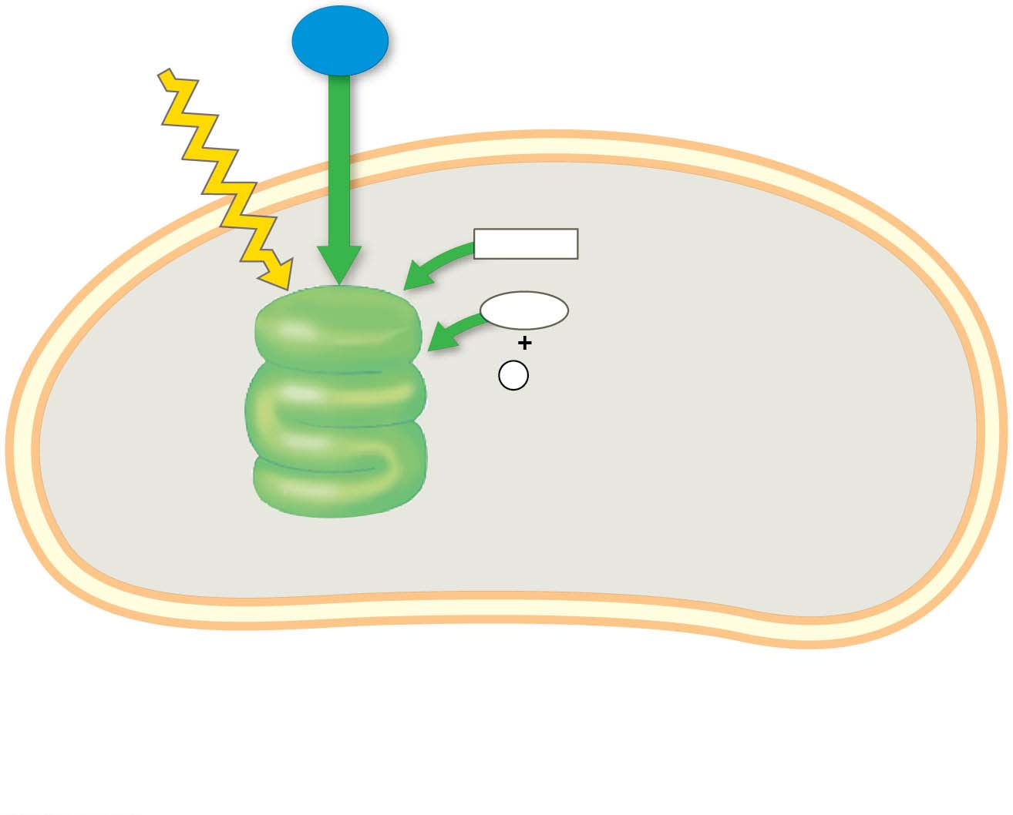
Figure 8.5-s1
Light
H₂O
NADP⁺
ADP
+
LIGHT
REACTIONS
P
i
Thylakoid
Stroma
Chloroplast
Notes:
Figure 8.5-s1 An overview of photosynthesis: cooperation of the light reactions and the Calvin cycle (step 1)

Slide 22
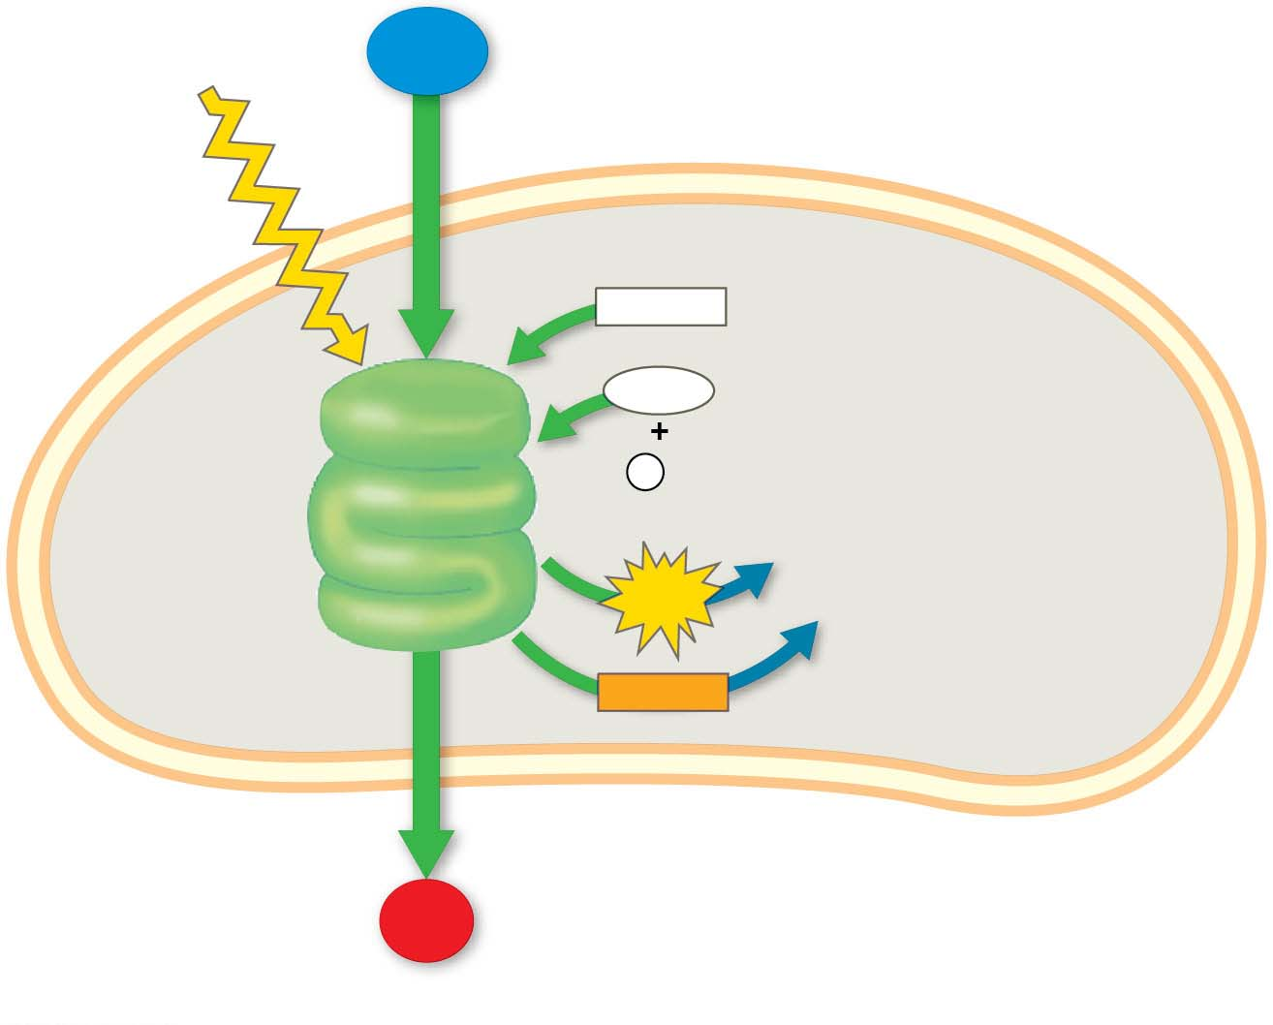
Figure 8.5-s2
Light
H₂O
NADP⁺
ADP
+
LIGHT
REACTIONS
P
i
ATP
Thylakoid
Stroma
N AD PH
Chloroplast
O₂
Notes:
Figure 8.5-s2 An overview of photosynthesis: cooperation of the light reactions and the Calvin cycle (step 2)

Slide 23
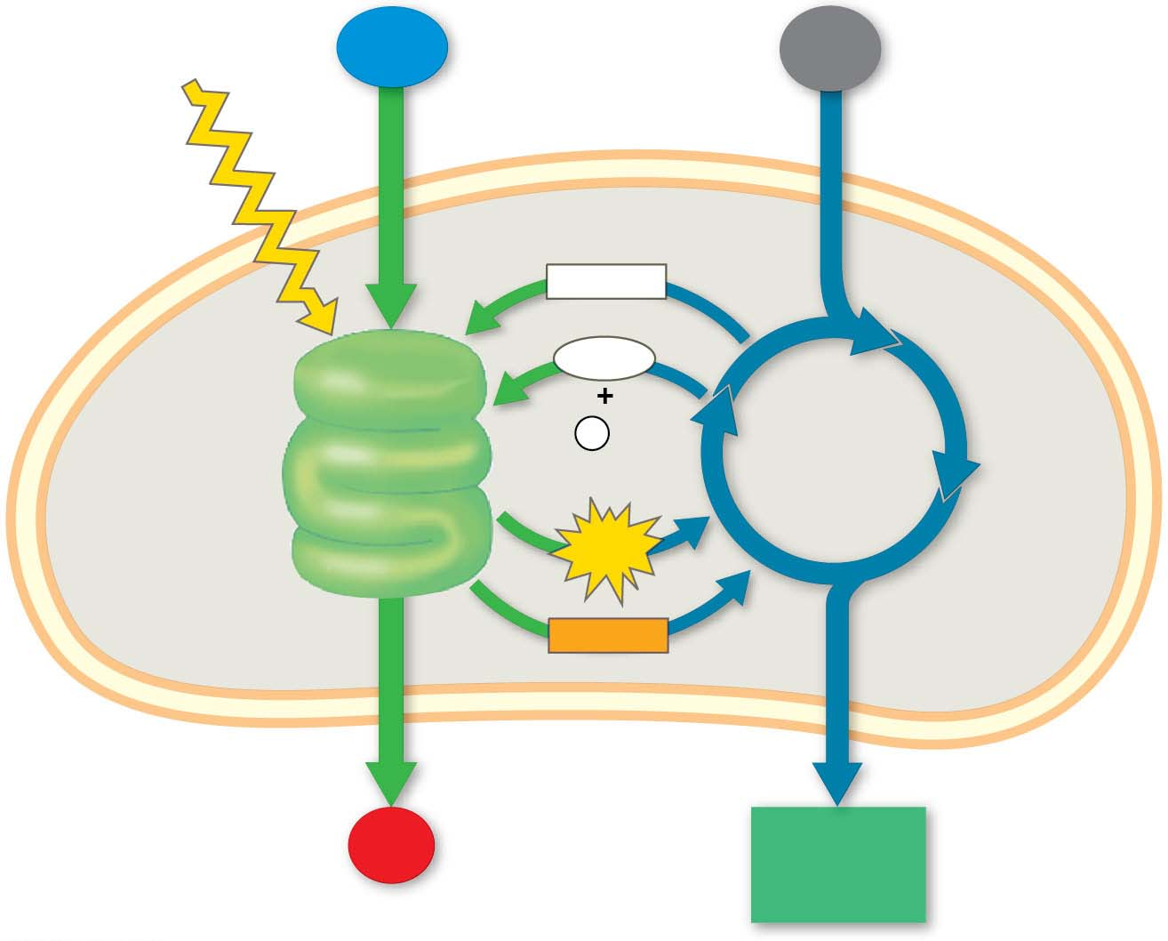
Figure 8.5-s3
Light
H₂O
CO₂
NADP⁺
ADP
+
LIGHT
REACTIONS
P
i
CA L VIN
CYCLE
ATP
Thylakoid
Stroma
N AD PH
Chloroplast
O₂
[CH₂O]
(sugar)
Notes:
Figure 8.5-s3 An overview of photosynthesis: cooperation of the light reactions and the Calvin cycle (step 3)

