Slide 1
Concept 7.5: Fermentation and anaerobic respiration enable cells to produce ATP without the use of oxygen
Most cellular respiration requires O₂ to produce ATP
Without O₂, the electron transport chain will cease to operate
In that case, glycolysis couples with fermentation or anaerobic respiration to produce ATP
Notes:
1

Slide 2
Anaerobic respiration uses an electron transport chain with a final electron acceptor other than O₂, for example, sulfate
Fermentation uses substrate-level phosphorylation instead of an electron transport chain to generate ATP
Notes:
2

Slide 3
Types of Fermentation
Fermentation consists of glycolysis plus reactions that regenerate NAD⁺, which can be reused by glycolysis
Two common types are alcohol fermentation and lactic acid fermentation
Notes:
3

Slide 4
In alcohol fermentation, pyruvate is converted to ethanol in two steps
The first step releases CO₂ from pyruvate, and the second step reduces the resulting acetaldehyde to ethanol
Alcohol fermentation by yeast is used in brewing, winemaking, and baking
Notes:
4

Slide 5
Animation: Fermentation Overview

Slide 6
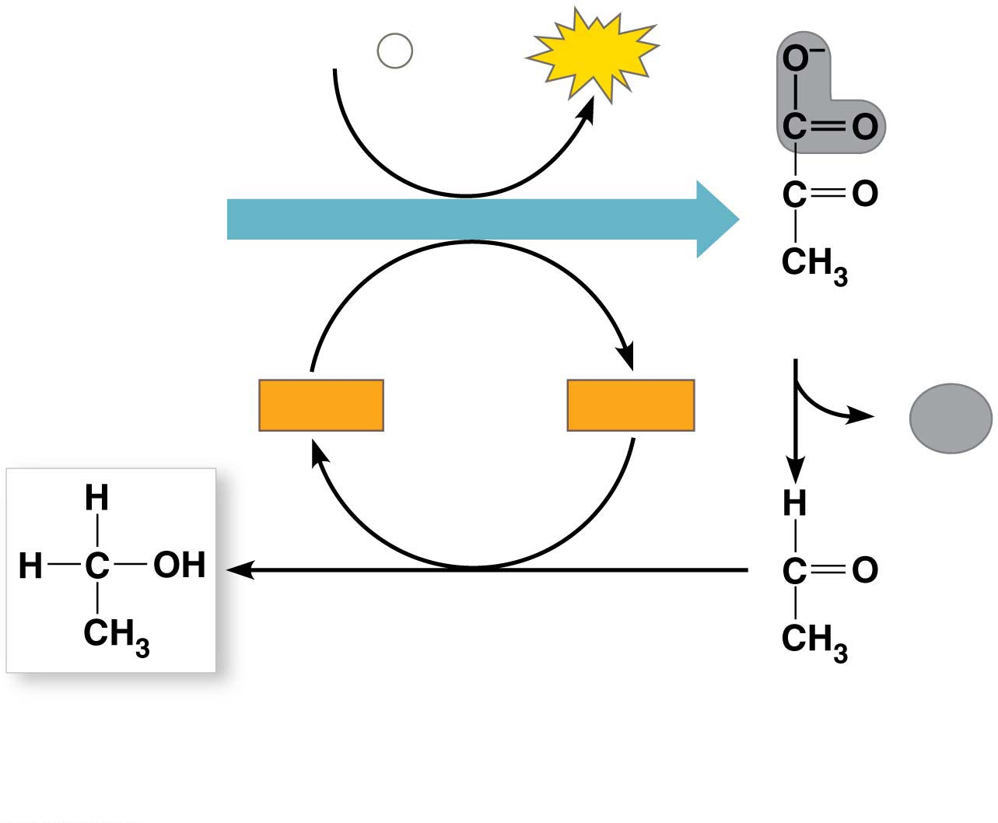
Figure 7.16-1
2 ADP + 2 P
2
ATP
i
Glucose
GLYCOLYSIS
2 Pyruvate
2
NAD⁺
2
NADH
2 CO₂
+ 2 H⁺
2 Ethanol
2 Acetaldehyde
(a) Alcohol fermentation
Notes:
Figure 7.16-1 Fermentation (part 1: alcohol)

Slide 7
In lactic acid fermentation, pyruvate is reduced by NADH, forming lactate as an end product, with no release of CO₂
Lactic acid fermentation by some fungi and bacteria is used to make cheese and yogurt
Human muscle cells use lactic acid fermentation to generate ATP when O₂ is scarce
Notes:
7

Slide 8
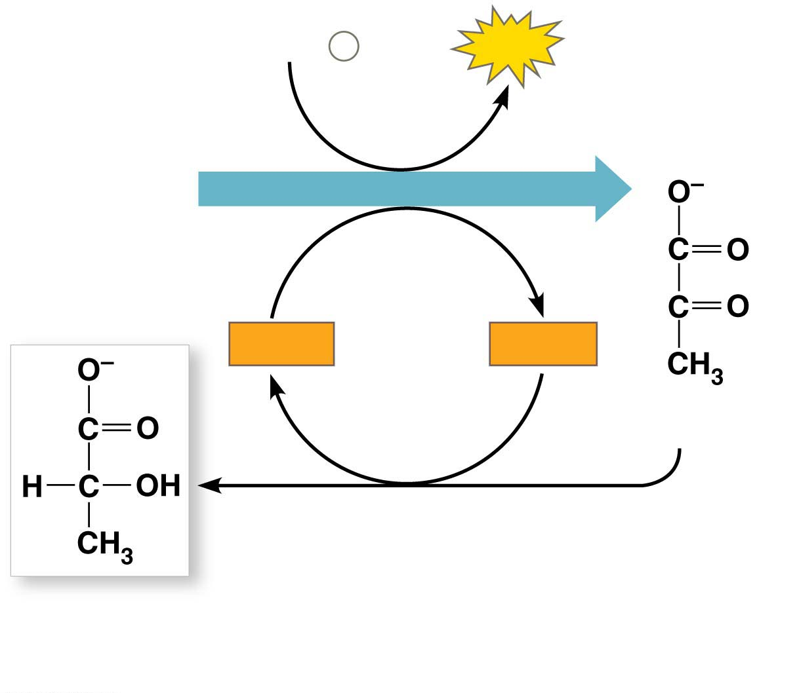
Figure 7.16-2
2 ADP +
2
P
2
ATP
i
Glucose
GLYCOLYSIS
2
NAD⁺
2
NADH
+ 2 H⁺
2 Pyruvate
2 Lactate
(b) Lactic acid fermentation
Notes:
Figure 7.16-2 Fermentation (part 2: lactic acid)

Slide 9
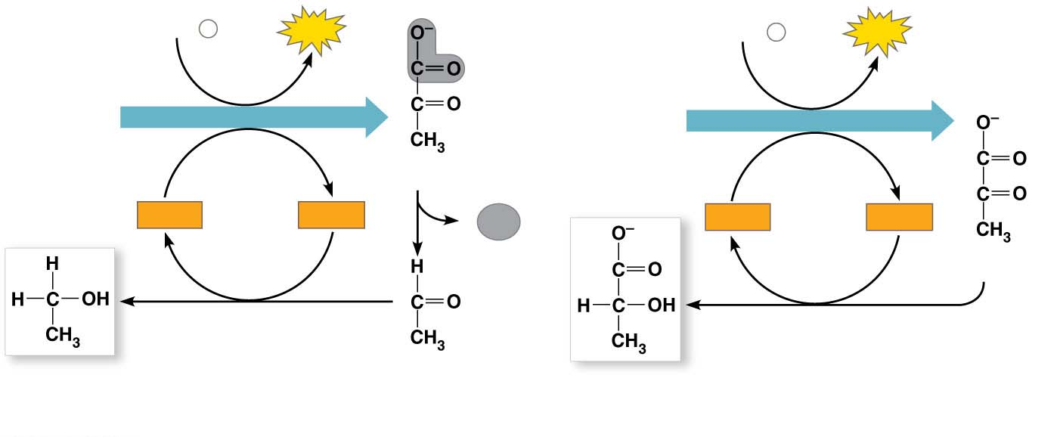
Figure 7.16
2 ADP + 2 P
i
2
ATP
2 ADP
+
2
P
i
2
ATP
Glucose
GLYCOLYSIS
Glucose
GLYCOLYSIS
2 Pyruvate
2
NAD⁺
2
NADH
2 CO₂
2
NAD⁺
2
NADH
+ 2 H⁺
+ 2 H⁺
2 Pyruvate
2 Ethanol
2 Acetaldehyde
2 Lactate
(a) Alcohol fermentation
(b) Lactic acid fermentation
Notes:
Figure 7.16 Fermentation

Slide 10
Comparing Fermentation with Anaerobic and Aerobic Respiration
All use glycolysis (net ATP = 2) to oxidize glucose and other organic fuels to pyruvate
In all three, NAD⁺ is the oxidizing agent that accepts electrons from food during glycolysis
The mechanism of NADH oxidation differs
In fermentation the final electron acceptor is an organic molecule such as pyruvate or acetaldehyde
Cellular respiration transfers electrons from NADH to a carrier molecule in the electron transport chain
Notes:
10

Slide 11
Cellular respiration produces about 32 ATP per glucose molecule; fermentation produces 2 ATP per glucose molecule
Notes:
11

Slide 12
Obligate anaerobes carry out only fermentation or anaerobic respiration and cannot survive in the presence of O₂
Yeast and many bacteria are facultative anaerobes, meaning that they can survive using either fermentation or cellular respiration
In a facultative anaerobe, pyruvate is a fork in the metabolic road that leads to two alternative catabolic routes
Notes:
12

Slide 13
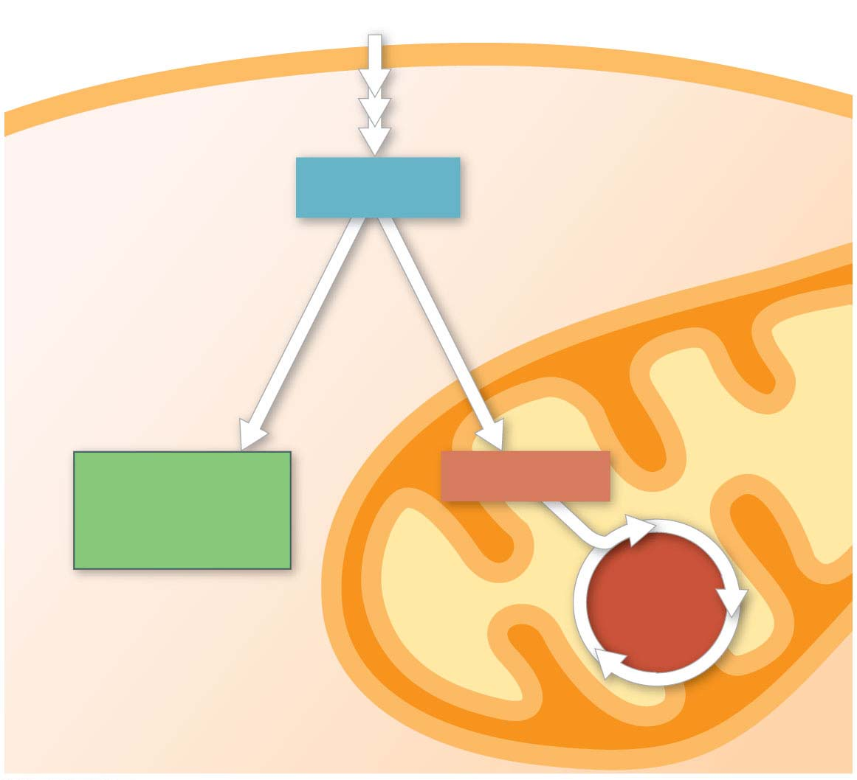
Figure 7.17
Glucose
Glycolysis
CYTOSOL
Pyruvate
No O₂ present:
Fermentation
O₂ present:
Aerobic cellular
respiration
MITOCHONDRION
Ethanol,
lactate, or
other products
Acetyl CoA
CITRIC
ACID
CYCLE
Notes:
Figure 7.17 Pyruvate as a key juncture in catabolism

Slide 14
The Evolutionary Significance of Glycolysis
Glycolysis is the most common metabolic pathway among organisms on Earth, indicating that it evolved early in the history of life
Early prokaryotes may have generated ATP exclusively through glycolysis due to the low oxygen content in the atmosphere
The location of glycolysis in the cytosol also indicates its ancient origins; eukaryotic cells with mitochondria evolved much later than prokaryotic cells
Notes:
14

Slide 15
Concept 7.6: Glycolysis and the citric acid cycle connect to many other metabolic pathways
Glycolysis and the citric acid cycle are major intersections to various catabolic and anabolic pathways
Notes:
15

Slide 16
The Versatility of Catabolism
Catabolic pathways funnel electrons from many kinds of organic molecules into cellular respiration
Glycolysis accepts a wide range of carbohydrates
Proteins must be digested to amino acids and amino groups must be removed before amino acids can feed glycolysis or the citric acid cycle
Notes:
16

Slide 17
Fats are digested to glycerol (used in glycolysis) and fatty acids
Fatty acids are broken down by beta oxidation and yield acetyl CoA
An oxidized gram of fat produces more than twice as much ATP as an oxidized gram of carbohydrate
Notes:
17

Slide 18
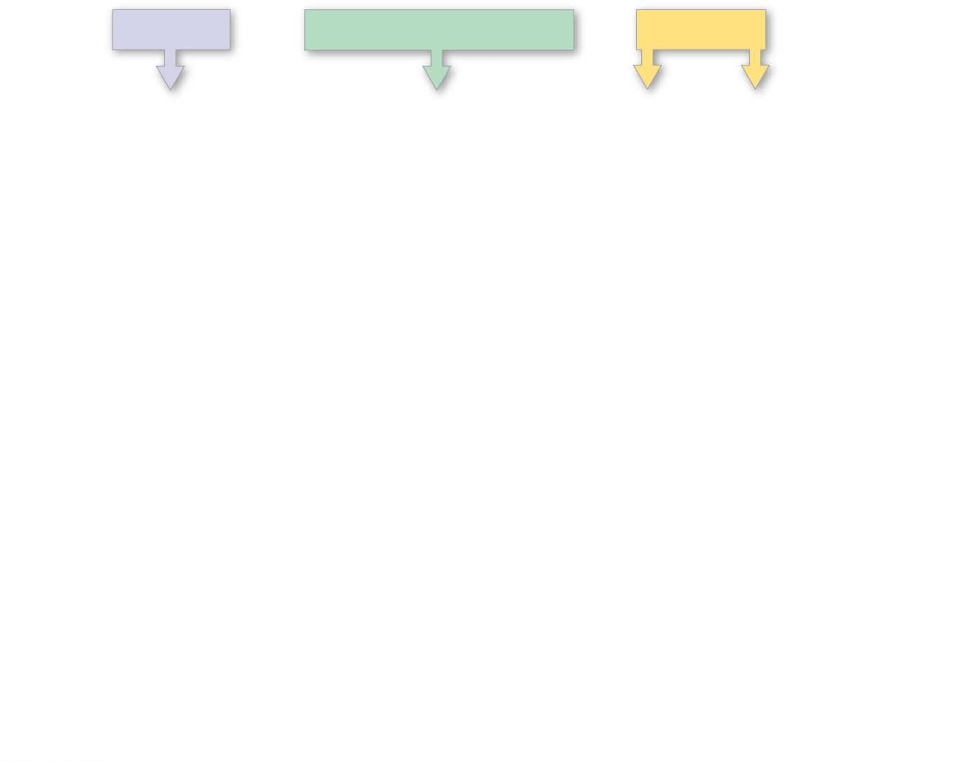
Figure 7.18-s1
Proteins
Carbohydrates
Fats
Amino
acids
Sugars
Glycerol
Fatty
acids
Notes:
Figure 7.18-s1 The catabolism of various molecules from food (step 1)

Slide 19
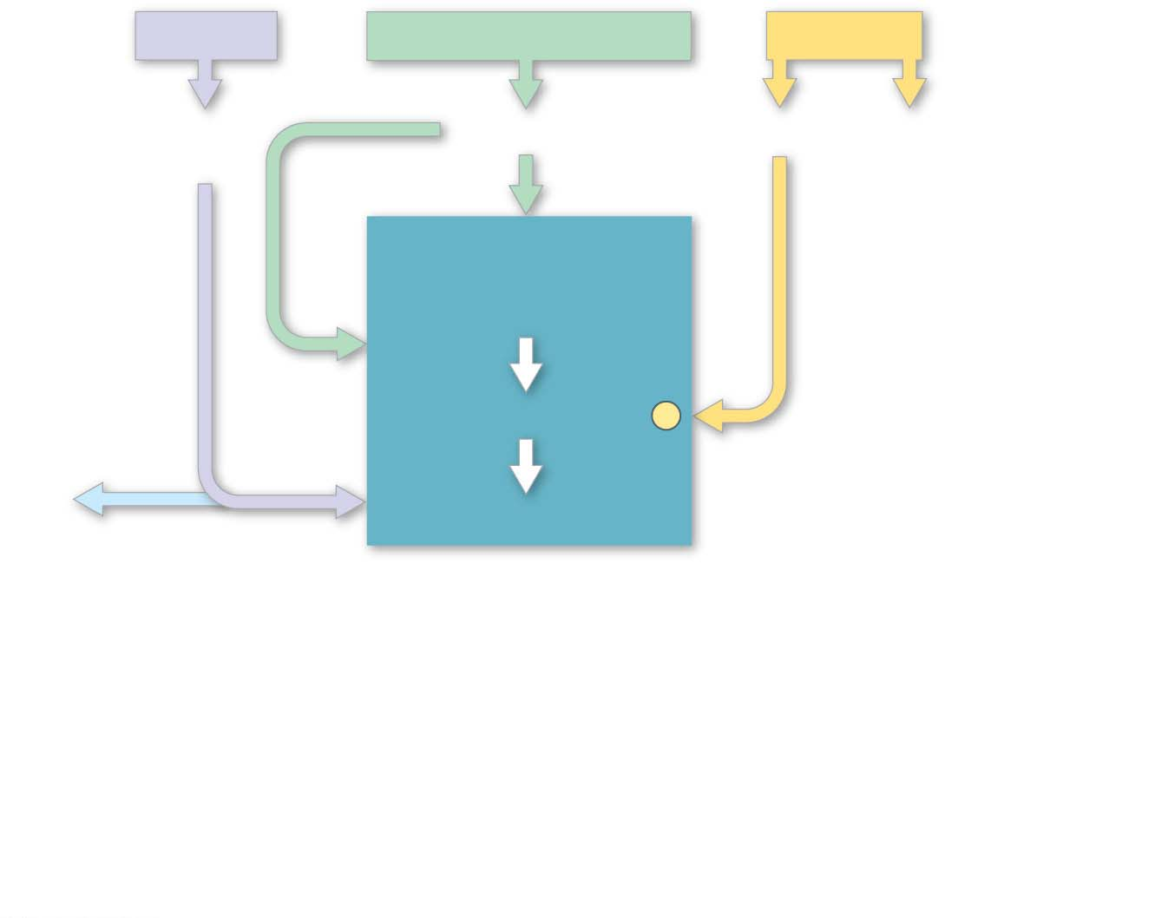
Figure 7.18-s2
Proteins
Carbohydrates
Fats
Amino
acids
Sugars
Glycerol
Fatty
acids
GLYCOLYSIS
Glucose
Glyceraldehyde 3-
P
NH₃
Pyruvate
Notes:
Figure 7.18-s2 The catabolism of various molecules from food (step 2)

Slide 20
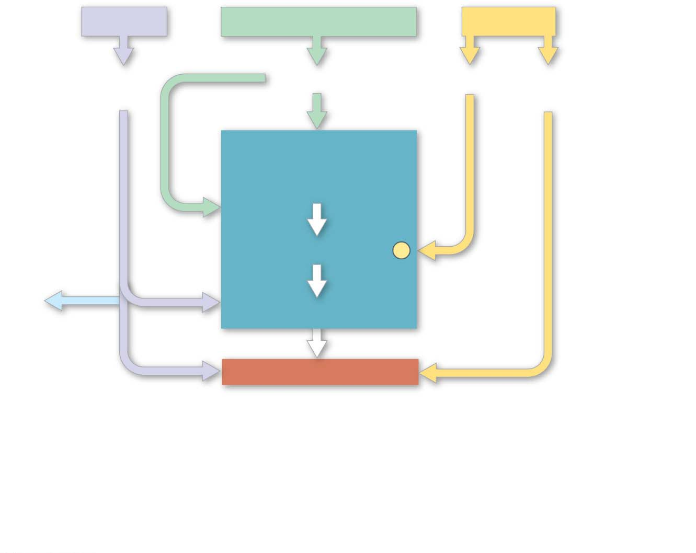
Figure 7.18-s3
Proteins
Carbohydrates
Fats
Amino
acids
Sugars
Glycerol
Fatty
acids
GLYCOLYSIS
Glucose
Glyceraldehyde 3-
P
NH₃
Pyruvate
Acetyl CoA
Notes:
Figure 7.18-s3 The catabolism of various molecules from food (step 3)

Slide 21
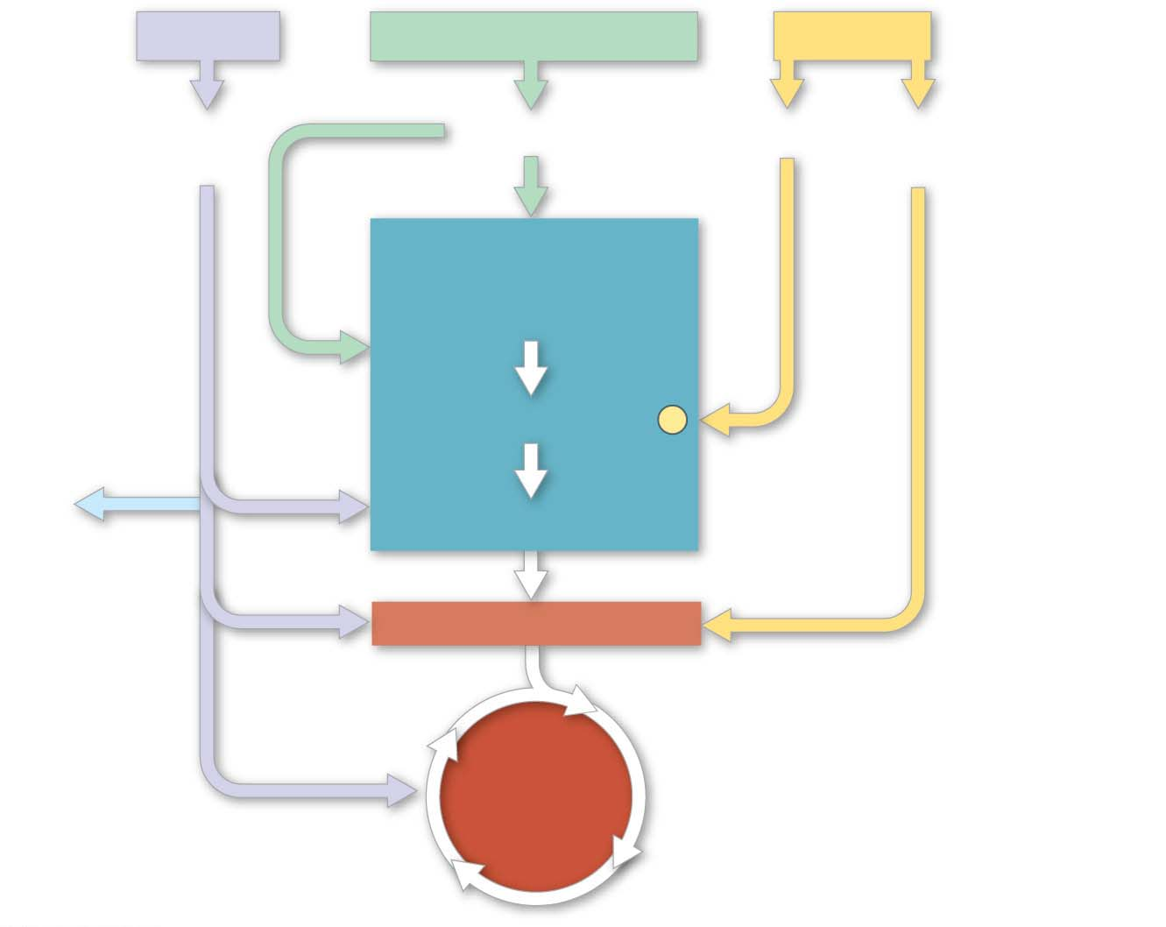
Figure 7.18-s4
Proteins
Carbohydrates
Fats
Amino
acids
Sugars
Glycerol
Fatty
acids
GLYCOLYSIS
Glucose
Glyceraldehyde 3-
P
NH₃
Pyruvate
Acetyl CoA
CITRIC
ACID
CYCLE
Notes:
Figure 7.18-s4 The catabolism of various molecules from food (step 4)

Slide 22
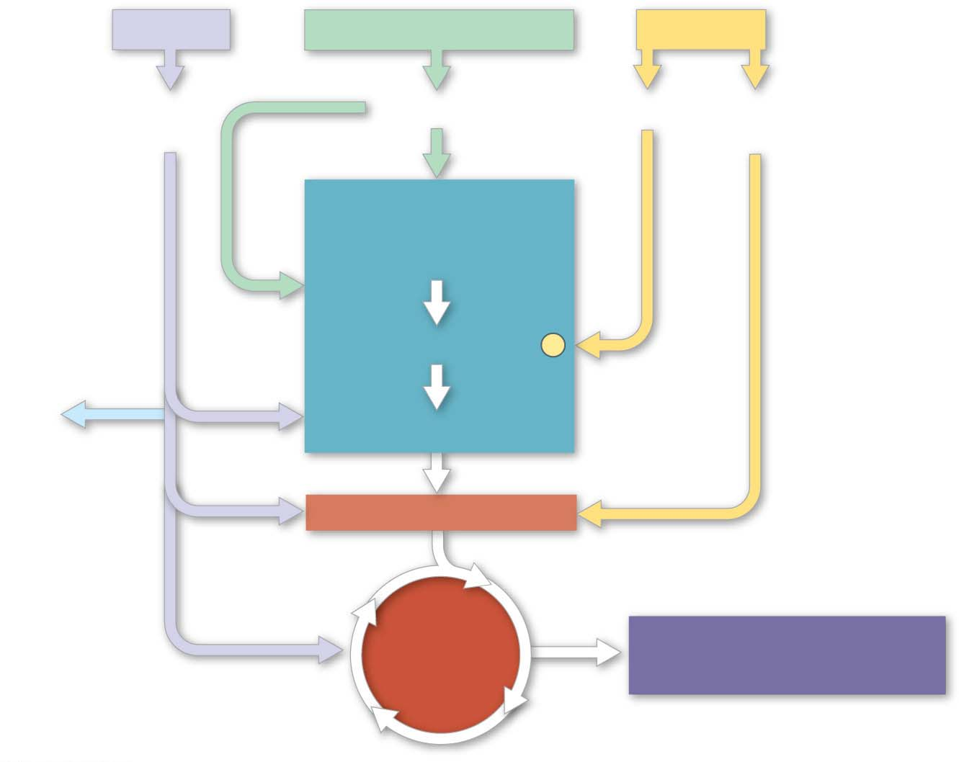
Figure 7.18-s5
Proteins
Carbohydrates
Fats
Amino
acids
Sugars
Glycerol
Fatty
acids
GLYCOLYSIS
Glucose
Glyceraldehyde 3-
P
NH₃
Pyruvate
Acetyl CoA
CITRIC
ACID
CYCLE
OXIDATIVE
PHOSPHORYLATION
Notes:
Figure 7.18-s5 The catabolism of various molecules from food (step 5)

Slide 23
Biosynthesis (Anabolic Pathways)
The body uses small molecules to build other substances
Some of these small molecules come directly from food; others can be produced during glycolysis or the citric acid cycle
Notes:
23

