Slide 1
Concept 7.4: During oxidative phosphorylation, chemiosmosis couples electron transport to ATP synthesis
Following glycolysis and the citric acid cycle, NADH and FADH₂ account for most of the energy extracted from food
These two electron carriers donate electrons to the electron transport chain, which powers ATP synthesis via oxidative phosphorylation
Notes:
1

Slide 2
The Pathway of Electron Transport
The electron transport chain is located in the inner membrane (cristae) of the mitochondrion
Most of the chain’s components are proteins, which exist in multiprotein complexes
The carriers alternate reduced and oxidized states as they accept and donate electrons
Electrons drop in free energy as they go down the chain and are finally passed to O₂, forming H₂O
Notes:
2

Slide 3
Electrons are transferred from NADH or FADH₂ to the electron transport chain
Electrons are passed through a number of proteins including cytochromes (each with an iron atom) to O₂
The electron transport chain generates no ATP directly
It breaks the large free-energy drop from food to O₂ into smaller steps that release energy in manageable amounts
Notes:
3

Slide 4
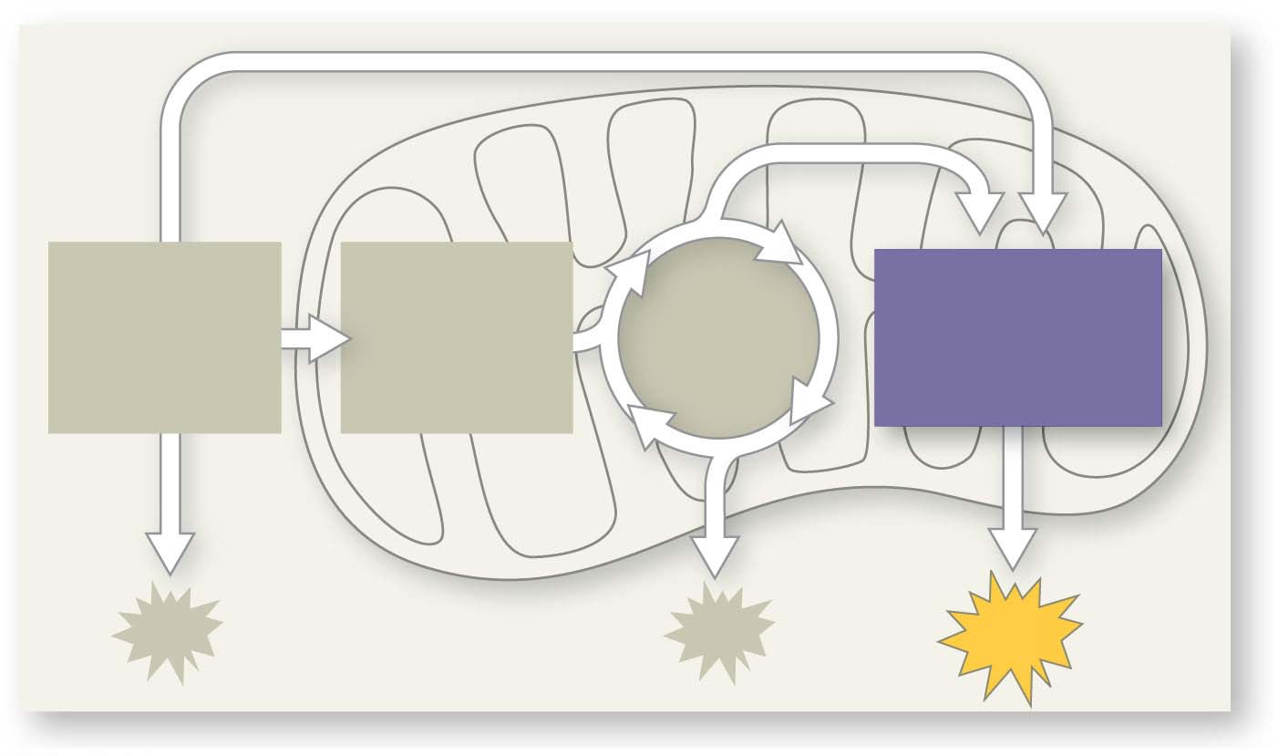
Figure 7.UN09
PYRUVATE
OXIDATION
CITRIC
ACID
CYCLE
OXIDATIVE
PHOSPHORYL-
ATION
GLYCOLYSIS
ATP
Notes:
Figure 7.UN09 In-text figure, mini-map, oxidative phosphorylation, p. 150

Slide 5
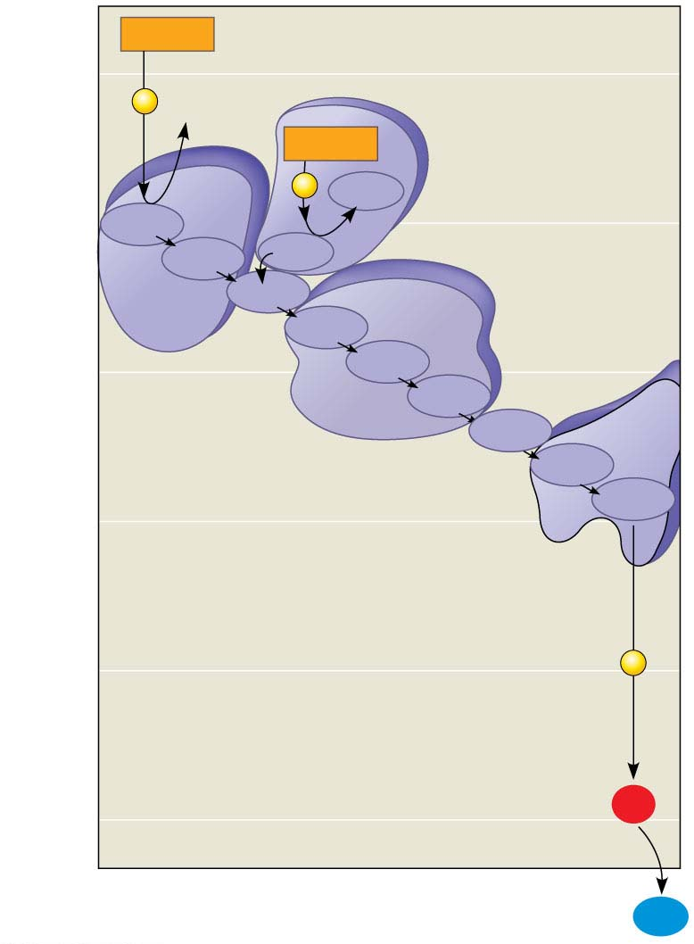
Figure 7.12
NADH
(least electronegative)
50
2
e⁻
NAD⁺
FADH₂
Free energy (G) relative to O₂ (kcal/mol)
Complexes I-IV
2
e⁻
FAD
40
FMN
I
Fe•S
Fe•S
II
Q
III
Cyt b
30
Fe•S
Cyt c₁
IV
Cyt c
Cyt a
Electron transport
chain
Cyt a₃
20
10
2
e⁻
0
2 H⁺ + ½
O₂
(most electronegative)
H₂O
Notes:
Figure 7.12 Free-energy change during electron transport

Slide 6
Chemiosmosis: The Energy-Coupling Mechanism
Electron transfer in the electron transport chain causes proteins to pump H⁺ from the mitochondrial matrix to the intermembrane space
H⁺ then moves back across the membrane, passing through the protein complex, ATP synthase
ATP synthase uses the exergonic flow of H⁺ to drive phosphorylation of ATP
This is an example of chemiosmosis, the use of energy in a H⁺ gradient to drive cellular work
Notes:
6

Slide 7
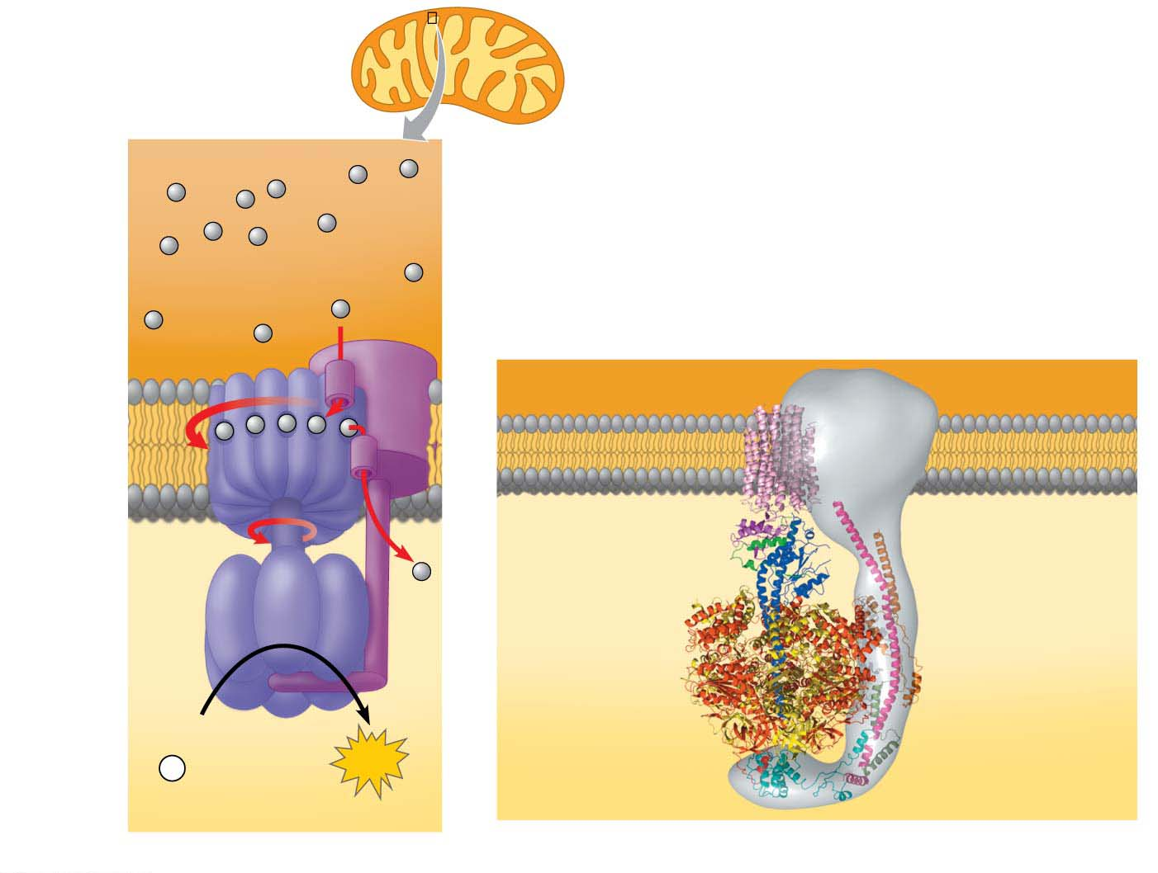
Figure 7.13
Intermembrane
space
Inner
mitochondrial
membrane
Mitochondrial
matrix
INTERMEMBRANE
SPACE
H⁺
Stator
Rotor
Internal
rod
Catalytic
knob
ADP
+
P
ATP
i
MITOCHONDRIAL MATRIX
(a) The ATP synthase protein complex
(b) Computer model of ATP synthase
Notes:
Figure 7.13 ATP synthase, a molecular mill

Slide 8
The energy stored in a H⁺ gradient across a membrane couples the redox reactions of the electron transport chain to ATP synthesis
The H⁺ gradient is referred to as a proton-motive force, emphasizing its capacity to do work
Notes:
8

Slide 9
Figure 7.UN09
PYRUVATE
OXIDATION
CITRIC
ACID
CYCLE
OXIDATIVE
PHOSPHORYL-
ATION
GLYCOLYSIS
ATP
Notes:
Figure 7.UN09 In-text figure, mini-map, oxidative phosphorylation, p. 150

Slide 10
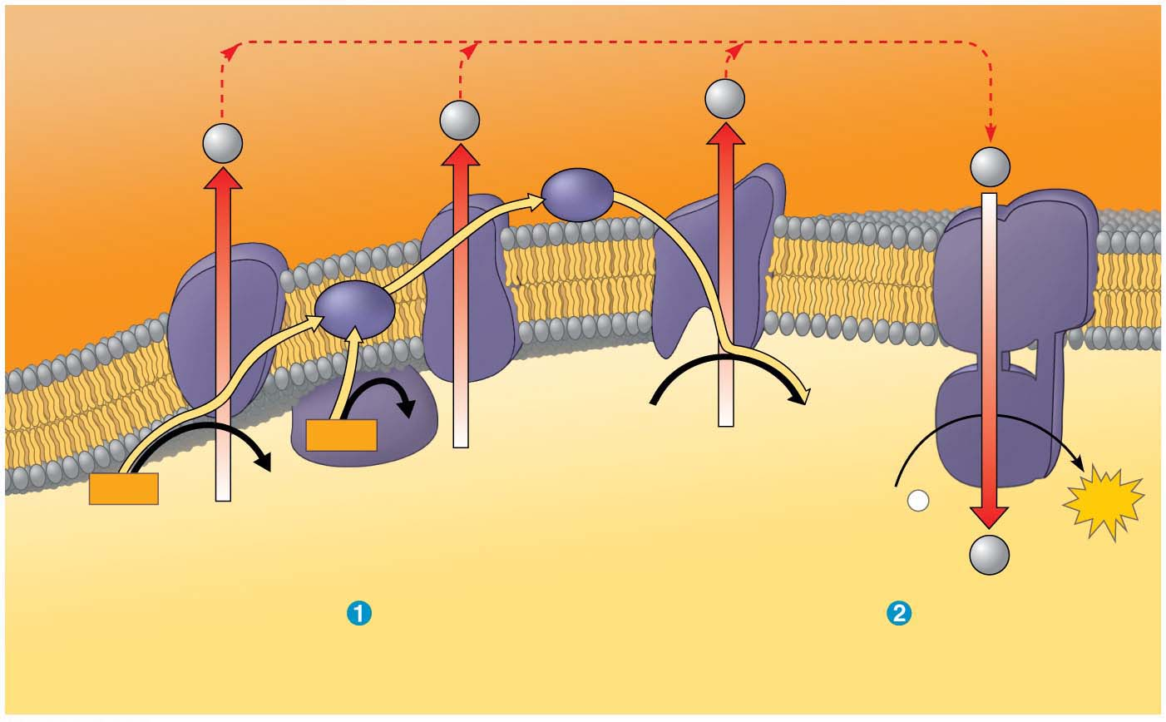
Figure 7.14
H⁺
ATP
synthase
H⁺
H⁺
H⁺
Protein complex
of electron
carriers
Cyt c
Q
IV
I
III
II
2 H⁺ + ½
O₂
H₂O
FADH₂
FAD
NADH
NAD⁺
ADP +
P
ATP
(carrying electrons
from food)
i
H⁺
Electron transport chain
Chemiosmosis
Oxidative phosphorylation
Notes:
Figure 7.14 Chemiosmosis couples the electron transport chain to ATP synthesis

Slide 11
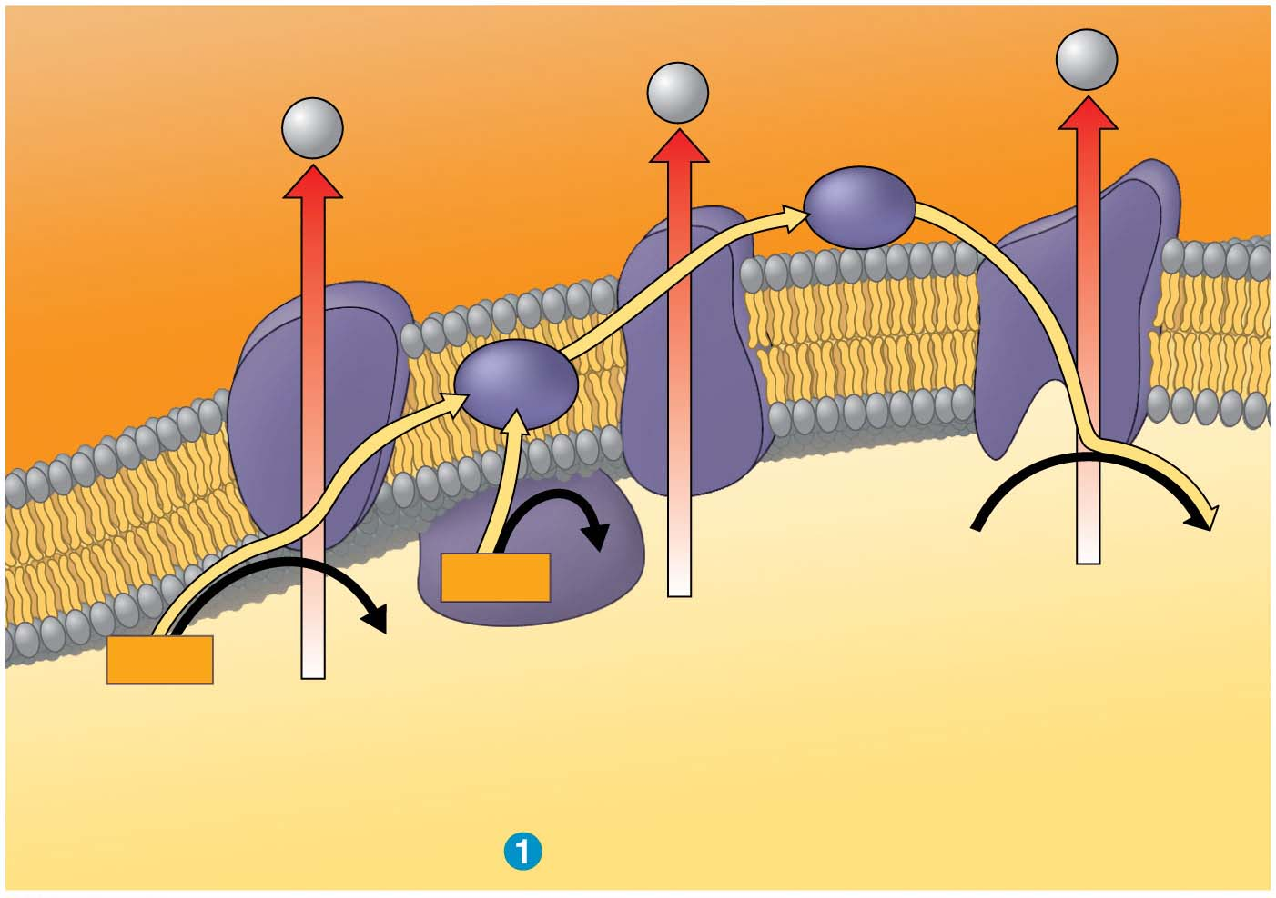
Figure 7.14-1
H⁺
H⁺
H⁺
Protein complex
of electron
carriers
Cyt c
IV
Q
I
III
II
FAD
2 H⁺ + ½
O₂
H₂O
FADH₂
NADH
NAD⁺
(carrying electrons
from food)
Electron transport chain
Notes:
Figure 7.14-1 Chemiosmosis couples the electron transport chain to ATP synthesis (part 1: electron transport chain)

Slide 12
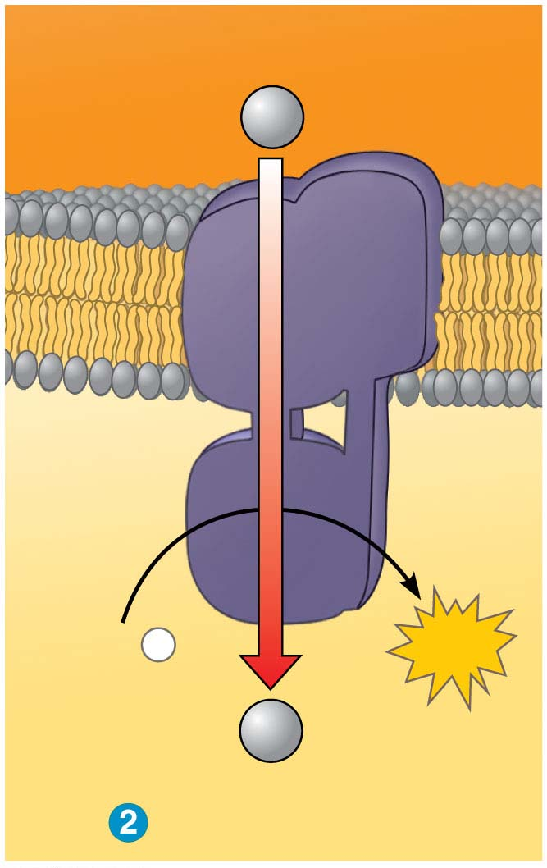
Figure 7.14-2
ATP
synthase
H⁺
ADP +
P
ATP
i
H⁺
Chemiosmosis
Notes:
Figure 7.14-2 Chemiosmosis couples the electron transport chain to ATP synthesis (part 2: chemiosmosis)

Slide 13
An Accounting of ATP Production by Cellular Respiration
During cellular respiration, most energy flows in the following sequence:
glucose → NADH → electron transport chain → proton-motive force → ATP
About 34% of the energy in a glucose molecule is transferred to ATP during cellular respiration, making about 32 ATP
There are several reasons why the number of ATP molecules is not known exactly
Notes:
13

Slide 14
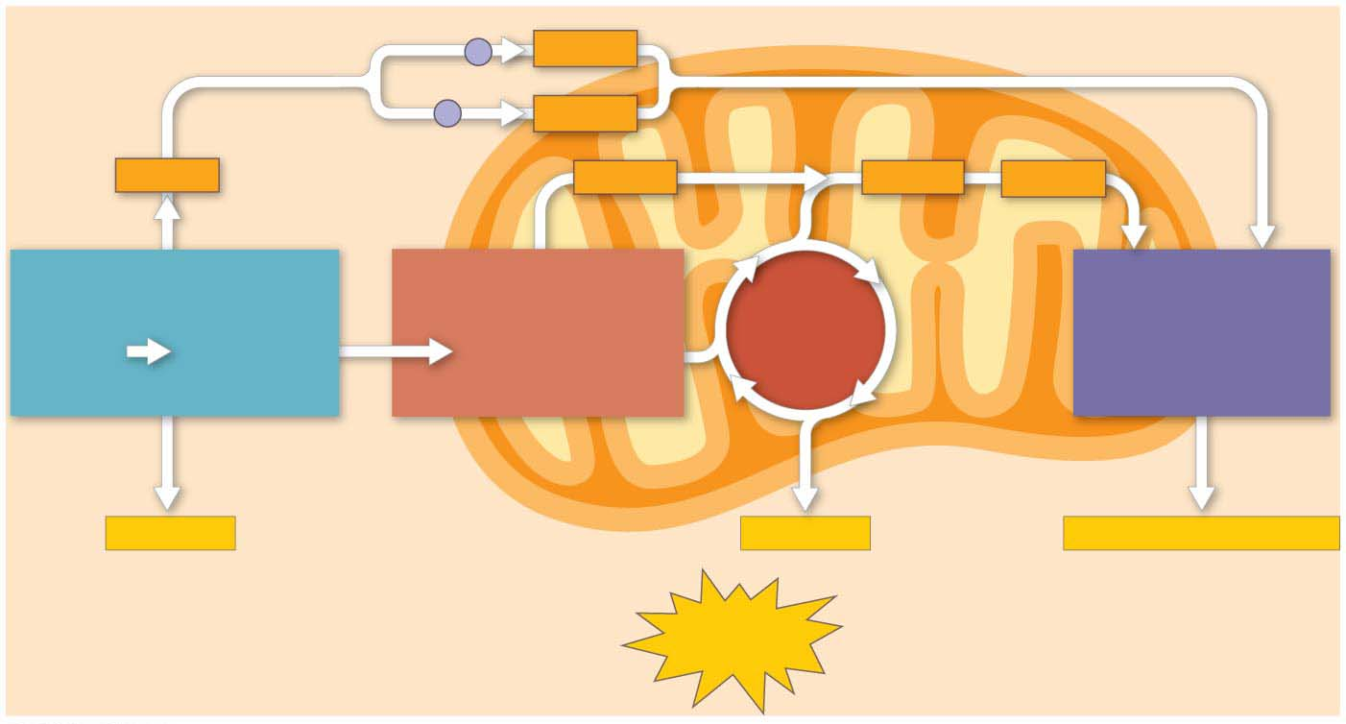
Figure 7.15
CYTOSOL
Electron shuttles
span membrane
MITOCHONDRION
2 NADH
or
2 FADH₂
2 NADH
2 NADH
6 NADH
2 FADH₂
GLYCOLYSIS
PYRUVATE OXIDATION
OXIDATIVE
PHOSPHORYLATION
CITRIC
ACID
CYCLE
Glucose
2 Pyruvate
2 Acetyl CoA
(Electron transport
and chemiosmosis)
+ 2 ATP
+ 2 ATP
+ about 26 or 28 ATP
Maximum per glucose:
About
30 or 32 ATP
Notes:
Figure 7.15 ATP yield per molecule of glucose at each stage of cellular respiration

Slide 15
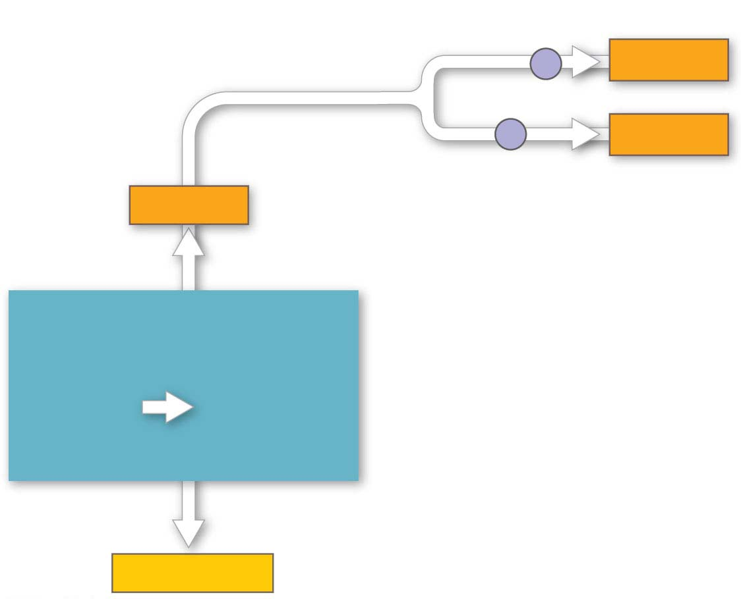
Figure 7.15-1
Electron shuttles
span membrane
2 NADH
or
2 FADH₂
2 NADH
GLYCOLYSIS
Glucose
2 Pyruvate
+ 2 ATP
Notes:
Figure 7.15-1 ATP yield per molecule of glucose at each stage of cellular respiration (part 1: glycolysis)

Slide 16
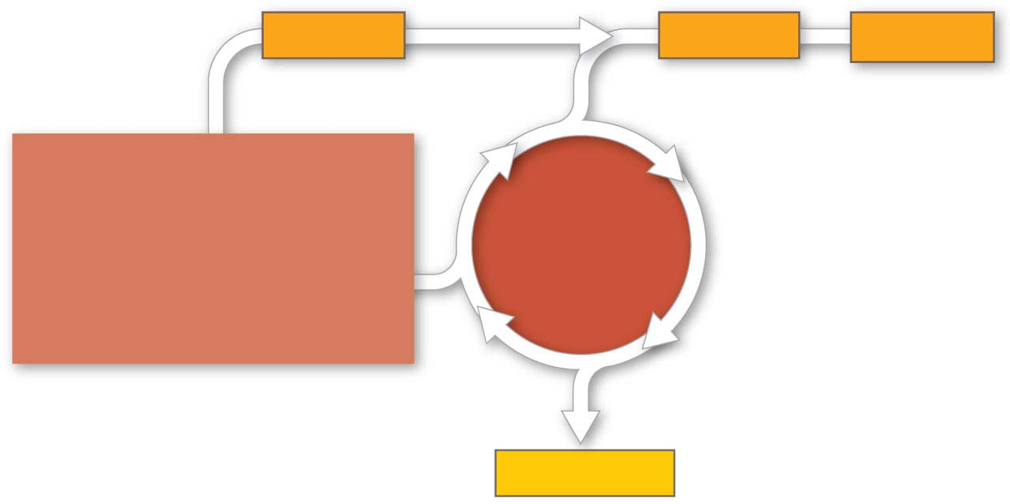
Figure 7.15-2
2 NADH
6 NADH
2 FADH₂
PYRUVATE OXIDATION
CITRIC
ACID
CYCLE
2 Acetyl CoA
+ 2 ATP
Notes:
Figure 7.15-2 ATP yield per molecule of glucose at each stage of cellular respiration (part 2: citric acid cycle)

Slide 17
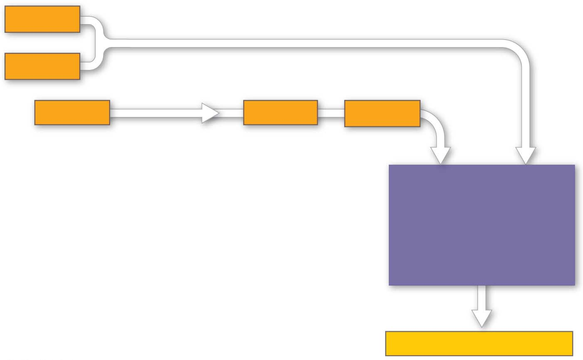
Figure 7.15-3
2 NADH
or
2 FADH₂
2 NADH
6 NADH
2 FADH₂
OXIDATIVE
PHOSPHORYLATION
(Electron transport
and chemiosmosis)
+ about 26 or 28 ATP
Notes:
Figure 7.15-3 ATP yield per molecule of glucose at each stage of cellular respiration (part 3: oxidative phosphorylation)

Slide 18
Figure 7.15-4
Maximum per glucose:
About
30 or 32 ATP
Notes:
Figure 7.15-4 ATP yield per molecule of glucose at each stage of cellular respiration (part 4: maximum ATP yield per glucose)

