Slide 1
Concept 5.3: Passive transport is diffusion of a substance across a membrane with no energy investment
Diffusion is the tendency for molecules to spread out evenly into the available space
Although each molecule moves randomly, diffusion of a population of molecules may be directional
At dynamic equilibrium, as many molecules cross the membrane in one direction as in the other
Notes:
1

Slide 2
Animation: Diffusion

Slide 3
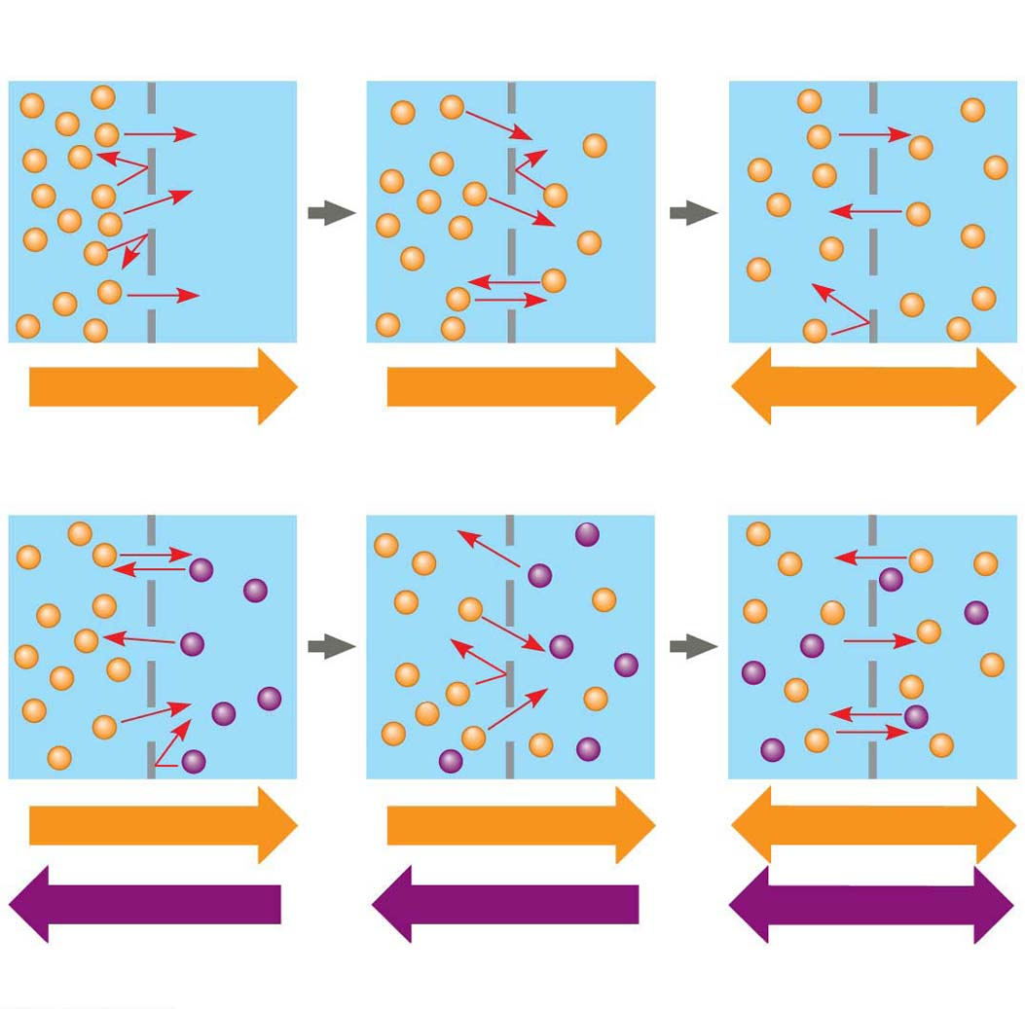
Figure 5.9
Molecules of dye
Membrane (cross section)
WATER
Net diffusion
Net diffusion
Equilibrium
(a) Diffusion of one solute
Net diffusion
Net diffusion
Equilibrium
Net diffusion
Net diffusion
Equilibrium
(b) Diffusion of two solutes
Notes:
Figure 5.9 The diffusion of solutes across a synthetic membrane

Slide 4
Substances diffuse down their concentration gradient, from where it is more concentrated to where it is less concentrated
No work must be done to move substances down the concentration gradient
The diffusion of a substance across a biological membrane is passive transport because no energy is expended by the cell to make it happen
Notes:
4

Slide 5
Effects of Osmosis on Water Balance
Osmosis is the diffusion of free water across a selectively permeable membrane
Water diffuses across a membrane from the region of lower solute concentration to the region of higher solute concentration until the solute concentration is equal on both sides
Notes:
5

Slide 6
Animation: Membrane Selectivity

Slide 7
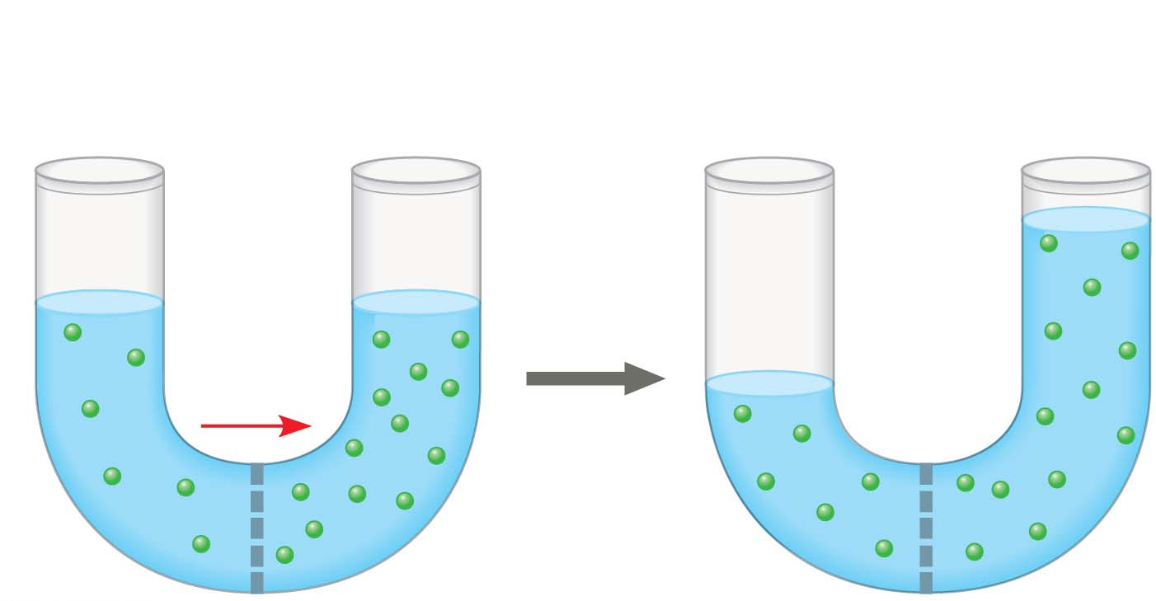
Figure 5.10-1
Lower
concentration
of solute (sugar)
Higher
concentration
of solute
More similar
concentrations of solute
Sugar
molecule
H₂O
Notes:
Figure 5.10-1 Osmosis (part 1)

Slide 8
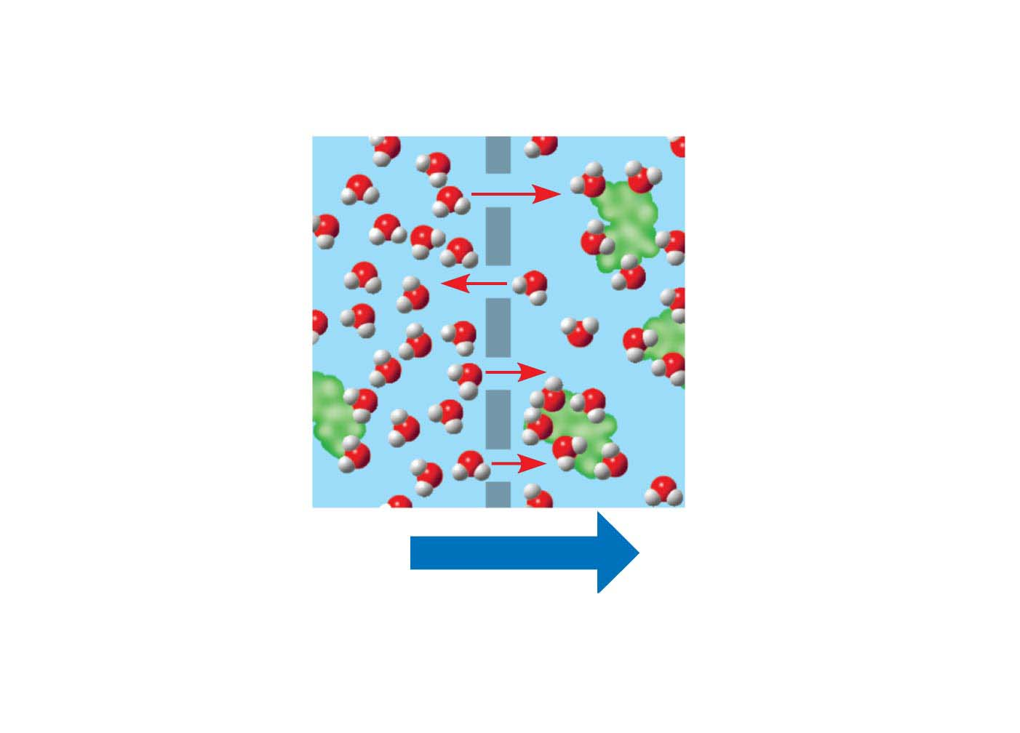
Figure 5.10-2
Selectively
permeable
membrane
Water molecules
can pass through
pores, but sugar
molecules cannot.
Water molecules
cluster around
sugar molecules.
This side has
fewer solute
molecules and
more free water
molecules.
This side has more
solute molecules
and fewer free
water molecules.
Osmosis
Water moves from an area of
higher to lower free water concentration
(lower to higher solute concentration).
Notes:
Figure 5.10-2 Osmosis (part 2)

Slide 9
Water Balance of Cells Without Walls
Tonicity is the ability of a surrounding solution to cause a cell to gain or lose water
Isotonic solution: Solute concentration is the same as inside the cell; no net water movement across the plasma membrane
Hypertonic solution: Solute concentration is greater than that inside the cell; cell loses water
Hypotonic solution: Solute concentration is less than that inside the cell; cell gains water
Notes:
9

Slide 10
Figure 5.11a
Hypotonic solution
Isotonic solution
Hypertonic solution
H₂O
H₂O
H₂O
H₂O
(a) Animal cell
Lysed
Normal
Shriveled
Notes:
Figure 5.11a The water balance of living cells

Slide 11
Hypertonic or hypotonic environments create osmotic problems for organisms
Osmoregulation, the control of solute concentrations and water balance, is a necessary adaptation for life in such environments
The protist Paramecium caudatum, which is hypertonic to its pondwater environment, has a contractile vacuole that can pump excess water out of the cell
Notes:
11

Slide 12
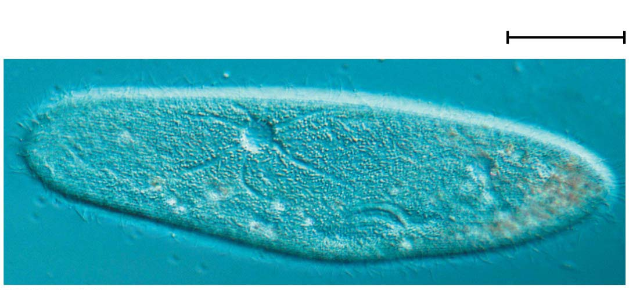
Figure 5.12
50 𝛍m
Contractile vacuole
Notes:
Figure 5.12 The contractile vacuole of Paramecium caudatum

Slide 13
Water Balance of Cells with Walls
Cell walls help maintain water balance
A plant cell in a hypotonic solution swells until the wall opposes uptake; the cell is now turgid (very firm)
If a plant cell and its surroundings are isotonic, there is no net movement of water into the cell; the cell becomes flaccid (limp), and the plant may wilt
In a hypertonic environment, plant cells lose water; eventually, the membrane pulls away from the wall, a usually lethal effect called plasmolysis
Notes:
13

Slide 14
Figure 5.11b
Plasma
membrane
Cell wall
H₂O
Plasma
membrane
H₂O
H₂O
H₂O
(b) Plant cell
Turgid (normal)
Flaccid
Plasmolyzed
Notes:
Figure 5.11b The water balance of living cells

Slide 15
Facilitated Diffusion: Passive Transport Aided by Proteins
In facilitated diffusion, transport proteins speed the passive movement of molecules across the plasma membrane
Channel proteins provide corridors that allow a specific molecule or ion to cross the membrane
Channel proteins include
Aquaporins, for facilitated diffusion of water
Ion channels that open or close in response to a stimulus (gated channels)
Notes:
15

Slide 16
Video: Membrane and Aquaporin

Slide 17
Carrier proteins undergo a subtle change in shape that translocates the solute-binding site across the membrane
The shape change may be triggered by binding and release of the transported molecule
No net energy input is required
Notes:
17

Slide 18
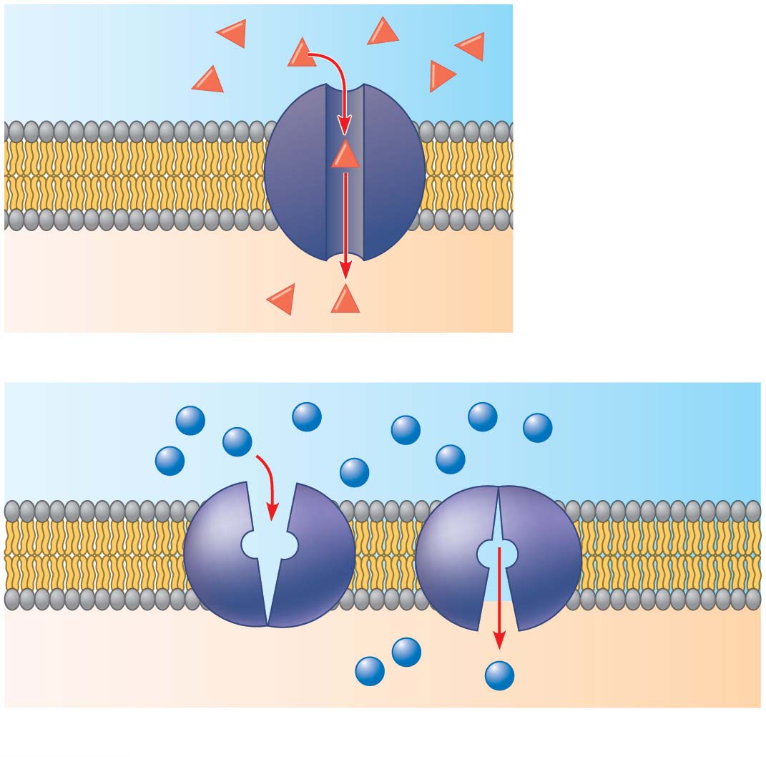
Figure 5.13
EXTRA-
CELLULAR
FLUID
(a) A channel
protein
Channel protein
Solute
CYTOPLASM
Carrier protein
Solute
(b) A carrier protein
Notes:
Figure 5.13 Two types of transport proteins that carry out facilitated diffusion

Slide 19
Concept 5.4: Active transport uses energy to move solutes against their gradients
Facilitated diffusion speeds transport of a solute by providing efficient passage through the membrane but does not alter the direction of transport
Some transport proteins, however, can move solutes against their concentration gradients
Notes:
19

Slide 20
The Need for Energy in Active Transport
Active transport moves substances against their concentration gradients
Active transport requires energy, usually in the form of ATP
Notes:
20

Slide 21
Active transport allows cells to maintain concentration gradients that differ from their surroundings
The sodium-potassium pump is one type of active transport system
Notes:
21

Slide 22
Animation: Active Transport

Slide 23
Video: Membrane Transport

Slide 24
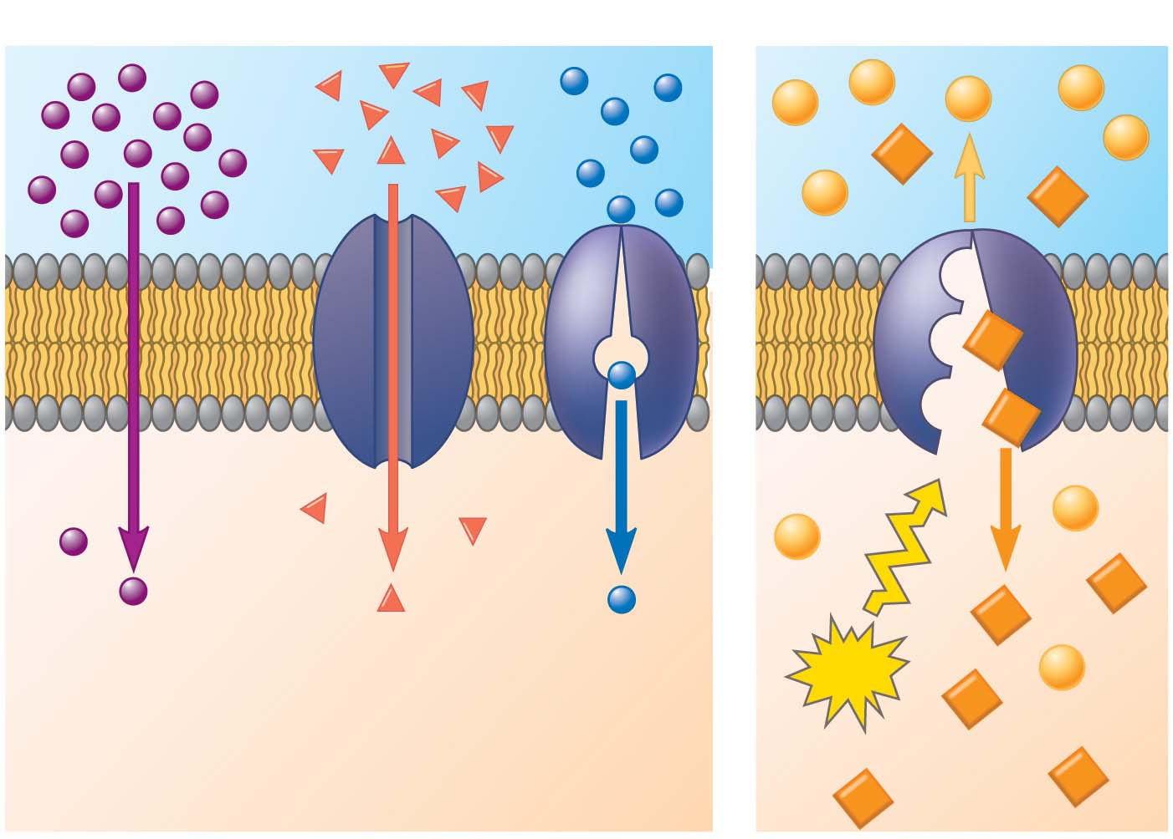
Figure 5.15
Passive transport
Active transport
Diffusion
Facilitated diffusion
ATP
Notes:
Figure 5.15 Review: passive and active transport

Slide 25
How Ion Pumps Maintain Membrane Potential
Membrane potential is the voltage across a membrane
Voltage is created by differences in the distribution of positive and negative ions across a membrane
Notes:
25

Slide 26
Two combined forces, collectively called the electrochemical gradient, drive the diffusion of ions across a membrane
A chemical force (the ion’s concentration gradient)
An electrical force (the effect of the membrane potential on the ion’s movement)
Notes:
26

Slide 27
An electrogenic pump is a transport protein that generates voltage across a membrane
The sodium-potassium pump is the major electrogenic pump of animal cells
The main electrogenic pump of plants, fungi, and bacteria is a proton pump
Electrogenic pumps help store energy that can be used for cellular work
Notes:
27

Slide 28
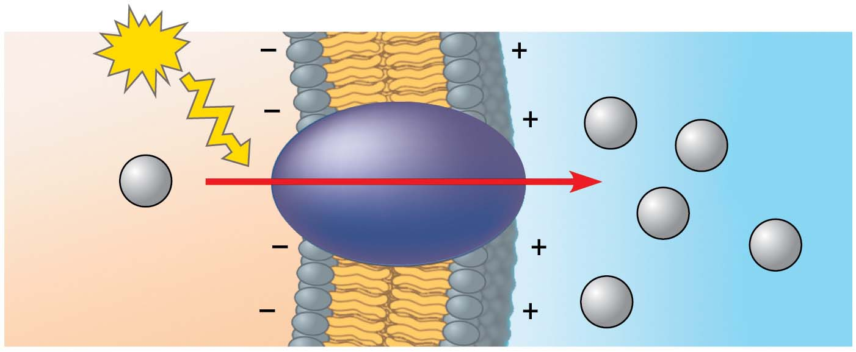
Figure 5.16
ATP
EXTRACELLULAR
FLUID
H⁺
H⁺
H⁺
Proton pump
H⁺
H⁺
H⁺
CYTOPLASM
Notes:
Figure 5.16 A proton pump

Slide 29
Cotransport: Coupled Transport by a Membrane Protein
Cotransport occurs when active transport of a solute indirectly drives transport of other solutes
Plant cells use the gradient of hydrogen ions generated by proton pumps to drive active transport of nutrients into the cell
Notes:
29

Slide 30
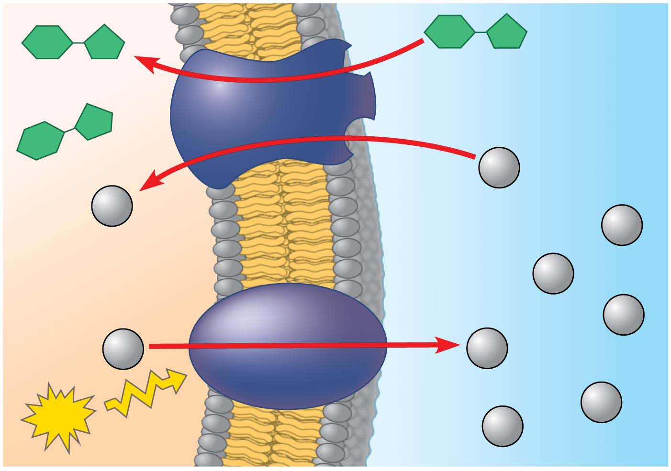
Figure 5.17
+
−
Sucrose
Sucrose
Sucrose-H⁺
cotransporter
Diffusion of H⁺
H⁺
+
H⁺
−
H⁺
+
−
H⁺
H⁺
H⁺
H⁺
Proton pump
H⁺
ATP
−
+
H⁺
Notes:
Figure 5.17 Cotransport: active transport driven by a concentration gradient

