Slide 1
Concept 3.6: Nucleic acids store, transmit, and help express hereditary information
The amino acid sequence of a polypeptide is programmed by a unit of inheritance called a gene
Genes are made of DNA, a nucleic acid made of monomers called nucleotides
Notes:
1

Slide 2
The Roles of Nucleic Acids
There are two types of nucleic acids
Deoxyribonucleic acid (DNA)
Ribonucleic acid (RNA)
DNA provides directions for its own replication
DNA also directs synthesis of messenger RNA (mRNA) and, through mRNA, controls protein synthesis
Notes:
2

Slide 3
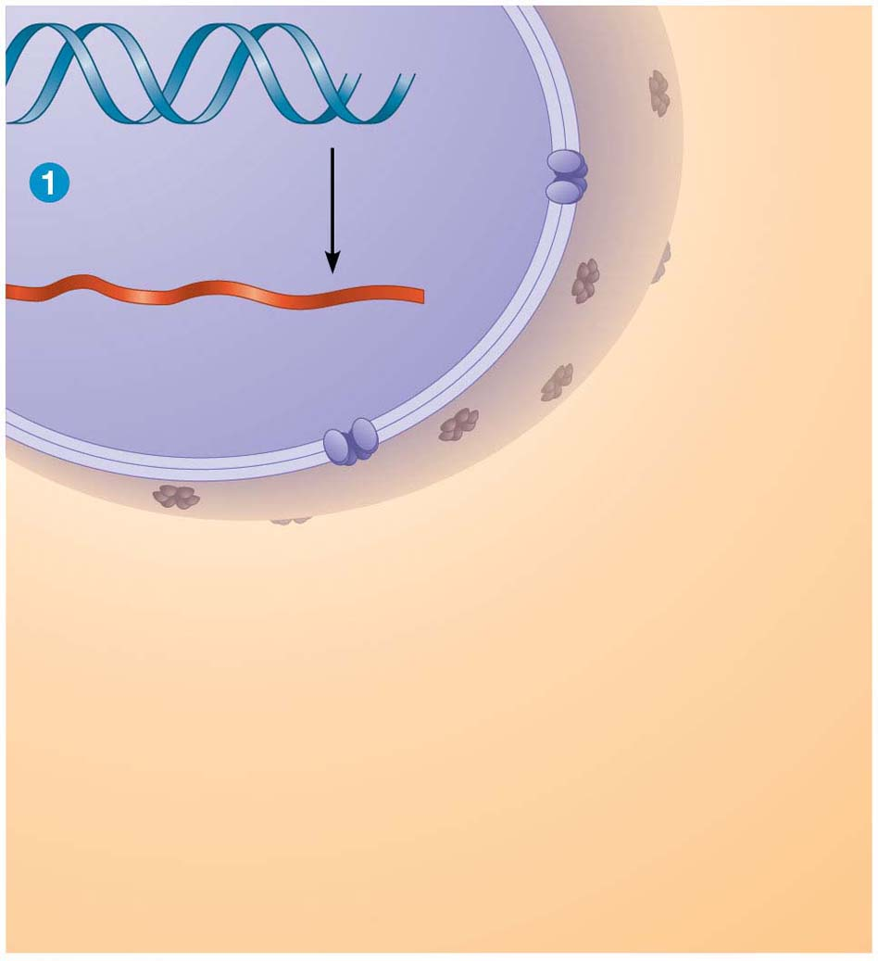
Figure 3.26-s1
DNA
Synthesis
of mRNA
mRNA
NUCLEUS
CYTOPLASM
Notes:
Figure 3.26-s1 Gene expression: DNA → RNA → protein (step 1)

Slide 4
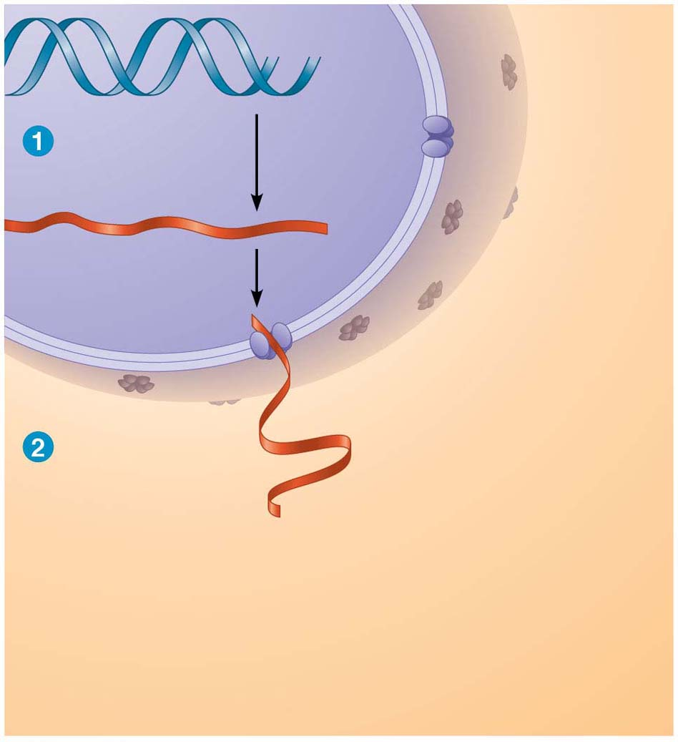
Figure 3.26-s2
DNA
Synthesis
of mRNA
mRNA
NUCLEUS
CYTOPLASM
mRNA
Movement of
mRNA into
cytoplasm
Notes:
Figure 3.26-s2 Gene expression: DNA → RNA → protein (step 2)

Slide 5
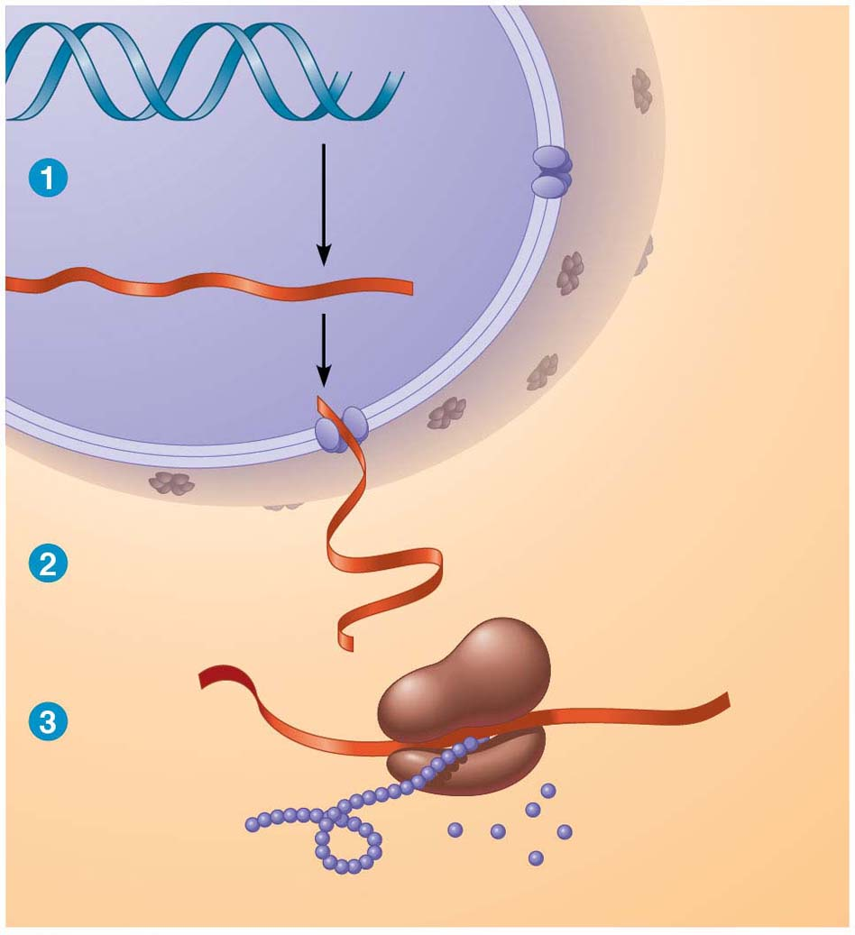
Figure 3.26-s3
DNA
Synthesis
of mRNA
mRNA
NUCLEUS
CYTOPLASM
mRNA
Movement of
mRNA into
cytoplasm
Ribosome
Synthesis
of protein
Amino
acids
Polypeptide
Notes:
Figure 3.26-s3 Gene expression: DNA → RNA → protein (step 3)

Slide 6
The Components of Nucleic Acids
Nucleic acids are polymers called polynucleotides
Each polynucleotide is made of monomers called nucleotides
Each nucleotide consists of a nitrogenous base, a pentose sugar, and one or more phosphate groups
The portion of a nucleotide without the phosphate group is called a nucleoside
Notes:
6

Slide 7
Animation: DNA and RNA Structure

Slide 8
Each nitrogenous base has one or two rings that include nitrogen atoms
There are two families of nitrogenous bases
Pyrimidines include cytosine (C), thymine (T), and uracil (U)
Purines include adenine (A) and guanine (G)
Thymine is found only in DNA, and uracil only in RNA; the rest are found in both DNA and RNA
Notes:
8

Slide 9
The sugar in DNA is deoxyribose; in RNA it is ribose
A prime (′) is used to identify the carbon atoms in the ribose, such as the 2′ carbon or 5′ carbon
A nucleoside with at least one phosphate attached is a nucleotide
Notes:
9

Slide 10
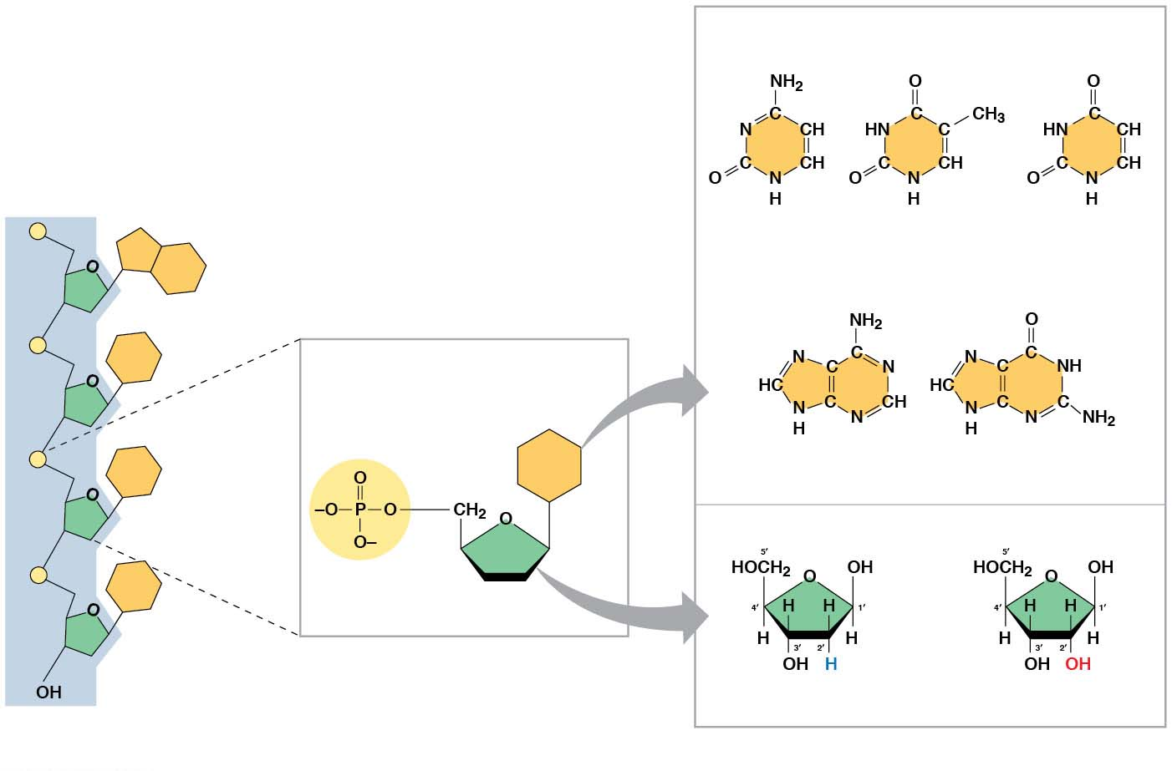
Figure 3.27
NITROGENOUS BASES
Pyrimidines
Sugar-phosphate backbone
(on blue background)
5′ end
Cytosine (C)
Thymine
(T, in DNA)
Uracil (U, in RNA)
5′C
3′C
Purines
Nucleoside
Nitrogenous
base
5′C
Adenine (A)
Guanine (G)
1′C
SUGARS
Phosphate
group
3′C
5′C
Sugar
(pentose)
3′C
(b) Nucleotide
3′ end
Deoxyribose (in DNA)
Ribose (in RNA)
(a) Polynucleotide, or nucleic acid
(c) Nucleoside components
Notes:
Figure 3.27 Components of nucleic acids

Slide 11
Nucleotide Polymers
Adjacent nucleotides are joined by covalent bonds between the —OH group on the 3′ carbon of one nucleotide and the phosphate on the 5′ carbon of the next
These links create a backbone of sugar-phosphate units with nitrogenous bases as appendages
The sequence of bases along a DNA or mRNA polymer is unique for each gene
Notes:
11

Slide 12
The Structures of DNA and RNA Molecules
RNA molecules usually exist as single polypeptide chains
DNA molecules have two polynucleotides spiraling around an imaginary axis, forming a double helix
In the DNA double helix, the two backbones run in opposite 5′→ 3′ directions from each other, an arrangement referred to as antiparallel
One DNA molecule includes many genes
Notes:
12

Slide 13
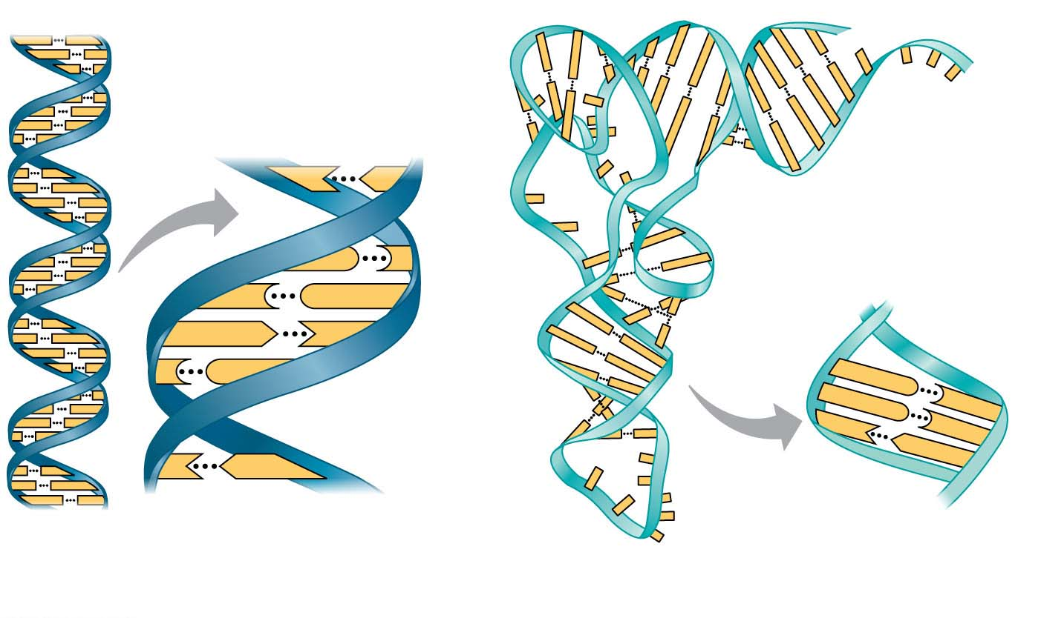
Figure 3.28
5′
3′
Sugar-phosphate
backbones
Hydrogen bonds
T
A
Base pair joined
by hydrogen bonding
G
C
C
G
A
T
C
G
G
G
C
U
C
A
A
T
3′
5′
Base pair joined
by hydrogen bonding
(a) DNA
(b) Transfer RNA
Notes:
Figure 3.28 The structures of DNA and tRNA molecules

Slide 14
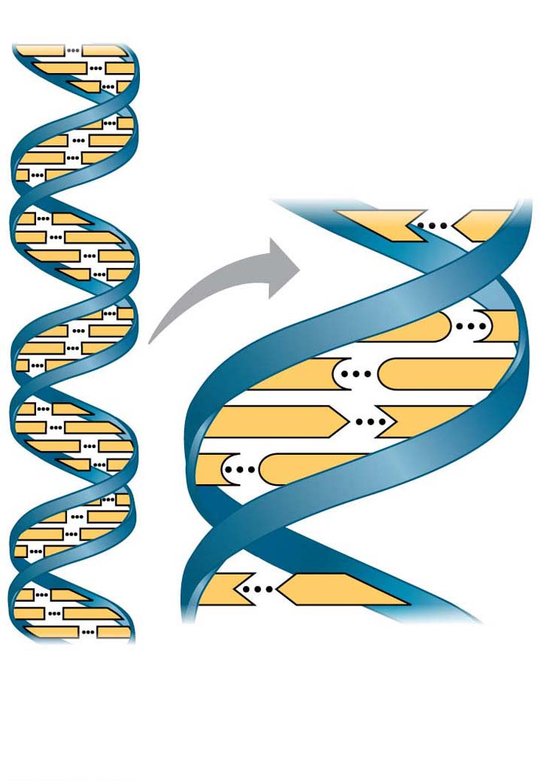
Figure 3.28-1
5′
3′
Sugar-phosphate
backbones
Hydrogen bonds
T
A
G
C
C
G
A
T
C
G
T
A
Base pair joined
by hydrogen bonding
3′
5′
(a) DNA
Notes:
Figure 3.28-1 The structures of DNA and tRNA molecules (part 1: DNA)

Slide 15
The nitrogenous bases in DNA pair up and form hydrogen bonds: adenine (A) always with thymine (T), and guanine (G) always with cytosine (C)
This is called complementary base pairing
Complementary pairing can also occur between two RNA molecules or between parts of the same molecule
In RNA, thymine is replaced by uracil (U), so A and U pair
Notes:
15

Slide 16
DNA and Proteins as Tape Measures of Evolution
The linear sequences of nucleotides in DNA molecules are passed from parents to offspring
Two closely related species are more similar in DNA than are more distantly related species
Molecular biology can be used to assess evolutionary kinship
Notes:
16

