Slide 1
Concept 3.3: Carbohydrates serve as fuel and building material
Carbohydrates include sugars and the polymers of sugars
The simplest carbohydrates are monosaccharides, or simple sugars
Carbohydrate macromolecules are polysaccharides, polymers composed of many sugar building blocks
Notes:
1

Slide 2
Sugars
Monosaccharides have molecular formulas that are usually multiples of CH₂O
Glucose (C₆H₁₂O₆) is the most common monosaccharide
Monosaccharides are classified by the number of carbons in the carbon skeleton and the placement of the carbonyl group
Notes:
2

Slide 3
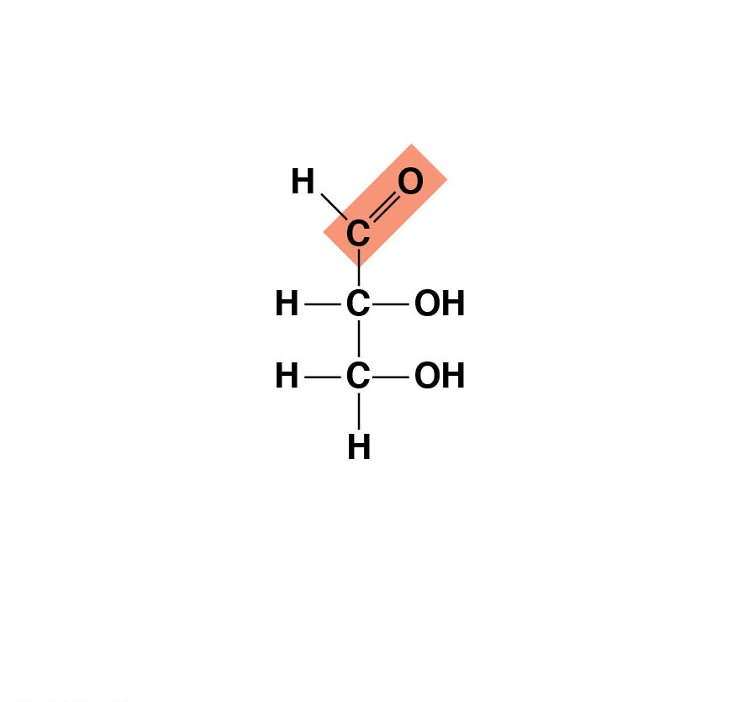
Figure 3.8-1
Triose: three-carbon sugar (C₃H₆O₃)
Glyceraldehyde
An initial breakdown
product of glucose in cells
Notes:
Figure 3.8-1 Examples of monosaccharides (part 1: triose)

Slide 4
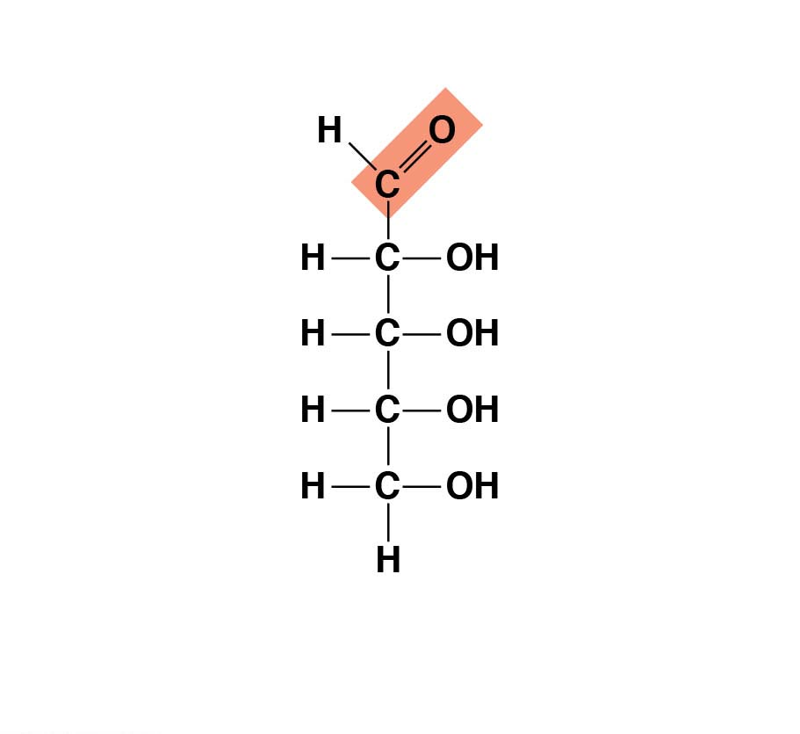
Figure 3.8-2
Pentose: five-carbon sugar (C₅H₁₀O₅)
Ribose
A component of RNA
Notes:
Figure 3.8-2 Examples of monosaccharides (part 2: pentose)

Slide 5
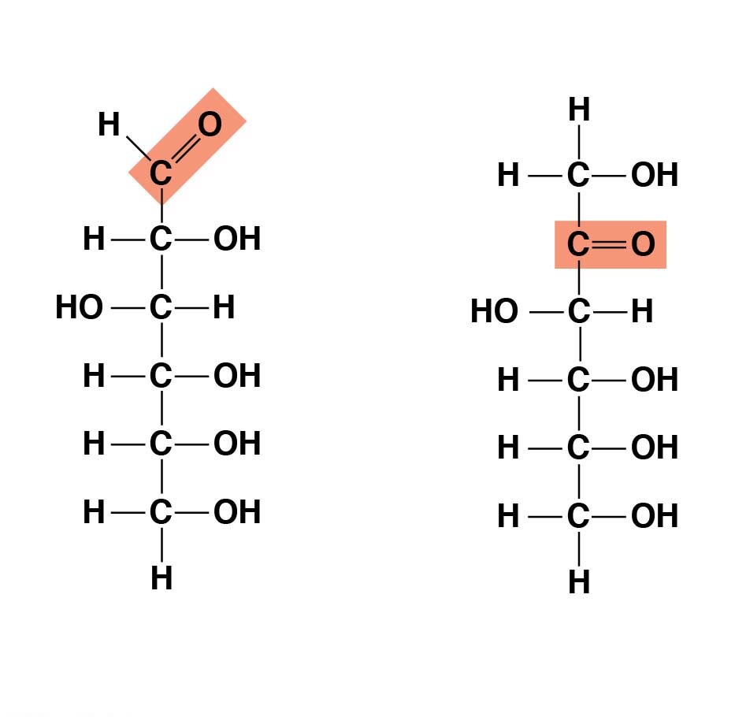
Figure 3.8-3
Hexoses: six-carbon sugars (C₆H₁₂O₆)
Glucose
Fructose
Energy sources for organisms
Notes:
Figure 3.8-3 Examples of monosaccharides (part 3: hexoses)

Slide 6
Though often drawn as linear skeletons, in aqueous solutions many sugars form rings
Monosaccharides serve as a major nutrients for cells and as raw material for building molecules
Notes:
6

Slide 7
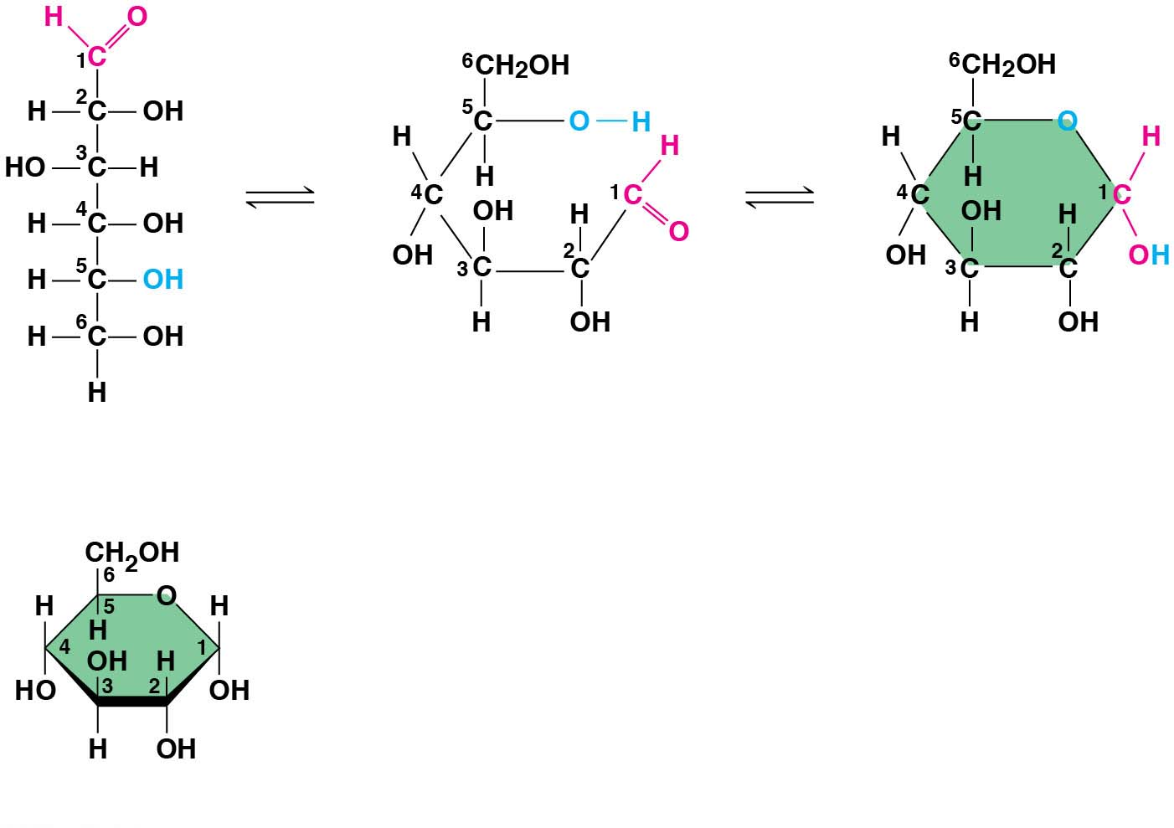
Figure 3.9
(a) Linear and ring forms
(b) Abbreviated ring structure
Notes:
Figure 3.9 Linear and ring forms of glucose

Slide 8
A disaccharide is formed when a dehydration reaction joins two monosaccharides
This covalent bond is called a glycosidic linkage
Notes:
8

Slide 9
Animation: Disaccharides

Slide 10
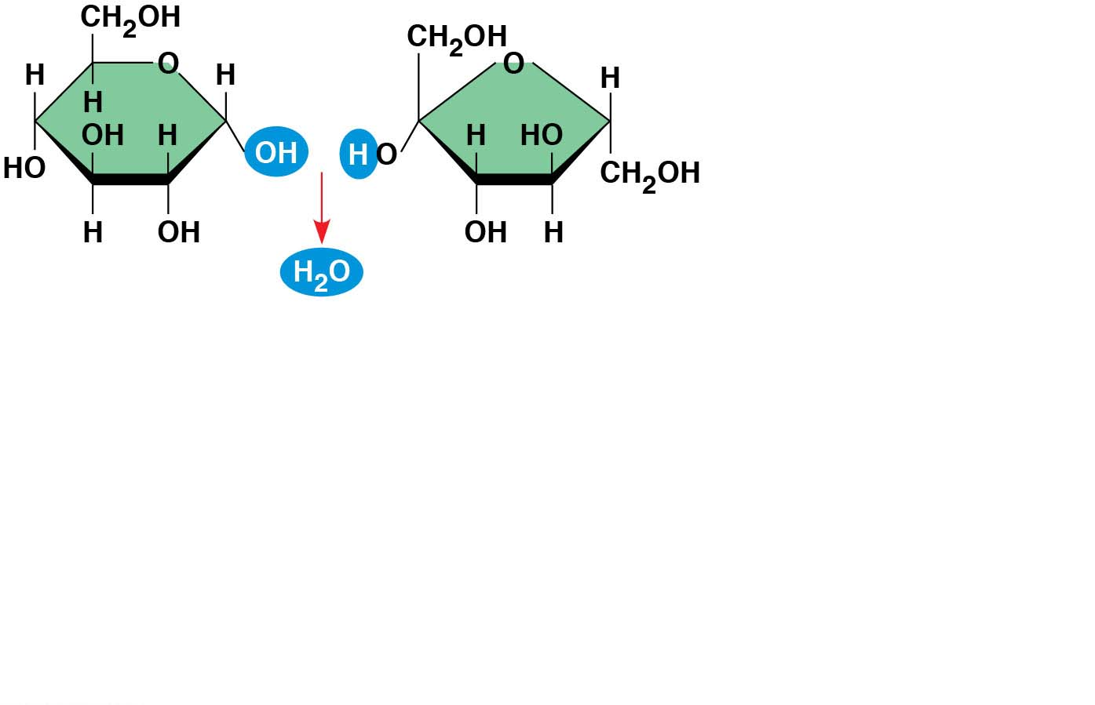
Figure 3.10-s1
Glucose
Fructose
Notes:
Figure 3.10-s1 Disaccharide synthesis (step 1)

Slide 11
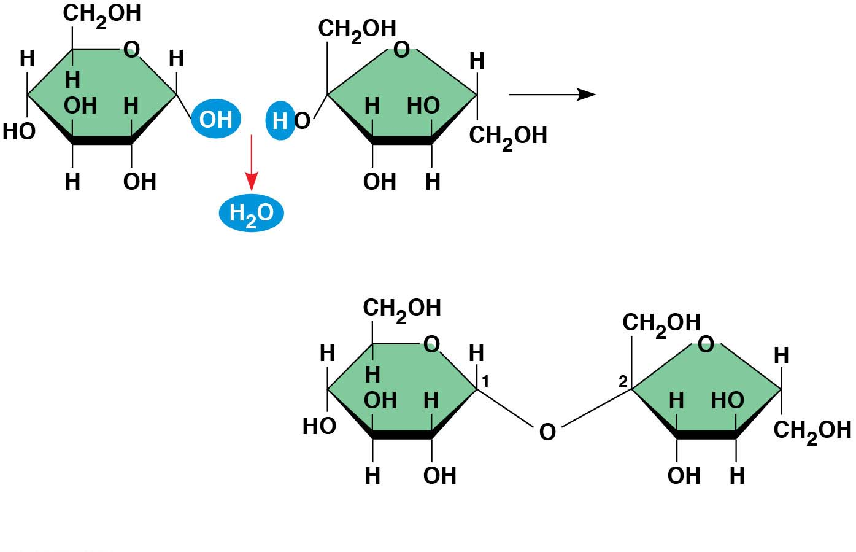
Figure 3.10-s2
Glucose
Fructose
1– 2
glycosidic
linkage
Sucrose
Notes:
Figure 3.10-s2 Disaccharide synthesis (step 2)

Slide 12
Polysaccharides
Polysaccharides, the polymers of sugars, have storage and structural roles
The structure and function of a polysaccharide are determined by its sugar monomers and the positions of glycosidic linkages
Notes:
12

Slide 13
Storage Polysaccharides
Starch, a storage polysaccharide of plants, consists entirely of glucose monomers
Plants store surplus starch as granules
Most animals have enzymes that can hydrolyze plant start, making glucose available as a nutrient
Notes:
13

Slide 14
Glycogen is a storage polysaccharide in animals
Humans and other vertebrates store glycogen mainly in liver and muscle cells
Notes:
14

Slide 15
Animation: Polysaccharides

Slide 16
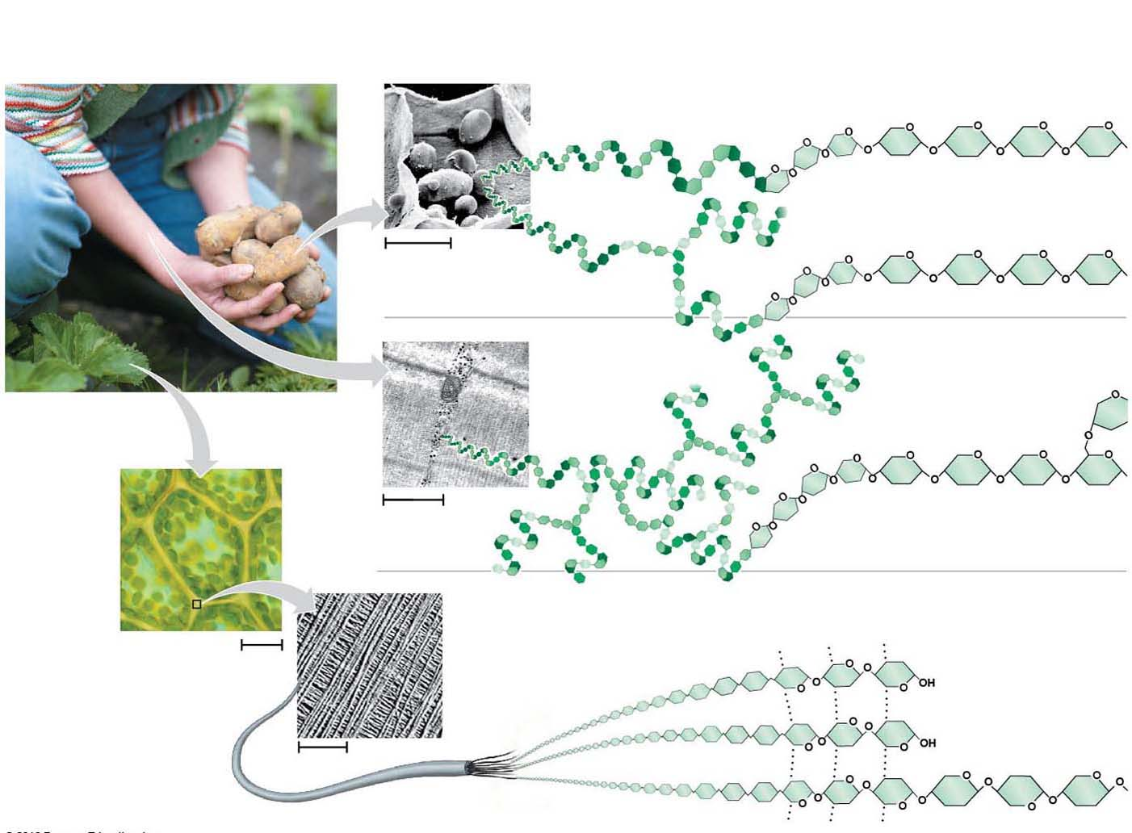
Figure 3.11
Storage structures
(plastids)
containing starch
granules in a potato
tuber cell
Amylose (unbranched)
Amylopectin
(somewhat
branched)
Glucose
monomer
50 μm
Muscle
tissue
(a) Starch
Glycogen
granules
in muscle
tissue
Glycogen
(extensively
branched)
Cell
wall
1 μm
(b) Glycogen
Cellulose microfibrils
in a plant cell wall
Cellulose molecule (unbranched)
Plant cell,
surrounded
by cell wall
10 μm
Microfibril
Hydrogen bonds
0.5 μm
(c) Cellulose
Notes:
Figure 3.11 Polysaccharides of plants and animals

Slide 17
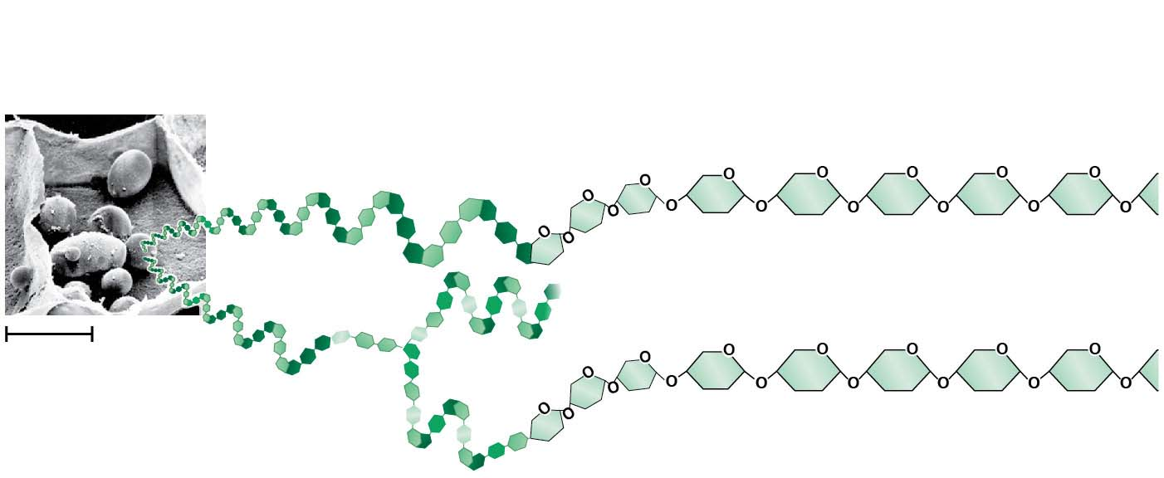
Figure 3.11-1
Storage structures
(plastids)
containing starch
granules in a potato
tuber cell
Amylose (unbranched)
Amylopectin
(somewhat
branched)
Glucose
monomer
50 μm
(a) Starch
Notes:
Figure 3.11-1 Polysaccharides of plants and animals (part 1: starch)

Slide 18
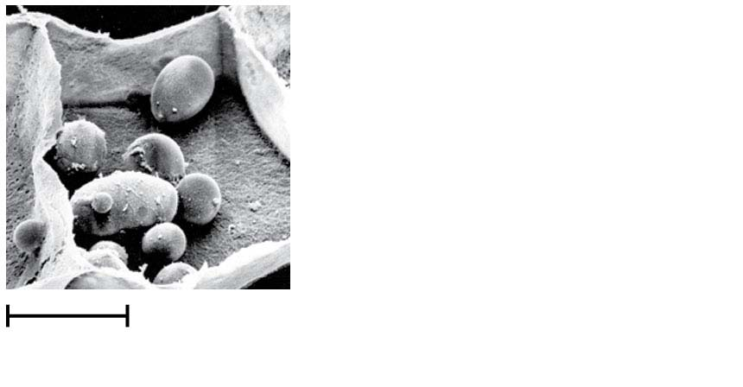
Figure 3.11-1a
Storage structures
(plastids)
containing starch
granules in a potato
tuber cell
50 μm
Notes:
Figure 3.11-1a Polysaccharides of plants and animals (part 1a: plastids containing starch granules, micrograph)

Slide 19
Figure 3.11-2
Glycogen
granules
in muscle
tissue
Glycogen
(extensively
branched)
1 μm
(b) Glycogen
Notes:
Figure 3.11-2 Polysaccharides of plants and animals (part 2: glycogen)

Slide 20
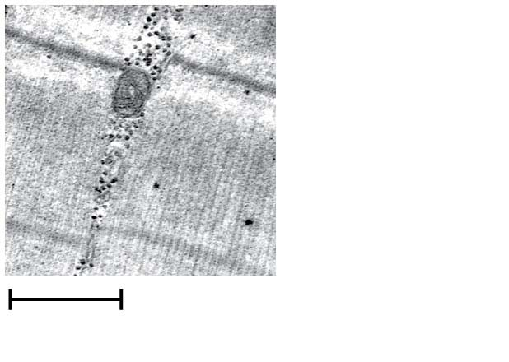
Figure 3.11-2a
Glycogen
granules
in muscle
tissue
1 μm
Notes:
Figure 3.11-2a Polysaccharides of plants and animals (part 2a: glycogen granules, micrograph)

Slide 21
Figure 3.11-3
Cellulose microfibrils
in a plant cell wall
Cellulose molecule
(unbranched)
Microfibril
Hydrogen bonds
0.5 μm
(c) Cellulose
Notes:
Figure 3.11-3 Polysaccharides of plants and animals (part 3: cellulose)

Slide 22
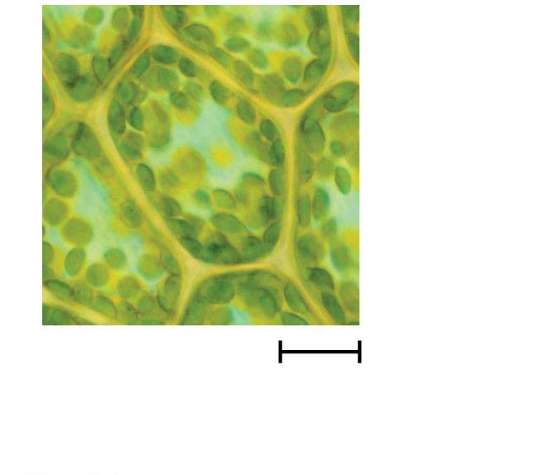
Figure 3.11-3a
Cell wall
Plant cell,
surrounded
by cell wall
10 μm
Notes:
Figure 3.11-3a Polysaccharides of plants and animals (part 3a: plant cell wall, micrograph)

Slide 23
Figure 3.11-3b
Cellulose microfibrils
in a plant cell wall
0.5 μm
Notes:
Figure 3.11-3b Polysaccharides of plants and animals (part 3b: cellulose microfibrils, micrograph)

Slide 24
Structural Polysaccharides
The polysaccharide cellulose is a major component of the tough wall of plant cells
Like starch and glycogen, cellulose is a polymer of glucose, but the glycosidic linkages in cellulose differ
The difference is based on two ring forms for glucose
Notes:
24

Slide 25
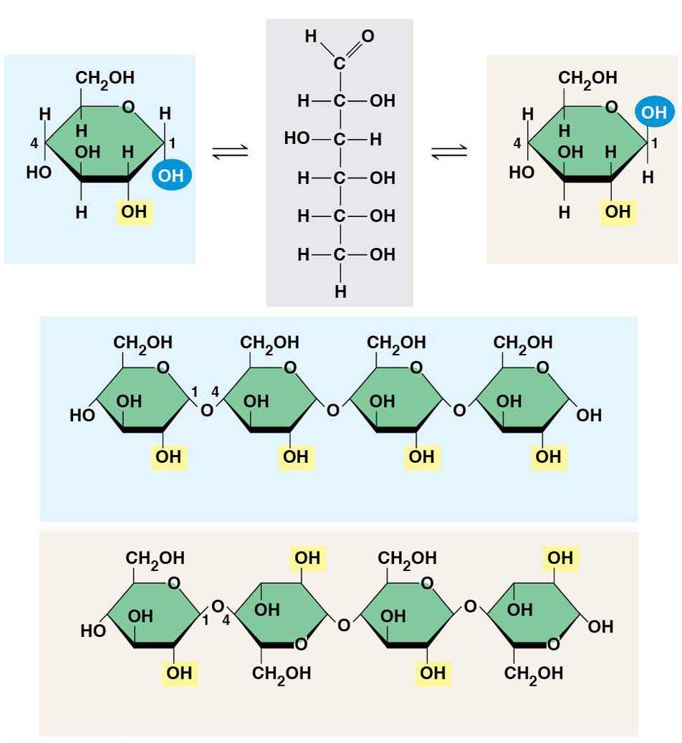
Figure 3.12
(a) α and β glucose ring structures
α Glucose
β Glucose
(b) Starch: 1–4 linkage of α glucose monomers
(c) Cellulose: 1–4 linkage of β glucose monomers
Notes:
Figure 3.12 Starch and cellulose structures

Slide 26
In starch, the glucose monomers are arranged in the alpha (α) conformation
Starch (and glycogen) are largely helical
In cellulose, the monomers are arranged in the beta (β) conformation
Cellulose molecules are relatively straight
Notes:
26

Slide 27
In cellulose, some hydroxyl groups on its glucose monomers can hydrogen-bond with hydroxyl groups of other cellulose molecules
Parallel cellulose molecules held together this way are grouped into microfibrils, which form strong building materials for plants
Notes:
27

Slide 28
Enzymes that digest starch by hydrolyzing α linkages can’t hydrolyze β linkages in cellulose
Cellulose in human food passes through the digestive tract as insoluble fiber
Some microbes use enzymes to digest cellulose
Many herbivores, from cows to termites, have symbiotic relationships with these microbes
Notes:
28

Slide 29
Chitin, another structural polysaccharide, is found in the exoskeleton of arthropods
Chitin also provides structural support for the cell walls of many fungi
Notes:
29

