Slide 1
Overview: The Key Roles of Cell Division
The ability of organisms to produce more of their own kind best distinguishes living things from nonliving matter
The continuity of life is based on the reproduction of cells, or cell division
Notes:
1

Slide 2
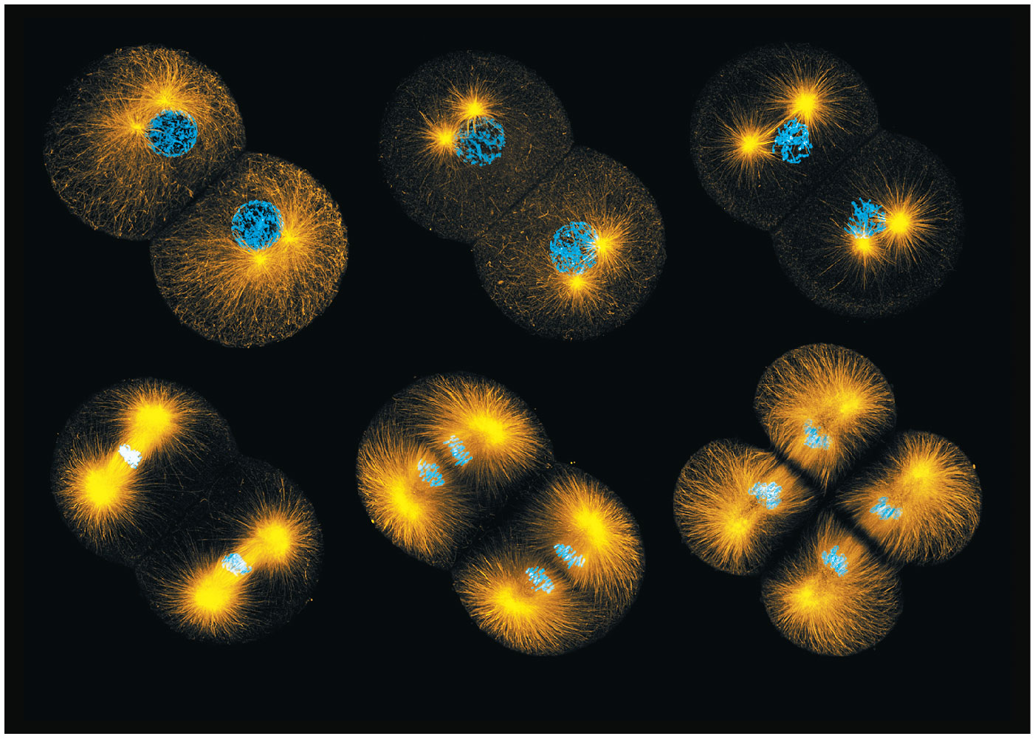
Figure 9.1
Notes:
Figure 9.1 How do dividing cells distribute chromosomes to daughter cells?

Slide 3
In unicellular organisms, division of one cell reproduces the entire organism
Cell division enables multicellular eukaryotes to develop from a single cell and, once fully grown, to renew, repair, or replace cells as needed
Cell division is an integral part of the cell cycle, the life of a cell from its formation to its own division
Notes:
3

Slide 4
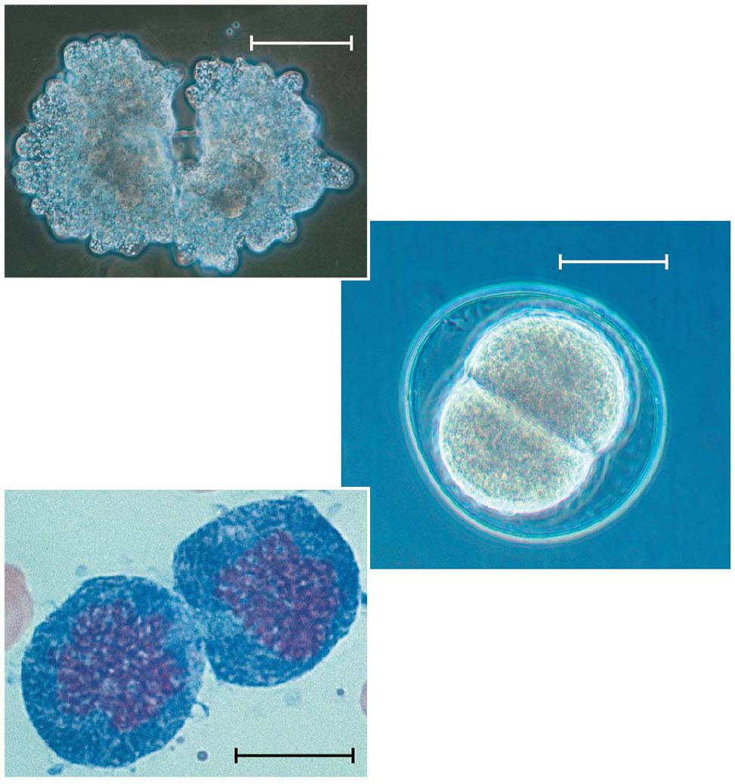
Figure 9.2
100 μm
(a) Reproduction
50 μm
(b) Growth and development
20 μm
(c) Tissue renewal
Notes:
Figure 9.2 The functions of cell division

Slide 5
Concept 9.1: Most cell division results in genetically identical daughter cells
Most cell division results in the distribution of identical genetic material—DNA—to two daughter cells
DNA is passed from one generation of cells to the next with remarkable fidelity
Notes:
5

Slide 6
Cellular Organization of the Genetic Material
All the DNA in a cell constitutes the cell’s genome
A genome can consist of a single DNA molecule (common in prokaryotic cells) or a number of DNA molecules (common in eukaryotic cells)
DNA molecules in a cell are packaged into chromosomes
Notes:
6

Slide 7
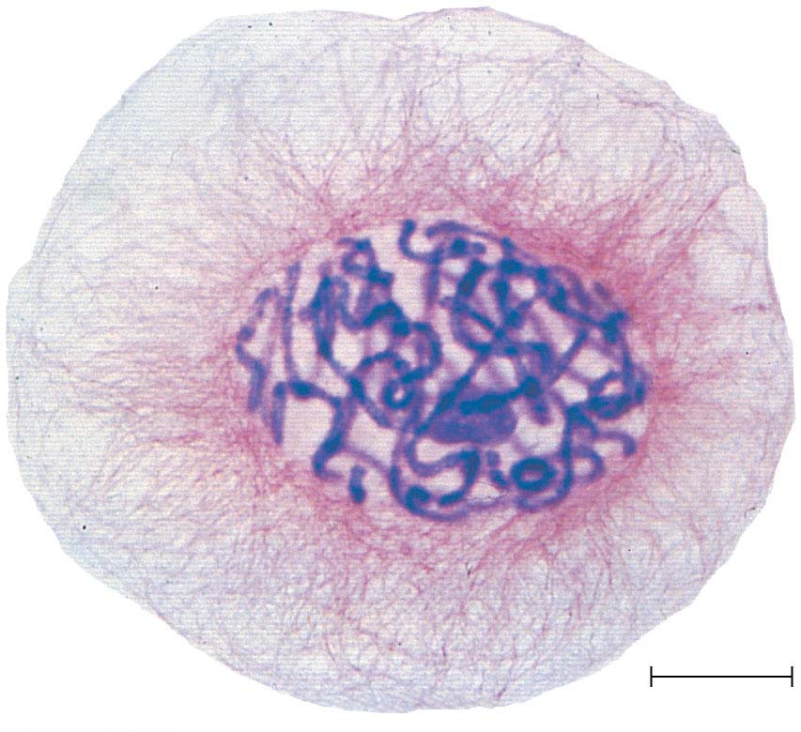
Figure 9.3
20 μm
Notes:
Figure 9.3 Eukaryotic chromosomes

Slide 8
Eukaryotic chromosomes consist of chromatin, a complex of DNA and protein
Every eukaryotic species has a characteristic number of chromosomes in each cell nucleus
Somatic cells (nonreproductive cells) have two sets of chromosomes
Gametes (reproductive cells: sperm and eggs) have one set of chromosomes
Notes:
8

Slide 9
Distribution of Chromosomes During Eukaryotic Cell Division
In preparation for cell division, DNA is replicated and the chromosomes condense
Each duplicated chromosome has two sister chromatids, joined identical copies of the original chromosome
The centromere is where the two chromatids are most closely attached
Notes:
9

Slide 10
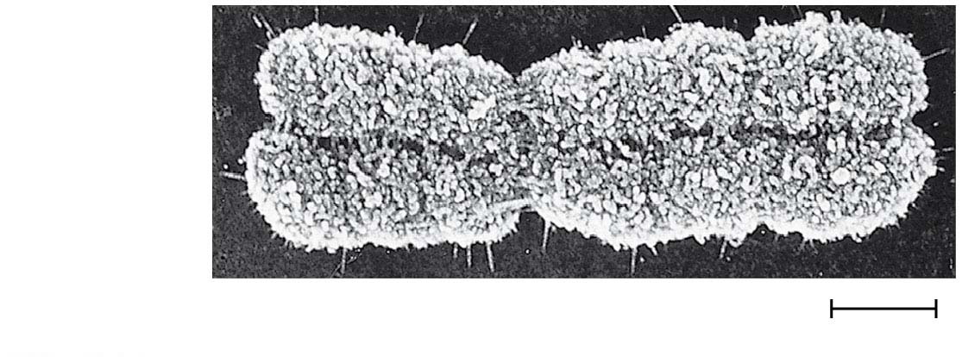
Figure 9.4
Sister
chromatids
Centromere
0.5 μm
Notes:
Figure 9.4 A highly condensed, duplicated human chromosome (SEM)

Slide 11
During cell division, the two sister chromatids of each duplicated chromosome separate and move into two nuclei
Once separate, the chromatids are called chromosomes
Notes:
11

Slide 12
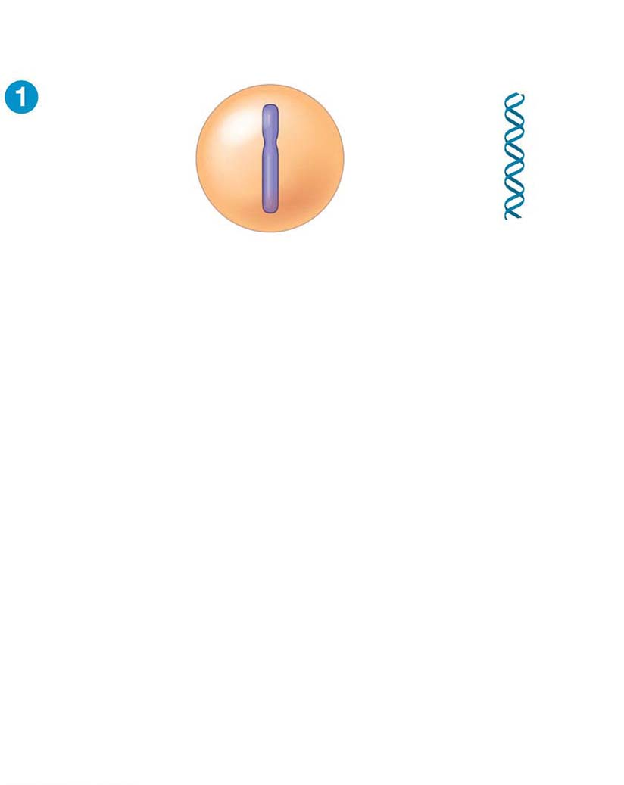
Figure 9.5-s1
Chromosomal
Chromosomes
DNA molecules
Centromere
Chromosome
arm
Notes:
Figure 9.5-s1 Chromosome duplication and distribution during cell division (step 1)

Slide 13
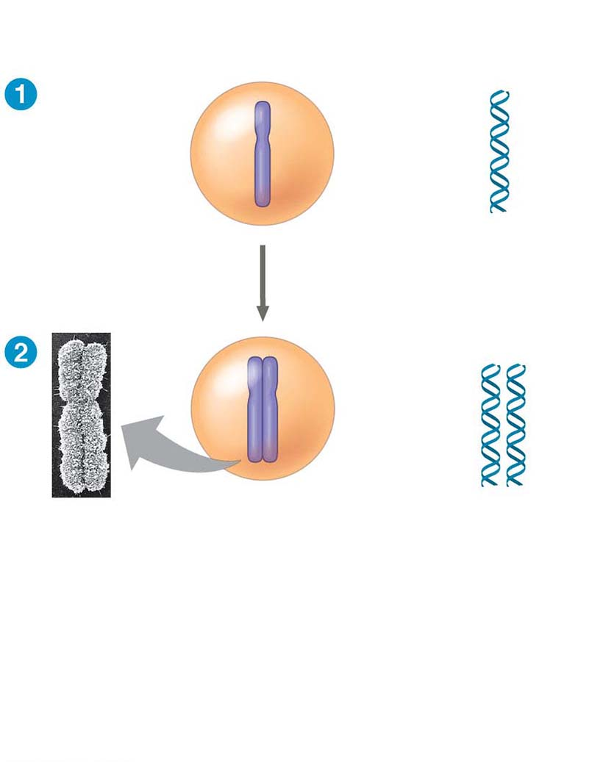
Figure 9.5-s2
Chromosomal
Chromosomes
DNA molecules
Centromere
Chromosome
arm
Chromosome duplication
Sister
chromatids
Notes:
Figure 9.5-s2 Chromosome duplication and distribution during cell division (step 2)

Slide 14
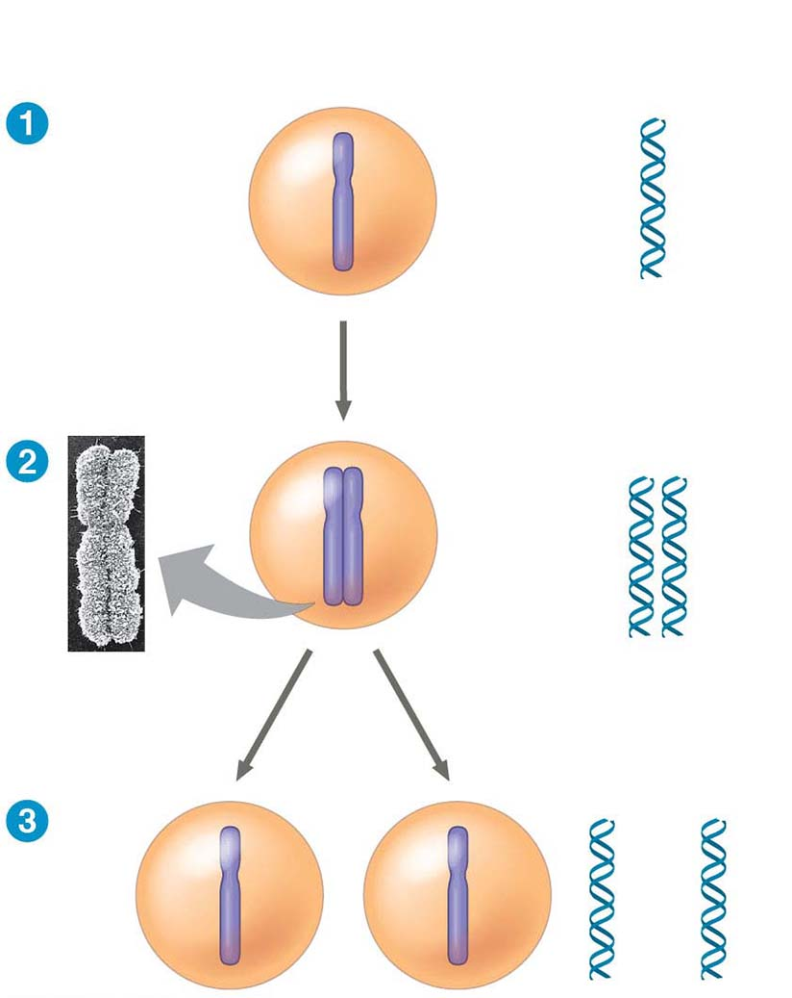
Figure 9.5-s3
Chromosomal
Chromosomes
DNA molecules
Centromere
Chromosome
arm
Chromosome duplication
Sister
chromatids
Separation of sister
chromatids
Notes:
Figure 9.5-s3 Chromosome duplication and distribution during cell division (step 3)

Slide 15
Eukaryotic cell division consists of
Mitosis, the division of the genetic material in the nucleus
Cytokinesis, the division of the cytoplasm
Gametes are produced by a variation of cell division called meiosis
Meiosis yields nonidentical daughter cells that have only one set of chromosomes, half as many as the parent cell
Notes:
15

