Slide 1
Concept 10.4: Genetic variation produced in sexual life cycles contributes to evolution
Mutations (changes in an organism’s DNA) are the original source of genetic diversity
Mutations create different versions of genes called alleles
Reshuffling of alleles during sexual reproduction produces genetic variation
Notes:
1

Slide 2
Origins of Genetic Variation Among Offspring
The behavior of chromosomes during meiosis and fertilization is responsible for most of the variation that arises in each generation
Three mechanisms contribute to genetic variation
Independent assortment of chromosomes
Crossing over
Random fertilization
Notes:
2

Slide 3
Independent Assortment of Chromosomes
Homologous pairs of chromosomes orient randomly at metaphase I of meiosis
In independent assortment, each pair of chromosomes sorts maternal and paternal homologs into daughter cells independently of the other pairs
Notes:
3

Slide 4
The number of combinations possible when chromosomes assort independently into gametes is 2^{n}, where n is the haploid number
For humans (n = 23), there are more than 8 million (2²³) possible combinations of chromosomes
Notes:
4

Slide 5
Figure 10.11-s1
Possibility 1
Possibility 2
Two equally probable
arrangements of
chromosomes at
metaphase I
Notes:
Figure 10.11-s1 The independent assortment of homologous chromosomes in meiosis (step 1)

Slide 6
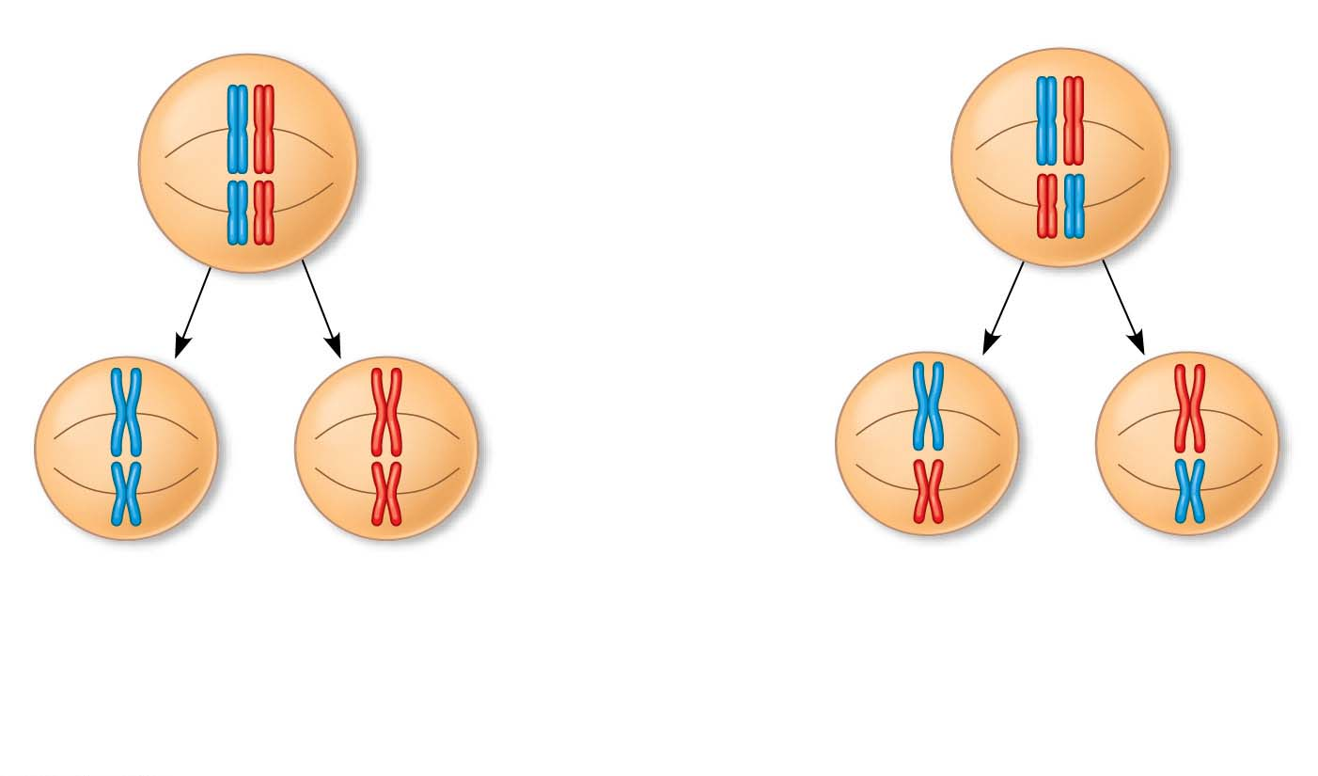
Figure 10.11-s2
Possibility 1
Possibility 2
Two equally probable
arrangements of
chromosomes at
metaphase I
Metaphase II
Notes:
Figure 10.11-s2 The independent assortment of homologous chromosomes in meiosis (step 2)

Slide 7
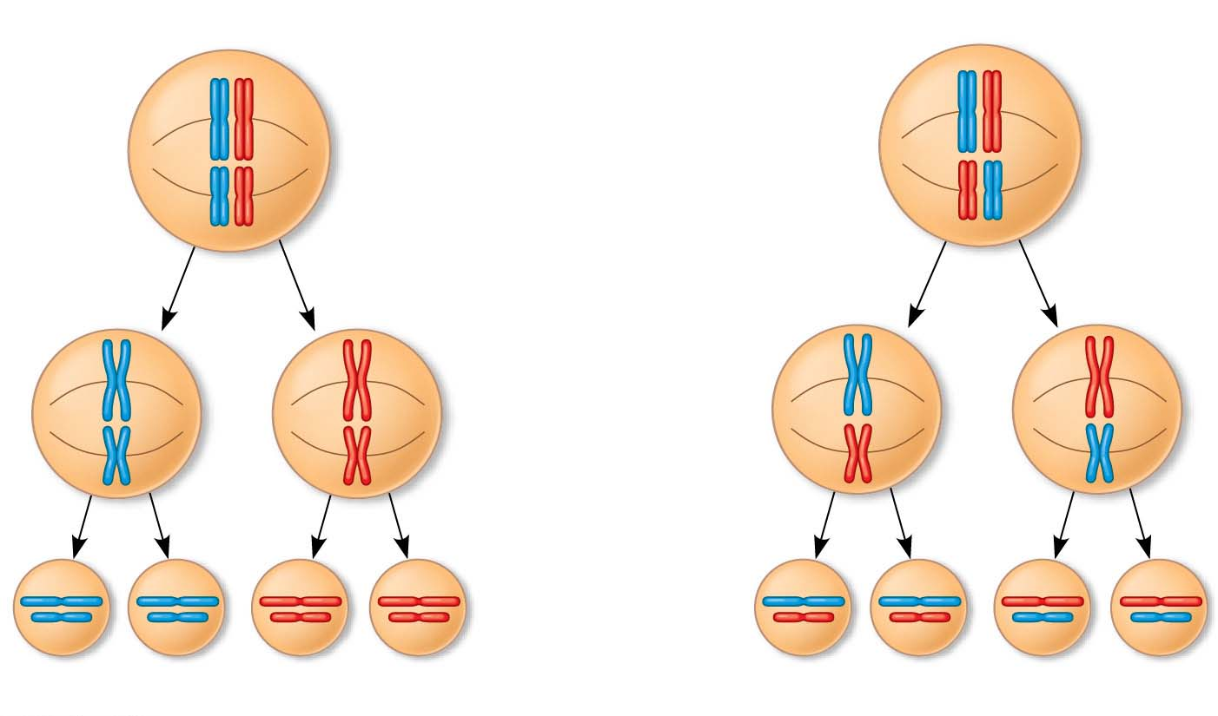
Figure 10.11-s3
Possibility 1
Possibility 2
Two equally probable
arrangements of
chromosomes at
metaphase I
Metaphase II
Daughter
cells
Combination 1
Combination 2
Combination 3
Combination 4
Notes:
Figure 10.11-s3 The independent assortment of homologous chromosomes in meiosis (step 3)

Slide 8
Crossing Over
Crossing over produces recombinant chromosomes, which combine DNA inherited from each parent
In meiosis in humans, on average, one to three crossover events occur per chromosome pair
Notes:
8

Slide 9
Crossing over contributes to genetic variation by combining DNA, producing chromosomes with new combinations of maternal and paternal alleles
Notes:
9

Slide 10
Animation: Genetic Variation

Slide 11
Figure 10.12-s1
Nonsister chromatids
held together
during synapsis
Prophase I
of meiosis
Pair of
homologs
Notes:
Figure 10.12-s1 The results of crossing over during meiosis (step 1)

Slide 12
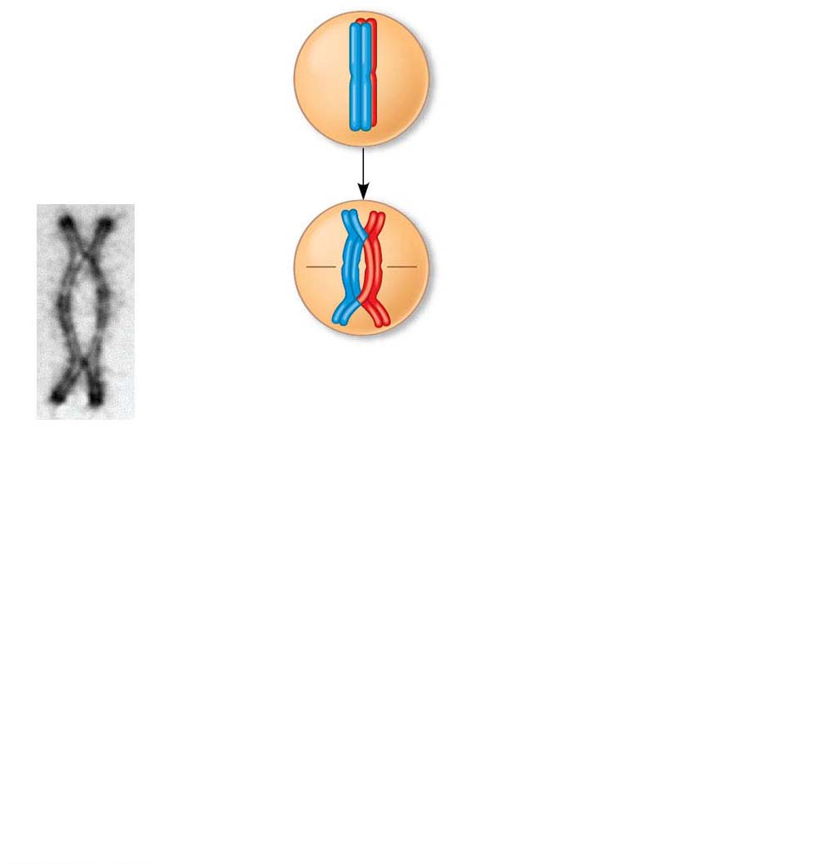
Figure 10.12-s2
Nonsister chromatids
held together
during synapsis
Prophase I
of meiosis
Pair of
homologs
Synapsis and
crossing over
Chiasma
site
Centromere
TEM
Notes:
Figure 10.12-s2 The results of crossing over during meiosis (step 2)

Slide 13
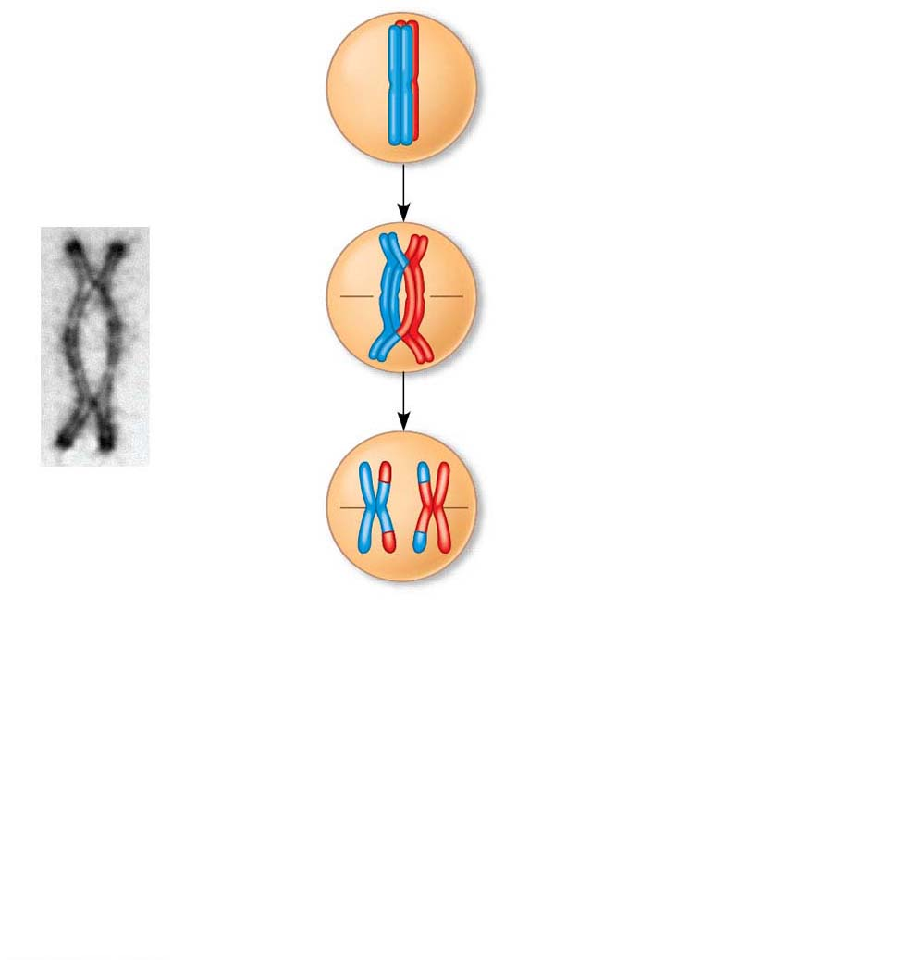
Figure 10.12-s3
Nonsister chromatids
held together
during synapsis
Prophase I
of meiosis
Pair of
homologs
Synapsis and
crossing over
Chiasma
site
Breakdown of
proteins holding sister
chromatid arms together.
Centromere
TEM
Anaphase I
Notes:
Figure 10.12-s3 The results of crossing over during meiosis (step 3)

Slide 14
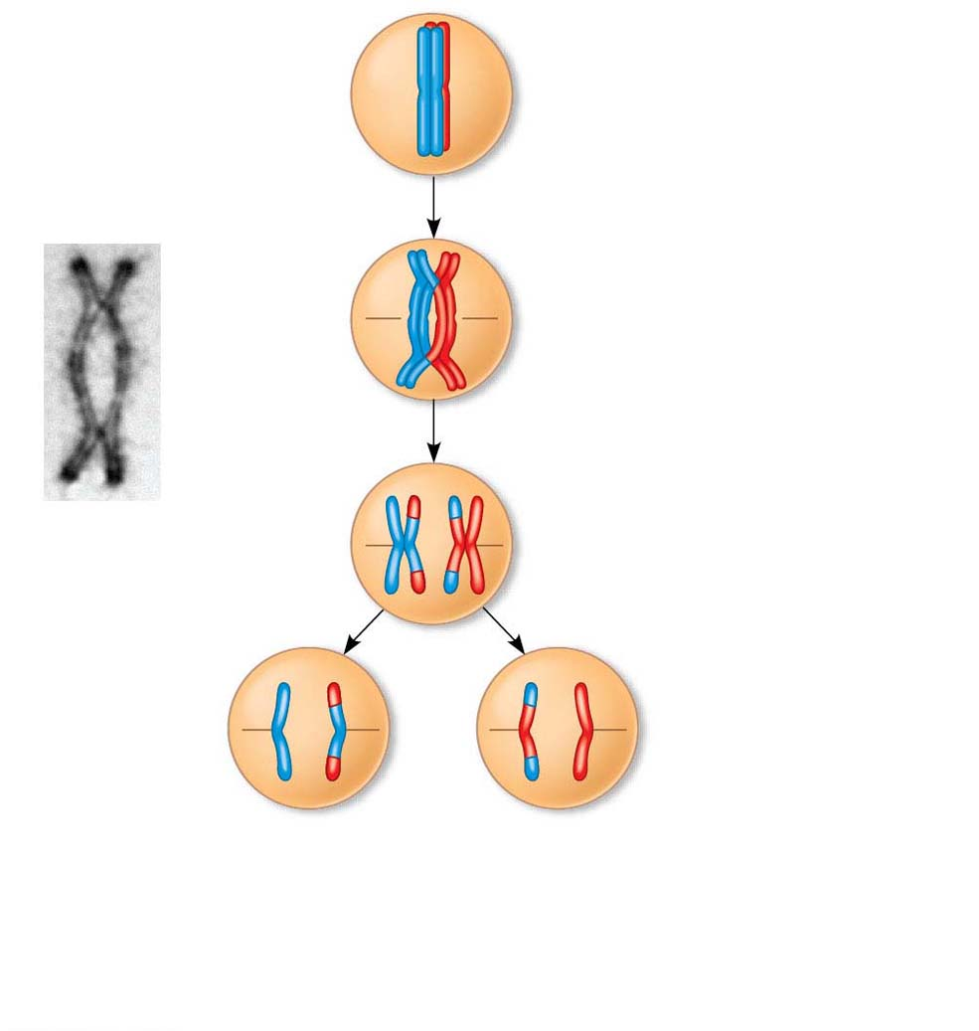
Figure 10.12-s4
Nonsister chromatids
held together
during synapsis
Prophase I
of meiosis
Pair of
homologs
Synapsis and
crossing over
Chiasma
site
Breakdown of
proteins holding sister
chromatid arms together.
Centromere
TEM
Anaphase I
Anaphase II
Notes:
Figure 10.12-s4 The results of crossing over during meiosis (step 4)

Slide 15
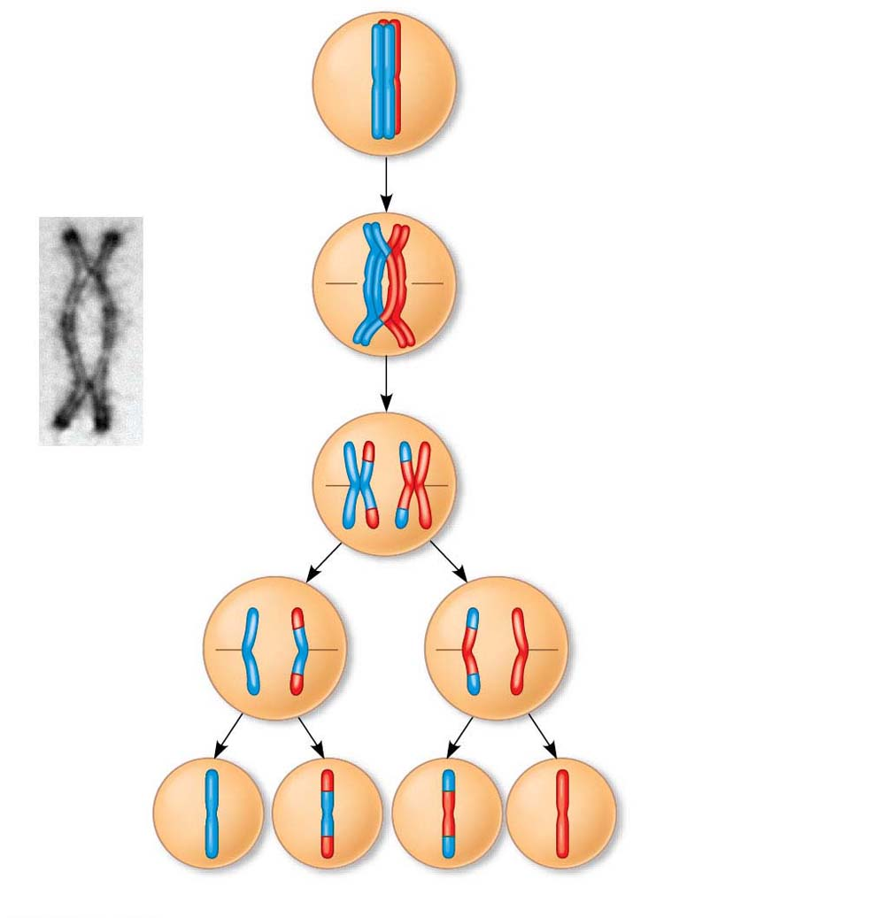
Figure 10.12-s5
Nonsister chromatids
held together
during synapsis
Prophase I
of meiosis
Pair of
homologs
Synapsis and
crossing over
Chiasma
site
Breakdown of
proteins holding sister
chromatid arms together.
Centromere
TEM
Anaphase I
Anaphase II
Daughter
cells
Recombinant chromosomes
Notes:
Figure 10.12-s5 The results of crossing over during meiosis (step 5)

Slide 16
Random Fertilization
Random fertilization adds to genetic variation because any sperm can fuse with any ovum (unfertilized egg)
The fusion of two gametes (each with 8.4 million possible chromosome combinations from independent assortment) produces a zygote with any of about 70 trillion diploid combinations
Notes:
16

Slide 17
Crossing over adds even more variation
Each zygote has a unique genetic identity
Notes:
17

Slide 18
The Evolutionary Significance of Genetic Variation Within Populations
Natural selection results in the accumulation of genetic variations favored by the environment
Sexual reproduction contributes to the genetic variation in a population, which originates from mutations
Notes:
18

Slide 19
Asexual reproduction is less expensive than sexual reproduction
Nonetheless, sexual reproduction is nearly universal among animals
Overall, genetic variation is evolutionarily advantageous
Notes:
19

