Slide 1
Concept 10.3: Meiosis reduces the number of chromosome sets from diploid to haploid
Like mitosis, meiosis is preceded by the duplication of chromosomes
Meiosis takes place in two sets of cell divisions, called meiosis I and meiosis II
The two cell divisions result in four daughter cells, rather than the two daughter cells in mitosis
Each daughter cell has only half as many chromosomes as the parent cell
Notes:
1

Slide 2
The Stages of Meiosis
For a single pair of homologous chromosomes in a diploid cell, both members of the pair are duplicated
The resulting sister chromatids are closely associated all along their lengths
Homologs may have different versions of genes, each called an allele
Homologs are not associated in any obvious way except during meiosis
Notes:
2

Slide 3
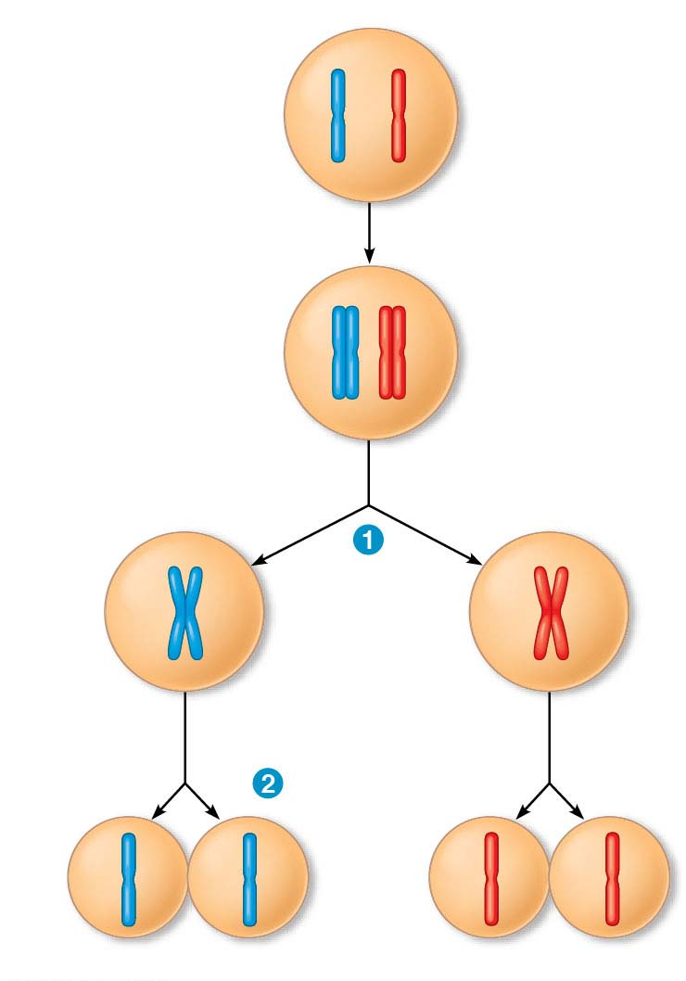
Figure 10.7
Interphase
Pair of homologous
chromosomes in
diploid parent cell
Pair of duplicated
homologous
chromosomes
Chromosomes
duplicate
Sister
chromatids
Diploid cell with
duplicated
chromosomes
Meiosis I
Homologous
chromosomes
separate
Haploid cells with
duplicated chromosomes
Meiosis II
Sister chromatids
separate
Haploid cells with unduplicated chromosomes
Notes:
Figure 10.7 Overview of meiosis: how meiosis reduces chromosome number

Slide 4
Meiosis halves the total number of chromosomes very specifically
It reduces the number of sets from two to one, with each daughter cell receiving one set of chromosomes
Notes:
4

Slide 5
In the first meiotic division, homologous pairs of chromosomes pair and separate
In the second meiotic division, sister chromatids of each chromosome separate
Four new haploid cells are produced as a result
Notes:
5
NOTE – this is not part of the text, but rather a quick summary of what is in Figure 10.8.

Slide 6
Animation: Meiosis

Slide 7
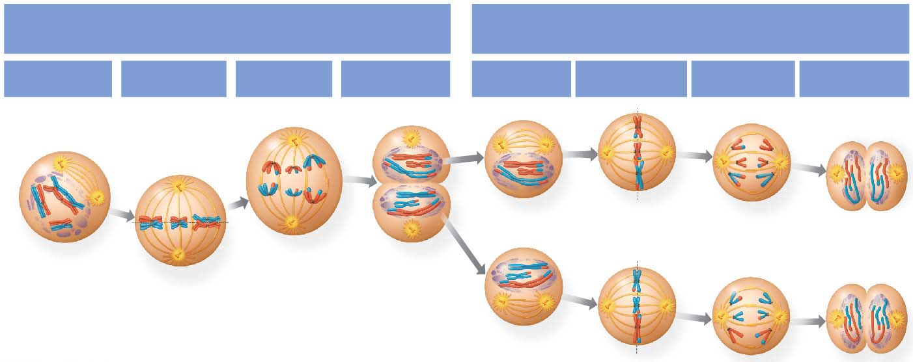
Figure 10.8
MEIOSIS I:
MEIOSIS II:
Separates homologous chromosomes
Separates sister chromatids
Prophase I
Metaphase I
Anaphase I
Telophase I
and Cytokinesis
Prophase II
Metaphase II
Anaphase II
Telophase II
and Cytokinesis
Notes:
Figure 10.8 Exploring meiosis in an animal cell

Slide 8
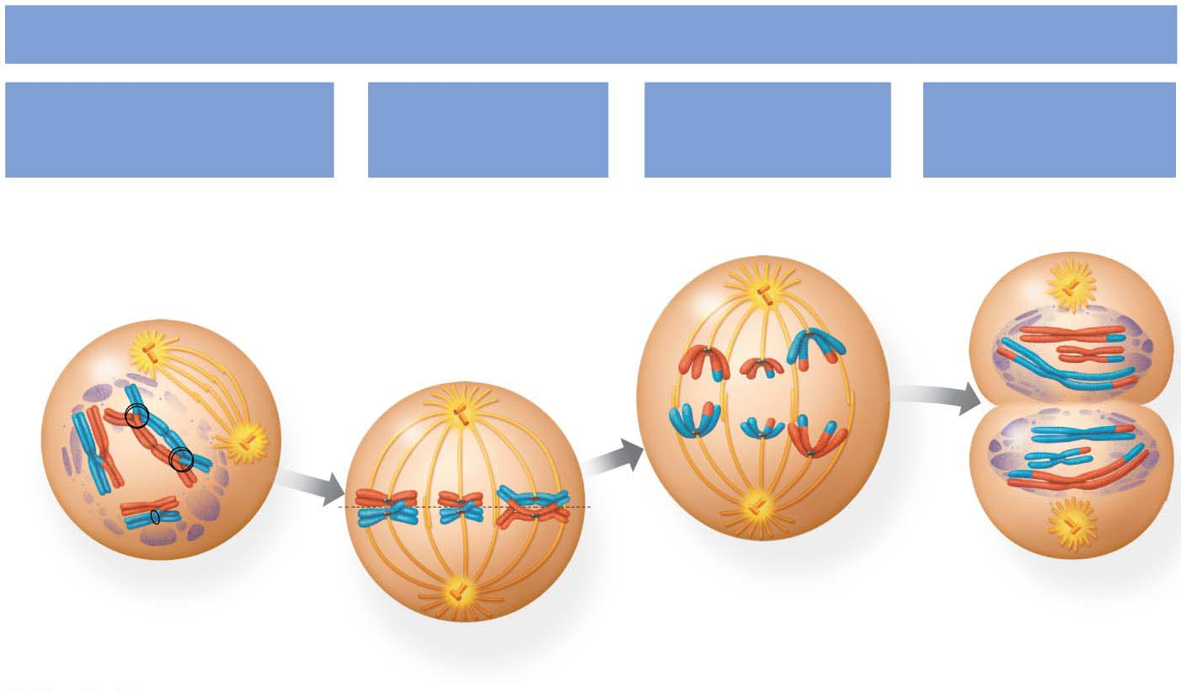
Figure 10.8-1
MEIOSIS I: Separates homologous chromosomes
Prophase I
Metaphase I
Anaphase I
Telophase I
and Cytokinesis
Centrosome
(with centriole pair)
Sister chromatids
remain attached
Kinetochore
(at centromere)
Sister
chromatids
Chiasmata
Spindle
microtubules
Kinetochore
microtubules
Metaphase
plate
Cleavage
furrow
Fragments
of nuclear
envelope
Homologous
chromosomes
separate
Pair of
homologous
chromosomes
Centromere
Notes:
Figure 10.8-1 Exploring meiosis in an animal cell (part 1: meiosis I)

Slide 9
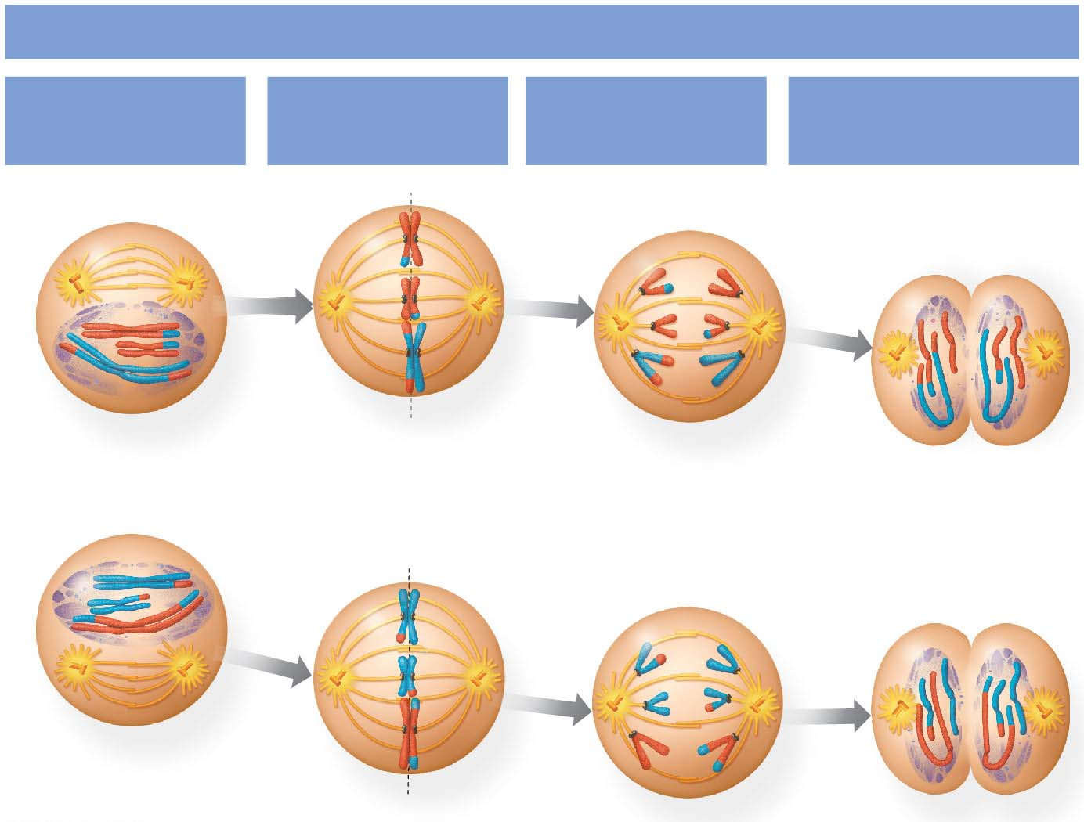
Figure 10.8-2
MEIOSIS II: Separates sister chromatids
Prophase II
Metaphase II
Anaphase II
Telophase II
and Cytokinesis
Sister chromatids
separate
Haploid daughter
cells forming
Notes:
Figure 10.8-2 Exploring meiosis in an animal cell (part 2: meiosis II)

Slide 10
Student groups will prepare posters depicting and describing each phase of Meiosis I and Meiosis II
Notes:
10

Slide 11
Prophase I
Chromosomes condense progressively throughout prophase I
Homologous chromosomes pair up, aligned gene by gene
Notes:
11

Slide 12
In crossing over, nonsister chromatids exchange DNA segments
Each homologous pair has one or more X-shaped regions called chiasmata
Chiasmata exist at points where crossing over has occurred.
Notes:
12

Slide 13
Metaphase I
In metaphase I, homologous pairs line up at the metaphase plate, with one chromosome facing each pole
Microtubules from one pole are attached to the kinetochore of one chromosome of each tetrad
Microtubules from the other pole are attached to the kinetochore of the other chromosome
Notes:
13

Slide 14
Anaphase I
In anaphase I, pairs of homologous chromosomes separate
One chromosome moves toward each pole, guided by the spindle apparatus
Sister chromatids remain attached at the centromere and move as one unit toward the pole
Notes:
14

Slide 15
Telophase I and Cytokinesis
In the beginning of telophase I, each half of the cell has a haploid set of chromosomes
Each chromosome still consists of two sister chromatids
Cytokinesis usually occurs simultaneously, forming two haploid daughter cells
Notes:
15

Slide 16
In animal cells, a cleavage furrow forms; in plant cells, a cell plate forms
No chromosome duplication occurs between the end of meiosis I and the beginning of meiosis II because the chromosomes are already replicated
Notes:
16

Slide 17
Division in meiosis II also occurs in four phases
Prophase II
Metaphase II
Anaphase II
Telophase II and cytokinesis
Meiosis II is very similar to mitosis
Notes:
17

Slide 18
Prophase II
In prophase II, a spindle apparatus forms
In late prophase II, chromosomes (each still composed of two chromatids) move toward the metaphase plate
Notes:
18

Slide 19
Metaphase II
The sister chromatids are arranged at the metaphase plate
Because of crossing over in meiosis I, the two sister chromatids of each chromosome are no longer genetically identical
The kinetochores of sister chromatids attach to microtubules extending from opposite poles
Notes:
19

Slide 20
Anaphase II
In anaphase II, the sister chromatids separate
The sister chromatids of each chromosome now move as two newly individual chromosomes toward opposite poles
Notes:
20

Slide 21
Telophase II and Cytokinesis
Nuclei form, and the chromosomes begin decondensing
At the end of meiosis, there are four daughter cells, each with a haploid set of unduplicated chromosomes
Each daughter cell is genetically distinct from the others and from the parent cell
Notes:
21

Slide 22
Crossing Over and Synapsis During Prophase I
During prophase I, two members of a homologous pair associate along their length, allele by allele
A zipper-like structure called the synaptonemal complex forms during this attachment (synapsis)
DNA molecules of the maternal and paternal chromatid are broken at matching points
The DNA breaks are closed so that a paternal chromatid is joined to a piece of maternal chromatid, and vice versa
Notes:
22

Slide 23
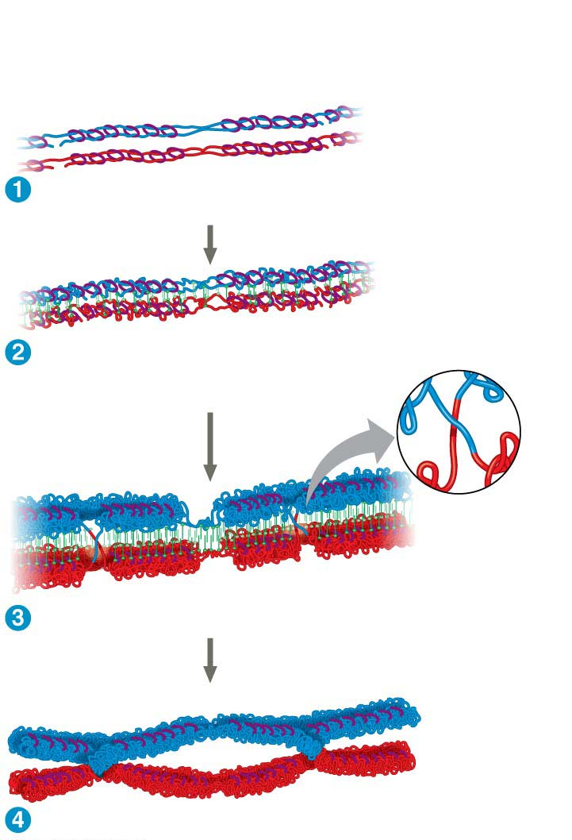
Figure 10.9
Pair of homologous
chromosomes:
DNA
breaks
Centromere
DNA
Cohesins
breaks
Paternal
sister
chromatids
Maternal
sister
chromatids
Synaptonemal
complex forming
Synaptonemal
complex
Crossover
Crossover
Chiasmata
Notes:
Figure 10.9 Crossing over and synapsis in prophase I (part 1: cohesins and the synaptonemal complex)

Slide 24
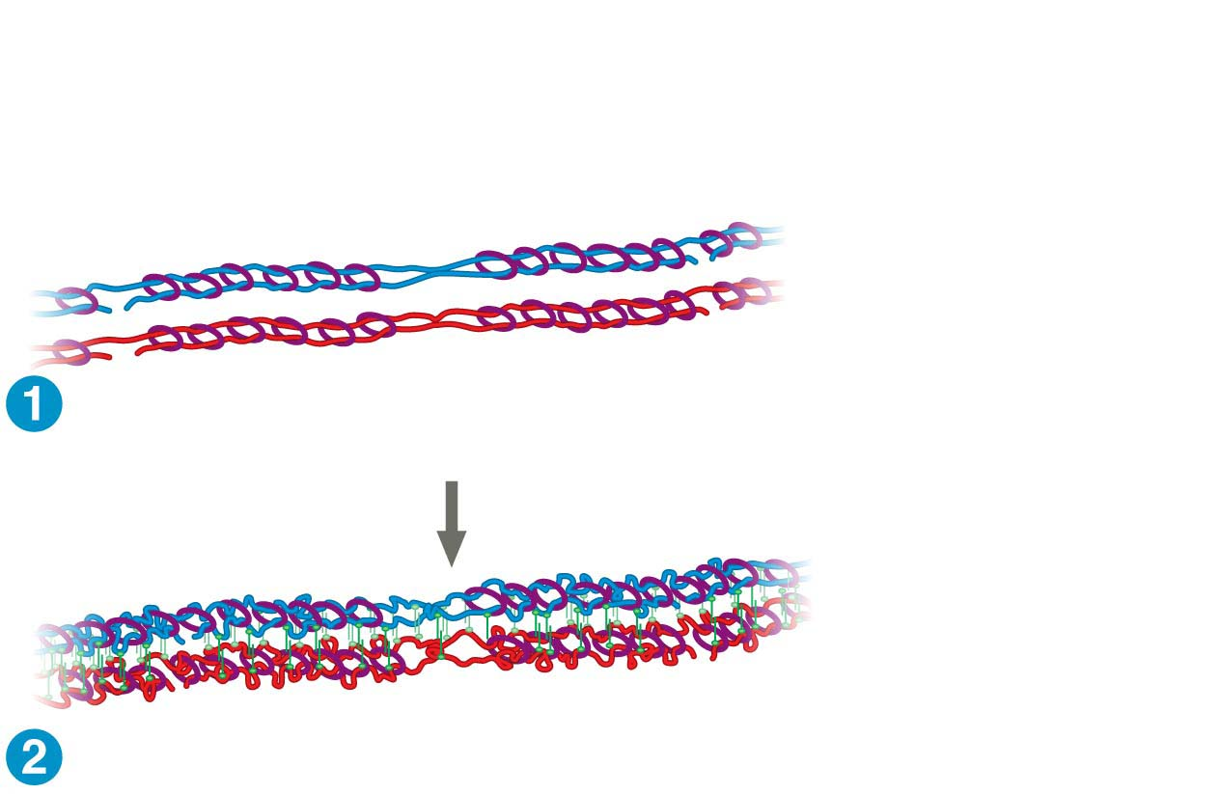
Figure 10.9-1
Pair of homologous
chromosomes:
DNA
breaks
Centromere
DNA
breaks
Paternal
sister
chromatids
Cohesins
Maternal
sister
chromatids
Synaptonemal
complex forming
Notes:
Figure 10.9-1 Crossing over and synapsis in prophase I (part 2: synapsis and chiasmata)

Slide 25
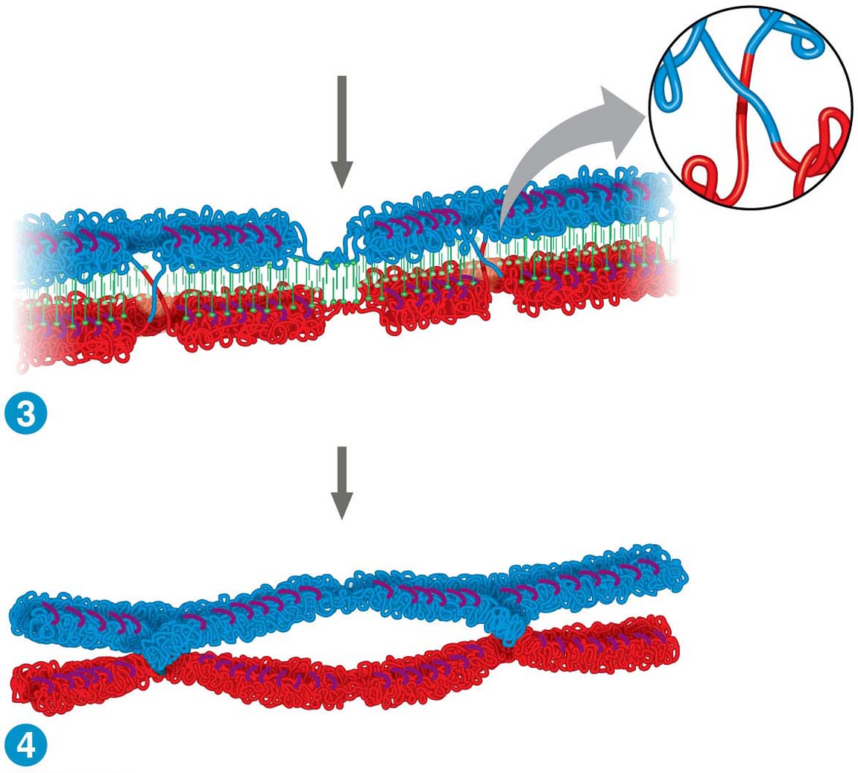
Figure 10.9-2
Synaptonemal
complex
Crossover
Crossover
Chiasmata
Notes:
Figure 10.9-2 Crossing over and synapsis in prophase I

Slide 26
A Comparison of Mitosis and Meiosis
Students will compare and contrast mitosis and meiosis in a Venn diagram.
Notes:
26

Slide 27
A Comparison of Mitosis and Meiosis
Mitosis conserves the number of chromosome sets, producing cells that are genetically identical to the parent cell
Meiosis reduces the number of chromosome sets from two (diploid) to one (haploid), producing cells that differ genetically from each other and from the parent cell
Meiosis includes two divisions after replication, each with specific stages
Notes:
27

Slide 28
Three events are unique to meiosis, and all three occur in meiosis l
Synapsis and crossing over in prophase I: Homologous chromosomes physically connect and exchange genetic information
Alignment of homologous pairs at the metaphase plate: Homologous pairs of chromosomes are positioned there in metaphase I
Separation of homologs during anaphase I
Notes:
28

Slide 29
Sister chromatids stay together due to sister chromatid cohesion
In mitosis, cohesins are cleaved at the end of metaphase
In meiosis, cohesins are cleaved along the chromosome arms in anaphase I (separation of homologs) and at the centromeres in anaphase II (separation of sister chromatids)
Notes:
29

