Slide 1
Concept 10.2: Fertilization and meiosis alternate in sexual life cycles
A life cycle is the generation-to-generation sequence of stages in the reproductive history of an organism
Notes:
1

Slide 2
Sets of Chromosomes in Human Cells
Human somatic cells have 23 pairs of chromosomes
A karyotype is an ordered display of the pairs of chromosomes from a cell
The two chromosomes in each pair are called homologous chromosomes, or homologs
Chromosomes in a homologous pair are the same length and shape and carry genes controlling the same inherited characters
Notes:
2

Slide 3
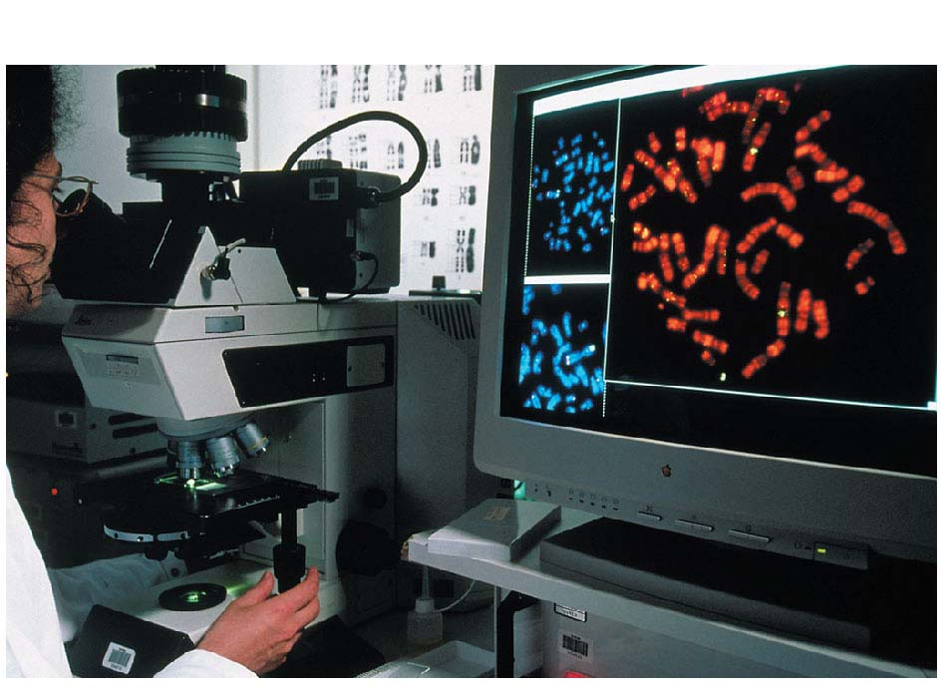
Figure 10.3-1
Technique
Notes:
Figure 10.3-1 Research method: preparing a karyotype (part 1: technique)

Slide 4
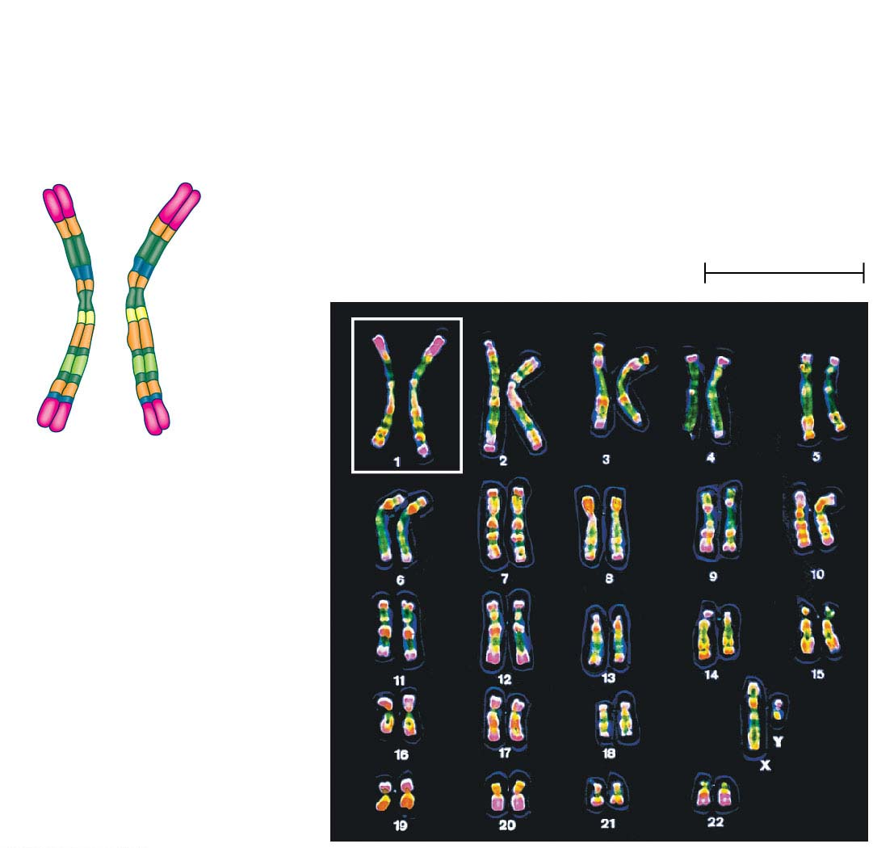
Figure 10.3-2
Results
Pair of homologous
duplicated chromosomes
Centromere
5 μm
Sister
chromatids
Metaphase
chromosome
Notes:
Figure 10.3-2 Research method: preparing a karyotype (part 2: results)

Slide 5
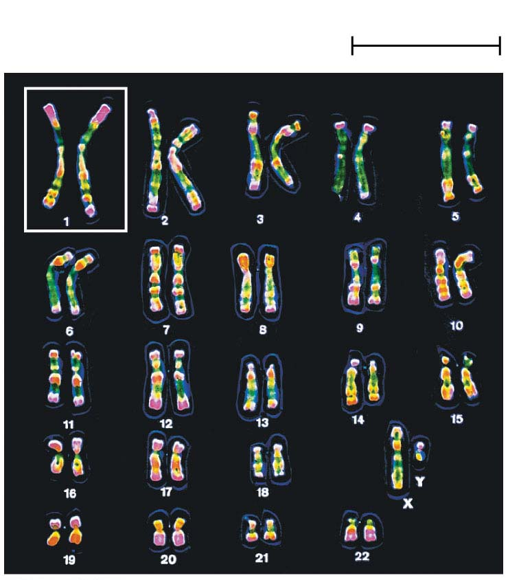
Figure 10.3-3
5 μm
Notes:
Figure 10.3-3 Research method: preparing a karyotype (part 3: karyotype)

Slide 6
The sex chromosomes, which determine the sex of the individual, are called X and Y
Human females have a homologous pair of X chromosomes (XX)
Human males have one X and one Y chromosome
The remaining 22 pairs of chromosomes are called autosomes
Notes:
6

Slide 7
Each pair of homologous chromosomes includes one chromosome from each parent
The 46 chromosomes in a human somatic cell are two sets of 23: one from the mother and one from the father
A diploid cell (2n) has two sets of chromosomes
For humans, the diploid number is 46 (2n = 46)
Notes:
7

Slide 8
In a cell in which DNA synthesis has occurred, each chromosome is replicated
Each replicated chromosome consists of two identical sister chromatids
Notes:
8

Slide 9
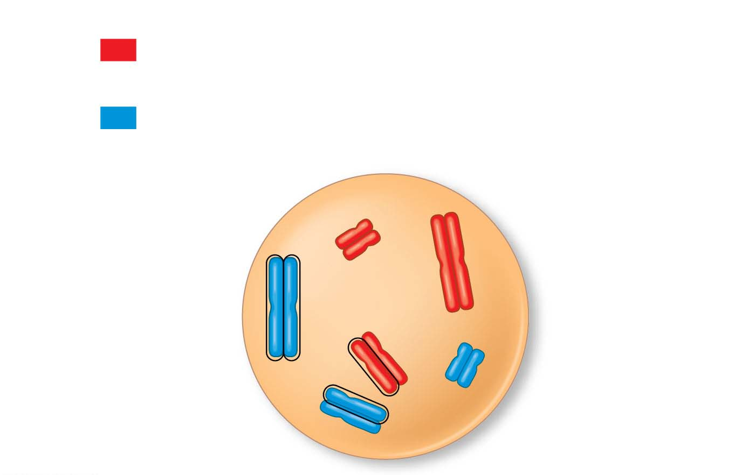
Figure 10.4
Key
Maternal set of
chromosomes (n = 3)
2n = 6
Paternal set of
chromosomes (n = 3)
Sister chromatids
of one duplicated
chromosome
Centromere
Two nonsister
chromatids in
a homologous pair
Pair of homologous
chromosomes
(one from each set)
Notes:
Figure 10.4 Describing chromosomes

Slide 10
A gamete (sperm or egg) contains a single set of chromosomes and is haploid (n)
For humans, the haploid number is 23 (n = 23)
Each set of 23 consists of 22 autosomes and a single sex chromosome
In an unfertilized egg (ovum), the sex chromosome is X
In a sperm cell, the sex chromosome may be either X or Y
Notes:
10

Slide 11
Behavior of Chromosome Sets in the Human Life Cycle
Fertilization is the union of gametes (the sperm and the egg)
The fertilized egg is called a zygote and has one set of chromosomes from each parent
The zygote produces somatic cells by mitosis and develops into an adult
Notes:
11

Slide 12
At sexual maturity, the ovaries and testes produce haploid gametes
Gametes are the only types of human cells produced by meiosis rather than mitosis
Meiosis results in one set of chromosomes in each gamete
Fertilization and meiosis alternate in sexual life cycles to maintain chromosome number
Notes:
12

Slide 13
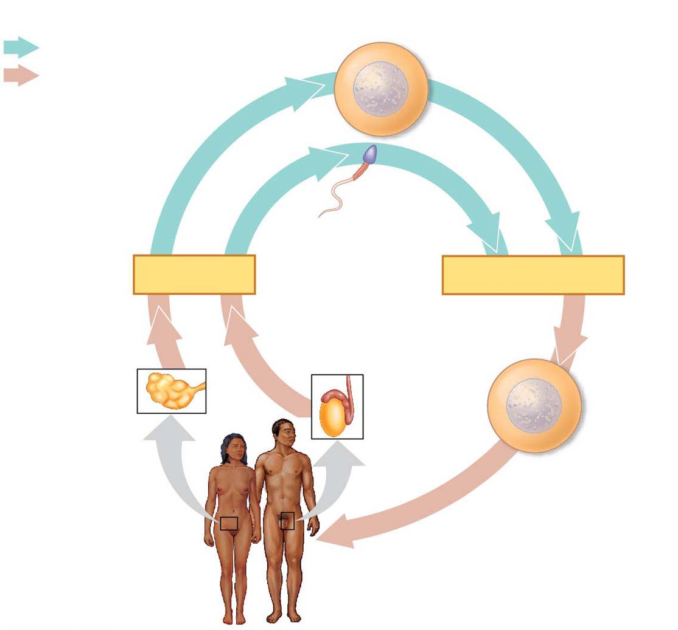
Figure 10.5
Key
Haploid gametes (n = 23)
Haploid (n)
Diploid (2n)
Egg (n)
Sperm (n)
MEIOSIS
FERTILIZATION
Testis
Ovary
Diploid
zygote
(2n = 46)
Mitosis and
development
Multicellular diploid
adults (2n = 46)
Notes:
Figure 10.5 The human life cycle

Slide 14
The Variety of Sexual Life Cycles
The alternation of meiosis and fertilization is common to all organisms that reproduce sexually
The three main types of sexual life cycles differ in the timing of meiosis and fertilization
Notes:
14

Slide 15
Gametes are the only haploid cells in animals
They are produced by meiosis and undergo no further cell division before fertilization
Gametes fuse to form a diploid zygote that divides by mitosis to develop into a multicellular organism
Notes:
15

Slide 16
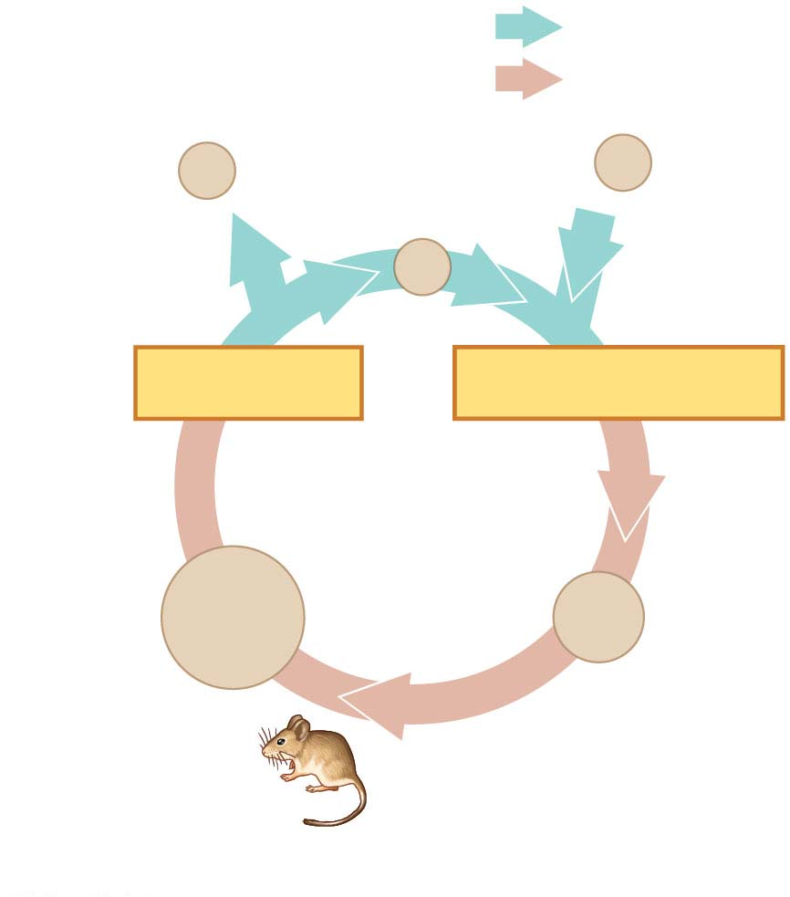
Figure 10.6-1
Haploid (n)
Diploid (2n)
n
Gametes
n
n
MEIOSIS
FERTILIZATION
2n
Zygote
2n
Diploid
multicellular
organism
Mitosis
(a) Animals
Notes:
Figure 10.6-1 Three types of sexual life cycles (part 1: animal)

Slide 17
Plants and some algae exhibit an alternation of generations
This life cycle includes both a diploid and haploid multicellular stage
The diploid organism, called the sporophyte, makes haploid spores by meiosis
Notes:
17

Slide 18
Each spore grows by mitosis into a haploid organism called a gametophyte
A gametophyte makes haploid gametes by mitosis
Fertilization of gametes results in a diploid sporophyte
Notes:
18

Slide 19
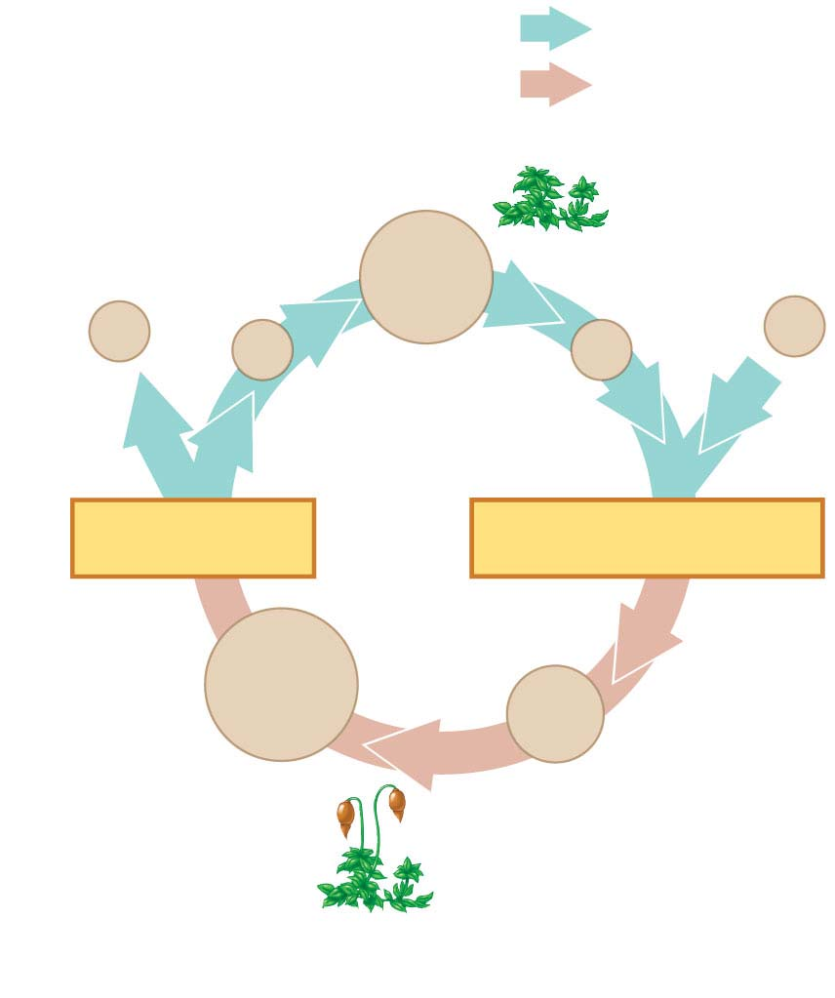
Figure 10.6-2
Haploid multi-
cellular organism
(gametophyte)
Haploid (n)
Diploid (2n)
Mitosis
n
Mitosis
n
n
n
n
Spores
Gametes
MEIOSIS
FERTILIZATION
2n
2n
Diploid
multicellular
organism
(sporophyte)
Zygote
Mitosis
(b) Plants and some algae
Notes:
Figure 10.6-2 Three types of sexual life cycles (part 2: plant)

Slide 20
In most fungi and some protists, the only diploid stage is the single-celled zygote; there is no multicellular diploid stage
The zygote produces haploid cells by meiosis
Each haploid cell grows by mitosis into a haploid multicellular organism
The haploid adult produces gametes by mitosis
Notes:
20

Slide 21
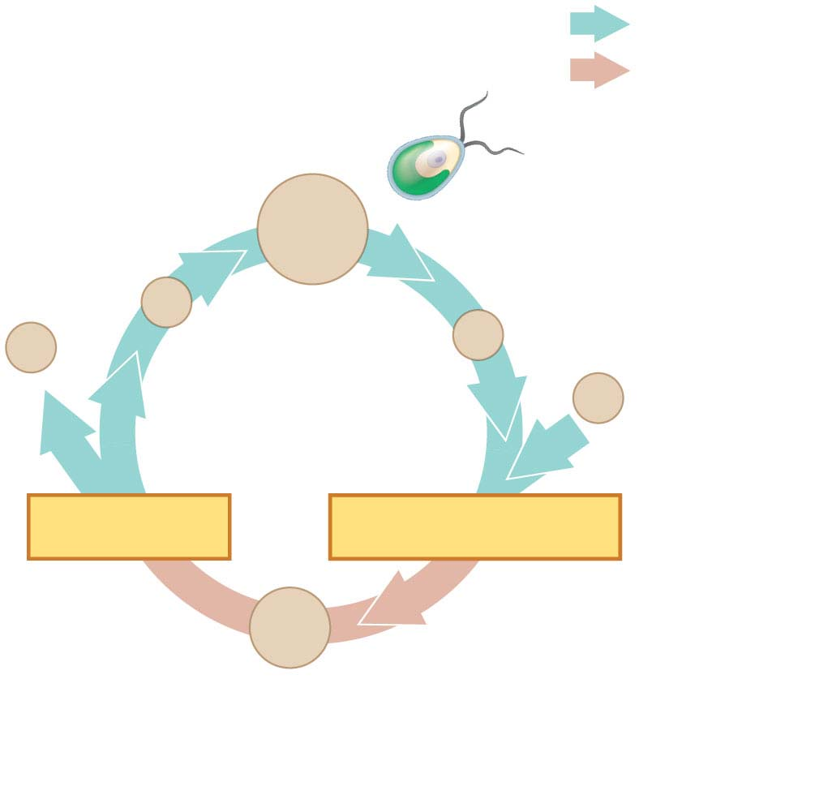
Figure 10.6-3
Haploid unicellular or
multicellular organism
Haploid (n)
Diploid (2n)
Mitosis
n
Mitosis
n
n
n
Gametes
n
MEIOSIS
FERTILIZATION
2n
Zygote
(c) Most fungi and some protists
Notes:
Figure 10.6-3 Three types of sexual life cycles (part 3: fungi)

Slide 22
Depending on the type of life cycle, either haploid or diploid cells can divide by mitosis
However, only diploid cells can undergo meiosis
In all three life cycles, the halving and doubling of chromosomes contribute to genetic variation in offspring
Notes:
22

