Slide 1
Concept 7.1: Catabolic pathways yield energy by oxidizing organic fuels
Catabolic pathways involving electron transfer are central processes to cellular respiration
Notes:
1

Slide 2
Catabolic Pathways and Production of ATP
The breakdown of organic molecules is exergonic
Fermentation is a partial degradation of sugars that occurs without O₂
Aerobic respiration consumes organic molecules and O₂ and yields ATP
Anaerobic respiration is similar to aerobic respiration but consumes compounds other than O₂
Notes:
2

Slide 3
Cellular respiration includes both aerobic and anaerobic processes but is often used to refer to aerobic respiration
Although carbohydrates, fats, and proteins are all consumed as fuel, it is helpful to trace cellular respiration with the sugar glucose
C₆H₁₂O₆ + 6 O₂ → 6 CO₂ + 6 H₂O + Energy (ATP + heat)
Notes:
3

Slide 4
Redox Reactions: Oxidation and Reduction
The transfer of electrons during chemical reactions releases energy stored in organic molecules
This released energy is ultimately used to synthesize ATP
Notes:
4

Slide 5
The Principle of Redox
Chemical reactions that transfer electrons between reactants are called oxidation-reduction reactions, or redox reactions
In oxidation, a substance loses electrons, or is oxidized
In reduction, a substance gains electrons, or is reduced (the amount of positive charge is reduced)
Notes:
5

Slide 6
Figure 7.UN01
becomes oxidized
(loses electron)
becomes reduced
(gains electron)
Notes:
Figure 7.UN01 In-text figure, NaCl redox reaction, p. 142

Slide 7
The electron donor is called the reducing agent
The electron acceptor is called the oxidizing agent
Some redox reactions do not transfer electrons but change the electron sharing in covalent bonds
An example is the reaction between methane and O₂
Notes:
7

Slide 8
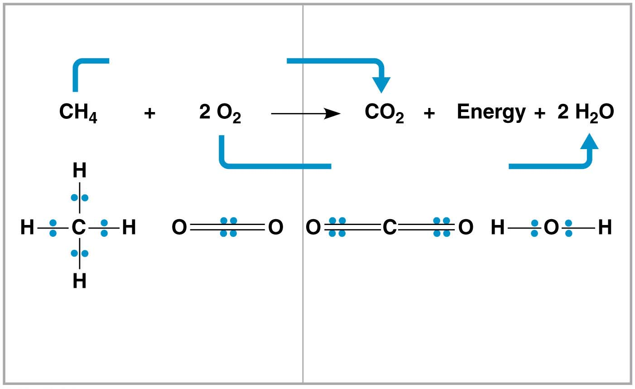
Figure 7.3
Reactants
Products
becomes oxidized
becomes reduced
Methane
Oxygen
Carbon dioxide
Water
(reducing agent)
(oxidizing agent)
Notes:
Figure 7.3 Methane combustion as an energy-yielding redox reaction

Slide 9
Redox reactions that move electrons closer to electronegative atoms, like oxygen, release chemical energy that can be put to work
Notes:
9

Slide 10
Oxidation of Organic Fuel Molecules During Cellular Respiration
During cellular respiration, fuel (such as glucose) is oxidized, and O₂ is reduced
Organic molecules with an abundance of hydrogen, like carbohydrates and fats, are excellent fuels
As hydrogen (with its electron) is transferred to oxygen, energy is released that can be used in ATP synthesis
Notes:
10

Slide 11
Figure 7.UN03
becomes oxidized
becomes reduced
Notes:
Figure 7.UN03 In-text figure, cellular respiration redox reaction, p. 143

Slide 12
Stepwise Energy Harvest via NAD⁺ and the Electron Transport Chain
In cellular respiration, glucose and other organic molecules are broken down in a series of steps
Electrons from organic compounds are usually first transferred to NAD⁺, a coenzyme
As an electron acceptor, NAD⁺ functions as an oxidizing agent during cellular respiration
Each NADH (the reduced form of NAD⁺) represents stored energy that is tapped to synthesize ATP
Notes:
12

Slide 13
Enzymes called dehydrogenases facilitate the transfer of two electrons and one hydrogen ion to NAD⁺
One hydrogen ion is released in this process
Notes:
13

Slide 14
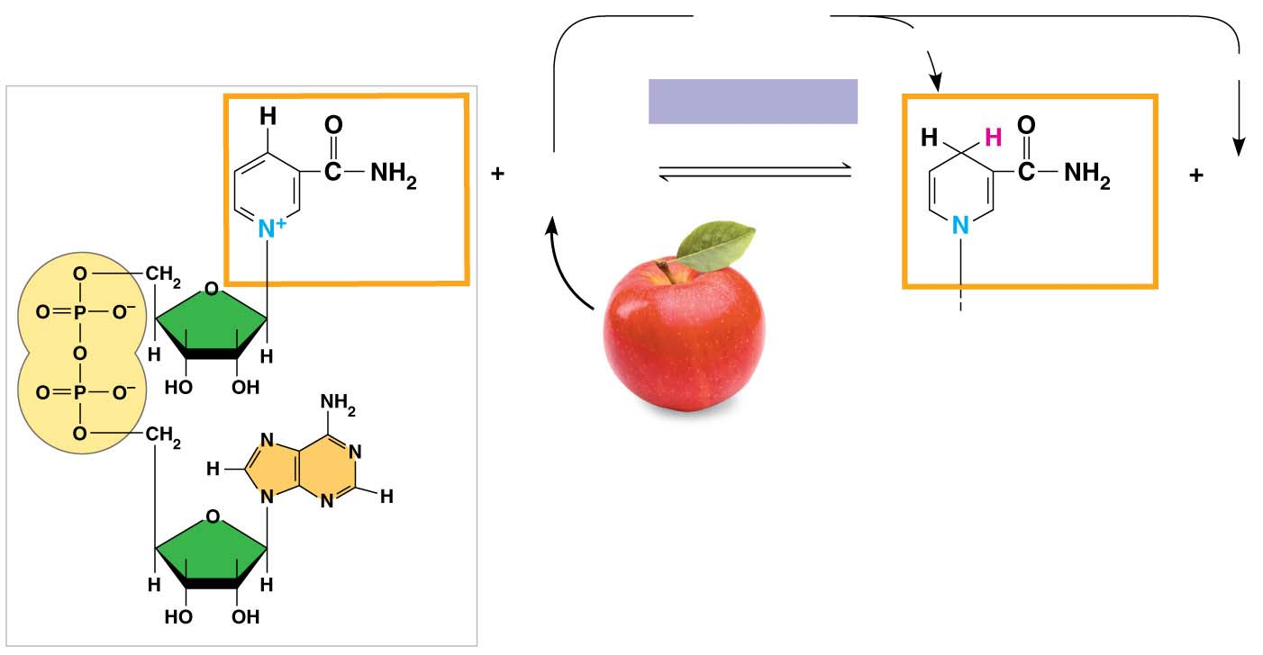
Figure 7.4
2 e⁻ + 2 H⁺
2 e⁻ + H⁺
NAD⁺
NADH
H⁺
Dehydrogenase
Reduction of NAD⁺
2[H]
H⁺
(from food)
Oxidation of NADH
Nicotinamide
Nicotinamide
(oxidized form)
(reduced form)
Notes:
Figure 7.4 NAD⁺ as an electron shuttle

Slide 15
NADH passes the electrons to the electron transport chain
Electrons are passed to increasingly electronegative carrier molecules down the chain through a series of redox reactions
Electron transfer to oxygen occurs in a series of energy-releasing steps instead of one explosive reaction
The energy yielded is used to regenerate ATP
Notes:
15

Slide 16
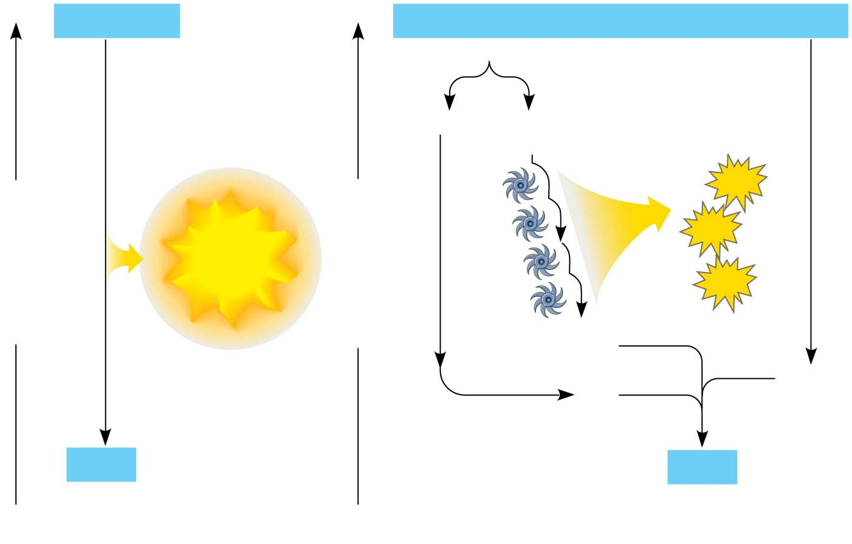
Figure 7.5
H₂ + ¹/₂ O₂
2 H
+
1
/2 O₂
Controlled
release of
energy
2 H⁺ + 2 e⁻
Free energy, G
Free energy, G
ATP
ATP
Explosive
release
chain
Electron transport
ATP
2 e ⁻
¹/₂ O₂
2
H⁺
H₂O
H₂O
(a) Uncontrolled reaction
(b) Cellular respiration
Notes:
Figure 7.5 An introduction to electron transport chains

Slide 17
The Stages of Cellular Respiration: A Preview
Harvesting of energy from glucose has three stages
Glycolysis breaks down glucose into two molecules of pyruvate in the cytosol
Pyruvate oxidation and the citric acid cycle completes the breakdown of glucose in the mitochondrial matrix
Oxidative phosphorylation accounts for most of the ATP synthesis and occurs in the inner membrane of the mitochondria
Notes:
17

Slide 18
Animation: Cellular Respiration

Slide 19
Figure 7.UN05
1. GLYCOLYSIS (color-coded blue throughout the chapter)
2. PYRUVATE OXIDATION and the CITRIC ACID CYCLE (color-coded orange)
3. OXIDATIVE PHOSPHORYLATION: Electron transport and chemiosmosis (color-coded purple)
Notes:
Figure 7.UN05 In-text figure, color code for stages of cellular respiration, p. 145

Slide 20
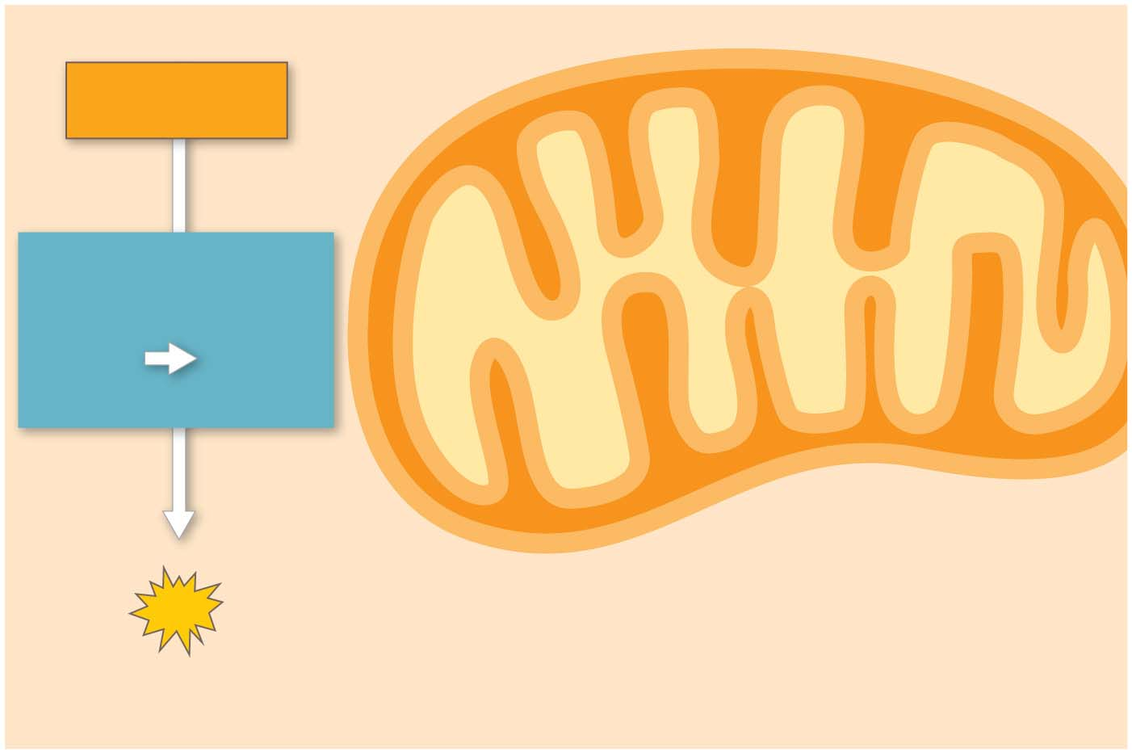
Figure 7.6-s1
Electrons
via NADH
GLYCOLYSIS
Glucose
Pyruvate
CYTOSOL
MITOCHONDRION
ATP
Substrate-level
Notes:
Figure 7.6-s1 An overview of cellular respiration (step 1)

Slide 21
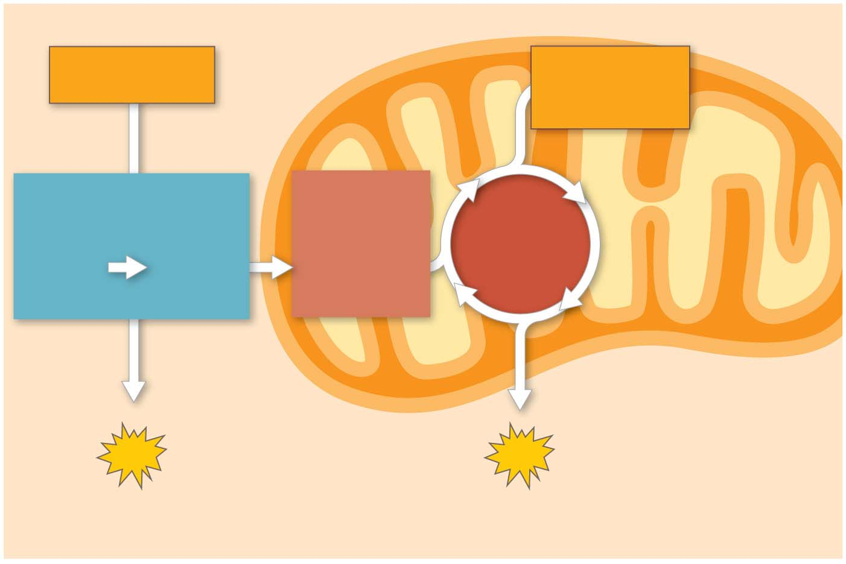
Figure 7.6-s2
Electrons
via NADH
Electrons
via NADH
and FADH₂
GLYCOLYSIS
PYRUVATE
OXIDATION
CITRIC
ACID
CYCLE
Glucose
Pyruvate
Acetyl CoA
CYTOSOL
MITOCHONDRION
ATP
ATP
Substrate-level
Substrate-level
Notes:
Figure 7.6-s2 An overview of cellular respiration (step 2)

Slide 22
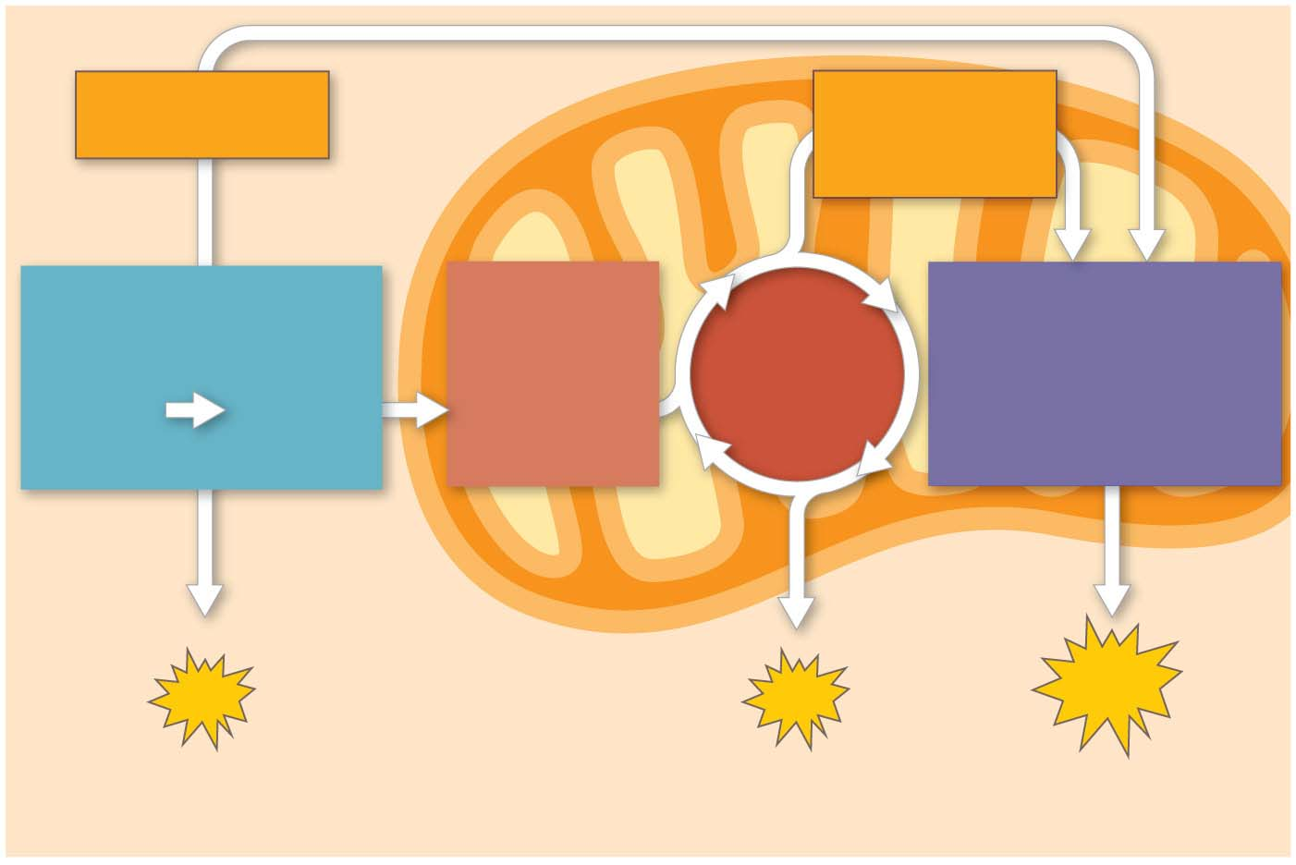
Figure 7.6-s3
Electrons
via NADH
Electrons
via NADH
and FADH₂
GLYCOLYSIS
PYRUVATE
OXIDATION
OXIDATIVE
PHOSPHORYLATION
CITRIC
ACID
CYCLE
Glucose
Pyruvate
Acetyl CoA
(Electron transport
and chemiosmosis)
CYTOSOL
MITOCHONDRION
ATP
ATP
ATP
Substrate-level
Substrate-level
Oxidative
Notes:
Figure 7.6-s3 An overview of cellular respiration (step 3)

Slide 23
Oxidative phosphorylation accounts for almost 90% of the ATP generated by cellular respiration
This process involves the transfer of inorganic phosphates to ADP
Notes:
23

Slide 24
A smaller amount of ATP is formed in glycolysis and the citric acid cycle by substrate-level phosphorylation
In this process, an enzyme transfers a phosphate group directly from a substrate molecule to ADP
Notes:
24

Slide 25
For each molecule of glucose degraded to CO₂ and water by respiration, the cell makes up to 32 molecules of ATP
Notes:
25

Slide 26
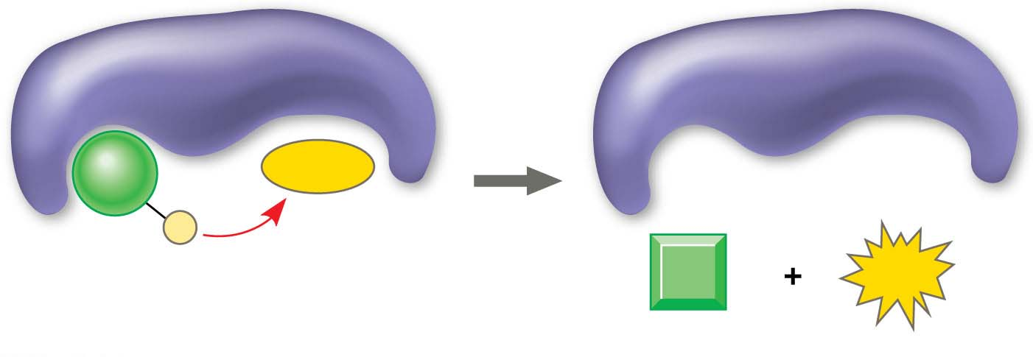
Figure 7.7
Enzyme
Enzyme
ADP
P
Substrate
ATP
Product
Notes:
Figure 7.7 Substrate-level phosphorylation

