Slide 1
Overview: Life at the Edge
The plasma membrane separates the living cell from its surroundings
The plasma membrane exhibits selective permeability, allowing some substances to cross it more easily than others
Notes:
1

Slide 2
Concept 5.1: Cellular membranes are fluid mosaics of lipids and proteins
Phospholipids are the most abundant lipid in most membranes
Phospholipids are amphipathic molecules, containing hydrophobic and hydrophilic regions
A phospholipid bilayer can exist as a stable boundary between two aqueous compartments
Notes:
2

Slide 3
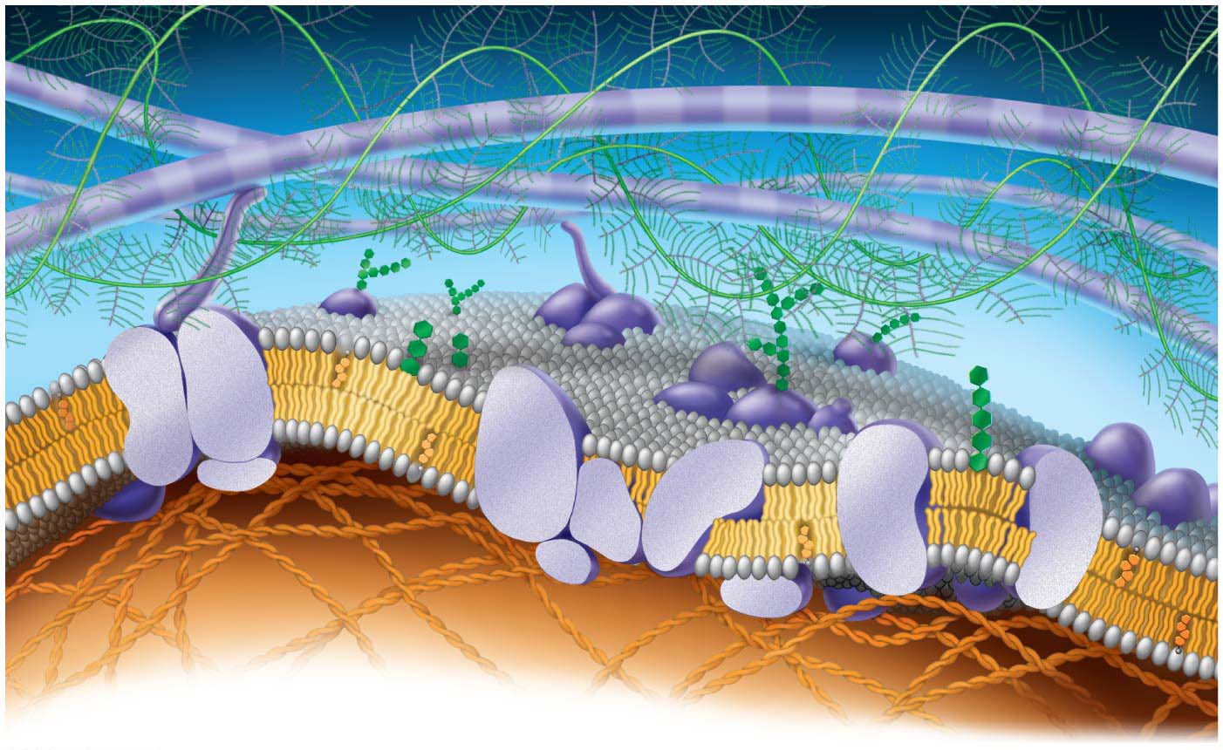
Figure 5.2
Fibers of extra-
cellular matrix (ECM)
Glyco-
protein
Carbohydrate
Glycolipid
EXTRA-
CELLULAR
SIDE OF
MEMBRANE
Phospholipid
Cholesterol
Microfilaments
of cytoskeleton
Peripheral
proteins
Integral
protein
CYTOPLASMIC SIDE
OF MEMBRANE
Notes:
Figure 5.2 Current model of an animal cell’s plasma membrane (cutaway view)

Slide 4
Most membrane proteins are also amphipathic and reside in the bilayer with their hydrophilic portions protruding
The fluid mosaic model states that the membrane is a mosaic of protein molecules bobbing in a fluid bilayer of phospholipids
Groups of certain proteins or certain lipids may associate in long-lasting, specialized patches
Notes:
4

Slide 5
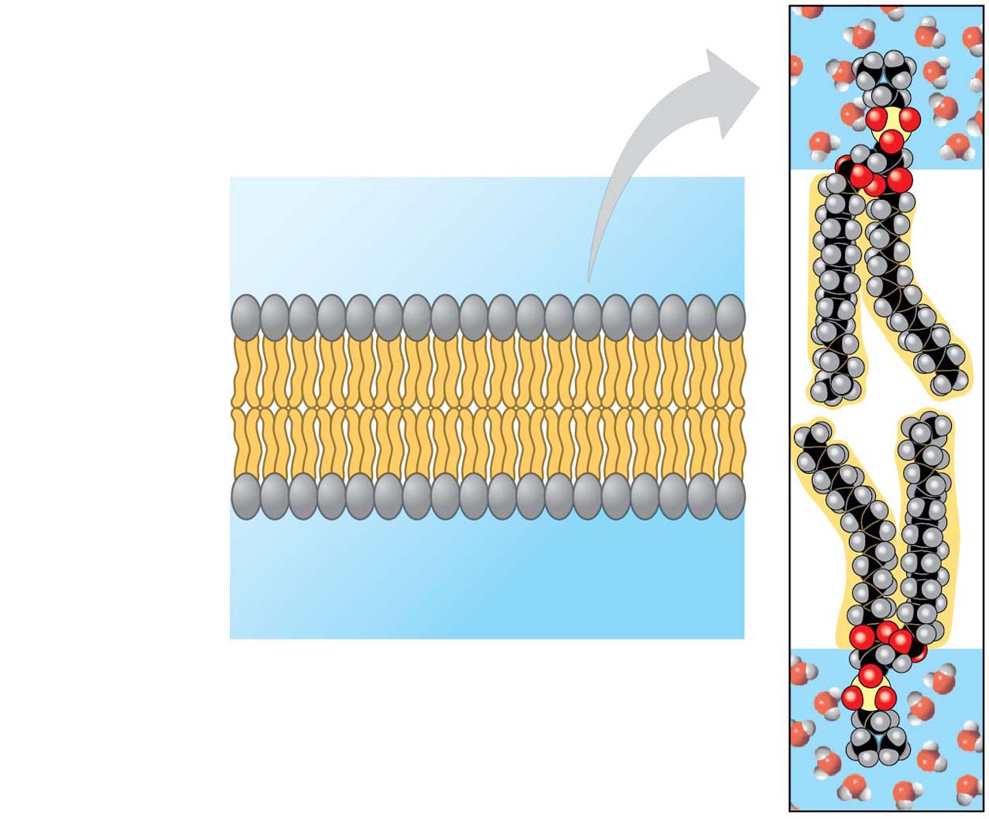
Figure 5.3
Two phospholipids
WATER
Hydrophilic
head
Hydrophobic
tail
WATER
Notes:
Figure 5.3 Phospholipid bilayer (cross section)

Slide 6
The Fluidity of Membranes
Most of the lipids and some proteins in a membrane can shift about laterally
The lateral movement of phospholipids is rapid; proteins move more slowly
Some proteins move in a directed manner; others seem to be anchored in place
Notes:
6

Slide 7
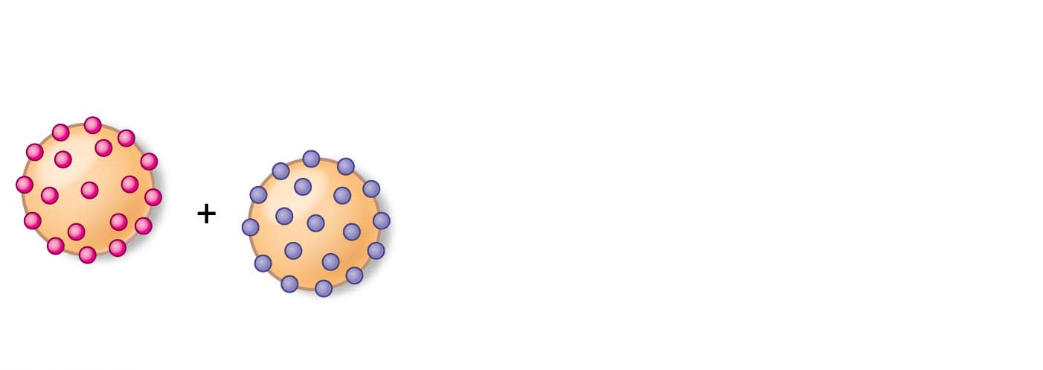
Figure 5.4-s1
Results
Membrane proteins
Mouse cell
Human cell
Notes:
Figure 5.4-s1 Inquiry: Do membrane proteins move? (step 1)

Slide 8
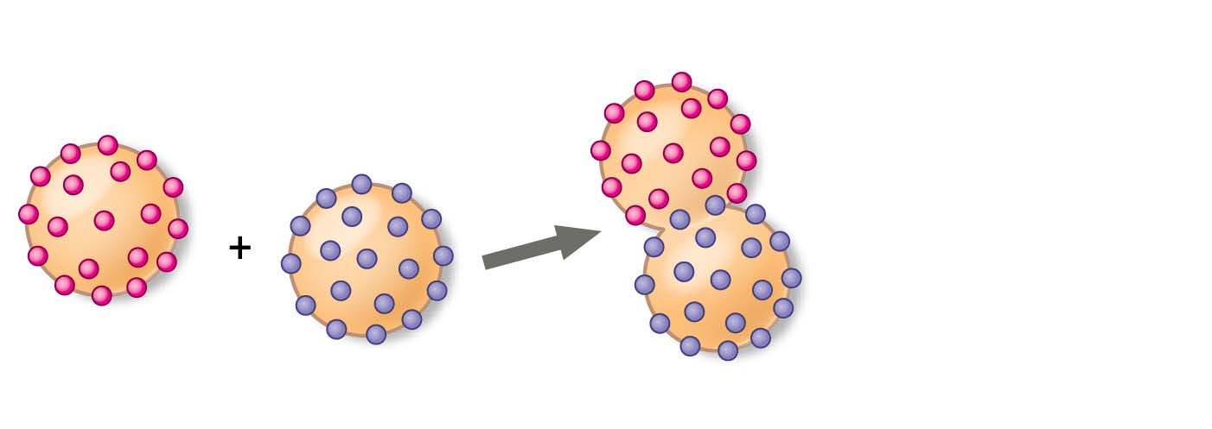
Figure 5.4-s2
Results
Membrane proteins
Mouse cell
Human cell
Hybrid cell
Notes:
Figure 5.4-s2 Inquiry: Do membrane proteins move? (step 2)

Slide 9
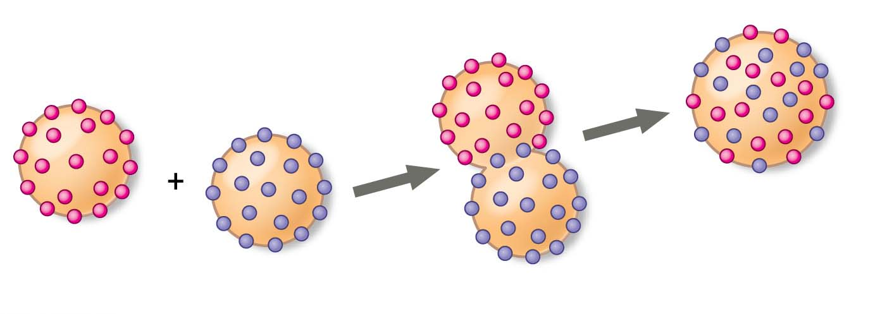
Figure 5.4-s3
Results
Membrane proteins
Mixed proteins
after 1 hour
Mouse cell
Human cell
Hybrid cell
Notes:
Figure 5.4-s3 Inquiry: Do membrane proteins move? (step 3)

Slide 10
As temperatures cool, membranes switch from a fluid state to a solid state
The temperature at which a membrane solidifies depends on the types of lipids
A membrane remains fluid to a lower temperature if it is rich in phospholipids with unsaturated hydrocarbon tails
Membranes must be fluid to work properly; they are usually about as fluid as salad oil
Notes:
10

Slide 11
The steroid cholesterol has different effects on membrane fluidity at different temperatures
At warm temperatures (such as 37°C), cholesterol restrains movement of phospholipids
At cool temperatures, it maintains fluidity by preventing tight packing
Notes:
11

Slide 12
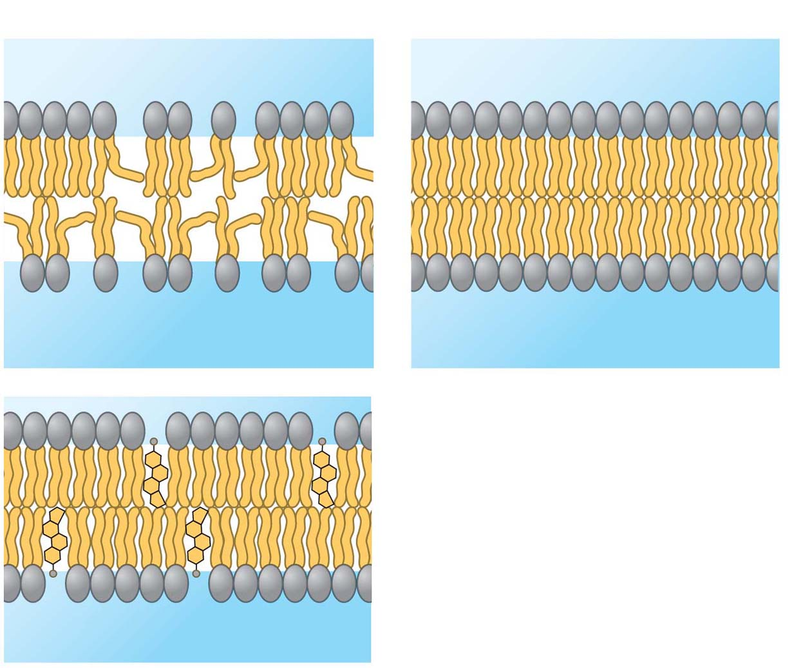
Figure 5.5
(a) Unsaturated versus saturated hydrocarbon tails.
Fluid
Viscous
Unsaturated tails prevent
packing.
Saturated tails pack
together.
(b) Cholesterol reduces
membrane fluidity at
moderate temperatures, but
at low temperatures hinders
solidification.
Cholesterol
Notes:
Figure 5.5 Factors that affect membrane fluidity

Slide 13
Evolution of Differences in Membrane Lipid Composition
Variations in lipid composition of cell membranes of many species appear to be adaptations to specific environmental conditions
Ability to change the lipid compositions in response to temperature changes has evolved in organisms that live where temperatures vary
Notes:
13

Slide 14
Membrane Proteins and Their Functions
A membrane is a collage of different proteins embedded in the fluid matrix of the lipid bilayer
Proteins determine most of the membrane’s specific functions
Notes:
14

Slide 15
Integral proteins penetrate the hydrophobic interior of the lipid bilayer
Integral proteins that span the membrane are called transmembrane proteins
The hydrophobic regions of an integral protein consist of one or more stretches of nonpolar amino acids, often coiled into α helices
Peripheral proteins are loosely bound to the surface of the membrane
Notes:
15

Slide 16
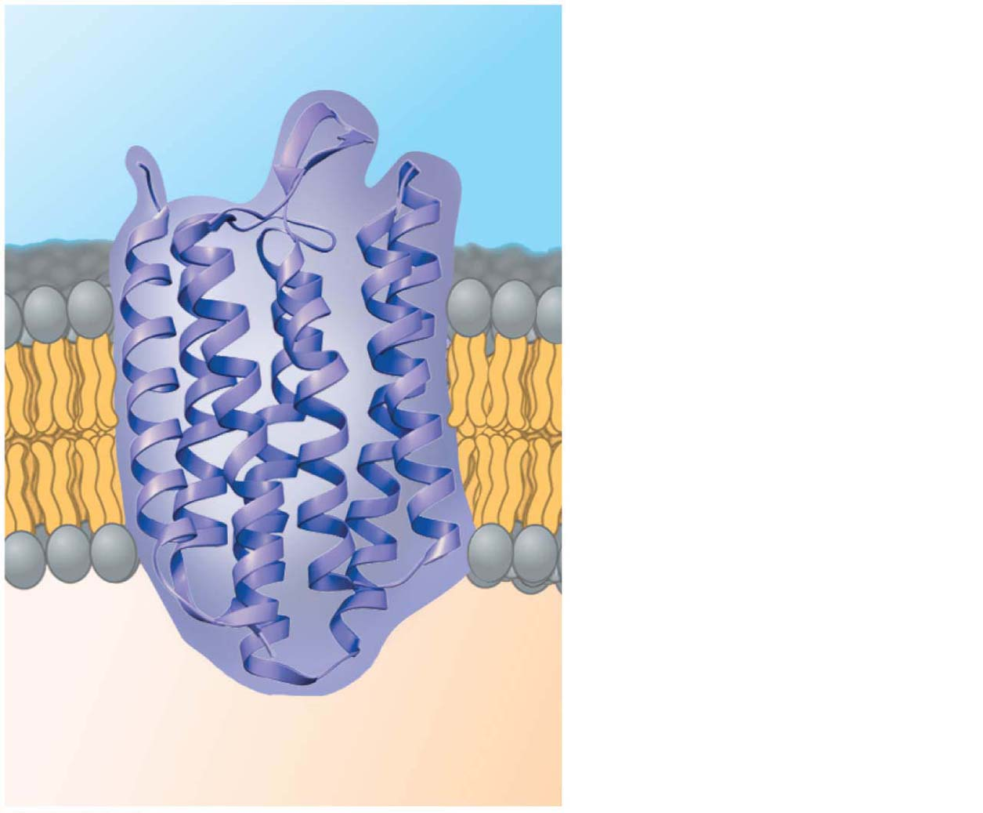
Figure 5.6
N-terminus
EXTRACELLULAR
SIDE
α helix
CYTOPLASMIC
SIDE
C-terminus
Notes:
Figure 5.6 The structure of a transmembrane protein

Slide 17
Six major functions of membrane proteins
Transport
Enzymatic activity
Signal transduction
Cell-cell recognition
Intercellular joining
Attachment to the cytoskeleton and extracellular matrix (ECM)
Notes:
17
NOTE: changed to match altered order in figure 5.7

Slide 18
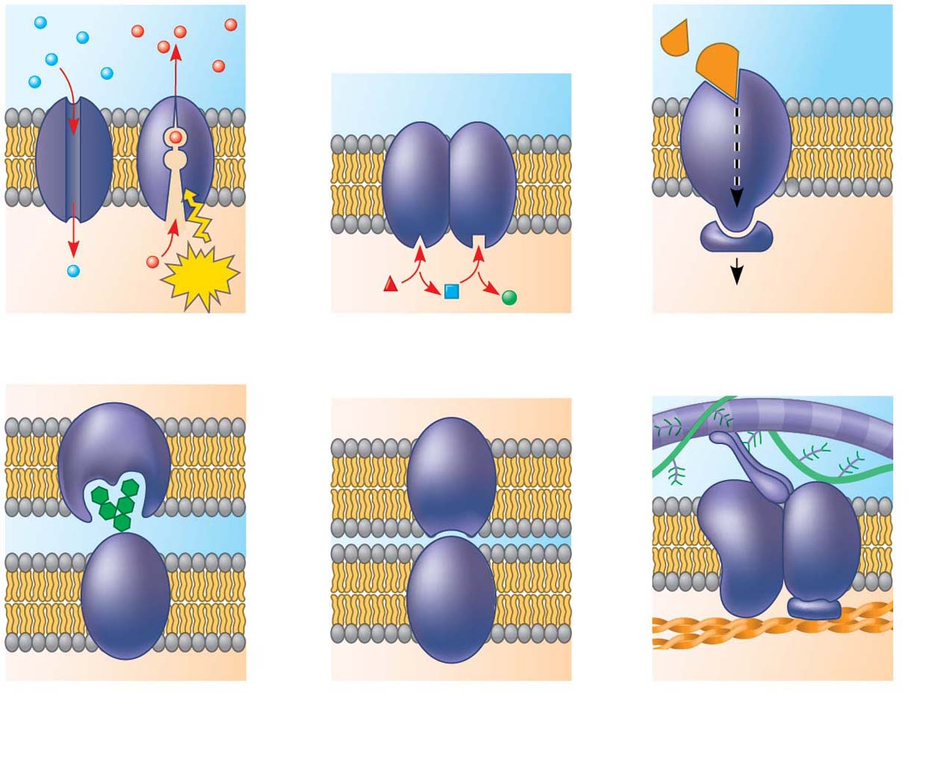
Figure 5.7
Signaling
molecule
Enzymes
Receptor
ATP
Signal transduction
(a) Transport
(b) Enzymatic activity
(c) Signal transduction
Glyco-
protein
(d) Cell-cell recognition
(e) Intercellular joining
(f) Attachment to the
cytoskeleton and extra-
cellular matrix (ECM)
Notes:
Figure 5.7 Some functions of membrane proteins

Slide 19
The Role of Membrane Carbohydrates in Cell-Cell Recognition
Cells recognize each other by binding to surface molecules, often containing carbohydrates, on the extracellular surface of the plasma membrane
Membrane carbohydrates may be covalently bonded to lipids (forming glycolipids) or, more commonly, to proteins (forming glycoproteins)
Carbohydrates on the external side of the plasma membrane vary among species, individuals, and even cell types in an individual
Notes:
19

Slide 20
Synthesis and Sidedness of Membranes
Membranes have distinct inside and outside faces
The asymmetrical arrangement of proteins, lipids, and associated carbohydrates in the plasma membrane is determined as the membrane is built by the ER and Golgi apparatus
Notes:
20

Slide 21
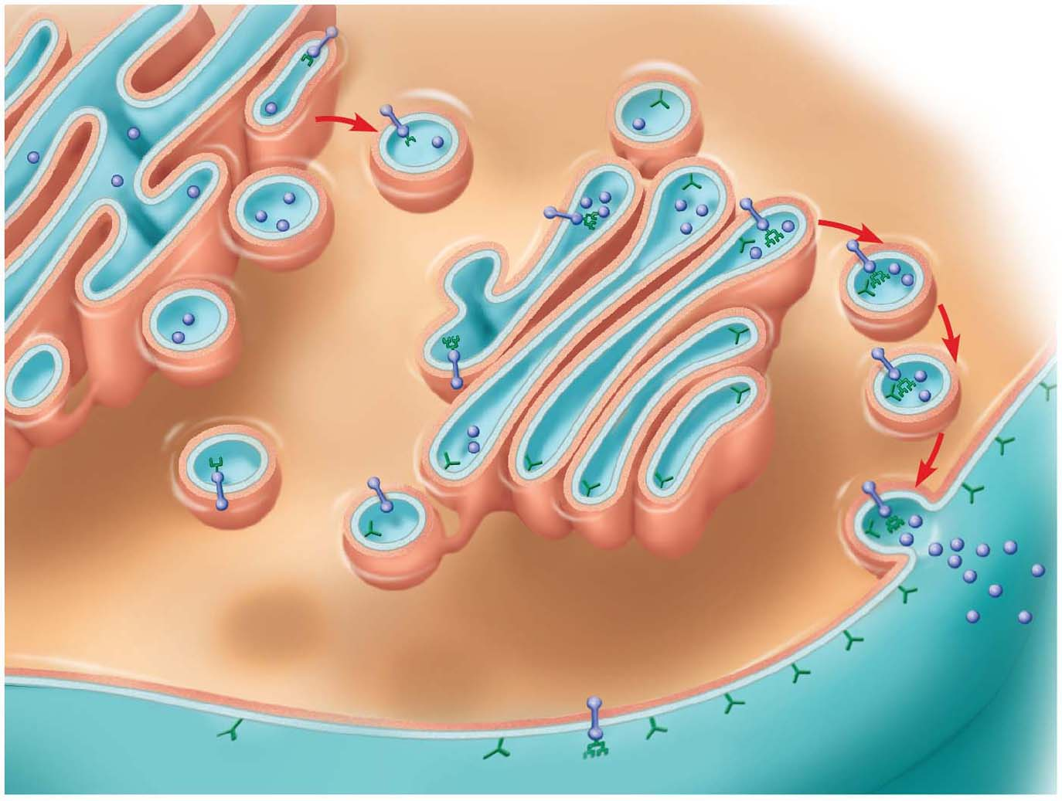
Figure 5.8
Secretory
protein
Transmembrane
glycoproteins
Golgi
apparatus
Vesicle
Attached
carbo-
hydrate
ER
Glycolipid
ER
lumen
Plasma membrane:
Cytoplasmic face
Transmembrane
glycoprotein
Extracellular face
Secreted
protein
Membrane
glycolipid
Notes:
Figure 5.8 Synthesis of membrane components and their orientation in the membrane

