Slide 1
Concept 9.3: The eukaryotic cell cycle is regulated by a molecular control system
The frequency of cell division varies with the type of cell
These differences result from regulation at the molecular level
Cancer cells manage to escape the usual controls on the cell cycle
Notes:
1

Slide 2
Evidence for Cytoplasmic Signals
The cell cycle is driven by specific signaling molecules present in the cytoplasm
Some evidence for this hypothesis comes from experiments with cultured mammalian cells
Cells at different phases of the cell cycle were fused to form a single cell with two nuclei at different stages
Cytoplasmic signals from one of the cells could cause the nucleus from the second cell to enter the “wrong” stage of the cell cycle
Notes:
2

Slide 3
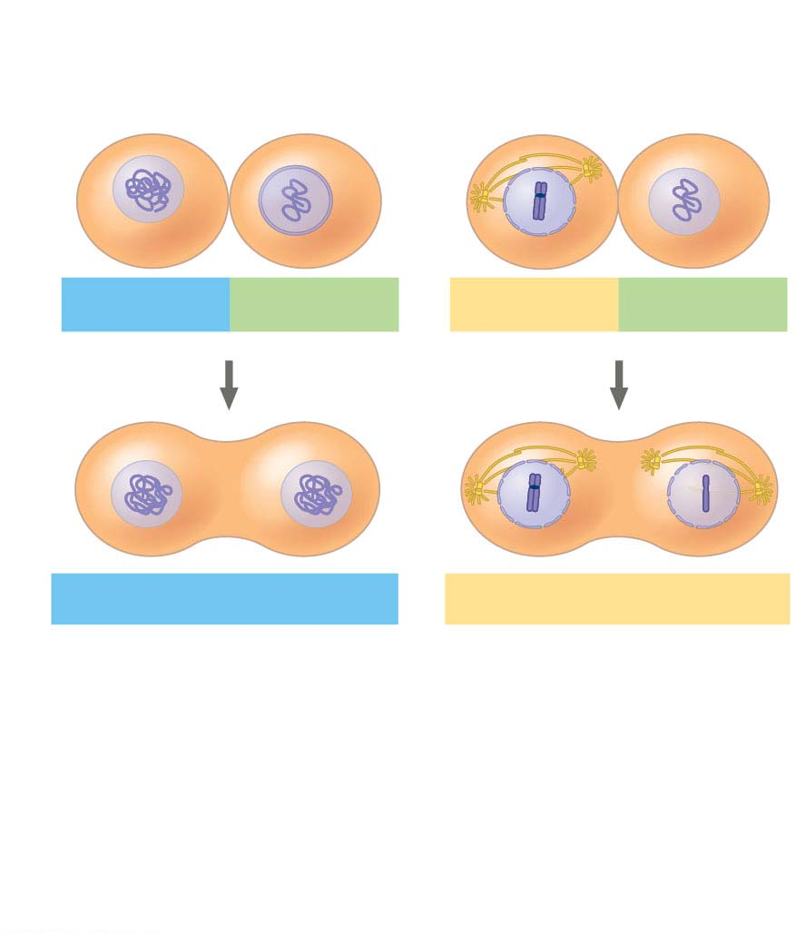
Figure 9.14
Experiment
Experiment 1
Experiment 2
S
G₁
M
G₁
Results
S
S
M
M
G₁ nucleus
immediately
entered S phase
and DNA was
synthesized.
G₁ nucleus began
mitosis without
chromosome
duplication.
Conclusion Molecules present in the cytoplasm
control the progression to S and M phases.
Notes:
Figure 9.14 Inquiry: Do molecular signals in the cytoplasm regulate the cell cycle?

Slide 4
Checkpoints of the Cell Cycle Control System
The sequential events of the cell cycle are directed by a distinct cell cycle control system, which is similar to a timing device of a washing machine
The cell cycle control system is regulated by both internal and external controls
The clock has specific checkpoints where the cell cycle stops until a go-ahead signal is received
Notes:
4

Slide 5
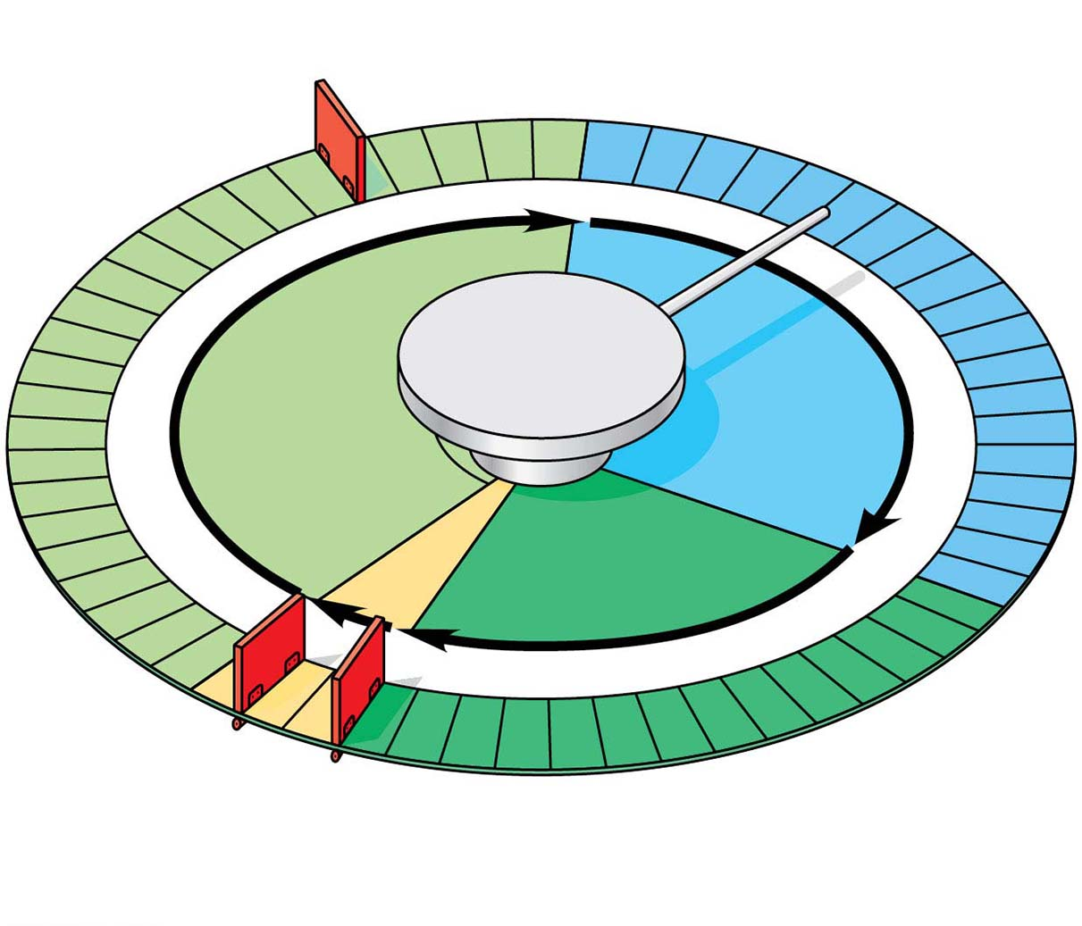
Figure 9.15
G₁ checkpoint
Control
system
S
G₁
M
G₂
M checkpoint
G₂ checkpoint
Notes:
Figure 9.15 Mechanical analogy for the cell cycle control system

Slide 6
For many cells, the G₁ checkpoint seems to be the most important
If a cell receives a go-ahead signal at the G₁ checkpoint, it will usually complete the S, G₂, and M phases and divide
If the cell does not receive the go-ahead signal, it will exit the cycle, switching into a nondividing state called the G₀ phase
Notes:
6

Slide 7
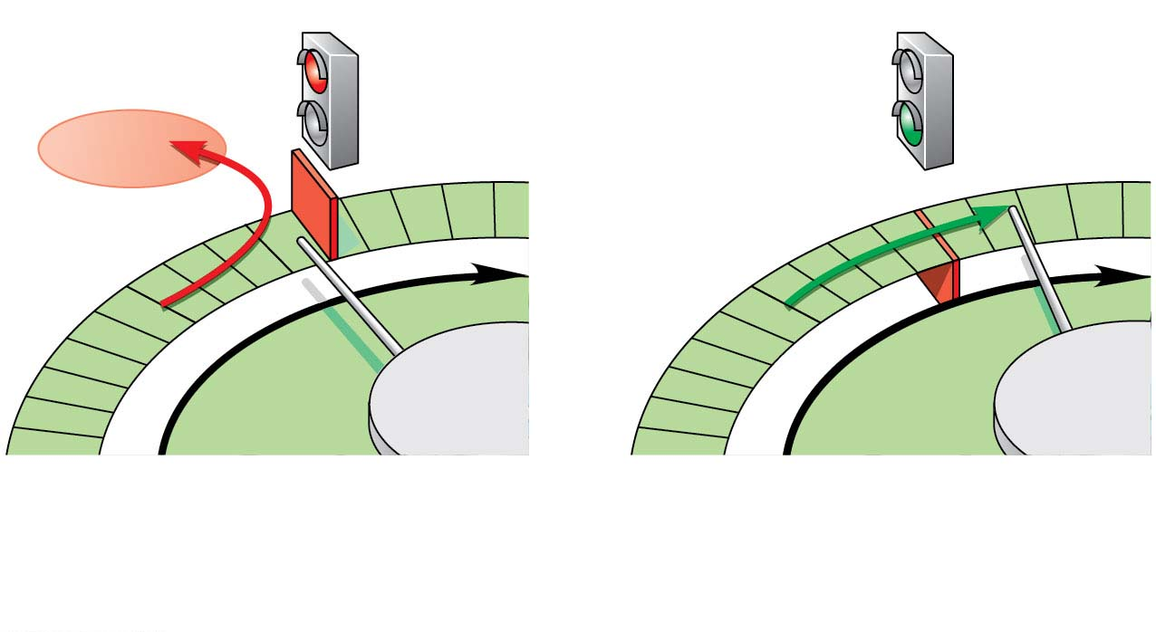
Figure 9.16-1
G₁ checkpoint
G₀
G₁
G₁
Without go-ahead signal, cell
enters G₀.
With go-ahead signal, cell
continues cell cycle.
(a) G₁ checkpoint
Notes:
Figure 9.16-1 Two important checkpoints (part 1: G₁ checkpoint)

Slide 8
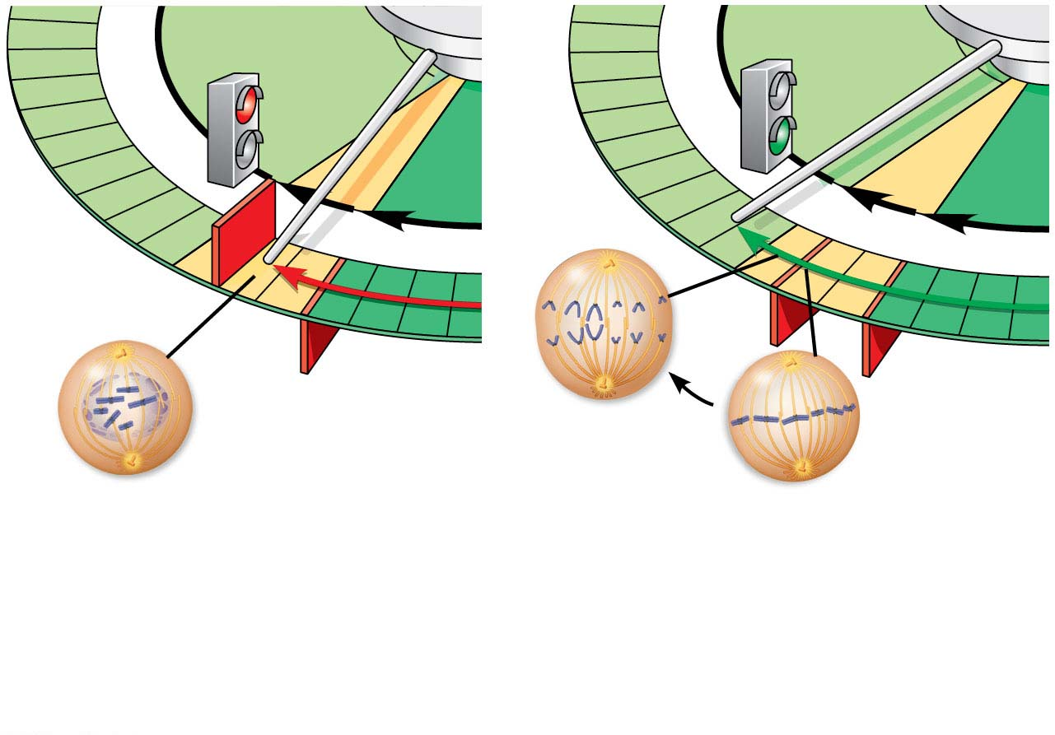
Figure 9.16-2
G₁
G₁
M
G₂
M
G₂
M
checkpoint
G₂
checkpoint
Anaphase
Prometaphase
Metaphase
Without full chromosome
attachment, stop signal is
received.
With full chromosome
attachment, go-ahead signal is
received.
(b) M checkpoint
Notes:
Figure 9.16-2 Two important checkpoints (part 2: M checkpoint)

Slide 9
The cell cycle is regulated by a set of regulatory proteins and protein complexes including kinases and proteins called cyclins
Notes:
9

Slide 10
An example of an internal signal occurs at the M phase checkpoint
In this case, anaphase does not begin if any kinetochores remain unattached to spindle microtubules
Attachment of all of the kinetochores activates a regulatory complex, which then activates the enzyme separase
Separase allows sister chromatids to separate, triggering the onset of anaphase
Notes:
10

Slide 11
Some external signals are growth factors, proteins released by certain cells that stimulate other cells to divide
For example, platelet-derived growth factor (PDGF) stimulates the division of human fibroblast cells in culture
Notes:
11

Slide 12
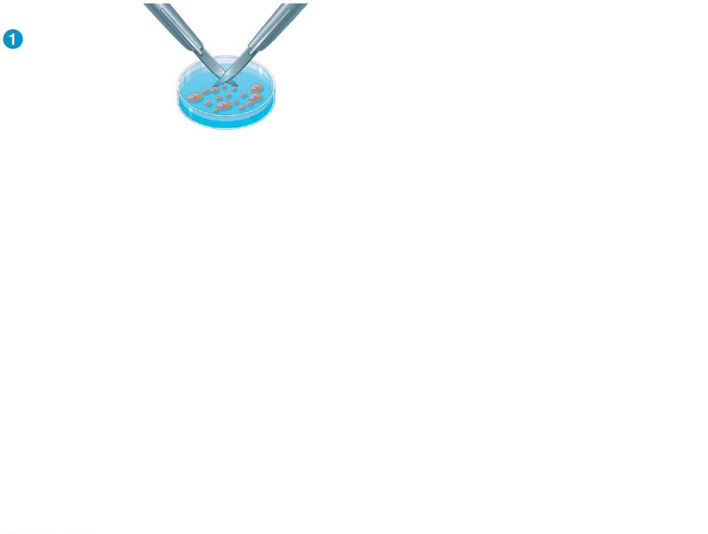
Figure 9.17-s1
Scalpels
A sample of
human connective
tissue is cut
up into small
pieces.
Petri
dish
Notes:
Figure 9.17-s1 The effect of platelet-derived growth factor (PDGF) on cell division (step 1)

Slide 13
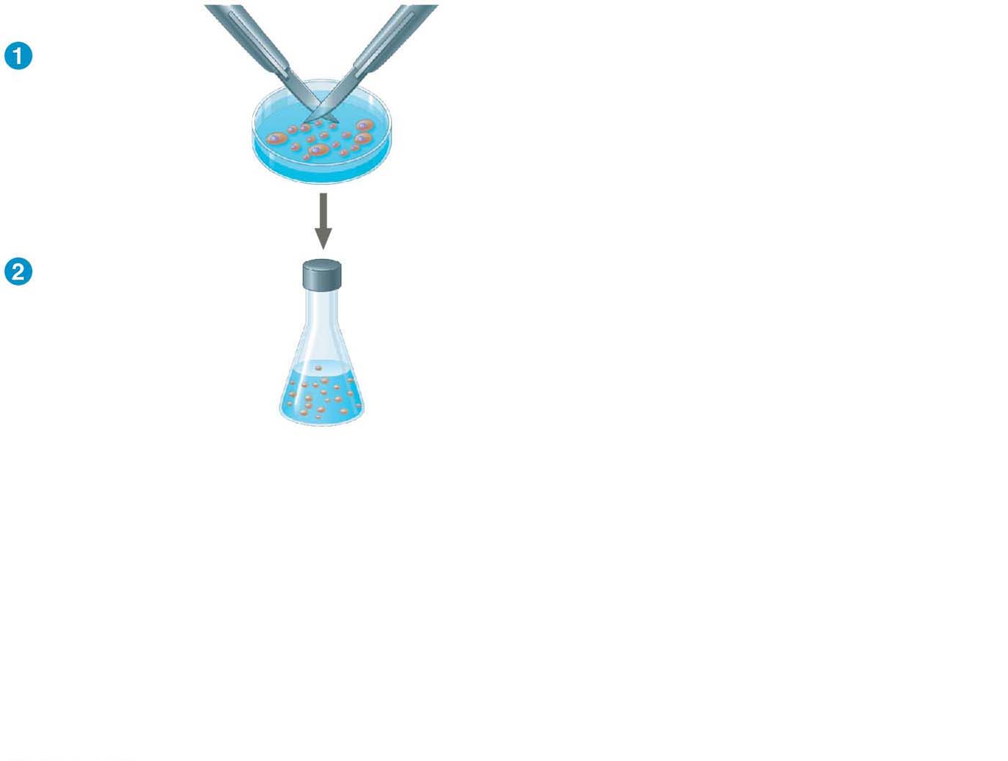
Figure 9.17-s2
Scalpels
A sample of
human connective
tissue is cut
up into small
pieces.
Petri
dish
Enzymes digest
the extracellular
matrix, resulting
in a suspension of
free fibroblasts.
Notes:
Figure 9.17-s2 The effect of platelet-derived growth factor (PDGF) on cell division (step 2)

Slide 14
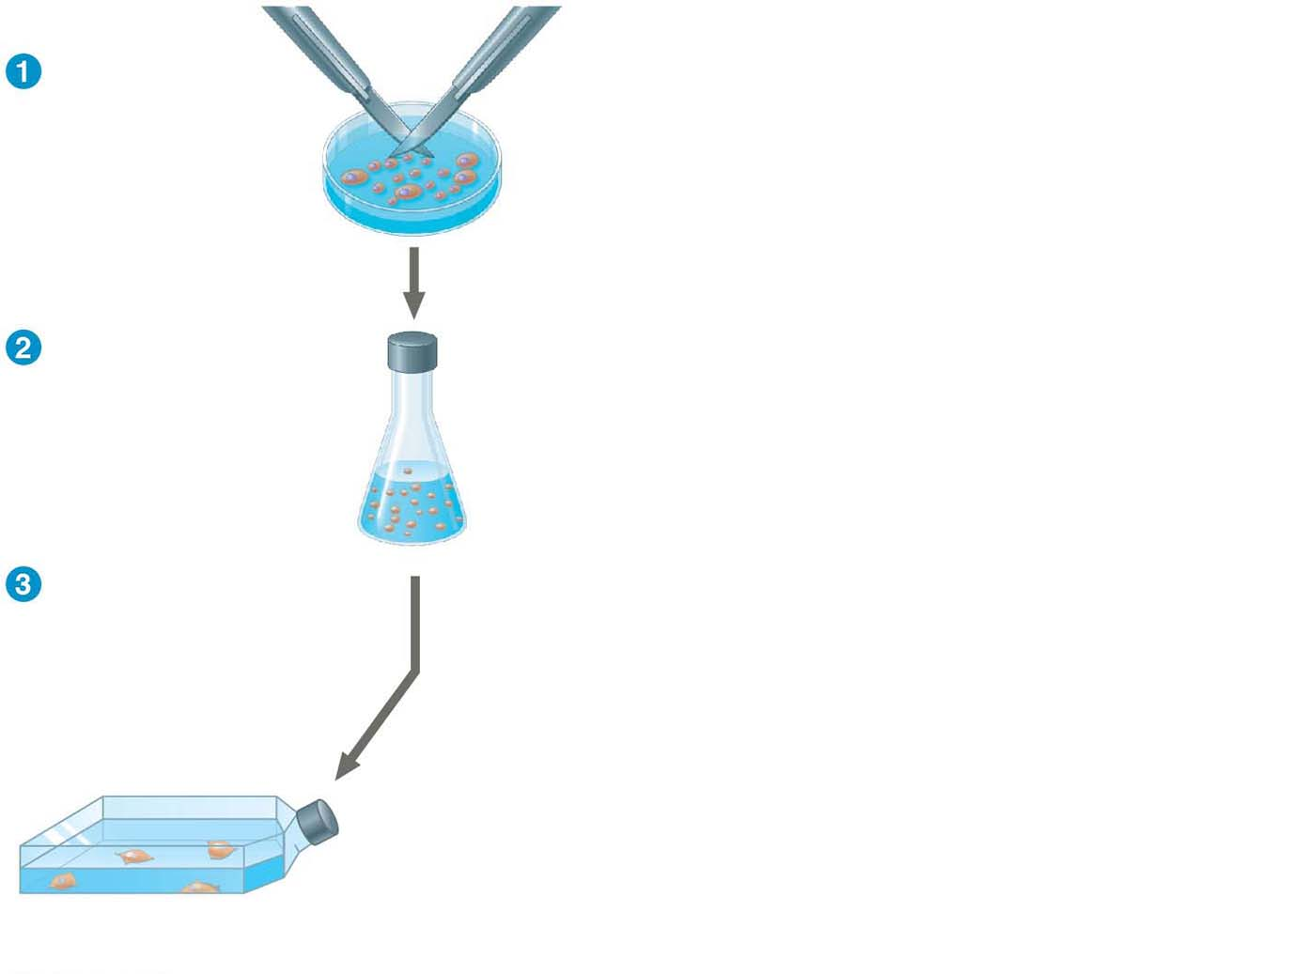
Figure 9.17-s3
Scalpels
A sample of
human connective
tissue is cut
up into small
pieces.
Petri
dish
Enzymes digest
the extracellular
matrix, resulting
in a suspension of
free fibroblasts.
Cells are transferred
to culture vessels.
Without PDGF
Notes:
Figure 9.17-s3 The effect of platelet-derived growth factor (PDGF) on cell division (step 3)

Slide 15
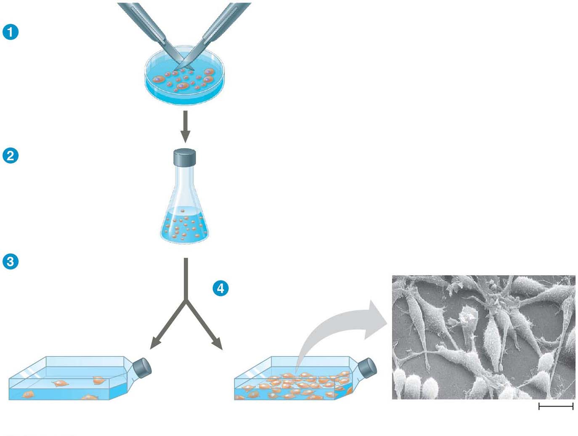
Figure 9.17-s4
Scalpels
A sample of
human connective
tissue is cut
up into small
pieces.
Petri
dish
Enzymes digest
the extracellular
matrix, resulting
in a suspension of
free fibroblasts.
Cells are transferred
to culture vessels.
PDGF is added to
half the vessels.
Without PDGF
With PDGF
Cultured fibroblasts
(SEM)
10 μm
Notes:
Figure 9.17-s4 The effect of platelet-derived growth factor (PDGF) on cell division (step 4)

Slide 16
Another example of external signals is density-dependent inhibition, in which crowded cells stop dividing
Most animal cells also exhibit anchorage dependence, in which they must be attached to a substratum in order to divide
Cancer cells exhibit neither density-dependent inhibition nor anchorage dependence
Notes:
16

Slide 17
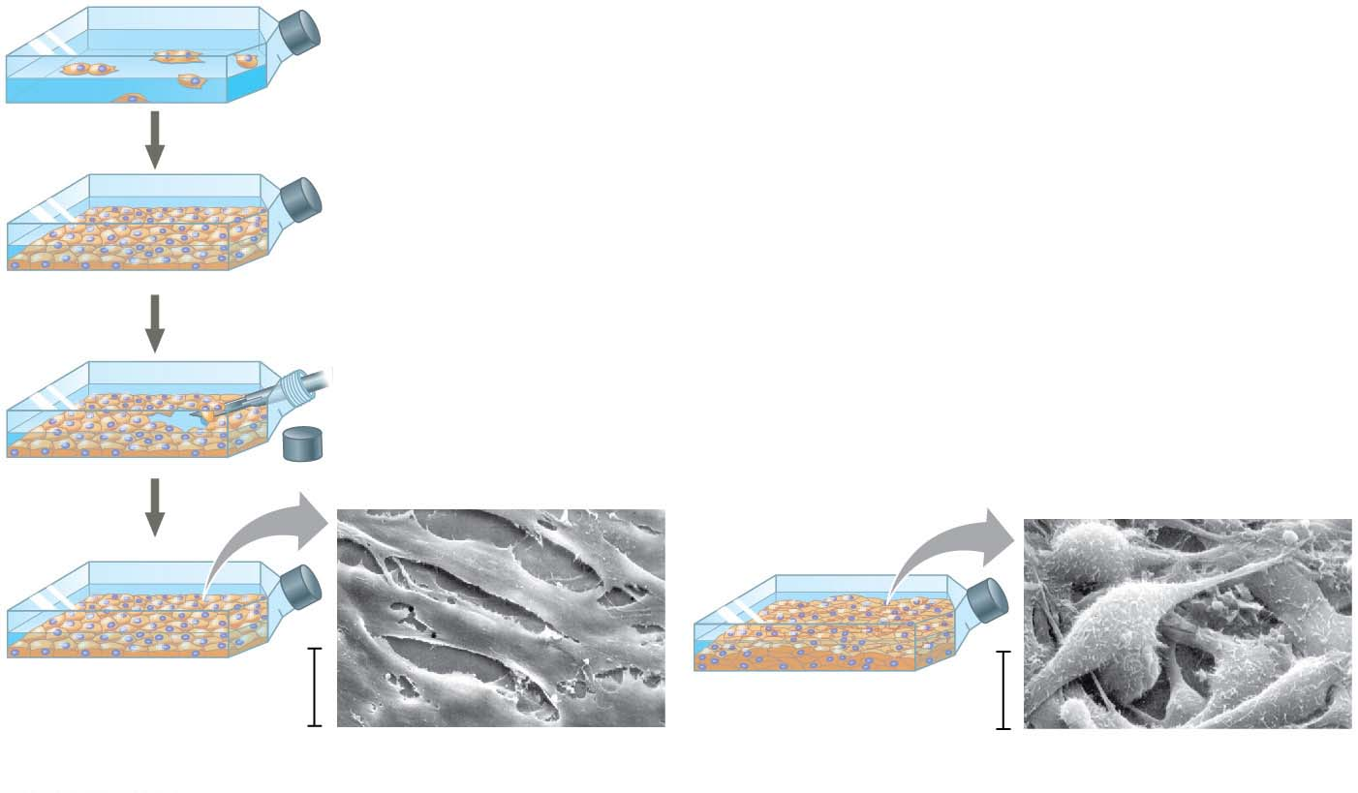
Figure 9.18
Anchorage dependence: cells
require a surface for division
Density-dependent inhibition:
cells form a single layer
Density-dependent inhibition:
cells divide to fill a gap and
then stop
20 μm
20 μm
(a) Normal mammalian cells
(b) Cancer cells
Notes:
Figure 9.18 Density-dependent inhibition and anchorage dependence of cell division

Slide 18
Loss of Cell Cycle Controls in Cancer Cells
Cancer cells do not respond to signals that normally regulate the cell cycle
Cancer cells do not need growth factors to grow and divide
They may make their own growth factor
They may convey a growth factor’s signal without the presence of the growth factor
They may have an abnormal cell cycle control system
Notes:
18

Slide 19
A normal cell is converted to a cancerous cell by a process called transformation
Cancer cells that are not eliminated by the immune system form tumors, masses of abnormal cells within otherwise normal tissue
If abnormal cells remain only at the original site, the lump is called a benign tumor
Malignant tumors invade surrounding tissues and undergo metastasis, exporting cancer cells to other parts of the body, where they may form additional tumors
Notes:
19

Slide 20
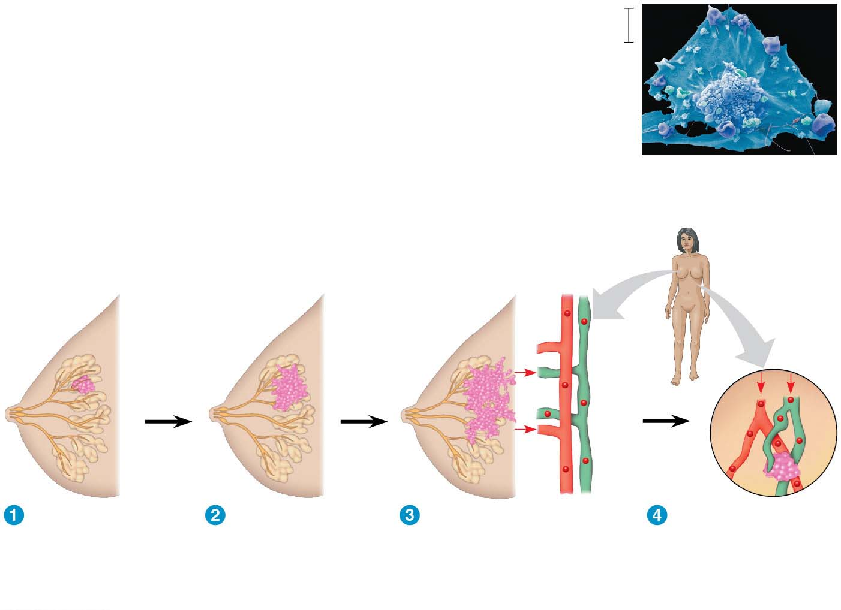
Figure 9.19
5 μm
Breast cancer cell
(colorized SEM)
Metastatic
tumor
Lymph
vessel
Tumor
Blood
vessel
Glandular
tissue
Cancer
cell
A tumor grows
from a single
cancer cell.
Cancer cells
invade
neighboring
tissue.
Cancer cells spread
through lymph and
blood vessels to
other parts of the
body.
A small percentage
of cancer cells may
metastasize to
another part of the
body.
Notes:
Figure 9.19 The growth and metastasis of a malignant breast tumor

Slide 21
Recent advances in understanding the cell cycle and cell cycle signaling have led to advances in cancer treatment
Medical treatments for cancer are becoming more “personalized” to an individual patient’s tumor
Notes:
21

