Slide 1
Concept 3.4: Lipids are a diverse group of hydrophobic molecules
Lipids do not form true polymers
The unifying feature of lipids is having little or no affinity for water
Lipids are hydrophobic because they consist mostly of hydrocarbons, which form nonpolar covalent bonds
The most biologically important lipids are fats, phospholipids, and steroids
Notes:
1

Slide 2
Fats
Fats are constructed from two types of smaller molecules: glycerol and fatty acids
Glycerol is a three-carbon alcohol with a hydroxyl group attached to each carbon
A fatty acid consists of a carboxyl group attached to a long carbon skeleton
Notes:
2

Slide 3
Animation: Fats

Slide 4
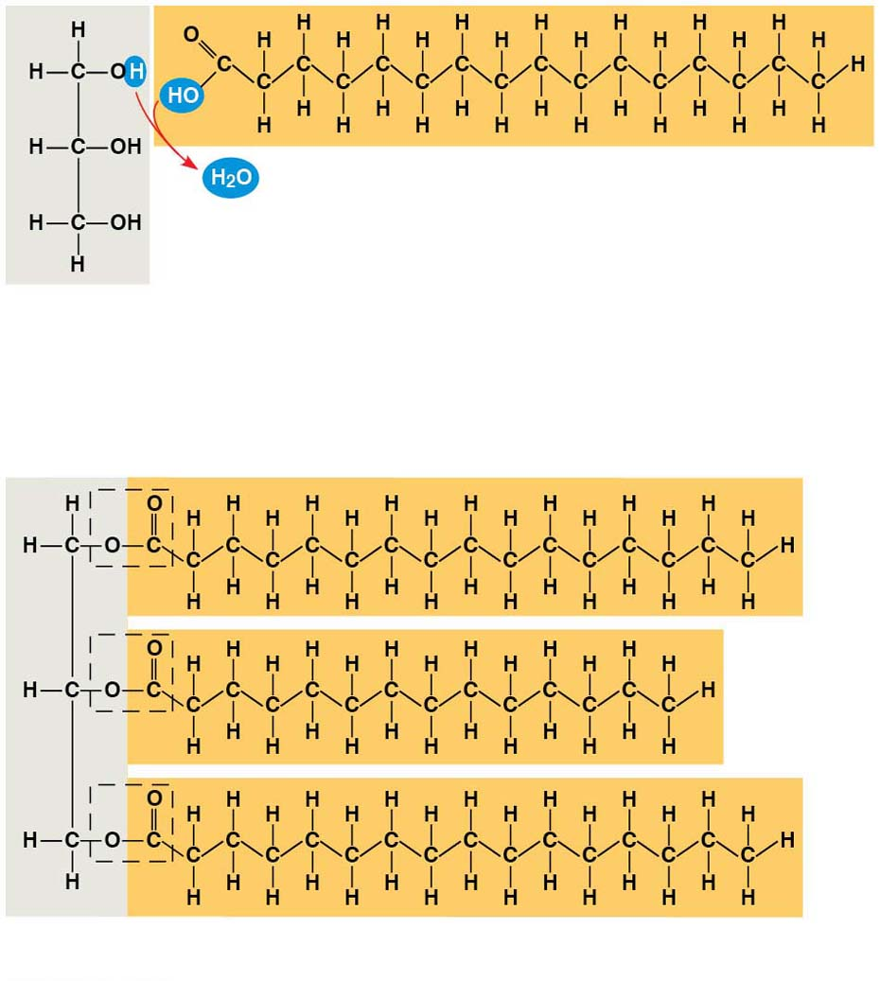
Figure 3.13
Fatty acid
(in this case, palmitic acid)
Glycerol
(a) One of three dehydration reactions in the synthesis of a fat
Ester linkage
(b) Fat molecule (triacylglycerol)
Notes:
Figure 3.13 The synthesis and structure of a fat, or triacylglycerol

Slide 5
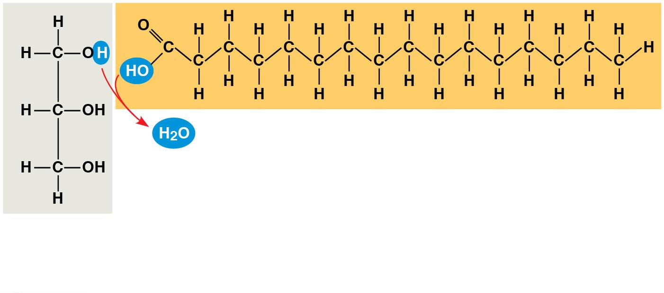
Figure 3.13-1
Fatty acid
(in this case, palmitic acid)
Glycerol
(a) One of three dehydration reactions in the synthesis of a fat
Notes:
Figure 3.13-1 The synthesis and structure of a fat, or triacylglycerol (part 1: dehydration reaction)

Slide 6
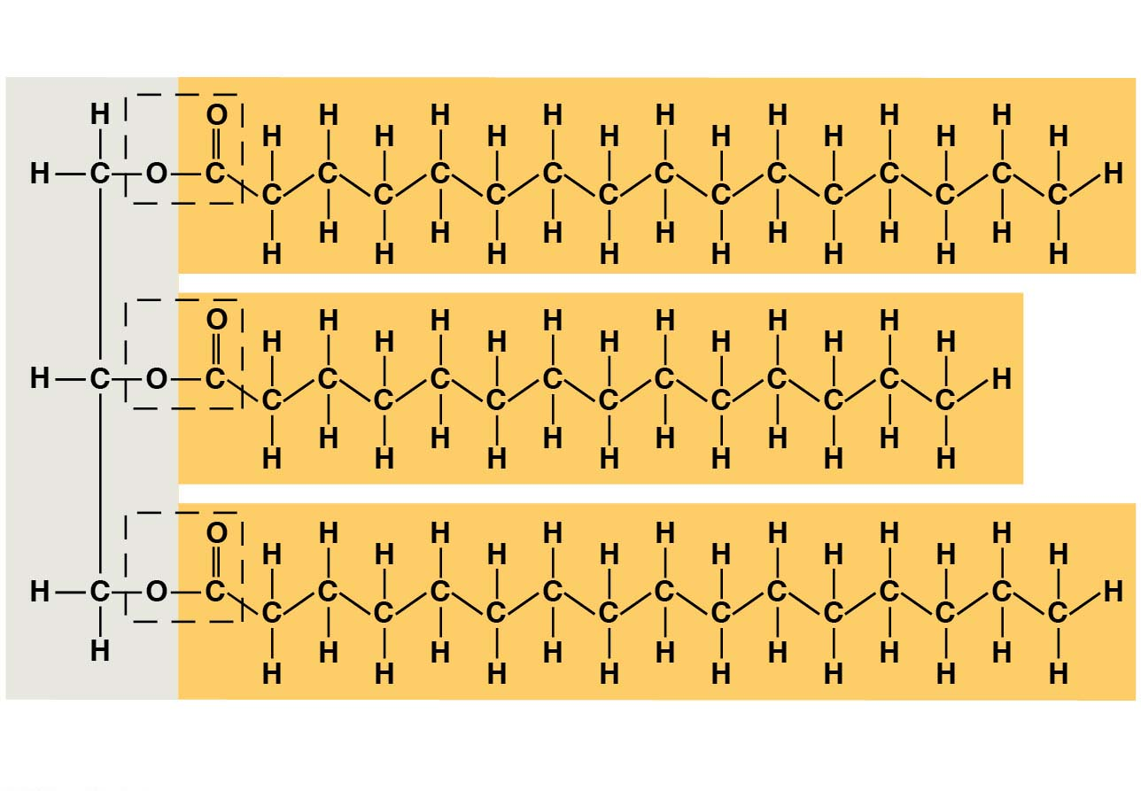
Figure 3.13-2
Ester linkage
(b) Fat molecule (triacylglycerol)
Notes:
Figure 3.13-2 The synthesis and structure of a fat, or triacylglycerol (part 2: a triacylglycerol molecule)

Slide 7
Fats separate from water because water molecules hydrogen-bond to each other and exclude the fats
In a fat, three fatty acids are joined to glycerol by an ester linkage, creating a triacylglycerol, or triglyceride
Notes:
7

Slide 8
Fatty acids vary in length (number of carbons) and in the number and locations of double bonds
Saturated fatty acids have the maximum number of hydrogen atoms possible and no double bonds
Unsaturated fatty acids have one or more double bonds
Notes:
8

Slide 9
Fats made from saturated fatty acids are called saturated fats and are solid at room temperature
Most animal fats are saturated
Plant fats and fish fats are usually unsaturated
Fats made from unsaturated fatty acids, called unsaturated fats or oils, are liquid at room temperature
Notes:
9

Slide 10
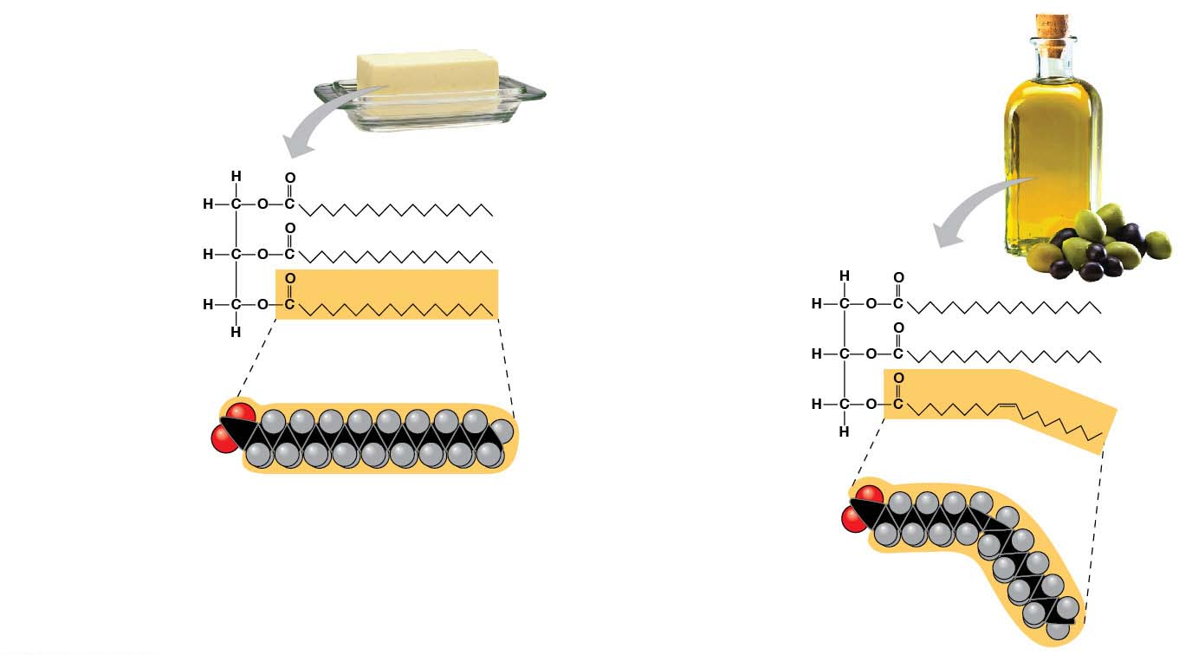
Figure 3.14
(a) Saturated fat
(b) Unsaturated fat
Structural
formula of a
saturated fat
molecule
Structural formula
of an unsaturated
fat molecule
Space-filling
model of
stearic acid,
a saturated
fatty acid
Space-filling
model of oleic
acid, an
unsaturated
fatty acid
Cis double bond
causes bending.
Notes:
Figure 3.14 Saturated and unsaturated fats and fatty acids

Slide 11
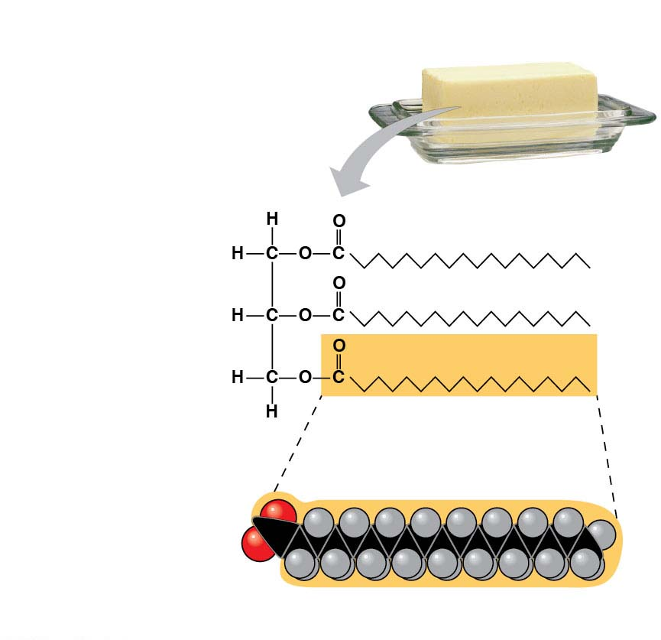
Figure 3.14-1
(a) Saturated fat
Structural
formula of a
saturated fat
molecule
Space-filling
model of
stearic acid,
a saturated
fatty acid
Notes:
Figure 3.14-1 Saturated and unsaturated fats and fatty acids (part 1: saturated fat)

Slide 12
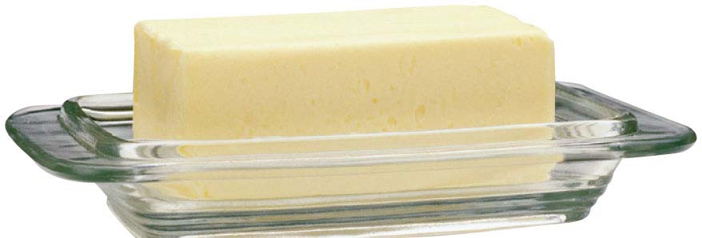
Figure 3.14-1a
Notes:
Figure 3.14-1a Saturated and unsaturated fats and fatty acids (part 1a: butter)

Slide 13
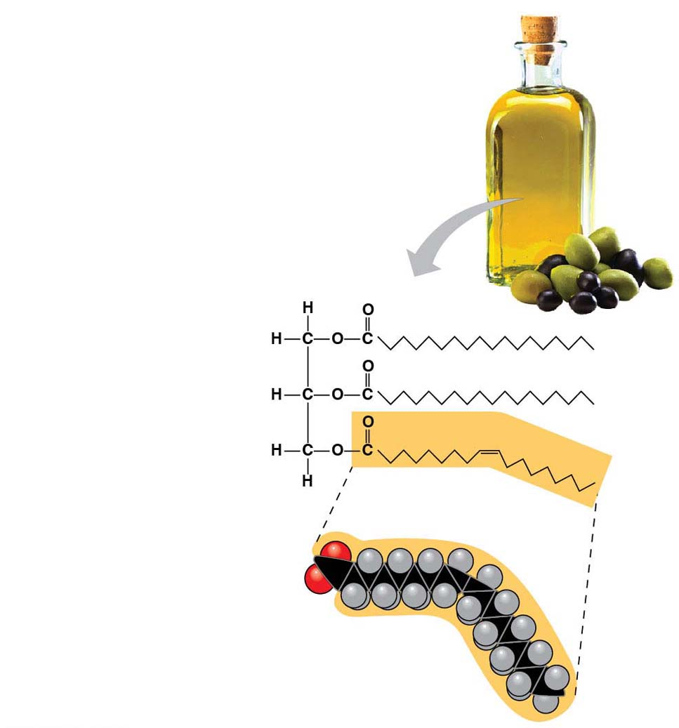
Figure 3.14-2
(b) Unsaturated fat
Structural formula
of an unsaturated
fat molecule
Space-filling
model of oleic
acid, an
unsaturated
fatty acid
Cis double bond
causes bending.
Notes:
Figure 3.14-2 Saturated and unsaturated fats and fatty acids (part 2: unsaturated fat)

Slide 14
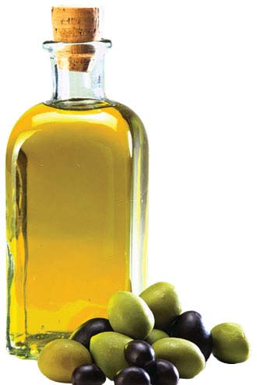
Figure 3.14-2a
Notes:
Figure 3.14-2a Saturated and unsaturated fats and fatty acids (part 2a: olive oil)

Slide 15
The major function of fats is energy storage
Fat is a compact way for animals to carry their energy stores with them
Notes:
15

Slide 16
Phospholipids
In a phospholipid, two fatty acids and a phosphate group are attached to glycerol
The two fatty acid tails are hydrophobic, but the phosphate group and its attachments form a hydrophilic head
Phospholipids are major constituents of cell membranes
Notes:
16

Slide 17
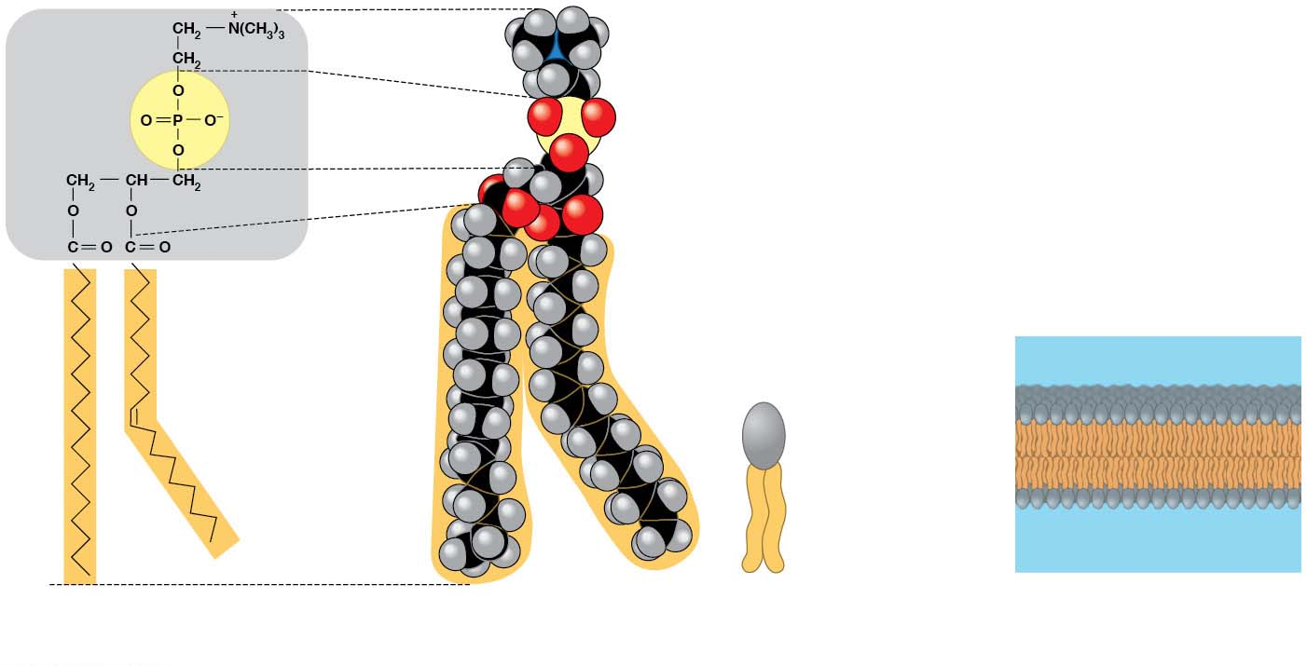
Figure 3.15
Hydrophilic head
Choline
Phosphate
Glycerol
Hydrophobic tails
Fatty acids
Kink due to cis
double bond
Hydrophilic
head
Hydrophobic
tails
(a) Structural formula
(b) Space-filling model
(c) Phospholipid symbol
(d) Phospholipid bilayer
Notes:
Figure 3.15 The structure of a phospholipid

Slide 18
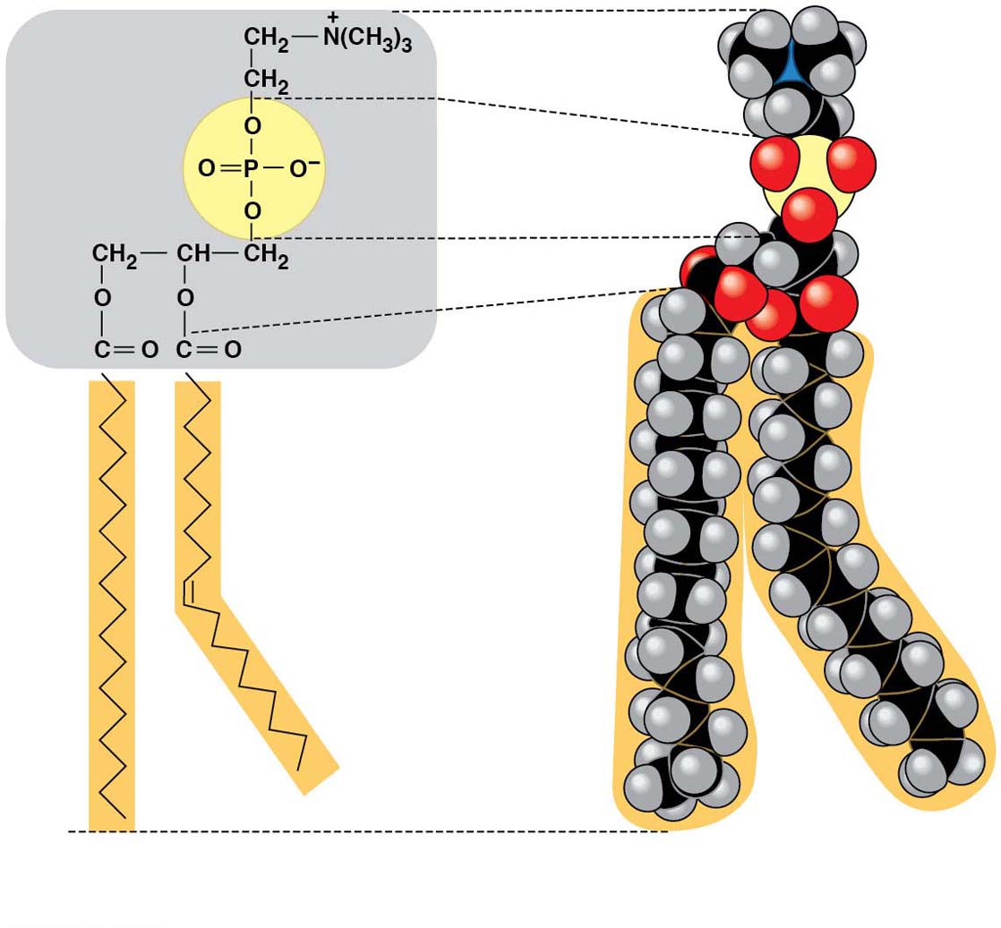
Figure 3.15-1
Hydrophilic head
Choline
Phosphate
Glycerol
Hydrophobic tails
Fatty acids
Kink due to cis
double bond
(a) Structural formula
(b) Space-filling model
Notes:
Figure 3.15-1 The structure of a phospholipid (part 1: structural formula and space-filling model)

Slide 19
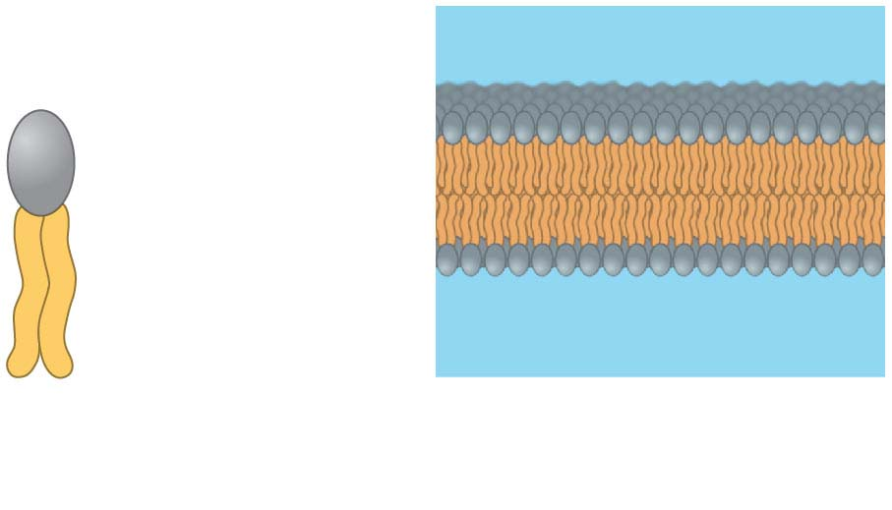
Figure 3.15-2
Hydrophilic
head
Hydrophobic
tails
(c) Phospholipid symbol
(d) Phospholipid bilayer
Notes:
Figure 3.15-2 The structure of a phospholipid (part 2: the phospholipid bilayer)

Slide 20
When phospholipids are added to water, they self-assemble into a bilayer, with the hydrophobic tails pointing toward the interior
This feature of phospholipids results in the bilayer arrangement found in cell membranes
The phospholipid bilayer forms a boundary between a cell and its external environment
Notes:
20

Slide 21
Steroids
Steroids are lipids characterized by a carbon skeleton consisting of four fused rings
Cholesterol, an important steroid, is a component in animal cell membranes
Although cholesterol is essential in animals, high levels in the blood may contribute to atherosclerosis
Notes:
21

Slide 22
Video: Cholesterol Space Model

Slide 23
Video: Cholesterol Stick Model

Slide 24
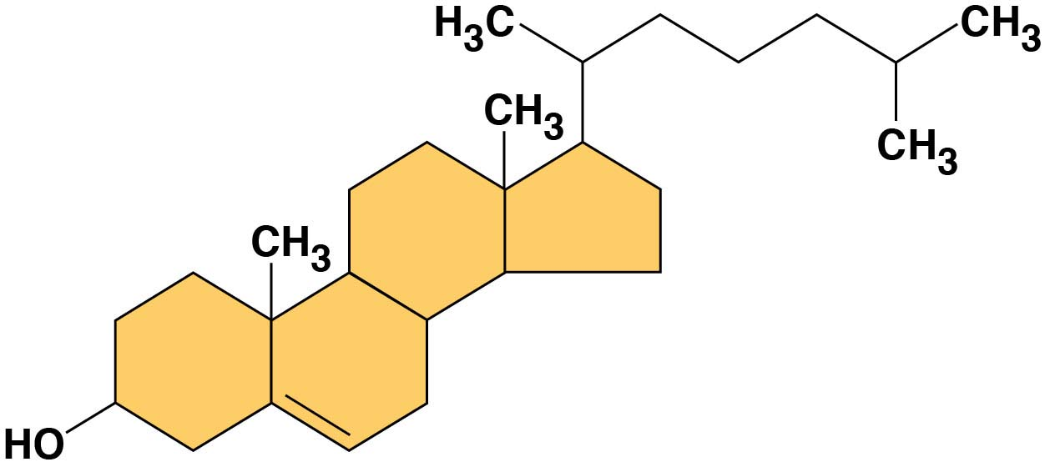
Figure 3.16
Notes:
Figure 3.16 Cholesterol, a steroid

