Slide 1
Animal Behavior

Slide 2
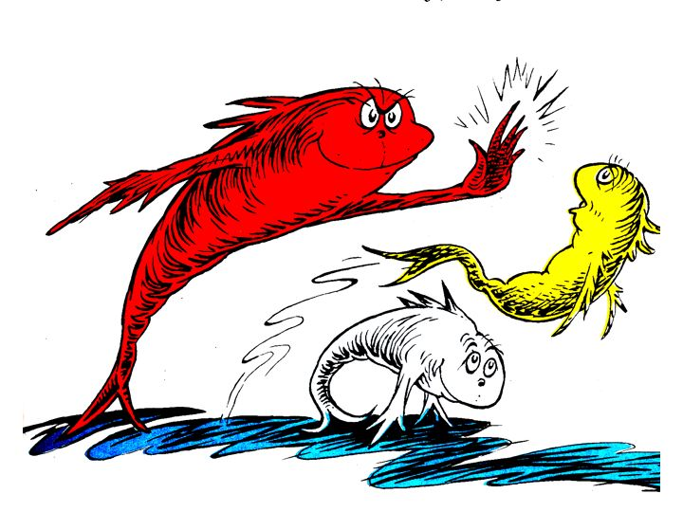
What is behavior?
Anything an animal does in response to a stimulus.
Behaviors are adaptations that help animals survive better.

Slide 3
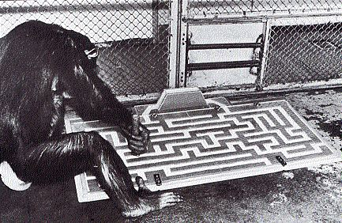
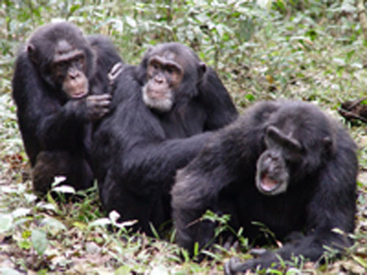
Types of Behavior
The three types of behavior are:
Innate behavior
Learned behavior
Social behavior

Slide 4
Innate Behavior
This is behavior you are born with.
You are not taught these behaviors.
Includes the following
Suckling
Taxis
Migration
Estivation
Hibernation

Slide 5
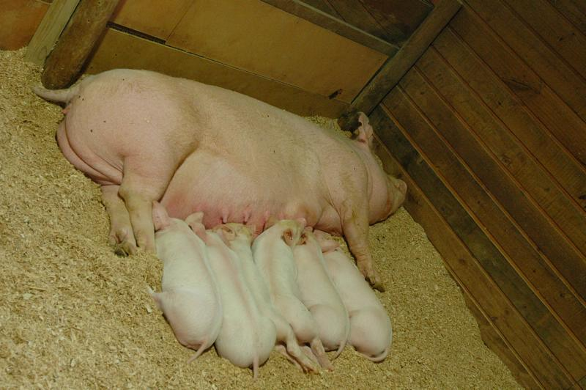
Suckling
An instinct babies are born with to get food

Slide 6
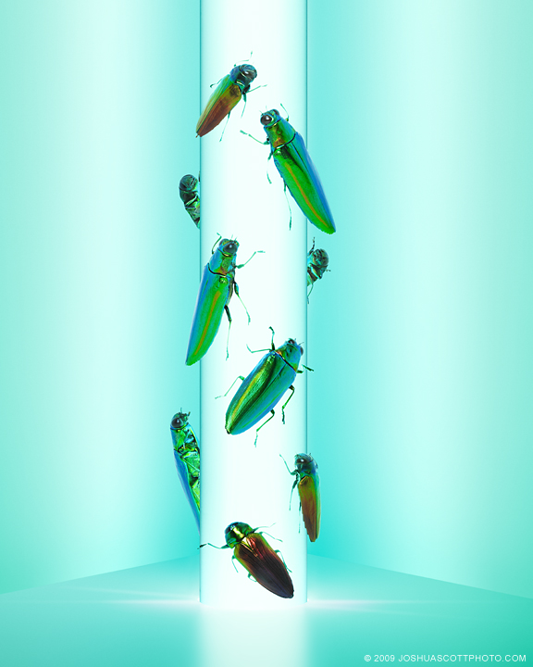
Taxis
Moving toward or away from a stimulus

Slide 7
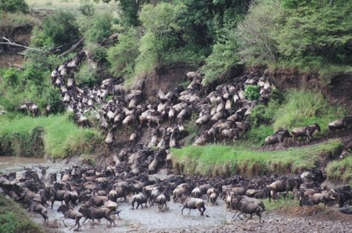
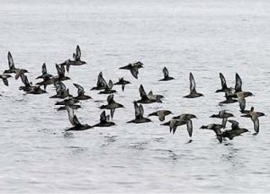
Migration
Seasonal movement of animals

Slide 8
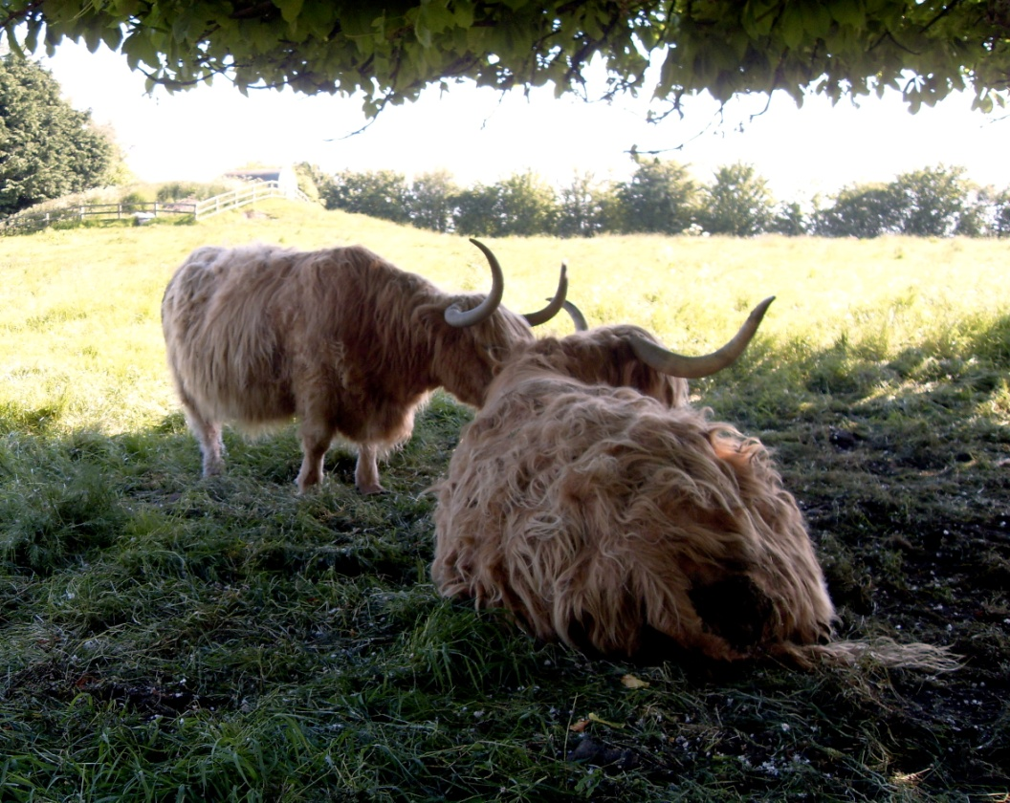
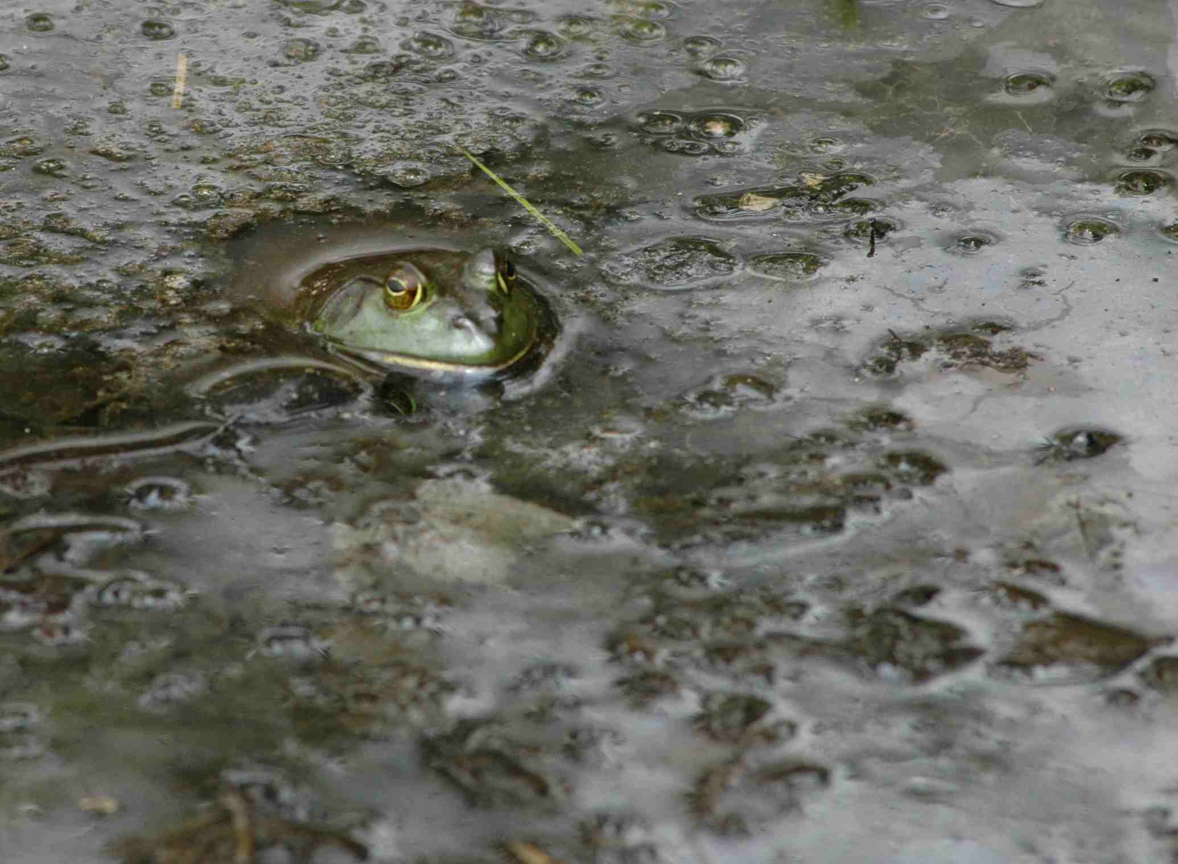
Estivation
A period of rest for animals during intense heat or drought.

Slide 9
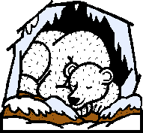
Hibernation
A deep sleep to conserve energy during periods of cold weather

Slide 10
Learned Behaviors
Learned behaviors are established through practice or experience.
Learned behaviors include:
Habituation
Imprinting
Classical Conditioning
Trial and Error

Slide 11
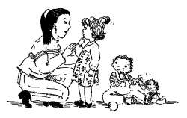
Habituation
When an animal is continually given a stimulus and eventually does not respond to it.

Slide 12
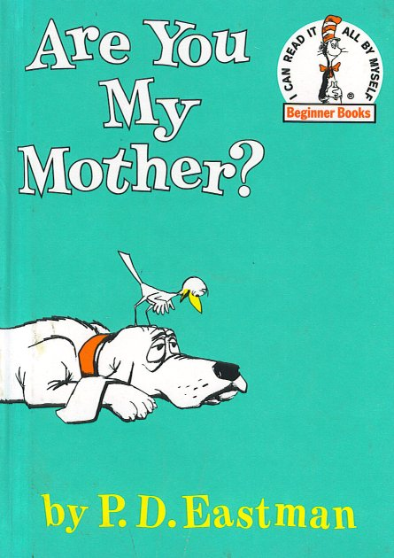
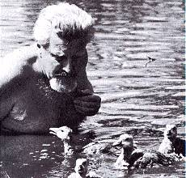
Imprinting
When an animal forms an attachment with another animal shortly after birth.

Slide 13
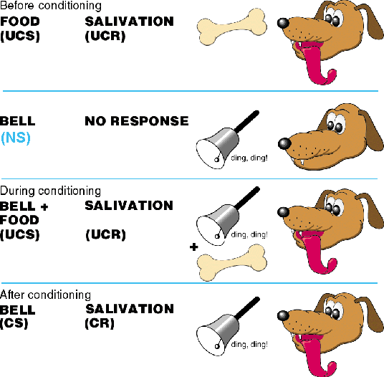
Classical Conditioning
Learning to relate two unrelated things

Slide 14
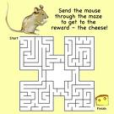
Trial and Error
When through practice, an animal receives a reward for a “correct” response.

Slide 15
Social Behavior
Social behavior taking place between members of the same species.
These include the following:
Phermones
Courtship Dances
Territorial Defense

Slide 16
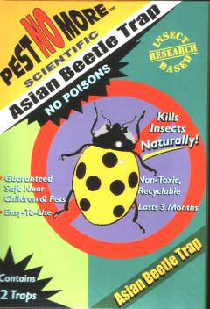
Phermones
Chemical signals that are given off by animals as a means of communication.

Slide 17
Courtship Dances
The behavior males and females carry out before mating.

Slide 18
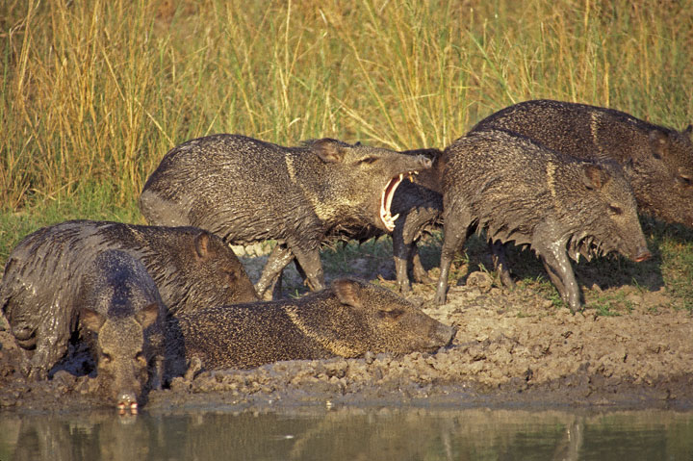
Territorial Defense
Defending an animals’ breeding area, feeding area or potential mates

Slide 19
Videos
Migration
http://www.youtube.com/watch?v=LawHWsIqa5s (monarch butterfly)
Imprinting
http://www.youtube.com/watch?v=-PBYySnwHxc (Tom and Jerry)

