Slide 1
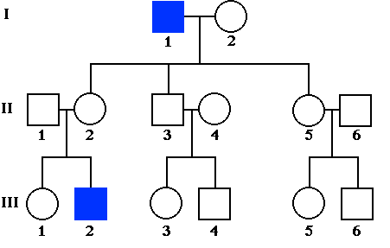
Genetic Disorders, Karyotypes, & Pedigrees
Objective 3.03:
Interpret and Predict Patterns of Inheritance
Identify the genotypes of individuals from a given pedigree.

Slide 2
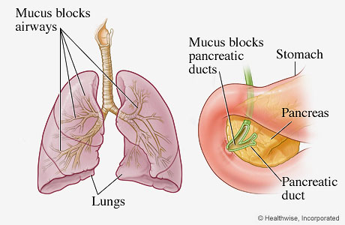
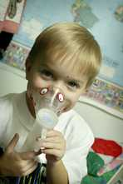
Genetic Disorders
Most genetic disorders are caused by two recessive alleles.
Cystic Fibrosis: A buildup of thick mucus in the digestive system and respiratory systems.
Affects mostly Children.

Slide 3
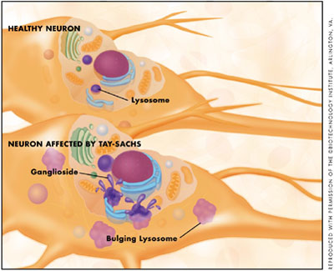
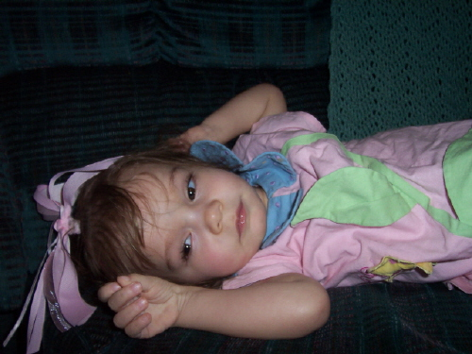
Tay –Sachs: Cannot break down a fatty acid (lipid)
Affects the brain
Affects mostly children

Slide 4
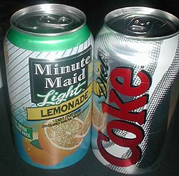
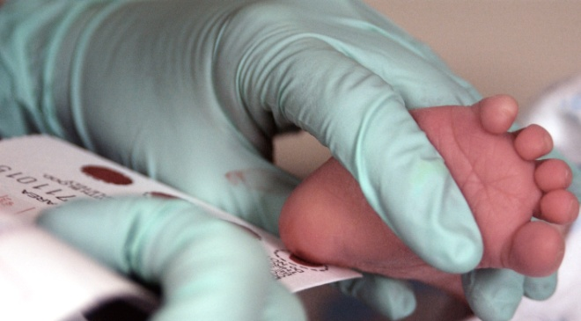
PKU (Phenylketonuria): Cannot digest the amino acid phenylalanine (phe)
All babies are tested at birth by pricking the heel.
Controlled by diet

Slide 5
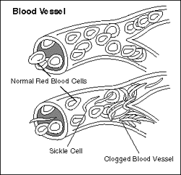
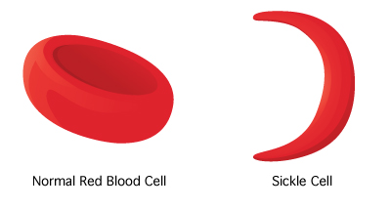
Sickle Cell Anemia: Red blood cells are misshaped. (Shaped like a comma instead of a donut).
Most common in African Americans, although anyone can be affected.

Slide 6
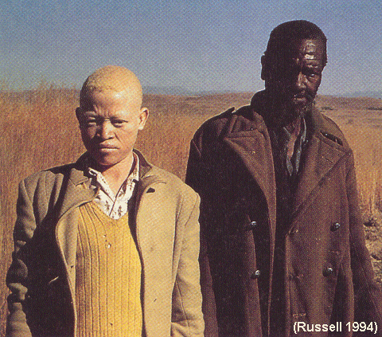
Albinism: Lacks pigments (color) in eyes, skin, and hair.

Slide 7
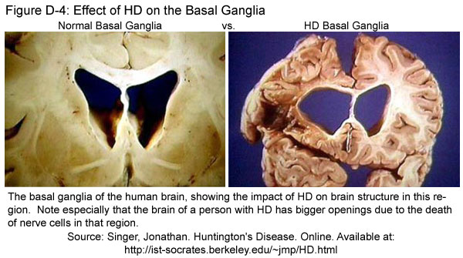
Huntington’s Disease: Causes brain degeneration and does not show symptoms until middle age (30-50yrs).
Huntington’s Disease is dominant, so if you carry even 1 allele, you are affected by the disorder.

Slide 8
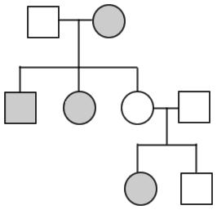
Pedigrees
Key
Unaffected Male
Affected Male
Unaffected Female
Affected Female
Married
Divorced
Siblings

Slide 9
Mrs. Naylor’s Pedigree
Me!
Me

Slide 10
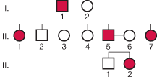
Autosomal Dominant
Every affected individual has one affected parent.
Two affected individuals may have unaffected children
Autosomal Recessive
Affected individual may have unaffected parents.
All children of two affected parents will be affected.
**Autosomal = NOT on SEX CHROMOSOMES!

Slide 11
Let’s Determine the Genotype!

Slide 12
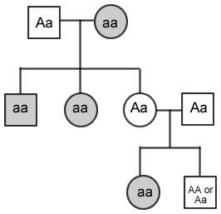
How’d We Do???

Slide 14
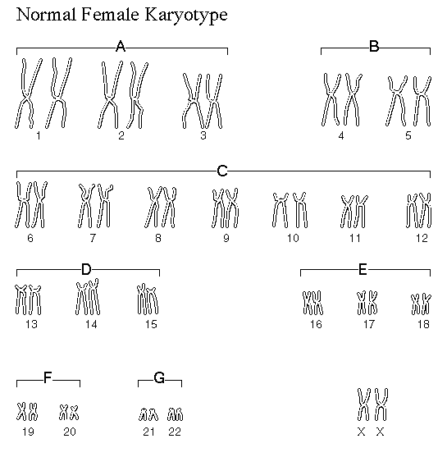
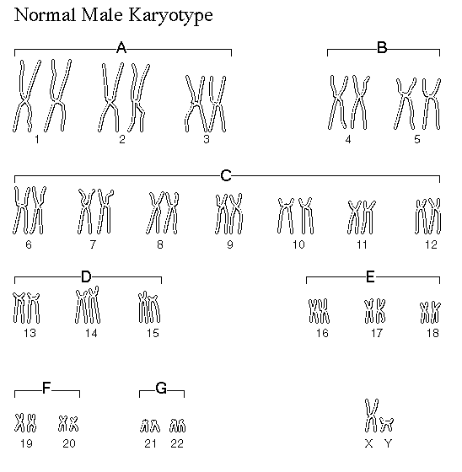
Genetic Disorders
Some genetic disorders are a result of an extra or missing chromosome.
A karyotype can be used to determine if an individual has one of these disorders
Normal Female (XX)
Normal Male (XY)

Slide 15
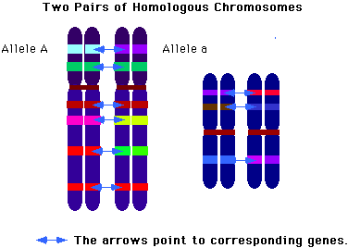
Karyotypes
A chart of chromosomes
Chromosomes are placed into homologous pairs (matches) – based on size and banding pattern
Lined up from biggest to smallest (#1-22)
The last pair is the sex chromosome pair (#23) – either X X or X Y

Slide 16
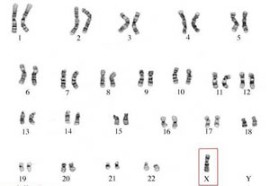
Monosomy: When an organism is missing a chromosome and therefore has less than 46 chromosomes. Usually lethal, except Turner’s Syndrome.
Turner’s Syndrome (XO): Only in females, symptoms include short stature, webbed feet, and sterile.
She will have
few female
characteristics

Slide 17
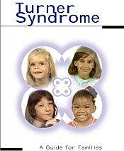

Slide 18
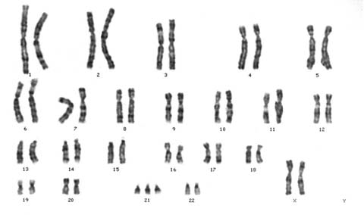
Trisomy: Instead of a pair of chromosomes, an individual has 3 copies. The organism has more than 46 chromosomes.
Down Syndrome (Trisomy 21): Individual has 3 copies of chromosome number 21.
Results in physical & mental retardation

Slide 19
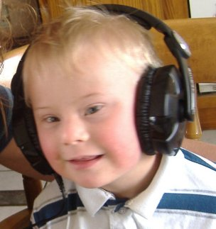
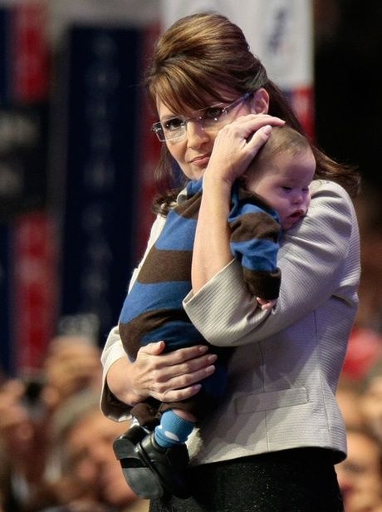
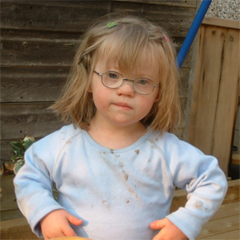
Down Syndrome

Slide 20
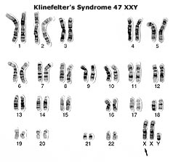
Klinefelter’s Syndrome (XXY): Individual’s gender is male, but has female characteristics. Individual is tall in stature, has enlarged breasts, and curved hips/shoulders

Slide 21
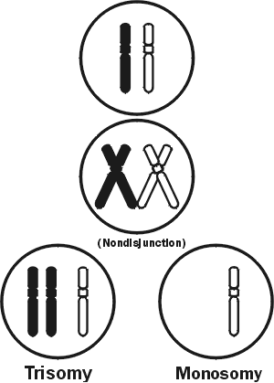
Nondisjunction
When chromosomes fail to separate properly during meiosis
Results in monosomy or trisomy in the offspring

