Slide 1
Biotechnology
Essential Standard 3.3
Understand the application of DNA technology.

Slide 2
What is Biotechnology?
It is the use of living organisms to perform a process, or modify an existing product
Some practical applications are:
Genetic/Paternity Testing
Medical (Gene Therapy, Pharmaceuticals)
Food/Agriculture
Forensic (DNA Analysis)

Slide 3
We’ve Come a long way since Watson and Crick…..
The following are biotechnologies that are commonplace today:
Human Genome Project
Genetically Modified Organisms (GMO’s)
Recombinant DNA
Stem Cell
Cloning

Slide 4
The Human Genome Project
Genome: The full DNA sequence of an organism (The order of the all of the bases)
Goals:
identify all the approximately 20,000-25,000 genes in human DNA,
determine the sequences of the 3 billion chemical base pairs that make up human DNA,
store this information in databases
Began world-wide effort in 1990; completed in 2003.

Slide 5
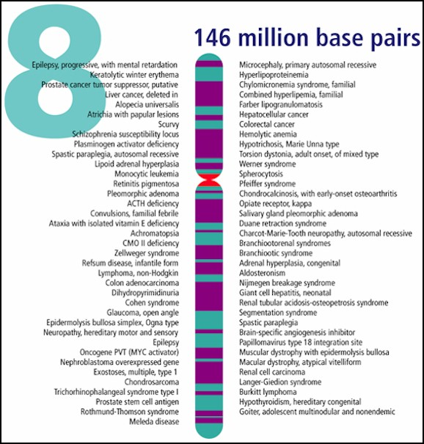
Scientists know where EVERY human gene is located on EVERY chromosome
Discovered that only 2% of all DNA actually codes for a protein

Slide 6
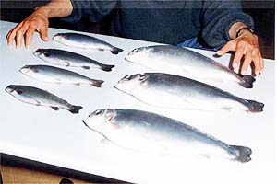
Human Genome Benefits
Medical
Disease detection (newborn & adult)
Gene Therapy (replace “bad” genes)
Production of medicines (insulin)
Food/Agricultural
Genetically Modified Food (bigger, cheaper, extra benefits)
“Roundup Ready” – plants resistant to herbicides (kills weeds, not plants)

Slide 7
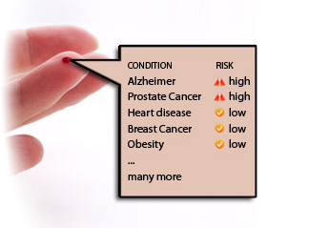
Only $199…

Slide 8
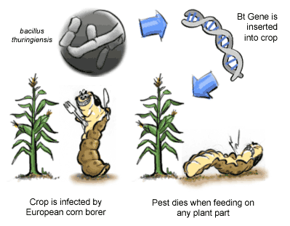
GMO’s – What are they?
A genetically modified organism is an organism that has had it’s DNA modified.
They are made by using a technique called recombinant DNA.

Slide 9
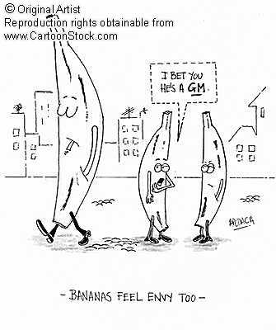
Genetically Modified Foods
Examples of Foods that may contain GM ingredients:
General Mills & Kellogg’s
Kraft
Coca~Cola & Pepsi
Chef Boyardee
Campbell’s
Betty Crocker

Slide 10
Bill Nye Video
Video Link

Slide 11
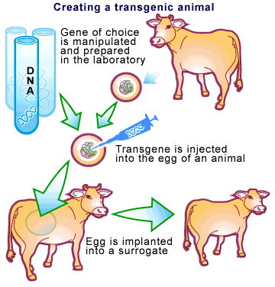
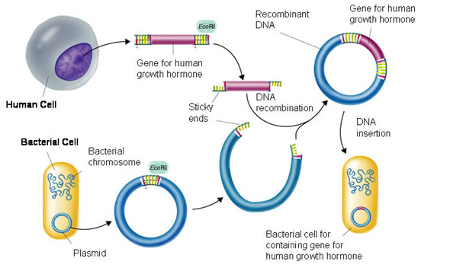
What is Recombinant DNA?
“combines” DNA from 2+ sources
Also called “transgenic”

Slide 12
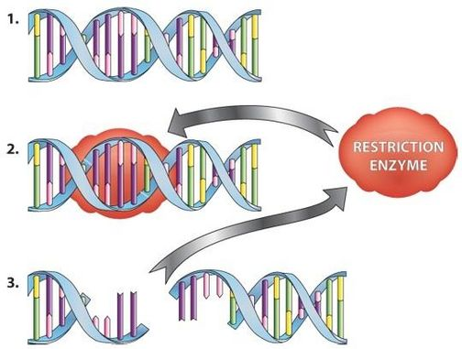
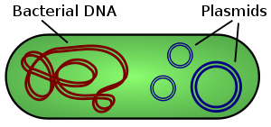
VOCABULARY ALERT
Restriction Enzyme – enzymes that cut DNA at a specific place. Leaves “sticky ends” so that the DNA segment can be inserted into another section of DNA.
Plasmid – small circles of DNA found in bacterial cells. These are separate from the cell’s chromosome.

Slide 13
How is Recombinant DNA made?
The desired gene is cut from the DNA of the organism that has this gene. Restriction enzymes are used.
This desired gene is inserted into a plasmid.
The plasmid enters a host cell.
The DNA fragment becomes part of the host cell’s chromosome.
The DNA fragment is transcribed and translated within the host cell.
The host cell produces a protein that it would not have produced naturally.

Slide 14
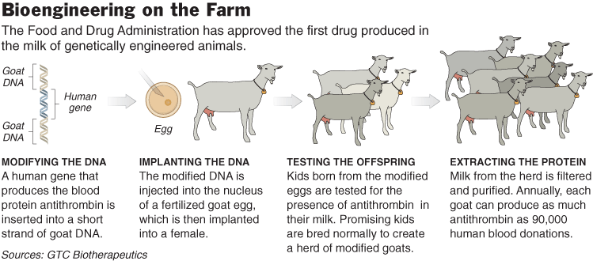
“Pharm Animals”
Goat produces blood clot protein and spider silk in its milk to make bullet proof vests

Slide 15
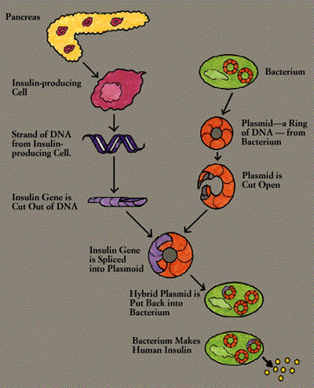
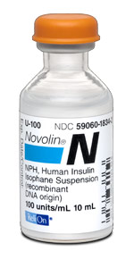
How Insulin is Made
DNA from insulin producing cell
Put into bacteria
Bacteria divide
Produce insulin in large amounts, quickly

Slide 16
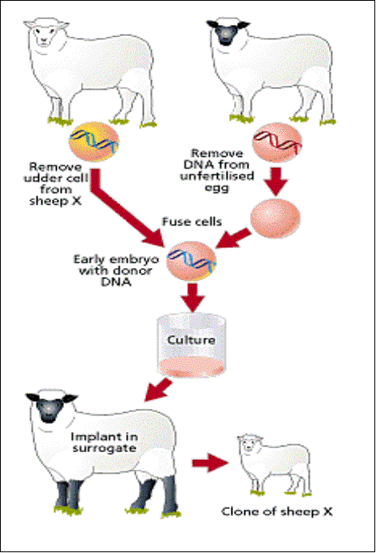
Cloning
Cloning is the creation of an organism that is an exact genetic copy of another.

Slide 17
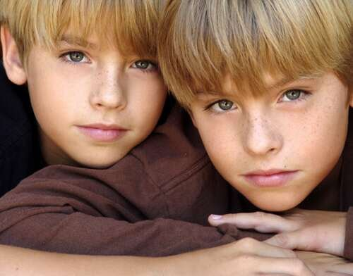
Can cloning occur naturally?
Cloning can occur naturally in mammals. Identical twins are natural clones.

Slide 18
Artificial Cloning
There are three types of artificial cloning:
Gene cloning – produces exact copies of genes.
Reproductive cloning – produces copies of whole organisms.
Therapeutic cloning – produces stem cells with the purpose of creating tissues to replace injured or diseased tissue.

Slide 19
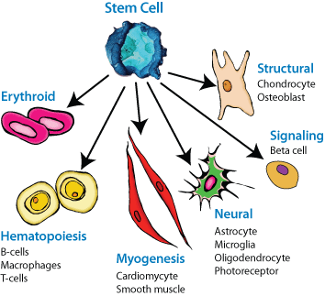
Stem Cells
Stem cells are unspecialized cells.
Stem cells are capable of dividing and renewing themselves for long periods of time.
Stem cells can give rise to specialized cell types.

Slide 20
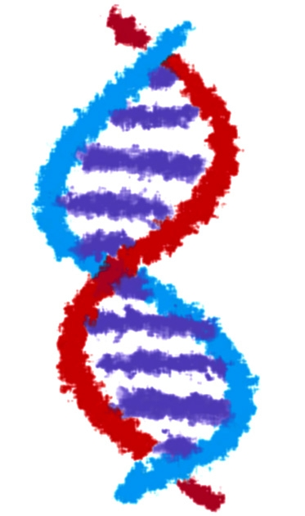
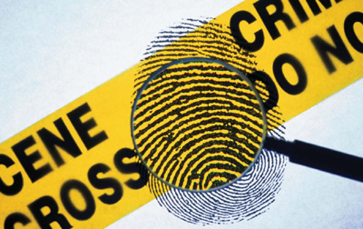
DNA Fingerprinting
Essential Standard 3.3
Understand the application
of DNA technology

Slide 21
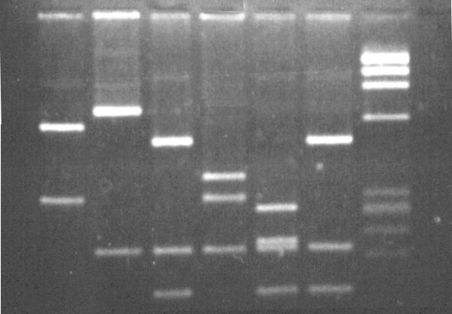
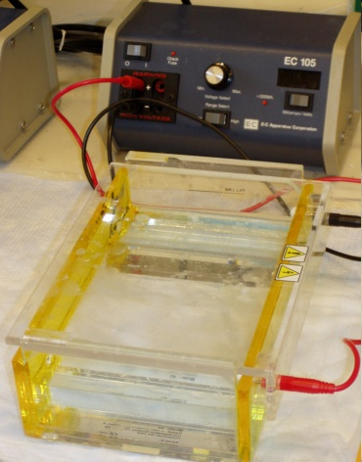
CSI: DNA Fingerprinting
DNA is collected and “cut” into fragments by enzymes
Fragments are put into a machine called a gel electrophoresis
Fragments are separated based on their size
Makes a “DNA Fingerprint”
Used in identifying criminals and paternity tests

Slide 22
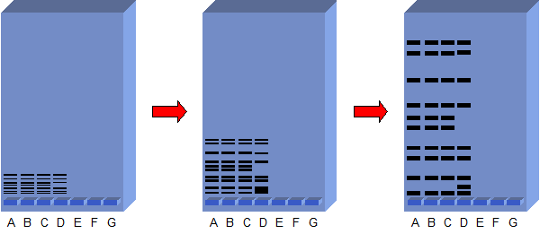
DNA Fingerprints with Gel Electrophoresis
The DNA fragments through the gel – the shorter they are, the farther they travel. Where they stop, they leave a band
DNA is put in these wells

Slide 23
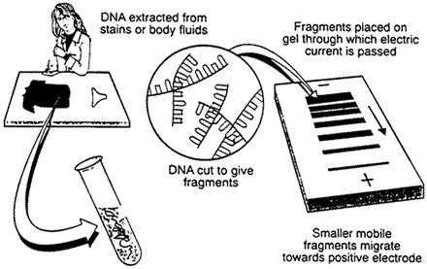
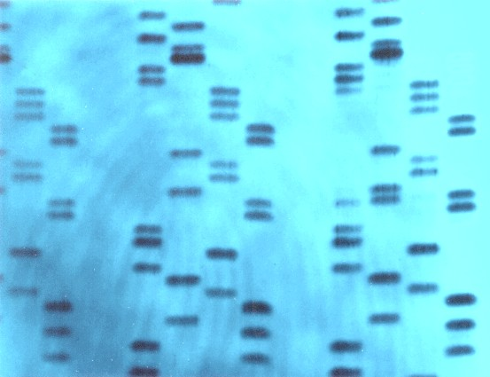

Slide 24
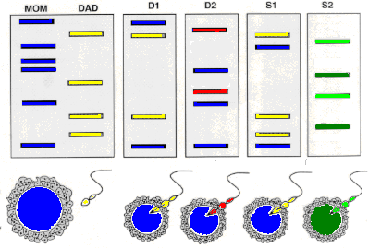
A person’s DNA is donated by his or her parents.
He or she could have DNA inherited from his or her mother or father, or a combination, but never have DNA that neither of his or her parents have.
Shown below are the DNA patterns for:
Mrs. Sillybilly [blue]
Mr. Sillybilly [yellow]
D1 (the Sillybilly s' biological daughter),
D2 (Mr. Sillybilly 's step-daughter, child of Mrs. Sillybilly and her former husband [red]),
S1 (the Sillybilly s' biological son), and
S2 (the Sillybilly s' adopted son, not biologically related [his parents are light and dark green]).

Slide 25
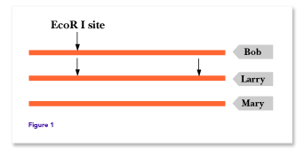
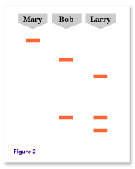
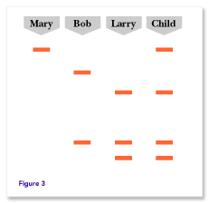
Who the Daddy?
Take the same stretch of DNA from everybody.
An EcoR1 enzyme only cuts at sequence GAATTC. Mary’s doesn’t cut at all, Bob’s DNA cuts 1 time, and Larry 2 times (fig 1).
The cut fragments settle as shown in fig.2
Fig. 3 shows the child’s DNA included. Who’s the baby daddy?

Slide 26
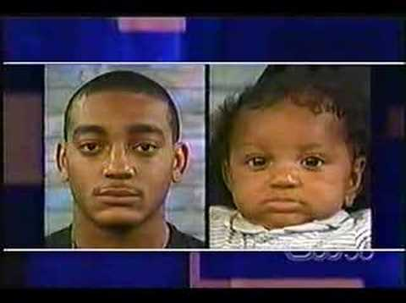
Larry, you ARE the father!!!

Slide 27
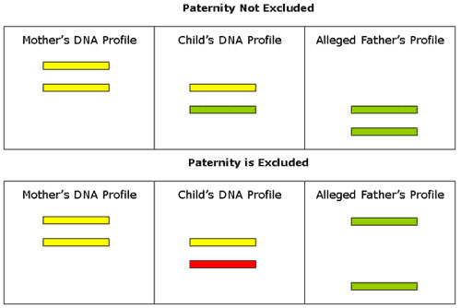

Slide 28
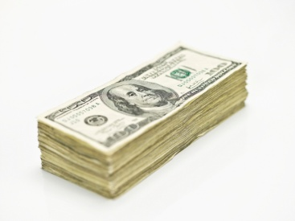
More than 56,000 workers are employed with skill sets ranging from bioprocess technicians to PhDs in 520 companies in N.C.. Almost 8,000 undergraduate students and over 1,500 graduate students are enrolled in biology, chemistry and engineering programs in public universities throughout the state. Every year, North Carolina institutions graduate over 5,500 students in engineering, biology and chemistry related fields.
North Carolina’s 58 campus Community College System offers many biotechnology related curricula ~ Wake Tech has “Biowork” Curriculum that leads to being a Process Technician – mainly lab based
The state’s biotechnology industry:
Generates $45.8 billion in economic activity annually
Grew 18 percent between 2001 and 2006, the fastest of all leading biotech states, and three times the rate of the national bioscience industry growth
Median salary for biotechnology careers in 2000 was $49,000

Slide 29
2016 Median Salary:
The median annual Scientist I - Biotech salary is $91,645, as of November 30, 2016, with a range usually between $83,258-$102,051, however this can vary widely depending on a variety of factors.
http://www1.salary.com/Scientist-I-Biotech-Salaries.html

Slide 30
Plasmid Activity:
Working with the person beside you, you will create a Plasmid model.
Color all strips (1-4) = purple
Color Ampicillin Resistance Gene = orange
Use your restriction enzyme (scissors) to cut through the DNA molecule between G & A along the GAATTC sequence (top of piece #4)
Insert your new AR gene into your plasmid

Slide 31
ANDi Article:
Working with the person beside you (NOT MOVING at this time):
read about ANDi and answer the questions on a old piece of notebook paper
you have 15 minutes!

