Slide 1
DNA to Protein Notes
2016

Slide 2
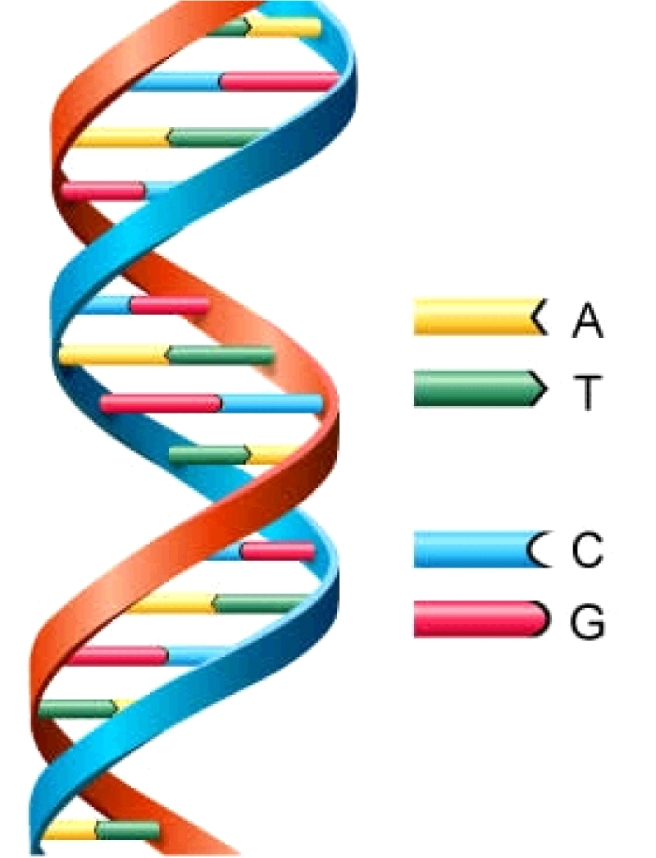
From DNA to Proteins:
Sequence of nucleotides in DNA contain information used to produce proteins
DNA RNA Proteins
transcription translation

Slide 3
Transcription:
genetic information in DNA is transferred to RNA
Occurs in the nucleus
Produces mRNA (messenger RNA)
Why? Because DNA cannot leave the nucleus and proteins are made in the ribosomes!

Slide 4
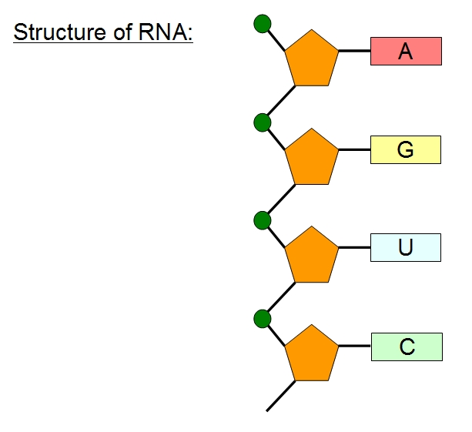
Differences in DNA & rna:
DNA:
RNA:
Deoxyribose sugar
Double strand
Thymine (A-T)
Stays in the nucleus
Ribose sugar
Single strand
Uracil (A-U)
Leaves the nucleus

Slide 5
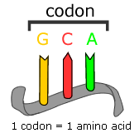
Codons:
mRNA builds proteins by using codons.
Codon = a group of 3 nucleotide bases in mRNA that determines amino acid sequence.
Some codons provide instructions for assembling the protein
Example: stop – UAA, UGA, UAG
start – AUG (methionine)

Slide 6
Find the amino acid that codes for the following codons: (need charts)
UAC
ACG
CGG
GCG
GAU
CCA

Slide 7
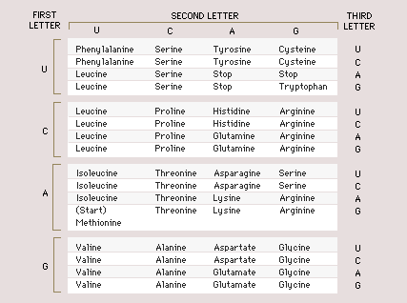

Slide 8
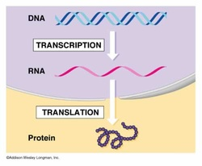
Translation:
three different kinds of RNA work together to assemble amino acids into proteins.
Occurs in the cytoplasm on the ribosomes
The ribosome contain rRNA (ribosomal RNA)
Begins when “start” codon located on mRNA binds to the ribosome.

Slide 9
Translation cont’d:
tRNA (transfer RNA) carries amino acids to the ribosome
On the tRNA is an anticodon which is looking for its complementary base pairs on the mRNA
The anticodon ensures that the amino acid is delivered to the “right address” on the mRNA.

Slide 10
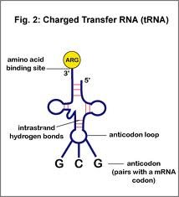
Illustration:

