Slide 1
Meiosis Notes
2016

Slide 2
Meiosis:
Organisms have tens of thousands of genes that determine individual traits.
Humans have 46 chromosomes
Exist in 23 pairs

Slide 3
Diploid Cells:
Cells with two of each kind of chromosome
Occurs in pairs (2n)
One from male parent & one from female parent

Slide 4
Haploid Cells
Cells that contain only one chromosome from each pair (n)
Human gametes (sex cells) only contain 23 chromosomes
Form by Meiosis

Slide 5
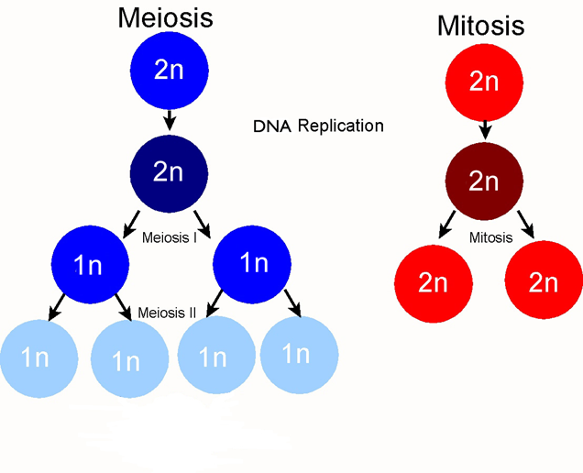
Cell division which produces gametes containing half the number of chromosomes (reduction division)
Two separate divisions
Interphase only occurs ONCE!
https://bio.rutgers.edu/~gb101/lab10_meiosis/meiosis_web/index10.html

Slide 6
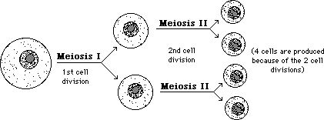
Meiosis I begins with ONE diploid cell and by the end of Meiosis II, FOUR haploid cells have formed.
Result in genetic recombination; variation among organisms
http://www2.sluh.org/bioweb/bi100/tutorials/meiosis.htm

Slide 7
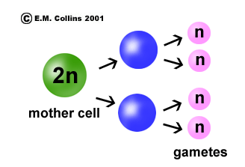
Meiosis makes sexual reproduction possible.
Sexual reproduction involves
Two parents
Combination of gametes.
Offspring that are genetically different from the parents and their siblings.
Meiosis keeps the chromosome number the same from generation to generation.

Slide 8
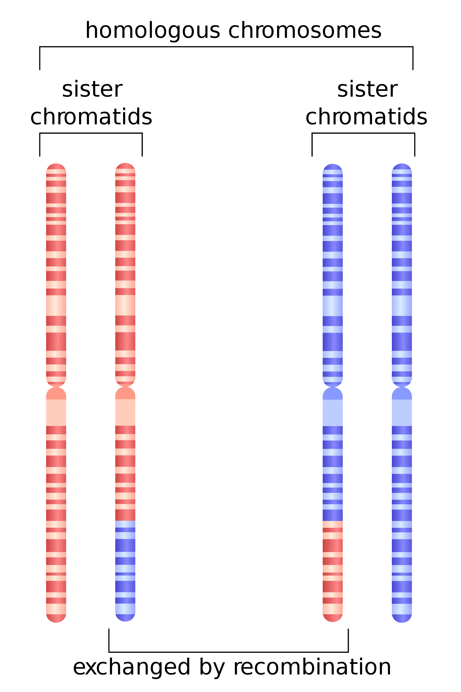
Homologous Chromosomes
https://www.google.com/imgres?imgurl=https://upload.wikimedia.org/wikipedia/commons/thumb/1/17/HR_in_meiosis.svg/2000px-HR_in_meiosis.svg.png&imgrefurl=https://en.wikipedia.org/wiki/Homologous_chromosome&h=3000&w=2000&tbnid=yuNpAcm2Uh85SM:&tbnh=160&tbnw=106&docid=oPIP81OkXnGj1M&usg=__eVE5iqluMXOpUUkcgvdAxOVlK9I=&sa=X&ved=0ahUKEwiDnIH87PPPAhXLRSYKHVClCpIQ9QEIHzAA
Paired chromosomes
The maternal and paternal chromosomes in homologous pair have the same genes at the same location, but possibly different alleles.
Crossing over = exchange of genetic material
Occurs during Prophase I

Slide 9
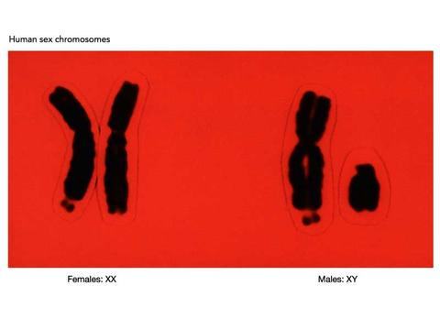
Sex Chromosomes
Determines whether you are MALE or FEMALE
XX – female chromosomes
XY – male chromosomes

Slide 10
Remember, MiTosis = MainTains the number of chromosomes (46 is your beginning number, 46 is your ending number)
while MeiOsis = LOwers the number of chromosomes (46 is your beginning number, 23 is your ending number)

Slide 12
Karyotype – a “normal” picture of all 23 sets of chromosomes

Slide 13
Mistakes in Meiosis creates mutations – extra chromosomes, missing chromosomes, etc.

Slide 14
Just a little “cell division humor"

