Slide 1
Cell Division & Mitosis
Biology

Slide 2
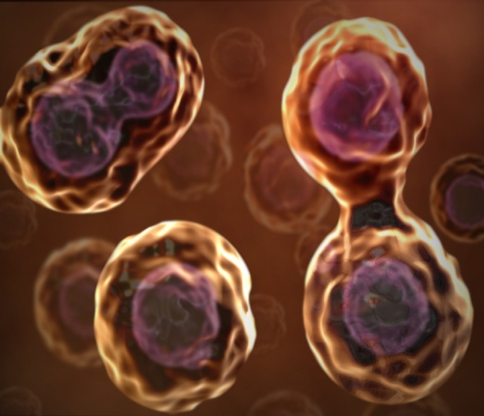
Why Do Cells Divide?
Keep cells small
Cells that are too big are not efficient
Replace worn out or damaged cells
Growth in multi-cellular organism

Slide 3
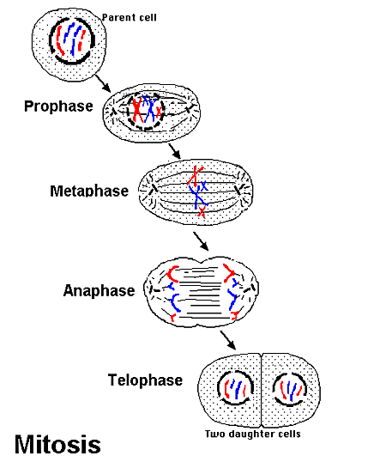
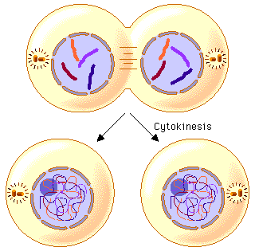
Parts that Divide
Nucleus
Mitosis: Division of
the nucleus
Cytoplasm
Cytokinesis: division of the cytoplasm

Slide 4
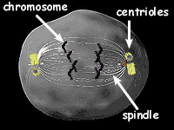
Structures Involved in Cell Division
Centrioles
Found only in animal cells
Location: near the nucleus
Job: to form mitotic spindle; helps to move chromosomes during mitosis.

Slide 5
DNA = genetic material
Organized in 2 ways
Chromatin
Occurs this way during interphase
Long and stringy
Chromosomes
Occurs this way during mitosis
Dense and compact

Slide 6
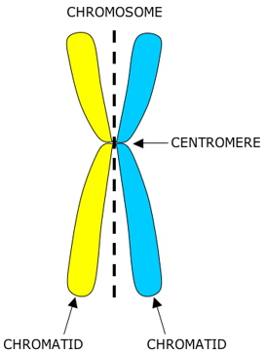
Chromatid
This is also known as an unreplicated chromosome
Sister Chromatids
This is also known as a replicated chromosome
Each sister chromatid contains the same genes
Centromere
Where the chromosome narrows

Slide 7
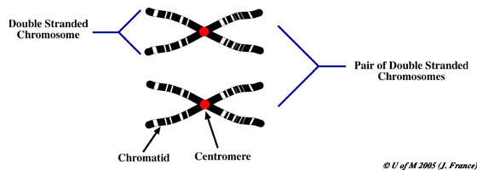

Slide 8
Phases of Mitosis
Interphase – before Mitosis!!
Mitosis: division of the nucleus
Phases of Mitosis
Prophase
Metaphase
Anaphase
Telophase

Slide 9
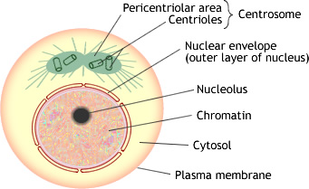
Interphase
DNA is in the form of chromatin.
Nuclear membrane is visible.
Nucleolus is visible.
Centrioles located near the nucleus

Slide 10
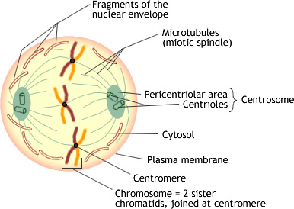
Prophase
Chromatin turn into chromosomes
Nuclear membrane disappears.
Nucleolus disappears.
Centrioles move to opposite ends.
Mitotic spindle form.

Slide 11
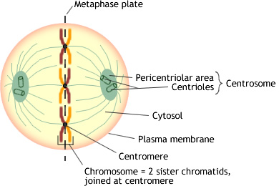
Metaphase
Meta : middle
Mitotic spindle finished forming.
Chromosomes are lined up in the middle of the cell.

Slide 12
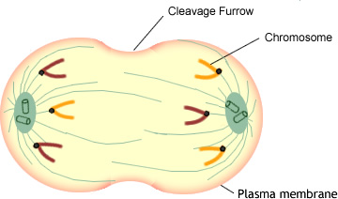
Anaphase
Think opposite like an antonym.
Chromatids are pulled to opposite ends of the cell
Cells starts to elongate.

Slide 13
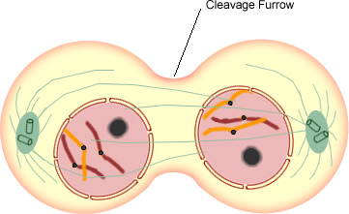
Telophase
Nuclear membrane reforms.
Nucleolus reforms.
Chromosomes change to chromatin.
Cytokinesis begins.

Slide 14
Results of Mitosis
Start with 1 parent cell and end with 2 daughter cells.
THE CHROMOSOME NUMBER STAYS THE SAME!!!!!!!!!

